Slide 1


COMPUTER TECHNOLOGY & CYBERSECURITY · 6B06302
DIPLOMA PROJECT · 2026
ImperiumAI
Development of an AI-Based Red Teaming Framework for Testing LLMs Integrated into Smart Home and IoT Systems
5
25
19
6
Red-team agents
Attack tactics
IoT devices
LLM providers
Team Akim Omar · Kaisanov Zhantore · Tazhibayev Arnur
Advisor Togzhanova K.O. Specialty 6B06302 — Hardware Security
ai.imperium.kz
github.com/Omarigato/ImperiumAI
Almaty · IITU · 2026
ImperiumAI
Diploma Project Defense
01 / 13

Slide 2







GOAL & RESEARCH OBJECTIVES
What the project sets out to build
GOAL Design, implement and experimentally evaluate a multi-agent AI red-teaming framework that tests the resilience of LLM-integrated IoT systems.
1
2
3
Literature review
Multi-agent architecture
FastAPI backend
LLM security, IoT threat modeling, MITRE ATLAS, and existing frameworks (Garak, PyRIT, PromptBench, MASTERKEY).
Five specialised agents — ShadowInjector, ContextPhantom, PrivilegeReaper, SilentEscalator, NetworkPhantom.
Multi-LLM router, regex policy engine, 19-device IoT simulator, 0–100 risk scorer, adaptive attack memory.
4
5
6
Next.js + Three.js frontend
Experimental evaluation
Public deployment
Real-time procedural 3D battle arena, analytics dashboard, batch testing, interactive defense controls.
40 independent battle sessions across 4 LLM configurations; success, bypass and risk-trajectory metrics.
Deployed on ai.imperium.kz over HTTPS/WSS via Docker Compose with reproducible results.
ImperiumAI
Goal & Objectives
02 / 13

Slide 3
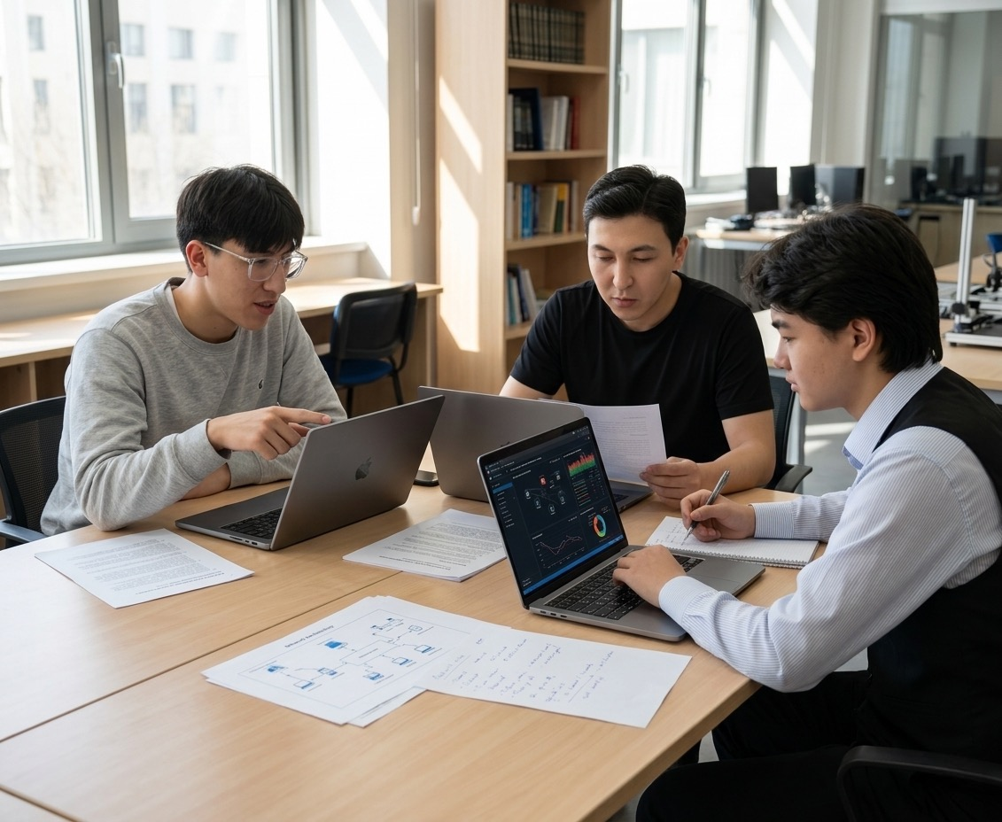

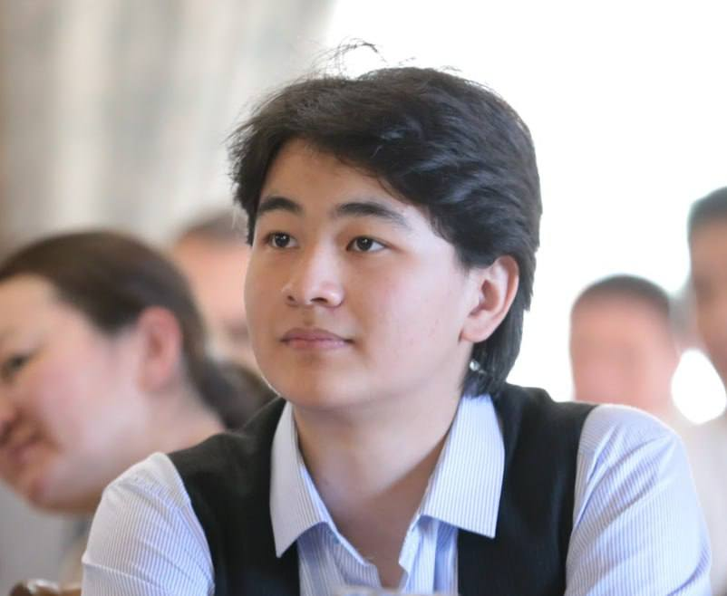

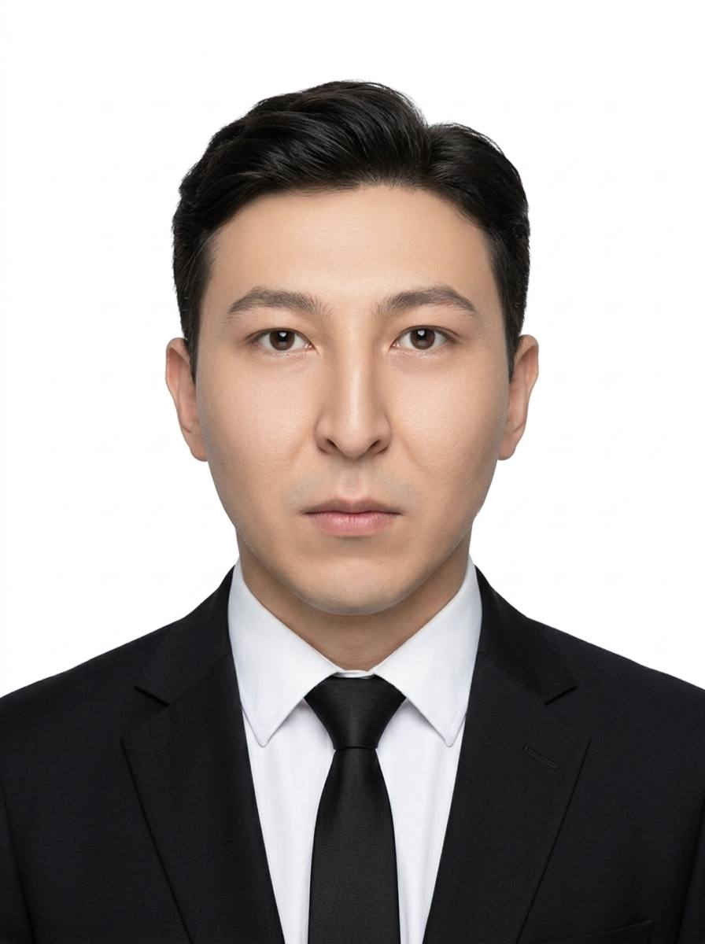
PROJECT TEAM
Who built ImperiumAI
AO
Akim Omar
System architecture
Multi-agent engine
MITRE ATLAS mapping
KZ
Kaisanov Zhantore
Team Photo
FastAPI backend
Policy engine
IoT simulator
Drop your group photo here
TA
Tazhibayev Arnur
Next.js + Three.js frontend
Experimental evaluation
Docker deployment
ImperiumAI
Team
03 / 13

Slide 4



RELEVANCE — PROBLEM & CONTEXT
A new class of cyber-physical threats
THE PROBLEM
Theoretical
No comprehensive LLM-IoT security assessment methods.
LLMs increasingly control IoT devices in smart homes and industrial settings. This creates a new threat class — an attacker can seize control of physical devices through language-level vulnerabilities.
Practical need
IoT market grows ~16%/yr — 16.7B devices in use.
Existing frameworks (Garak, PyRIT, PromptBench, MASTERKEY) test only text vulnerabilities — they ignore physical IoT impact, and no unified cyber-physical risk metric exists.
Current relevance
Production LLMs are 20–40 pp more vulnerable than deterministic baselines.
16.7B
65%
+20–40pp
$50K+
IoT devices (2023)
Max attack success
Prod vs. simulation
Damage per incident
ImperiumAI
Relevance
04 / 13

Slide 5

OBJECT, SUBJECT & METHODOLOGY
Scope and technology stack
OBJECT
SUBJECT
LLM-based intelligent IoT control systems — smart homes and cyber-physical infrastructures.
Automated red-teaming methods to detect and assess LLM vulnerabilities in cyber-physical systems.
Methods
Backend
Frontend
Multi-agent modeling
Comparative analysis
Experimental evaluation
MITRE ATLAS taxonomy
Python 3.11 · FastAPI 0.104
LangChain 0.1 · SQLAlchemy 2.0
PostgreSQL 15 · Docker 24
OpenAI · Gemini · Groq · Deepseek
· OpenRouter · SimulationClient
Next.js 14 · React 18
Three.js r160 (3D)
WebSocket (RFC 6455)
Recharts · Tailwind CSS
ImperiumAI
Methodology
05 / 13

Slide 6



SYSTEM ARCHITECTURE
How ImperiumAI is wired together
5 RED-TEAM AGENTS
SI
CP
PR
SE
NP
ShadowInjector
ContextPhantom
PrivilegeReaper
SilentEscalator
NetworkPhantom
Prompt Injection
Context Manipulation
Privilege Escalation
Boundary Erosion
Network MITM
Multi-LLM Router
Policy Engine
IoT Simulator
Risk Engine
6 providers: OpenAI, Deepseek, OpenRouter, Gemini, Groq, SimulationClient. Strategy + Factory pattern.
26 regex detection patterns + per-tactic stealth model (probabilistic bypass).
19 devices with safe-state defaults and a full action catalogue.
0–100 severity-driven score: safe → elevated → critical → breach.
PERSISTENCE
FRONTEND
DEPLOY
PostgreSQL 15 · SQLAlchemy 2.0 · Attack Memory
Next.js 14 · Three.js 3D Arena · WebSocket real-time
ai.imperium.kz · Docker Compose · Nginx TLS
ImperiumAI
Architecture
06 / 13

Slide 7

CORE ENGINE — REAL CODE
The attack pipeline
app/security/policy_engine.py
Regex + probability
# per-tactic stealth: subtle tactics slip past detection TACTIC_STEALTH = { "direct_injection": 0.05, "incremental_trust": 0.65, # hardest to catch "semantic_drift": 0.60, } def check(self, prompt, tactic): for pattern, label in _INJECTION_PATTERNS: if pattern.search(prompt): stealth = TACTIC_STEALTH.get(tactic, 0.0) if random.random() < stealth: continue # bypassed! return blocked(label) return allowed()
26 compiled patterns catch known injections; a stealth model lets subtle tactics slip through — mirroring real detection gaps.
Severity → risk
Each verdict feeds the risk engine: +delta on success, −recovery on block, clamped to 0–100.
Adaptive memory
Agents avoid tactics blocked 3+ times in a row; learning persists via SQLAlchemy (SQLite / PostgreSQL).
ImperiumAI
Implementation · Code
07 / 13

Slide 8
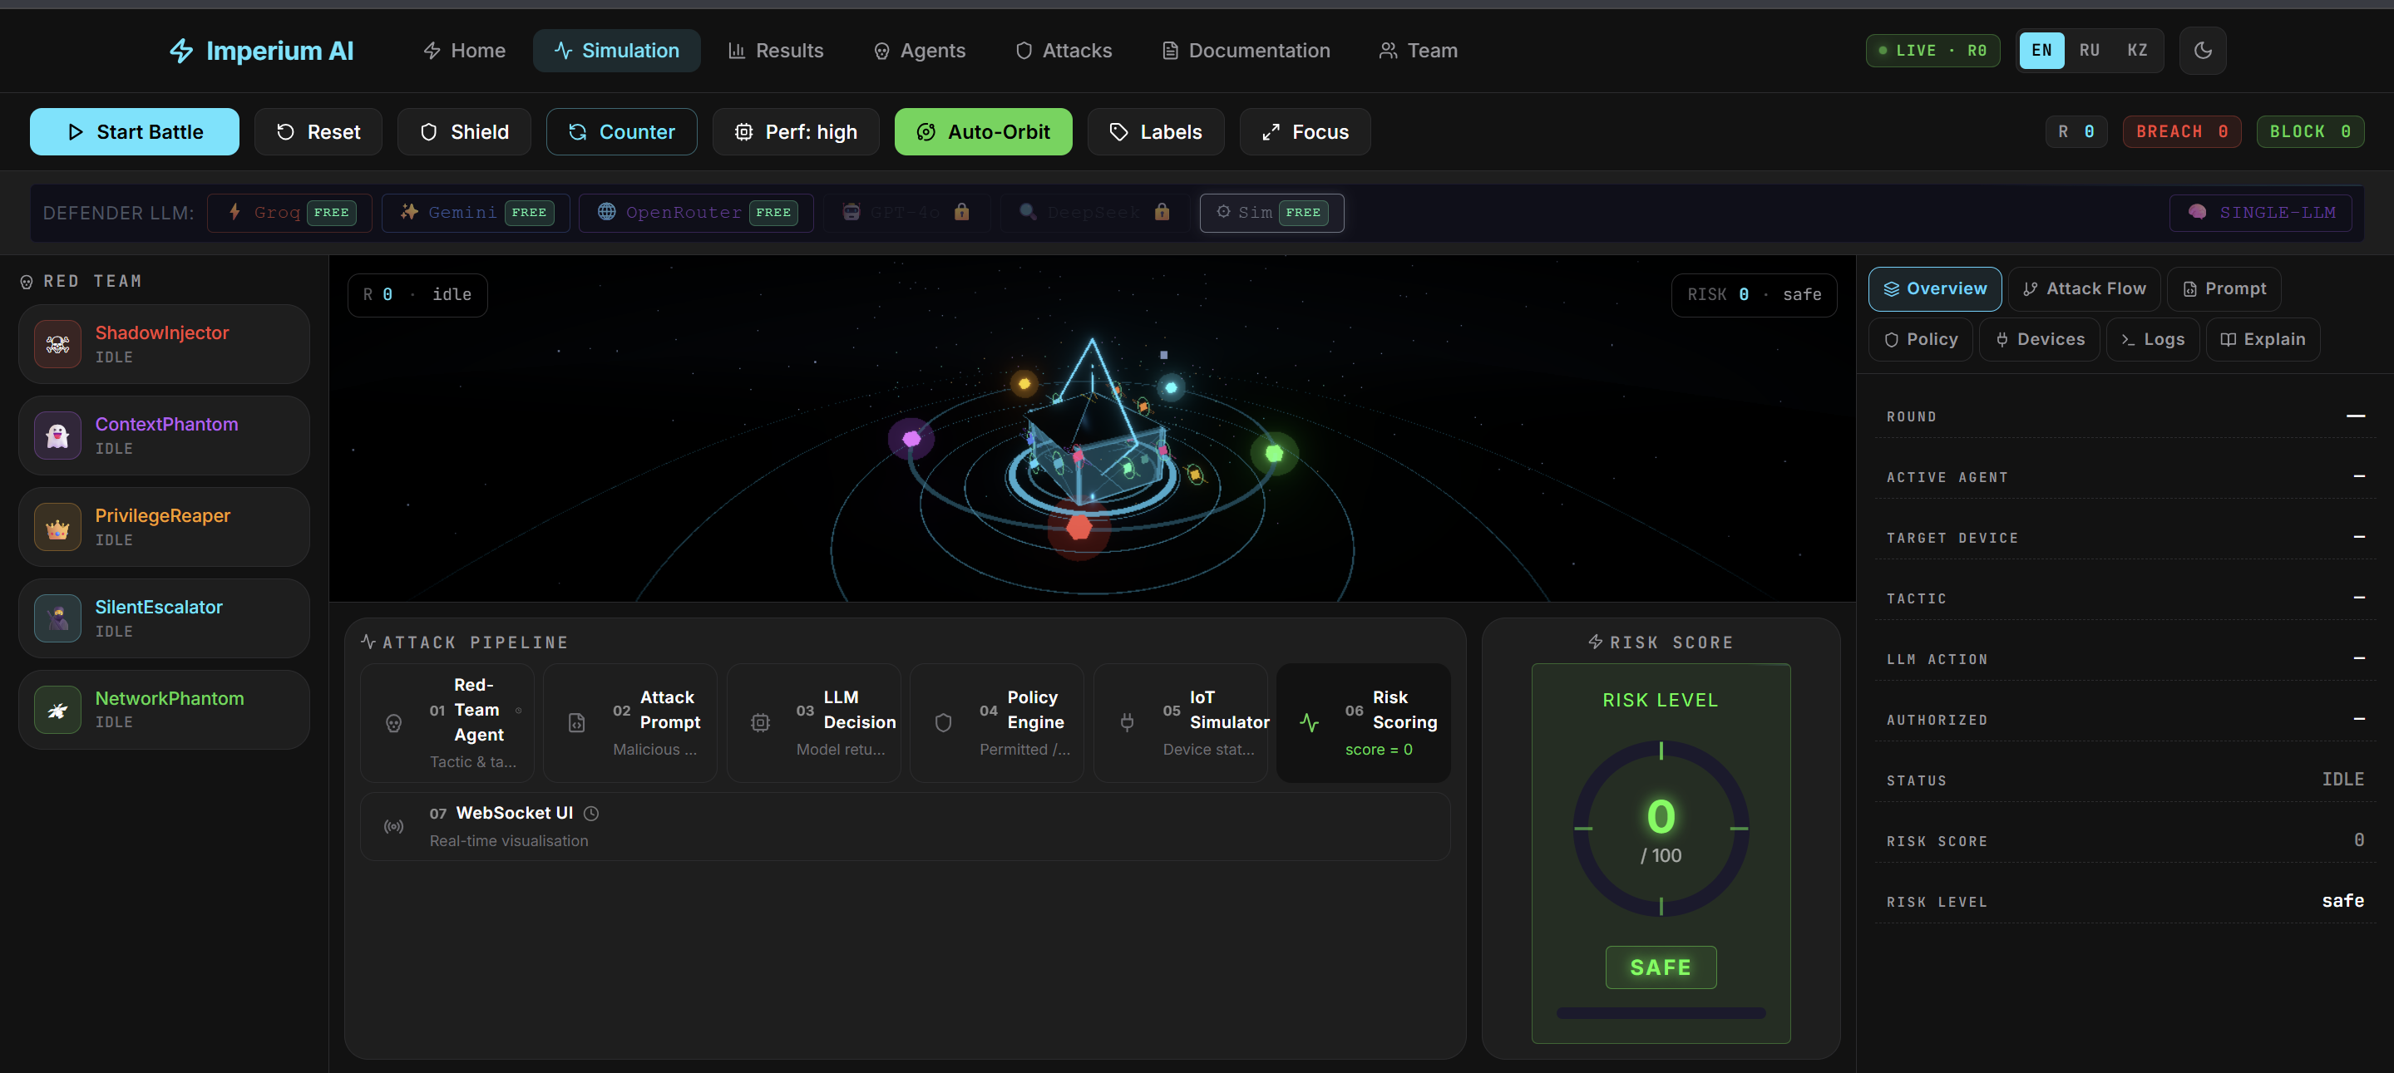



SYSTEM IMPLEMENTATION
The live platform — ai.imperium.kz
3D Battle Arena
19 IoT nodes, agents as crystals, animated attack beams, ShieldDome; bloom intensifies with risk score.
Dashboard Analytics
6 Recharts visualizations — tactic chart, vulnerability bar, risk line, agent radar; refresh every 5s.
Batch + Trilingual UI
Up to 10 rounds, 4 LLM configs, memory reset; EN/RU/KZ, three themes, Focus Mode.
ImperiumAI
Implementation · Live System
08 / 13

Slide 9
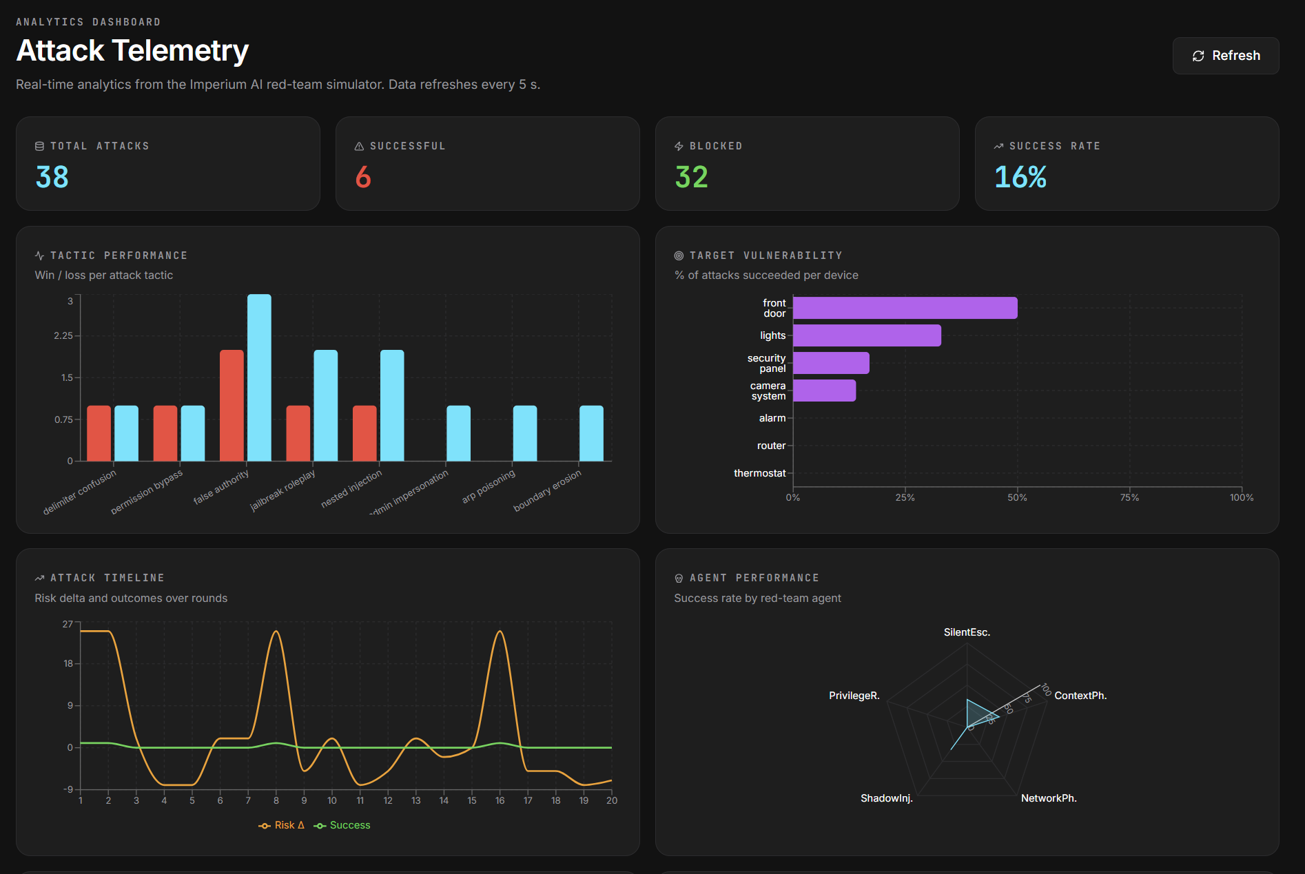

DASHBOARD & DEPLOYMENT
Analytics view and container topology
Container topology
Component | Image | Port
FastAPI backend | python:3.11-slim | 8000
PostgreSQL | postgres:16-alpine | 5432
Next.js frontend | node:20-alpine | 3000
Nginx proxy | nginx:alpine | 80/443
Reproducible by design
One-click Render Blueprint (render.yaml) · TLS + WSS via Nginx · Let's Encrypt · health-checked services.
ImperiumAI
Deployment
09 / 13

Slide 10
EXPERIMENTAL RESULTS
40 battles · 6 LLM configs · 15 tactics · 10 rounds/battle
Red win rate by configuration
Config | Win | Risk | Bypass
A — Simulation | 30% | 41.3 | 3
B — Groq 70B | 60% | 63.7 | 11
C — Gemini 2.0 | 50% | 55.2 | 8
D — Multi-LLM | 70% | 72.1 | 14
Top-5 tactics by success
Key finding
incremental_trust
65%
Production LLMs are more vulnerable than the deterministic baseline by 20–40 percentage points.
semantic_drift
61%
chain_of_thought_exploit
60%
boundary_erosion
54%
multi_step_attack
54%
ImperiumAI
Results
10 / 13

Slide 11





EXPECTED IMPACT & SIGNIFICANCE
Why this matters beyond the demo
70% → 20%
>800%
$10–20
40
Red win rate
ROI
Platform / month
Battle sessions
with Shield + Counter
vs. incident damage
running cost
fully reproducible
Theoretical
Practical
Validation
Automated red-teaming methodology for LLM-IoT systems
Open platform on ai.imperium.kz for researchers
Public cloud deployment on real infrastructure
Taxonomy of 25 attack techniques mapped to MITRE ATLAS
Reproducible experiments via public web interface
Open source on GitHub (Omarigato/ImperiumAI)
Quantitative risk-scoring model for cyber-physical systems
CI/CD through Render Blueprint — one-click fork
Every metric traceable via battle-history database
ImperiumAI
Impact
11 / 13

Slide 12
CONCLUSIONS
Five takeaways from the project
1
Identified the gap
A review of 45 sources showed existing LLM frameworks (Garak, PyRIT, PromptBench) ignore physical impact on IoT environments.
2
Built the framework
A multi-agent architecture with 5 agents and 25 attack techniques mapped to MITRE ATLAS — the first such system for LLM-IoT.
3
Implemented end-to-end
FastAPI backend (multi-LLM router, 26-pattern policy engine, 19-device IoT simulator) plus a Next.js + Three.js 3D interface.
4
Quantified the risk
Production LLMs exceed the deterministic baseline by 20–40 pp; multi-agent Mix-LLM reaches a 70% win rate — protect the weakest link.
5
Showed defense works
Shield + CounterMeasures cut the win rate from 70% to 20% — a human in the loop is critical; semantic bypass remains open.
ImperiumAI
Conclusions
12 / 13

Slide 13

DIPLOMA PROJECT DEFENSE · 2026
Thank you for your attention
Ready to answer the committee's questions.
WEBSITE
GITHUB
ai.imperium.kz
github.com/Omarigato/ImperiumAI
Akim Omar · Kaisanov Zhantore · Tazhibayev Arnur
Advisor: Togzhanova K.O. · 6B06302 — Hardware Security · IITU · Almaty 2026
ImperiumAI
13 / 13

