Slide 1
Covid-19
A deep learning model for detecting Covid-19 virus

Slide 2





Meet our Team
Emam
Al-Husseini
Rana
Hussien
Omar

Slide 3
Table of Contents
1
2
3
4
Problem Statement
5
Results
Dataset
6
GUI
Data Preprocessing
7
Pre-trained model comparison
Implementation
8
Conclusion

Slide 4
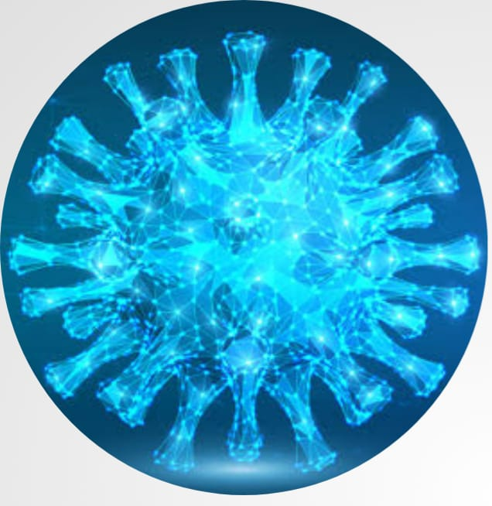
Problem Statement
Since 2019, Corona Virus has been spread over the world and a lot of people died. It was difficult to know it is a normal flu or the virus, so programmers tried to help by making a deep learning model identifies the virus, here we are trying to enhancement the model and increase the accuracy of a competitive model from Kaggle.

Slide 5
Dataset
What data sources already exist?
01
What privacy concerns are there?
02
03
Is the data is public?
Where should we store the files?
04

Slide 6
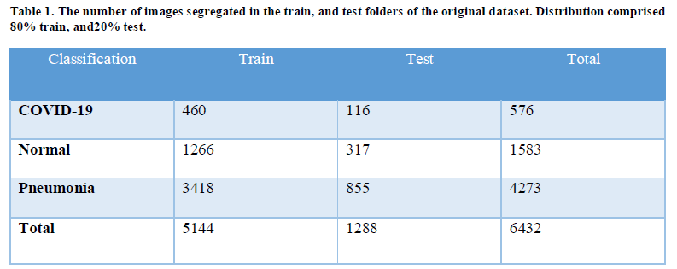
Dataset(Before Preprocessing)

Slide 7
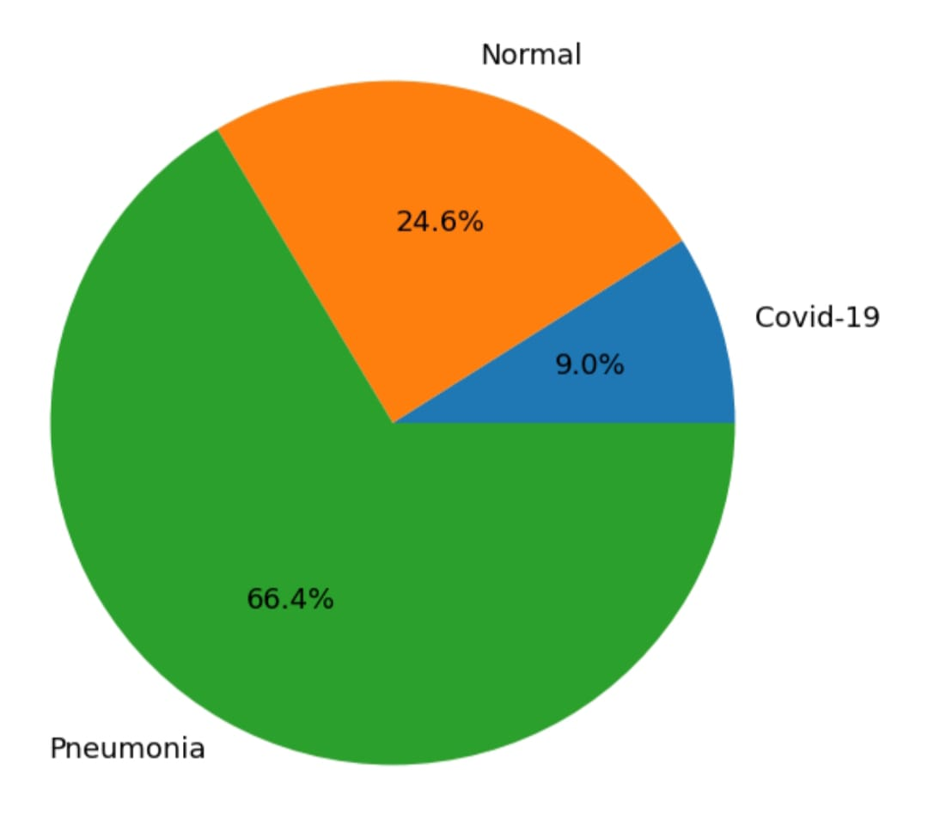
Dataset(Before Preprocessing)
Here as you see, There is class imbalance problem which occurs when there is many more instances of some classes than others.
Before

Slide 8
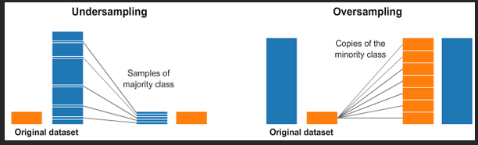
Preprocessing Stage
The unbalancing of the data solved using: Resampling Technique

Slide 9
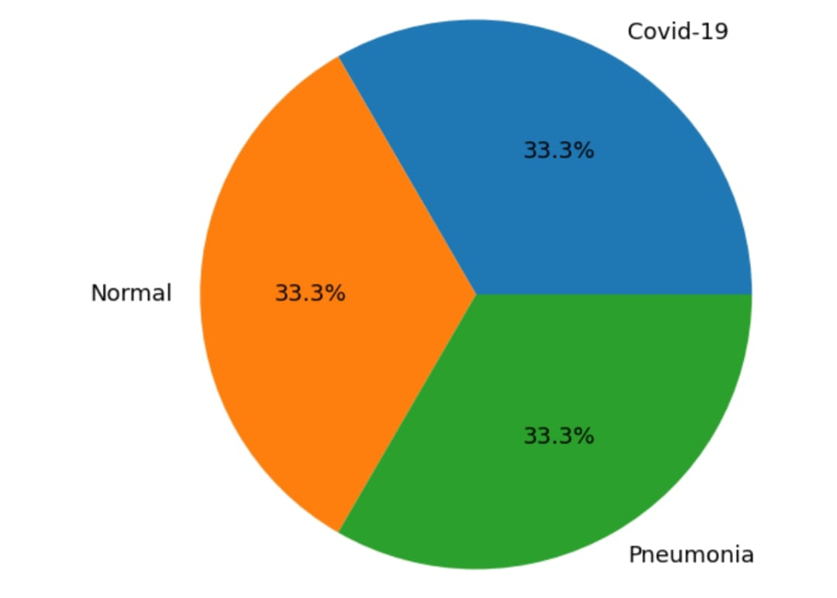
Dataset(After preprocessing)
Here, this a visualization of the data after the imbalance was solved

Slide 10
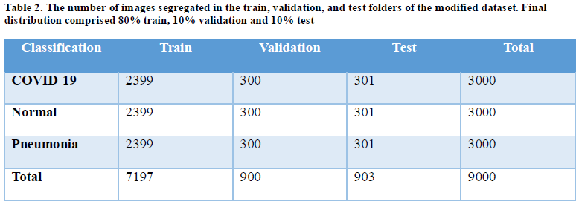
Dataset(After preprocessing)

Slide 11
Image Enhancements Techniques
Image enhancements techniques improve the quality of an image as perceived by a human.
Here we used three techniques:
Histogram Equalization (HE)
Contrast limited adaptive histogram equalization (CLAHE)
Image Invert/ Complement
We also use center crop mechanism, which was applied to all the X-ray images to reduce background noise and enhance focal length position.

Slide 12
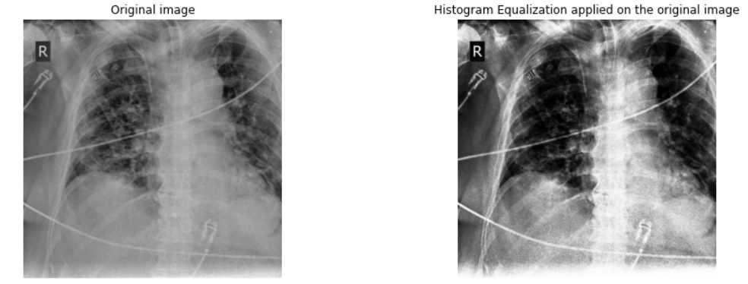
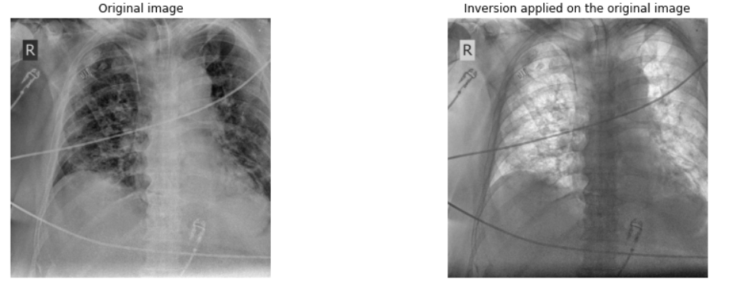
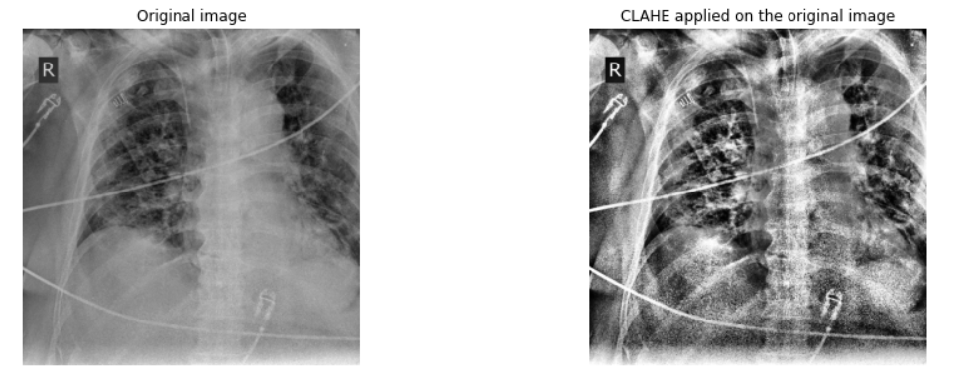

Slide 13
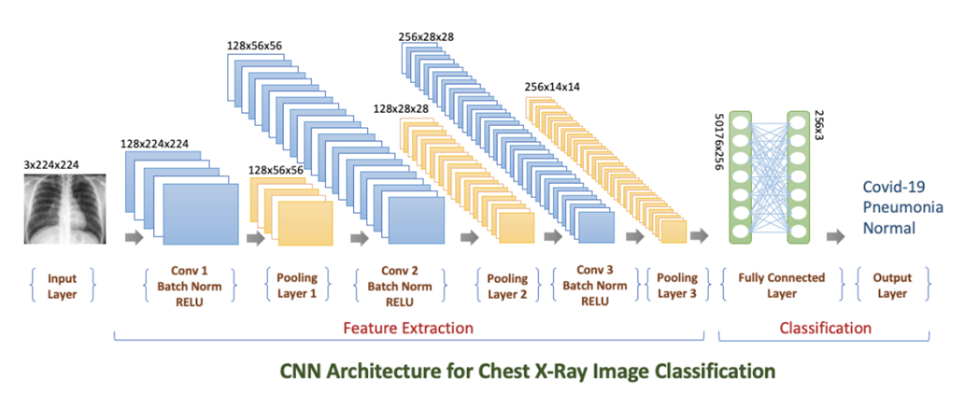
Implementation

Slide 14
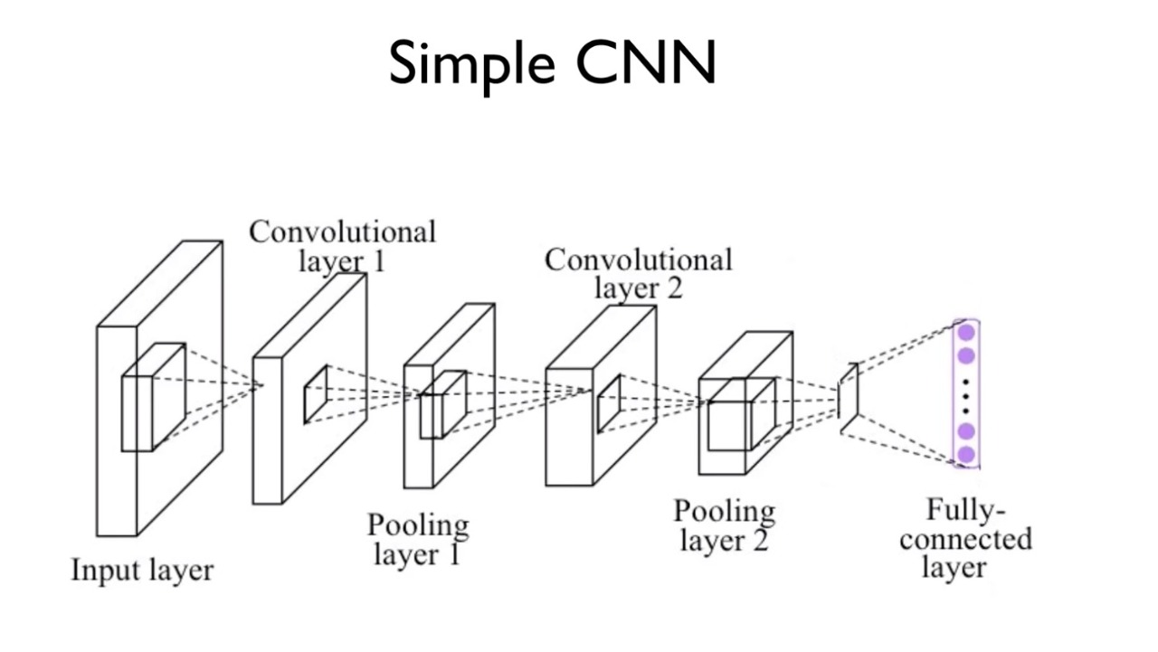
Convolutional Neural Network (CNN)
CNNs are regularized versions of multilayer perceptions.
Has one or more convolutional layers.
It looks at smaller portions of the image.
CNNs have two main parts:
A convolution/pooling mechanism
A fully connected layers

Slide 15
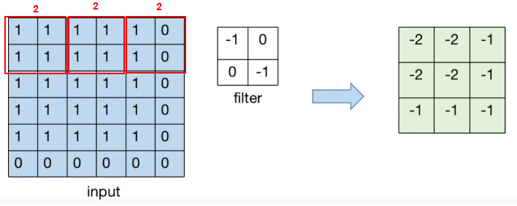
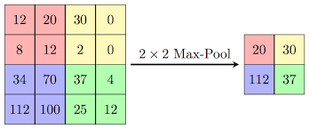
Architecture layers
Conv2D layer
What is Conv2D layer?
Why Conv2D layer?
MaxPooling2D layer
What is MaxPooling2D?
Why MaxPooling2D?

Slide 16
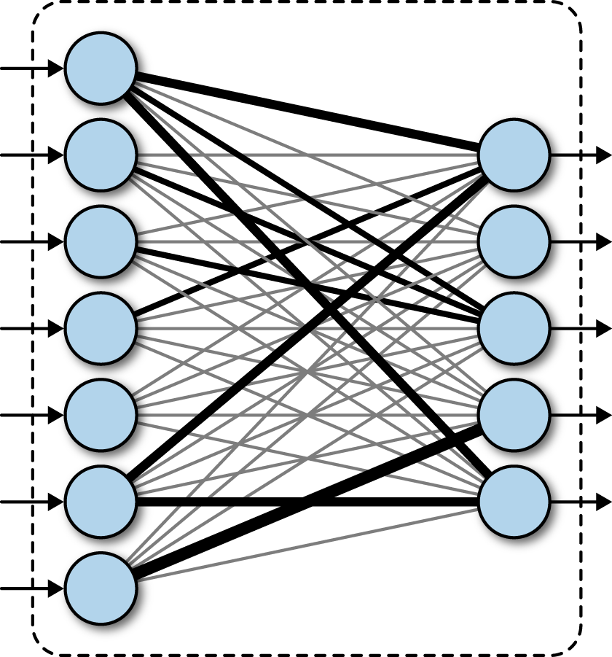
Architecture layers(cont.)
BATCHNORM2D layer
What is BATCHNORM2D layer?
Why BATCHNORM2D layer?
Fully Connected layers

Slide 17
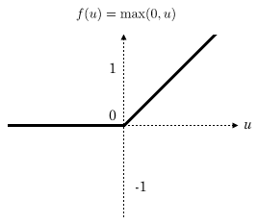
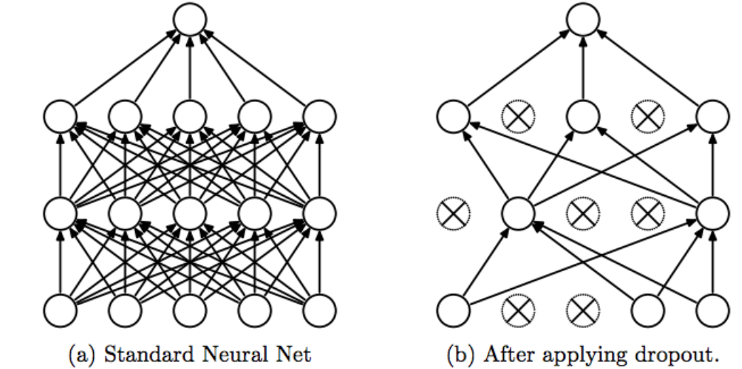
Architecture layers(cont.)
Activation layer(RELU)
What is Activation layer?
Why Activation layer?
Drop Out layer
What is Drop Out layer?
Why Drop Out layer?

Slide 18

How the model work?
Forward pass.
Calculate the loss.
Backward pass.
repeat the steps until the end of epochs.

Slide 19
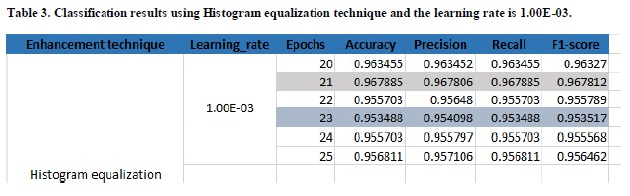
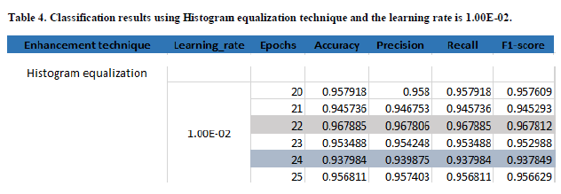
RESULTS(CNN-Pytorch)

Slide 20
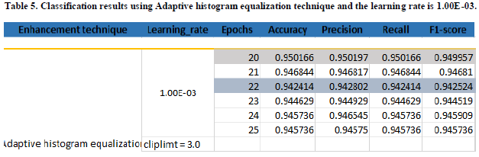
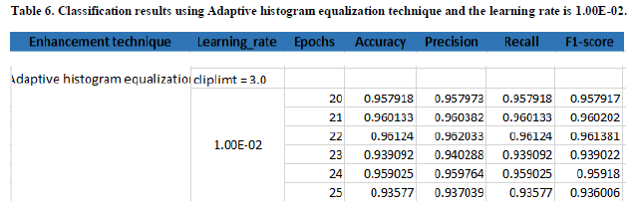
RESULTS(CNN-Pytorch)

Slide 21
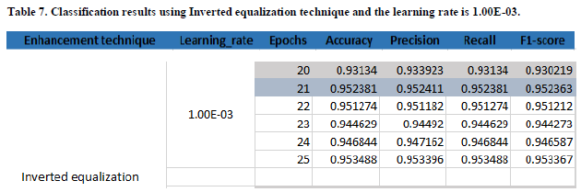
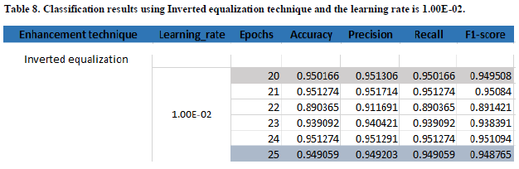
RESULTS(CNN-Pytorch)

Slide 22
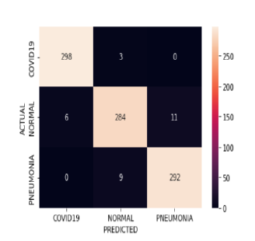
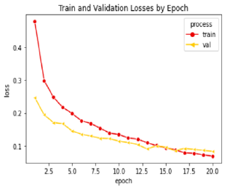
Comparison between Pytorch and Keras
Highest result of pytorch:
Confusion matrix of the highest accuracy:

Slide 23

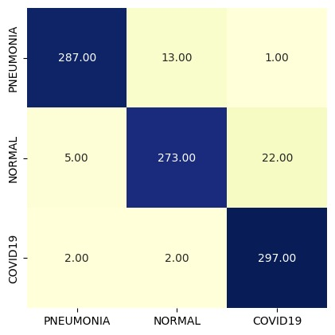
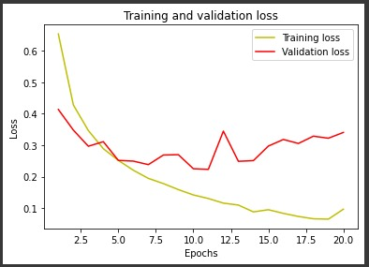
Comparison between Pytorch and Keras(cont.)
Highest result of keras:
Confusion matrix of the highest accuracy:

Slide 24
Comparison between Pytorch and Keras(cont.)
More concise, simpler API.
Great access to tutorials and reusable code.
Less frequent need to debug simple networks.
More deployment options (directly and through the TensorFlow backend), easier model export.
Speed of executions is low.
PYTORCH
more flexible, encouraging deeper understanding of deep learning concepts.
Excellent community support and active development.
Way better debugging capabilities.
As far as training speed is concerned, PyTorch outperforms Keras.
KERAS

Slide 25
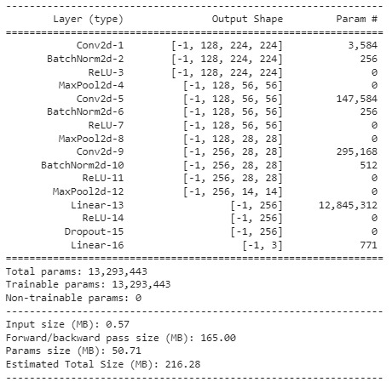
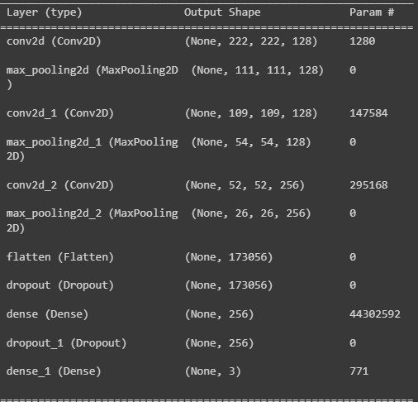
Summaries of Pytorch and Keras models
Summary of Pytorch model
Summary of Keras model

Slide 26
GUI
We have used Gradio library to generate our interface.
Gradio is a way to demo your deep learning model with a friendly web interface so that anyone can use it, anywhere!
To use Gradio to generate interface for pytorch model there are some steps to follow:
Save the pretrained model and upload it to drive.
Define the architecture of the model.
Load the saved model.
Define classification method to take the input as image and return the list of probabilities.
Take the classification method as a parameter to generate the interface.

Slide 27
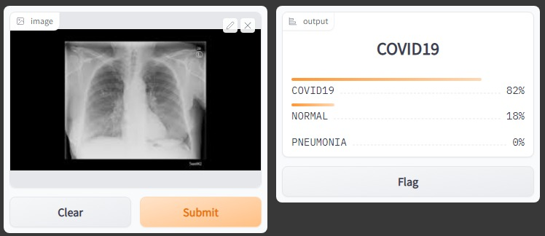
GUI-Example

Slide 28
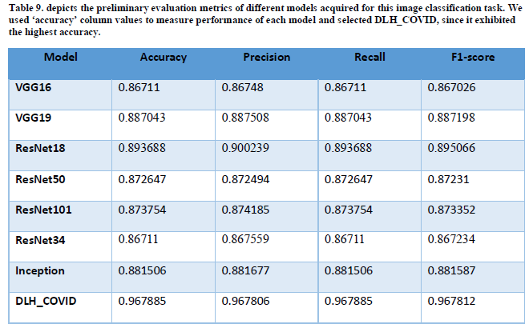
Comparison among Pytorch and pretrained models

Slide 29
Pretrained models
VGG16 - VGG19
It is a very good architecture for benchmarking on a particular task.
Also, pre-trained networks for VGG are available freely on the internet, so it is commonly used out of the box for various applications like image classification.

Slide 30
Pretrained models(cont.)
ResNet18 - ResNet18 - ResNet50 - ResNet101
Networks with large number (even thousands) of layers can be trained easily without increasing the training error percentage.
ResNets help in tackling the vanishing gradient problem using identity mapping.

Slide 31
Pretrained models(cont.)
Inception
High-performance gain on convolutional neural networks.
Efficient utilization of computing resource with minimal increase in computation load for the high-performance output of an Inception network.
Ability to extract features from input data at varying scales through the utilization of varying convolutional filter sizes.
1x1 conv filters learn cross channels patterns, which contributes to the overall feature extractions capabilities of the network.

Slide 32
Conclusion
A deep learning-based technique is proposed for the classification of different chest infections. The proposed automated system can differentiate chest infections after the evaluation of chest X-ray images. Histogram equalization is used as a preprocessing tool to enhance the images as the data are gathered from different sources. We trained our model with different epochs and learning rate, the best case was when we applied histogram equalization technique with the learning rate is 1.00E-03 at the number of epochs 21, the test accuracy was 96.78%. We passed our data and compared our model with different types of pre trained models, they were resnet18, resnet34, resnet50, resnet101, vgg16, vgg19 and inception.

Slide 33
Thanks!
Do you have any questions?

