Slide 1
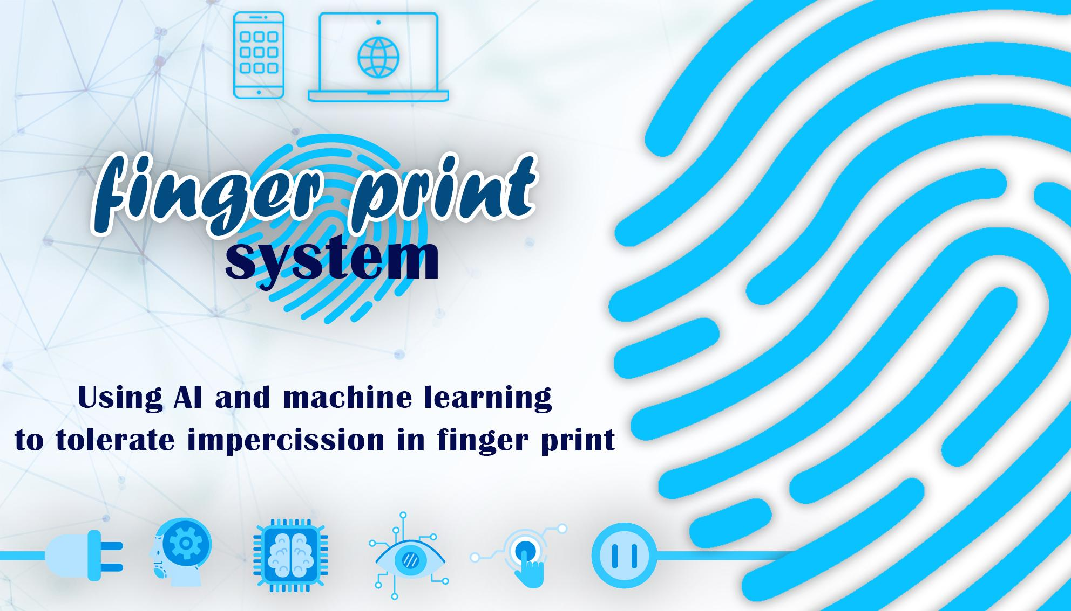

Slide 2
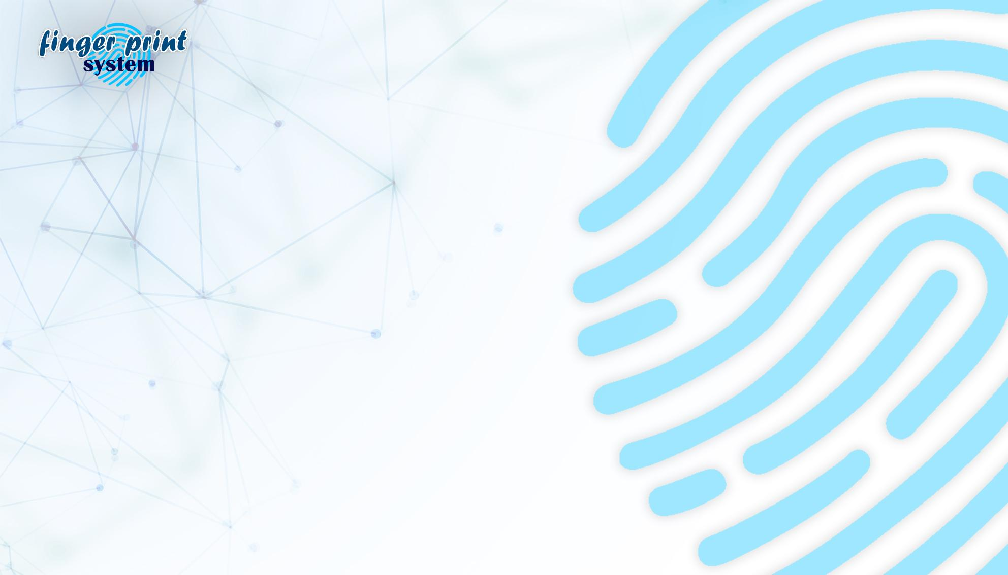
Agenda
Introduction
Problem
Components & Cost
Languages & Code
Video
Future vision &References

Slide 3
Introduction
In This presentation, we will talk about Fingerprint Identification Attendance , how project work, problem, description of this System ha solved .
This project help to make the complex and difficult process to automatic process .
This project work to take the attendance from user or employee and recognize the identity of employee or user From Web development (website) or Mobile Application which it connect with API (backed-end) Which API connect with Hardware (Arduino) and Software (Front-end) to make the process so easy and isn’t expensive.

Slide 4
Problem
Problem Definition:
The definition of the problem is a quick examination and presents the problem that we are solving, and therefore through our systems we are able to transform a manual or paper process into automated process effective, fast and accurate.
Problem Description:
Like what we talked about in defining the problem, as we have transformed the problem from a slow manual process, in which many errors occur, to a fast automated process.
Where we made from the process of taking the paper absence to an automated process by taking fingerprint from user or employee Which is effective, fast and accurate in calculate Absence or presence of user without Wasting time in taking it in paper and waste some time in working time.

Slide 5
Components & Cost
Components | Price (LE)
Arduino UNO R3 | 150
Advanced Fingerprint module | 430
RTC module | 140
ESP8266 module | 60
Character LCD module 16x2 | 50
Buzzer 5V | 5
on/of rocker switch small | 5
Tack Switch (Push Buttons) | 5
Resistors | 5
Rheostat | 10
Round LEDS | 5
9V battery adapter | 10
9v battery | 30
Breadboard 840 pin | 30
Male-Male jumper wires | 15
Male-Female jumper wires | 15
Female-Female jumper wires | 10
Arduino USB programming cable | 10
Plastic wax, paperboard and stickers | 30
Shipping expenses | 65
Future electronics and UGE electronic stores | Total: 1100

Slide 6
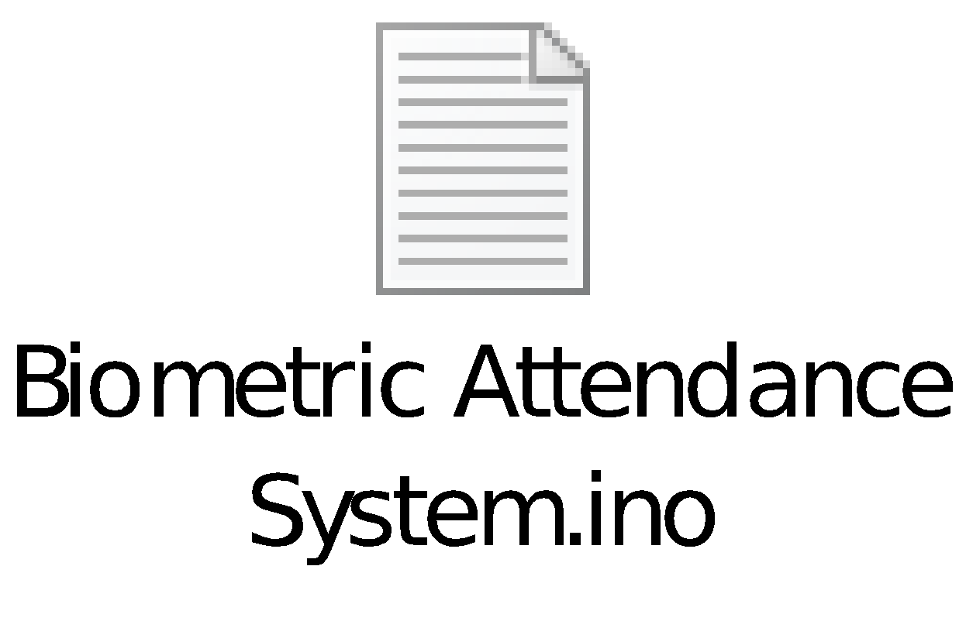
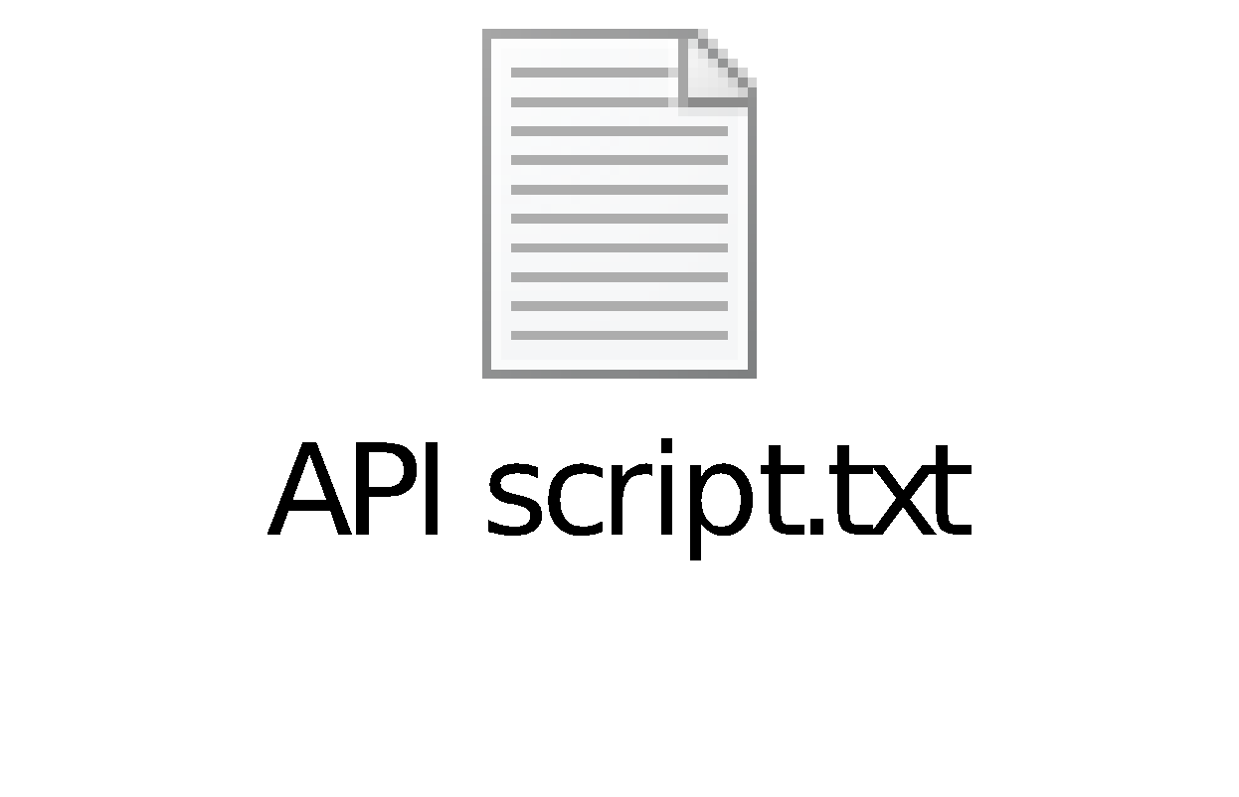
Languages & Code
Hardware (Arduino) | Back-end | Front-end
C & Python | Python & Flask | React & React Native
IDEs and any other used tools:
-Arduino IDE , PyCharm and Visual studio code .
-Fritzing virtualization environment.
Code

Slide 7
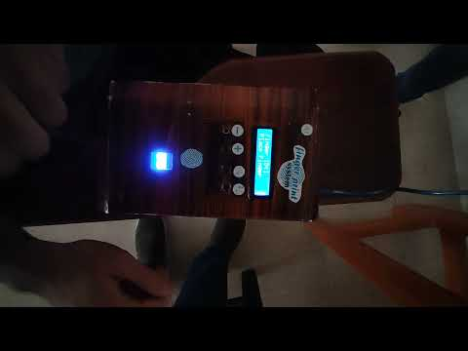
Video

Slide 8
Future vision &References
Make the attendance depends on facial recognition (or eye recognition) instead of fingerprint.
Embed module to determine persons temperature and make alarm if person may be infected with COVID-19.
Detect if workers wear mask or not and make alarm if not.
Fingerprint which makes Houses more safe and secure Like Doors and modern devices.
Modern websites need to unique identity from User like fingerprint can save his / her information by more secure like government websites and big companies.
References
•Arabic book (اردوينو ببساطة).
•A lot of repository on git hub and YouTube tutorials.

