Slide 1

Welcome to Our Medical Website
Youssef Zaher 202300641
Omar Tamer Samir 202300713
Youssef Mamdouh 202300659

Slide 2

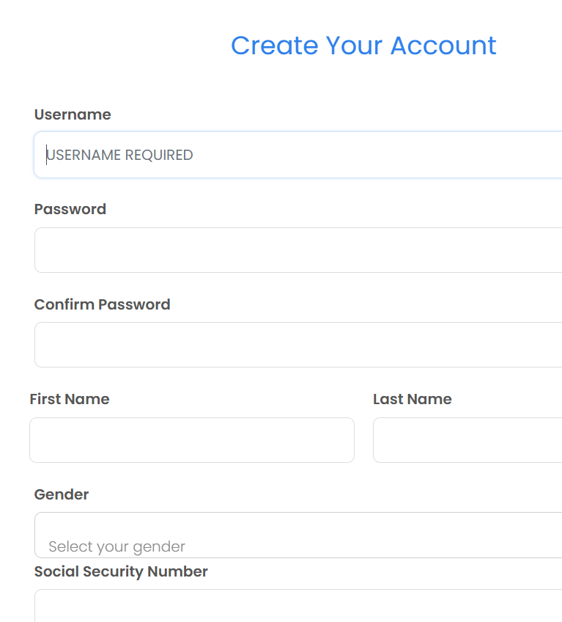
User Registration
- Easy and intuitive registration process.
- Fields include username, password, personal details, and contact information.

Slide 3
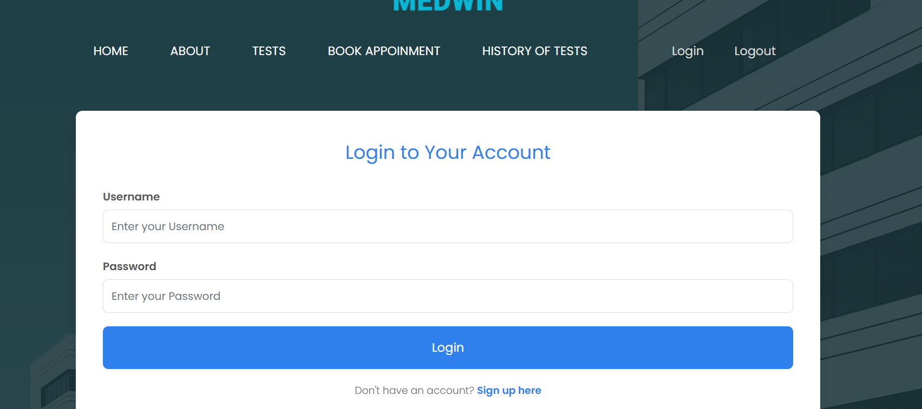
Secure Login
- Users can securely log in to their accounts.
- Ensures privacy and data protection.

Slide 4
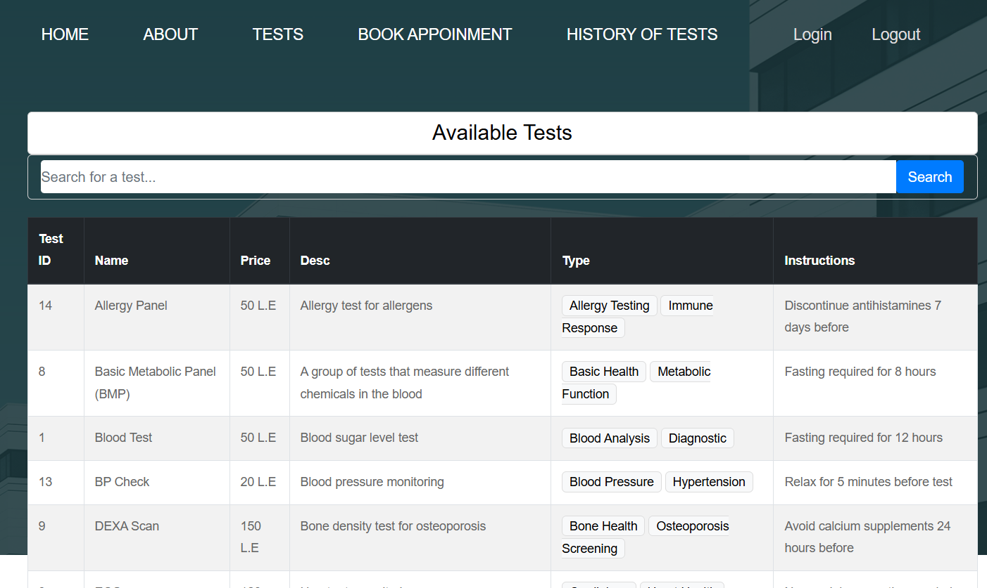
Comprehensive Test Directory
- View a list of available tests with descriptions, prices, and instructions.
- Integrated search functionality for convenience.

Slide 5
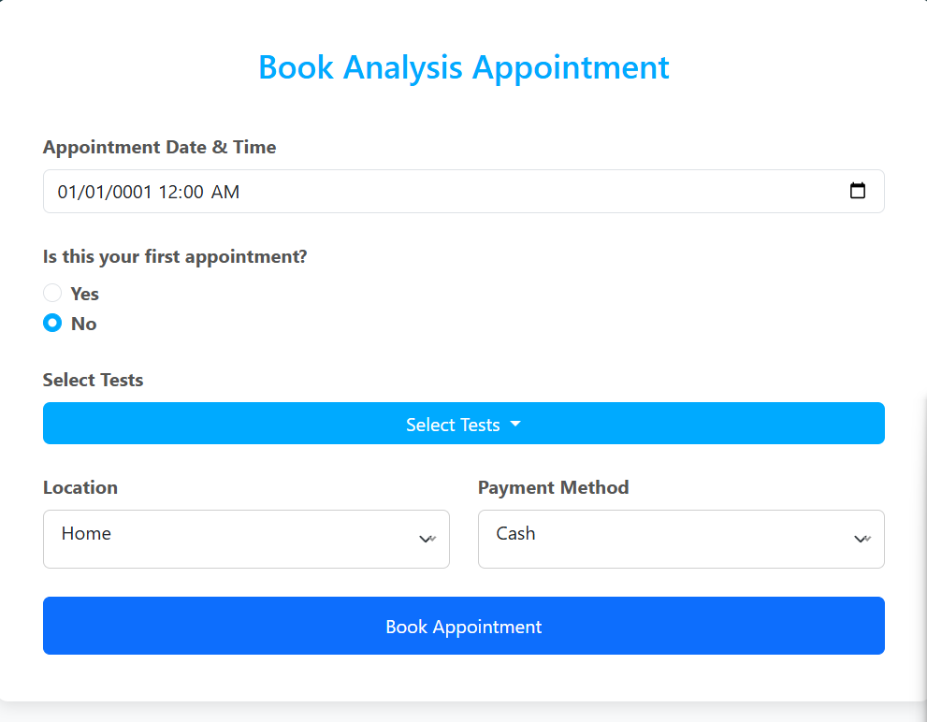
Appointment Booking
- Book appointments with customizable options.
- Select tests, choose a location, and payment method.

Slide 6
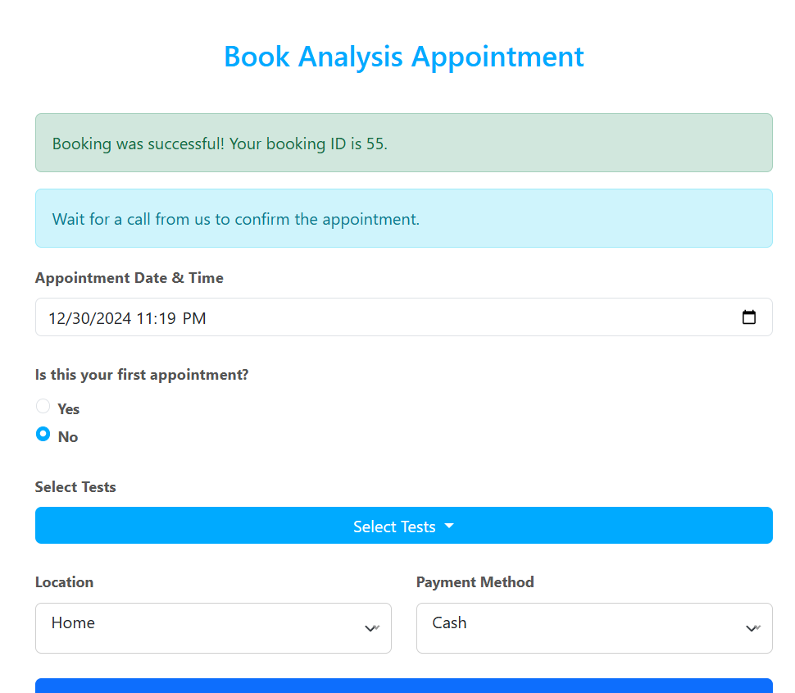
Confirmation Process
- Appointment booking success messages.
- Users receive confirmation and follow-up instructions.

Slide 7
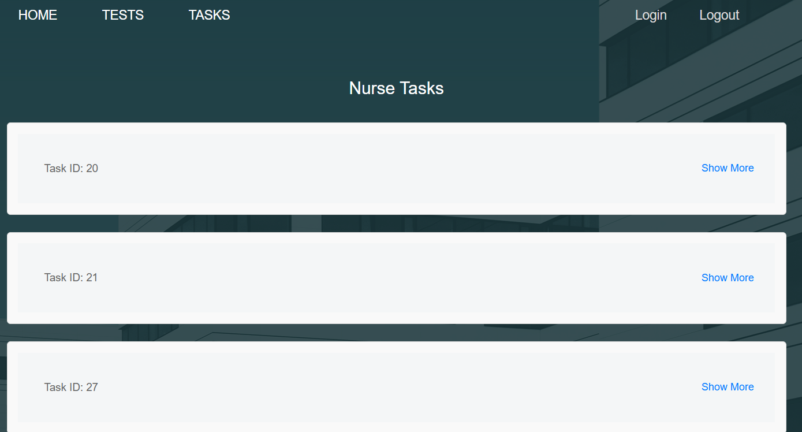
Task Management
- View and manage tasks assigned to nurses.
- Streamlined task tracking and completion.

Slide 8
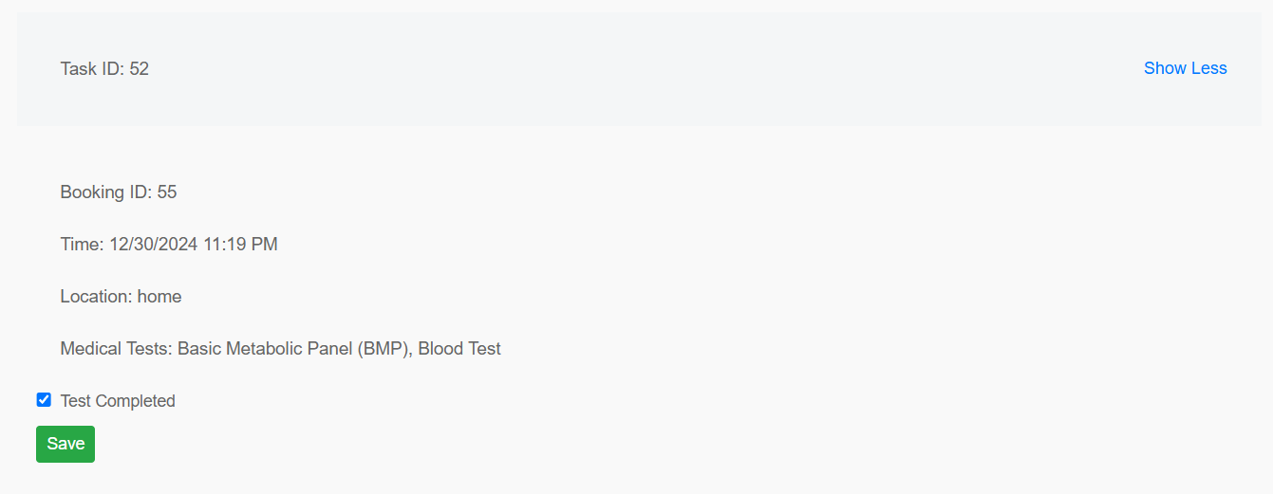
Detailed Task View
- Comprehensive details for each task.
- Includes test status and submission options.

Slide 9
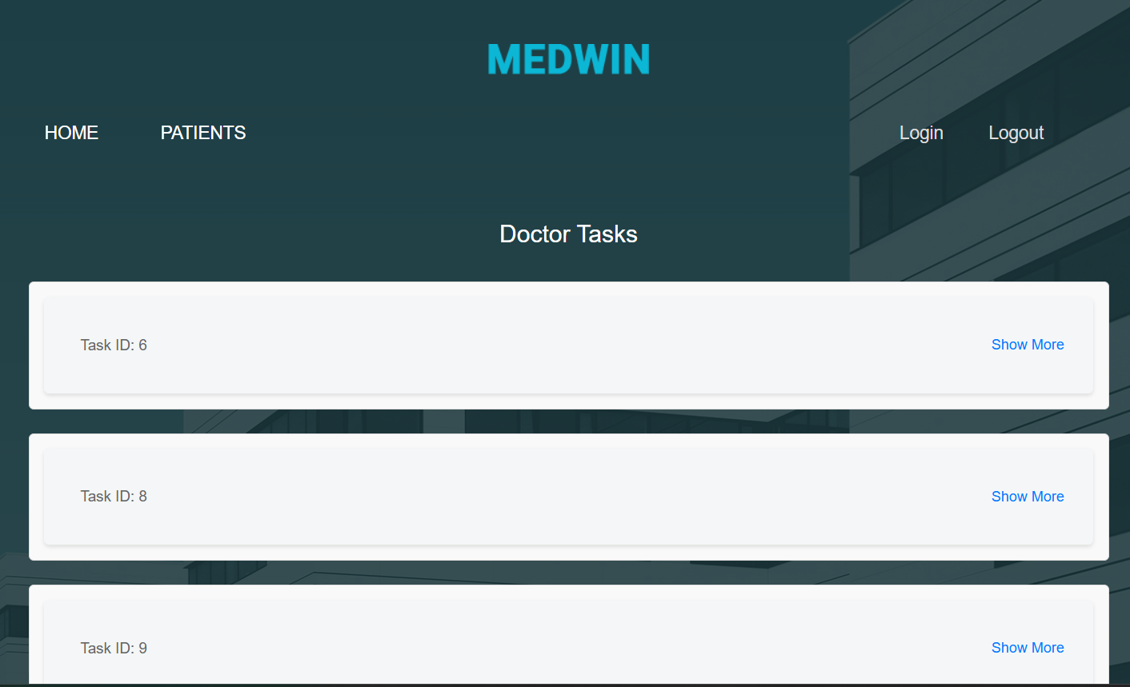
This screenshot showcases the Doctor Tasks page in the Medwin application, highlighting a clean layout with task IDs listed in expandable cards. The interface ensures clarity with a minimal design, allowing doctors to view detailed information through "Show More" links, promoting usability and simplicity.

Slide 10
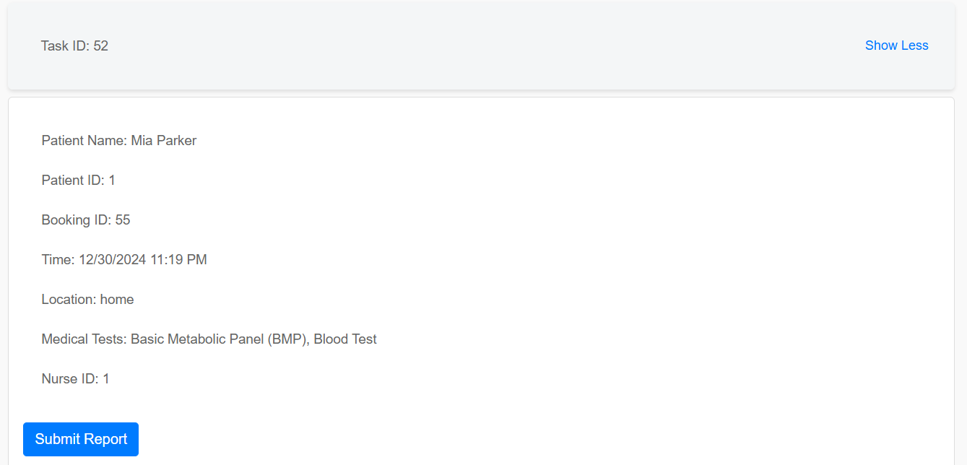
This screenshot displays a detailed view of a specific task assigned to a nurse or doctor. It includes relevant information such as patient details, booking ID, appointment time, location, and medical tests. The "Submit Report" button allows the healthcare provider to finalize and submit their task.

Slide 11
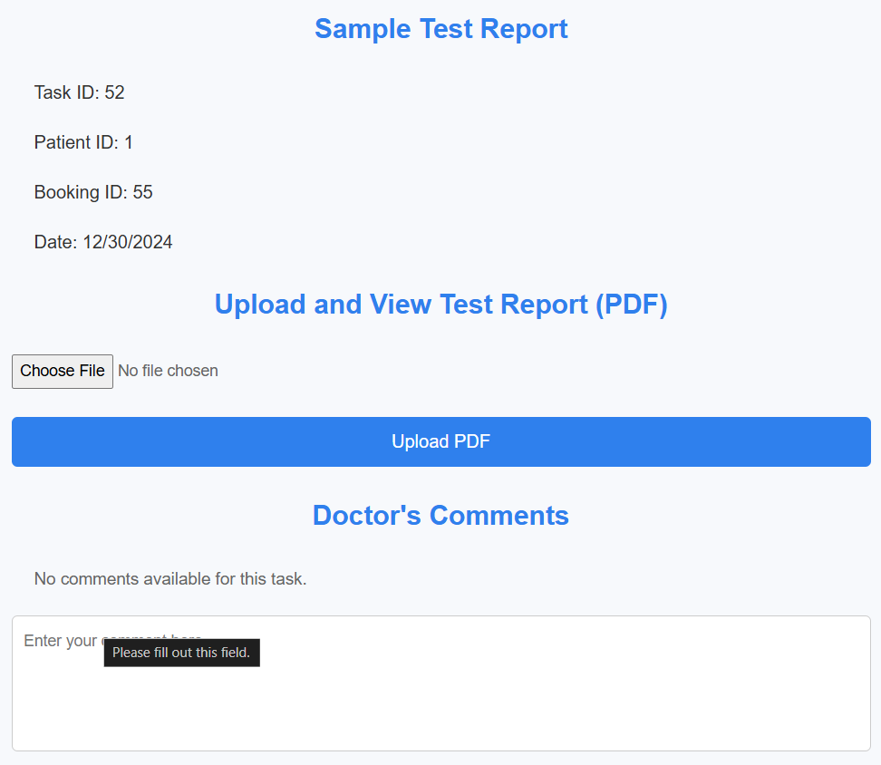
Allows users to upload and view test reports in PDF format.
Includes fields for entering comments and providing additional context for the test results.

Slide 12
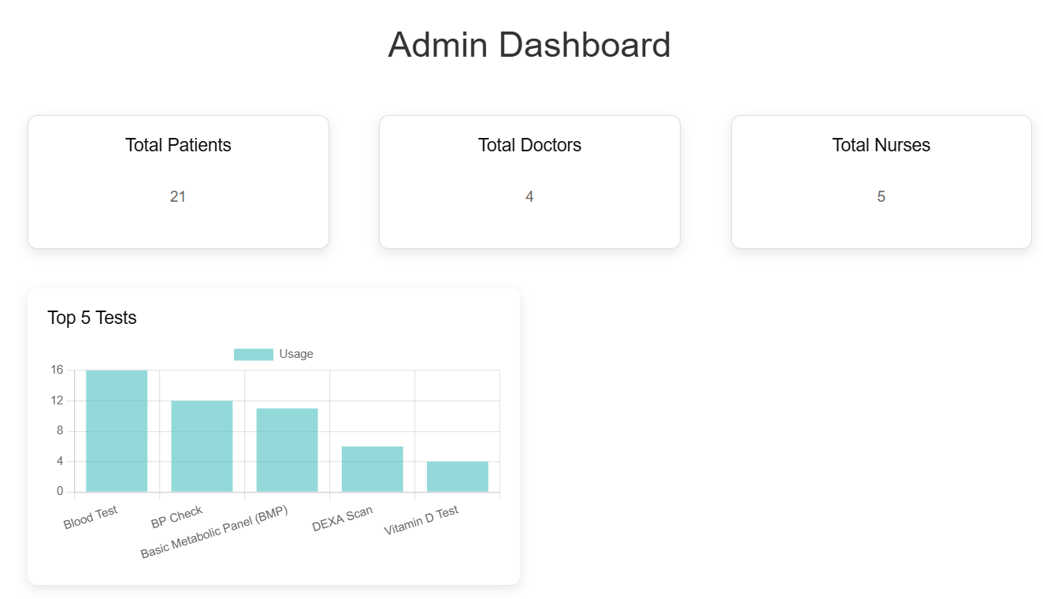
Displays key metrics: total patients, doctors, and nurses.
Features a chart showcasing the top 5 most-used tests, offering insights into test popularity.

Slide 13
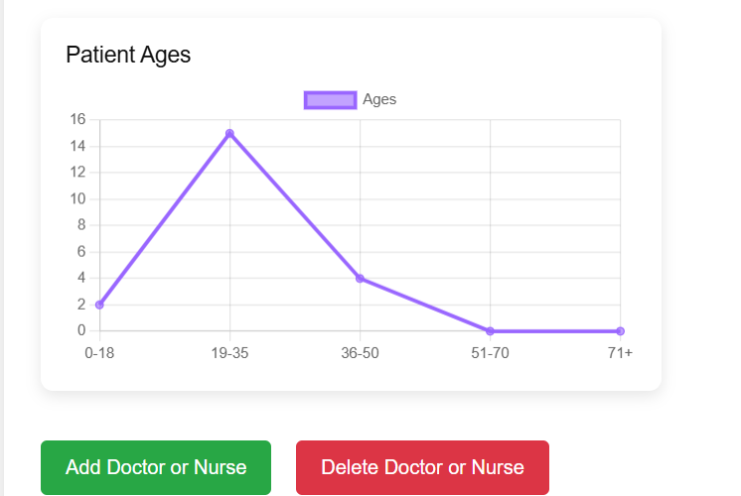
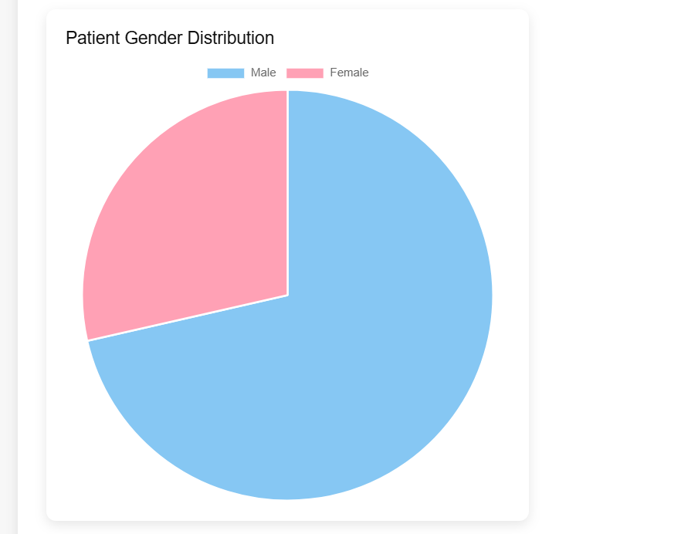
Administrative Tools
Visual representation of the gender distribution among patients.
Provides an easy-to-understand pie chart indicating male and female percentages.
Displays a line chart showing the distribution of patients
across different age groups.
Includes action buttons for adding or removing doctors and nurses,
ensuring efficient management.

Slide 14
Thank You for Exploring!
Contact us for more information or assistance.

