Slide 1
Contact Manager Application
A Comprehensive Guide to the Development and Validation
Start

Slide 2
Table of Contents
01
02
03
04
05
06
Project Overview
App
Features
Testing Plan Overview
Test Automation
Test Split
Conclusion

Slide 3
01
Project Overview

Slide 4
The Contact Manager application simplifies personal contact management with features like adding, viewing and deleting contacts. This presentation highlights its key features and a robust testing plan ensuring functionality, usability, and reliability

Slide 5
02
App Features

Slide 6
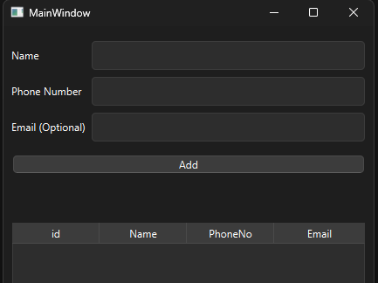
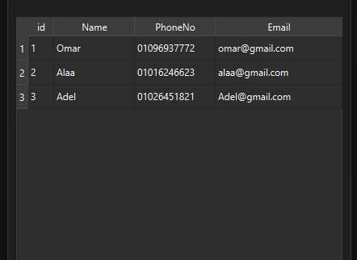
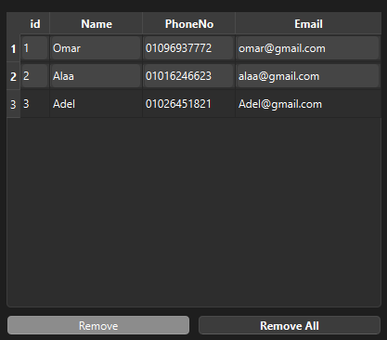
App Features
Add Contact
View all
Contacts
Delete /
Delete All

Slide 7
03
Testing Plan Overview
Testing…
Okay
Hurry up

Slide 8
Testing Plan Overview
The test plan ensures the Contact Manager application's quality by focusing on various aspects, with automated testing for continuous reliability.
Test-case Deriving sequence:
Define Happy Scenario Path
Identify Edge Cases (ex: boundary conditions)
Create Negative Scenarios (ex: invalid inputs/ actions)
Test for app’s effective error handling (ex: descriptive error messages)

Slide 9
04
Test Split
A dive into the chosen tests and their handling from the App’s side

Slide 10
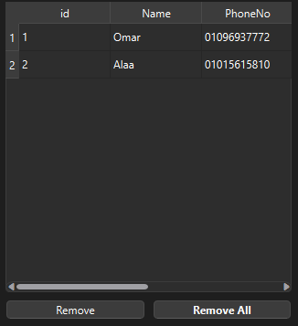
Test Split
1.1 UI Testing
Ensures a consistent, responsive and visually appealing UI.
Key Test Cases:
Window Resize
Scrollable Contacts Listing
Layout Check
App handling example
~scrollable table

Slide 11
Test Split
1.2 Functionality Testing
Verifies that all features work as intended and respond to user actions.
Key Test Cases:
Adding contacts with valid and invalid data
Deleting single/multiple/all contacts.
Handling duplicates and empty fields.

Slide 12
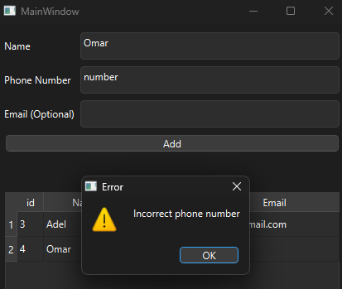
Test Split
1.3 Data Validation Testing
Confirms the accuracy and integrity of user inputs and stored data
Key Test Cases:
Validating phone number and email formats.
Enforcing character limits.
App handling example
~field input validation

Slide 13
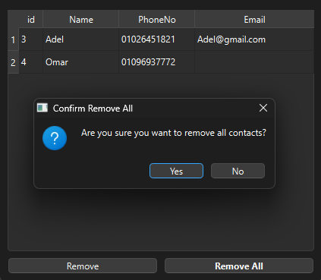
Test Split
1.4 Usability Testing
Assesses the ease of use and intuitiveness of the application for users.
Key Test Cases:
Descriptive error messages presence
Confirmation modals for critical actions.
App handling example
~confirmation modal

Slide 14
05
Test Automation

Slide 15
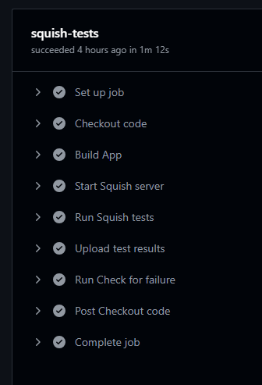
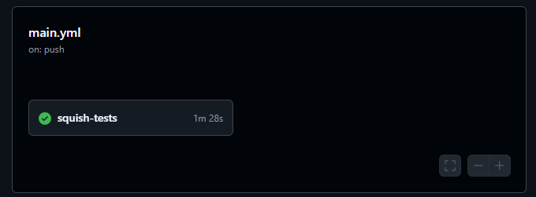
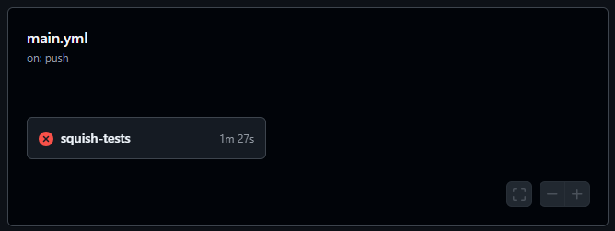
Automation Workflow
Build QT App
Start Squish Server
Running Squish Scripts on the built app
Saving test report
Checking for any failure occurs
Abort if any failure occured
Automating process on push using github actions

Slide 16

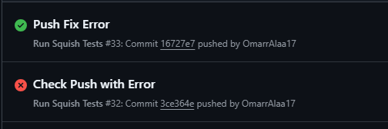
Github Actions Runner
Due to privacy and license concerns I have used self-hosted github action runner. To use the local Qt and Squish environment and run the automated tests.
This should be replaced with an actual server with the setup.
Note: license ends within 5 days.

Slide 17
In Conclusion,
Thank You
the Contact Manager application delivers efficient and reliable personal contact management through a robust design, comprehensive testing plan and error handling techniques.

