Slide 1


Slide 2
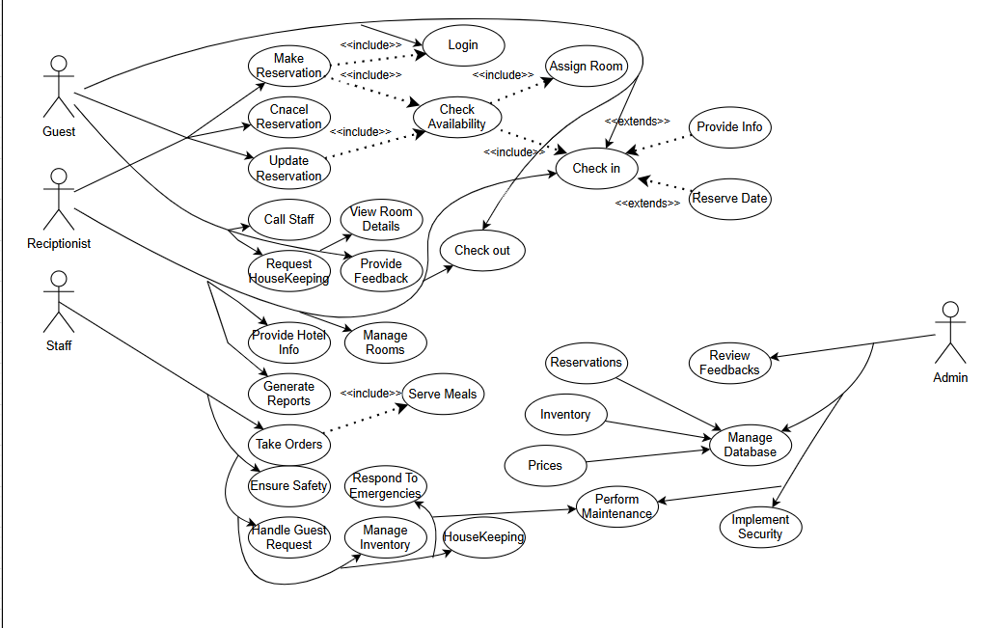
Use Case Diagram

Slide 3
Use-Case Narrative
Use Case Name: | Hotel Reservation System
Use Case Id: | 123A99
Priority: | Medium
Description: | This Use Case allows a checked-in guest to request room service from housekeeping.
Precondition: | The guest is checked in and the room is assigned.
Typical Course of Events:
Actor Action: |  | System Response:
1. Guest requests room service via phone or platform. 3. Housekeeping confirms receipt of the request. 5. Housekeeping fulfills the requested service. |  | 2. The system records the request and notifies housekeeping. 4. The system acknowledges the request and updates the status to "In Progress." 6. The system marks the request as completed and notifies the guest
Conclusion: |  | The requested room service is successfully delivered, and the request is marked as completed.

Slide 4
Use Case Name: | Hotel Reservation System
Use Case Id: | 123B99
Priority: | High
Description: | This Use Case allows a guest or receptionist to book a room for a specified period.
Precondition: | The system is accessible, and the guest provides check-in and check-out dates with the room type.
Typical Course of Events:
Actor Action: |  | System Response:
1. Guest or receptionist initiates the room reservation. 3. Guest provides required dates and selects room type. 6. Guest or receptionist selects a specific room. |  | 2. The system prompts for check-in/check-out dates and room type. 4. If it's the guest's first time, the system adds a new record to its database, capturing their information for future reference. 5.The system displays a list of available rooms that match the criteria. 7. The system confirms the booking, assigns a reference number, and displays a confirmation message.
Conclusion: |  | The guest is checked in, and the room is marked as occupied.

Slide 5
Use Case Name: | Hotel Reservation System
Use Case Id: | 123C99
Priority: | High
Description: | The admin is responsible for managing and maintaining the hotel database. This ensures all information is accurate and up-to-date for hotel operations.
Precondition: | Admin must have system access with the appropriate permissions.
Typical Course of Events:
Actor Action: |  | System Response:
1. The admin logs into the hotel management system with appropriate credentials. 3. The admin navigates to the "Manage Database" section and selects the specific function they want to perform, such as updating reservations, managing inventory, or modifying room prices. 5. The admin enters the necessary updates, such as adjusting room availability, updating room prices, or adding inventory items. |  | 2. The system verifies the admin’s credentials and grants access to the database management interface. 4. The system displays the selected database section and provides options for modification 6. The system validates the inputs to ensure they meet format and data requirements. If valid, the system saves the changes and updates the relevant sections.
Conclusion: |  | The database is updated with the latest information as the admin's input.

Slide 6
Use Case Name: | Hotel Reservation System
Use Case Id: | 123A99
Priority: | Medium
Description: | The guest arrives at the hotel and checks in to their reserved room. The receptionist verifies the reservation details, confirms the guest’s identity, assigns a room, and provides the guest with room access information.
Precondition: | The guest must have a confirmed reservation.
Typical Course of Events:
Actor Action: |  | System Response:
1. The guest approaches the reception and provides their reservation details and ID for verification. 3. The receptionist verifies the guest’s identity and assigns them a room. 5. The receptionist provides the guest with room access information. |  | 2. The system retrieves the reservation details and displays them for the receptionist. 4. The system updates the room status to "Occupied" and marks the reservation as "Checked In." 6. The system records the check-in time and finalizes the reservation as active.
Conclusion: |  | The guest is checked in, and the room is marked as occupied.

