Slide 1

PROJECT DELIVERABLE
Aethera — University Edition
Unified Modelling Language (UML) Software Engineering Project
Student Author: Omar Saeed
Student ID: 222101064
Course: Software Engineering & UML Modeling
Core Engine: Groq Cloud Llama 3.3 70B Versatile

Slide 2
UML SOFTWARE ENGINEERING PROJECT
1. Problem Statement & Project Vision
⚠️ The Problem
🚀 The Vision & Solution
• Information Overload: Textbooks and lectures require excessive time to digest.
• Inefficient Revision: Manual flashcard creation and note-taking waste study hours.
• Fragmented Tools: Students switch between disconnected applications for summaries, quizzes, and planning.
• All-In-One Platform: Unified academic workspace containing 17+ AI-powered tools.
• Privacy-First Parsing: Local document extraction for PDF, DOCX, and TXT files.
• Live Ecosystem Integration: Instant synchronization with Notion databases and export to Anki (.apkg).

Slide 3
UML SOFTWARE ENGINEERING PROJECT
2. Requirements Engineering & System Specs
Functional Requirements
Non-Functional Specs
Integration Specs
• Academic Summaries (4 modes)
• Exam Question Generator
• Flashcards & Mind Maps
• GPA Calculator & Pomodoro
• Sub-second Groq AI inference
• Local file parsing privacy
• High availability & uptime
• Responsive Cyberpunk UI
• Notion API Live Sync
• Supabase Vector Database
• SQLite3 Local Storage
• Web Speech API (TTS/STT)

Slide 4
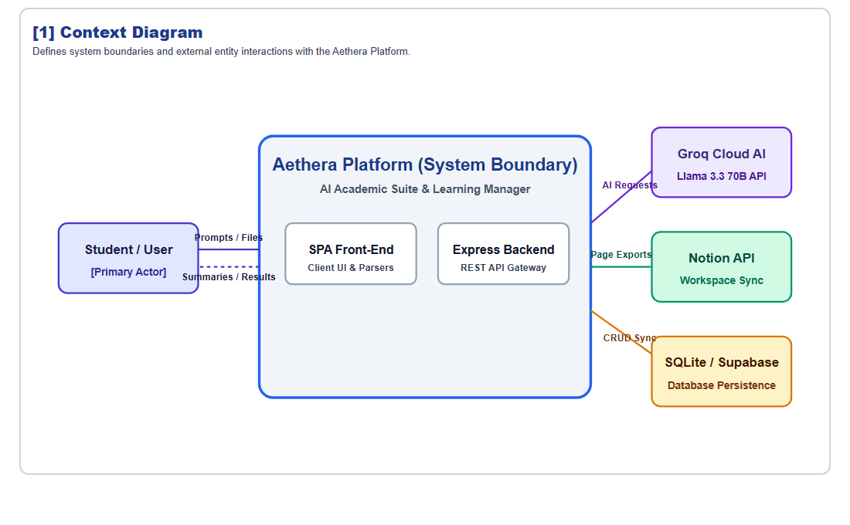
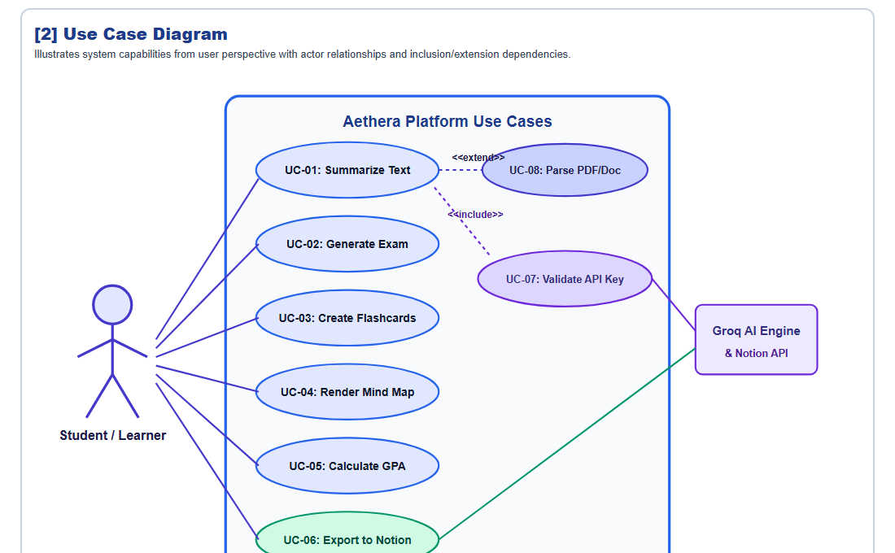
UML SOFTWARE ENGINEERING PROJECT
3.1 UML Diagrams — System Boundary & Use Cases
[1] Context Diagram
[2] Use Case Diagram

Slide 5
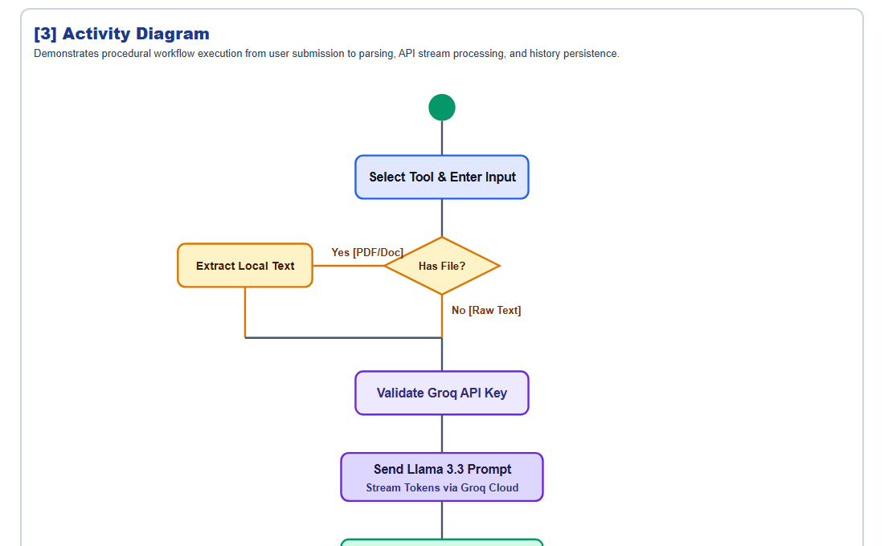
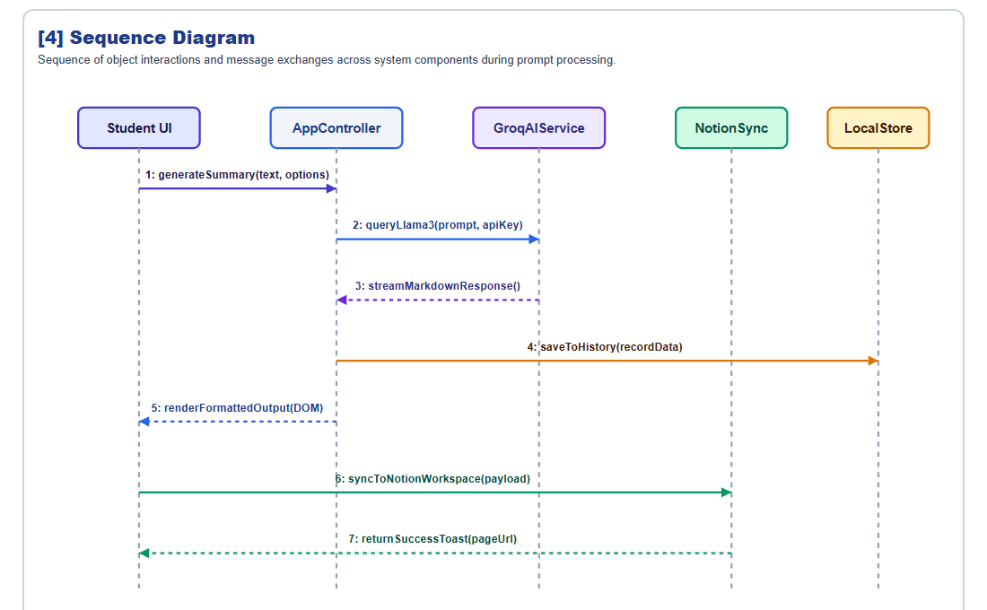
UML SOFTWARE ENGINEERING PROJECT
3.2 UML Diagrams — Dynamic Behavior & Flow
[3] Activity Diagram
[4] Sequence Diagram

Slide 6
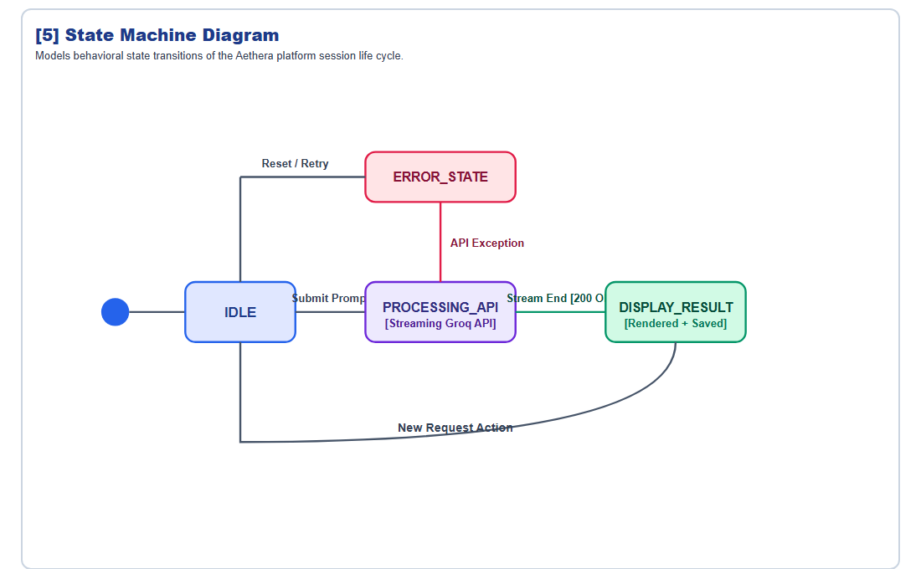
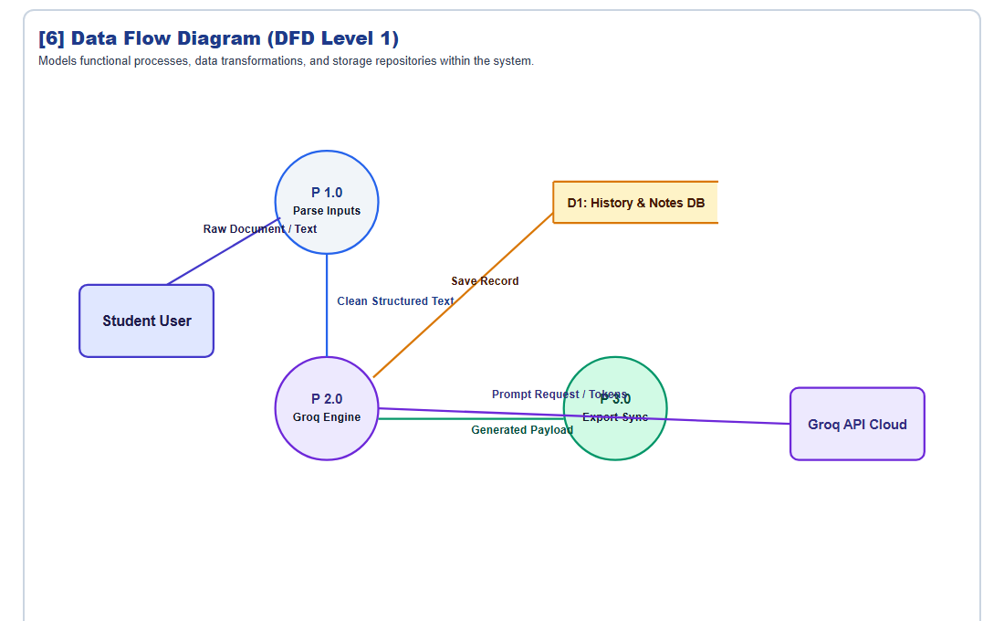
UML SOFTWARE ENGINEERING PROJECT
3.3 UML Diagrams — State Behavior & Data Flow
[5] State Machine Diagram
[6] Data Flow Diagram (DFD)

Slide 7
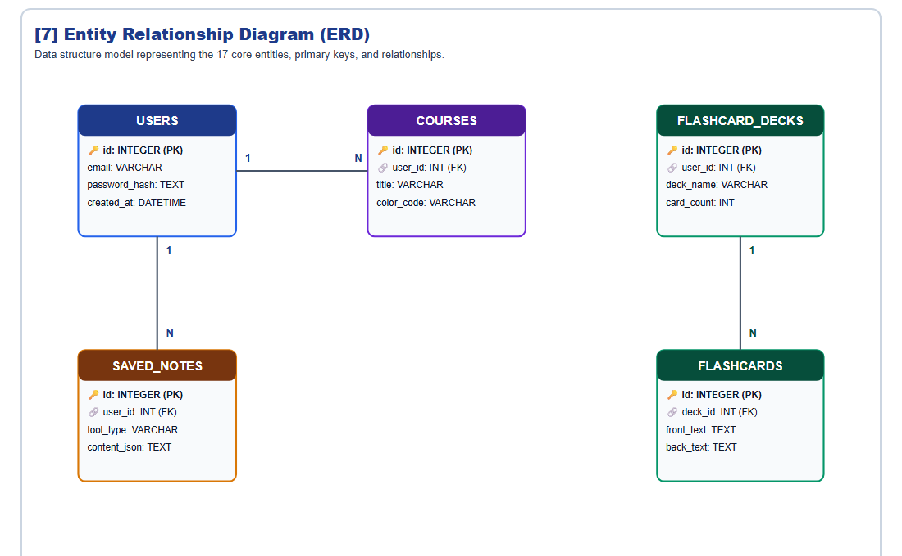
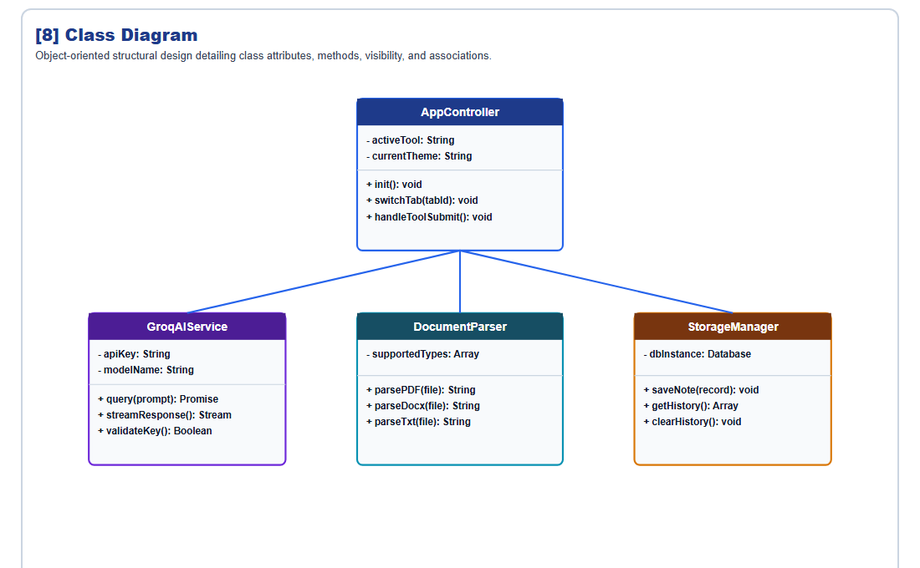
UML SOFTWARE ENGINEERING PROJECT
3.4 UML Diagrams — Data Schema & Object Design
[7] Entity Relationship Diagram (ERD)
[8] Class Diagram

Slide 8
UML SOFTWARE ENGINEERING PROJECT
4. Full-Stack System Architecture
Client Layer (SPA)
HTML5, CSS Glassmorphic Cyberpunk Theme, Vanilla JS SPA, PDF.js & DOCX parsers.
Application Backend
Node.js & Express REST API, JWT Authentication, Express Rate Limiter, Resend Mailer.
Data Layer
SQLite3 local storage (aethera.sqlite) & Supabase PostgreSQL with pgvector extension.
AI Inference Layer
Groq Cloud API (Llama 3.3 70B Versatile) for sub-second streaming inference.

Slide 9
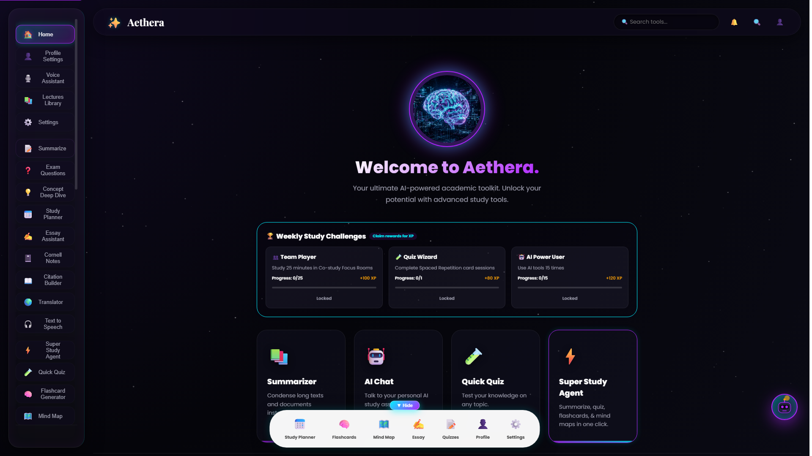
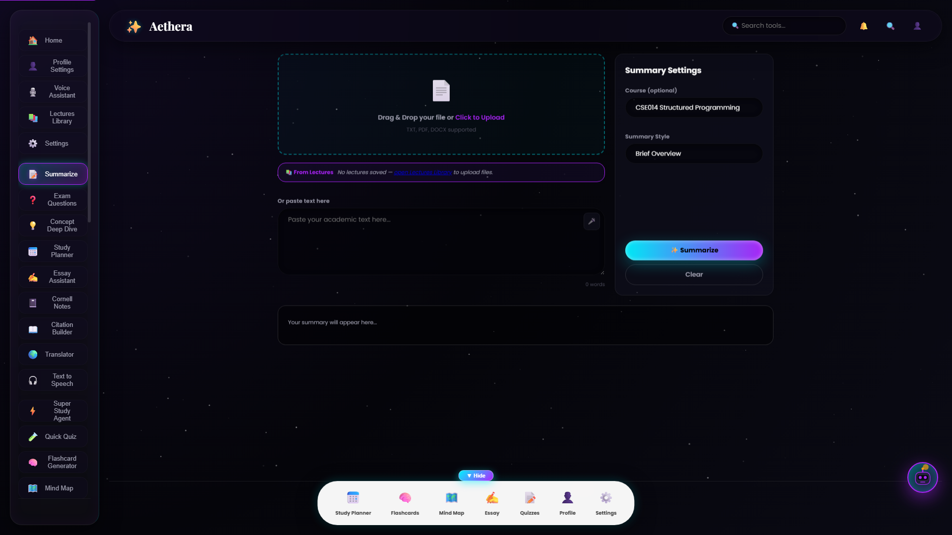
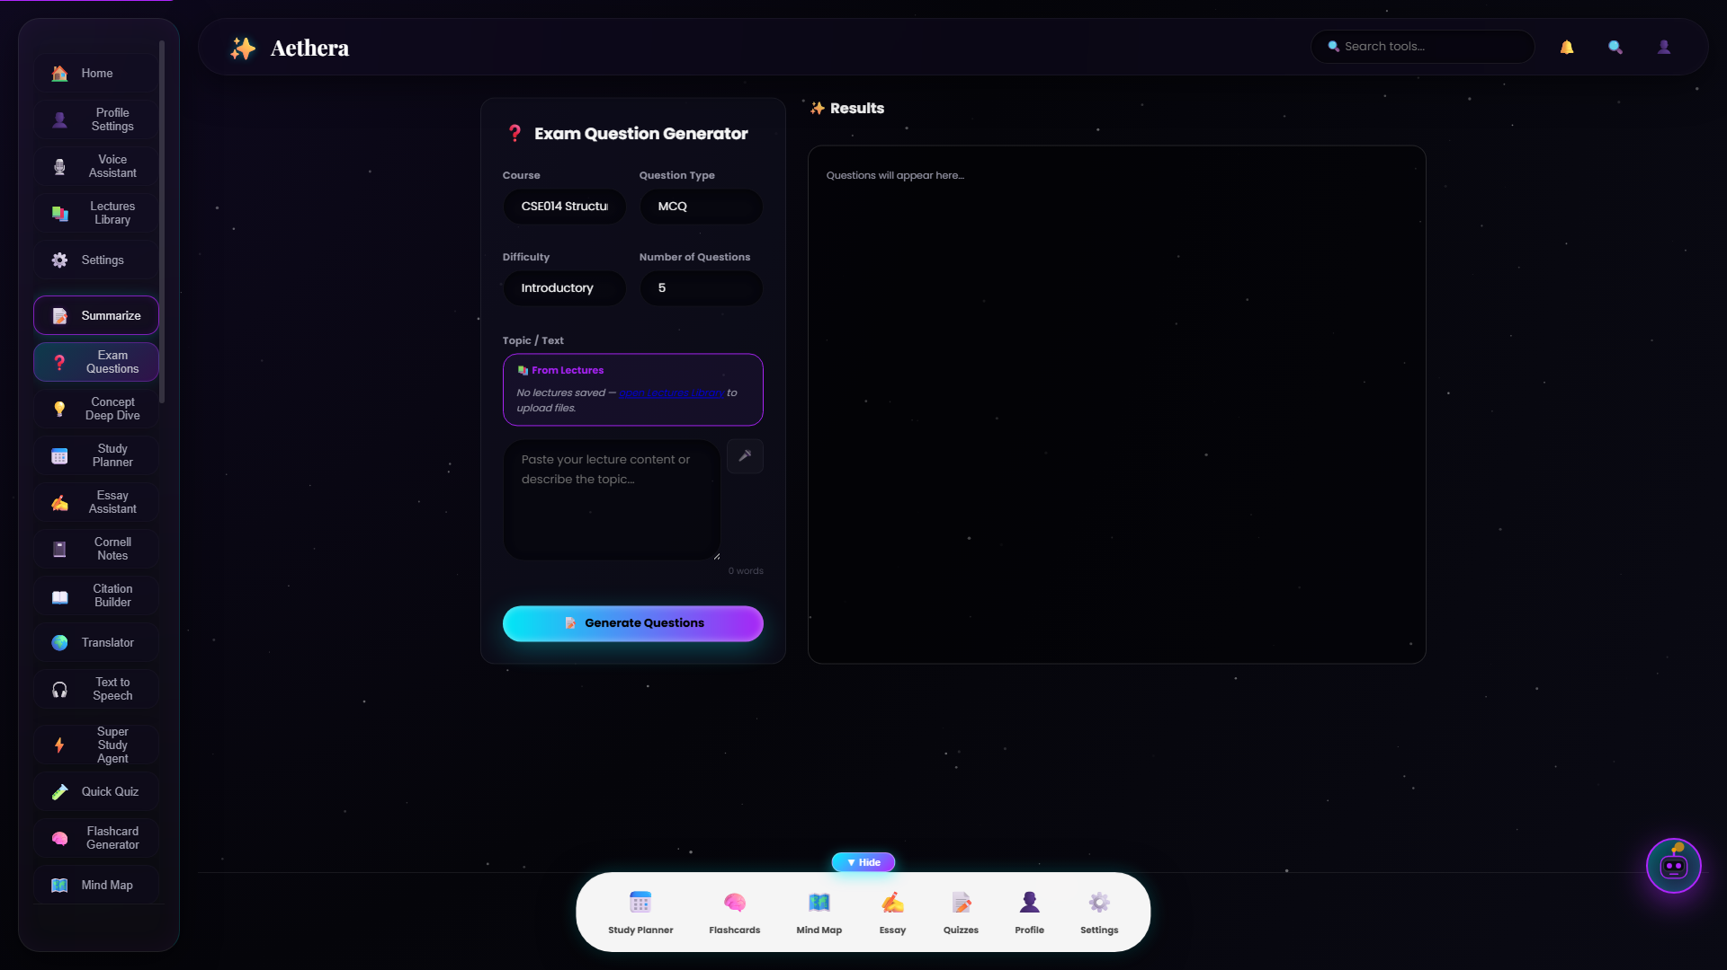
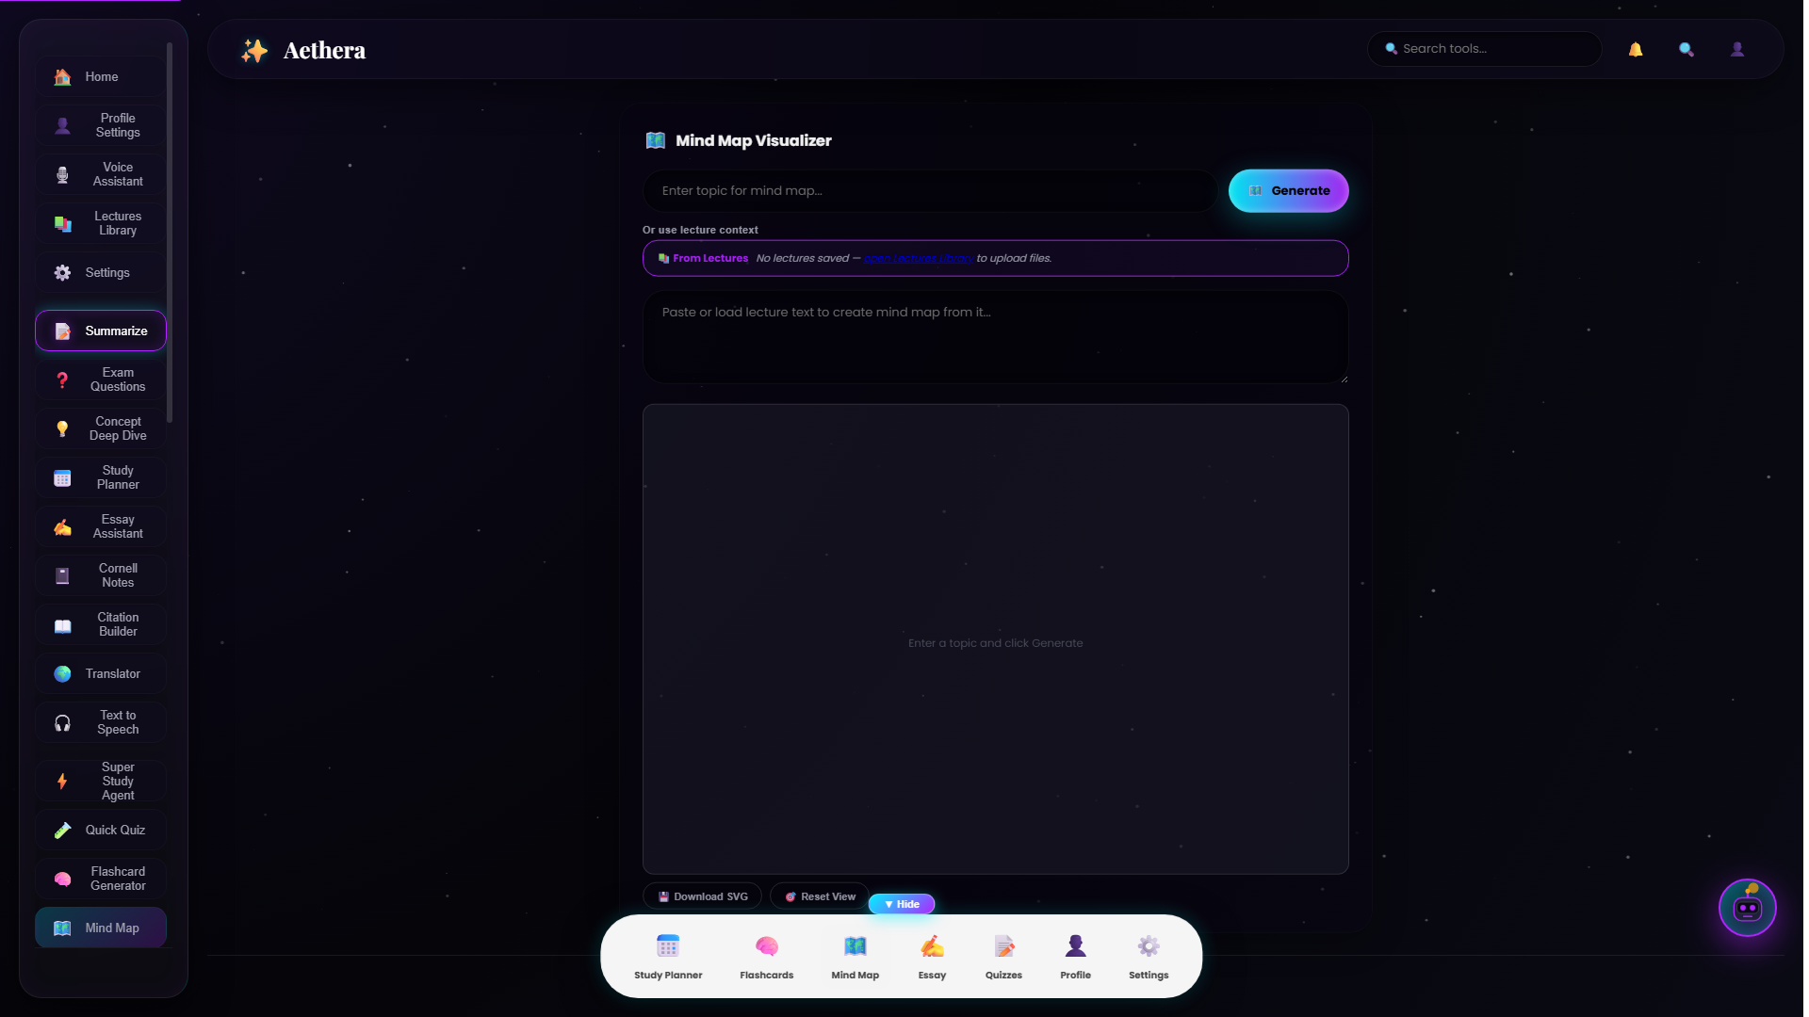
UML SOFTWARE ENGINEERING PROJECT
5. Front-End Prototype Screenshots
Main Academic Dashboard
Academic Summarizer
Exam Question Generator
Mind Map Visualizer

Slide 10
UML SOFTWARE ENGINEERING PROJECT
6. Project Deliverables & Conclusion
🎯 Project Outcome Summary
1. Final Report (PDF): Complete requirements, 8 UML diagrams, and software architecture specs.
2. Project Presentation (PPTX & PDF): Comprehensive presentation detailing problem, design decisions, and embedded UML diagrams.
3. Software Prototype: Full front-end implementation supported by Node.js backend & SQLite/Supabase database.
Student Author: Omar Saeed (ID: 222101064)

