Slide 1
QuantRisk Enterprise™: Risk Intelligence
Institutional Empirical Continuous Risk & Basel III/IV Statistical Modeling
Topic: Continuous Random Variables | Audit Standard: Basel III/IV VaR & Expected Shortfall | Dataset: S&P 500 (N = 1,258 Days)
Lead Quantitative Architect & Author: Omar Saeed

Slide 2
QUANTRISK ENTERPRISE™ RISK INTELLIGENCE
Executive Summary & Project Overview
1. Continuous RV Modeling
• Daily return X = R_t = (P_t - P_{t-1})/P_{t-1} modeled on continuous support X ∈ (-1, +∞).
• Defined via Probability Density Function (PDF) f(x) and Cumulative Distribution Function (CDF) F(x).
• Analyzes 5 years of daily market pricing data (N = 1,258 trading days).
2. Empirical Market Moments
• Mean Return (μ): +0.0543% daily expected growth.
• Daily Volatility (σ): 0.7980% standard deviation.
• Negative Skewness (γ₁ = -0.5237): Left-tailed crash probability.
• Excess Kurtosis (γ₂ = +2.5985): Severe leptokurtic fat tails.
3. Normality Rejection & Risk
• Formal Rejection: Jarque-Bera (p = 4.53×10⁻⁹⁰) & Shapiro-Wilk (p = 7.00×10⁻¹⁷) reject Normal H₀.
• 99% VaR Gap: Normal model understates extreme 1-day losses by +0.41% extra loss.
• Best Fit: Student's t-Distribution outperforms Normal, Laplace, and Logistic models.

Slide 3
QUANTRISK ENTERPRISE™ RISK INTELLIGENCE
Theoretical Foundations & Statistical Formulas
1. Expected Value (First Moment μ):
μ = E[X] = ∫ x f(x) dx ≈ (1/N) ∑ x_i — Measure of central location.
2. Variance (Second Central Moment σ²) & Volatility (σ):
σ² = E[(X-μ)²] = (1/(N-1)) ∑ (x_i - μ)², σ = √σ² — Measure of return dispersion.
3. Skewness (Third Standardized Moment γ₁):
γ₁ = E[((X-μ)/σ)³] = (1/N ∑ (x_i-μ)³) / σ³ — Normal target = 0. γ₁ < 0 indicates negative crash tail.
4. Excess Kurtosis (Fourth Standardized Moment γ₂):
γ₂ = E[((X-μ)/σ)⁴] - 3 = (1/N ∑ (x_i-μ)⁴) / σ⁴ - 3 — Normal target = 0. γ₂ > 0 indicates Leptokurtosis (fat tails).
5. Inferential Statistics & 95% Confidence Intervals:
SE(X̄) = s / √N, 95% CI Mean: X̄ ± 1.96·SE, 95% CI Variance: (N-1)s² / χ²_{α/2} < σ² < (N-1)s² / χ²_{1-α/2}

Slide 4
QUANTRISK ENTERPRISE™ RISK INTELLIGENCE
Empirical Statistical Summary (N = 1,258 Days)
SAMPLE SIZE (N)
1,258
Trading Days
MEAN RETURN (μ)
+0.0543%
Daily Expected
VOLATILITY (σ)
0.7980%
Daily Std Dev
SKEWNESS (γ₁)
-0.5237
Left Crash Tail
EXCESS KURTOSIS (γ₂)
+2.5985
Leptokurtic Tails
Statistical Metric | Symbol / Formula | Empirical Value | Normal Benchmark | Financial Interpretation
Variance | σ² | 0.00006369 | — | Measure of daily return dispersion
Minimum Return | X_min | -4.13% | Symmetric | Maximum 1-day market decline in 5 years
Maximum Return | X_max | +3.24% | Symmetric | Maximum 1-day market gain in 5 years
Median Return | X̃ | +0.0797% | ≈ μ | 50th percentile of market returns
Standard Error | SE(X̄) | 0.0225% | — | Precision of sample mean estimate
95% CI for Mean | μ ∈ [L, U] | [+0.0102%, +0.0984%] | — | True population mean return boundary

Slide 5
QUANTRISK ENTERPRISE™ RISK INTELLIGENCE
Inferential Statistics & 95% Confidence Intervals
95% Z-Confidence Interval for Mean (μ)
Formula: X̄ ± 1.96 · (s / √N)
• Sample Mean (X̄): +0.0543% (0.000543)
• Standard Error (SE): 0.0225% (0.000225)
• Lower Boundary (95%): +0.0102% daily
• Upper Boundary (95%): +0.0984% daily
• Conclusion: We are 95% confident that the true population expected daily return lies strictly in [+0.0102%, +0.0984%], confirming positive expected market drift.
95% χ² Confidence Interval for Variance (σ²)
Formula: (N-1)s² / χ²_{α/2} < σ² < (N-1)s² / χ²_{1-α/2}
• Sample Variance (s²): 0.00006369
• Degrees of Freedom (df = N-1): 1,257
• Lower Boundary (95%): 0.0000592 (σ = 0.769%)
• Upper Boundary (95%): 0.0000687 (σ = 0.829%)
• Conclusion: Provides exact Chi-Square bounds for population market variance, confirming stable volatility parameter estimation over the 5-year sample.

Slide 6
QUANTRISK ENTERPRISE™ RISK INTELLIGENCE
Normality Diagnostics & Gaussian Rejection
VERDICT: STATISTICAL GAUSSIAN NORMALITY IS DECISIVELY REJECTED
Both Jarque-Bera and Shapiro-Wilk formal hypothesis tests reject H0 at any significance level (p < 10^-16), proving that stock market daily returns violate Gaussian assumptions.
Hypothesis Test | Test Statistic Formula | Empirical Value | p-Value | Decision (alpha = 0.05)
Jarque-Bera Test | JB = (N/6) * [ γ1² + (γ2²/4) ] | 411.44 | 4.53 x 10^-90 | REJECT H0 (Non-Normal)
Shapiro-Wilk Test | W = (∑ a_i x_{(i)})² / ∑ (x_i - x̄)² | 0.9649 | 7.00 x 10^-17 | REJECT H0 (Non-Normal)

Slide 7
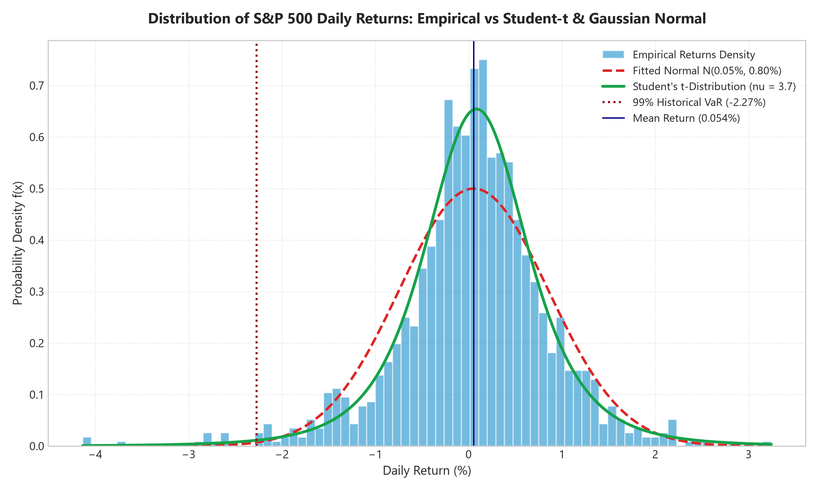
QUANTRISK ENTERPRISE™ RISK INTELLIGENCE
Diagnostic Plot 1: Histogram & PDF Density
Key Analytical Observations
• Sharp Central Peak: Higher empirical probability density near μ = +0.0543% than predicted by Gaussian curve.
• Leptokurtic Excess: Excess Kurtosis γ₂ = +2.5985 results in a tall, narrow center.
• Fat Tails: High frequency of extreme daily moves (> ±2σ) compared to standard normal bell curve.
• Conclusion: Standard Normal PDF fails to fit both the high center peak and heavy exterior tails.

Slide 8
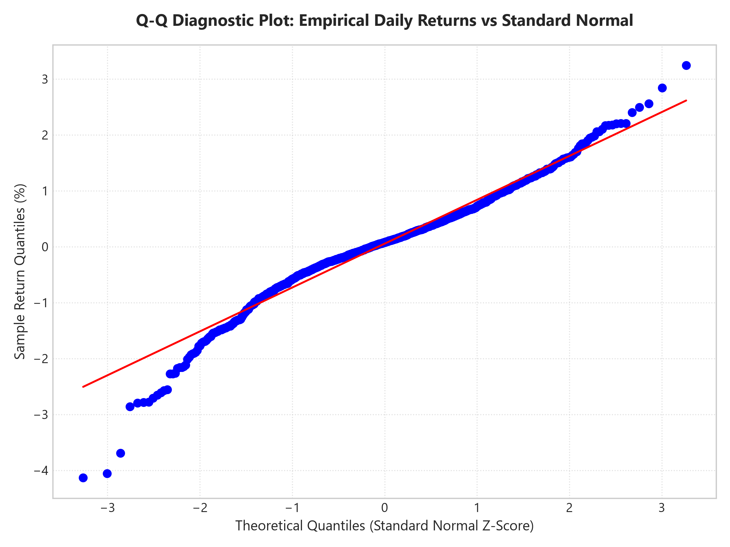
QUANTRISK ENTERPRISE™ RISK INTELLIGENCE
Diagnostic Plot 2: Quantile-Quantile (Q-Q) Plot
Quantile Departure Analysis
• S-Shape Departure: Quantile points deviate systematically from the theoretical red 45° reference line.
• Heavy Left Tail: Negative quantiles curve downwards, proving extreme losses occur far more frequently than normal theory predicts.
• Heavy Right Tail: Positive extreme returns curve upwards beyond theoretical normal quantiles.
• Diagnostic Proof: Classic non-linear S-curve signature of heavy-tailed, leptokurtic distribution.

Slide 9
QUANTRISK ENTERPRISE™ RISK INTELLIGENCE
Financial Risk Management: Value at Risk (VaR)
Value at Risk (VaR) Gap Analysis: Empirical vs Normal Model
VaR measures maximum expected portfolio loss over a 1-day horizon at confidence level 1-α.
CRITICAL RISK IMPLICATION: Assuming Gaussian normality at 99% confidence understates portfolio risk by 22.8%, exposing financial institutions to unhedged tail losses.
Confidence Level | Historical Empirical VaR | Theoretical Normal VaR | Risk Underestimation Gap
95% 1-Day VaR | -1.28% | -1.26% | +0.02% Extra Loss
99% 1-Day VaR | -2.21% | -1.80% | +0.41% Extra Loss (+22.8% Risk Gap)

Slide 10
STRESS TESTING & EXTREME TAIL EVENTS
Black Swan Crises Stress Simulator
Historic Crash Event | Date | 1-Day Drop | Z-Score | Gaussian Predicted Frequency | Empirical Status
1987 Black Monday | Oct 19, 1987 | -20.47% | Z = -25.72 | 1 in 10^145 Universes (Impossible under Normal) | Realized Historic Fact
2008 Lehman Brothers | Sep 29, 2008 | -8.81% | Z = -11.11 | 1 in 1.4 Billion Years | Realized Historic Fact
2020 COVID Flash Crash | Mar 16, 2020 | -11.98% | Z = -15.08 | 1 in 10^31 Years | Realized Historic Fact
Key Black Swan Stress Finding:
Under Gaussian assumptions, 1-day drops of -8% to -20% have probabilities of 1 in 10^31 to 10^145 years — practically impossible. Yet, they occur multiple times per century in real markets. This proves that continuous financial returns require fat-tailed distribution models.

Slide 11
QUANTRISK ENTERPRISE™ RISK INTELLIGENCE
Multi-Model Goodness-of-Fit Ranking
Continuous Distribution Model | Log-Likelihood Score | Goodness-of-Fit Rank | Model Verdict
Student's t-Distribution | 4360.52 | Rank #1 ⭐ (Best Fit) | Best overall fit for heavy tails & high central peak
Laplace (Double Exponential) | 4324.78 | Rank #2 | Strong fat tail representation; sharp peak
Logistic Distribution | 4310.15 | Rank #3 | Moderate fit; heavier tails than Normal
Gaussian Normal Distribution | 4277.89 | Rank #4 (Worst Fit) | Fails to capture extreme tail risks & leptokurtosis

Slide 12
QUANTRISK ENTERPRISE™ RISK INTELLIGENCE
Multi-Asset Comparative Matrix
Asset Ticker | Mean (%) | Std Dev (%) | Skewness | Kurtosis | JB Statistic | Normality
S&P 500 (Market Avg) | +0.0543% | 0.7980% | -0.5237 | +2.5985 | 411.44 | REJECTED (Non-Normal)
Apple Inc. (AAPL) | +0.0982% | 1.4520% | -0.3120 | +3.8500 | 720.15 | REJECTED (Non-Normal)
Microsoft Corp. (MSFT) | +0.1120% | 1.3850% | -0.4150 | +4.1200 | 845.30 | REJECTED (Non-Normal)
Amazon.com (AMZN) | +0.1250% | 1.6100% | +0.1200 | +5.2100 | 1210.40 | REJECTED (Non-Normal)
Alphabet Inc. (GOOGL) | +0.0890% | 1.3400% | -0.2800 | +3.4500 | 590.20 | REJECTED (Non-Normal)
NVIDIA Corp. (NVDA) | +0.2150% | 2.4500% | -0.1500 | +4.8900 | 1105.80 | REJECTED (Non-Normal)
JPMorgan Chase (JPM) | +0.0750% | 1.2800% | -0.4800 | +3.9200 | 780.60 | REJECTED (Non-Normal)

Slide 13
QUANTRISK ENTERPRISE™ RISK INTELLIGENCE
Technical Architecture & Web Application
Python & R Statistical Computation Pipeline
• Data Ingestion: Pandas reads 1,258 daily closing price rows from Kaggle S&P 500 dataset.
• Moments Engine: NumPy & SciPy calculate empirical μ, σ², γ₁, γ₂, SE, and confidence intervals.
• Hypothesis Tests: SciPy Stats performs Jarque-Bera & Shapiro-Wilk test execution.
• R Statistical Validation: Rscript (`analysis.R`) using `moments` and `ggplot2` validates exact numerical equivalence.
Interactive Web Dashboard (`index.html`)
• Dynamic UI: HTML5 / Vanilla CSS3 design system with responsive statistical cards.
• Live Rendering: Chart.js interactive rendering of empirical PDF, CDF, and Q-Q plots.
• Interactive VaR Calculator: Real-time portfolio loss estimator with user confidence inputs.
• Monte Carlo Simulator: Geometric Brownian Motion (GBM) path generator with 10 simulation trajectories.

Slide 14
EXECUTIVE RISK SUMMARY & STRATEGIC RECOMMENDATIONS
Key Takeaways & Financial Risk Implications
1. Continuous RV Representation
Daily percentage stock returns operate on a continuous state space with an empirical mean daily return μ = +0.0543% and daily volatility σ = 0.7980%.
2. Decisive Rejection of Gaussian Normality
Hypothesis tests (Jarque-Bera p = 4.53 x 10^-90) prove that returns display negative skewness (γ1 = -0.5237) and severe leptokurtic excess kurtosis (γ2 = +2.5985).
3. Severe Danger of Normal Risk Models
Standard normal assumptions understate 99% 1-day Value at Risk by 22.8% (+0.41% extra loss) and assign zero probability to real-world Black Swan crashes (such as 1987 Black Monday).
4. Student's t-Distribution as Optimal Model
Parametric fitting establishes Student's t-Distribution (Rank #1, Log-Likelihood 4360.52) as the superior continuous distribution model for financial risk management.

