Slide 1

ITI FINAL PROJECT
Chirp Spread Spectrum (CSS)
PHY Transmitter
IEEE 802.15.4 · 2450 MHz Band — From Floating-Point Model to FPGA Hardware
Discussion Presentation

Slide 2

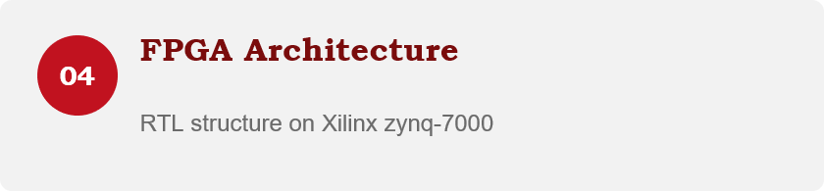
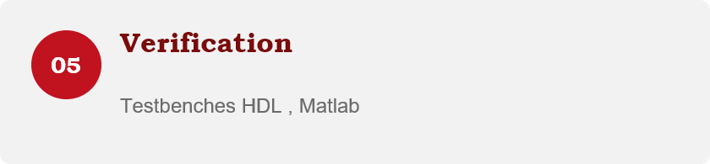
AGENDA
What We'll Cover
01
What is CSS PHY?
02
Packet Structure
Definition inside IEEE 802.15.4
PPDU format for 250 kbps
03
Transmitter Architecture
Full signal-processing chain, block by block
02

Slide 3
DEFINITION
What Is Chirp Spread Spectrum (CSS)?
CSS is a spread-spectrum modulation technique that encodes data using chirps, pulses whose frequency sweeps linearly across the channel over time, instead of transmitting on a fixed carrier frequency.
Developed by Nanotron, it was adopted into IEEE 802.15.4 in 2007 as an alternate PHY in the 2450 MHz band.
A chirp is a Linear Frequency Modulated (LFM) pulse as it sweeps across the full channel bandwidth rather than sitting at one frequency.
One chirp symbol is built from a pattern of 4 smaller “subchirps” (k = 0,1,2,3).
Spreading each symbol across the whole bandwidth gives CSS strong immunity to noise and multipath fading.
03
03

Slide 4
PACKET STRUCTURE
CSS PHY Protocol Data Unit (PPDU)
Every transmission is built from three parts: a synchronization header (preamble + SFD), a PHY header (PHR) carrying the payload length, and the PSDU payload from the MAC layer.
Preamble
SFD
PHR
PSDU (payload)
Synchronization header
PHY header + payload
Data Rate | Preamble | SFD | PHR | PSDU
250 kbps | 20 symbols | 4 symbols | 8 symbols | variable
PHR format (12 bits)
Bits 0–6 | Bit 7 | Bits 8–11
Length of payload (bytes) | Not used | Reserved
05

Slide 5
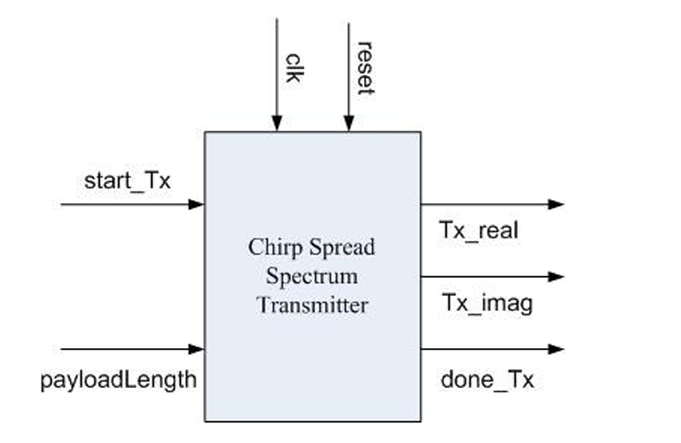
ARCHITECTURE
Transmitter Architecture
Signal name | Bit width | Direction | Description
clk | 1 | Input | System clock
reset | 1 | Input | System reset
Start_Tx | 1 | Input | Signal comes from MAC to PHY to initiate transmission process
payloadlength | 8 | Input | Payload length in byte
done_tx | 1 | Output | Signal goes from PHY to MAC to indicate finishing of transmission process
Tx_real | 8 | Output | Real part of CSS Symbol
Tx_imag | 8 | Output | Imaginary part of CSS Symbol

Slide 6
ARCHITECTURE
Transmitter Architecture
Payload
RAM
127×8 bits
Zero Padding
DeMUX
(I/Q)
Symbol Mapper
ROM (I)
Interleaver
Controller
QPSK ×
DQPSK
(4-FF delay)
CSS
Modulated
Symbol
(Tx_real,
Tx_imag)
MUX
I/Q
Symbol Mapper
ROM (Q)
Interleaver
Preamble / SFD ROM
CSS Symbols
ROM (CSK)
INPUT
OUTPUT
PHR + PSDU bits , plus fixed preamble & SFD patterns
Real and Imaginary Signals ready to be transmitted.
06

Slide 7
BLOCK 1–2 OF 8
Zero Padding & Demux
Before symbol coding can begin, the PHR+PSDU bitstream must be sized correctly and split into two parallel paths.
INPUT → OUTPUT
Signal | Description
Input | PHR bits + PSDU payload bits
Padding rule | Pad zeros so total bits are a multiple of N
N (250 kbps) | 24 bits
Demux rule | Even-indexed bits → I path, Odd-indexed bits → Q path
Why it matters
• Zero Padding : According to this equation
PHR = 12 bit & PPDU = Payload length * 8 → 12 + payload length*8
The padding bits is determined according to payload length to be divisible by 24.
• Demux : Splits the padded stream into I (upper) and Q (lower) paths that are processed independently and in parallel.
07

Slide 8
BLOCK 3 OF 8
Symbol Mapper
Converts each short sequence of raw bits into a longer, more robust codeword .
INPUT → OUTPUT
Signal | Description
250 kbps | n = 6 bits → m = 32 bits (rate 3/16)
First half of the codewords are Walsh–Hadamard codes (mutually orthogonal patterns).
Second half are the same codes with the sign negated.
Effect: block coding trades bit rate for redundancy — 250 kbps mode spends far more bits per symbol (3/16 rate).
How the codebook is built
08

Slide 9
BLOCK 4 OF 8
Interleaver
Rearranges the coded bits so that consecutive errors are spread out, making them easier to correct.
INPUT → OUTPUT
Signal | Description
Used for | 250 kbps data rate only.
Block size | 64 bits → 16 groups (G0…G15) of 4 bits each
Group Gn | bits b4n … b4n+3
Interleaving pattern
Input order: G0 G1 G2 G3 G4 G5 G6 G7 G8 G9 G10 G11 G12 G13 G14 G15
Output order: G0 G13 G2 G15 G4 G9 G6 G11 G8 G5 G10 G7 G12 G1 G14 G3
09

Slide 10
BLOCK 5 OF 8
Form PPDU
Reassembles the fully processed I and Q bitstreams together with the preamble and SFD into the final packet structure.
INPUT → OUTPUT
Signal | Description
Inputs | Preamble, SFD, interleaved/coded PHR+PSDU (I & Q)
Output | Complete PPDU bit sequence, ready for QPSK mapping
Order | Preamble → SFD → PHR → PSDU
Role in the chain
This block is the reassembly point of the transmitter: everything generated earlier, fixed sync fields and the two coded/interleaved data paths, is stitched into one continuous packet.
It's a structural, not a coding, step: no bit values change here, only their placement into the final PPDU frame that feeds the QPSK Mapper.
PACKET ASSEMBLY
Preamble
SFD
PHR
PSDU
(I & Q)
PPDU (Preamble + SFD + PHR + PSDU)
11

Slide 11
BLOCK 6–7 OF 8
QPSK Mapper & DQPSK Coding
The I/Q bit pairs become QPSK phase symbols, then each symbol is differentially encoded against the symbol four positions earlier.
QPSK Mapper
DQPSK Coding
Sₙ = Xₙ · Sₙ₋₄
(-1,1)
(1,1)
Xₙ = output of the QPSK Mapper (current symbol)
Sₙ = differentially-coded output symbol
Sₙ₋₄ = output from 4 symbols earlier (fed back)
Initial condition: S₀ = S₁ = S₂ = S₃ = exp(jπ/4)
Why differential? The receiver can demodulate using the phase difference between symbols, avoiding the need for an absolute phase reference — simpler, more robust receiver design.
(-1,-1)
(1,-1)
I and Q bit pairs select one of four QPSK phase points from this constellation.
11

Slide 12
BLOCK 8 OF 8 — THE CORE
CSK Generation & Chirp Modulation
The key process in the CSS transmitter: each DQPSK symbol selects one of 4 possible Chirp Sequences, built from 4 sinusoidal subchirps plus a time gap.
k=0
k=1
k=2
k=3
T-gap
4 subchirps × 38 samples (1.1875 µs each), modulated by Sₙ, Sₙ₊₁, Sₙ₊₂, Sₙ₊₃
Teven + Todd = 80 samples (2.5 µs), split depends on index m
Subchirp equation
Index m selects the time gap
Subchirpₘ,ₖ = exp[ j2π( fₖ,ₘ/fs + μξₖ,ₘ·array / 2fs² ) · array ] · RaisedCosine
m | Teven | Todd
1 | 10 | 70
2 | 20 | 60
3 | 30 | 50
4 | 40 | 40
Raised-cosine shaping (roll-off α = 0.25) smooths subchirp edges to control out-of-band emission.
fs = 32 MHz sampling rate
fₖ,ₘ = ±3.15 MHz center frequency (sign per table)
ξₖ,ₘ = ±1, chirp sweeps up or down
μ = 7.3158 s⁻² chirp rate constant
12

Slide 13
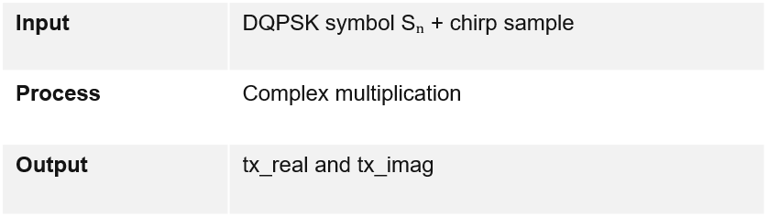
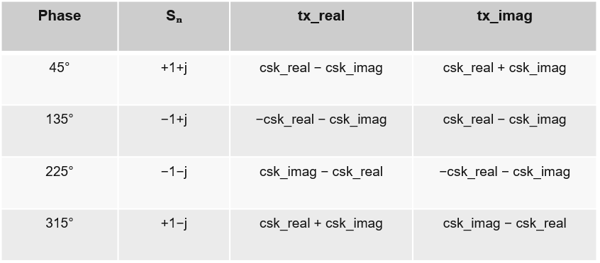
BLOCK 8 OF 8 — THE CORE
Final Multiplier
Multiplies the DQPSK symbol by the complex chirp sample to generate the final transmitted I/Q signal.
INPUT → OUTPUT
HARDWARE OPTIMIZATION
The DQPSK symbol has only four possible phases. Therefore, the hardware avoids a full complex multiplier and uses simple sign changes, additions, and subtractions.
KEY EQUATIONS
Tx = Sₙ × (csk_real + j·csk_imag)
tx_real = Re(Sₙ) * csk_real − Im(Sₙ) * csk_imag
tx_imag = Re(Sₙ) * csk_imag + Im(Sₙ) * csk_real
12

Slide 14
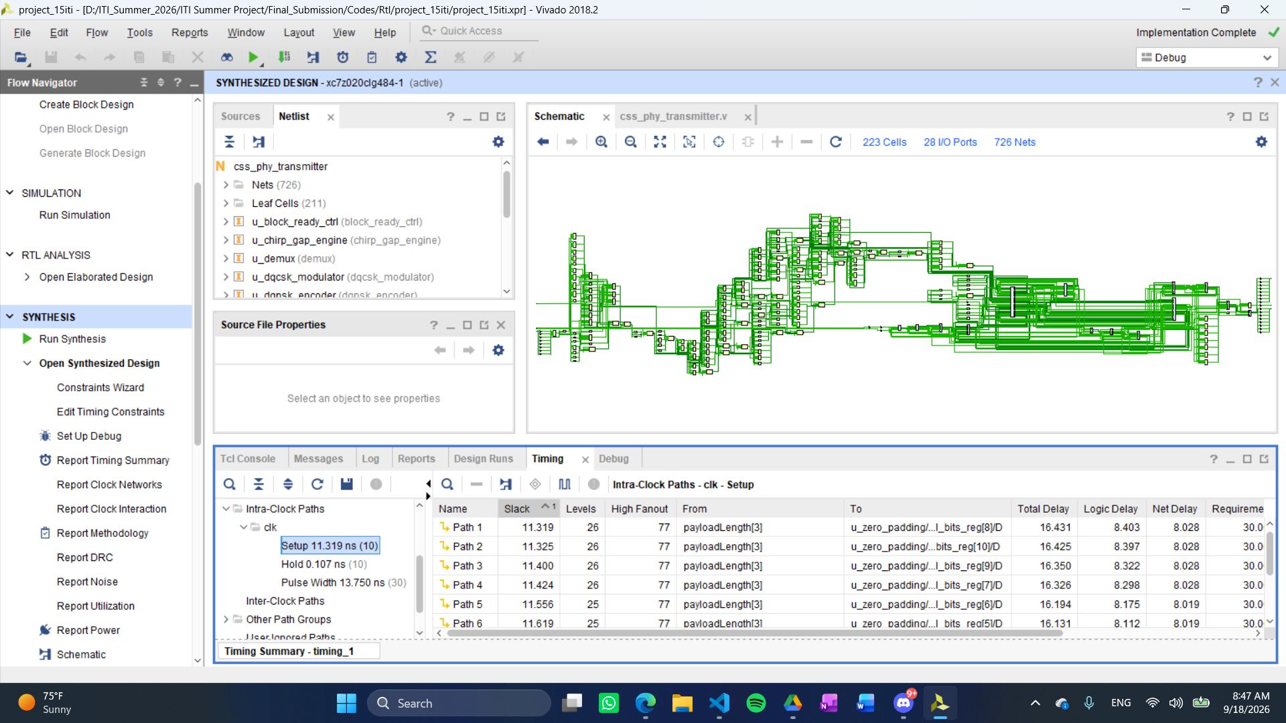
FPGA
FPGA Implementation: Synthesis
16

Slide 15
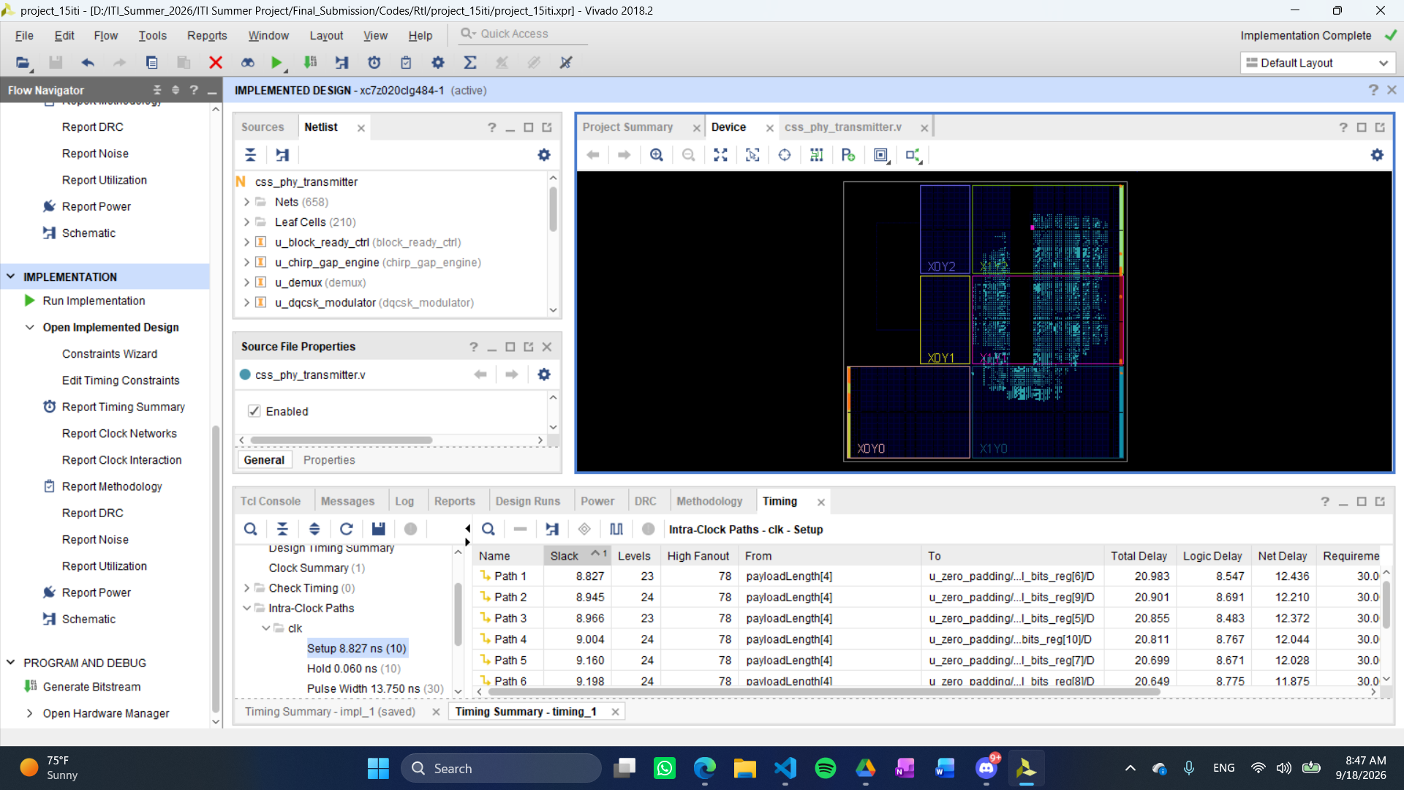
FPGA
FPGA Implementation: Implementation
16

Slide 16
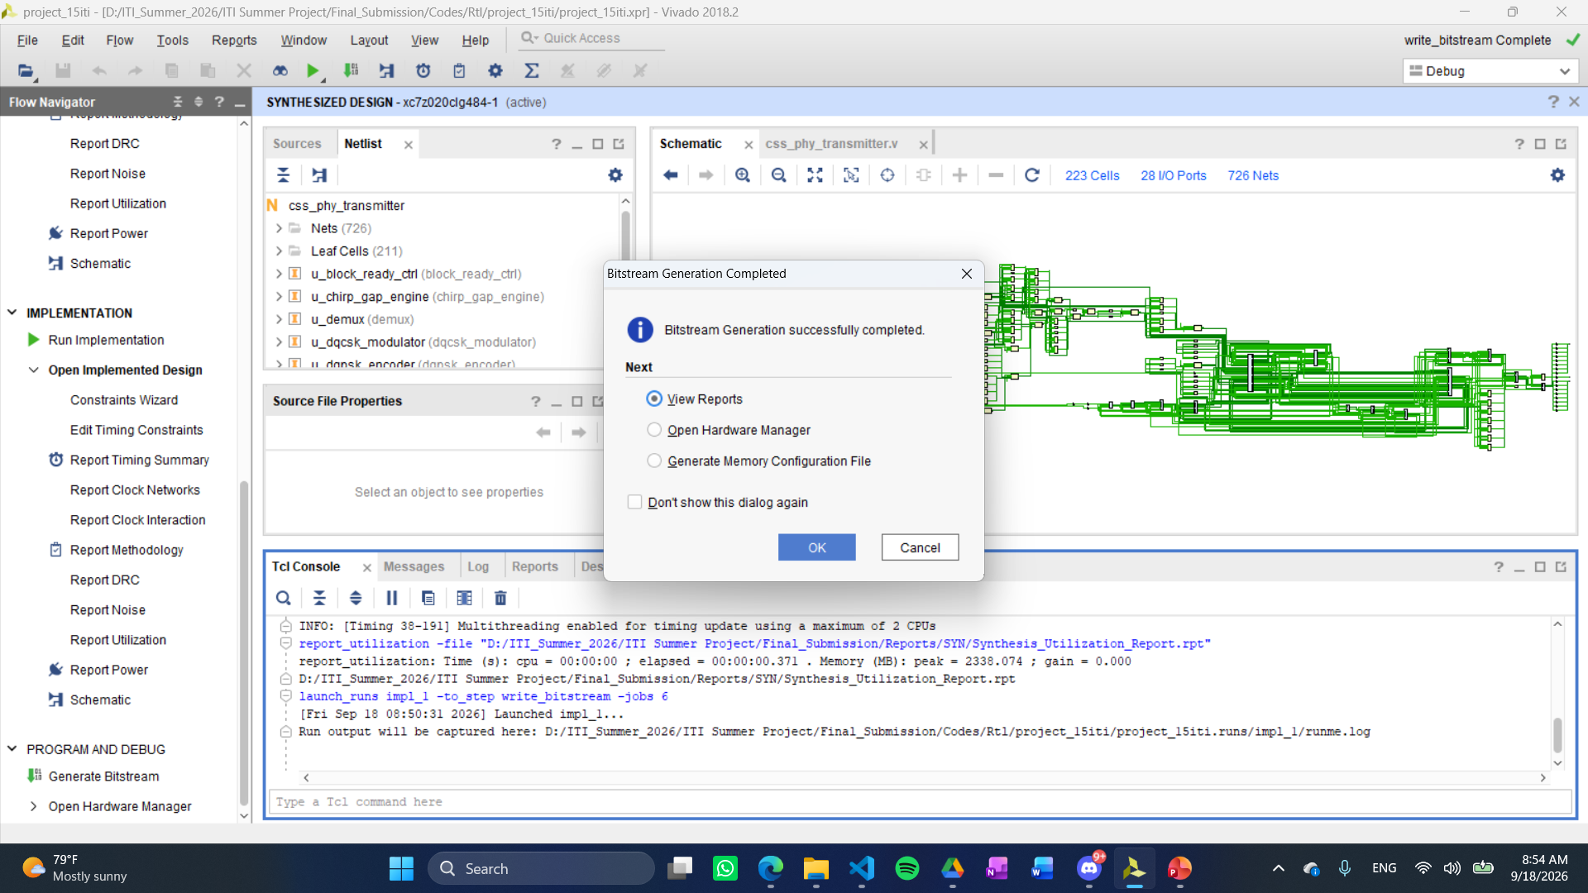
FPGA
FPGA Implementation: Bitstream
16

Slide 17
VERIFICATION
Hardware Verification Strategy
Two complementary methods were used across the design flow.
1
2
HDL Testbenches
EDA Simulator Link
PRE-PROGRAMMING
PRE-PROGRAMMING
Self-contained Verilog testbenches with a stimulus generator and verifier, used for unit testing of individual modules against known values.
Bidirectional MATLAB ↔ ModelSim link. MATLAB supplies stimulus and checks HDL output against the fixed-point reference — faster debugging, no file I/O overhead.
16

Slide 18
CONCLUSION
Thank you.
Omar Waleed
Ahmed Nossier
Jessica Bahaa
Ahmed Naeim
Fatma Alzahraa Yasser
Moaaz Mohsen

