Slide 1


ConnectTel – CHURN PREDICTION

Slide 2
TABLE OF CONTENT
BUSINESS OVERVIEW
OBJECTIVE
DATA DESCRIPTION
PREPARE THE DATA (CLEANING)
EXPLORATORY DATA ANALYSIS (EDA)
IDENTIFY KEY FEATURES OF THE DATASET
MODEL PERFORMANCE SUMMARY
KEY INSIGHT AND RECOMMENDATRIONS

Slide 3
1. BUSINESS OVERVIEW ConnectTel is a leading telecommunications company at the forefront of innovation and connectivity solutions. it has strong presence in the global market, with a well-established trusted provider of reliable voice, data, and internet services. Offering a comprehensive range of Telecommunications solutions, including mobile networks, broadband connections, and enterprise solutions. It caters to both individual and corporate customers, they are commited to providing exceptional customer service and cutting-edge technology. ConnectTel ensures seamless communication experiences for millions of users worldwide through strategic partnerships and a customer-centric approach, ConnectTel continue to revolutionize the telecom industry, empowering individuals and businesses to stay connected and thrive in the digital age

Slide 4
2. OBJECTIVE
To address customer Churn, using supervised learning Machine which poses a significant threat to ConnectTel business sustainability and growth. The Company current customer retention strategies lack precision and effectiveness, resulting in the loss of valuable customers to competitors. To overcome this challenge, there is the need to develop a robust customer churn prediction system by leveraging on advance analytics and Machine learning techniques on available customer data to accurately predict customer churn and implement targeted retention initiatives. This approach will help to reduce customer attrition and bring back customer confidence, and maintain a competitive edge in the highly dynamic and competitive telecommunications industry.

Slide 5
3. DATA DESCRIPTION
The data provided is of various customers
Data Dictionary
1. customerID: A unique Identifier assigned to each Telecom customer, enabling tracking and identification of individual customer.
2. Gender: The gender of the customer, which can be categorized as male, or female. This information helps to analyzing gender- based trends in customer churn.
3. SeniorCitizen: A binary indicator that identifies whether the customer is a senior Citizen or not.This attributes help in understanding if there are any specific churn patterns among the senior customers.
4. Partner: Indicates whether the customer has a partner or not. This attribute helps in evaluating the impact of having a partner on churn behavior.
5.Dependents:Indicates whether the customer has dependants or not.This attribute help in assessing the influence of having dependents oncustomer churn.
6. Tenure: The duration for which the customer has been subscribed to the telecom service. It represents the loyalty of longevity of the customer's relationship with the company and it is a significant predictor of churn.
7. PhoneService: Indicates whether the customer has a phone service or not.This attribute helps in understanding the impact of phone service on churn
8.MultipleLines: Indicates whether the customer has multiple lines or not.This attribute helps in analyzing the effect of having multiple lines on customer churn.
9. InternetService: Indicates the type of internet service subscribed by the customer, such as DSL, fibre optics or no internet service. It helps in evaluating the relationship between internet service and churn.
10. OnlineSecurity: Indicates whether the customer has online security or not. This attributes helps in analyzing the impact of online security on customer churn.
11. OnlineBackup: Indicates whether the customer has online backup services or not. This service helps in evaluating the impact of online backup on churn behaviour.

Slide 6
DATA DESCRIPTION CONT’
12. DeviceProtection: This indicates whether the customer has device protection services or not. The attribute helps in understanding the influence of device protection on churn.
13.TechSupport: Indicates whether the customer has technical support services or not.This attribute helps in assessing the impact of tech support on churn behavior.
14.StreamingTV: Indicates whether the customer has streaming Tv services or not.The attribute helps in evaluating the impact of streaming Tv on customer churn.
15.StreamingMovies:Indicates whether the customer has streaming Movies services or not. This attribute helps in understanding the influence of streaming movies on churn behavior.
16.Contract:Indicates the type of contract the customer has, such as a month-to-month, one-year, or two year contract. It is a crucial factor in predicting churn as different contract length may have varying impacts on customer loyalty.
17.PaperlessBilling: Indicates whether the customer has opted for paperless billing or not.This attribute helps in analyzing the effect of paperless billing on customer churn.
18.PaymentMethod: Indicates the payment method used by the customer, such as electronic checks, mailed checks, bank transfers, or credit cards. This attribute helps in evaluating the impact of payment method on churn.
19.MonthlyCharges: The total amount charged to the customer over the entire tenure. It represents the cumulative revenue generated from the customer and may have an impact on the churn.
20.Churn: The target variable indicates whether the customer has churn(cancel the service) or not. It is the main variable to predict in Telecom customer churn analysis

Slide 7
PREPARE THE DATA (CLEANING)
The various Libraries were imported
The data was loaded into the Jupyter notebook.
It was observed that there are 7043 rows and 21 columns
There are 18 categorical variables and 3 Numerical variables
There are no duplicated data.
There are no missing data while exploring the missing data.
Unique column was dropped. The customer ID was dropped because it will not influence our findings.

Slide 8
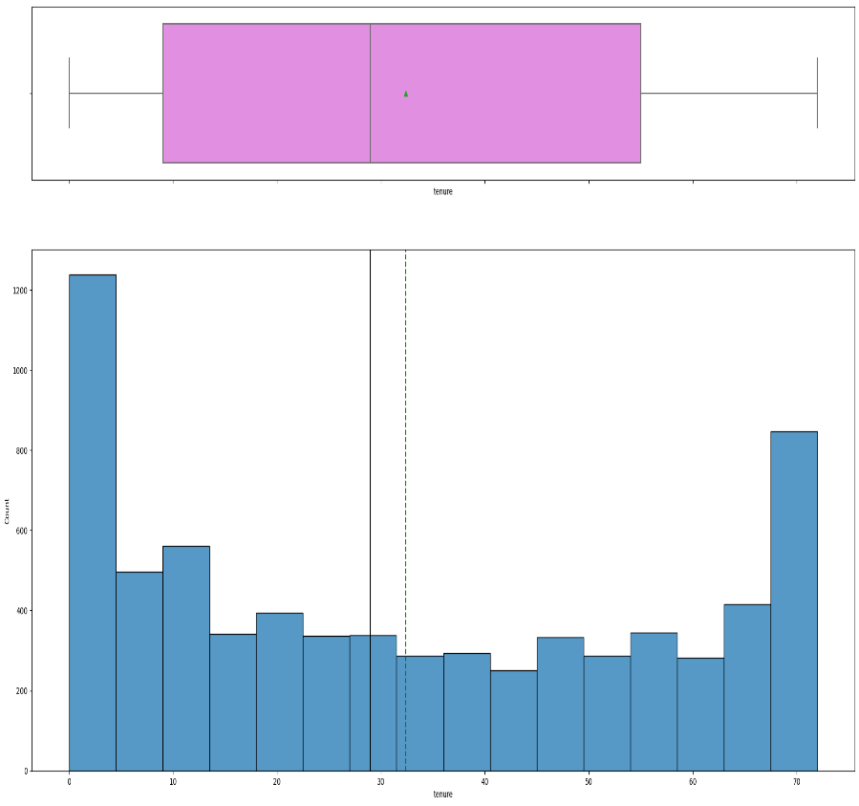
5. Exploratory Data Analysis – Univariate : Education Tenure
Observations
The tenure is uniformly distributed.
The range of tenure is 0 and 72
The average tenure is 32
The mean and median is 32 and 29 respectively they are not far apart which means there are no outliers.

Slide 9
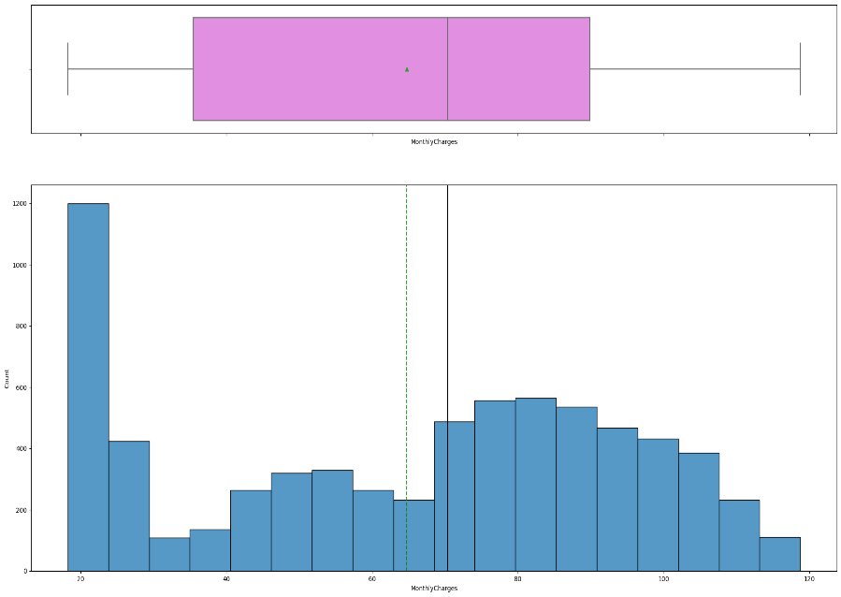
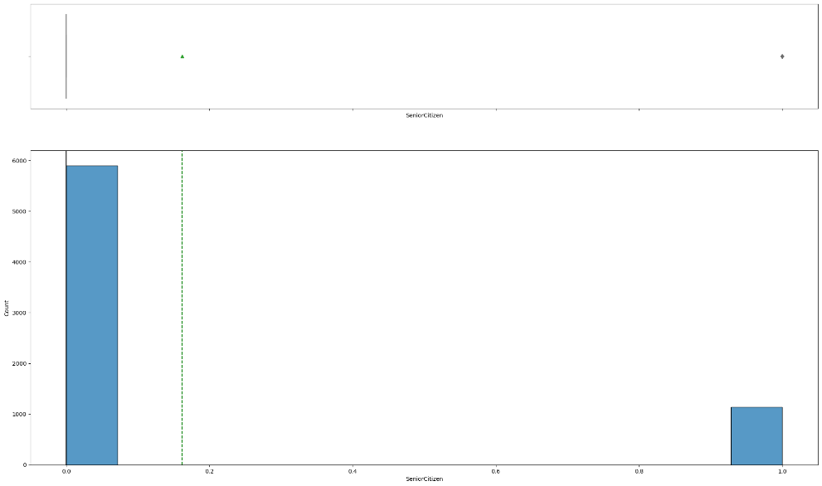
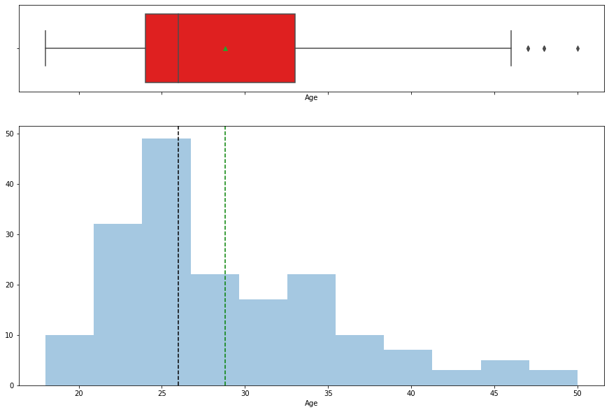
Exploratory Data Analysis –
SeniorCitizen
MonthlyChargse
The company has about 1200 seniorCitizen as customer while the balance 5,843 are young adult.
There are outlier because the 75 percentile i9s far from the max value and skewed to the right.
The customer MonthlyCharges is uniformly distributed but slightly skewed to the right
The range of MonthlyCharges is between 18.25 to 118.75
The average MonthlyCharge is 64.762
There are no outlier because the mean and the median are not far apart.
The maximum Monthly Charge is 118.750 is could be customer using all three of the service.

Slide 10
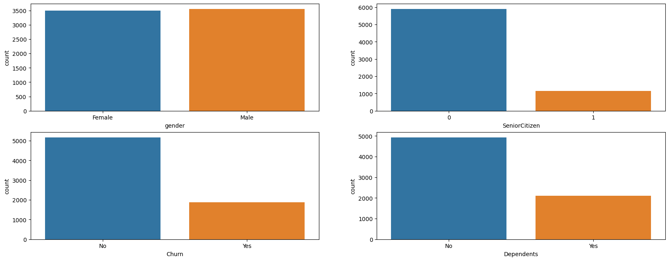
Exploratory Data Analysis –Gender, SeniorCitizen, Churn & Depen &Dependendts
The fitness level is left skewed
There are more male customer than female
2110 out of 7043 are dependents
27% of the customer chruned the company services
The distribution of the income is highly skewed to t

Slide 11
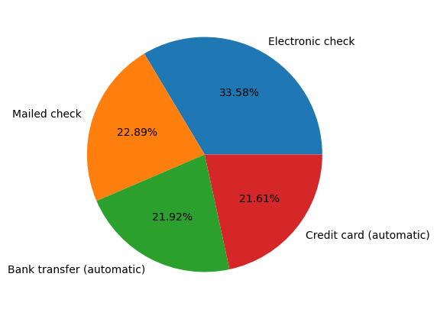
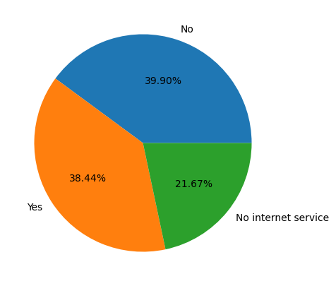
Exploratory Data Analysis – StreamingTV &PaymentMenthod
Observation
38.44% of the customer v iew there program
through StreamingTV this is a lot
Observation
Customers prefered mode of payment is Electronic Check, which is 33.58% followed by Mailed check

Slide 12
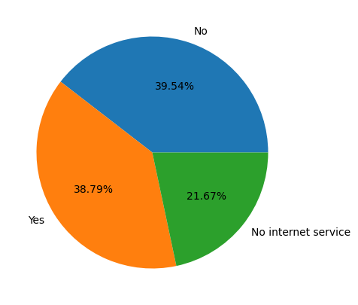
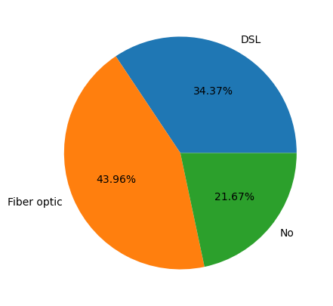
Exploratory Data Analysis –StreamingMovies & InternetService
Observation
Observation
43.96% of the customers use fiber optic
I
c [ ]:
StreamingMovies
Observation
38.79% of their customer stream movies

Slide 13
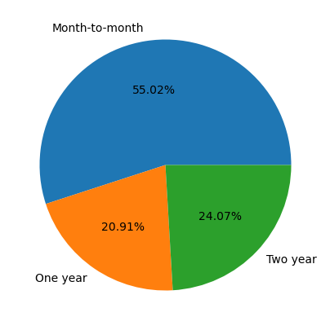
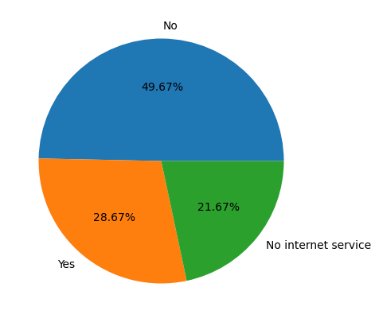
Exploratory Data Analysis –
CONTRACT OnlineSecurity
:
Observation
Most of the customers prefer to Month-to- month payment
Observation
28.67% use OnlineSecurity

Slide 14
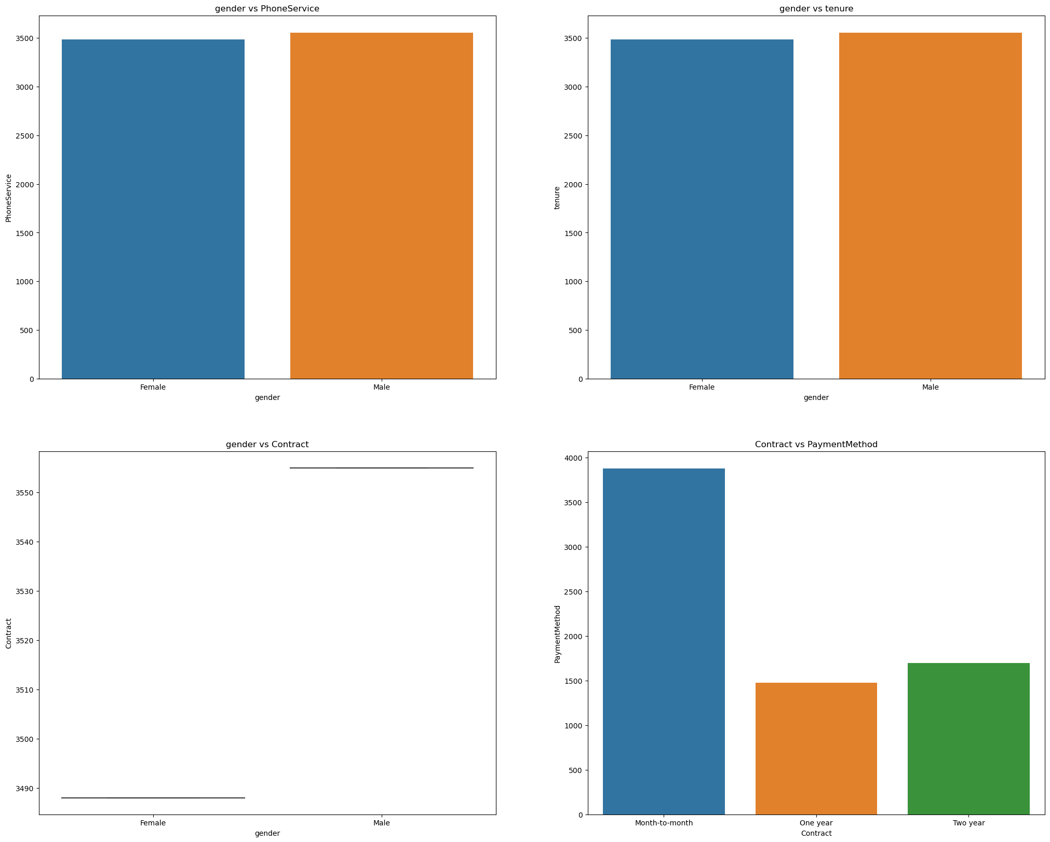
Exploratory Data Analysis – BIVARIATE
Gender vs Tenure
Gender vs PhoneService
Observation
Male uses PhoneService than their female counterpart
The male customers have spent more time using the company's services than the female customer
The male prefer the highest subscription than the female.
Most customers prefer to Month-to-month subscription

Slide 15
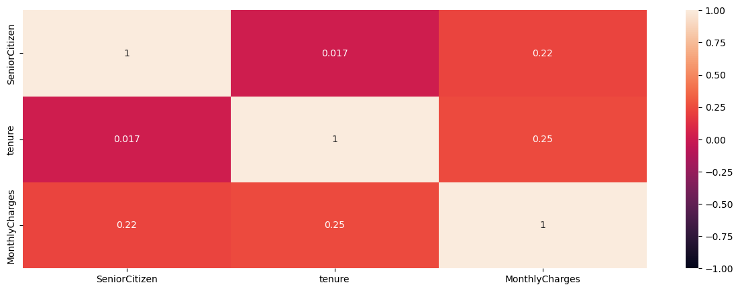
Exploratory Data Analysis –Heatmap-Correlation matrix
Observation
There is correlation between all the variables and they are positive but not high.
There correlation between tenure and monthlyCharges is higher than the others.

Slide 16
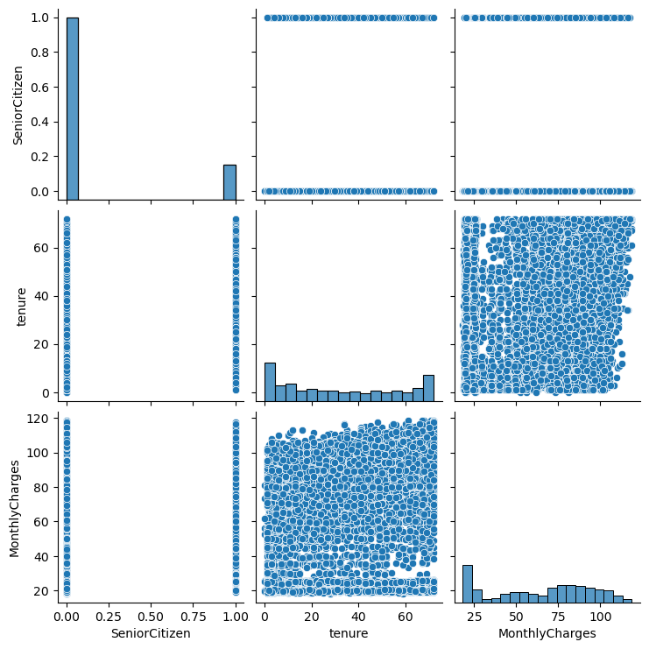
Exploratory Data Analysis –
Observation
The correlation between tenure and monthly charges is evenly distributed but the longer the tenure the higher the charges

Slide 17
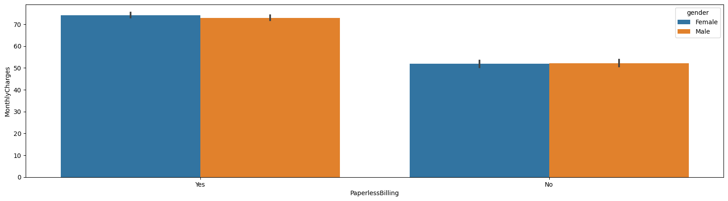
Exploratory Data Analysis –Multivariate
MonthlyCharges vs PaperlessBilling vs gender
Observation
Female using PaperlessBilling are charged more on Monthly bases than their male counterpart using PaperlessBilling an indication that female uses voice, data and internet services more.
The Female and Male without PaperlessBilling are charged the same.

Slide 18
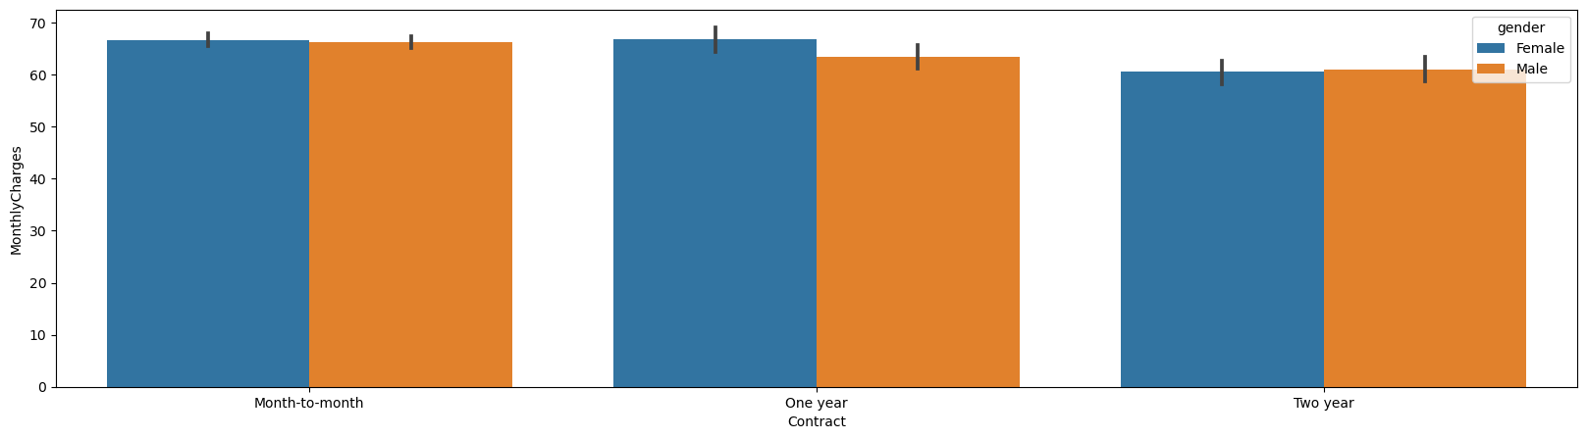
Exploratory Data Analysis – MonthlyCharges vs Contract vs gender
Observation
Most of the customers prefer Month-to-month subcription followed by one year.

Slide 19
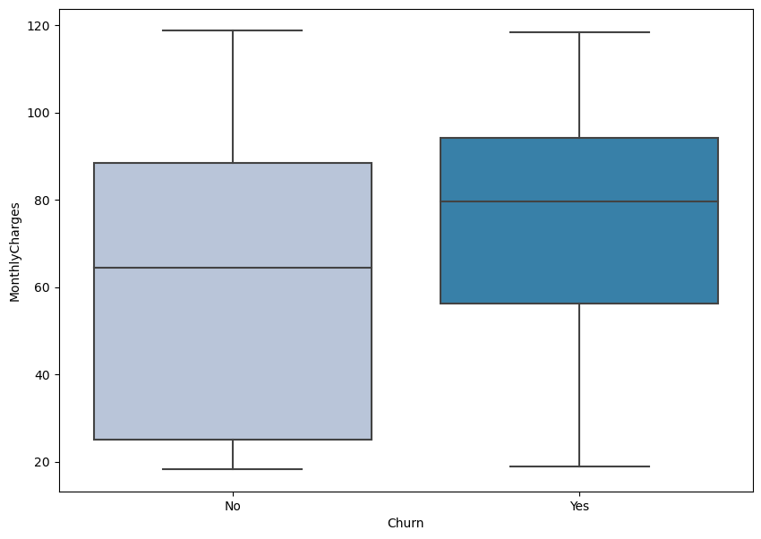
Exploratory Data Analysis – MonthlyCharges vs Churn
Observation
Churn customers are those
who are charged between 60
90
with an average monthly
charge of 80

Slide 20
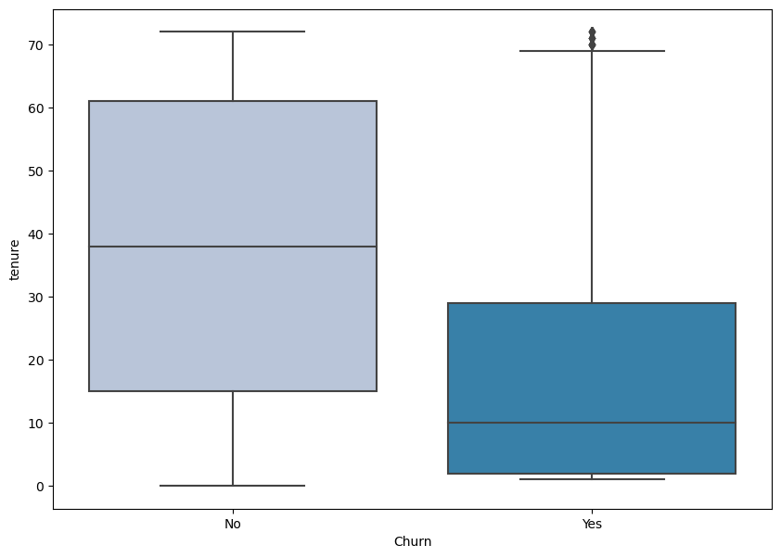
Exploratory Data Analysis –Tenure vs Churn
Observation
Churn customers have only tenures between 3 to 26 while the existing customers have spent longer time.
There are outliers for those churn customers and indication of their unusual behaviour to leave the company.
The mean for the customer not churning is higher than those churn customer. The mean is an indication of their stay in the company.

Slide 21
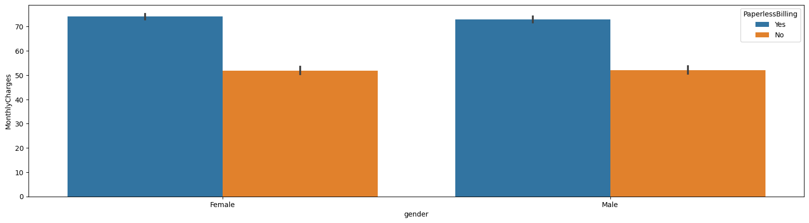
Exploratory Data Analysis –MonthlyCharges vs gender
Observation
Female are charged more an indication that they use the services more.

Slide 22
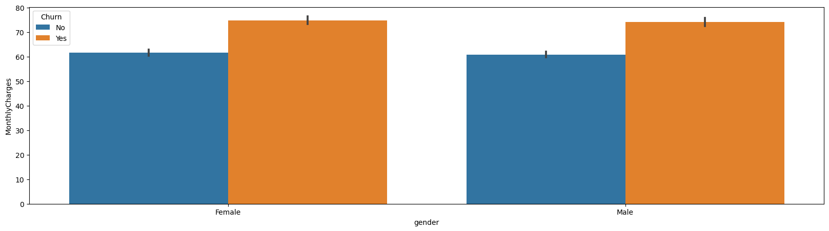
Exploratory Data Analysis –MonthlyCharges vs gender vs Churn
Observation
Female customers churn the company services more than the male customers because they are charged more monthly due to the fact they spend more on the company services affecting their financies. In spite of the fact they churn more the female customers using the services are still more.

Slide 23
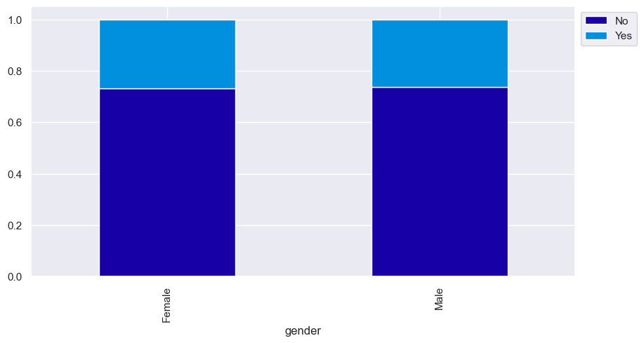
Exploratory Data Analysis –Gender vs Churn
Observations
Female customers are slightly more to churn the company's services than male customers

Slide 24
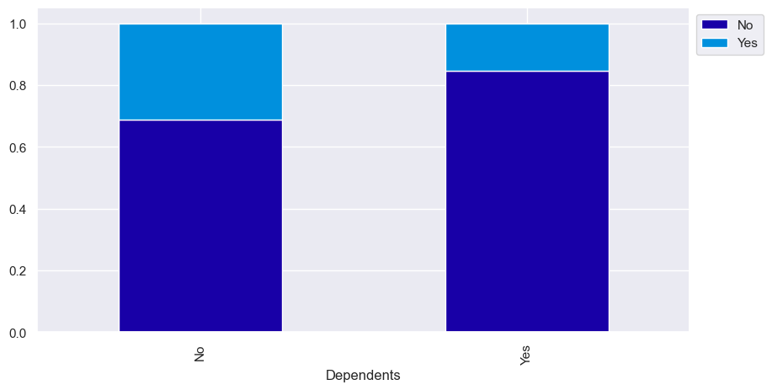
Exploratory Data Analysis –Dependents vs Churn
Observation
Customers with dependents are less likely to churn than those without dependents

Slide 25
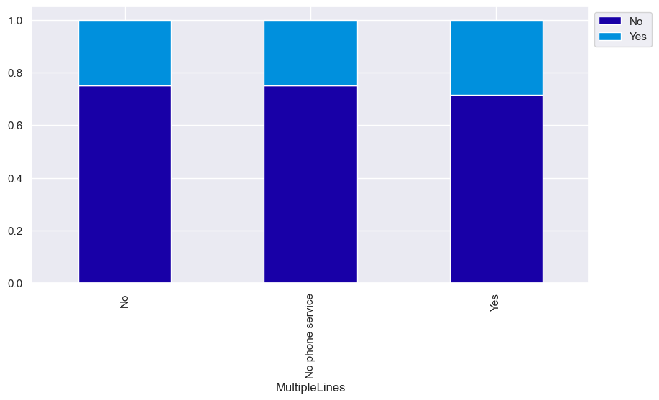
Exploratory Data Analysis –MultipleLines vs Churn
Observation
Those with multipleLines are more likely to churn ConnetTel Services than those without multiple lines and no Phone service

Slide 26
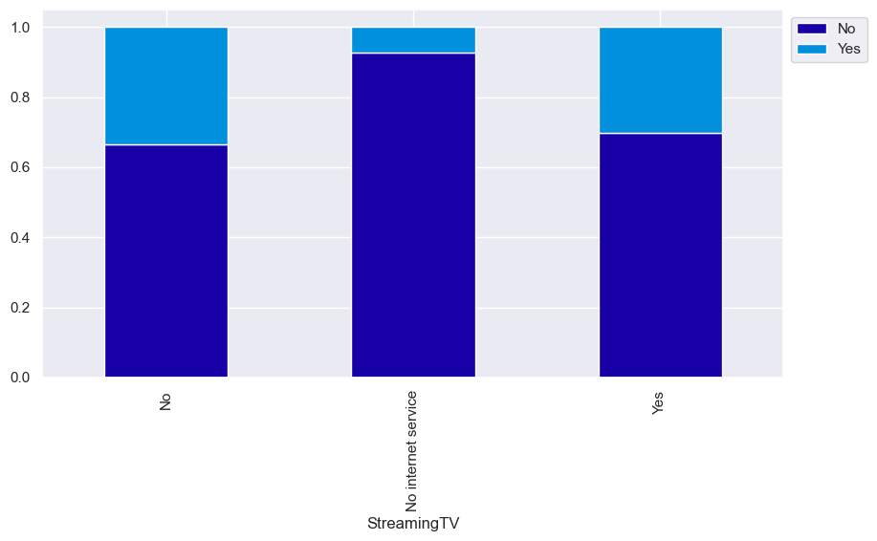
Exploratory Data Analysis –StreamingTV vs Churn
Observation
Customers with no StreamingTV are slight likely to churn than those with StreamingTV, while those with no internet service are more likely not to churn probably they are only using the PhoneService.

Slide 27
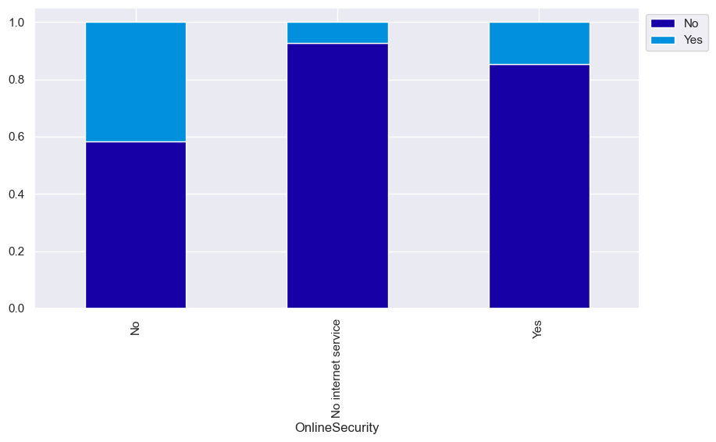
Exploratory Data Analysis –OnlineSecurity vs Churn
Observation
It is clear that trhose with no OnlineSecurity service are more likely to churn than those with OnlineSecurity and no internet services respectively.

Slide 28
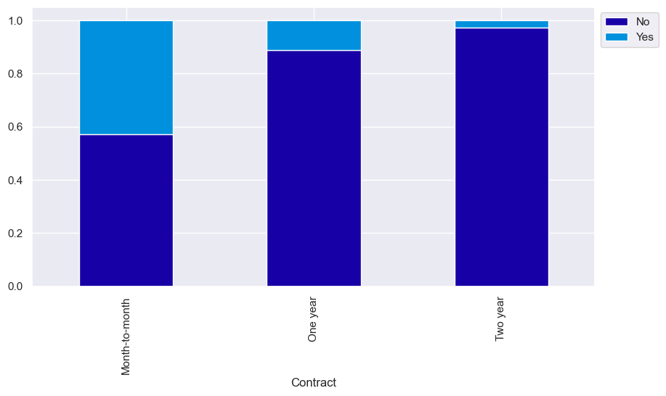
Exploratory Data Analysis –Contract vs Churn
Observation
It is very clear that the contract terms affect customers use of the company's service. The longer the contract the more likelihood that the customer will not churn the services.

Slide 29

Exploratory Data Analysis –TechSupport vs Churn
Observation
Likewise as the case with OnlineSecurity so as with TechSupport. That those with no TechSupport Are more likely to churn the company's services than those with TechSupport and those with no internet service respectively

Slide 30

Exploratory Data Analysis –StreamingMovies vs Churn
Observation
The difference in churning the company between customers with No StreamingMovies and customers with StreamingMovies is very small. Customer with no StreamingMovies are slightly likely to churn than those with StreamingMovies.

Slide 31
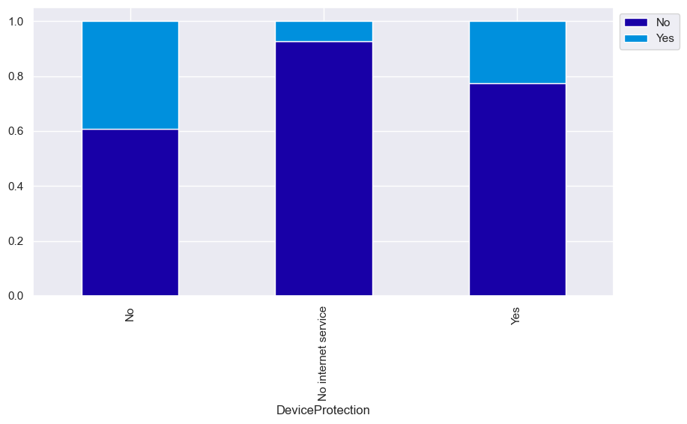
Exploratory Data Analysis –DeviceProtection vs Churn
Observation
Customers without DeviceProtection are more likely to churn the company's services than those with DeviceProtection

Slide 32
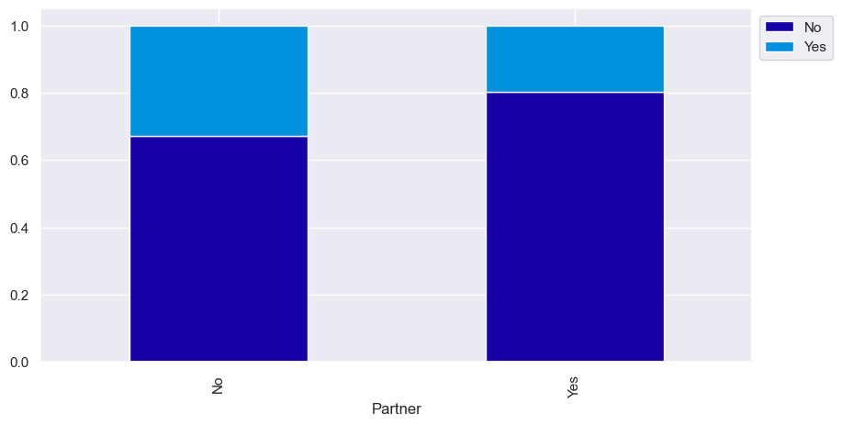
Exploratory Data Analysis –Partner vs Churn
Observation
Customers without Partners are more likely to churn the company services than customers with Partner

Slide 33
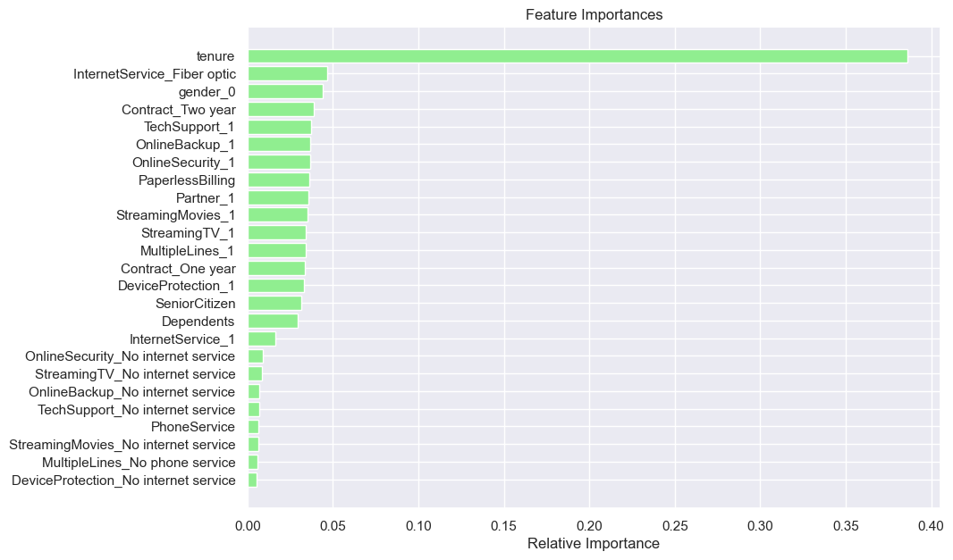
6. IDENTIFY KEY FEATURES OF THE DATASET
Observation
The tenure is the most important features meaning the more the tenure the higher the monthlyCharges and the totalChargesand the likely customer might churn the company's services
Fiber optic is another feature that the customer might consider to churn the company

Slide 34
7. MODEL PERFORMANCE SUMMARY
● We want to use the best model to predict if the customer is going to churn using the company’s service or not.
● We will use Recall as the metric to evaluate our model and try to minimize the number of false negatives
● We will build different models- Logistic Regression, Decision, Random Forest, Bagging, Ada Boost, GradientBoosting. XGBoost classifier.
● We will also perform hyperparameter tuning for the model built and evaluate their performance using different metrics and confusion matrix

Slide 35
MODEL PERFORMANCE SUMMARY CONT’
 | Model | Train_Accuracy | Test_Accuracy | Train_Recall | Test_Recall | Train_Precision | Test_precisio
1 | Logistic Regression with over sampling | 0.755 | 0.757 | 0.781 | 0.781 | 0.526 | 0.529
2 | Logistic Regression with under sampling | 0.750 | 0.747 | 0.800 | 0.777 | 0.519 | 0.515
0 | XGBoost | 0.800 | 0.808 | 0.534 | 0.544 | 0.649 | 0.670
6 | AdaBoost Classifier | 0.803 | 0.810 | 0.531 | 0.526 | 0.659 | 0.686
5 | Logistic Regression | 0.911 | 0.793 | 0.802 | 0.520 | 0.852 | 0.635
7 | Random Forest | 0.814 | 0.807 | 0.546 | 0.517 | 0.688 | 0.681
3 | Decision Tree | 0.972 | 0.737 | 0.921 | 0.485 | 0.973 | 0.506
4 | Gradient Boosting Classifier | 0.972 | 0.780 | 0.942 | 0.467 | 0.953 | 0.614
The best three model
Gradient Boosting classifier
Decision Tree
Logistic Regression
The True positives of the above is higher than the rest.

Slide 36
8. KEY INSIGHT AND RECOMMENDATIONS
1. We have been able to build a predictable model
(a That ConnectTel can deploy to identify customers who are at the risk of Churning.
(b The ConnectTel can use to find the key causes that drive the Churn
2. Factors that drive the Churn- Tenure /MonthlyCharges because they are correlated,InternetService_Fiber optic
3. Female customers should be the target customers for any kind of marketing campaign as they are the ones who make use of the services more.
4. There should be incentives to promote the use of TechSupport to encourage users

Slide 37

Thank you
16
Proprietary content. © Great Learning. All Rights Reserved. Unauthorized use or distribution prohibited.

