Slide 1

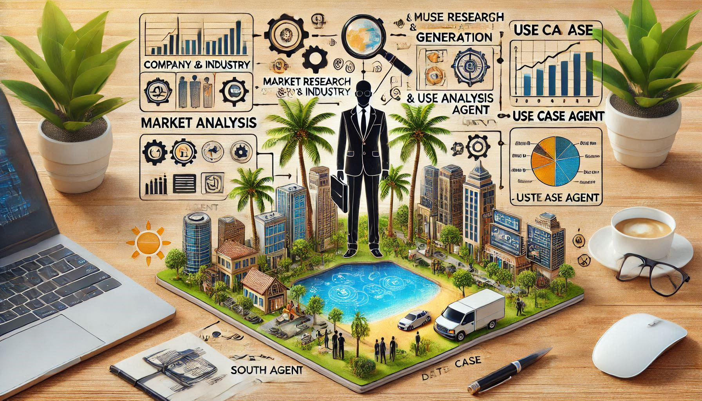
MARKET RESEARCH & USE CASE AGENT

Slide 2
Contents
Introduction
Problem Statement
Objectives
Project Overview
Features and Functionalities
Technology stack
Benefits
Conclusion

Slide 3
Introduction
A multi-agent system (MAS) consists of multiple interacting intelligent agents, which can be software programs or robots, that work together to solve complex problems.
These agents are autonomous entities that perceive their environment, make decisions, and take actions to achieve their goals.
Agents in a MAS often cooperate and communicate to complete tasks that may be beyond the capabilities of a single agent.
Used in various domains such as robotics, e-commerce, traffic management, gaming, and healthcare.

Slide 4
Problem Statement
Companies need an automated and intelligent system that can collect, analyze, and summarize valuable insights from various sources like industry trends, company information, and datasets related to artificial intelligence (AI) and machine learning (ML). The goal is to provide businesses with a comprehensive, easy-to-understand market research report, helping them make informed decisions and stay competitive.

Slide 5
Objectives
Automated Market Research
Multi-Agent System
Search and Extract Relevant Data.
To create a user-friendly interface for seamless interaction with the system.
To save time and enhance productivity by eliminating the need for manual searches in large documents.

Slide 6
Methodologies
Multi-Agent Architecture
Web Scraping with SerpAPI
Automated Industry Detection
Data Extraction and Parsing
Dataset Collection from Multiple Sources
Report Generation

Slide 7
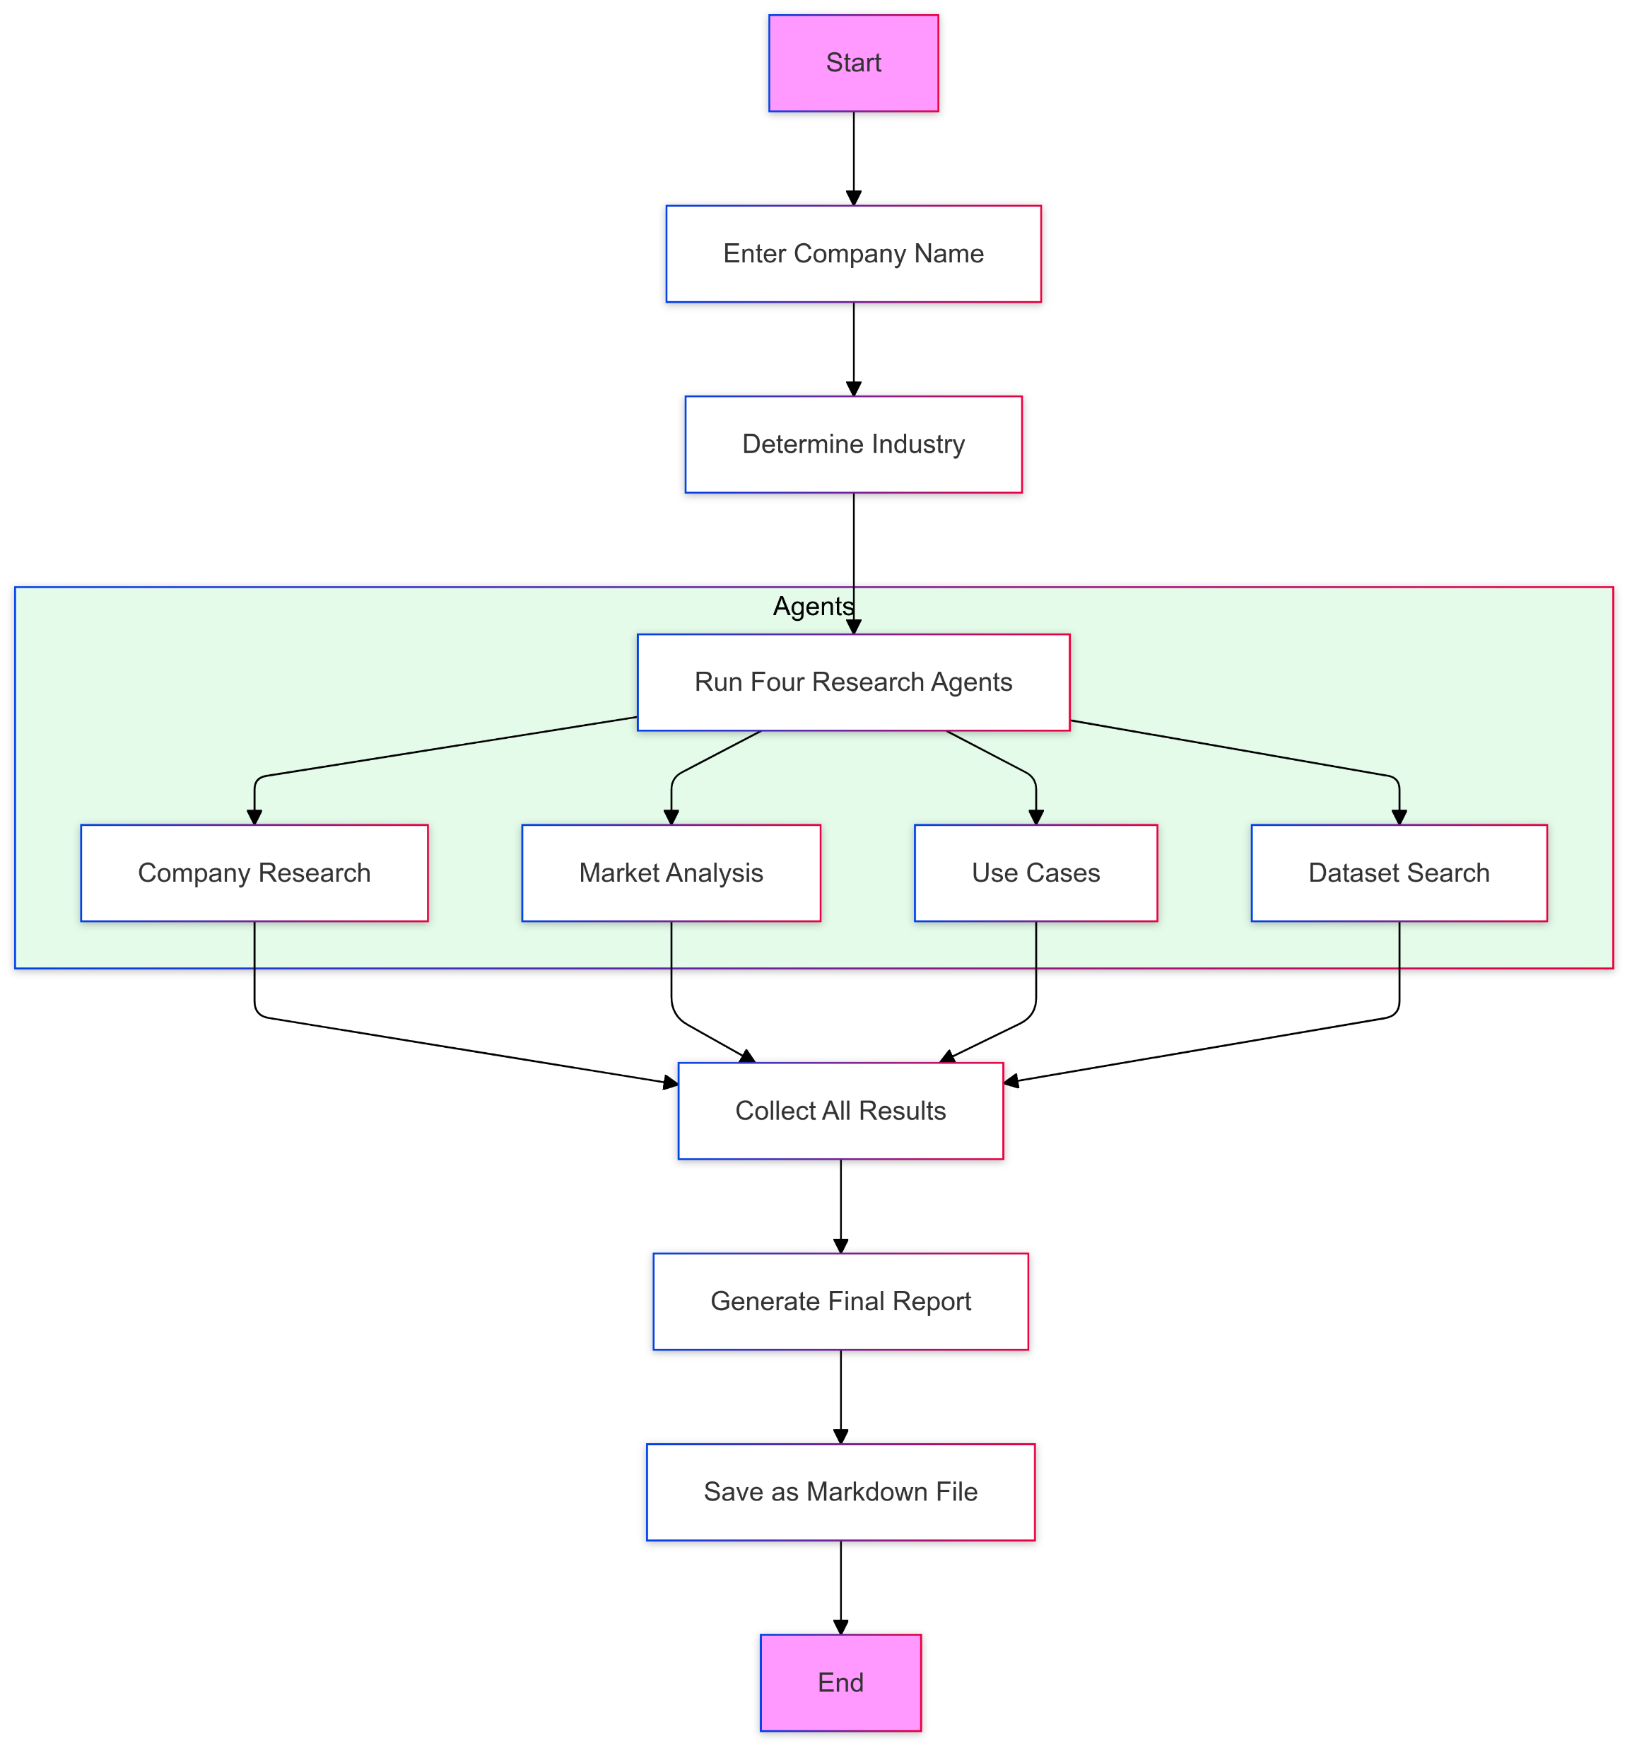
Flowchart

Slide 8
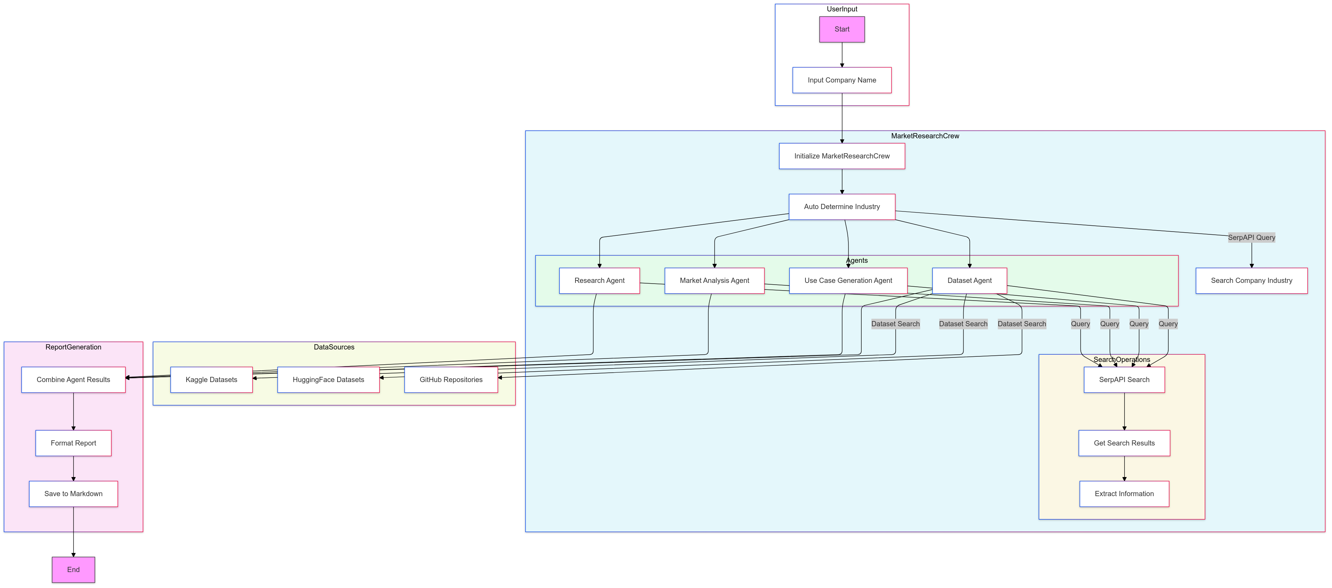
Flowchart

Slide 9
Conclusion
In conclusion, this project effectively utilizes a multi-agent system to automate the process of gathering and analyzing market data.
By leveraging APIs and search engines, it provides valuable insights into industries and companies, helping businesses stay updated with the latest trends, use cases, and available datasets for AI and machine learning applications.
The generated reports offer a comprehensive overview that can guide decision-making and strategy development.
Overall, this system streamlines market research, saving time and effort, and ensures that businesses have access to accurate and relevant information in a format that is easy to understand and share.

Slide 10
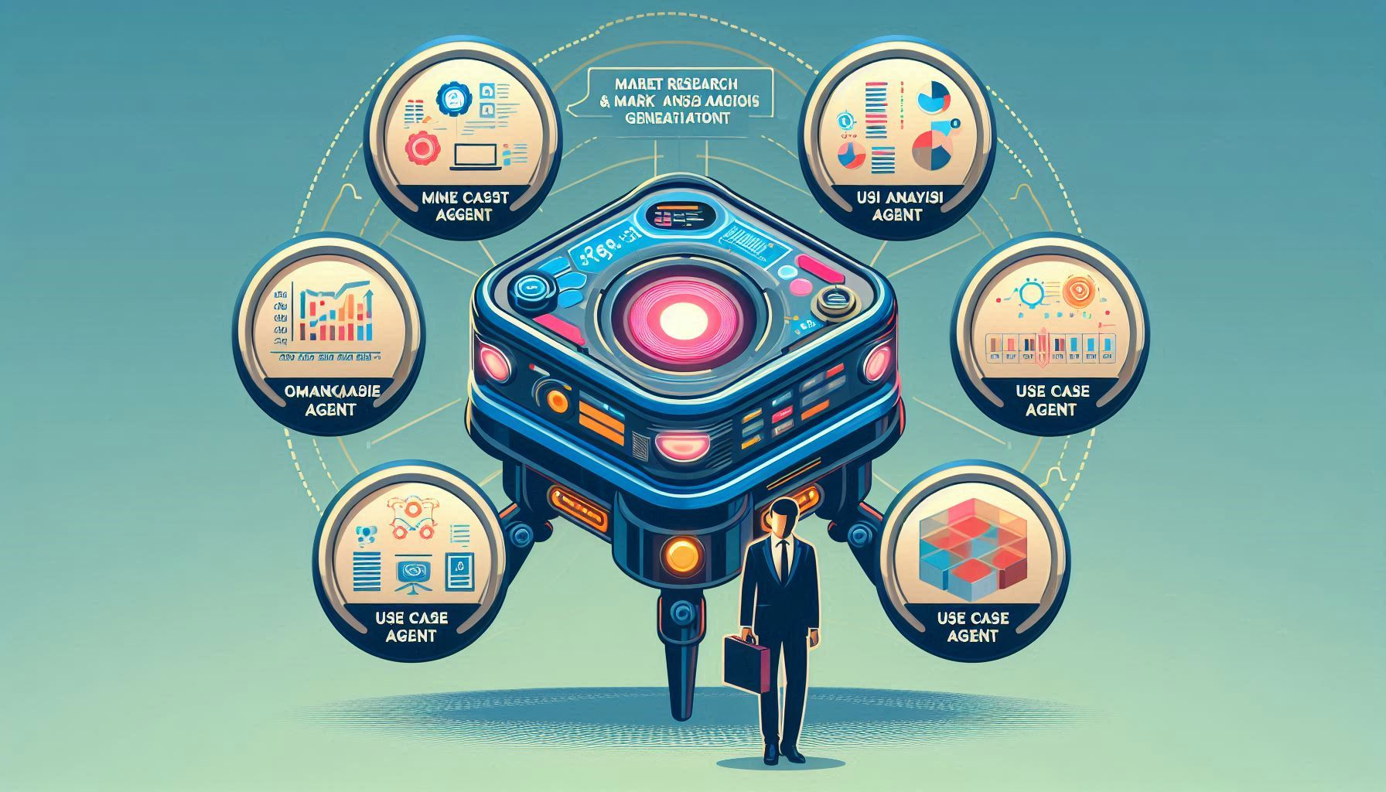
Thank You

