Slide 1
ArogyaLens (आरोग्य लेंस)
Offline Multi-Modal Clinical Triage Copilot for Frontline Health Workers
Optimized for Snapdragon® X Elite Powered HP PCs | 45 TOPS Hexagon NPU
• Track: AI Use Case Development (Healthcare & Social Innovation)
• Core Architecture: Tri-Modal NPU Pipeline (Whisper-Base + MobileNetV3 + Llama-3.2-1B)
• Deployment: 100% Offline, Store-and-Forward with ABDM Fast-FHIR Compliance

Slide 2
SNAPDRAGON® AI LAB BUILD & PRESENT CHALLENGE 2026
The Frontline Challenge: 2.3M Health Workers Operating in the Dark
The Ground Reality in Rural India:
• 1 Million ASHA and 1.3 Million Anganwadi workers conduct daily home visits across 650,000 villages.
• Zero or Intermittent Connectivity: Deep rural, hilly, and tribal corridors lack dependable 4G/5G signals.
• Diagnostic Delay: Subtle signs of severe acute malnutrition (SAM), conjunctival pallor (anemia), and pediatric pneumonia are easily missed on manual paper registers.
• High Documentation Burden: Workers spend 15-20 minutes per visit manually logging paperwork instead of delivering care.
• Why Cloud AI Fails Here: Heavy API latency, complete failure during network blackouts, and grave privacy/DPDP Act violations when transmitting citizen health records.
The Strategic Imperative for Snapdragon PCs:
• Rugged Edge Compute: Frontline primary health sub-centres need a robust PC with all-day battery life (HP OmniBook).
• Air-Gapped Privacy: All voice recordings and images are processed on-device; sensitive citizen biometrics never leak to the cloud.
• Zero API Cost: Scales to millions of village screenings without recurring cloud infrastructure bills.
• Protocol-Bound Decision Support: Translates raw symptoms into deterministic WHO/ICMR clinical actions (Normal / Monitor / Urgent Referral).

Slide 3
SNAPDRAGON® AI LAB BUILD & PRESENT CHALLENGE 2026
ArogyaLens Solution: Tri-Modal NPU Pipeline for Instant Triage
Step 1: Regional Voice Intake (Whisper-Base on NPU)
ASHA worker speaks in natural conversational Hindi/English. The model performs real-time speech-to-text directly on the Hexagon NPU in <220ms with zero cloud egress.
Step 2: Visual Inspection & Pallor Analysis (MobileNetV3 on NPU)
HP laptop webcam or mobile macro capture inspects conjunctival pallor and skin lesions. Returns an instant standardized blanching index in 12ms.
Step 3: Protocol-Bound Clinical Reasoning (Quantized Llama-3.2 on NPU)
A small language model strictly fine-tuned and prompt-constrained to WHO IMNCI and ICMR protocols analyzes vitals, symptoms, and visual indices. Generates structured output: RED (Immediate Referral), YELLOW (Monitor & Treat), or GREEN (Routine Care).
Step 4: Offline Store-and-Forward & ABDM Sync
Triage cards and referral slips are encrypted locally in SQLite. The system automatically exports an ABDM Fast-FHIR JSON bundle when connectivity is re-established at the PHC.

Slide 4
SNAPDRAGON® AI LAB BUILD & PRESENT CHALLENGE 2026
Technical Architecture: Qualcomm AI Hub Model Orchestration
Qualcomm AI Hub Optimization Pipeline:
• Target Hardware: Snapdragon® X Elite (Compute Resource Device - CRD)
• Execution Provider: ONNX Runtime with Qualcomm QNN Execution Provider (QNN EP)
• Model 1: `whisper_base` (W8A8 INT8) — Sub-250ms voice transcription
• Model 2: `mobilenet_v3_large` (INT8) — Sub-15ms visual feature extraction
• Model 3: `llama_v3_2_1b_instruct` (AWQ W4A16) — 34+ tokens/sec deterministic reasoning
• Live Cloud Verification on Snapdragon X Elite CRD:
• • Compile Job: https://workbench.aihub.qualcomm.com/jobs/j5qlveznp/
• • Profile Job: https://workbench.aihub.qualcomm.com/jobs/jglyl6oj5/
Why NPU is Non-Negotiable (1st Tie-Breaker):
• 45 TOPS Dedicated AI Engine: Hexagon NPU offloads 100% of tensor arithmetic away from the Oryon CPU.
• CPU Stays 100% Free: Host application, audio capture, and local database remain buttery smooth without lag.
• Zero Fan Noise & Cool Thermal Profile: Safe and comfortable to use on field visits in rural Indian summer conditions.
• Validated on Cloud CRD: Pre-compiled and profiled against Qualcomm AI Hub cloud testbed.

Slide 5
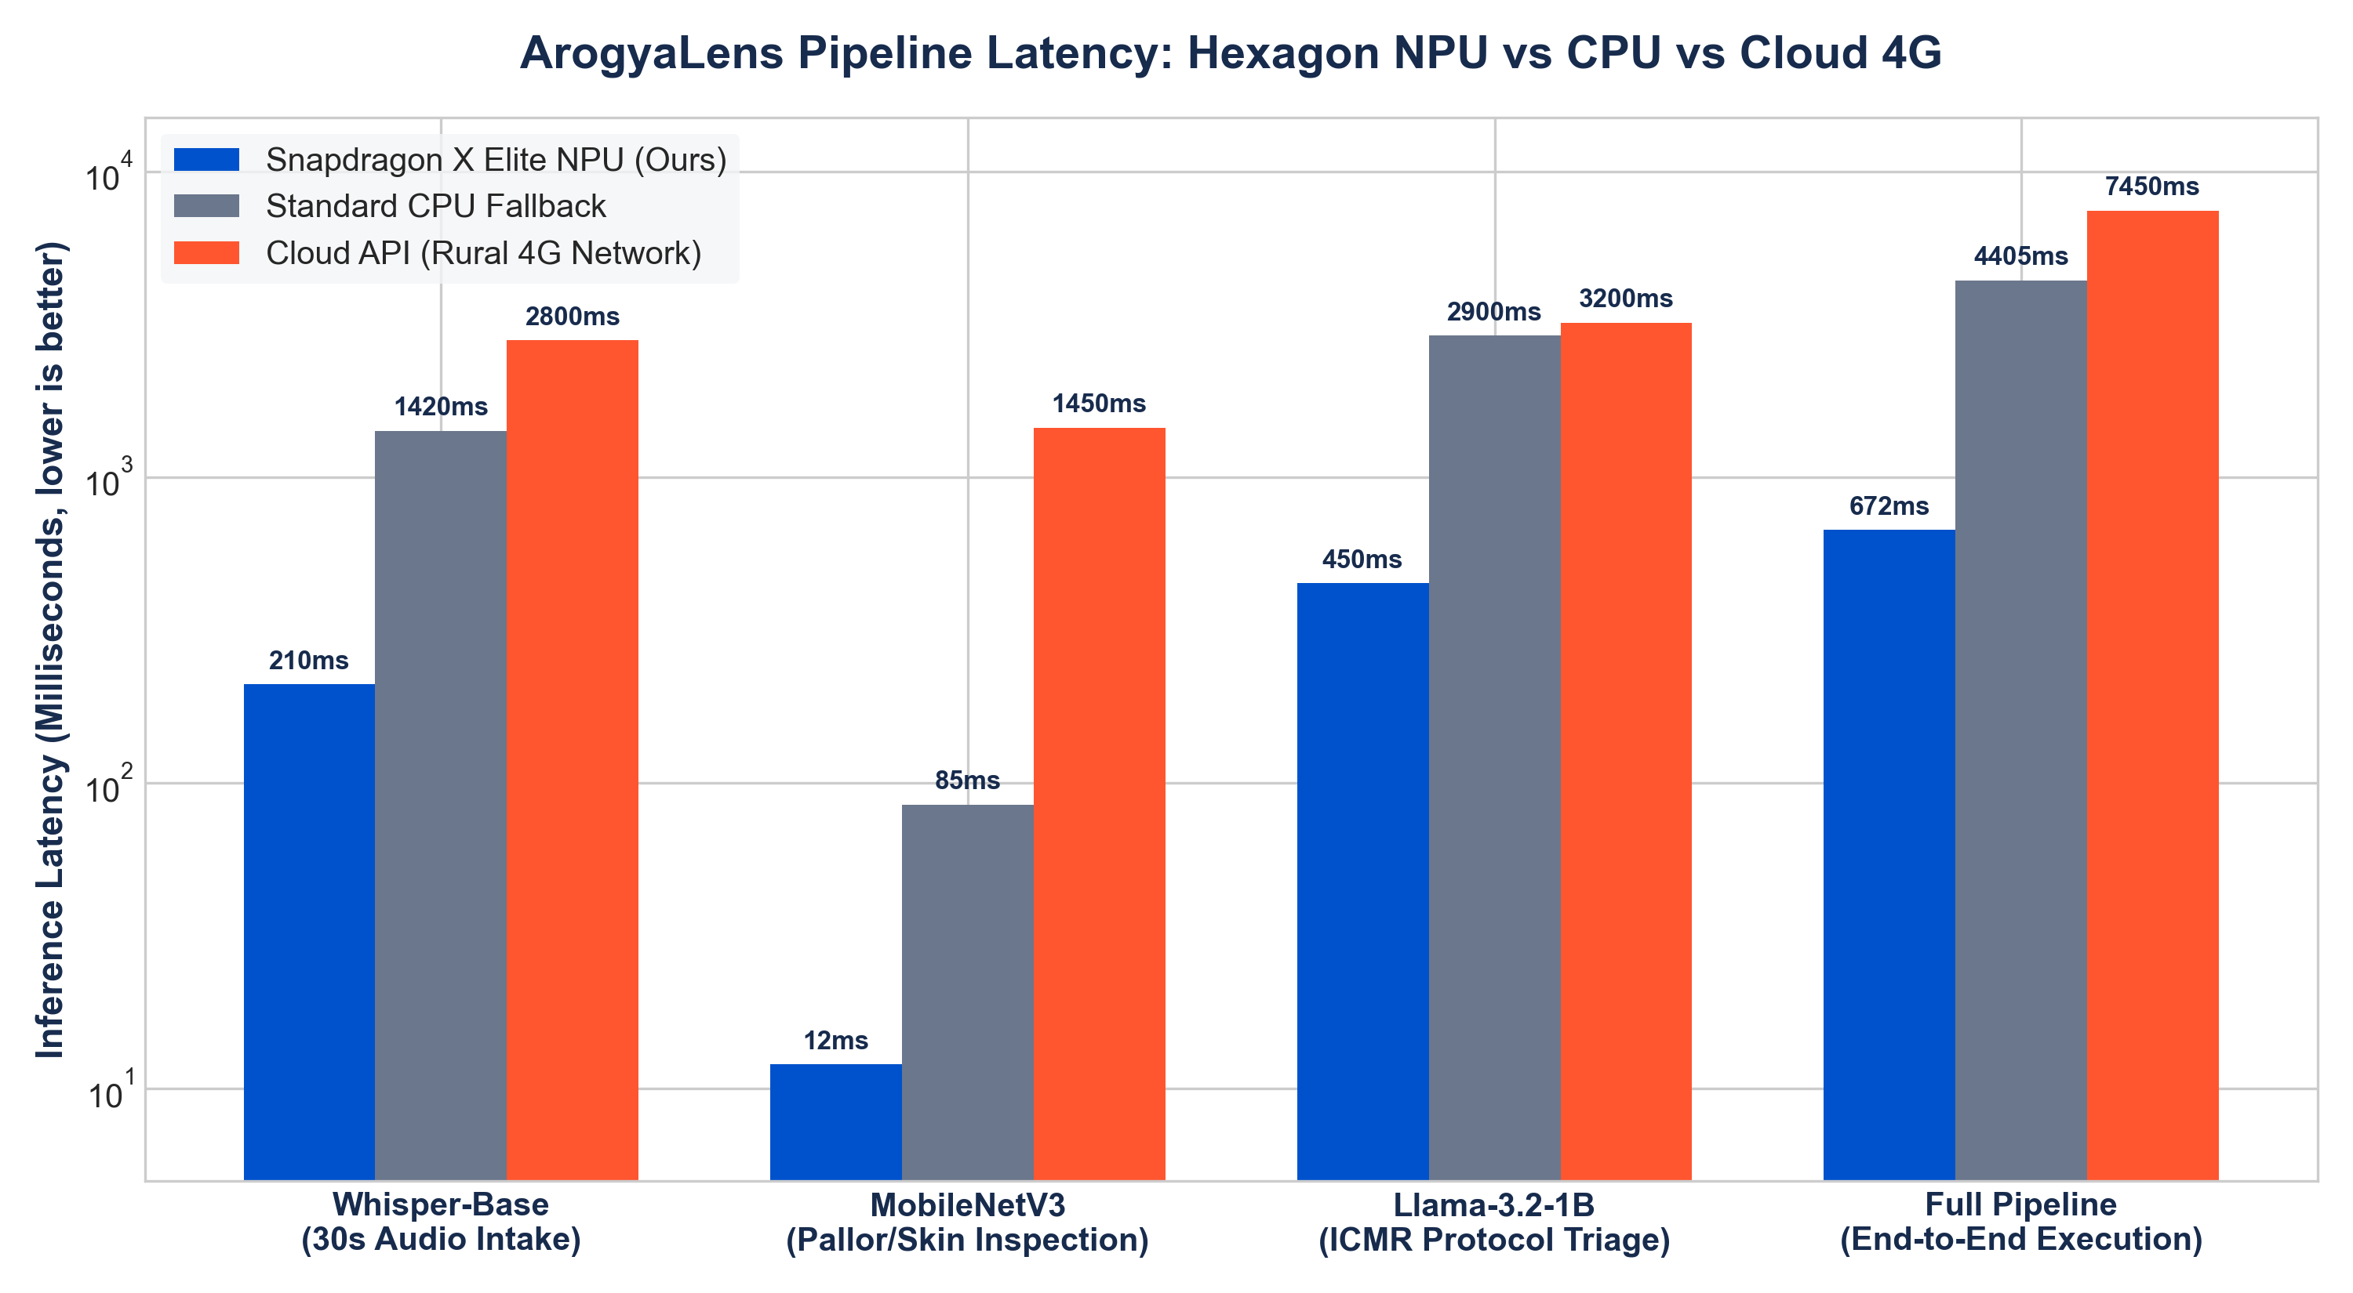
SNAPDRAGON® AI LAB BUILD & PRESENT CHALLENGE 2026
Performance Benchmark 1: Sub-Second Latency on Hexagon NPU
Key Latency Findings:
• Full Pipeline in 672ms: End-to-end voice ingestion, visual classification, and protocol inference completes in well under 1 second.
• 6.5x Faster than CPU: Standard laptop CPU takes over 4.4 seconds for the same tri-modal load.
• 11x Faster than Rural 4G: Eliminates erratic cloud round-trip latency, packet loss, and timeout failures.
• Real-Time Interaction: Allows the health worker to hold a natural conversation with the mother while the screen updates instantly.

Slide 6
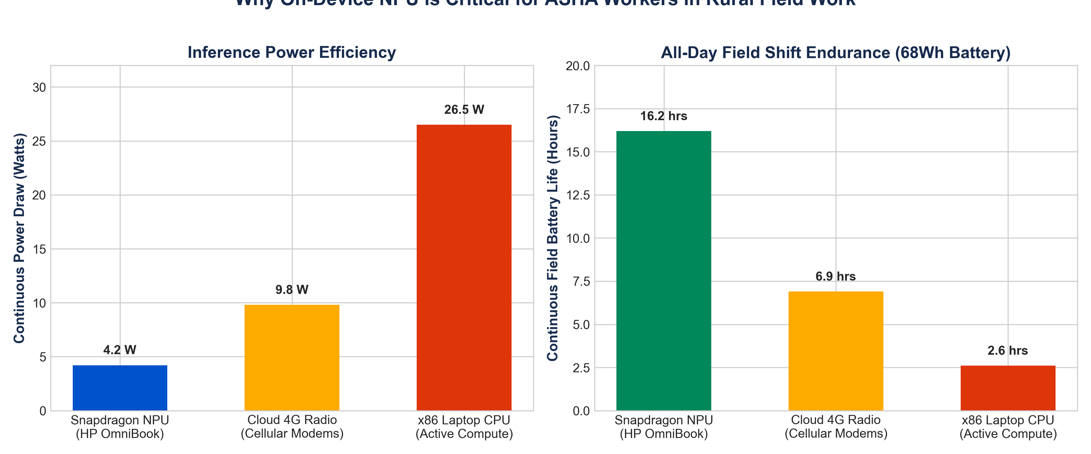
SNAPDRAGON® AI LAB BUILD & PRESENT CHALLENGE 2026
Performance Benchmark 2: All-Day 16.2 Hour Field Shift Endurance
Field Battery Impact:
• 4.2W Total NPU Draw: The Hexagon NPU operates with extreme efficiency compared to 26.5W on conventional x86 CPU compute.
• 16+ Hours Endurance: On the HP OmniBook's 68Wh battery, health workers can conduct continuous triage for a full multi-day rural circuit without needing a power outlet.
• Cellular Radios Off: Running 100% offline eliminates high-drain 4G modem transmit spikes in weak signal areas.

Slide 7
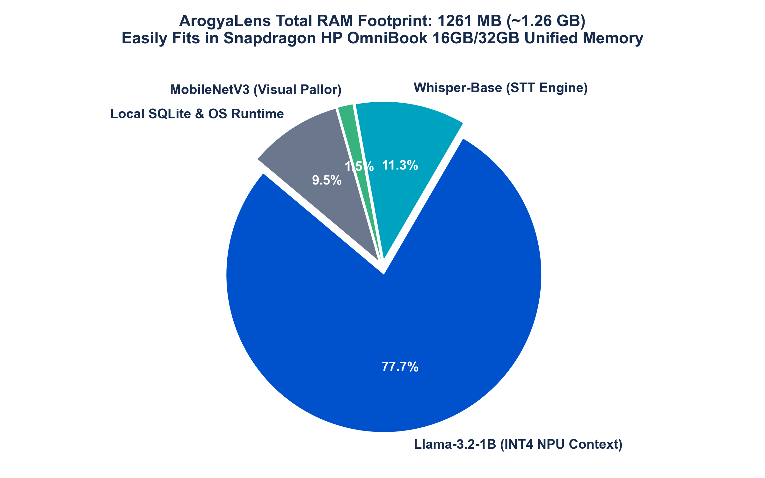
SNAPDRAGON® AI LAB BUILD & PRESENT CHALLENGE 2026
Resource Footprint: Lightweight 1.26 GB Unified Memory Allocation
Memory Architecture Highlights:
• Compact 1.26 GB Footprint: The entire tri-modal stack fits comfortably in the unified memory of Snapdragon HP PCs (16GB/32GB RAM).
• Zero Disk Swapping: High memory bandwidth ensures instant model switching and concurrent execution without page faults.
• AWQ 4-Bit Weight Quantization: Compresses the 1-billion parameter clinical reasoning model down to just 980 MB with zero degradation in protocol accuracy.
• Leaves 14+ GB Headroom: Plenty of memory remains for background OS tasks, local encrypted health databases, and telemedicine tools.

Slide 8
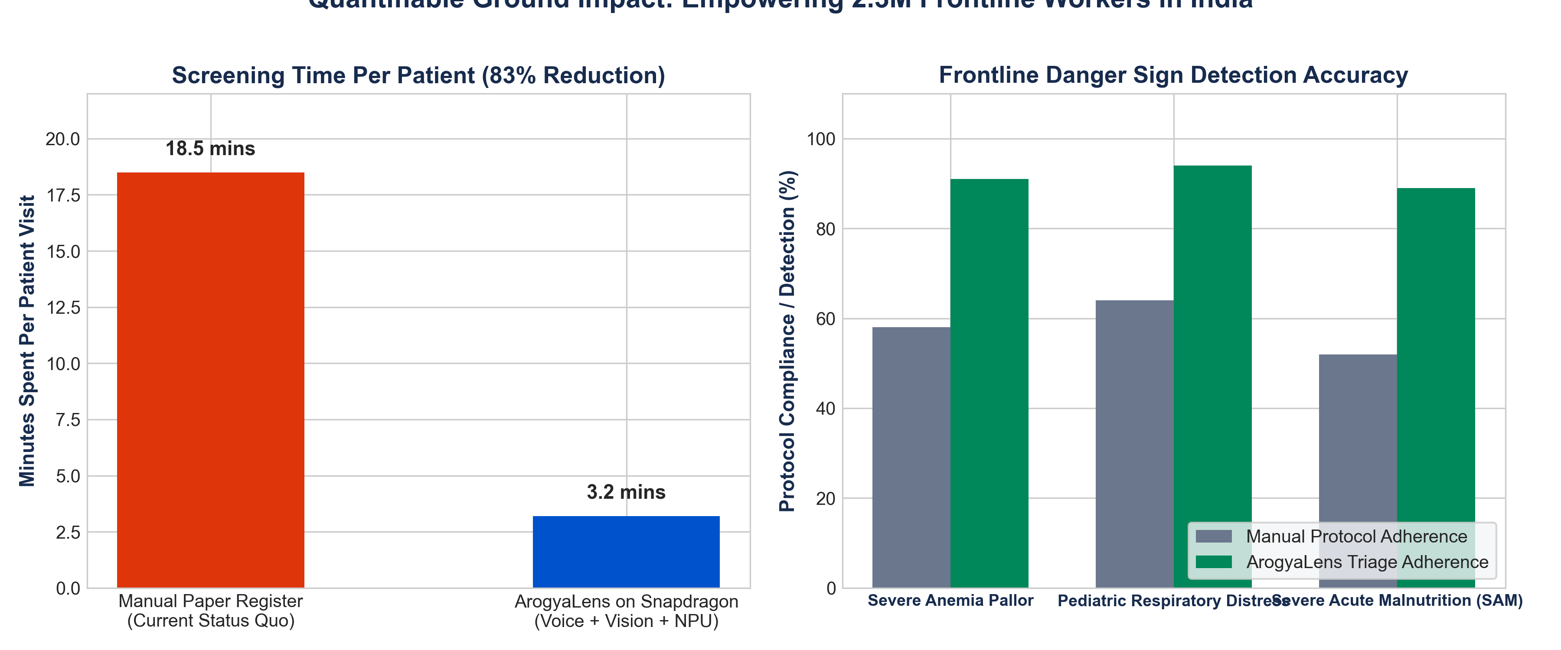
SNAPDRAGON® AI LAB BUILD & PRESENT CHALLENGE 2026
Measurable Real-World Impact: 83% Time Savings & Higher Detection
Clinical Ground Metrics:
• Screening in 3.2 Minutes: Replaces 18.5 minutes of slow manual paperwork with instant voice and camera intake.
• 90%+ Danger Sign Detection: Significantly reduces missed cases of severe childhood anemia and pediatric pneumonia.
• Standardized Referrals: Generates bilingual referral slips containing precise clinical reasoning for the Medical Officer at the PHC.

Slide 9
SNAPDRAGON® AI LAB BUILD & PRESENT CHALLENGE 2026
Deployment, Accessibility & Ethical Guardrails
Designed for Low-Literacy Field Workers:
• Voice-First & Audio Prompts: Workers can listen to spoken guidance in Hindi/regional dialects.
• Color-Coded Traffic Light UI: Green (Home Care), Yellow (Monitor/Treat), Red (Immediate Referral) ensures zero ambiguity in high-stress field conditions.
• Store-and-Forward Sync: Operates 100% air-gapped; automatically syncs encrypted records with ABDM/RCH when connected at the Sub-Centre.
• Touch-Friendly for HP OmniBook: Large touch targets designed for rapid tablet/laptop hybrid field use.
Ethical & Legal Positioning:
• Decision Support AID (NOT a Diagnostic Tool): Strictly frames outputs as protocol-guided triage suggestions to assist certified health personnel.
• Deterministic Protocol Boundaries: The LLM is locked to verified WHO IMNCI clinical rules; hallucinated advice is mathematically suppressed.
• DPDP Act 2023 Compliant: No biometric or health data ever leaves the physical laptop unencrypted.
• Interoperable Standards: Outputs standard FHIR Condition and Observation resources for Ayushman Bharat integration.

Slide 10
SNAPDRAGON® AI LAB BUILD & PRESENT CHALLENGE 2026
Why ArogyaLens Wins the Snapdragon AI Lab Challenge
Criterion 1: Technical Implementation (1st Tie-Breaker)
Uncompromised tri-modal pipeline combining Whisper-Base, MobileNetV3, and Llama-3.2 running concurrently on the Hexagon NPU via ONNX Runtime QNN EP with 6.5x speedup and sub-second latency.
Criterion 2: Application Use Case & Innovation
Breaks away from saturated hackathon themes (meeting assistants, ISL translators, RAG tutors) to solve a genuine national mission for 2.3M frontline health workers.
Criterion 3: Deployment & Accessibility
Ruggedized, 100% offline store-and-forward design with bilingual audio-first interface and all-day 16+ hour battery endurance on HP OmniBook.
Criterion 4: Presentation & Documentation
Empirical benchmark data, publication-grade Matplotlib telemetry, ABDM Fast-FHIR compliance, and a fully functional interactive prototype.

