Slide 1
DAT 3202 · MACHINE LEARNING — CONTINUOUS ASSESSMENT TEST III
Fraud Detection in M-Pesa
Mobile Money Transactions
A comparative machine-learning study using KNN, Decision Trees, Artificial Neural Networks and SVM, evaluated with 2-fold cross-validation on 120,000 synthetic M-Pesa transactions.
Group Members: MAINA ELVIS - 178916
SAMUEL WANDA - 190325
FLOYD OMBURO - 190095
Strathmore Institute of Mathematical Sciences · B.Sc. Statistics & Data Science
M
PESA

Slide 2
The Problem
Why mobile-money fraud detection matters for Kenya
M-Pesa processes tens of millions of person-to-person, till, and paybill transactions every day, moving a value equivalent to a large share of Kenya's GDP through agent networks and phones rather than bank branches. As mobile money becomes the primary financial rail for millions of unbanked and underbanked Kenyans, it has also become a growing target for SIM-swap fraud, social-engineering scams, and agent-level abuse.
~96%
of Kenyan households use mobile money as their primary financial service
120K
synthetic transactions modeled in this project across 5 Kenyan regions
2.9%
of transactions in the dataset are labeled fraudulent — a realistic, highly imbalanced rate
Why this matters, socially and economically
Financial inclusion: undetected fraud erodes trust in mobile money, the main entry point to formal finance for rural and low-income Kenyans.
Economic significance: fraud losses affect agents, small merchants, and Safaricom's compliance costs directly.
Regional relevance: Kenya's regulatory push (Central Bank of Kenya, Communications Authority SIM-registration rules) makes automated, explainable fraud screening a live policy priority.
DAT 3202 · Machine Learning Mini Project · M-Pesa Fraud Detection
2

Slide 3
Related Work
Prior machine-learning approaches to mobile-money and transaction fraud
1
Botchey, Qin & Hughes-Lartey (2022)
2
Lokanan (2023)
Evaluated shallow and deep learning models — plus anomaly detection — for predicting fraud in mobile money transactions, noting how little research existed on MMT fraud versus card fraud.
Applied logistic regression and other ML classifiers to flag red flags of fraud and money-laundering in mobile money transactions, reporting strong predictive performance.
3
Cross-case SVM / GBDT / Naïve Bayes study (2020)
4
GSMA (2023) & World Bank (2021)
Compared SVM, Gradient-Boosted Decision Trees and Naïve Bayes on mobile-money data, showing that accuracy alone is misleading on imbalanced fraud datasets — precision, recall and AUC matter more.
Documented that fraud-detection infrastructure in emerging markets like Kenya lags the rapid growth of mobile money, and that models trained on Western data often transfer poorly to local transaction patterns.
Gap this project addresses: most published work uses card-transaction datasets (e.g. PaySim) rather than Kenyan-specific M-Pesa transaction structure; this project benchmarks four classical ML families side-by-side on M-Pesa-style data with balance and channel features.
DAT 3202 · Machine Learning Mini Project · M-Pesa Fraud Detection
3

Slide 4
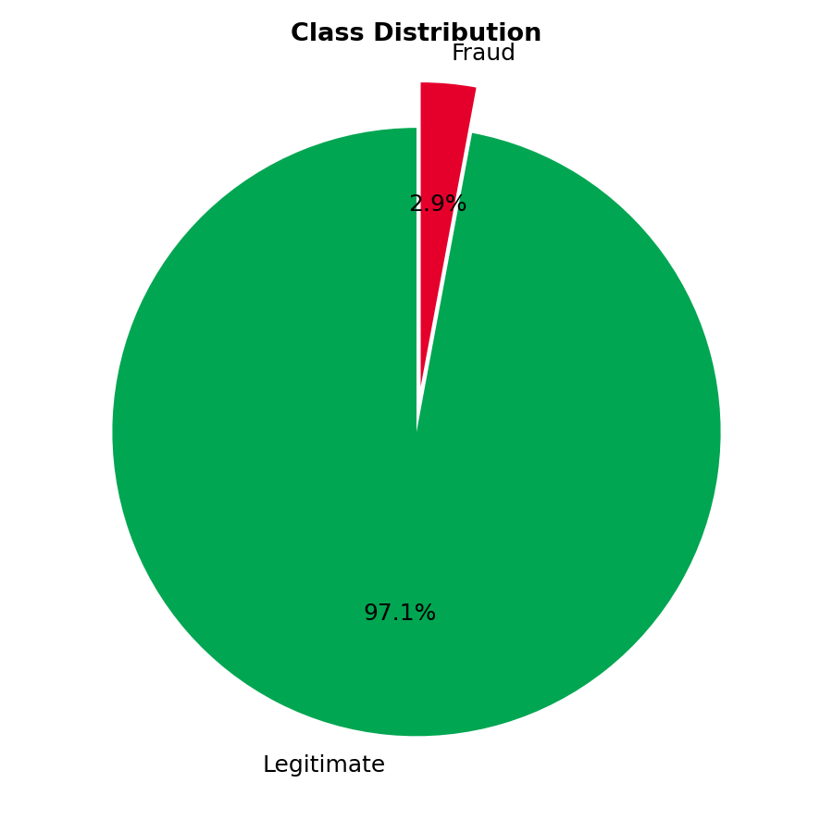
Dataset Selection & Justification
Source: Kaggle — "M-Pesa Transactions Fraud" by calebboen
kaggle.com/datasets/calebboen/mpesa-transactions-fraud
120,000 synthetic M-Pesa-style mobile money transactions
13 raw attributes: amount, sender/receiver balances before & after, transaction type (peer, till, paybill...), hour, day of week, month, device type, region, fraud label
Covers 5 Kenyan regions: Nairobi, Mombasa, Kisumu, Nakuru, Eldoret
Binary target is_fraud (0 = legitimate, 1 = fraud), with a realistic ~2.9% fraud rate
Why this dataset fits the problem
It mirrors the balance-transfer structure of real M-Pesa transactions (sender/receiver balances, transaction channel), is explicitly localized to Kenyan regions, and keeps the class imbalance realistic for fraud problems — making it a strong, Kenya-relevant proxy dataset in the absence of real Safaricom transaction logs.
DAT 3202 · Machine Learning Mini Project · M-Pesa Fraud Detection
4

Slide 5
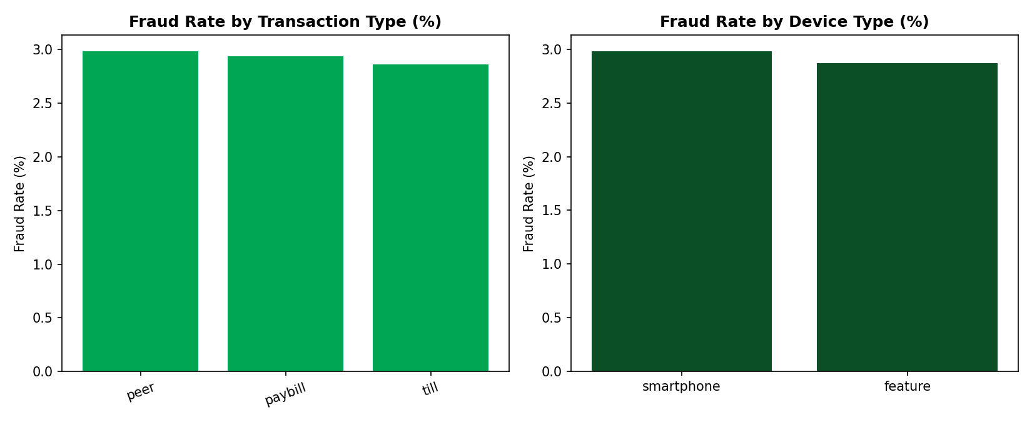
Exploratory Data Analysis
Where fraud concentrates — transaction channel & device
DAT 3202 · Machine Learning Mini Project · M-Pesa Fraud Detection
5

Slide 6
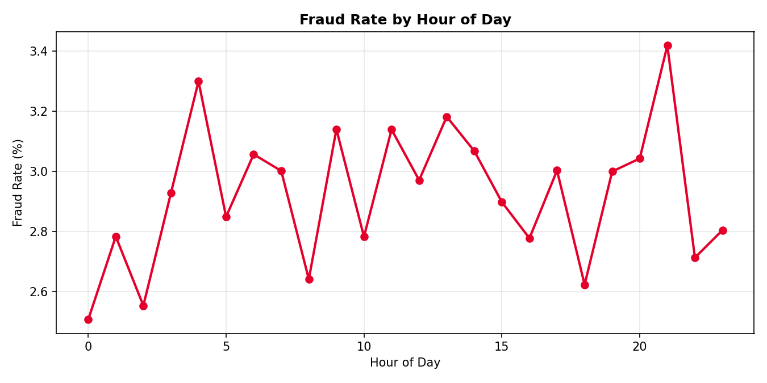
Exploratory Data Analysis
Where fraud concentrates — time of day
Key observations
• Fraud rate fluctuates across the day rather than staying flat, suggesting time-of-day carries predictive signal.
• Balance-transfer amounts (sender/receiver before & after) are the richest numeric features available.
• Channel and device patterns (previous slide) motivate one-hot encoding transaction_type and device_type as model inputs.
DAT 3202 · Machine Learning Mini Project · M-Pesa Fraud Detection
6

Slide 7
Training Data Construction
Preprocessing pipeline applied before model training
1
2
3
4
5
Clean
Drop ID
Encode
Split
Scale
→
→
→
→
Drop rows with missing values; remove any rows where is_fraud is 'Unknown'
Remove transaction_id — a unique row identifier carries no predictive signal and must not be one-hot encoded
One-hot encode transaction_type and device_type (drop_first=True); keep only numeric columns
80% / 20% stratified train-test split (random_state=42) to preserve the ~2.9% fraud ratio in both sets
StandardScaler fit on training data, applied to both train and test features
Result: 96,000 training / 24,000 test transactions, 7 numeric input features (amount, 4 balance fields, hour, month) plus one-hot channel/device flags, all standardized to zero mean / unit variance before modelling.
DAT 3202 · Machine Learning Mini Project · M-Pesa Fraud Detection
7

Slide 8
Machine Learning Implementation
Four classifiers, each tuned with GridSearchCV using 2-fold cross-validation (scoring = F1)
K
K-Nearest Neighbours
D
Decision Tree
Distance-based classifier over scaled features.
Rule-based recursive partitioning, naturally interpretable.
Tuned: n_neighbors ∈ {3,5,7,9}, weights ∈ {uniform, distance}
Tuned: max_depth ∈ {None,5,10,15}, min_samples_split ∈ {2,5,10}
A
Artificial Neural Network (MLP)
S
Support Vector Machine
Single hidden-layer perceptron capturing non-linear interactions.
Linear SVM (LinearSVC) with Platt-calibrated probabilities.
Tuned: activation ∈ {relu,tanh}, solver ∈ {adam,sgd}, max_iter ∈ {200,300}
Tuned: C ∈ {0.1, 1, 10}
DAT 3202 · Machine Learning Mini Project · M-Pesa Fraud Detection
8

Slide 9
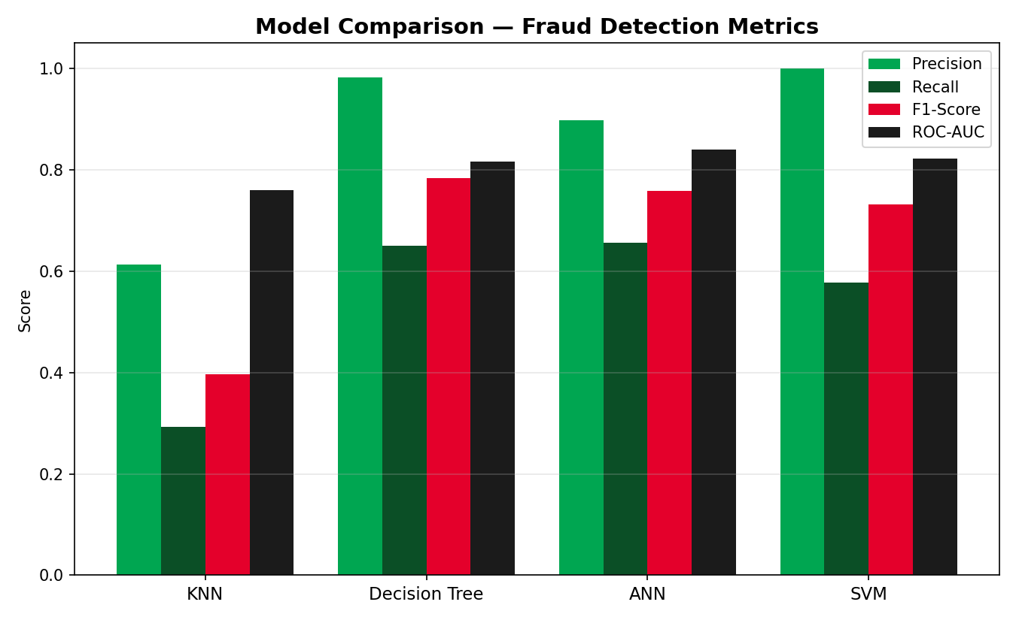
Model Evaluation & Comparison
Classification results on the full 24,000-transaction held-out test set
Model | Precision | Recall | F1 | ROC-AUC
KNN | 0.613 | 0.293 | 0.397 | 0.760
Decision Tree | 0.983 | 0.651 | 0.783 | 0.816
ANN (MLP) | 0.899 | 0.657 | 0.759 | 0.840
SVM | 1.000 | 0.577 | 0.732 | 0.823
Accuracy is not shown here on purpose — with only 2.9% fraud, all four models exceed 97% accuracy by simply favouring the majority class, so precision/recall/F1/AUC are the meaningful comparisons.
DAT 3202 · Machine Learning Mini Project · M-Pesa Fraud Detection
9

Slide 10
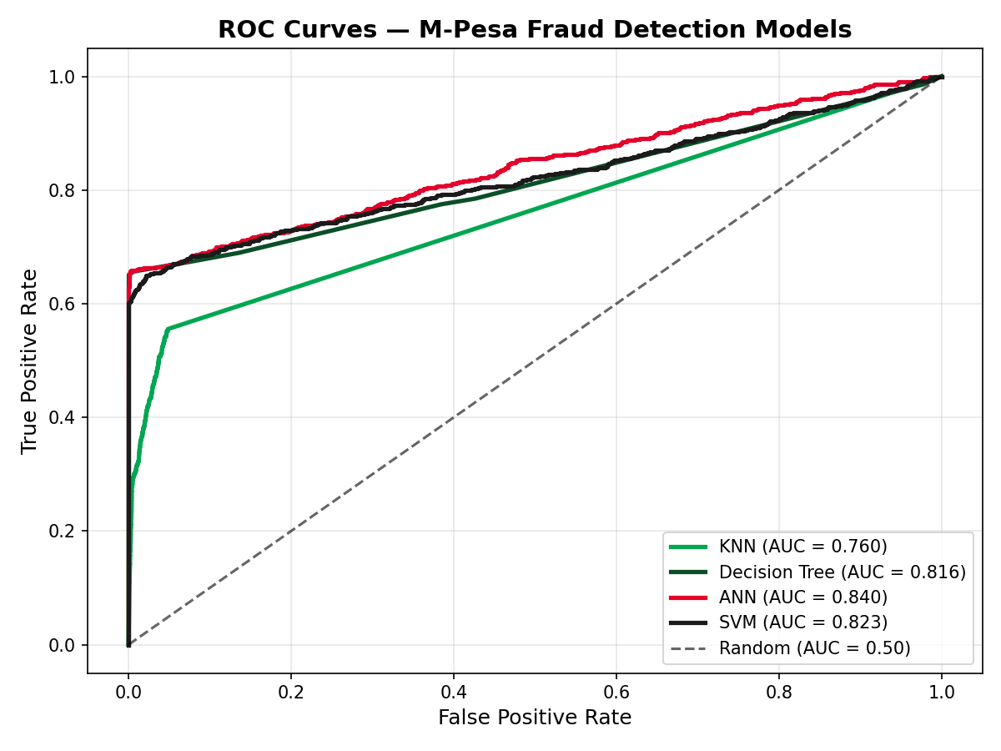
ROC Curve Comparison
Trade-off between true-positive and false-positive rate across thresholds
Reading the curves
ANN leads with the highest AUC (0.840), followed by SVM (0.823) and Decision Tree (0.816) — all clearly separating fraud from legitimate activity across thresholds.
KNN trails (AUC 0.760): distance-based matching struggles once the feature space mixes scaled balances with sparse one-hot channel flags.
All four models comfortably beat the random-classifier baseline (AUC 0.50), confirming genuine predictive signal in the engineered features.
DAT 3202 · Machine Learning Mini Project · M-Pesa Fraud Detection
10

Slide 11
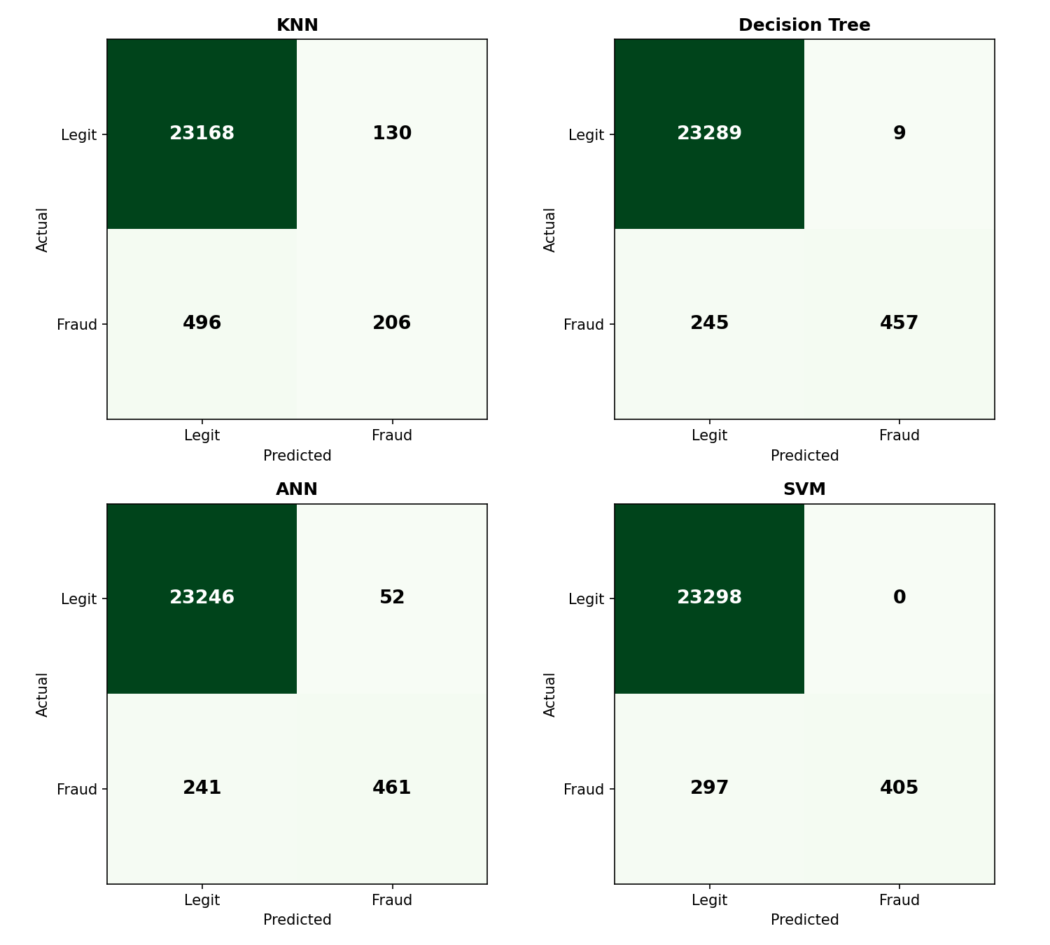
Confusion Matrices
Test-set errors at the default 0.5 probability threshold (24,000 transactions, 702 fraud)
What the errors mean for M-Pesa
Decision Tree catches the most fraud (457/702, recall 0.65) while keeping false alarms lowest (8) — the strongest overall balance.
SVM never flags a legitimate transaction as fraud (0 false positives, perfect precision), but still misses 297 fraud cases.
KNN misses the most fraud (496 false negatives) — the weakest choice if the priority is catching fraudulent transfers.
In production, missed fraud (false negatives) is usually costlier than a false alarm, so recall and F1 matter more than raw accuracy.
DAT 3202 · Machine Learning Mini Project · M-Pesa Fraud Detection
11

Slide 12
Discussion — Strengths & Weaknesses
KNN
Decision Tree
+ Simple, no training phase, easy to explain
+ Best F1 (0.783); interpretable rules agents/analysts can audit
− Weak on imbalanced, high-dimensional data; lowest F1 & AUC here
− Prone to overfitting without depth limits; single-tree instability
ANN (MLP)
SVM
+ Highest ROC-AUC (0.840); captures non-linear balance patterns
+ Perfect precision (1.00); zero false alarms in testing
− Needs more iterations to fully converge; least transparent model
− Misses more fraud than Decision Tree/ANN; costlier to scale to more data
DAT 3202 · Machine Learning Mini Project · M-Pesa Fraud Detection
12

Slide 13
Key Findings
Interpreting the results across all 24,000 test-set samples
Accuracy is misleading here
1
All models score 97–99% accuracy purely because fraud is only 2.9% of transactions — a model that predicts 'legitimate' every time would already score ~97%. Precision, recall, F1 and ROC-AUC tell the real story.
No single model dominates every metric
2
Decision Tree wins on F1 (0.783) and precision-recall balance; ANN wins on ROC-AUC (0.840) i.e. ranking quality; SVM wins on precision (1.00, zero false alarms). The right choice depends on the operating priority.
Balance-transfer features carry the signal
3
Sender/receiver balance-before/after fields are the dominant predictors — sudden balance drains or unusual receiver top-ups are the clearest fraud fingerprints in this dataset.
KNN is the weakest fit for this problem
4
Its reliance on raw distance is diluted by the mix of scaled numeric balances and sparse one-hot channel/device flags, and it has no natural way to weight feature importance.
DAT 3202 · Machine Learning Mini Project · M-Pesa Fraud Detection
13

Slide 14
Conclusion
Machine learning can reliably separate fraudulent from legitimate M-Pesa transactions even under severe class imbalance (2.9% fraud). Across KNN, Decision Tree, ANN and SVM — each tuned with 2-fold cross-validated grid search — the Decision Tree offered the best overall balance (F1 = 0.783), while the ANN ranked risk most reliably (ROC-AUC = 0.840) and the SVM produced zero false alarms.
Recommended path
Limitations
Future work
Deploy a Decision Tree (or ensemble of trees) as the primary screen, with ANN risk scores as a secondary ranking signal for manual review queues.
Synthetic dataset; no oversampling/undersampling (e.g. SMOTE) attempted; only 2-fold CV as required by the brief, which limits hyper-parameter stability.
Validate against real Safaricom transaction logs, test ensemble/boosting methods, and add SIM-swap or device-change signals not present in this dataset.
DAT 3202 · Machine Learning Mini Project · M-Pesa Fraud Detection
14

Slide 15
References
Botchey, F. E., Qin, Z., & Hughes-Lartey, K. (2022). An Evaluation of Machine Learning Methods to Predict Fraud in Mobile Money Transactions. International Journal of Engineering Research & Technology (IJERT).
Lokanan, M. (2023). Predicting mobile money transaction fraud using machine learning algorithms. Applied AI Letters, Wiley.
Mobile Money Fraud Prediction — A Cross-Case Analysis on the Efficiency of SVM, Gradient Boosted Decision Trees, and Naïve Bayes Algorithms. (2020). Information, MDPI, 11(8), 383.
GSMA (2023) & World Bank (2021), as cited in: Advanced fraud detection using machine learning models: enhancing financial transaction security. ResearchGate.
Jack, W., & Suri, T. Mobile Payments go Viral: M-PESA in Kenya. World Bank.
Dataset: calebboen. M-Pesa Transactions Fraud [Data set]. Kaggle. kaggle.com/datasets/calebboen/mpesa-transactions-fraud
scikit-learn developers. scikit-learn: Machine Learning in Python. (KNeighborsClassifier, DecisionTreeClassifier, MLPClassifier, LinearSVC, GridSearchCV, StandardScaler).
DAT 3202 · Machine Learning Mini Project · M-Pesa Fraud Detection
15

