Slide 1
Coding
Coding

Slide 2
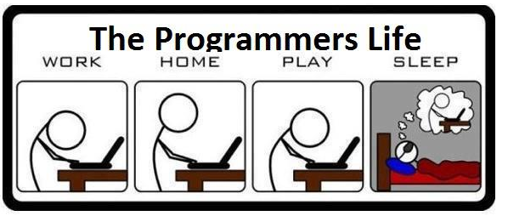
Coding

Slide 3
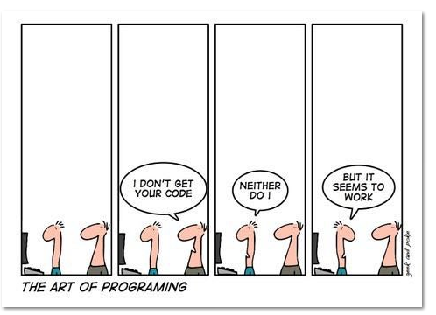
Coding

Slide 4
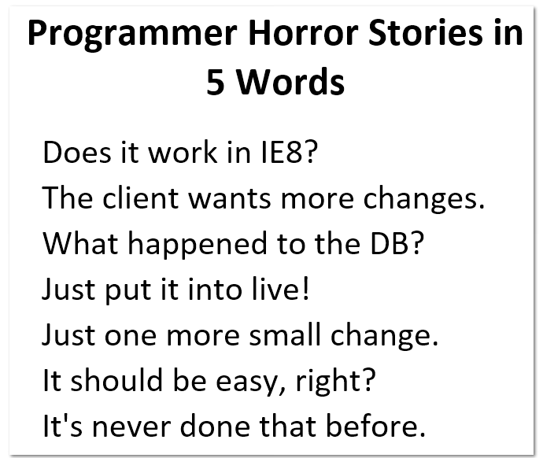
Coding

Slide 5
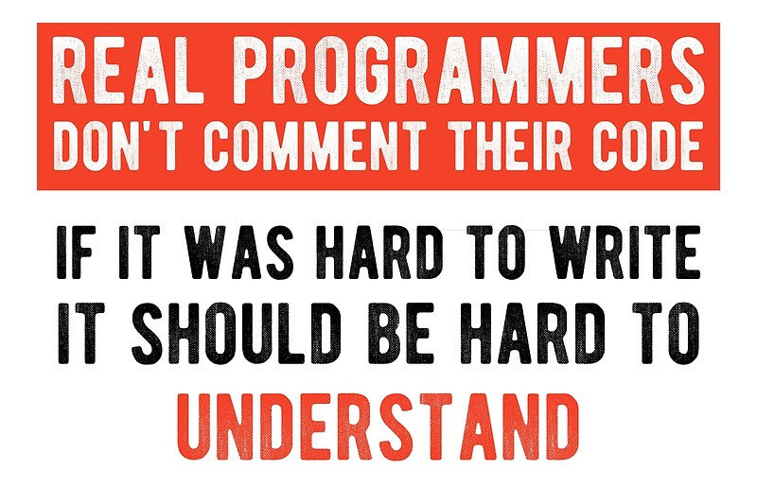
Coding

Slide 6
Some programming related quotes
Without requirements or design, programming is the art of adding bugs to an empty text file. (Louis Srygley)
It’s not a bug – it’s an undocumented feature. (Anonymous)
One man’s crappy software is another man’s full time job. (Jessica Gaston)
Coding

Slide 7
Always code as if the guy who ends up maintaining your code will be a violent psychopath who knows where you live. (Martin Golding)
Walking on water and developing software from a specification are easy if both are frozen. (Edward V Berard)
Coding

Slide 8
Coding
Goal is to implement the design in best possible manner
Coding affects testing and maintenance
As testing and maintenance costs are high, aim of coding activity should be to write code that reduces them
Hence, goal should not be to reduce coding cost, but testing and maintenance cost, i.e. make the job of tester and maintainer easier
Coding

Slide 9
Coding…
Code is read a lot more
  Coders themselves read the code many times for debugging, extending etc.
  Maintainers spend a lot of effort reading and understanding code
  Other developers read code when they add to existing code
Hence, code should be written so it is easy to understand and read, not easy to write!
Coding

Slide 10
Coding…
Having clear goal for coding will help achieve them
Weinberg experiment showed that coders achieve the goal they set
  Diff coders were given the same problem
  But different objectives were given to diff programmers – minimize effort, min size, min memory, maximize clarity, max output clarity
  Final programs for diff programmers generally satisfied the criteria given to them
Coding

Slide 11
Weinberg experiment..
 | Resulting Rank (1=best) O1 o2 o3 o4 o5
Minimize Effort (o1) Minimize prog size (o2) Minimize memory (o3) Maximize code clarity (o4) Maximize output clarity (o5) | 1 4 4 5 3 2-3 1 2 3 5 5 2 1 4 4 4 3 3 2 2 2-3 5 5 1 1
Coding

Slide 12
Programming Principles
The main goal of the programmer is write simple and easy to read programs with few bugs in it
Of course, the programmer has to develop it quickly to keep productivity high.
Some of the criteria to judge a program:
Readability,
Size of the program,
Execution time
Required memory
There are various programming principles that can help write code that is easier to understand (and test…)
Coding

Slide 13
Structured Programming
Structured programming started in the 70s, primarily against indiscriminate use of control constructs like gotos
Goal was to simplify program structure so it is easier to argue about programs
Is now well established and followed
Coding

Slide 14
Structured Programming…
A program has a static structure which is the ordering of statements in the code – and this is a linear ordering
A program also has dynamic structure –order in which statements are executed
Both dynamic and static structures are ordering of statements
Correctness of a program must talk about the dynamic structure
Coding

Slide 15
Structured Programming…
To show a program as correct, we must show that its dynamic behavior is as expected
But we must argue about this from the code of the program, i.e. the static structure
I.e program behavior arguments are made on the static code
This will become easier if the dynamic and static structures are similar
Closer correspondence will make it easier to understand dynamic behavior from static structure
This is the idea behind structured programming
Coding

Slide 16
Structured Programming…
Goal of structured programming is to write programs whose dynamic structure is same as static
I.e. stmts are executed in the same order in which they are present in code
As stmts organized linearly, the objective is to develop programs whose control flow is linear
Coding

Slide 17
Structured Programming…
Meaningful programs cannot be written as seq of simple stmts
To achieve the objectives, structured constructs are to be used
These are single-entry-single-exit constructs
With these, execution of the stmts can be in the order they appear in code
The dynamic and static order becomes same
Coding

Slide 18
Structured Programming…
Each structured construct should also have a clear behavior
Then we can compose behavior of stmts to understand behavior of programs
Hence, arbitrary single-entry-single-exit constructs will not help
It can be shown that a few constructs like while, if, and sequencing suffice for writing any type of program
Coding

Slide 19
Structured Programming…
SP was promulgated to help formal verification of programs
Without linear flow, composition is hard and verification difficult
But, SP also helps simplify the control flow of programs, making them easier to understand and argue about
SP is an accepted and standard practice today – modern languages support it well
Coding

Slide 20
Information Hiding
Software solutions always contain data structures that hold information
Programs work on these DS to perform the functions they want
In general only some operations are performed on the information, i.e. the data is manipulated in a few ways only
E.g. on a bank’s ledger, only debit, credit, check cur balance etc are done
Coding

Slide 21
Information Hiding…
Information hiding – the information should be hidden; only operations on it should be exposed
I.e. data structures are hidden behind the access functions, which can be used by programs
Info hiding reduces coupling
This practice is a key foundation of OO and components, and is also widely used today
Coding

Slide 22
Some Programming Practices
Control constructs: Use only a few structured constructs (rather than using a large no of constructs)
Goto: Use them sparingly, and only when the alternatives are worse
Info hiding: Use info hiding
Use-defined types: use these to make the programs easier to read
Coding

Slide 23
Some Programming Practices..
Nesting: Avoid heavy nesting of if-then-else; if disjoint nesting can be avoided
Module size: Should not be too large – generally means low cohesion
Module interface: make it simple
Robustness: Handle exceptional situations
Side effects: Avoid them, document
Coding

Slide 24
Some Programming Practices..
Empty catch block: always have some default action rather than empty
Empty if, while: bad practice
Correlated parameters: Should check for compatibility
Coding

Slide 25
Coding Standards
Programmers spend more time reading code than writing code
They read their own code as well as other programmers code
Readability is enhanced if some coding conventions are followed by all
Coding standards provide these guidelines for programmers
Generally are regarding naming, file organization, statements/declarations, …
Some Java conventions discussed here
Coding

Slide 26
Coding Standards…
Naming conventions
  Package name should be in lower case (mypackage, edu.iitk.maths)
  Type names should be nouns and start with uppercase (Day, DateOfBirth,…)
  Var names should be nouns in lowercase; vars with large scope should have long names; loop iterators should be i, j, k…
  Const names should be all caps
  Method names should be verbs starting with lower case (eg getValue())
  Prefix is should be used for boolean methods
Coding

Slide 27
Coding Standards…
Files
  Source files should have .java extension
  Each file should contain one outer class and the name should be same as file
  Line length should be less than 80; if longer continue on another line…
Coding

Slide 28
Coding Standards…
Statements
  Vars should be initialized where declared in the smallest possible scope
  Declare related vars together; unrelated vars should be declared separately
  Class vars should never be declared public
  Loop vars should be initialized just before the loop
  Avoid using break and continue in loops
  Avoid executable stmts in conditionals
  Avoid using the do… while construct
Coding

Slide 29
Coding Standards…
Commenting and layout
  Single line comments for a block should be aligned with the code block
  There should be comments for all major vars explaining what they represent
  A comment block should start with a line with just /* and end with a line with */
  Trailing comments after stmts should be short and on the same line
Coding

Slide 30
Common Coding Errors
Goal of programmer is to write quality code with few bugs in it
Much of effort in developing software goes in identifying and removing bugs
Common bugs which occur during coding directly or indirectly manifest themselves to a larger damage to the running program
List of common coding errors can help a programmer avoid them
Coding

Slide 31
Undeclared Variables
int main()
{
cin>>x;
cout<<x;
}
"Huh? Why do I get an error?"
Your compiler doesn't know what x means. You need to declare it as a variable.
int main()
{
int x;
cin>>x;
cout<<x;
}
Coding

Slide 32
Uninitialized variables
int count;
while(count<100)
{
cout<<count;
count++;
}
Remember to initialize your variables
Coding

Slide 33
Setting a variable to an uninitialized value
int a, b;
int sum=a+b;
cout<<"Enter two numbers to add: ";
cin>>a;
cin>>b;
cout<<"The sum is: "<<sum;
Coding

Slide 34
To fix this error, move the addition step after the input line.
int a, b;
int sum;
cout<<"Enter two numbers to add: ";
cin>>b;
cin>>a;
sum=a+b;
cout<<"The sum is: "<<sum;
Coding

Slide 35
Using a single equal sign to check equality
char x='Y';
while(x='Y')
{
//...
cout<<"Continue? (Y/N)";
cin>>x;
}
Coding

Slide 36
Undeclared Functions
int main()
{
menu();
}
void menu()
{
//...
}
Coding

Slide 37
Extra Semicolons
int x;
for(x=0; x<100; x++);
cout<<x;
Coding

Slide 38
Overstepping array boundaries
int array[10];
//...
for(int x=1; x<=10; x++)
cout<<array[x];
Coding

Slide 39
Misusing the && and || operators
int value;
do
{
//...
value=10;
}while(!(value==10) || !(value==20))
Coding

Slide 40
Memory Leaks
A memory leak is a situation, where the memory is allocated to the program which is not freed subsequently
Occurs frequently in the languages which do not have automatic garbage collection
Can cause increasing usage of memory which at some point of time can lead to exceptional halt of the program
E.g char* foo(int s)
  {
    Char *output;
    If(s>0)
      Output=(char*) malloc (size)
    If(s==1)
      Return NULL /* if s==1 then mem leaked */
    Return (output);
  }
Coding

Slide 41
Freeing an Already Freed Resource
Programmer tries to free the already freed resource
May be serious, if some malloc between the two free stmts as the freed location may get allocated to a new variable, and subsequent free will deallocate the new variable.
E.g main()
{
char *str;
      Str=(char *)malloc(10);
      If(global==0)
        free(str);
      free(str); /* str is already freed */
    }
Coding

Slide 42
NULL Dereferencing
Occurs when we access a location that points to NULL
Improper initialization and missing the initialization in different paths leads to the NULL reference error
Can also be caused by aliases- for e.g two variables refer to same object , and one is freed and an attempt is made to dereference the second
E.g char *ch=NULL;
  if (x>0)
  {
    ch=‘c’;
  }
  printf(“\%c”. *ch); /* ch may be NULL */
  *ch=malloc(size)
  ch=‘c’; /* ch will be NULL if malloc returns NULL */
Coding

Slide 43
NULL Dereferencing (accessing uninitialized memory)
NULL dereference is the error of accessing initialized memory
Often occurs if data is initialized in most cases, but most cases do not get covered
  E.g switch(i)
  {
    case 0: s=OBJECT_1; break;
    case 1: s=OBJECT_2; break;
  }
  return (s); /* s not initialized for values other than 0 or 1 */
Coding

Slide 44
Lack of Unique Addresses
Aliasing creates many problems among them is violation of unique addresses when we expect different addresses.
For e.g in the string concatenation function, we expect source and destination addresses to be different.
strcat (src , destn );
/* In above function , if src is aliased to destn , then we may get a runtime error */
Coding

Slide 45
Other common type of errors
Array index out of bounds, care needs to be taken to see that the array index values are not negative and do not exceed their bounds
Enumerated data types can lead to overflow and underflow errors, care should be taken while assuming the values of such types
    typedef enum {A, B,C, D} grade ;
    void foo( grade x){
    int l,m;
    l= GLOBAL_ARRAY [x -1];
    /* Underflow when A */
    m= GLOBAL_ARRAY [x +1];
    /* Overflow when D and size of array is 4 */
    }
Coding

Slide 46
Other common type of errors..
Arithmetic exceptions, include errors like divide by zero and floating point exceptions
Off by one errors like starting variable at 1 instead of starting at 0 or vice versa, writing <= N instead of < N or vice versa etc.
String handling errors like failure of string handling functions e.g strcpy, sprintf, gets etc.
Coding

Slide 47
Coding Process
Coding starts when specs for modules from design is available
Usually modules are assigned to programmers for coding
In top-down development, top level modules are developed first; in bottom-up lower levels modules
For coding, developers use different processes; we discuss some here
Coding

Slide 48
An Incremental Coding Process
Basic process: Write code for the module, unit test it, fix the bugs
It is better to do this incrementally – write code for part of functionality, then test it and fix it, then proceed
I.e. code is built for a module incrementally
Coding

Slide 49
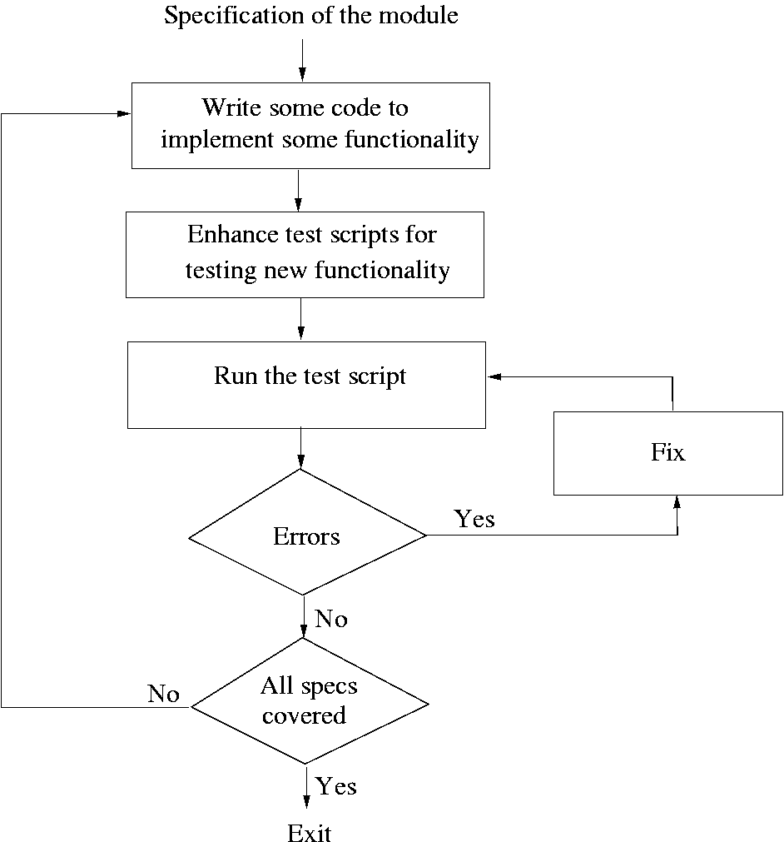
Coding

Slide 50
Test Driven Development
This coding process changes the order of activities in coding
In TDD, programmer first writes the test scripts and then writes the code to pass the test cases in the script
This is done incrementally
Is a relatively new approach, and is a part of the extreme programming (XP)
Coding

Slide 51
TDD…
In TDD, you write just enough code to pass the test
I.e. code is always in sync with the tests and gets tested by the test cases
  Not true in code first approach, as test cases may only test part of functionality
Responsibility to ensure that all functionality is there is on test case design, not coding
Help ensure that all code is testable
Coding

Slide 52
TDD…
Focus shifts to how code will be used as test cases are written first
  Helps validate user interfaces specified in the design
  Focuses on usage of code
Functionality prioritization happens naturally
Has possibility that special cases for which test cases are not possible get left out
Code improvement through refactoring will be needed to avoid getting a messy code
Coding

Slide 53
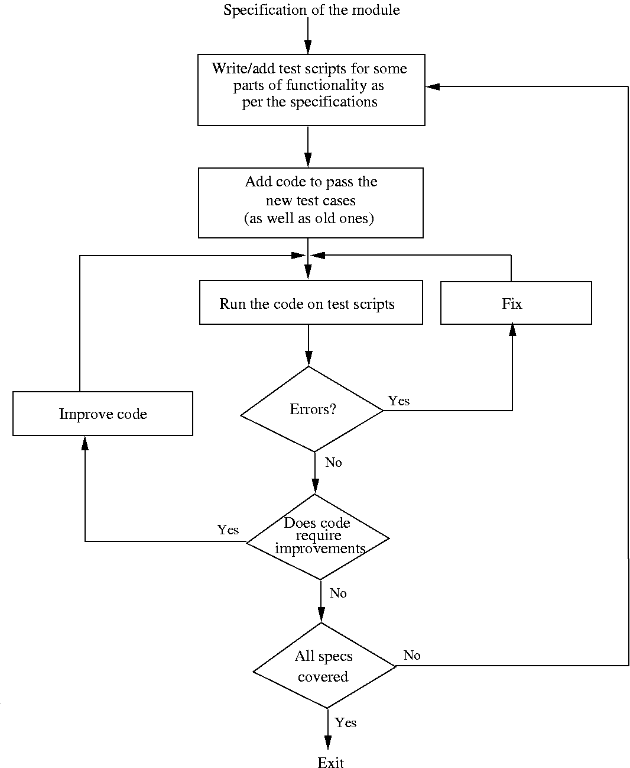
Coding

Slide 54
Pair Programming
Also a coding process that has been proposed as key practice in XP
Code is written by pair of programmers rather than individuals
  The pair together design algorithms, data structures, strategies, etc.
  One person types the code, the other actively reviews what is being typed
  Errors are pointed out and together solutions are formulated
  Roles are reversed periodically
Coding

Slide 55
Pair Programming…
PP has continuous code review, and reviews are known to be effective
Better designs of algos/DS/logic/…
Special conditions are likely to be dealt with better and are not forgotten
It may, however, result in loss of productivity
Ownership and accountability issues are also there
Effectiveness is not yet fully known
Coding

Slide 56
Source Code Control and Built
Source code control is an essential step programmers have to do
Generally tools like CVS, VSS are used
A tool consists of repository, which is a controlled directory structure
The repository is the official source for all the code files
System build is done from the files in the repository only
Tool typically provides many commands to programmers
Coding

Slide 57
Source code control…
Checkout a file: by this a programmer gets a local copy that can be modified
Check in a file: changed files are uploaded in the repository and change is then available to all
Tools maintain complete change history and all older versions can be recovered
Source code control is an essential tool for developing large projects and for coordination
Coding

Slide 58
Verification
Code has to be verified before it can be used by others
Here we discuss only verification of code written by a programmer (system verification is discussed in testing)
There are many different techniques; key ones – unit testing, inspection, and program checking
Program checking can also be used at the system level
Coding

Slide 59
Code Inspections
The inspection process can be applied to code with great effectiveness
Inspections held when code has compiled and a few tests passed
Usually static tools are also applied before inspections
Inspection team focuses on finding defects and bugs in code
Checklists are generally used to focus the attention on defects
Coding

Slide 60
Code Inspections…
Some items in a checklist
  Do all pointers point to something
  Are all vars and pointers initialized
  Are all array indexes within bounds
  Will all loops always terminate
  Any security flaws
  Is input data being checked
  Obvious inefficiencies
Coding

Slide 61
Code inspections…
Are very effective and are widely used in industry (many require all critical code segments to be inspected)
Is also expensive; for non critical code one person inspection may be used
Code reading is self inspection
  A structured approach where code is read inside-out
  Is also very effective
Coding

