Slide 1
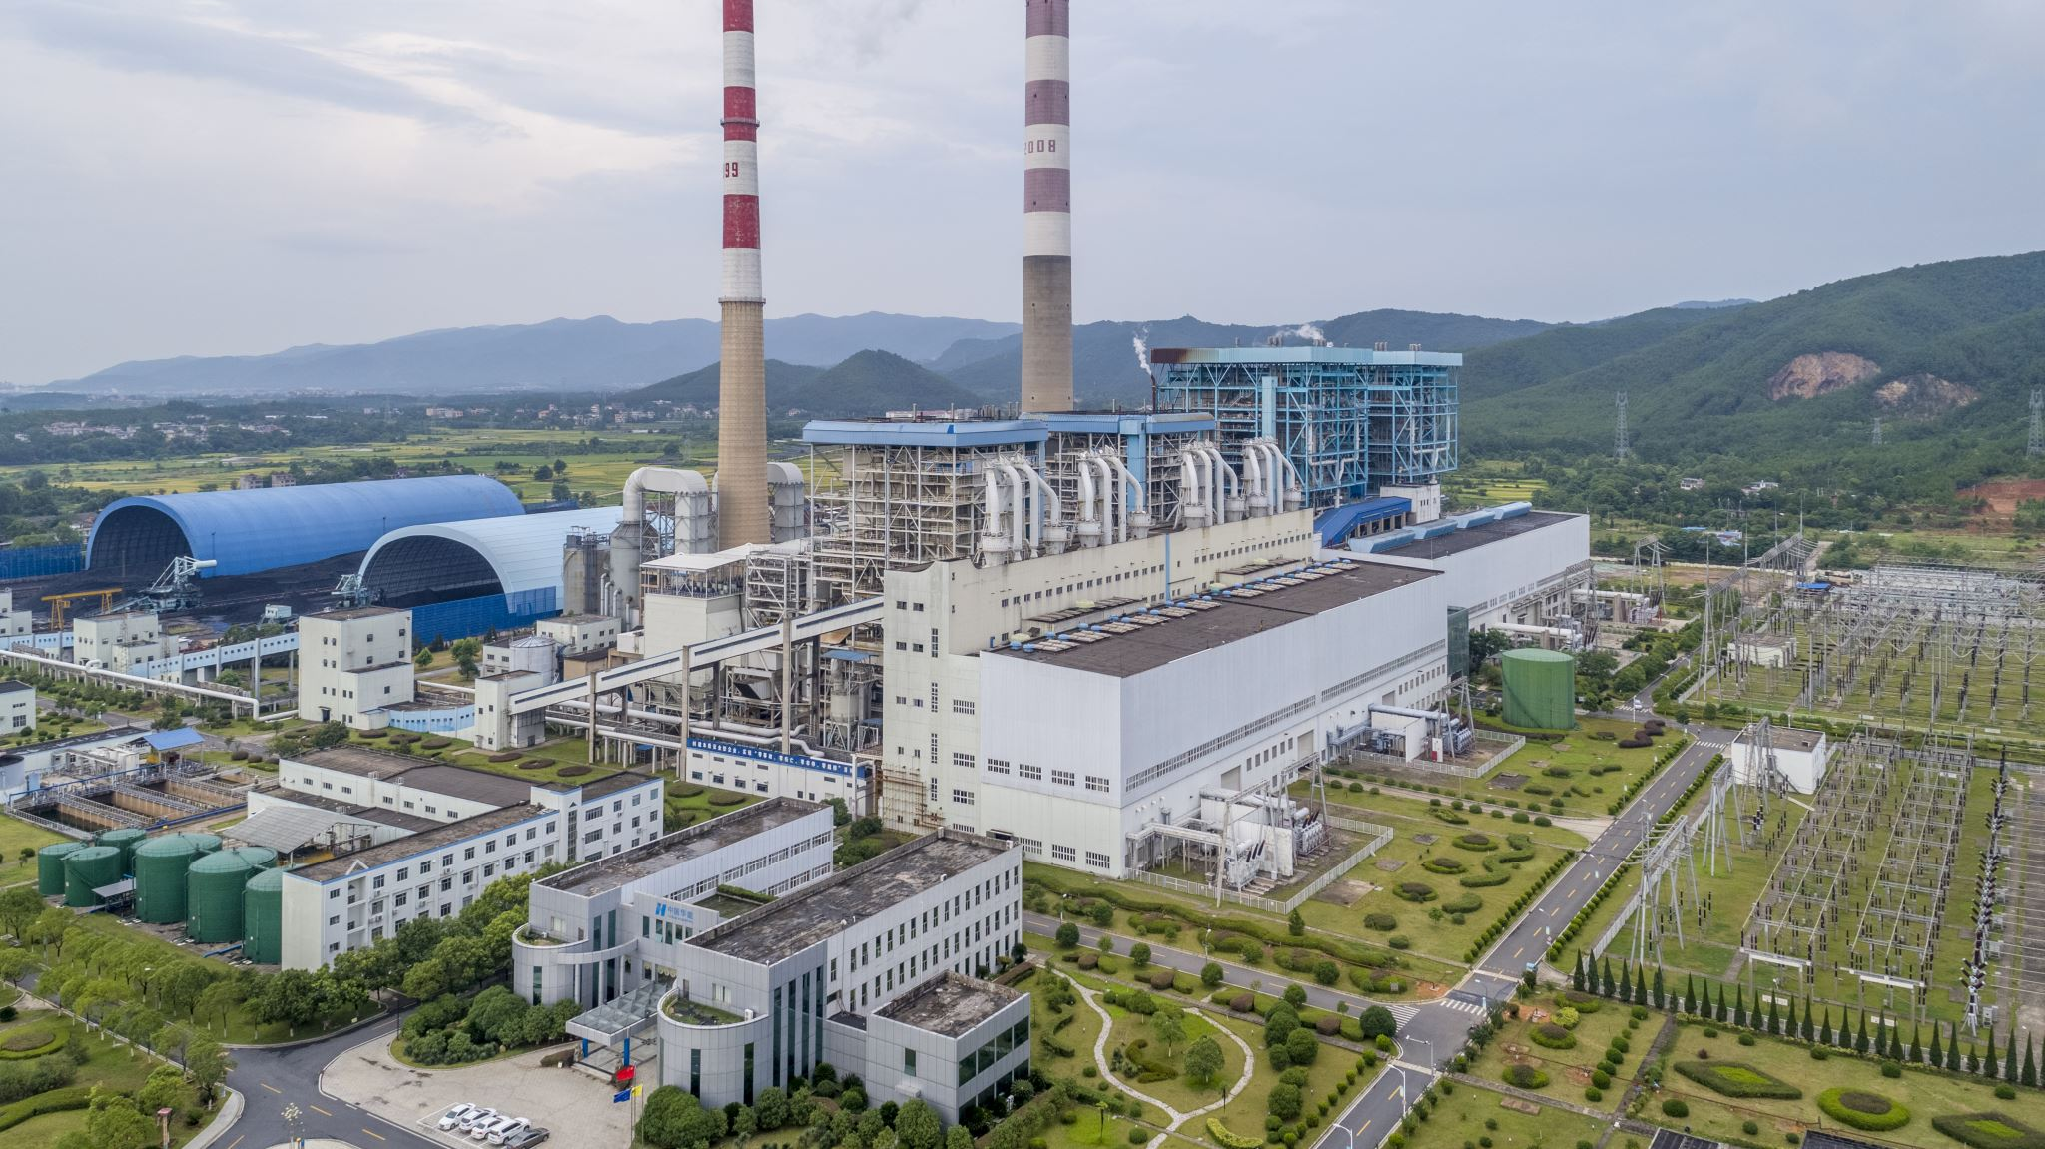
Omdena Chennai Electricity Power Outage Analysis
Task01-Satellite Data Extraction

Slide 2
Steps to extract data from Google Earth Engine
Request access to GEE using your gmail ID to access their APIs
Once access is provided, choose the API that is required to extract data from. In this case, WRI/GPPD/power_plants is the collection that we would be interested in
Open the code editor and paste the code that is generated after you choose the API.
Tweak the generated code according to the ask
Extract the data in form of CSV using the options to download it either a Google drive or S3 bucket of your choice

Slide 3
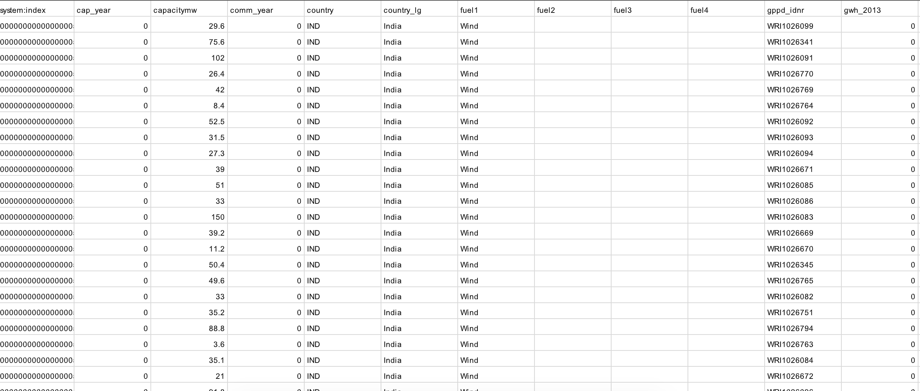
Data Extracted Sample File

Slide 4
References
https://drive.google.com/drive/u/0/folders/1wupadDrarxVHLLtSLhACUrDSEU80xuhd
https://earthengine.google.com/

