Slide 1
Introduction to: Files, Filesystems, and Disks
Moshe Caplan
moshecaplan@isis.poly.edu
Winter 2012

Slide 2
What is a File?
A computer file is a block of arbitrary information, or resource for storing information, which is available to a computer program and is usually based on some kind of durable storage. A file is durable in the sense that it remains available for programs to use after the current program has finished. Computer files can be considered as the modern counterpart of paper documents which traditionally are kept in offices' and libraries' files, and this is the source of the term.
--Wikipedia
Questions:
How are files stored?
How do we retrieve them?
Definition obtained from: http://en.wikipedia.org/wiki/Computer_file

Slide 3
How are files stored?
At a low level, files are stored as a bunch of bytes on a hard drive (or other storage media)
However, hard drives don’t understand “files”
Hard drives simply contain a huge collection of bytes of data
We need some way to retrieve the bytes composing our file from the hard drive
That’s where filesystems come in

Slide 4
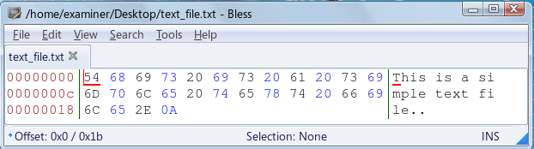
Human vs. Hard Drive View of a File
Left Side: Hard Drive View
Actually, data would be further converted from hex to binary (1 and 0)
Right Side: Human View
Data is converted into human readable characters

Slide 5
Filesystems

Slide 6
Filesystems
A filesystem is the middleman between users who only understand files and disks that only understand bytes and addresses
Responsible for organizing the data on a disk
To ensure efficient storage and retrieval
Data organized in a hierarchy of files and directories
Analogy: Filing system in a medical office
Files organized by last name to promote efficient storage and retrieval

Slide 7
More about Filesystems
Filesystems are OS dependant
Responsibilities
Creating files
Deleting files
Retrieving files
Generally, a filesystem will maintain an index of files
The index contains the name of the file, address of the actual data blocks, and other useful info
The index is similar to a phone book
The index is also stored on the hard drive

Slide 8
Common Filesystems
Windows
FAT32
NTFS
Apple Mac
HFS
HFS+
Linux
ext2
ext3
DVD
UDF
USB Drives
FAT32

Slide 9
Example Filesystem: FAT32
Overview
Really just a version of the FAT filesystem
Other versions are FAT12 and FAT16
One of the most simple filesystems
Usage:
Older versions of Windows (before XP)
USB Drives
Digital Camera Memory Cards

Slide 10
FAT32
Components
FAT (File Allocation Table)
Data Blocks
Directory Entries
Stored within the data blocks
Layout of a drive using FAT32:
Reserved Area contains filesystem information
Reserved Area | FAT | Data Blocks

Slide 11
FAT32 Data Structures (1)
FAT (File Allocation Table)
Maintains allocation status of each data block
Links each block with the following block in large files
There is one entry for each data block in the filesystem. That entry contains the location of the following block in a given file or indicates that it is the last block in the file.
There is a primary and backup FAT

Slide 12
FAT Data Structures (2)
Directory Entries
Contains file name, size, metadata, and starting address of file contents
Stored within the data blocks
Analogy: Phone Book
Data Blocks
Clusters containing the actual file contents

Slide 13
FAT File Allocation (1)
Directory Entry Added
Containing file name and location of first cluster
Data Blocks Allocated
Number of blocks depends on file size
FAT Updated
Each entry points to the next block of the file

Slide 14
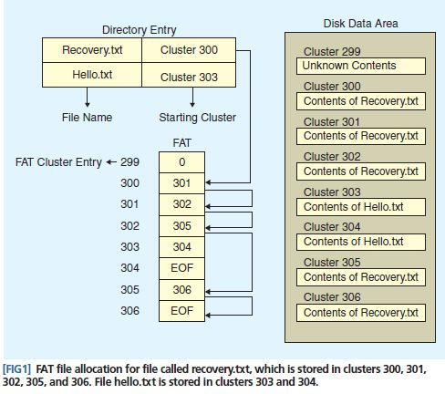
FAT File Allocation (2)
Image Obtained From: http://digital-assembly.com/technology/research/pubs/ieee-spm-2009.pdf

Slide 15
Related Topics
Volume Layout – Partitions
PC Boot Process
Memory vs. Hard Disk

Slide 16
Volume Layout - Partitions
A disk can be split up into multiple sections
Each section is called a partition
Ex. On Windows your “C” and “D” drives are each a partition
Each partition can have a different filesystem
MBR (Master Boot Record)
Generally in first 512 bytes (first sector) of volume
Boot Code
4 Entry Partition Table
Specifies the partitions on the volume
More information on the MBR (including layout) can be found at:
http://en.wikipedia.org/wiki/Master_boot_record
MBR | Partition 1 | Partition 2

Slide 17
Viewing the MBR (1)
One of the easiest ways to view the contents of the MBR is using the “mmls” command
A component of “The Sleuth Kit” (TSK)
http://cyfor.isis.poly.edu/modules/tsk-autopsy
You will need to specify the volume you are looking at.
On Linux it will generally be /dev/sda
You could also look at the first 512 bytes of a disk (see video)
DO NOT MODIFY ANYTHING IN THE MBR
Your computer may not boot if you do

Slide 18
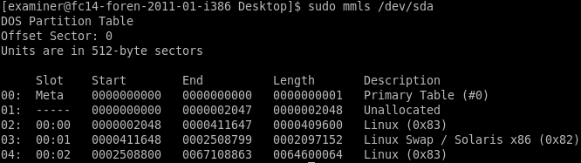
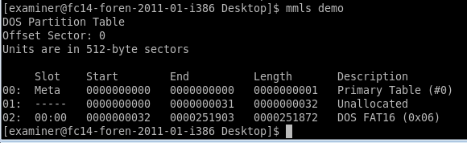
Viewing the MBR (2)
CERT ADIA MBR
128 MB Flashdrive MBR

Slide 19
PC Boot Process
Power On
BIOS (Basic Input Output Sequence)
Hardcoded into the firmware
POST (Power-On Self-Test)
Identifies and Initializes System Devices
Hard Drive, Keyboard, Video Card, etc.
BIOS finds a non-volatile bootable device
Generally your hard drive
Loads the boot sector and passes off control
More detailed discussion:
http://www.webopedia.com/DidYouKnow/Hardware_Software/2004/BootProcess.asp

Slide 20
Memory vs. Hard Disks
Two types of storage on a computer
Hard Disk
Long term storage
Non-Volatile (Can retain data without power)
Memory
RAM
Temporary storage
Volatile (Can’t retain data without power)
Stores things that are currently being used
Files being presently modified
Open programs
Running processes

