Slide 1
Steganography & Steganalysis: The Art of Message Hiding
Marc Budofsky
September 11, 2012

Slide 2
Agenda
Background
Application
Encoding an Image
Decoding an Image
Analyzing an Image
Conclusion

Slide 3
Background
Steganography is the art of hiding data in such a way that only the sender and intended recipient are aware of it's existence
Dates back to 440 BC: Message was written on a wooden tablet that was then dipped into wax.
Steganalysis is the art of detecting hidden steganographic messages
Similar to Cryptanalysis and Cryptography

Slide 4
Application
Python Script
Requires Python Image Library (PIL) (http://www.pythonware.com/products/pil/)
Command Line Options or Interactive Menu
Functions
Encode Image:
Sequentially (Row by Row)
Pseudorandomly (Determined by User Defined Keyword)
Decode Image
Analyze Image (Steganalysis)

Slide 5
Using the Command Line
Usage: $ python Stegonagraphy.py [options] image <message>
Options:
-e, --encode Encode an Image
-d, --decode Decode an Image
-a, --analyze Analyze an Image
--encrypt=ENCRYPTIONKEY
Encryption Key
--rnd=RNDKEY Random Key
--debug Enable Debug Output
Arguments:
Image: Name of Image File to be Encoded, Decoded or Analyzed
Message: If Encoding, Name of Text File to be Embedded
One of these options
is required. Program will
fallback to interactive menu
if absent
Optional choices to
add additional functionality

Slide 6
Understanding the Options
Encryption Key
The application has a Vigenere cipher built-in to allow for message encryption before it is encoded in the image.
If a key is provided for the `--encrypt=ENCRYPTIONKEY` option or entered during execution, the message is automatically encrypted.
Random Key
The application encodes the message in 2 ways: sequentially or pseudorandomly.
If a key is provided for the `--rnd=RNDKEY` option or entered during execution, pseudorandom distribution is selected. If the key is absent, sequential encoding is used.

Slide 7
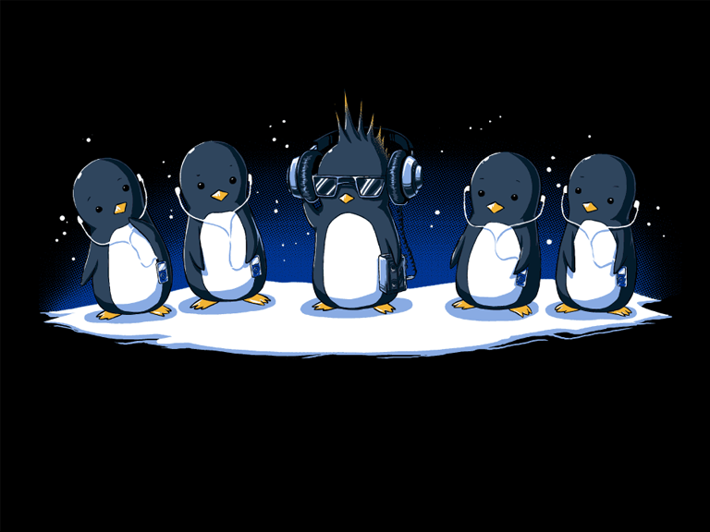

Encoding an Image
Cover Image
$ python Steganography.py –e <Cover Image> <Message>
OR
$ python Steganography.py --encode <Cover Image> <Message>
OR
$ python Steganography.py
$ Menu Selection: 1
$ Cover Image File: <Cover Image>
$ Encrypt Message (Y/N): <Y/N>
$ Random Key: [Optional]
$ Message: <Message>
$ Encoded Image Filename: <Output Image>
Output Image

Slide 8
Decoding an Image
$ python Steganography.py –d <Image>
OR
$ python Steganography.py --decode <Image>
OR
$ python Steganography.py
$ Menu Selection: 2
$ Stego Image File: <Image>
$ Is Message Encrypted (Y/N): <Y/N>
$ Stego Key: [Optional]

Slide 9
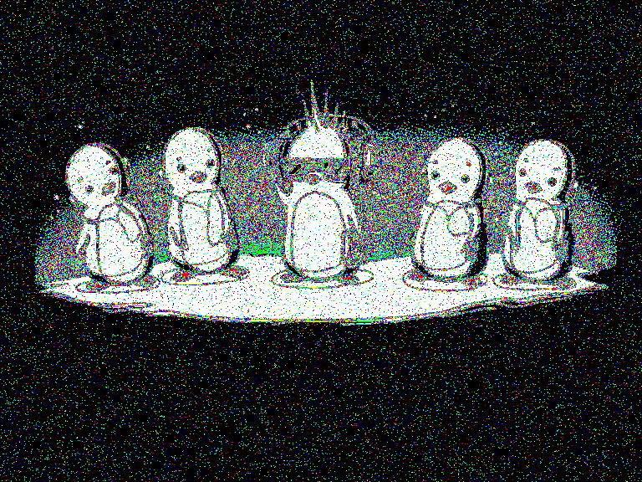
Analyzing an Image
Stego Image
$ python Steganography.py –a <Image>
OR
$ python Steganography.py --analyze <Image>
OR
$ python Steganography.py
$ Menu Selection: 3
$ Stego Image File: <Image>
$ Analyzed Image Filename: <Output Image>
$ Attempt to Decode? (Y/N): <Y/N>
$ Brute Force Attack? (Y/N): <Y/N>
Analysis Image

Slide 10
Conclusion
Simple script to provide in-depth view of Steganography and Steganalysis
Ability to create and distribute encoded messages to protect against eavesdroppers
Additional Tools:
S-Tools <http://www.spychecker.com/program/stools.html>
Virtual Steganography Laboratory (VSL) <http://vsl.sourceforge.net/>

