Slide 1

DSSA • DEPARTMENT OF AI & DATA SCIENCE
IDEA SUBMISSION PPT | 24-HOUR ONLINE HACKATHON
TEAM NAME
ReadmitFlow
TEAM LEADER NAME
Sarvesh Haldikar
PROBLEM STATEMENT TITLE
Predictive Hospital Readmission Risk for Chronic Disease Patients
THEME
Meditech

Slide 2



1
Problem Statement
• High Readmission Burden in India: In India, chronic disease patients (diabetes, hypertension, COPD, cardiovascular conditions) face 18–25% 30-day unplanned readmission rates, driving catastrophic out-of-pocket healthcare expenses (exceeding ₹1.2–2.5 Lakhs per episode) and straining hospital bed capacity.
• The 'Black-Box' Trust Barrier: Existing predictive AI tools generate isolated risk percentages without plain-language clinical explanations, breeding physician skepticism, alert fatigue, and low adoption in fast-paced clinical environments.
• Fragmented Discharge & Follow-up Protocols: Care teams and coordinators lack integrated digital systems connecting risk scores with standardized post-discharge actions, follow-up capacity management, and structured shift handoffs.
IDEA
TITLE
01
2
Existing Solution
• Static Scoring Heuristics (LACE / HOSPITAL Index): Manual linear point checklists that miss non-linear vitals, lab interactions, and multi-morbidity patterns, leading to poor discriminative accuracy for chronic care.
• Opaque Proprietary EHR Risk Engines: Deliver unexplainable probability scores without factor attribution, data-completeness validation, or audit trails for clinician overrides.
• Disjointed Workflows & Unmonitored Capacity: Follow-up tasks slip through during shift changes due to unstructured notes, lack of coordinator capacity tracking, and no persistent audit trail.
02
Team Name: ReadmitFlow

Slide 3
1
Proposed Solution
01. Explainable Risk Stratification & Drivers
• Machine learning scoring trained on encounter features (prior utilization, comorbidities, vitals).
• Transparent plain-language risk factors (e.g. '3 prior ER visits in 12m', 'High acute LOS').
• Instant clinical interpretation replacing confusing black-box scores for chronic care.
02. Prediction Confidence & Data-Quality Guard
• Real-time data integrity guard flagging missing fields, sparse data, or abnormal vitals.
• Clinical honesty boundary: explicit 'Demo Only' notices and model limitation transparency.
• Ensures clinical staff know exactly when input data is complete or uncertain.
03. Actionable Templates & Human-in-the-Loop Override
• Evidence-based follow-up templates (48h Phone Call, Med Reconciliation, Outpatient Slot).
• Clinicians retain 100% final authority: adjust recommendations or change risk priority.
• Immutable, timestamped audit trail recording staff member, action, and rationale.
04. Care Capacity Planner & 1-Click Shift Handoff
• Daily capacity allocator prevents care coordinator burnout by enforcing slot limits.
• 1-Click Shift Handoff generation in PDF (jsPDF), CSV, and TXT with safety notices.
• Ensures seamless nursing transitions and zero dropped patient follow-ups.
03
Team Name: ReadmitFlow

Slide 4
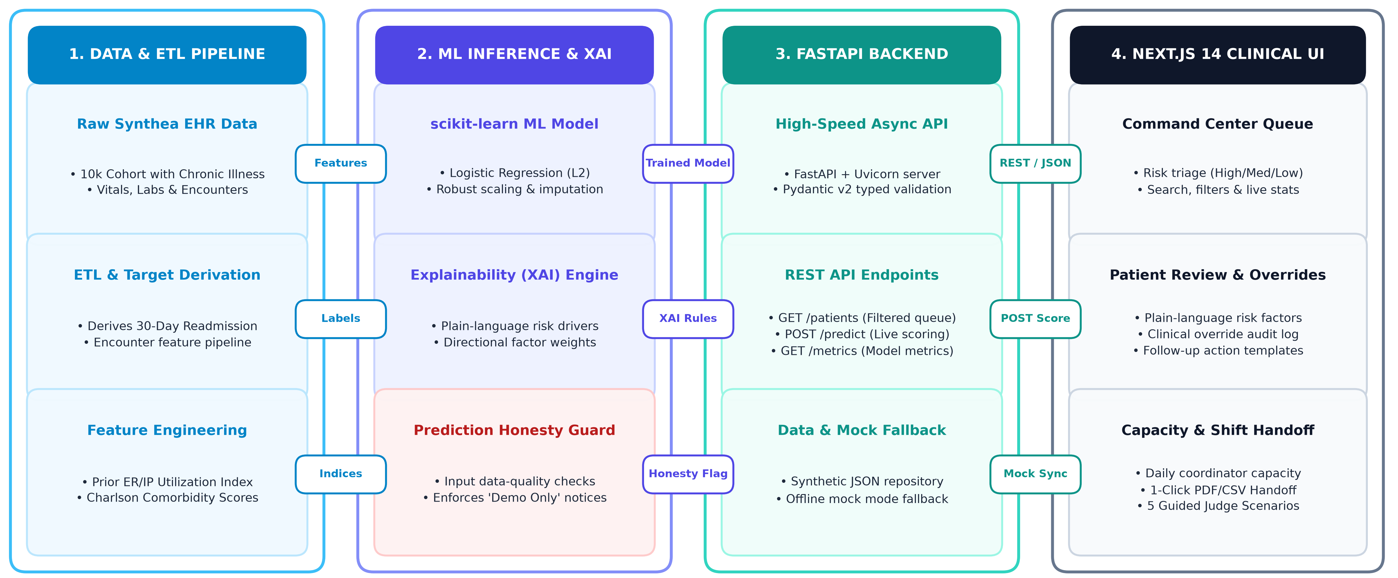
1
Architecture/Block diagram/Flow Diagram
04
Team Name: ReadmitFlow

Slide 5


04
Impact & Benefits
1
Technological Stack
Frontend & UI Experience
• Next.js 14 (App Router) & React 18
• TypeScript for strict end-to-end typing
• Tailwind CSS 3 & shadcn/ui (Radix)
• Lucide React Icons & jsPDF Client Engine
Backend API & ML Services
• FastAPI & Uvicorn Async Web Server
• Pydantic v2 Schema Validation Contracts
• scikit-learn Baseline & Logistic Regression
• pandas, NumPy & joblib Model Serialization
Data, DevOps & Cloud Hosting
• Synthea Synthetic EHR ETL Pipeline
• Docker & Docker Compose Orchestration
• Render (Containerized API Backend)
• Vercel (Edge Hosted Next.js Frontend)
2
Impacts and Benefit
Clinical Efficacy
15–25% reduction in preventable 30-day readmissions through early, risk-stratified post-discharge interventions.
Care Team Efficiency
Capacity-aware slot allocation prevents staff burnout; 1-click PDF/CSV handoffs eliminate shift transition errors.
Safety & Clinician Trust
Plain-language drivers + data-quality flags + 100% human-approved action audit trails ensure safe decision support.
Financial & Social ROI
Prevents catastrophic out-of-pocket costs for families, optimizes hospital bed turnover, and reduces uncompensated care.
05
Team Name: ReadmitFlow

Slide 6
05
Research & References
1
Demo Video link , website URL, documents to be used.
Live Deployments & Interactive Links
• Frontend App: https://readmitflow.vercel.app/
• Backend API: https://readmitflow-backend.onrender.com
• Swagger / OpenAPI: https://readmitflow-backend.onrender.com/docs
• GitHub Repository: https://github.com/Omega-127/ReadmitFlow
• Offline Fallback: Built-in mock mode guarantees 100% demo uptime without network
Project Documentation & Guides
• ARCHITECTURE.md: End-to-end system design, module contracts, and ETL pipelines
• DEPLOYMENT.md: Multi-cloud deployment instructions & Docker Compose setup
• data-dictionary.md: Clinical feature definitions, data types, and synthetic mappings
• demo-script.md: Judge presentation flow with 5 guided clinical demo scenarios
• Model & Safety Page: In-app metrics, confusion matrix, and safety boundaries
Clinical Research & References
• Chronic Disease & Readmission: Epidemiological studies on COPD, Diabetes, and Heart Failure readmission patterns in Indian tertiary care
• Synthea™ Patient Simulator: Walonoski et al., 'Synthea: Synthetic electronic health record simulator', JAMIA 2018
• Explainable AI (XAI): Lundberg et al., 'Explainable machine learning in healthcare', Nature Biomedical Eng.
• I-PASS Handoff Study: Starmer et al., 'Changes in Medical Errors with a Handoff Program', NEJM 2014
06
Team Name: ReadmitFlow

Slide 7
THANK YOU
Team Name: ReadmitFlow | Team Leader: Sarvesh Haldikar
PRARAMBHA 2.0 — DSSA, Department of AI & DS, D.K.T.E.S. IET, Ichalkaranji

