Slide 1
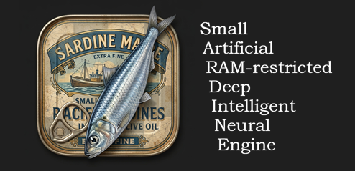
SARDINE: Chess AI Under Hard Memory Limits
Small Artificial RAM-restricted Deep Intelligent Neural Engine
ICTP Internship · July 2026
Notes:
Open with the constraint story: we target strong chess on a microcontroller with less RAM than a JPEG.

Slide 2
The Hardware Ceiling
Resource | Wio Terminal | Why it matters
CPU | 120 MHz (SAMD51) | Eval latency caps search depth
RAM | 192 KB | TT must dominate; accumulators ~16 KB
Flash | 512 KB | Weights ~10% after int8 + L1 prune
Move budget | ~1 second | Urusov ESP32 baseline ~20 kNps (no NNUE)
Target | ≥ 1700 Elo | Dog (ESP32) proves feasibility at ~320 KB RAM
192 KB RAM
< one JPEG image
Notes:
Frame the problem viscerally: total RAM is smaller than a single photo file.

Slide 3
What the Kaggle Challenge Taught Us
FIDE & Google Efficient Chess AI — 5 MiB RAM, 64 KiB binary cap
NNUE won at the top
Micro int8 nets + king mirroring + geometric zeros beat pure HCE for peak Elo.
RAM = search depth
Winners gutted history/hash tables to free 512 KB–1 MiB for the transposition table.
Buckets help
2nd place Approvers: 8 output buckets by piece count in ~45 KB net.
C over C++
Cfish base — lower runtime overhead; informs SARDINE's planned C port.
Notes:
Cite linrock (1st), Approvers (2nd). Consensus: quantized NNUE + TT-heavy RAM + C implementation.

Slide 4
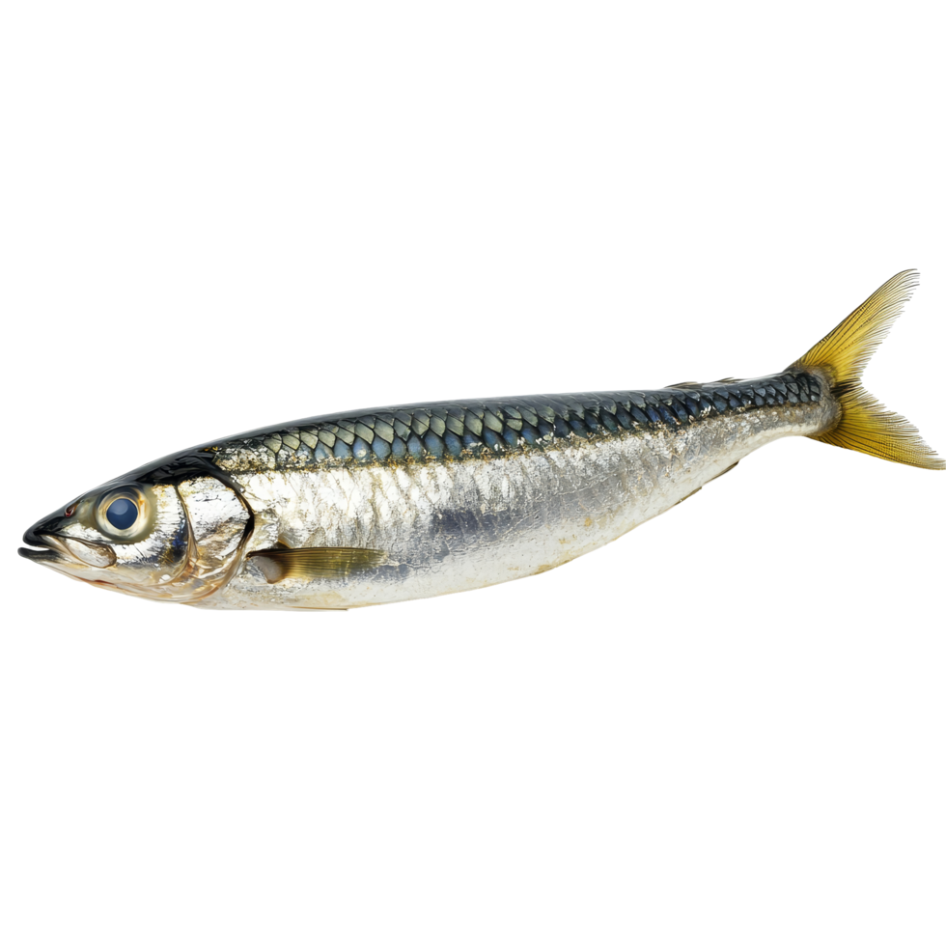
Principle | Kaggle (5 MiB) | SARDINE (192 KB)
Eval | Micro NNUE, int8, buckets | 844-dim bucketed NNUE + MoE (8 experts)
RAM layout | TT 512 KB – 1 MiB | TT-dominant 128–160 KB
Compression | King mirror, pawn-rank zeros | Same + gradual L1 prune 70–80%
Runtime | Cfish / C port | C engine after PC bring-up
Search | LMR, null-move, SPSA | Alpha-beta v0.3 → full stack + SPSA
Design
Principles
We Adopted
Notes:
Same ideas as Kaggle winners, scaled down 25× on RAM.

Slide 5
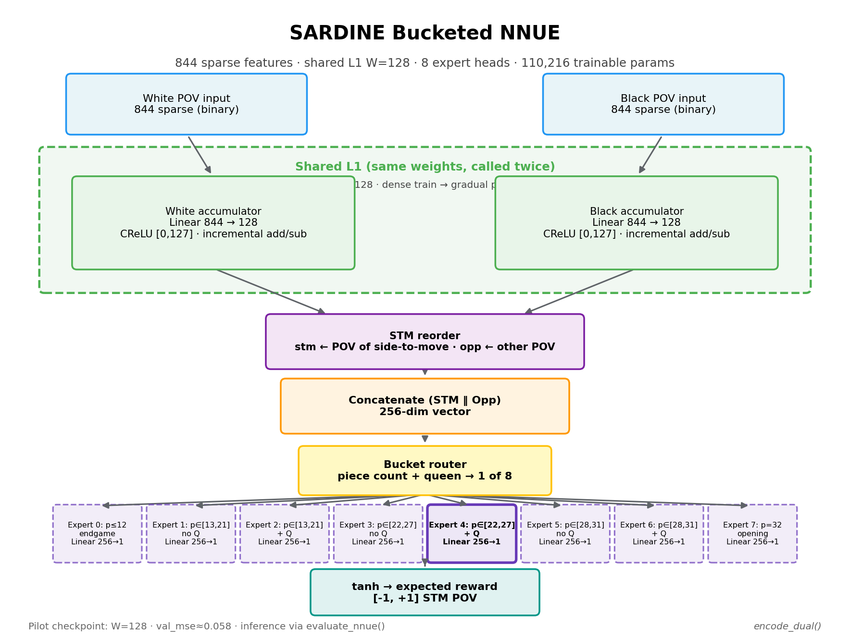
Evaluation: Bucketed
NNUE + MoE
844 sparse features (716 base + 128 tactical) · dual perspective
Shared L1: 844 → W (W=128) · CReLU hidden · tanh LUT → expected reward [−1, +1]
8 expert heads routed by piece count (+ queen-split at p ≤ 12)
Notes:
Teacher: Lc0 WDL (expected_reward = W − L). Production training via label_positions.py.

Slide 6
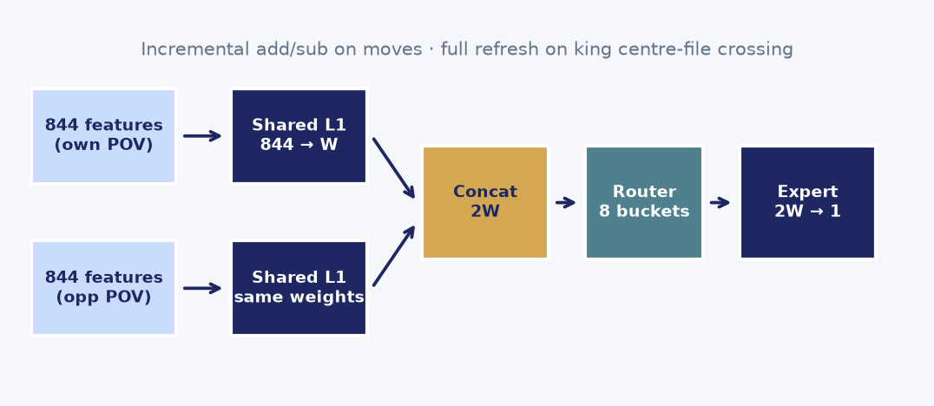
Shared L1 Accumulator
Same pruned L1 weights called twice (own POV + mirrored opponent POV)
Incremental add/sub on piece moves — bucket-agnostic shared layer
Lazy full refresh only when the king crosses the centre fil
Notes:
Incremental updates are why NNUE fits MCU budgets.

Slide 7
Alpha-Beta Search (v0.3)
Implemented now
Fixed-depth negamax alpha-beta
Capture quiescence at leaf nodes
MVV-LVA move ordering
Perft validated: d5 = 4,865,609 nodes
HCE default; NNUE via --eval nnue
Roadmap
Futility pruning + LMR + null-move
Lazy evaluation (paired with accumulators)
Iterative deepening with stable TT
Killer moves (depth > 4)
SPSA search-parameter tuning
Notes:
Search skeleton is playable on PC; device port follows NNUE production train.

Slide 8
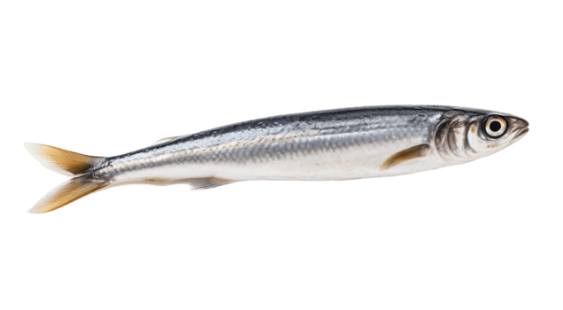
How We Estimate Strength: Stockfish ACPL Gate
1
Engine self-play
N games at fixed depth (currently 16)
2
Stockfish analysis
100 ms/move — judges each played move
3
ACPL
Average centipawn loss vs Stockfish best move
4
Heuristic Elo
Elo ≈ 2855 − ACPL × 10 (floor 400, not FIDE)
5
Final gate
cutechess-cli head-to-head for ≥ 1700 Elo (future)
Notes:
Method A1 from blueprint. Fast sanity check before expensive cutechess tournaments. Not win-rate vs Sunfish.

Slide 9
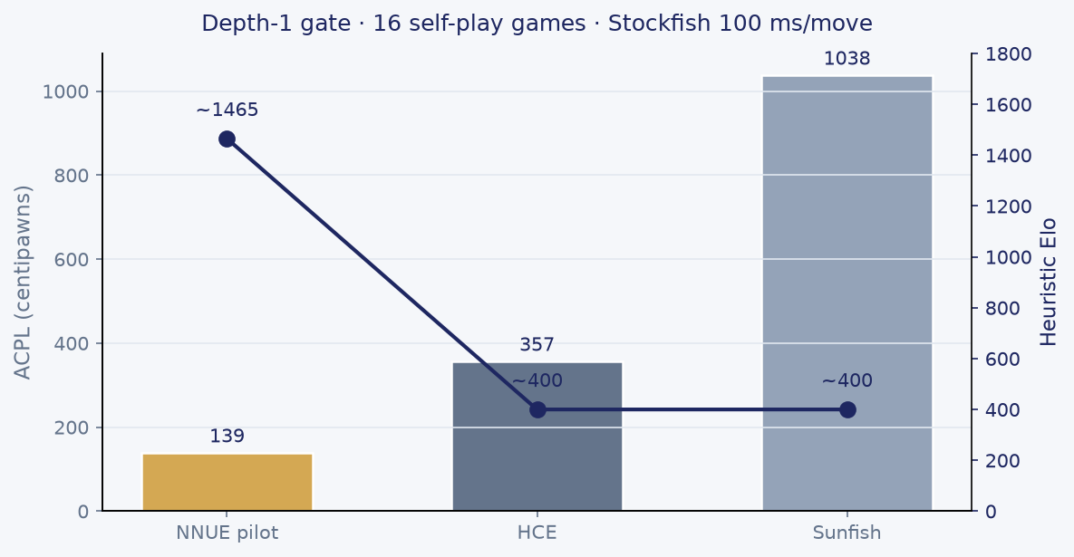
Early Results (16 self-play games, depth 1)
NNUE pilot ~1465 Elo (ACPL 139) — smoke net, not production
HCE ~400 Elo (ACPL 357) — high variance, gross blunders
Sunfish ~400 Elo (ACPL 1038) — calibration reference
Pilot val_mse 0.056 · production Lichess+Lc0 train pending
Notes:
Few games → high variance. GIF demos available on request. NNUE d2 still weak until production net + search tuning.

Slide 10
Status & Next Steps
✅ 844-dim feature encoder (dual POV, 8 buckets, 94 tests)
✅ Search v0.3 (alpha-beta, quiescence, MVV-LVA, perft)
✅ NNUE pilot wired to engine (--eval nnue)
✅ Stockfish ACPL gate + label_positions.py scaffold
⬜ Lichess PGN → FEN + production nnue-pytorch training
⬜ C port to Wio + incremental accumulators on device
⬜ Full search stack + cutechess Elo gate (≥ 1700)
⬜ Plays online
Thank you — questions?
Notes:
Close with honest status: PC pipeline works; device deployment and Elo gate are next milestones.

