Slide 1
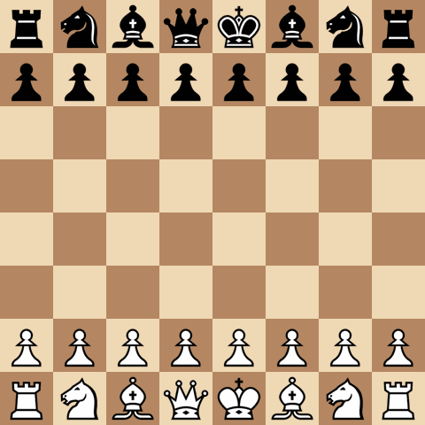
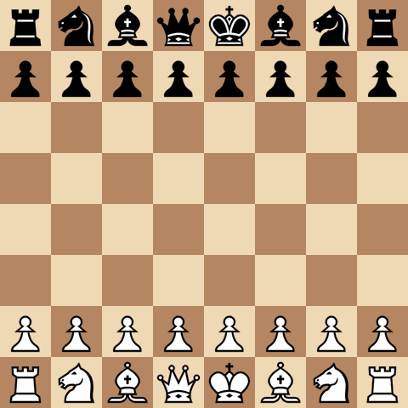
MASTER'S THESIS DEFENSE · UNIVERSITY OF TRIESTE
Unsupervised State Bucketing
for Mixture-of-Experts in
Resource-Constrained Chess Engines
Can a tiny chess engine choose the right expert?
Omar Cusma Fait
Data Science and Artificial Intelligence
Thesis Supervisor: Alessio Ansuini, Area Science Park
Internship Supervisor: Marco Zennaro, ICTP

Slide 2

EFFICIENTLY UPDATABLE NEURAL NETWORK
The Big Picture: AI on the Edge
Two families of modern approaches to chess
BIG neural networks
Value function,
Policy function
MCTS,
AlphaZero
small neural networks
Can run on small devices,
Edge computing,
Power-efficient,
NNUE, Elmo
2

Slide 3
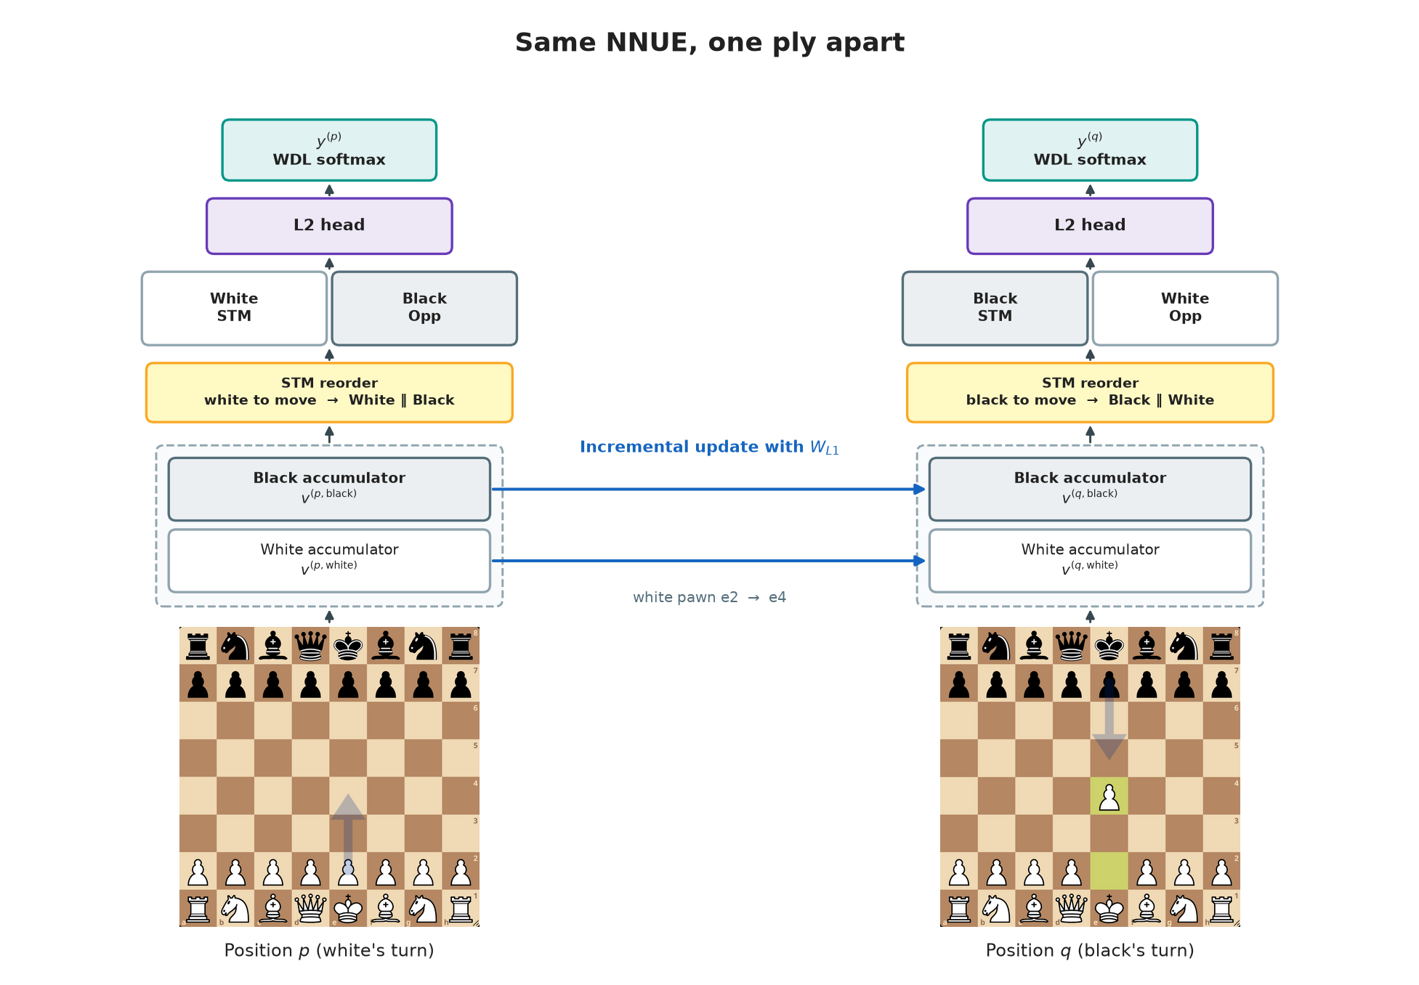
NNUE
The Base Architecture
of the NNUE
3
What is the difference between the NNUE and a dense FFNN? The Accumulator layer.

Slide 4
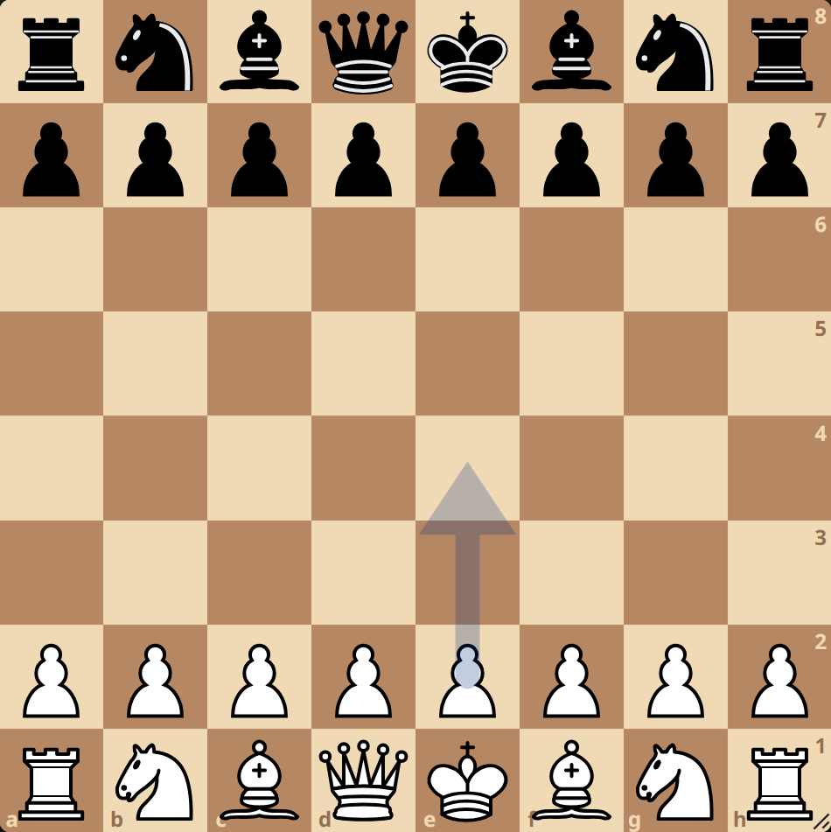
NNUE
The Accumulator Layer
L1 Accumulator
Input layer
-
L1 is the shared first-layer representation. During inference, it’s activations are mostly recycled.

Slide 5
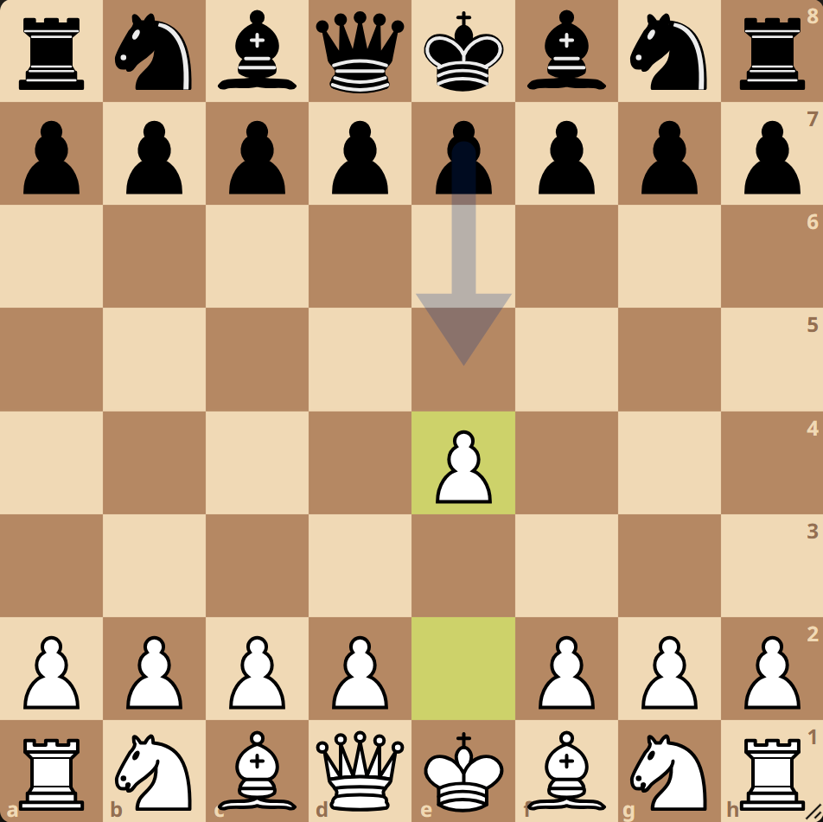
NNUE
The Accumulator Layer
L1 Accumulator
Input layer
-
L1 is the shared first-layer representation. During inference, it’s activations are mostly recycled.

Slide 6
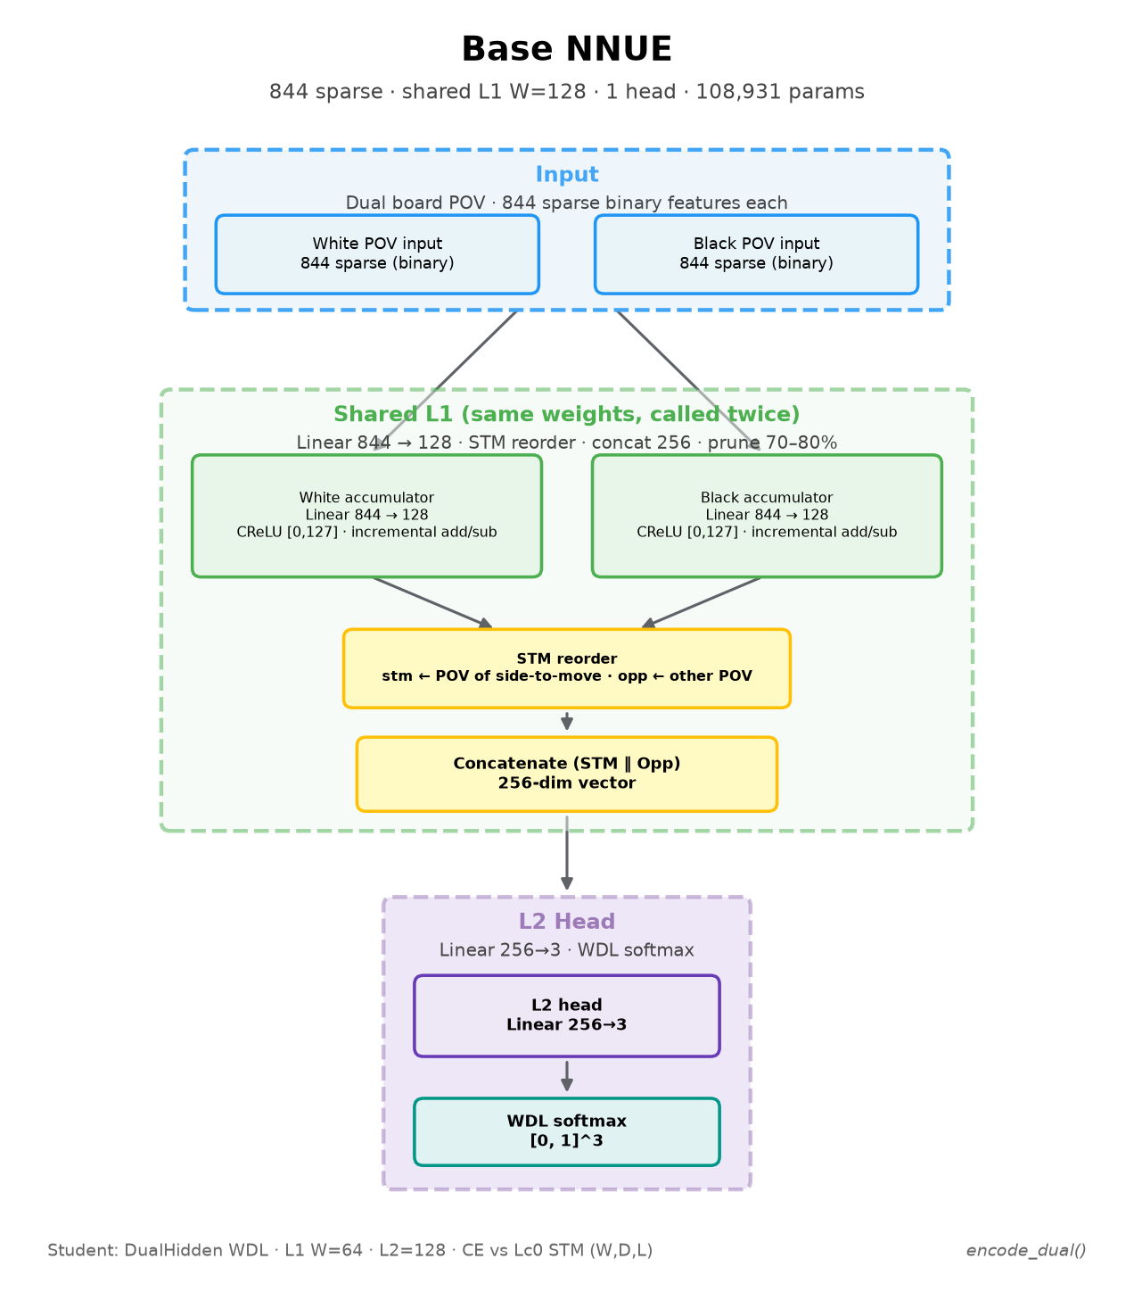
NNUE
The Architecture
of the base NNUE
Input layer
Accumulator layer (L1)
L2 hidden layer
Output layer
Base NNUE

Slide 7
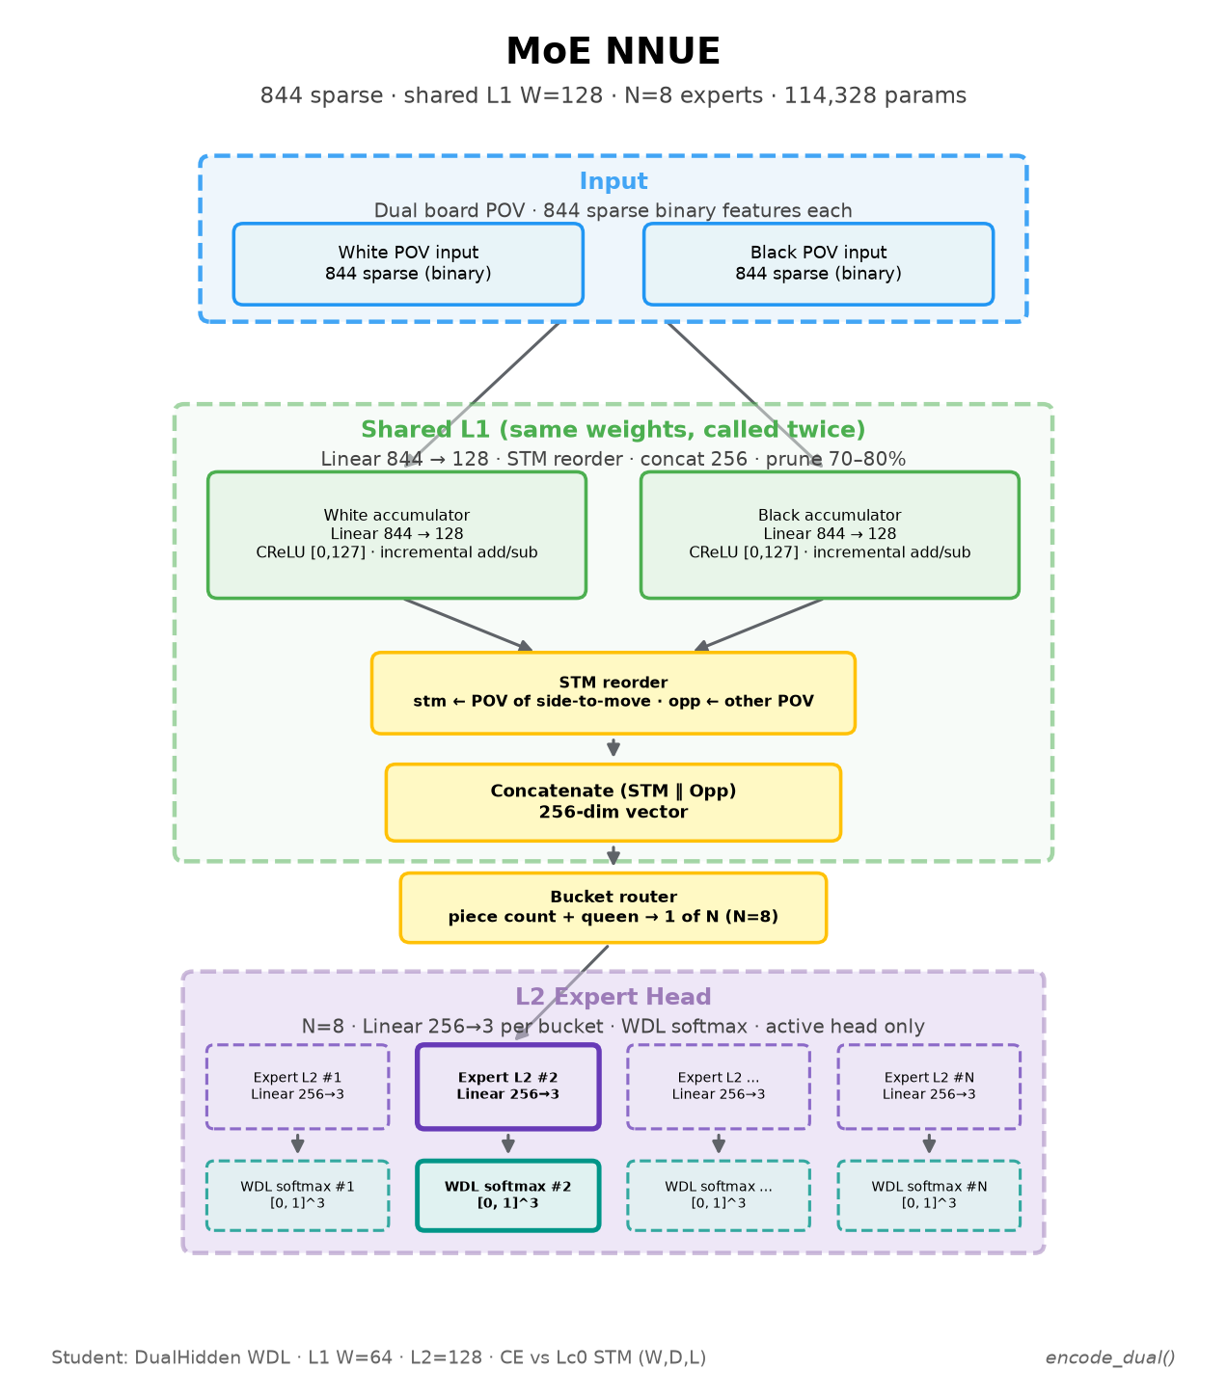
MoE NNUE ARCHITECTURE
The Architecture
of the MoE NNUE
A router decides which head
should be called
Expert heads can occupy
a lot of memory
During inference, only one head called
(also the dispatcher)
MoE NNUE

Slide 8

MoE NNUE ARCHITECTURE
Number
of parameters
Accumulator (L1 = 128)
Dispatcher (256 classes)
216k
215k
2
3
4
5
6
7
8
263k
Base model
Experts (L2 = 256)
Base head
7
Representation of the number of parameters of the MoE NNUE

Slide 9
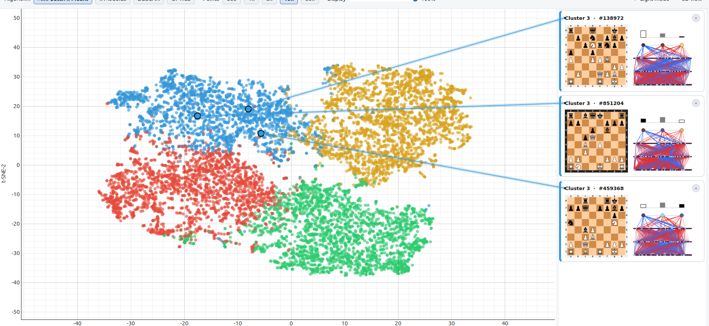
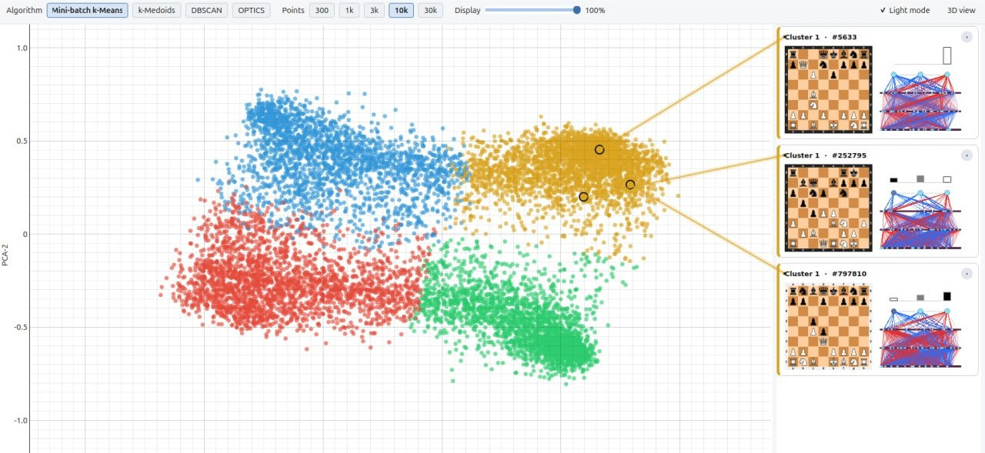
SAMPLE GRADIENTS
Clustering
Sample Gradients

Slide 10
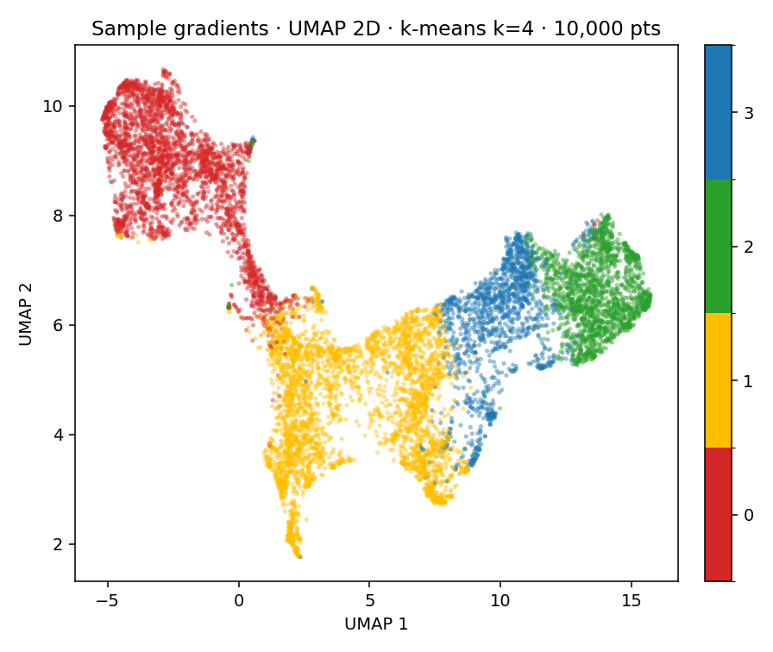
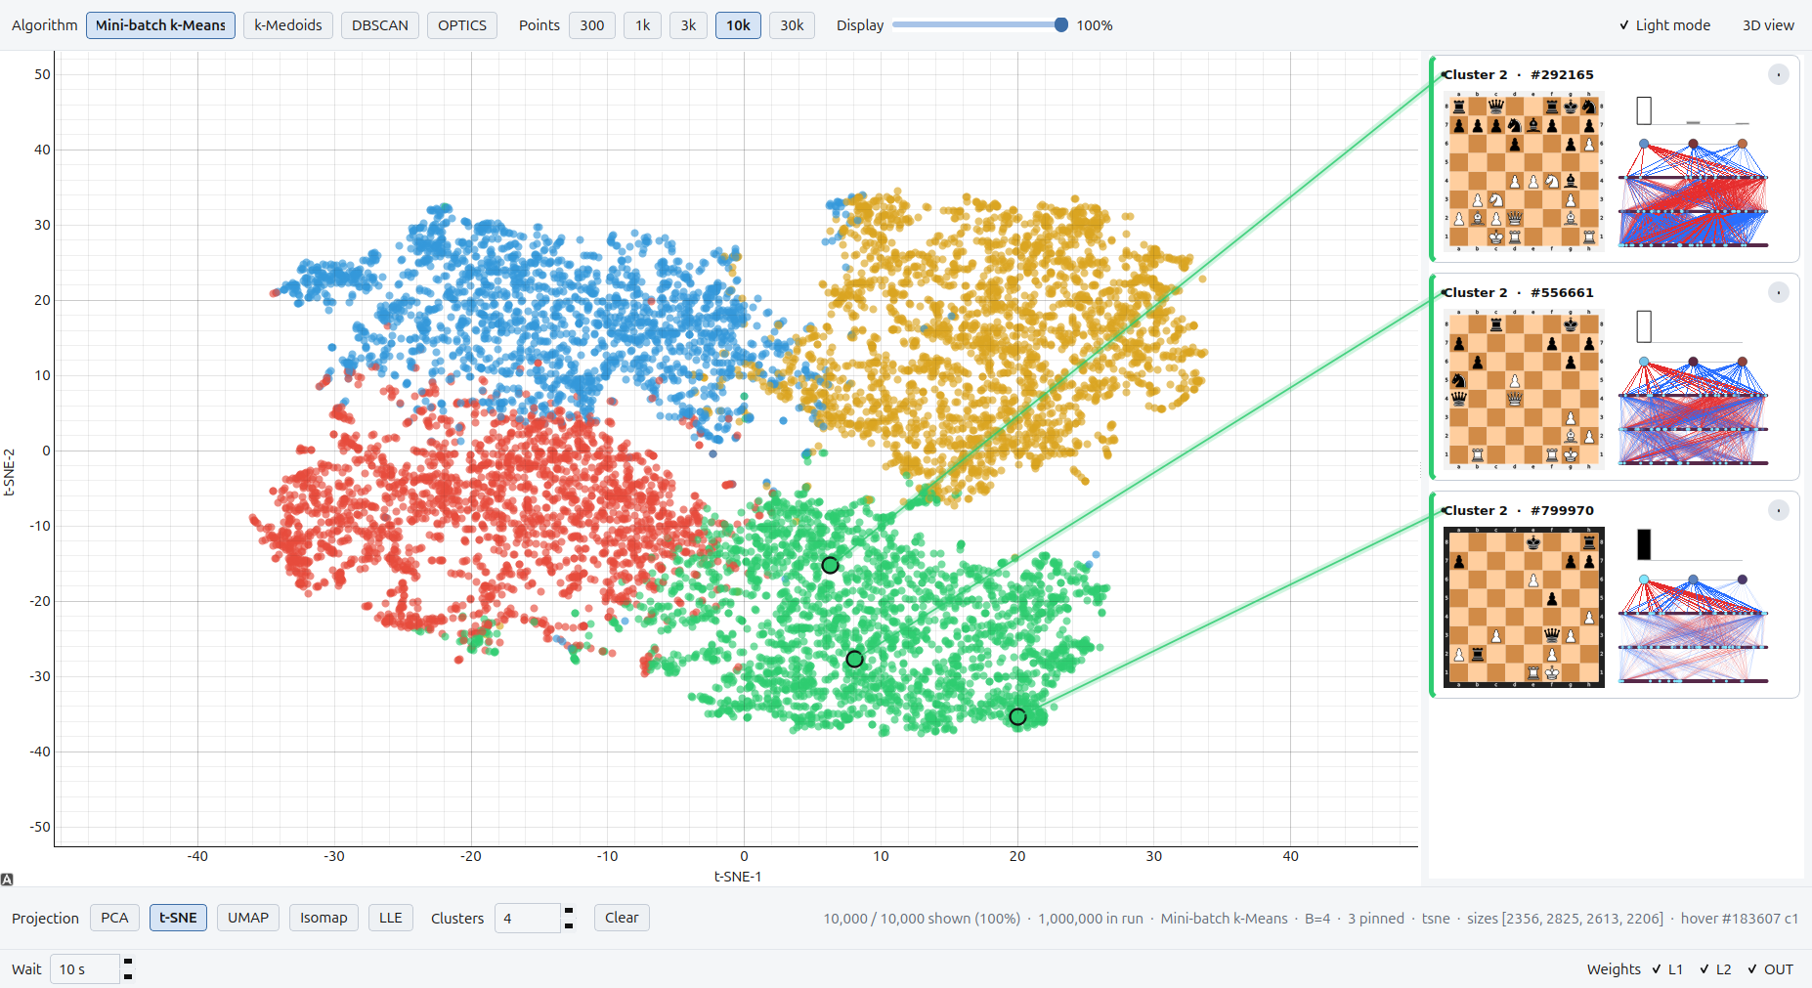
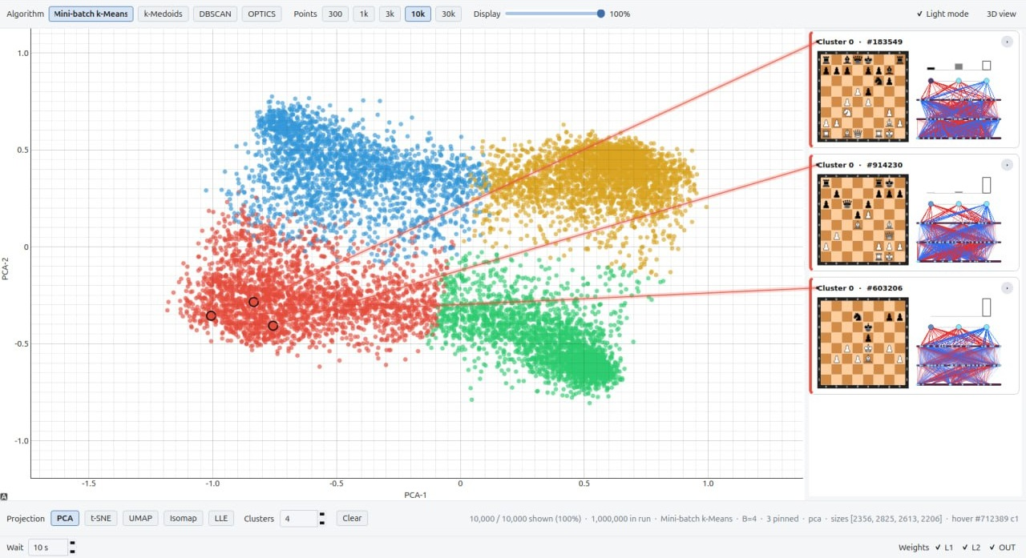
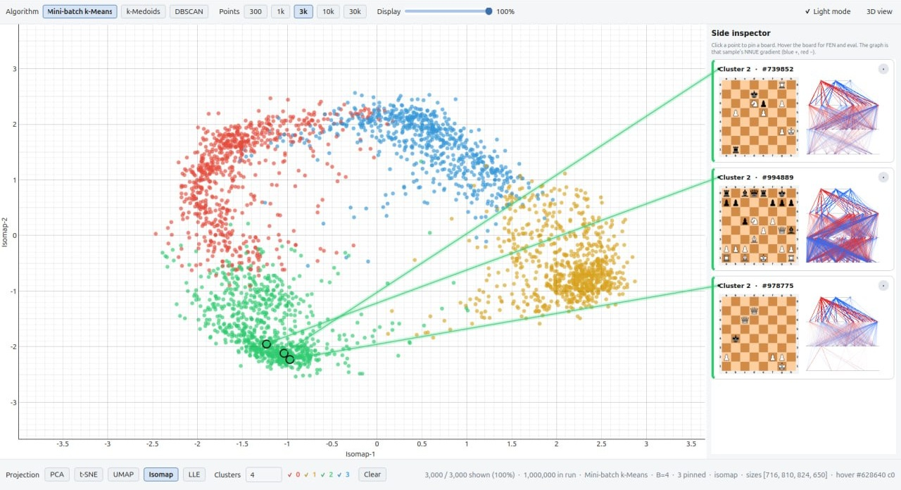
Clustering of the sample gradients

Slide 11
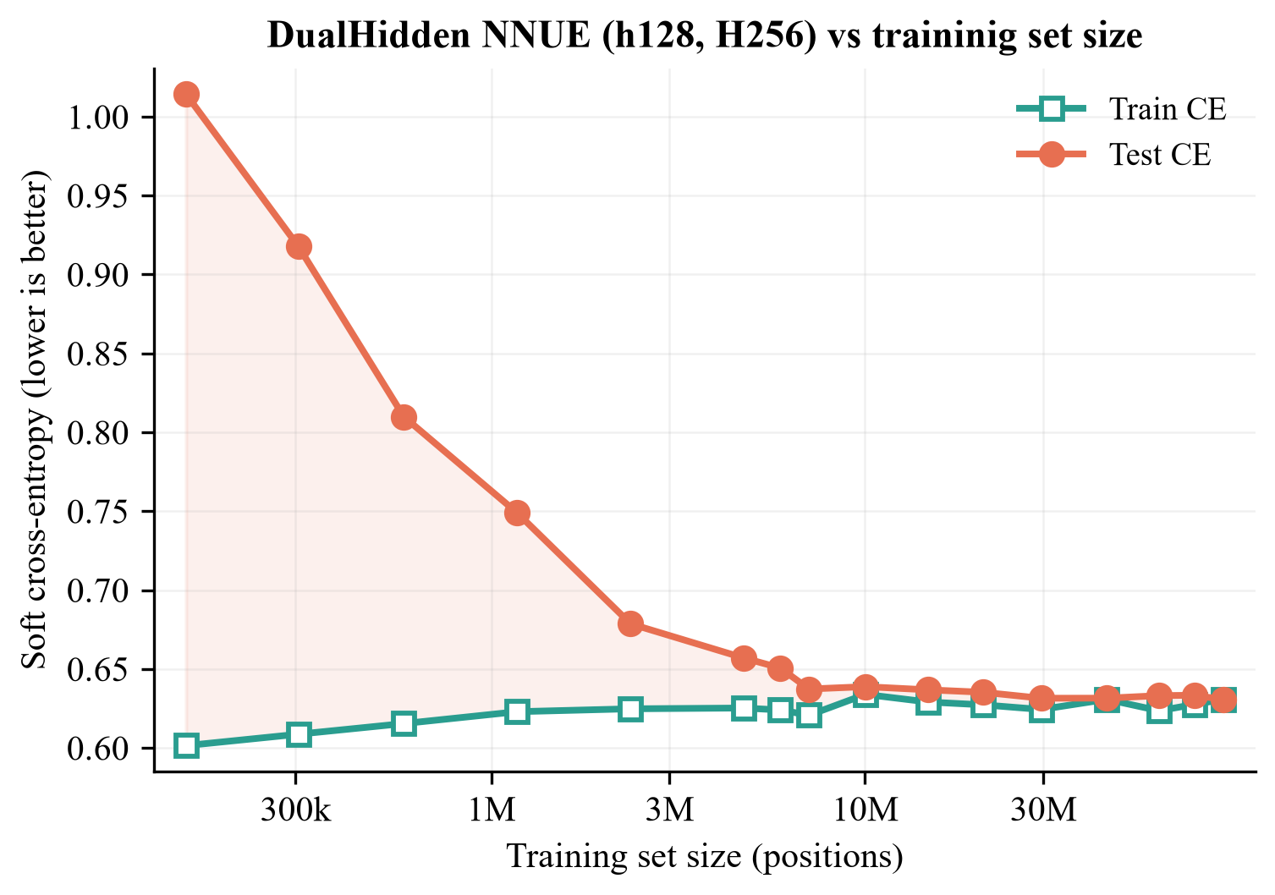
TEACHER DISTILLATION
Training and evaluation protocol
150M
Training positions, mainly from Lichess.
~7M
Positions to overcome overfitting.
175k
Parameters in the biggest NNUE.
Example of overfitting due to lack of data
10

Slide 12
TEACHER DISTILLATION
Linear model
Base NNUE
NNUE MoE – input-clustering
NNUE MoE – L1 clustering
NNUE MoE – sample gradient clustering
KITSUNE
NNUE MoE –
piece-count clustering
FFNN
NNUE + World Model
All the Architectures
that we Tried
11
A diagram showing the implemented algorithms. The graph structure reflects the model architecture.

Slide 13
SAME L1 INPUT, SAME MLP DISPATCHER, EIGHT BUCKETS
Gradient buckets are hard to recover
L1 buckets
98.0%
Gradient buckets
52.5%
Gradient buckets are hard to approximate
A linear dispatcher cannot effectively learn the sample-gradient-based routing from L1 alone.
Comparison of the L1 clustering dispatcher vs the sample gradient dispatcher
12

Slide 14
PRIMARY EXPERIMENTS, TEST CROSS-ENTROPY
Strong-base MoE gains are marginal
Model | K | CE
Reference NNUE | — | 0.6541
Piece-count MoE | 8 | 0.6303
L1-clustered hard MoE | 16 | 0.6300
Gradient-clustered hard MoE | 8 | 0.6300
Soft-gated MoE, top-2 | 2 | 0.6304
Best observed change in CE.
No decisive improvement over the reference NNUE… but why??
Tables 5.10–5.11, 50,000 held-out positions. Lower CE is better. These figures are not an Elo gain.
13

Slide 15
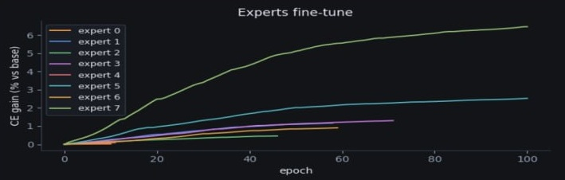
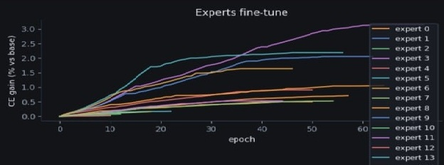
L1 CLUSTERING
Expert fine-tuning step
Some partitions produce very effective experts
Many partitions produce modest improvements
The depth of the loss basen is rougly proportional to the initial magnitude of the gradient
Some training trajectories for L1 clustering MoE NNUE

Slide 16

KITSUNE
KITSUNE stitches micro-buckets offline
1
Partition L1
Cut the activation space into many small, convex micro-buckets.
2
Stitch offline
Group those buckets by their mean head gradient. This step never runs during play.
Knowledge-guided
Initialization and
Two-stage
Segregation for
Unsupervised
Neural
Experts
3
Train the experts
Disconnected L1 regions can share one expert, then each head is fine-tuned.
15

Slide 17
KITSUNE
KITSUNE - Stitching
You want $B$ experts
You want 𝐵 experts
Partition the space to $B’=B k_{refinement}$
mini-clusters
Partition the space to 𝐵’=𝐵 𝑘_𝑟𝑒𝑓𝑖𝑛𝑒𝑚𝑒𝑛𝑡
mini-clusters
Stitch together the partitions with similar
average sample gradient
Accuracy vs $B$
Accuracy vs 𝐵
Mini-partitions of the L1 embedding space, and their respective average sample gradients.
The activation space is first partitioned precisely, then the clusters with similar sample gradients are mearged
16

Slide 18
KITSUNE
KITSUNE - Stitching
You want $B$ experts
You want 𝐵 experts
Partition the space to $B’=B k_{refinement}$
mini-clusters
Partition the space to 𝐵’=𝐵 𝑘_𝑟𝑒𝑓𝑖𝑛𝑒𝑚𝑒𝑛𝑡
mini-clusters
Stitch together the partitions with similar
average sample gradient
Accuracy vs $B$
Accuracy vs 𝐵
Expert 1
Expert 2
Partitions of the L1 embedding space, and their respective average sample gradients.
The activation space is first partitioned precisely, then the clusters with similar sample gradients are mearged
16

Slide 19
KITSUNE
KITSUNE matches that L1 result…
0.65043
K | B′/K | MoE CE | Best expert | Gain
4 | 4 | 0.65118 | 0.63726 | 2.51%
4 | 8 | 0.65137 | 0.64050 | 2.01%
8 | 4 | 0.65102 | 0.61748 | 5.54%
8 | 8 | 0.65093 | 0.61275 | 6.26%
16 | 2 | 0.65043 | 0.60571 | 7.34%
16 | 4 | 0.65061 | 0.60234 | 7.85%
16 | 8 | 0.65138 | 0.60865 | 6.89%
Routed mixture
K = 16, two micro-buckets per expert. 0.0033 below the base, and 0.0005 higher than the best L1 run.
0.60234
Best expert, own bucket
Factor 4. A 7.85% reduction against the base CE. Factor 2 is already at 0.60571.
Refinement factor at 16x
Still no significant improvement
At K = 16 the mixture rises to 0.65138 and the best expert to 0.60865.
Table 5.16. Expert gain uses the full-base CE, not a same-bucket comparison. Strong-base KITSUNE, Elo, and nodes per second are still open.
18

Slide 20
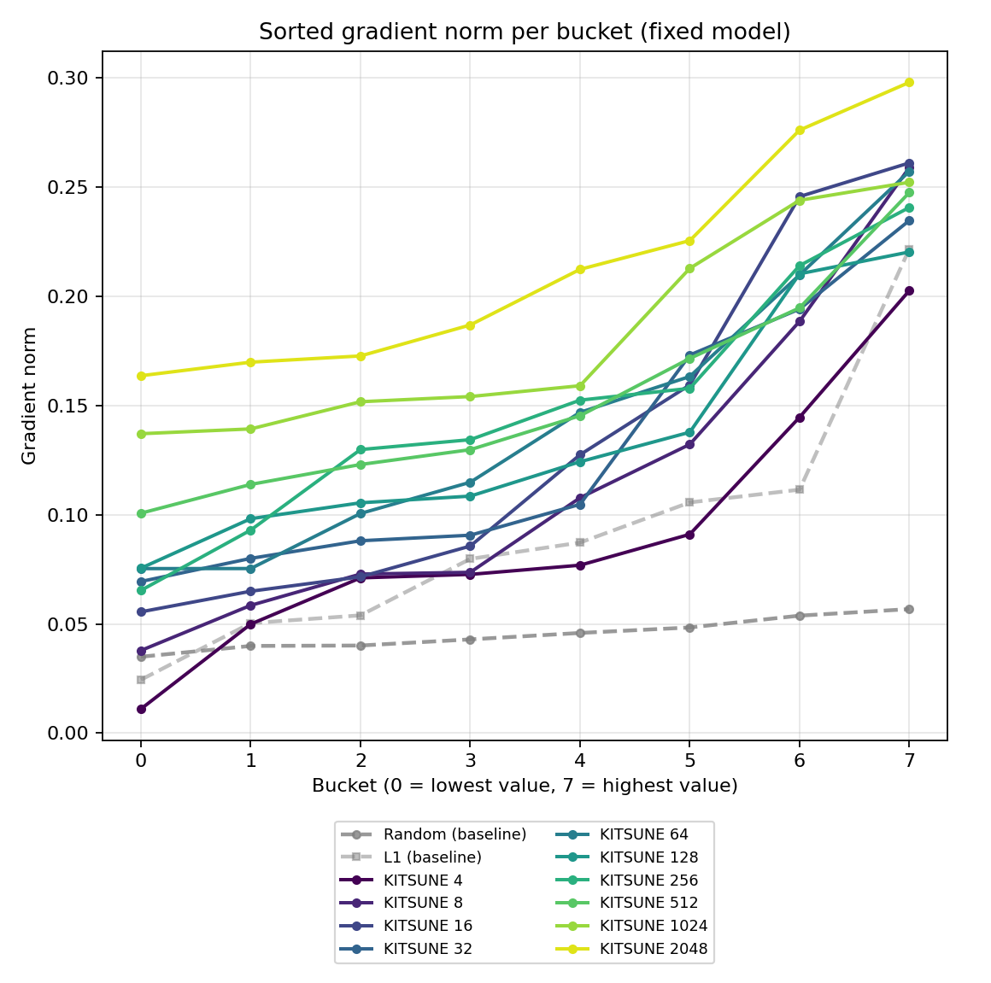
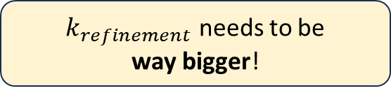
Some Last-minute Results!
$k_{refinement}$ needs to be
way bigger!
More clusters = Less points in the cluster
= More aligned sample gradients
Downside: the dispatcher gets really big!
… but that is OK.
Stitch together hundreds of partitions with similar
average sample gradient
Accuracy on $B′$ is not important
Accuracy on 𝐵′ is not important
Each series represents gradient magnitudes of increasing strength for that algorithm. The more mini-clusters, the better!
19

Slide 21
Thank you.
Questions?
Omar Cusma Fait · University of Trieste

Slide 22
Omar Cusma Fait · University of Trieste

Slide 24
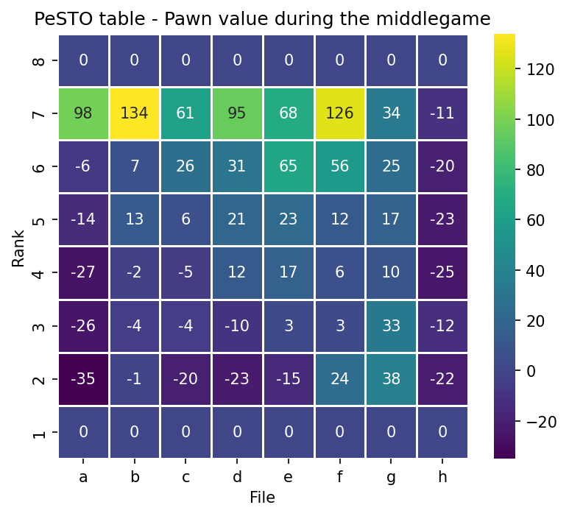
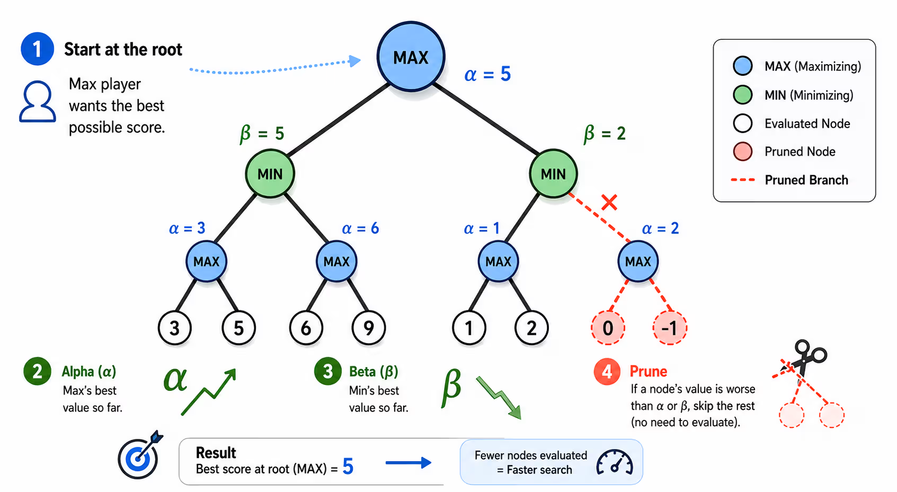
Some more slides…

Slide 25
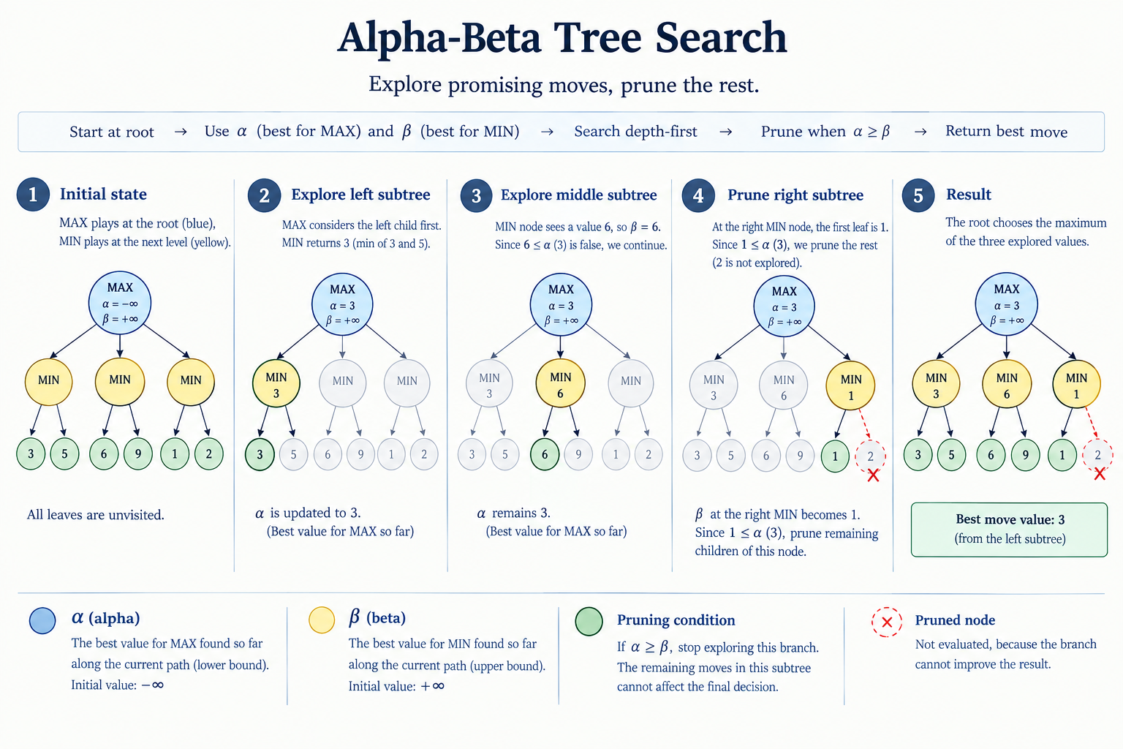

Slide 26
Paper/source | Contribution
Silver et al. (2018) | AlphaZero — superhuman performance with no human data
Nasu (2018) | NNUE — efficient and strong neural evaluation for shogi (base structure of out algorithms)
NNUE for Stockfish | Neural value evaluation for Stockfish
de Man (2016) | Cfish — C-based implementation of Stockfish for efficient microcontroller implementation (very useful, efficiently implements alpha-beta search)
Shazeer et al. (2017) | Sparsely-Gated Mixture-of-Experts
Fedus, Zoph & Shazeer (2021) | Switch Transformer—Simpified routing MoE with top-1 assignment
Kawata et al. (2025) | MoE and cluster latent structure – how much can a MoE exploit latent cluster structure of the data
Hu et al. (2021) | LoRA - Low-Rank Adaptation – training lower-rank matrices to fine-tune LLM (useful for big models, not necessary for us)
Li et al. (2025) | ELREA - Ensembles of Low-Rank Expert Adapters – clustering training instructions based on gradients
Sridharan et al. (2025) | GradientSpace - clustering of LoRA gradients for expert specialization
Zhang et al. (2025) — TAGCOS | Task-Agnostic Gradient Clustered Coreset Selection for Instruction Tuning Data

Slide 27
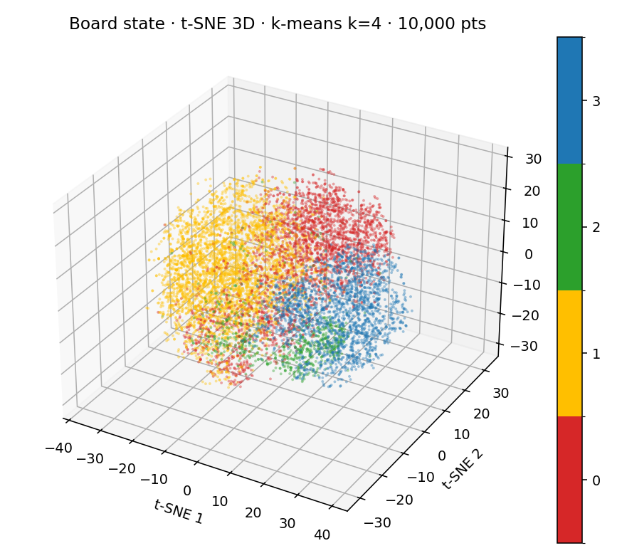
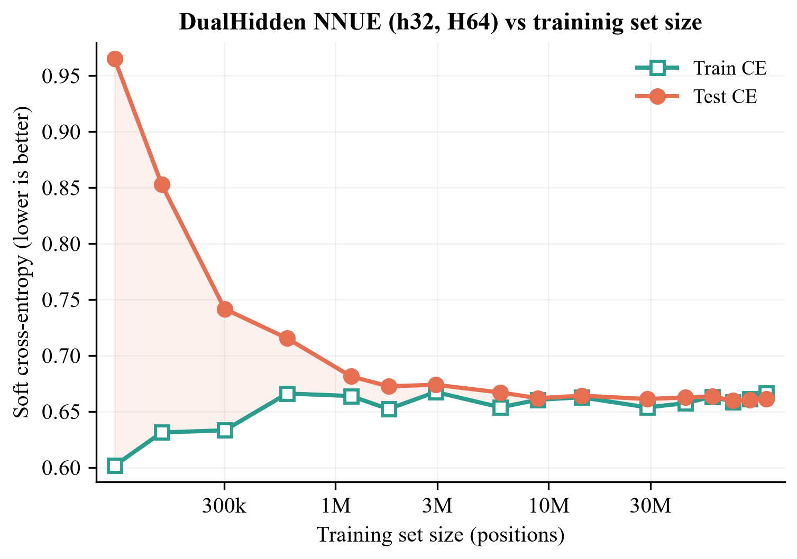

Slide 28
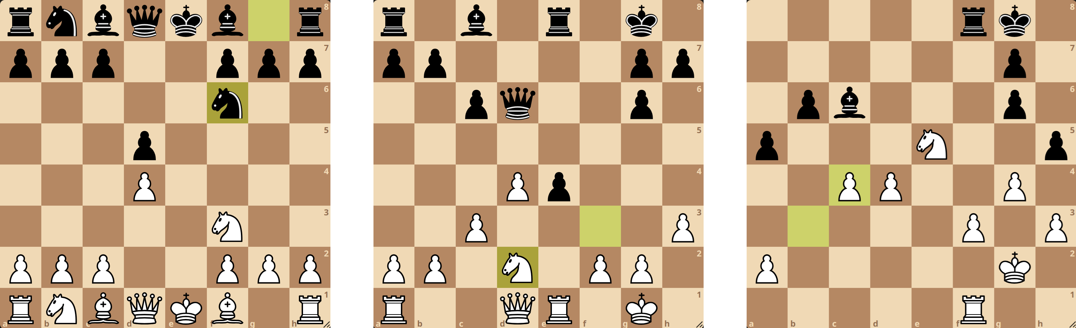

Slide 29
SAME GRADIENT-TRAINED EXPERTS, DIFFERENT SELECTION RULES
The oracle exposes assignment headroom
K = 16
K = 16
K = 16
0.6301
0.6280
0.6005
Actual dispatcher
Gradient-centroid proxy
Minimum-loss oracle
What can run online.
Still needs the teacher target.
Each position goes to its best expert.
Table 5.13. The single-head base is CE 0.6303. Centroid proxy and oracle both need the unavailable teacher target.
10 / 15

Slide 30
NNUE
NNUE updates only the changed features
1
2
3
A move touches few inputs
Edit the accumulator
Reuse it on the next node
Of the 844 board features, only the squares that change are active.
Subtract the removed features and add the new ones. The rest stays.
The L1 accumulator persists across moves, so evaluation stays cheap.
4

Slide 31
OUTLOOK
Where do we go
from here?
Re-run the training with higher $k_{refinement}$
Re-run the training with higher 𝑘_𝑟𝑒𝑓𝑖𝑛𝑒𝑚𝑒𝑛𝑡
Tweak the architecture
Clustering on input to make the big dispatcher an accumulator
Measure the results
…
20
The improvement process for the following iterations of KITSUNE.

Slide 32
KITSUNE
Online inference needs no gradients
Shared L1
Linear router
Static lookup
One head
Already updated
incrementally
Micro-bucket m
Expert T[m]
WDL output
The online cost is a linear map plus a table lookup. Convex micro-buckets are what make that map enough.
The routed mixture on the weaker base is measured. It does not require a gradient at play time.
17

Slide 33
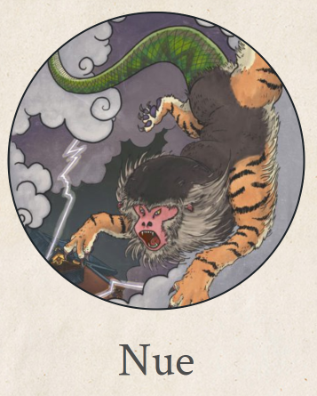
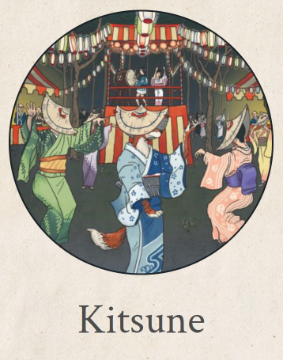

Slide 34
MAIN CONCLUSION
The take-home message
KITSUNE routes robustly with L1 clustering and a lookup.
Stitching seems to work only when the number of mini-clusters is very high.
We will leverage these all findings for the next iteration of KITSUNE.
Omar Cusma Fait · University of Trieste

