Slide 1
MASTER'S THESIS DEFENSE · UNIVERSITY OF TRIESTE
Unsupervised State Bucketing
for Mixture-of-Experts in
Resource-Constrained Chess Engines
Can a tiny chess engine choose the right expert?
Omar Cusma Fait
MSc Data Science and Artificial Intelligence
Supervisor: Alessio Ansuini · Co-supervisor: Marco Zennaro, ICTP

Slide 2
EFFICIENTLY UPDATABLE NEURAL NETWORK
NNUE updates only the changed features
1
2
3
A move touches few inputs
Edit the accumulator
Reuse it on the next node
Of the 844 board features, only the squares that change are active.
Subtract the removed features and add the new ones. The rest stays.
The L1 accumulator persists across moves, so evaluation stays cheap.
L1 is the shared first-layer representation throughout. Thesis Fig. 1.1.
3 / 15

Slide 3
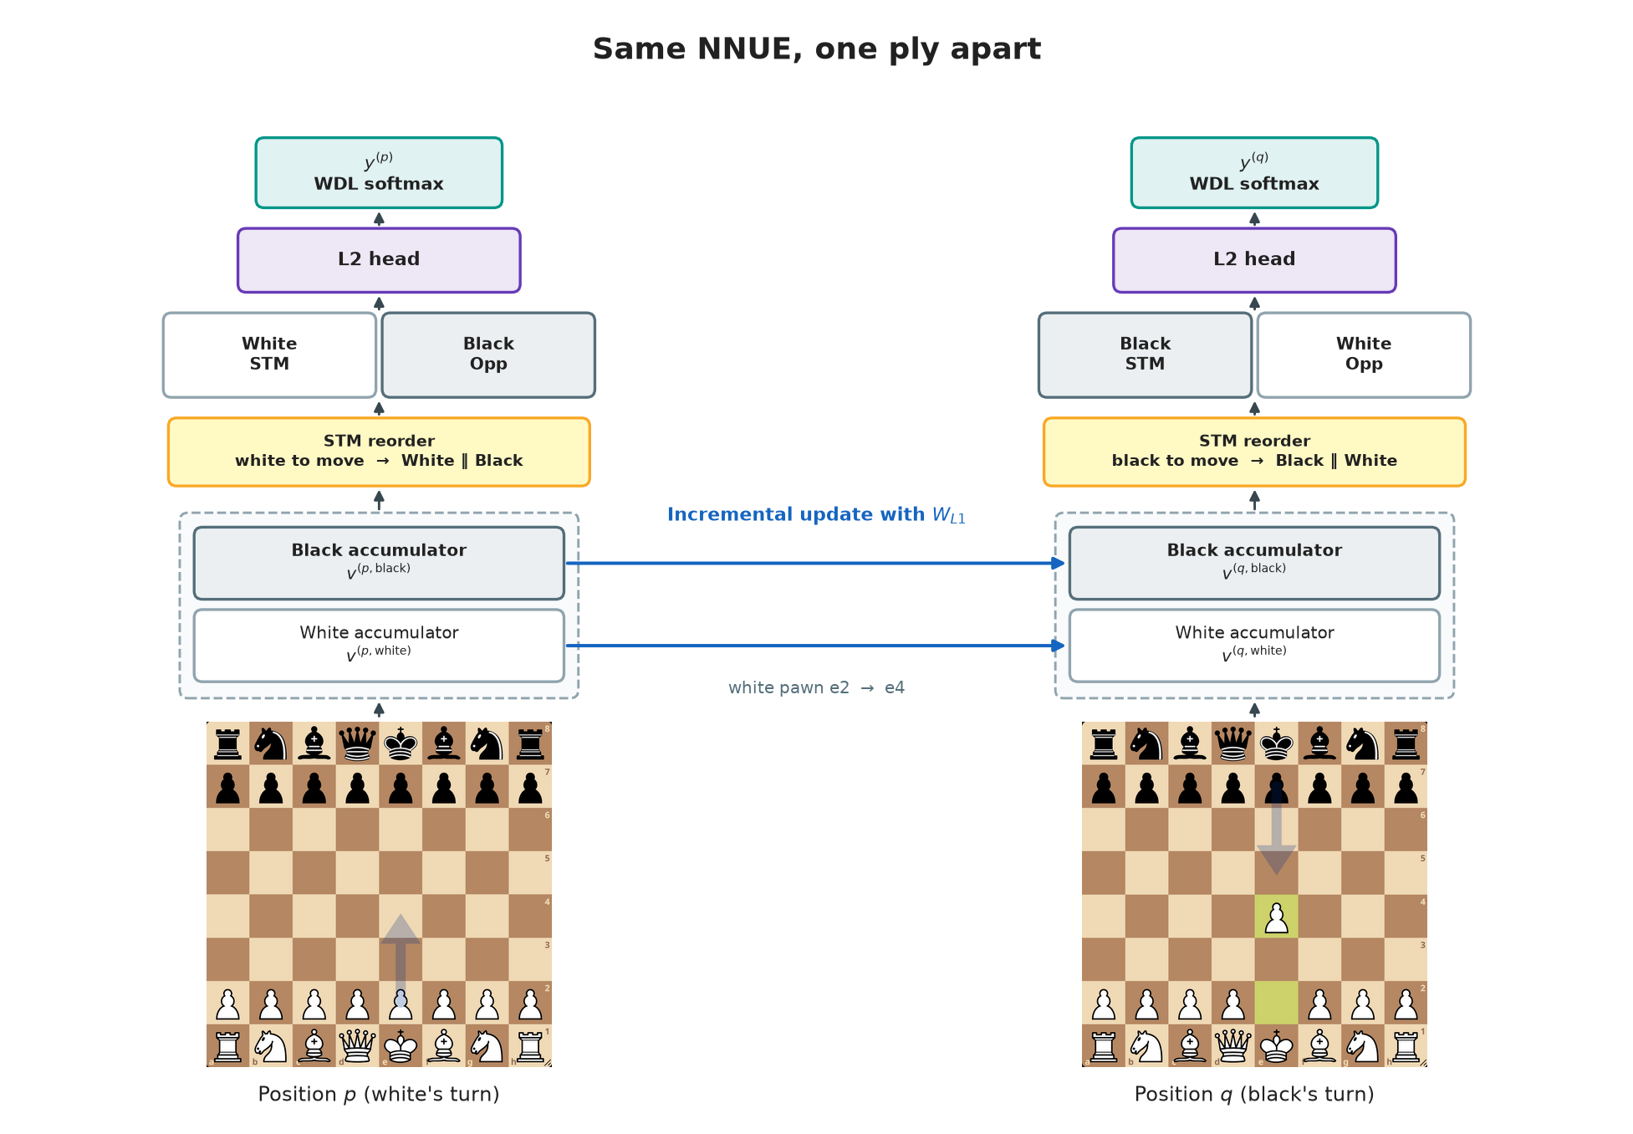
The Architecture
of the base NNUE

Slide 4
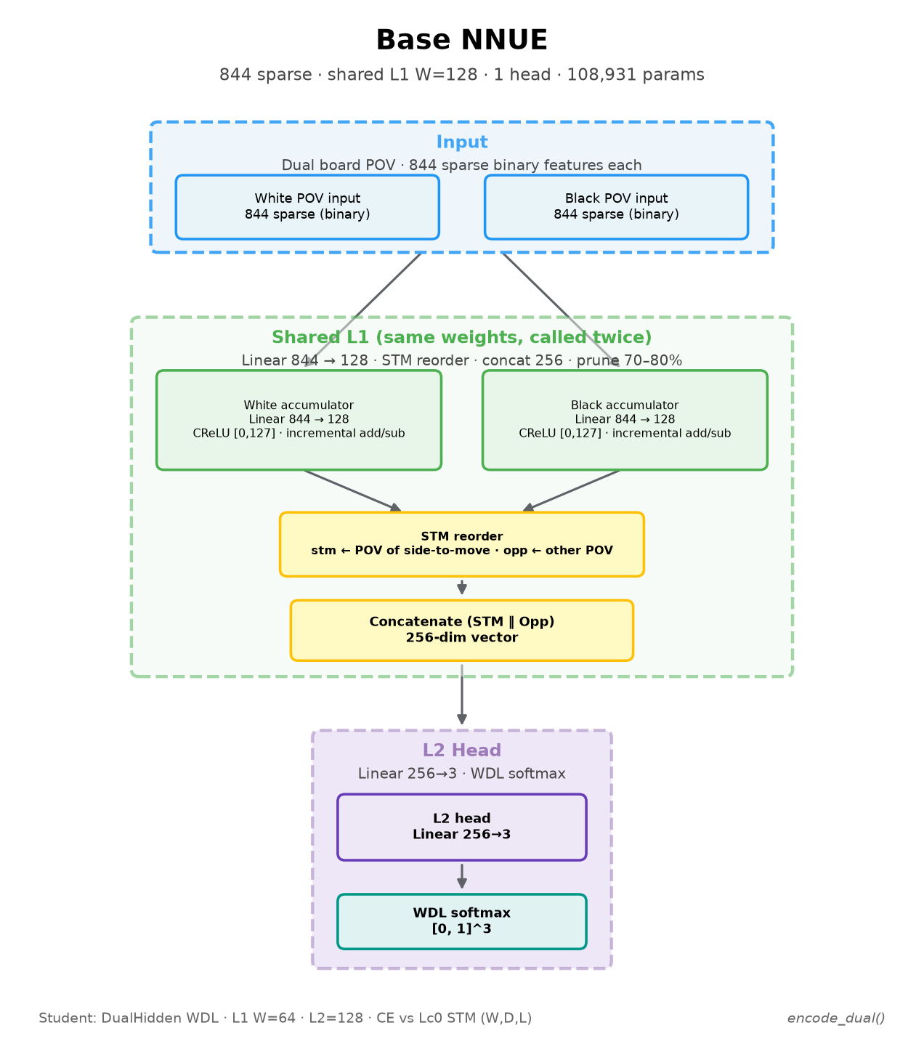
The Architecture
of the base NNUE
Input layer
Accumulator layer (L1)
L2 hidden layer
Output layer

Slide 5
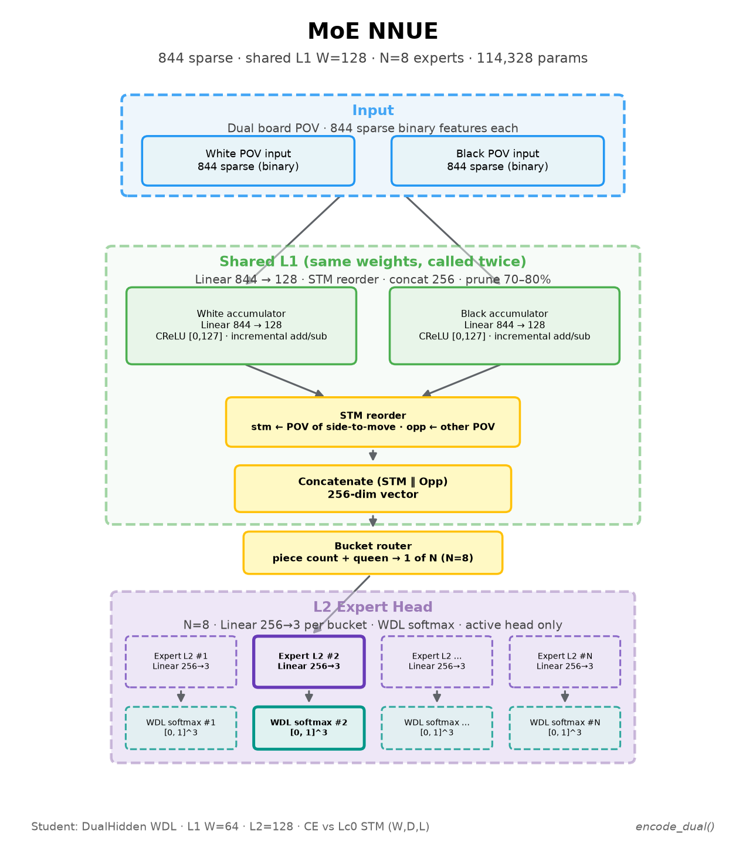
The Architecture
of the MoE NNUE
A router decides which head
should be called

Slide 6
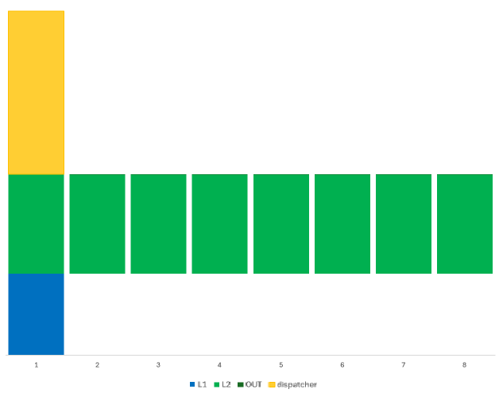
Number of parameters
Dispatcher (512 classes)
432k
Experts (L2 = 256)
263k
Base model
216k
Accumulator (L1 = 128)

Slide 7
HARD MIXTURE OF EXPERTS
One accumulator, one selected expert
Board
Shared L1
Dispatcher
Expert head
844 features
Frozen
Picks one head
WDL output
Expert 1
Expert 2
Expert K
Fine-tuning stores several small heads. At inference, L1 activations select one of them. The others stay in memory and do not run.
Hard routing, thesis §§3.3–3.4. Extra experts still cost memory.
4 / 15

Slide 8
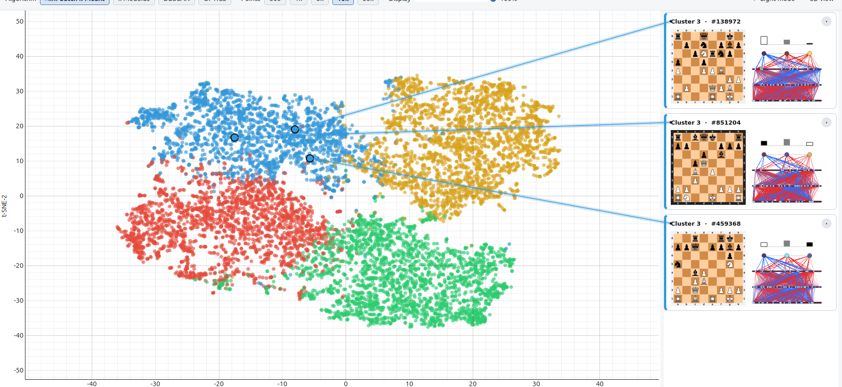
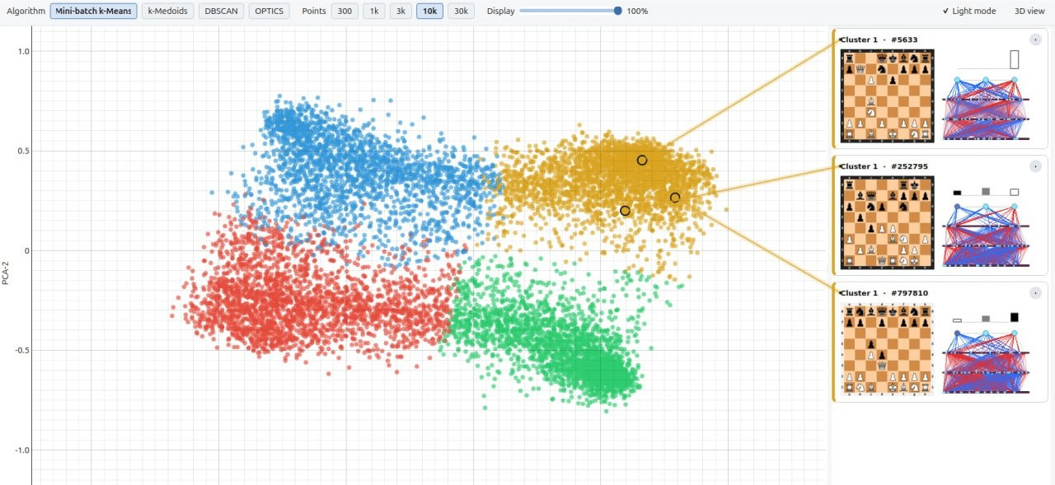
SAMPLE GRADIENTS
Clustering
Sample Gradients

Slide 9
ALTERNATIVE SPECIALIZATION SIGNALS
Bucketing defines each expert’s task
Bucket signal | Groups positions by | Available online?
Piece count | A hand-designed game-phase proxy | Yes — a fixed rule
L1 activations | Similar hidden representations | Yes — already computed
Sample gradients | Similar updates of the head | No — needs the teacher WDL
Jointly learned gate | An end-to-end routing objective | Yes — after training
L1 describes the position. Gradients describe how the head should change.
Thesis §3.3. Per-sample head gradient uses the teacher target, which is unknown at play time.
5 / 15

Slide 10
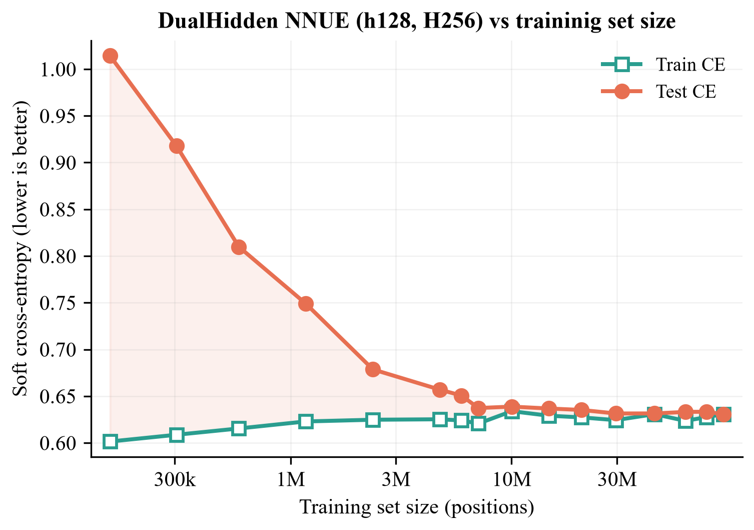
TEACHER DISTILLATION AND HELD-OUT COMPARISON
Training and evaluation protocol
150M
Training positions, mainly from Lichess.
~7M
Positions to overcome overfitting.
175k
Parameters in the biggest NNUE.
Lc0 supplies win / draw / loss targets. Lower cross-entropy is closer to the teacher. CE is not Elo. §§4.1–4.2, 5.1, 5.5.
6 / 15

Slide 11
OFFLINE STRUCTURE
Gradients form more separated clusters
Silhouette at K = 8, each score measured in its own representation.
0.191
0.003
Sample gradients
L1 activations
The most separated of the three signals.
Almost no silhouette. Easy to draw, little separation.
Separation is not the same as a better expert or a usable router. Table 5.2; gradient UMAP in Fig. 5.3.
7 / 15

Slide 12
SAME L1 INPUT, SAME MLP DISPATCHER, EIGHT BUCKETS
Gradient buckets are hard to recover
L1 buckets
98.0%
Gradient buckets
52.5%
45.5 percentage-point gap
A training signal that depends on the true value is difficult to infer from L1 alone.
Tables 5.6–5.7. MLP width 64, K = 8, 1M-position cache, 90/10 split. Clustering was fit before the split.
8 / 15

Slide 13
PRIMARY EXPERIMENTS, TEST CROSS-ENTROPY
Strong-base MoE gains are marginal
Model | K | CE
Reference NNUE | — | 0.6303
Piece-count MoE | 8 | 0.6303
L1-clustered hard MoE | 16 | 0.6300
Gradient-clustered hard MoE | 8 | 0.6300
Soft-gated MoE, top-2 | 2 | 0.6304
−0.0003
Best observed change in CE.
No decisive improvement over the reference NNUE.
Tables 5.10–5.11, 50,000 held-out positions. Lower CE is better. These figures are not an Elo gain.
9 / 15

Slide 14
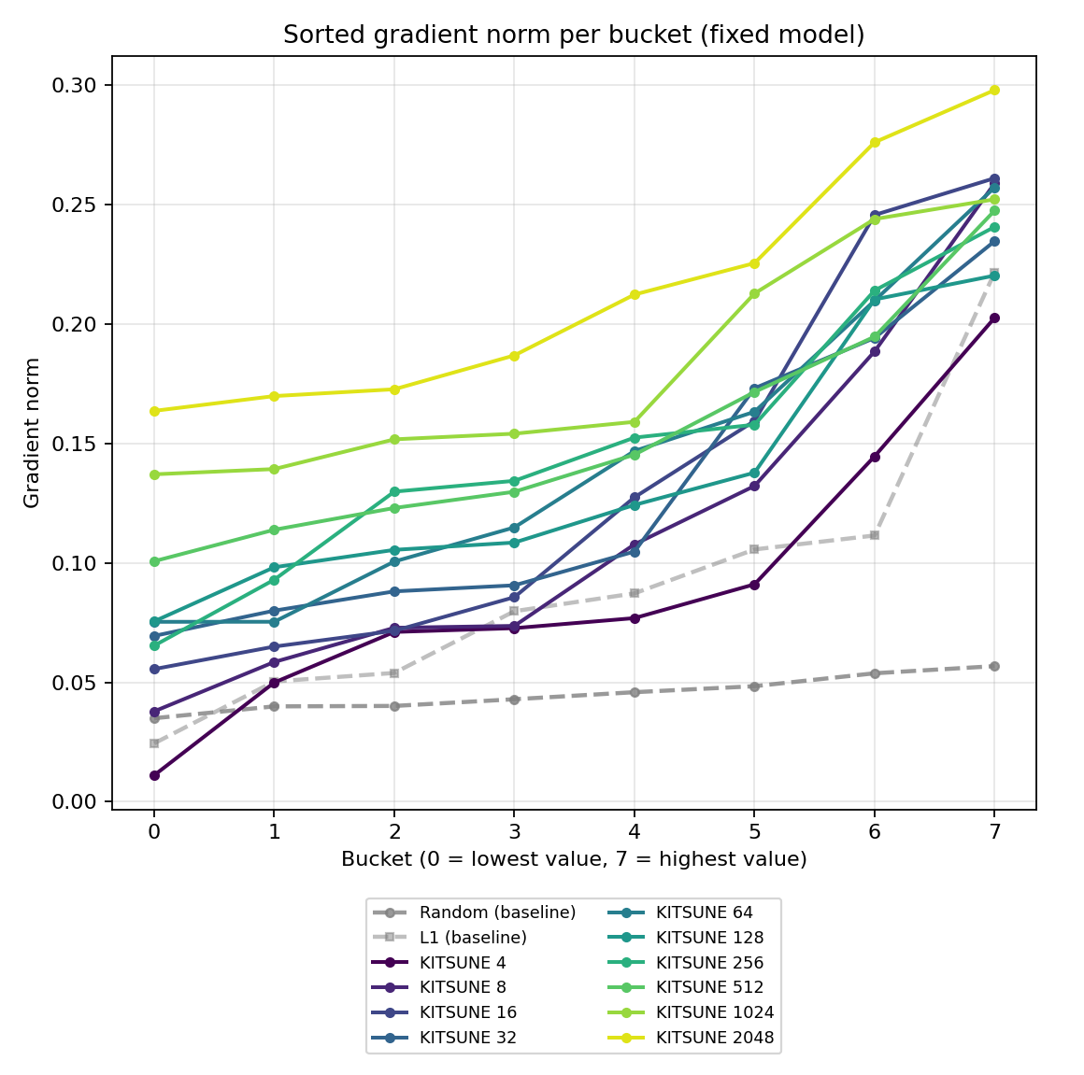
Some Last-minute Results…

Slide 15
SAME GRADIENT-TRAINED EXPERTS, DIFFERENT SELECTION RULES
The oracle exposes assignment headroom
K = 16
K = 16
K = 16
0.6301
0.6280
0.6005
Actual dispatcher
Gradient-centroid proxy
Minimum-loss oracle
What can run online.
Still needs the teacher target.
Each position goes to its best expert.
Table 5.13. The single-head base is CE 0.6303. Centroid proxy and oracle both need the unavailable teacher target.
10 / 15

Slide 16
FOLLOW-UP ON A MODEL THAT STILL HAS ROOM TO IMPROVE
Longer fine-tuning helps a weaker base
BASE · W64 / H128
FOUR L1 EXPERTS
0.6537
0.6499
Test CE of the single evaluation head.
Linear dispatcher, longer fine-tuning.
A reduction of 0.0038.
This is the weaker base, not the strong reference. §5.5.4, K = 4. The gain depends on the model and the training budget.
11 / 15

Slide 17
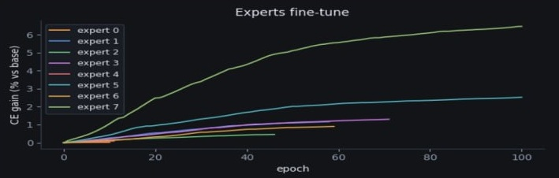
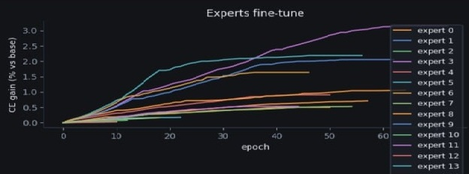
Expert fine-tuning step
Some partitions produce very effective experts
Many partitions produce modest improvements
The depth of the minimum is rougly proportional to the initial magnitude of the gradient

Slide 18
PROPOSED TWO-STAGE METHOD
KITSUNE stitches micro-buckets offline
1
Partition L1
Cut the activation space into many small, convex micro-buckets.
2
Stitch offline
Group those buckets by their mean head gradient. This step never runs during play.
3
Train the experts
Disconnected L1 regions can share one expert, then each head is fine-tuned.
Thesis §3.3.5. Schematic, not a plot of measured geometry. Gradients shape the experts; they are not an online feature.
12 / 15

Slide 19
KITSUNE DEPLOYMENT PATH
Online inference needs no gradients
Shared L1
Linear router
Static lookup
One head
Already updated
incrementally
Micro-bucket m
Expert T[m]
WDL output
The online cost is a linear map plus a table lookup. Convex micro-buckets are what make that map enough.
The routed mixture on the weaker base is measured. It does not require a gradient at play time.
§3.3.5. Router cost scales with L1 width and the micro-bucket count. The lookup itself is a fixed table.
13 / 15

Slide 20
WEAKER BASE W64 / H128 · BASE CE 0.6537 · BEST SINGLE-STAGE L1 0.6499
KITSUNE matches that L1 result
0.65043
K | B′/K | MoE CE | Best expert | Gain
4 | 4 | 0.65118 | 0.63726 | 2.51%
4 | 8 | 0.65137 | 0.64050 | 2.01%
8 | 4 | 0.65102 | 0.61748 | 5.54%
8 | 8 | 0.65093 | 0.61275 | 6.26%
16 | 2 | 0.65043 | 0.60571 | 7.34%
16 | 4 | 0.65061 | 0.60234 | 7.85%
16 | 8 | 0.65138 | 0.60865 | 6.89%
Routed mixture
K = 16, two micro-buckets per expert. 0.0033 below the base, and 0.0005 higher than the best L1 run.
0.60234
Best expert, own bucket
Factor 4. A 7.85% reduction against the base CE. Factor 2 is already at 0.60571.
Factor 8
Stops helping
At K = 16 the mixture rises to 0.65138 and the best expert to 0.60865.
Table 5.16. Expert gain uses the full-base CE, not a same-bucket comparison. Strong-base KITSUNE, Elo, and nodes per second are still open.
14 / 15

Slide 21
MAIN CONCLUSION
Useful experts need
a cheap, reliable assignment.
Online
KITSUNE routes with L1 and a lookup. Gradients are used only while the buckets are stitched.
Mixture
On the weaker base, routed CE 0.65043 matches the best single-stage L1 result, 0.6499.
Experts
The best head, on its own bucket, reaches 0.60234. Past four micro-buckets per expert, both numbers worsen.
Omar Cusma Fait · University of Trieste

Slide 22
Thank you.
Questions?
Omar Cusma Fait · University of Trieste

Slide 23
Omar Cusma Fait · University of Trieste

Slide 24
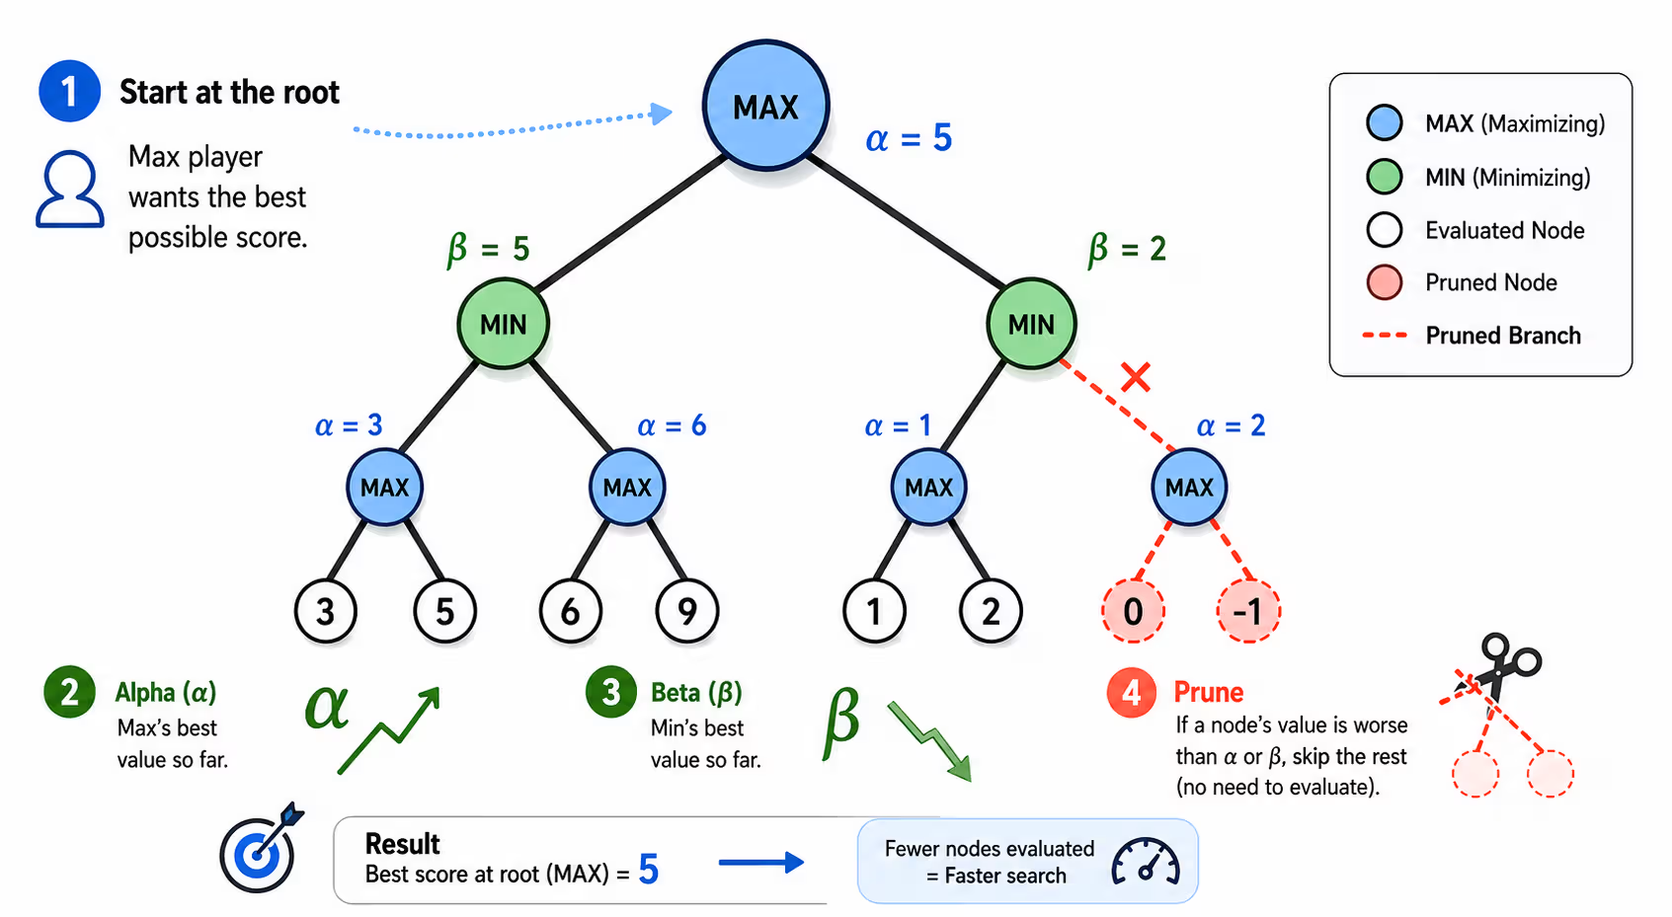
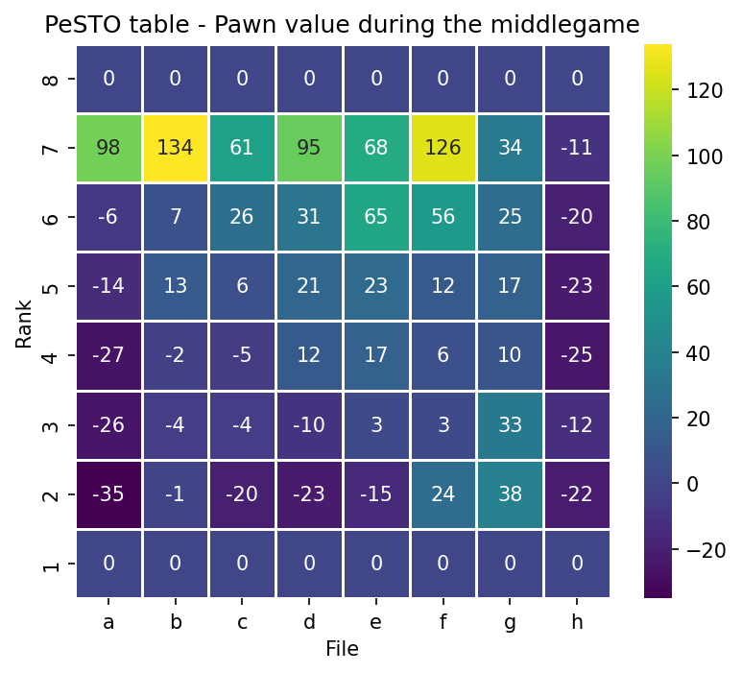
Some more slides…

Slide 25
THE DEPLOYMENT CONSTRAINT
Specialization must preserve search speed
120 MHz
192 KB
512 KB
CPU frequency
Internal RAM
Internal flash
Alpha–beta search calls the evaluator over and over. A slower network can cost a ply of search, which often matters more than a small gain in the value itself.
The question
Can specialization improve the prediction inside this budget?
Target: Wio Terminal, ARM Cortex-M4.
Hardware specifications, not measured deployment. Thesis §4.8.
2 / 15

Slide 26
KITSUNE

Slide 27
KITSUNE

