Slide 1
ENSE 470, Milestone 5
Team DCC
Dakota Fisher, Chengyu Lou, Connor Meredith
March 15th, 2018

Slide 2
Acceptance Test-Driven Development (ATDD)
Total number of scenarios? 36
Describe your experience
This activity simply reinforced our views on the MVP.
Testing seems straightforward, there are very few boundary points and equivalence classes to manage.
On one hand, this might have helped before lo-fi prototyping, as it would allow us to better describe and understand the intricacies of our design.
On the other hand, lo-fi helped us to visualize the overall design requirements used in the creation of this milestone.

Slide 3
ATDDs
User focus: IT Analyst
User story theme: Form Management
As an IT Analyst I would like to be able to receive approved forms so I can provision access.
Acceptance test-driven development criteria (ATDD) (positive/negative) | Failed | Passed
[P] Viewing the tasks page when clicking on a task then displays the task. | *
[N] given they load the tasks page, when they view it, the page displays an ‘empty’ message | *

Slide 4
ATDDs
User focus: IT Analyst
User story theme: Data Validation
As an IT Analyst I would like to be able to review user data to be able to provision access correctly
Acceptance test-driven development criteria (ATDD) (positive/negative) | Failed | Passed
[P] Given the user is on a task page, when they read the page, all required data is present. | *
[N] Given the user is on a task page, when the data is insufficient, there is notice of the flaws. | *

Slide 5
ATDDs
User focus: IT Analyst
User story theme: Access Provisioning
As an IT Analyst I would like to be able to provision access to users so they can access their software.
Acceptance test-driven development criteria (ATDD) (positive/negative) | Failed | Passed
[P] given they are on a tasks page when they provision access, they can record the completion. | *
[N] given they are on a tasks page, when they deny provisioning, the task is updated. | *

Slide 6
ATDDs
User focus: IT Analyst
User story theme: Contacting
As an IT Analyst I would like to be able to contact the approver to be able to verify provisioning of software in fringe cases.
Acceptance test-driven development criteria (ATDD) (positive/negative) | Failed | Passed
[P] given they are on a task page, when they look up the approver, then they can contact the approver. | *
[N] given they are viewing an approver’s information, when they read it, all the data is displayed, or shown as omitted/unavailable. | *

Slide 7
ATDDs
User focus: IT Analyst
User story theme: Information Request
As an IT Analyst I would like to be able to request for more information from the software user when their information is insufficient to provision access.
Acceptance test-driven development criteria (ATDD) (positive/negative) | Failed | Passed
[P] given the analyst views the user’s request, all the data required is visible and no contact is required. | *
[N] Given the analyst views the user data, when data is missing, then they can request information from the user. | *

Slide 8
ATDDs
User focus: IT Analyst
User story theme: Finalizing Tasks
As an IT Analyst I would like to be able to send the user notice upon the completion of provisions to let them know they can use the software.
Acceptance test-driven development criteria (ATDD) (positive/negative) | Failed | Passed
[P] given the analyst has provisioned software, when they mark it as complete, the user’s ticket status is updated. | *
[N] given the analyst has provisioned software, and forgets to mark it as complete, it remains in their queue until marked as complete. | *

Slide 9
ATDDs
User focus: IT Analyst
User story theme: Finalizing Tasks
As an IT Analyst I would like to be able to update the software user with a rejection notice when it isn’t possible to provision access.
Acceptance test-driven development criteria (ATDD) (positive/negative) | Failed | Passed
[P] Given the analyst cannot provision software, when they mark the task as completed, the user receives a reason and the task is updated to denied. | *
[N] given the analyst incorrectly provisions software, when they attempt to provision access, they receive a verification message. | *

Slide 10
ATDDs
User focus: approver
User story theme: approving requests but the number of users are excess the max number of users allowed to use a software
As an approver, I would like to approval the requests, but when the max number is reached the system will show pendinf
Acceptance test-driven development criteria (ATDD) (positive/negative) | Failed | Passed
[P] Given the approver is on a task page, when the system shows pending, the system will send a message to user about the situation. | *
[p] Given the user is on a task page, when new space is released, the system will change the pending status to approved and send a message to the user. | *

Slide 11
ATDDs
User focus: approver
User story theme: review User requests
As an approver, I would like to review all the requests to be able to approve them
Acceptance test-driven development criteria (ATDD) (positive/negative) | Failed | Passed
[P] Given the approver is on a task page, when they on the task page, they are able to see all the requests. | *
[N] Given the user is on a task page, when they finish approval existing requests, new request will automatically pop up no need for approver to refresh the page. | *

Slide 12
ATDDs
User focus: approver
User story theme: approval user request
As an approver, I would like to approve user requests.
Acceptance test-driven development criteria (ATDD) (positive/negative) | Failed | Passed
[P] Given the approver is on a task page, when they approving software, they only need one click to approve the request | *
[N] Given the user is on a task page, when they regret about theirs decision, they can undo it in one click. | *

Slide 13
ATDDs
User focus: approver
User story theme: reject user requests
As an approver, I would like to reject user requests.
Acceptance test-driven development criteria (ATDD) (positive/negative) | Failed | Passed
[P] Given the approver is on a task page, when they rejecting requests, they are able to write comments about the reason why the request is rejected. | *
[N] Given the user is on a task page, when the users send a second request, approver can see the reason why their request is rejected in the first time. | *

Slide 14
ATDDs
User focus: Software Requester (All Users)
User story theme: Login
As a user I would like to be able to login to to the software portal so that I can make requests and check the status of my existing requests
Acceptance test-driven development criteria (ATDD) (positive/negative) | Failed | Passed
[P] Given the user has input the correct credentials, when they click the sign in button, the user should be redirected to the create request page | *
[N] Given the user has input invalid credentials, when they click the sign in button, the user should receive a popup notifying them that sign in has failed and then be redirected back to the sign in page | *

Slide 15
ATDDs
User focus: Software Requester (All Users)
User story theme: Creating Requests
As a user I would like to be able to create software requests so that I can ensure I have all the approriate software required for my role.
Acceptance test-driven development criteria (ATDD) (positive/negative) | Failed | Passed
[P] Given the user has is signed in, when they click the create request tab up top, the user should be redirected to the software request form | *
[P] Given the user is on the create request page, when the user attempts to fill in the form, they should be able to input text into the modifiable fields and should be able to find and select software via a dropdown list. | *

Slide 16
ATDDs
User focus: Software Requester (All Users)
User story theme: Creating Requests
As a user I would like to be able to create software requests, so that I can ensure I have all the approriate software required for my role.
Acceptance test-driven development criteria (ATDD) (positive/negative) | Failed | Passed
[P] Given the user has filled in all mandatory fields on the software request form, when the user clicks the submit button, the software request should be submitted and the user should receive a popup indicating the submission was successful | *
[N] Given the user has not filled in all mandatory fields on the software request form, when the user clicks the submit button, the form should not be submitted and the user should receive a popup indicating that not all mandatory fields have been filled in. | *

Slide 17
ATDDs
User focus: Software Requesters (All Users)
User story theme: Monitoring Status of Requests
As a user I would like to receive notifications whenever my software requests are approved, rejected, or completed so that I can monitor the status of my requests
Acceptance test-driven development criteria (ATDD) (positive/negative) | Failed | Passed
[P] Given that a request has successfully been submitted, when the request is approved, users should be notified that the state of the request has changed to approved | *
[P] Given that a request has been approved, when the request is completed, users should be notified that the state of the request has changed to completed | *
[N] Given that a request is submitted for software that a user does not qualify for, when the request is denied, the user should be notified that that the request has been denied and additionally the user should have access to optional notes that may explain why the request was denied | *

Slide 18
ATDDs
User focus: Software Requesters (All Users)
User story theme: Logout
As a user I would like to be able to logout of my account when I am not using it so that my account is not accessible to other people.
Acceptance test-driven development criteria (ATDD) (positive/negative) | Failed | Passed
[P] Given that a user is signed in, when they click the sign out button, the user should be signed out and then redirected to the sign in page. | *

Slide 19
“Daily” Scrum
Are you on track?
Yes, we are. The design follows a very bullish scope-time approach and will fall together rapidly.
Any barriers to your group’s success?
We have been busy with other coursework, but our availability should increase now that we are done with midterms. Google docs has been a useful platform for sharing work thus far.
Do you envision being able to achieve more (or less) for your release 1/MVP?
We believe that will we able to achieve the release as defined, given it builds as expected and schedule.

Slide 20
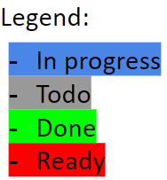
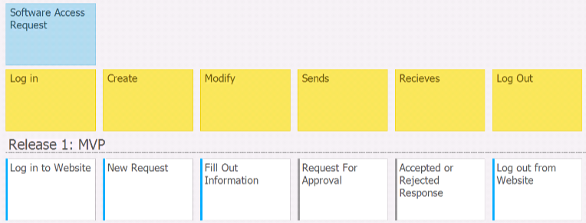
Software User User Story Map
Team DCC: Dakota Fisher, Chengyu Lou, Connor Meredith

Slide 21
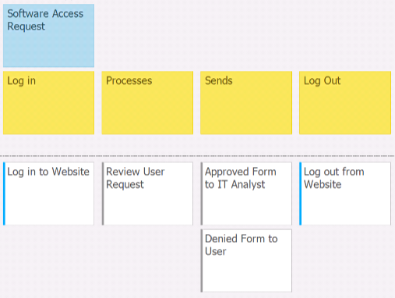
Approver User Story Map
Team DCC: Dakota Fisher, Chengyu Lou, Connor Meredith

Slide 22
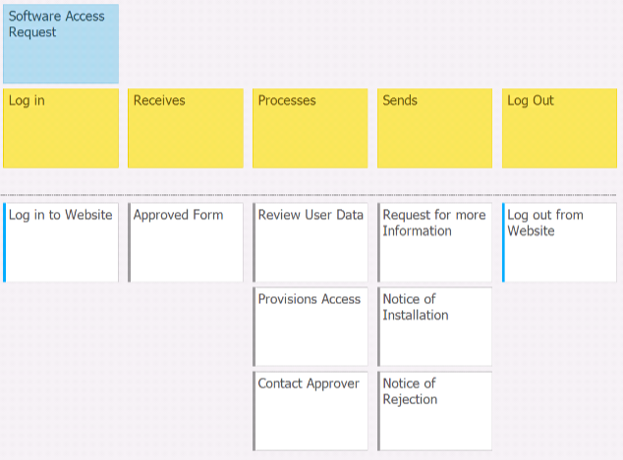
IT Analyst User Story Map
Team DCC: Dakota Fisher, Chengyu Lou, Connor Meredith

Slide 23
Changes & Misc.
Have your plans changed since your group’s initial conception and project evolution
Not really, Just been further and further concentrated, with small flare such as “forgot password” functionality for example being discussed and negated.
Our initial FSM was quite ambitious, and as we progressed, the MVP has been further condensed based on conversations.

Slide 24
Group reflection
What did you learn about yourself as you collaborated and worked through this milestone?
The usefulness of writing acceptance tests before beginning development
How will you use what you have learned going forward?
Use the acceptance tests to guide development and remain focused during the development phase

Slide 25
Group reflection
How did you feel about this milestone? What did you like about it? What did you dislike?
Simple and useful for planning upcoming development.
No complaints.
What “stuff & things” related to this milestone would you want help with?
Nothing in particular. Just any feedback that you have that may help us.

