Slide 1
ENSE 470, Milestone 3
DCC
Dakota Fisher, Chengyu Lou, Connor Meredith
February 1, 2018

Slide 2
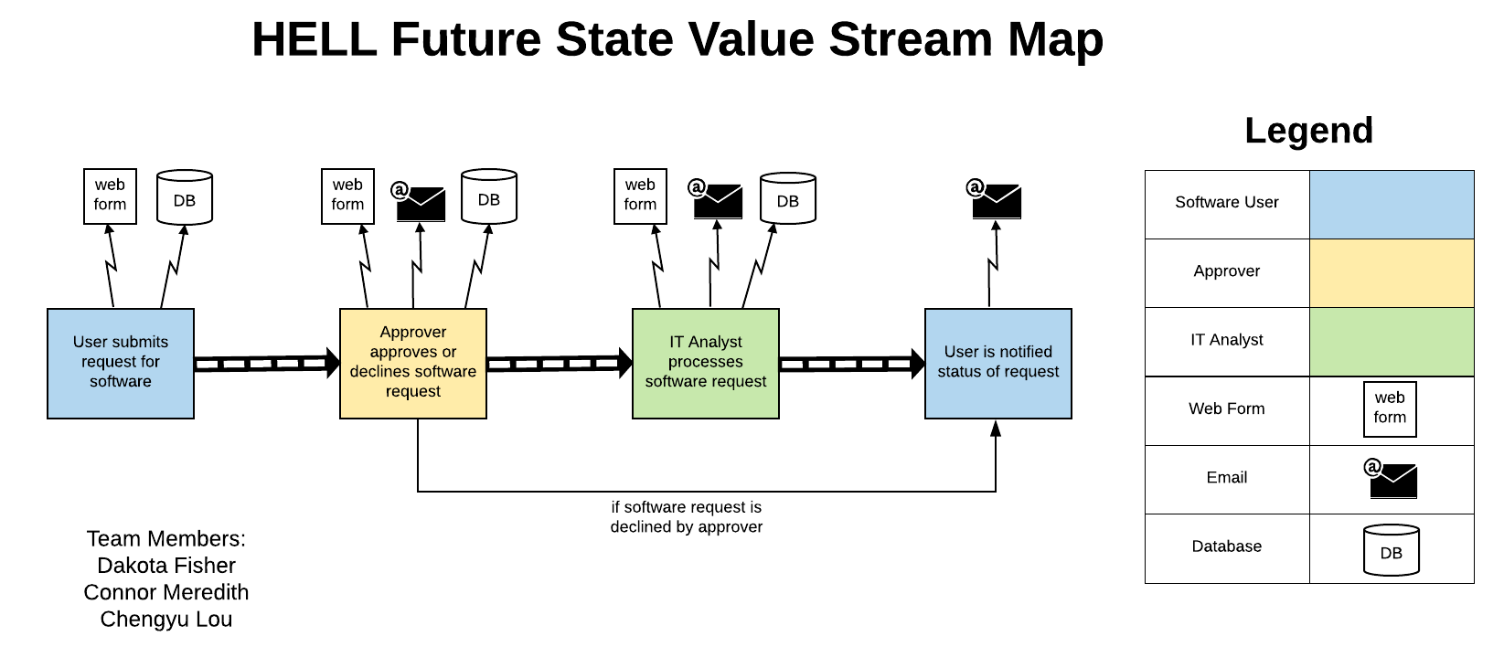

Slide 3
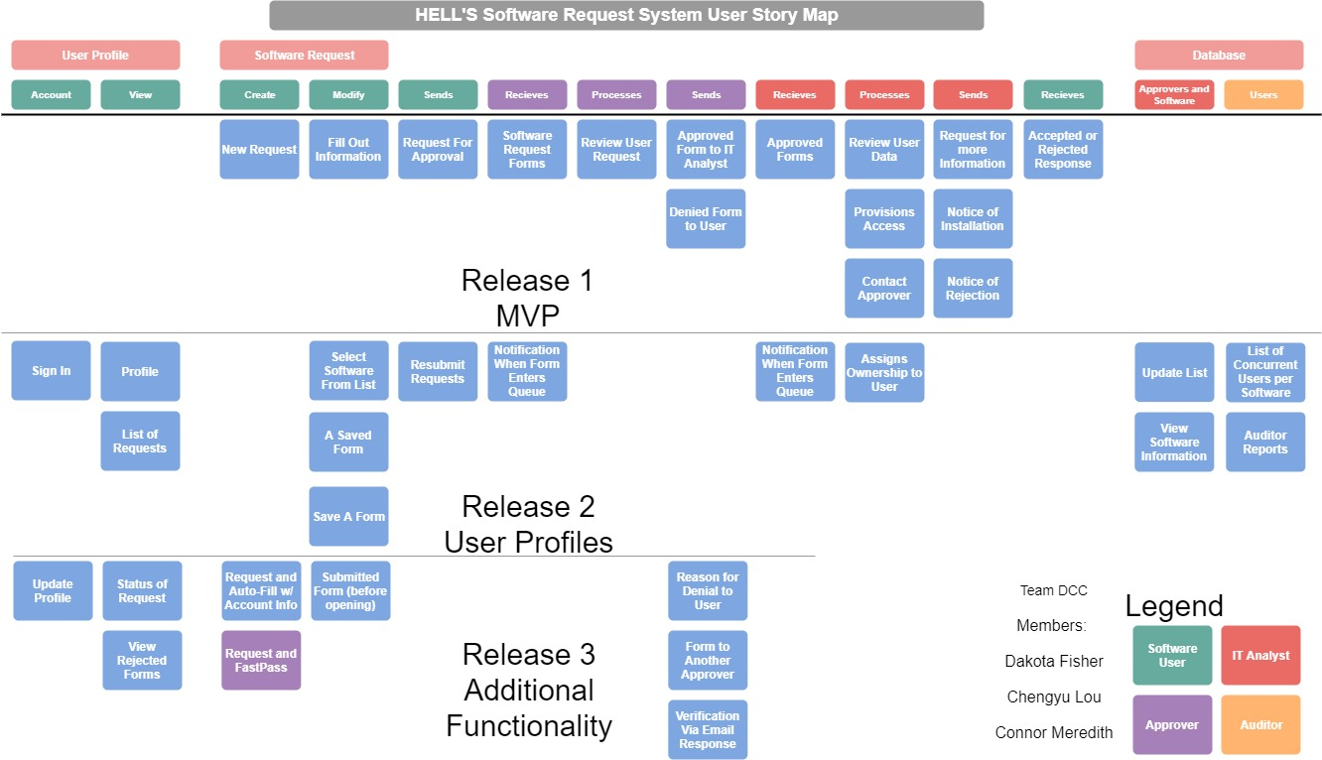

Slide 4
Changes & Misc.
Have your plans changed since your group’s initial conception and project evolution?
Not really, The process flow has stayed fairly consistent.
Since we have a web form, it should be contained on a website.
Add Extra Utility
a portal for the IT Analysts to update their lists.
Account System for Users (could tie into Pre-existing System?)
There’s always the “what if’s” and scope creeping towards the final implementation.

Slide 5
Group reflection
How did you feel about this milestone? What did you like about it? What did you dislike?
Likes: simple, useful concept for aiding in the design process, more organized method than using product backlog
Dislikes: None
What did you learn about yourself as you collaborated and worked through this milestone?
importance of looking at a design from the user’s perspective rather than only from a developer's perspective

Slide 6
Group reflection
How will you use what you have learned going forward?
be more considerate of user’s perspective
What “stuff & things” related to this milestone would you want help with?
provide more clarity about the different levels of a user story map and the differences between a user story map and a product backlog

Slide 7
