Slide 1

Why I use Julia
And why you might not want to

Slide 2

Pre-Workshop Checklist
1
Julia
Install Julia via JuliaUp
2
Data
Download the data

3
Workspace
Have a workspace ready for Julia coding
💻

Slide 3

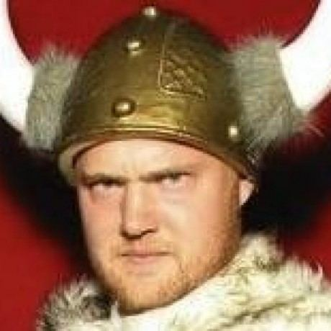
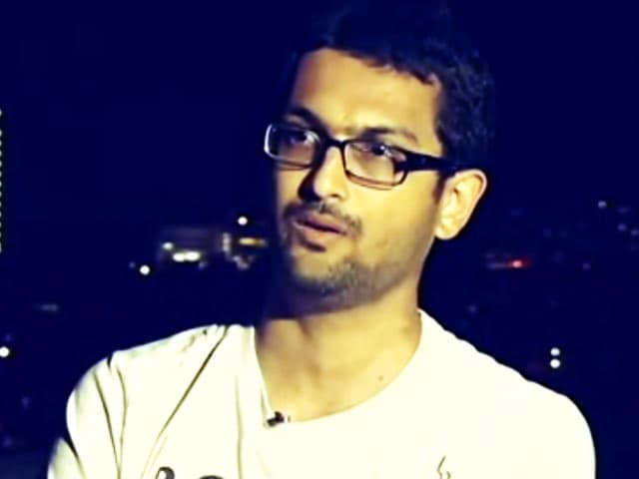
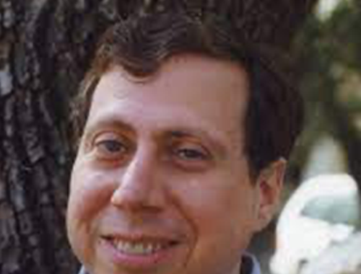
Julia in Brief
2009 | 2012 | 2014 | 2018
Work begins on Julia | Julia officially announced | First JuliaCon | Julia 1.0 released
Jeff Bezanson
We want a language that's open source, with a liberal license. We want the speed of C with the dynamism of Ruby. We want a language that's homoiconic, with true macros like Lisp, but with obvious, familiar mathematical notation like Matlab. We want something as usable for general programming as Python, as easy for statistics as R, as natural for string processing as Perl, as powerful for linear algebra as Matlab, as good at gluing programs together as the shell. Something that is dirt simple to learn, yet keeps the most serious hackers happy. We want it interactive and we want it compiled.
Stefan Karpinski
Viral Shah
Alan Edelman

Slide 4
Why Julia?
Multiple Dispatch
Dynamic Types
Overload functions
Most specific match runs
Types are optional
More info = Faster Code
Metaprogramming
JIT Compiled
Everything in Julia has a type
Code which writes code
Compile code once during runtime
Extendable
Opinionated
Robust Package Ecosystems:
Visualisation, Statistics, Machine Learning, Quantum Computing, HPC, and Astronomy!
Built in:
Package Management, Profiling, Debugging, Logging
Interactable
Interface with C, Fortran, C++, Python, R, Java, Mathematica, Matlab, etc...

Slide 5
Practical Example – Fit a Model to Data
REPL, Notebooks, Scripting, Environments
Optimisation Basics, Profiling, Debugging, Docs, and Tests
Advanced Optimisations, Interoperability
GPU, HPC,
Basics
Intermediate
Advanced
Expert
1
2
3
4

Slide 6
Basics: Interacting with Julia
REPL
Interactive command-line read-eval-print loop
] - Package Mode ? - Help Mode ; - Shell Mode Colours Tab Completion Unicode / LaTeX Input
julia ≅ ipython
Notebook
Reactive and Reproducible
Automatic Cell Re-evaluation PlutoUI – Sliders, Buttons, etc... Built-in Package Manager No mutable workspace, no hidden state
Pluto ≅ Jupyter
Scripts
julia script.jl include(“script.jl”)
Feature-Rich VSCode Integration Emacs, Vim, Atom, Zed, Notepad++, Sublime, Intellij, and more!
script.jl ≅ script.py

Slide 7
Basics: Reading, analysing, and writing
JuliaWorkshop/Code/1. Basics/Scripts

Julia
Python
julia script.jl
output_jl.txt
python script.py
output_py.txt

Slide 8
Basics: Environments, Workflow, and Plotting
JuliaWorkshop/Code/1. Basics/Environments/AnalyseLightcurve.{jl,py}

Julia
Python
julia script.jl
output_jl.txt
python script.py
output_py.txt

Slide 9
Basics: Environments and Plotting

] generate AnalyseLightcurve.jl
Create Environment
python -m venv .venv
] activate .
Activate Environment
source .venv/bin/activate
using AnalyseLightcurve
Import Project
import AnalyseLightcurve
AnalyseLightcurve.main()
Run Project
AnalyseLightcurve.main()

Slide 10
Basics: Iterative Workflow

%load_ext autoreload
%autoreload 2
using Revise
Activate AutoReload
edit(AnalyseLightcurve)
Edit code
%edit AnalyseLightcurve.py
;imv Supernova\ Lightcurve.svg
View results
!imv Supernova\ Lightcurve.svg

Slide 11
About realistic galaxy consulting toolkit infographics
This template contains an assortment of complementary infographic resources for the Realistic Galaxy Consulting Toolkit presentation.
These infographics are adapted to the style of the aforementioned presentation, so you can insert them easily and have them completely integrated at once. You just need to do the following:
  Select the element that you want to copy
  Right-click and choose “Copy”
  Go to the slide where you want the element to appear
  Right-click and choose “Paste”

Slide 12
Realistic galaxy consulting toolkit
 | Step 1 | Step 2 | Step 3 | Step 4
Saturn
Neptune
Earth
Mercury
Venus
Mars
Jupiter
Mercury is the smallest planet
Venus has a beautiful name
Mars is actually a cold place
Jupiter is the biggest planet

Slide 14
Realistic galaxy consulting toolkit
25%
50%
Mercury
Mars
Mercury is the closest planet to the Sun
Despite being red, Mars is a cold place
75%
90%
Venus
Jupiter
Venus is the second planet from the Sun
Jupiter is the biggest planet of them all

Slide 15
Realistic galaxy consulting toolkit
Mercury
Mars
Mercury is the closest planet to the Sun
Despite being red, Mars is a cold place
Venus
Jupiter
Venus is the second planet from the Sun
Jupiter is the biggest planet of them all

Slide 16
Realistic galaxy consulting toolkit
60%
40%
75%
25%
30%
70%
Mercury
Venus
Mars
Mercury is the smallest planet
Venus has a beautiful name
Mars is actually a cold place

Slide 17
Realistic galaxy consulting toolkit
Mercury
Jupiter is a gas giant and the biggest planet
It’s the fourth-brightest object in the sky
Mercury is the closest planet to the Sun
Despite being red, Mars is actually a cold place
It’s full of iron oxide dust, which gives its red cast
Venus is the second planet from the Sun
Venus

Slide 18
Realistic galaxy consulting toolkit
Mercury
Mercury is the closest planet to the Sun
Venus
Venus is the second planet from the Sun

Slide 19
Realistic galaxy consulting toolkit
Mercury
=
+
Mercury is the smallest planet
Venus
=
+
Venus has a beautiful name
Jupiter
=
+
Jupiter is the biggest planet

Slide 20
Realistic galaxy consulting toolkit
Mercury is the closest planet to the Sun
Mercury
Despite being red, Mars is actually a cold place
Venus
Venus is the second planet from the Sun
Venus
Jupiter is a gas giant and the biggest planet
Mars

Slide 21
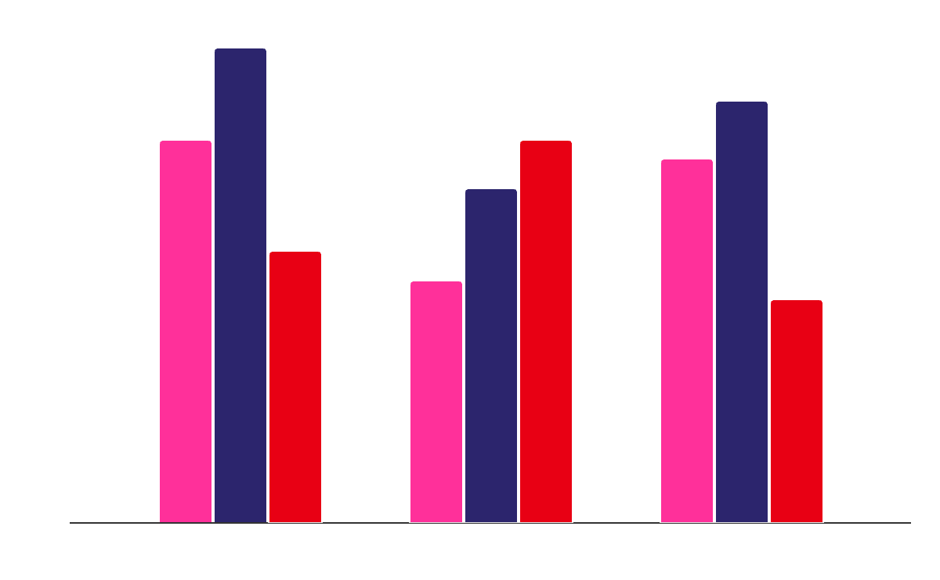
Realistic galaxy consulting toolkit
Mercury
It’s the smallest planet
Venus
Venus has a beautiful name
Jupiter
Jupiter is the biggest planet
Follow the link in the graph to modify its data and then paste the new one here. For more info, click here

Slide 22
Realistic galaxy consulting toolkit
Mercury is the smallest planet
Mars is actually a cold place
Venus has a beautiful name
Jupiter is the biggest planet
Mercury
Mars
Venus
Jupiter
Saturn
Neptune
Earth
Pluto
Saturn has beautiful rings
Neptune is far away from us
Earth is the planet with life
Pluto is considered a dwarf planet

Slide 23
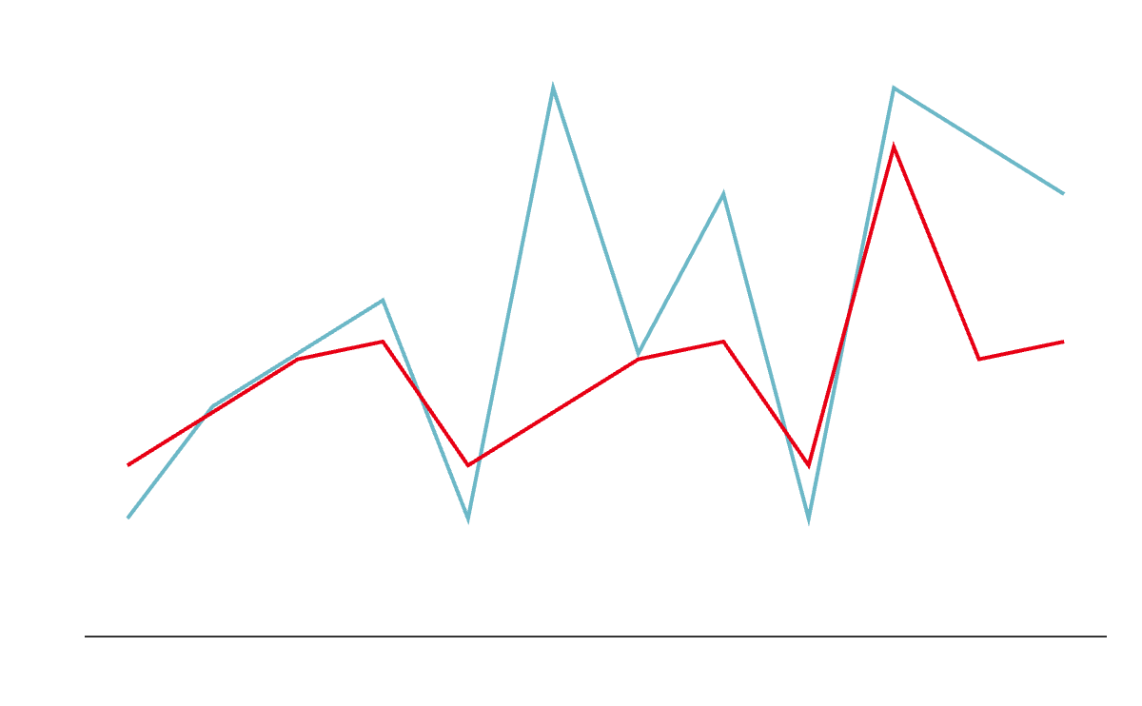
Realistic galaxy consulting toolkit
Mercury
Mercury is the closest planet to the Sun
Venus
Venus is the second planet from the Sun
Follow the link in the graph to modify its data and then paste the new one here. For more info, click here

Slide 24
Realistic galaxy consulting toolkit
 | Jan | Feb | Mar | Apr | May | Jun | Jul | Aug | Sep | Oct | Nov | Dec
Task 1 |  |  |  | ✔
Task 2 |  |  |  |  |  |  | ✔
Task 3 |  |  |  |  |  |  |  |  |  | ✔
Task 4 |  |  |  |  |  |  |  |  |  |  |  | ✔

Slide 25
Realistic galaxy consulting toolkit
Mercury
55%
Mercury is the smallest planet
Venus
80%
Venus has high temperatures
Jupiter
15%
Jupiter is the biggest planet
Mars
30%
Mars is actually a cold place
Saturn
50%
Saturn has several rings

Slide 26
Realistic galaxy consulting toolkit
Mercury
Venus
Mars
Mercury is the closest planet to the Sun
Venus is the second planet from the Sun
Despite being red, Mars is a cold place

Slide 27
Realistic galaxy consulting toolkit
1st quarter |  | 2nd quarter
January | 29,847€ | April | 49,586€
February | 60,293€ | May | 73,049€
March | 84,760 | June | 58,670€
3rd quarter |  | 4th quarter
July | 29,384€ | October | 34,986€
August | 76,023€ | November | 72,039€
September | 94,867€ | December | 84,678€

Slide 28
Realistic galaxy consulting toolkit
February 14
June 25
September 12
December 08
20,000€
50,000€
30,000€
10,000€
Venus
Mercury
Jupiter
Mars
Venus is the second planet from the Sun
Mercury is the closest planet to the Sun
Jupiter is a gas giant and the biggest planet
Despite being red, Mars is actually a cold place

Slide 29
Realistic galaxy consulting toolkit
1
Mercury is the closest planet to the Sun
5
Jupiter is the biggest planet of them all
2
Venus is the second planet to the Sun
6
Saturn is a gas giant and has several rings
3
Earth is the third planet from the Sun
7
Neptune is very far away from us
4
Despite being red, Mars is a cold place
8
The Sun is the star that all planets orbit

Slide 30
Realistic galaxy consulting toolkit
15%
Mars
Mercury
It’s the smallest planet
45%
Despite being red, Mars is a cold place
30%
Venus
Venus has a nice name
Jupiter
75%
Jupiter is the biggest planet of them all
60%
Mars
Mars is actually a cold place

Slide 31
Realistic galaxy consulting toolkit
Venus has a beautiful name and a highly toxic atmosphere
Venus
Mercury is the closest planet to the Sun and the smallest one in the Solar System
Despite being red, Mars is actually a cold place. It’s full of iron oxide dust
Mercury
Mars

Slide 32
Realistic galaxy consulting toolkit
A
Mercury
Mars
Mercury is the closest planet to the Sun
Despite being red, Mars is a cold place
A
B
Venus
Jupiter
Venus is the second planet from the Sun
Jupiter is the biggest planet of them all
B

Slide 33
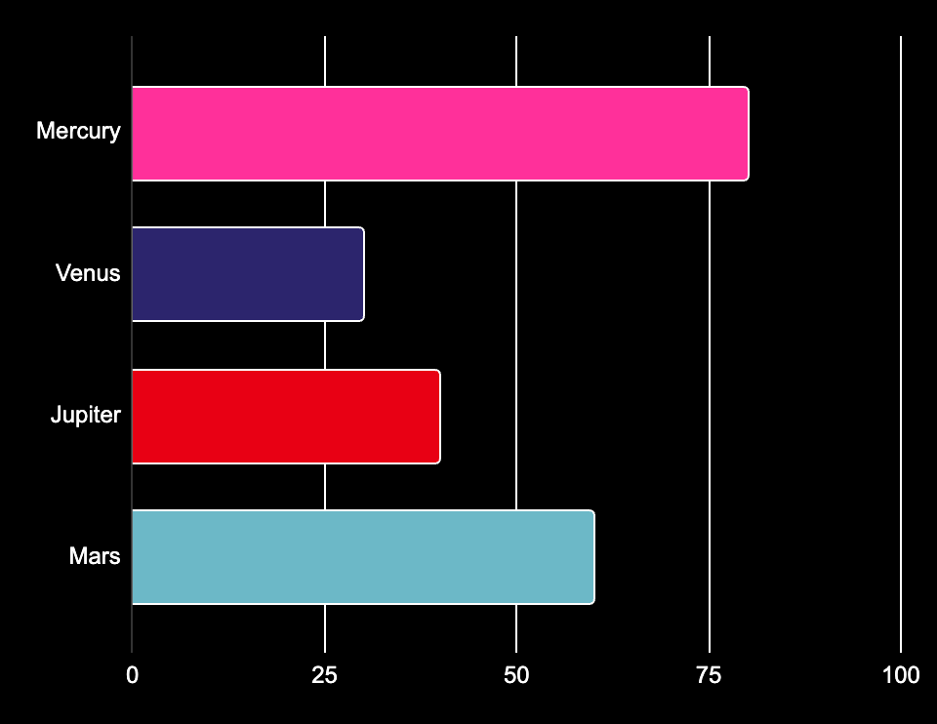
Realistic galaxy consulting toolkit
80%
Mercury
Mercury is the smallest planet
30%
Venus
Venus has a beautiful name
40%
Jupiter
Jupiter is the biggest planet
60%
Follow the link in the graph to modify its data and then paste the new one here. For more info, click here
Mars
Mars is actually a cold place

Slide 34
Realistic galaxy consulting toolkit
Mercury
Venus
Mars
Mercury is the smallest planet
Venus has a beautiful name
Mars is actually a cold place
A
10%
A
15%
A
50%
B
55%
B
30%
B
20%
Jupiter
Saturn
Neptune
Jupiter is the biggest planet
Saturn has beautiful rings
Neptune is far away from us
A
25%
A
60%
A
40%
B
90%
B
75%
B
80%

Slide 35
Instructions for use
If you have a free account, in order to use this template, you must credit Slidesgo in your final presentation. Please refer to the next slide to read the instructions for premium users.
As a Free user, you are allowed to:
- Modify this template.
- Use it for both personal and commercial projects.
You are not allowed to:
- Sublicense, sell or rent any of Slidesgo Content (or a modified version of Slidesgo Content).
- Distribute Slidesgo Content unless it has been expressly authorized by Slidesgo.
- Include Slidesgo Content in an online or offline database or file.
- Offer Slidesgo templates (or modified versions of Slidesgo templates) for download.
- Acquire the copyright of Slidesgo Content.
For more information about editing slides, please read our FAQs or visit our blog:
https://slidesgo.com/faqs and https://slidesgo.com/slidesgo-school

Slide 36
Instructions for use (premium users)
As a Premium user, you can use this template without attributing Slidesgo.
You are allowed to:
Modify this template.
Use it for both personal and commercial purposes.
Share this template in an editable format with people who are not part of your team.
You are not allowed to:
Sublicense, sell or rent this Slidesgo Template (or a modified version of this Slidesgo Template).
Distribute this Slidesgo Template (or a modified version of this Slidesgo Template) or include it in a database or in any other product or service that offers downloadable images, icons or presentations that may be subject to distribution or resale.
Use any of the elements that are part of this Slidesgo Template in an isolated and separated way from this Template.
Register any of the elements that are part of this template as a trademark or logo, or register it as a work in an intellectual property registry or similar.
For more information about editing slides, please read our FAQs or visit our blog:
https://slidesgo.com/faqs and https://slidesgo.com/slidesgo-school

Slide 37
Infographics
You can add and edit some infographics to your presentation to present your data in a visual way.
Choose your favourite infographic and insert it in your presentation using Ctrl C + Ctrl V or Cmd C + Cmd V in Mac.
Select one of the parts and ungroup it by right-clicking and choosing “Ungroup”.
Change the color by clicking on the paint bucket.
Then resize the element by clicking and dragging one of the square-shaped points of its bounding box (the cursor should look like a double-headed arrow). Remember to hold Shift while dragging to keep the proportions.
Group the elements again by selecting them, right-clicking and choosing “Group”.
Repeat the steps above with the other parts and when you’re done editing, copy the end result and paste it into your presentation.
Remember to choose the “Keep source formatting” option so that it keeps the design. For more info, please visit our blog.

