Slide 1
Team Alligator's Interim Progress Report
So just how are we doing exactly?

Slide 2
PANIC AT THE MIDTERM DISCO
          (Image courtesy of www.genericstockphotos.com)

Slide 3
We have the technology!
Things currently in a standstill until major midterms are finished.
Currently evaluating the actual plot and flow of our project.
Working on creating a female model to use for our two main characters.
Plan to use an online model for inspiration/to base it off of.
Extraneous details expected to be finalized by weeks end.

Slide 4
Model we are using for frame of reference.
Warning: Final product may vary.

Slide 5
Our actual model so far. . .
Warning: Final product may not vary.

Slide 6
 | Cole Fudge | Aedan Burnett | Aaron Padlesky | Pranjali Pokharel
1st coordinator | X
 | We’ve all been present at any and all meetings
2nd coordinator |  | X
 | https://github.com/SuperSheep18/307project.git
Modeling & Texture | X | X | X | X
 | 0% completed
Animation | X | X | X | X
 | 0% completed
Special effects | X | X | X | X
 | 0% completed

Slide 7
 | Wk5 | Wk6 | Wk7 | Wk8 | Wk9 | Wk10 | Wk11 | Wk12 | Wk13
Cole | 8hr | 8hr | 8hr | 8hr | 8hr | 8hr | 8hr | 8hr | 8hr
 | Below target
Aedan | 8hr | 8hr | 8hr | 8hr | 8hr | 8hr | 8hr | 8hr | 8hr
 | Below target
Aaron | 8hr | 8hr | 8hr | 8hr | 8hr | 8hr | 8hr | 8hr | 8hr
 | Below target
Pranjali | 8hr | 8hr | 8hr | 8hr | 8hr | 8hr | 8hr | 8hr | 8hr
 | Below target

Slide 8
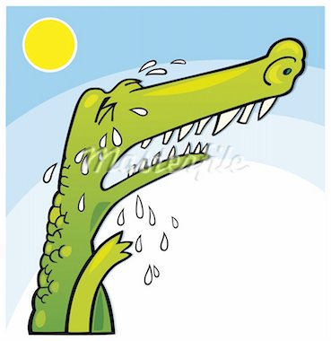
THE END
Warning: Actual Tears may vary.
(Image courtesy of www.genericstockphotos.com)

