Slide 1
AWS Lambda
Vladislav Savranschi
Max Wiegant
Brian Smith

Slide 2

Background - What is AWS Lambda?
Runs code, then terminates
Run code without provisioning or managing servers
Continuous scaling
Great for large jobs or small (BigData or Internet of Things)
Many languages
Node.js
Java
Python
C#

Slide 3
Problem Definition
Wanted to show how lambda could solve:
Computing big data
Getting big data
Analysing big data
Server-less architecture using AWS Lambda
Needed something to scale up and down when we needed
Needs to be cheap when we don’t use it
Can be invoked programmatically

Slide 4
Responsibilities - Brian Smith
General Lambda architecture
Explore how Lambda works
Picture color analysis example
Create a local test of color analyser
Test analyser on AWS Lambda
Analyses and report findings

Slide 5
Motivation/Significance/Challenge
Motivation: To test and see how AWS Lambda could handle computing large data sets.
Significance: Lambda can scale up easily to handle large tasks in parallel. Lambda can also be used to save money, if there isn’t many tasks to compute.
Challenge: Getting an example to show what Lambda can accomplish, without accidentally going over budget.

Slide 6
Implementation
Analysing images and extracting the prominent colors from it.
Using a library called Vibrant.js
Building a test example in Node.js on local computer
Timing how long it takes on local computer
Testing it on AWS Lambda
Analysing results and comparing the differences
Writing a report

Slide 7


Evaluation
Time single picture operation
Determine how many jobs we can do in parallel
Run the jobs on AWS Lambda
Compare the results

Slide 8
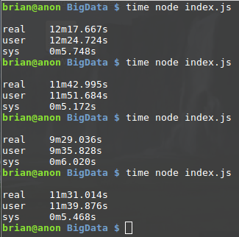
Evaluation
Local Test:
1000 images = 11 minutes average
Lambda Test:
1000 images = ??

Slide 9
Summary
AWS Lambda can handle large computations very well.
AWS Lambda can scale up large operations quickly and parallelize tasks.
The simple image color analysis shows that a task that takes a while on one machine, can be done easily using Lambda.
There is little to no cost incurred when there is no tasks to run, so it saves cost.

Slide 10
Timeline - Brian
April 23 - Create example on local computer
May 1: Implement on AWS Lambda
May 2: Analyse results
May 7 - May 15: Write report

Slide 11
Responsibilities - Vladislav Savranschi
Research Airbnb API
Create Lambda function for Airbnb
Cost analysis for running large scale data retrieval
Gather data on a small scale (zipcode, city)
Repeat on a larger scale (state, country)
Build a secured website for deployment

Slide 12
Motivation/Significance/Challenge
Motivation:
Analyzing all listings in an area may be useful to learn about opportunities in the housing market.
Significance:
Airbnb provides a very large amount of data which is difficult to sort through and evaluate by hand at a large scale.
Challenge:
Figuring out how to grab all listings in a wide area.

Slide 13
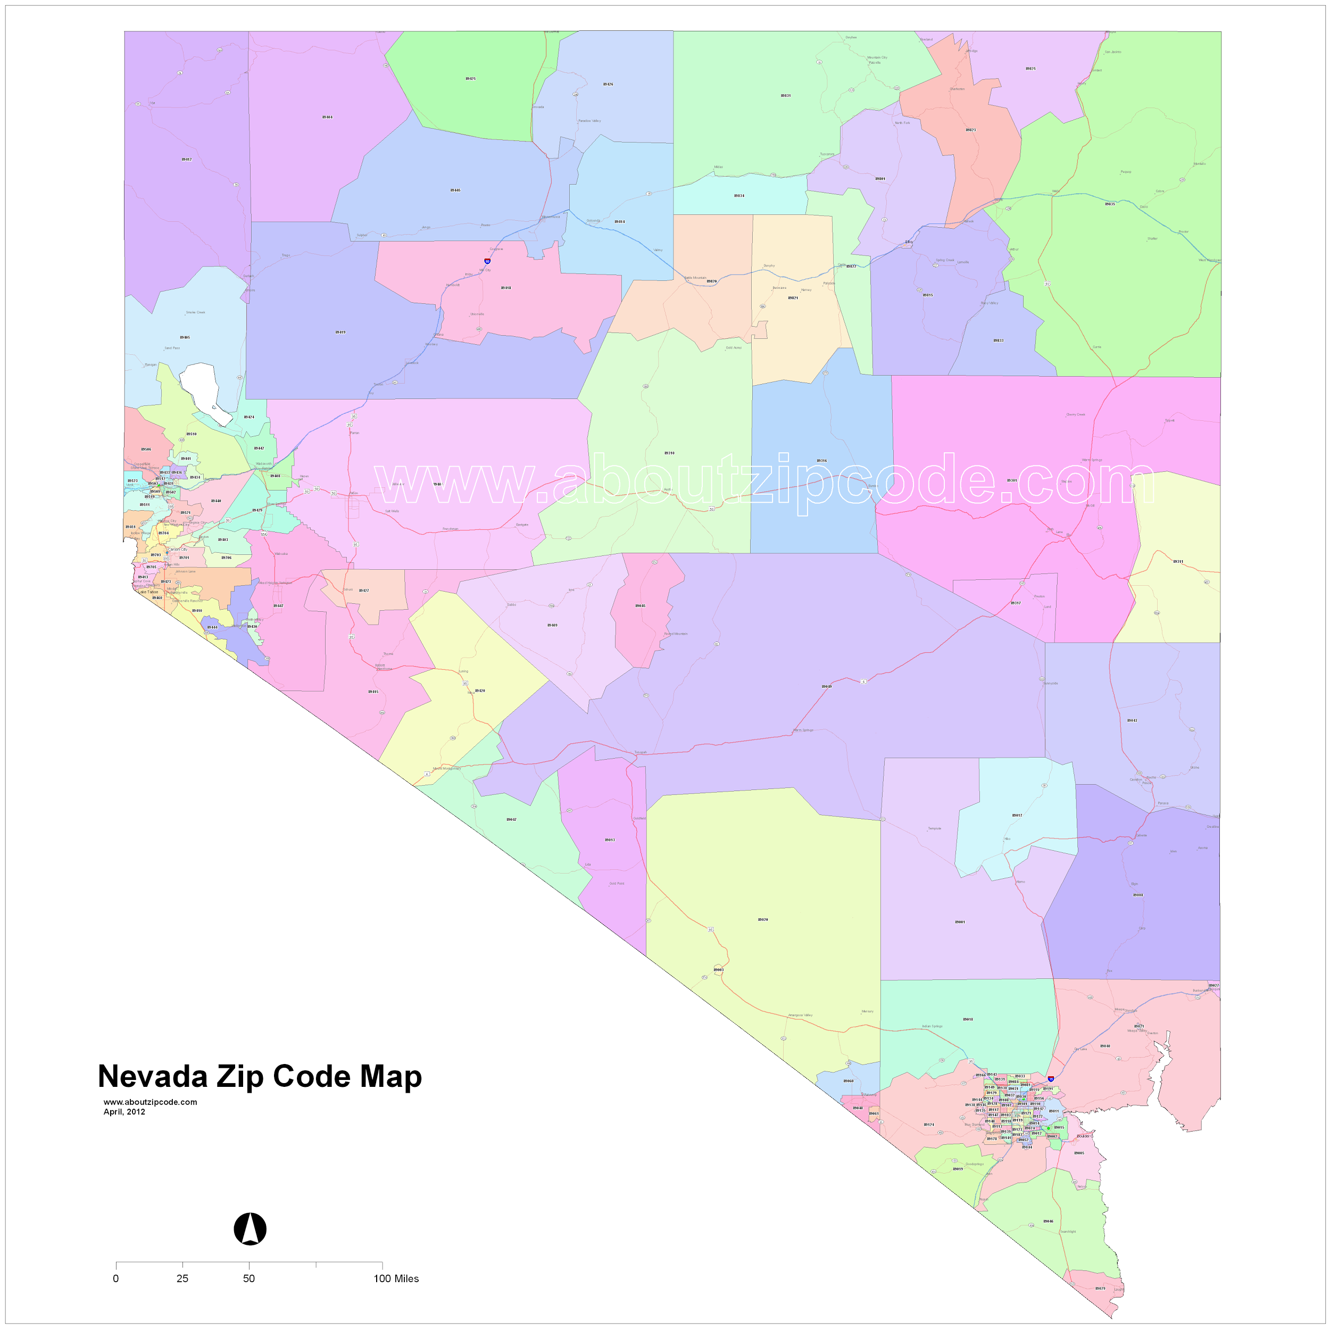
Implementation
Airbnb Lambda Function:
Use a publically available online list of 43,000 ZIP codes across the United States
Send a request using ZIP Code and State (Link)
Aggregate Airbnb listings retrieved from many concurrent localized API requests
Store listings in S3
Secure Website:
Cannot be publically available due to cost
Simple interface to run AWS Lambda

Slide 14
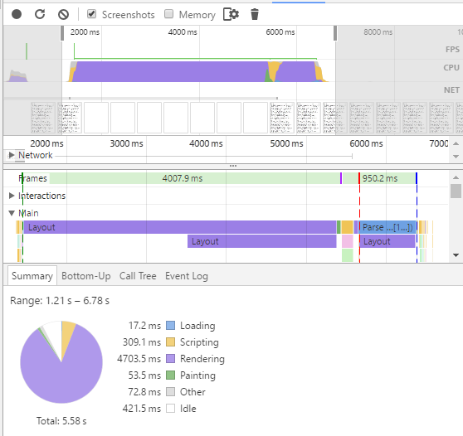
Evaluation
Benchmark analysis: 1000 Listings in New York City, Zip Code 10003
AWS Billed time = 4.300 Seconds
Max Bandwidth = 36MB-Seconds
Amazon cost: $0.00000625125 per 128 MB-s
Max cost for retrieving listings across the country: (0.00000625125/128) * 36 * 4.3 * 43000 = $0.33
Assuming 1,000 listings per zip code
Using Approx. 43000 total zip codes
Most zip codes are low-density and will not contain 1000 listings

Slide 15
Summary
Strength: AWS Lambda is faster for each request
4.3 seconds (Lambda) vs. 6.8 seconds (PC)
Strength: Parallelization
Can run 43,000 requests in chunks of 200 (free limit)
PC cannot run too many requests concurrently
Weakness: Cost
AWS Lambda can cost more than a few cents when running over 1,000,000 large requests

Slide 16
Timeline
April 23 - April 31: Airbnb Lambda Function
May 1 - May 7: Deployment site
May 7 - May 15: Final Paper

Slide 17
Responsibilities - Max Wiegant
Data collection
How, exactly, do we get the data?
What does the data have?
What do we need in order to get the data?
Building the algorithms
How do we use Zillow listings to rank AirBnb listings?
How do we rank AirBnB listings? What is an ideal “rank”?

Slide 18
Motivation/Significance/Challenge
Motivation: To test and see how AWS Lambda can handle retrieving large data sets and then using it to get useful information
Significance: Adds a new dynamic to big data, that uses external data sets and then analysing them at once
Challenge: Getting and parsing the data in an easy way, then interpreting it in a meaningful way

Slide 19
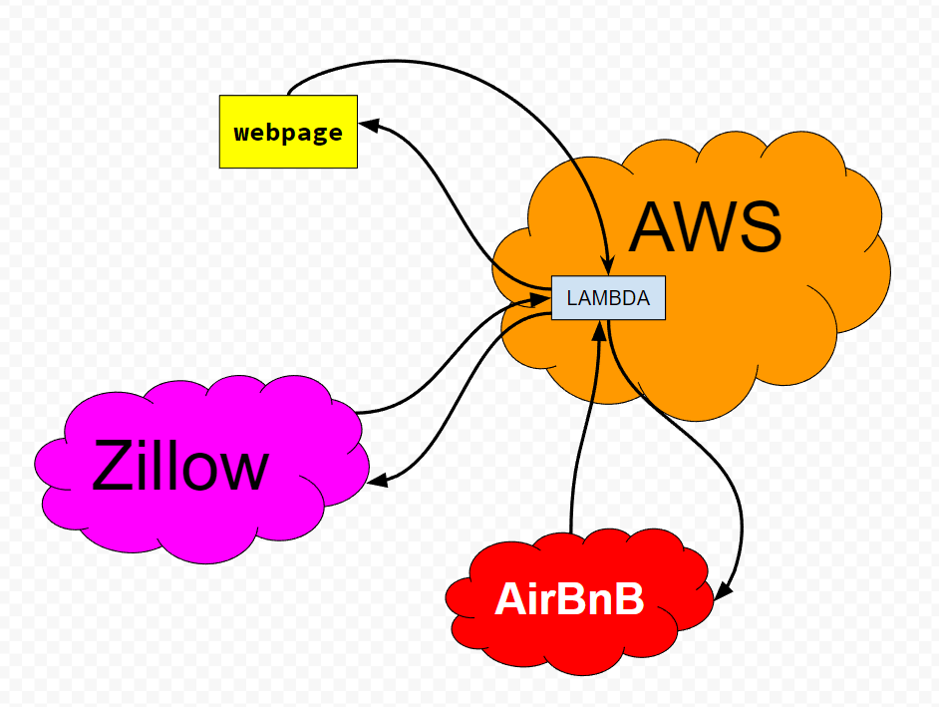
Implementation
Getting the correct data
Getting data from Zillow vs Getting data from AirBnB
AirBnB wants City, State, ZIP
Zillow wants Longitude / Latitude
Interpreting the data in a meaningful way
Saving the data
Results from the requests will be stored into S3
Gauging performance
Programmatically timing the entire operation
Comparing the times

Slide 20
Evaluation
Consideration: Is Lambda actually effective for Big Data projects?
How well Lambda manages large data sets
Does the free tier of Lambda provide sufficient memory space for data?
How long Lambda takes to perform analysis and gather data
Evaluate runtime of functions
How well Lambda does in sending data between multiple Lambda functions
Evaluate if the data is sent as expected, verify correctness of that data

Slide 21
Summary
Determine if Lambda handles big data analysis as well as expected
Grab data from Zillow and from Airbnb
Do calculations on the resulting data
Output best listings in a given area

Slide 22
Timeline
April 23 - May 30: Gather data, write algorithms, build a sample infrastructure
May 1 - May 7: Analyze results, record observations
May 8 - May 15: Work with team to write the final paper

Slide 23
Conclusion
AWS Lambda has a range of applications
It can be used for high load operations
Can be used for:
Big data computations
Big data retrieval
Big data analysis
Can be done in many languages
Easy to get started

Slide 24
Questions?

