Slide 1
GIT & GIT Flow intro
JKP tutorials

Slide 2



Prerequisites
Githug
Useful, but optional
Notes:
https://github.com/Gazler/githug
Solutions to githug: http://www.tobscore.com/githug-what-is-it/

Slide 3
Course plan
Basic Git
Git flow branching model
Source tree demo
Lab time!
Notes:
Git is a distributed VCS. It is closely resembling file system.
It is more a protocol, a toolkit providing access to manipulate files.
Implementation: Github, Gitlabs, BitBucket

Slide 4
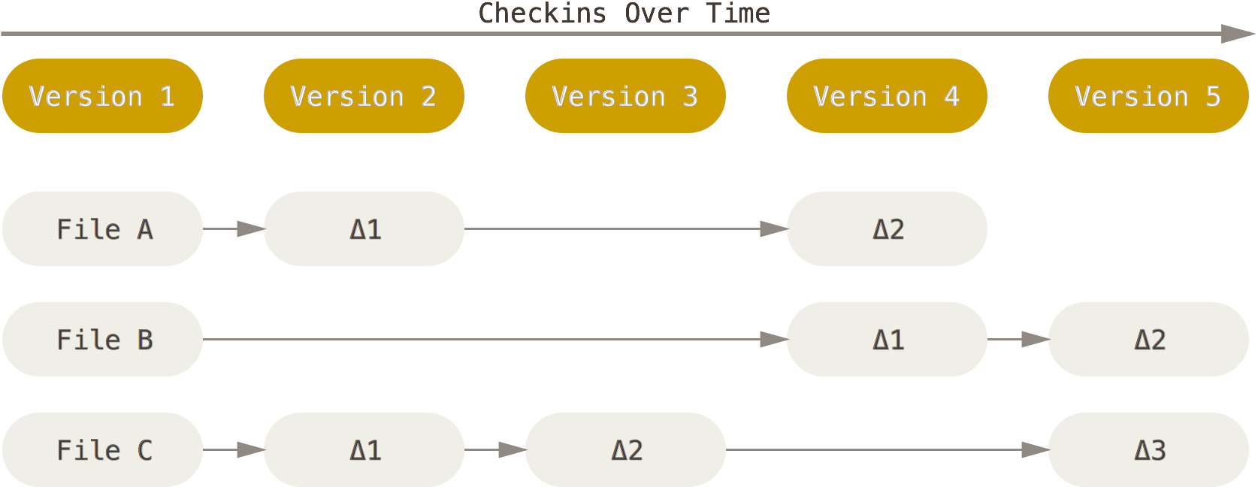
Centralised VCS
Notes:
Centralised VCS (SVN, CVS) use file-based deltas to track history.
Branching is expensive and complicated.
Difficult to merge different branches.
If file is renamed, the history can get lost.
Difficult to work together on build-breaking code
Impossible to work with central node being down

Slide 5
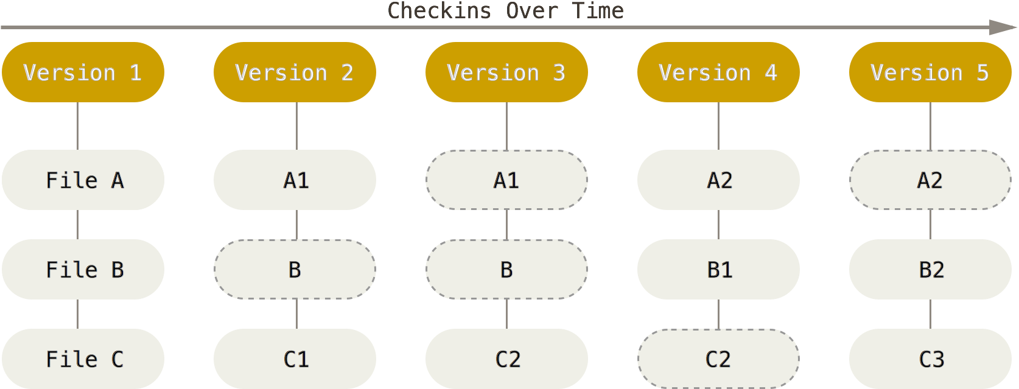
Distributed VCS
Notes:
DVCS (Git, Mercurial) uses snapshot based tracking
Branching is non-event
History is preserved on file renaming

Slide 6
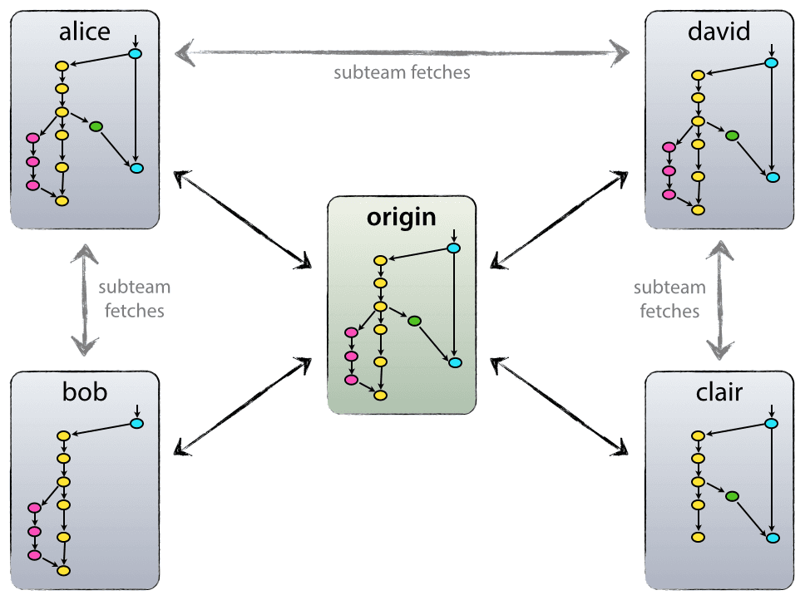
Distributed work
Notes:
Each checked-out repo can serve as a new trunk
Easy to collaborate on build-breaking experimental code.
Can work independently of central server

Slide 7
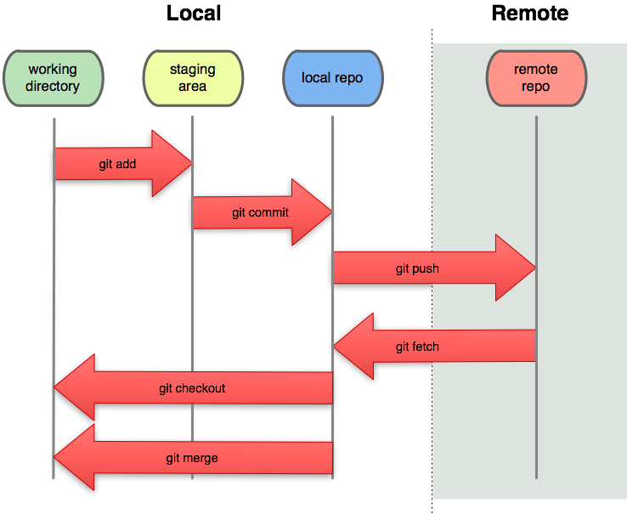
Git process
Notes:
Working directory – your locally modified files
Staging – files prepared to be committed to local repository
Local repo – repository clone stored on a local machine, can be synced with any other repo or serve as the source of truth
Remote repo – usually a central server, that keeps an authoritative version of the code

Slide 8

Git Flow

Slide 9
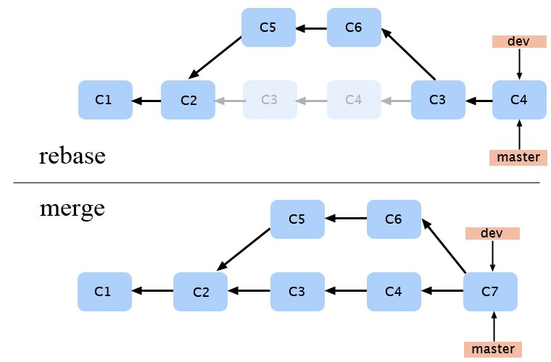
Git Merge & Git Rebase

Slide 10
Good practices
One line commit description
Use Issue ID in commit text
Short-lived branches
Use Pull requests
Merge downstream and resolve conflicts before push

Slide 11
Lab time!
Resources
http://danielkummer.github.io/git-flow-cheatsheet/
https://www.atlassian.com/git/tutorials
https://github.com/Gazler/githug
Notes:
Git ignore - https://www.gitignore.io/
Git config
http://www.tobscore.com/githug-what-is-it/

