Slide 1
Algorithm and Data Structure Comparison Tool
Integrated system across search, linked structures, maps, hashes, priority queues, graphs, sets, Bubble Sort, and Quickselect.
Built to show theory, implementation, benchmarks, and recommendations as one final portfolio Only the overview, analysis, and recommendation guides features of the Search Comparison, Linked Structures, Tree Map, Hash Priority, and Graph Algorithms modules are explored in this presentation..
CSC506 Final Portfolio Presentation
License: Apache-2.0
1
Notes:
The following is a web application is an “Algorithm and Data Structure Comparison Tool” that compares search algorithms, linked structures, tree-backed maps, hash tables, priority queues, graph-based methods, sets, Bubble Sort, and Quickselect inside one Streamlit interface. The project is part of the final portfolio that implements benchmark evidence, written analysis, and recommendation guidance.

Slide 2
Presenter Information
Alexander Ricciardi
Colorado State University Global
CSC506 - Design and Analysis of Algorithms
Professor Dr. Jonathan Vanover
May 10, 2026
2
Notes:
I am Alexander Ricciardi. This is my final portfolio presentation for my CSC506 - Design and Analysis of Algorithms at Colorado State University Global course .

Slide 3
Important Note
This presentation showcases the CSC506 Final Portfolio Presentation.
It focuses the integration of the prior milestone and critical thinking projects and on the last module of the course: Bubble Quickselect Sets; as well as the final comprehensive performance analysis.
Only the overview, analysis, and recommendation guides features of the Search Comparison, Linked Structures, Tree Map, Hash Priority, and Graph Algorithms modules are explored in this presentation.
2
Notes:
The purpose of this slide is to explain the presentation scope. Note that only all the Bubble “Quickselect Sets” module features are explored fully, as well as the final comprehensive performance analysis. Only the overview, analysis, and recommendation guides features of the Search Comparison, Linked Structures, Tree Map, Hash Priority, and Graph Algorithms modules are explored in this presentation, as these modules were previously examined in detail in prior course assignments.

Slide 4
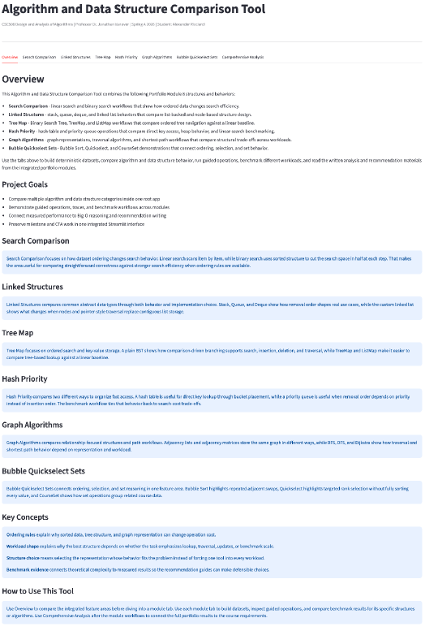
App Landing Page
Show the root application as the unified entry point for the complete Portfolio Module 8 system.
Key Takeaway
- One Streamlit entry point unifies every portfolio module.
- Tabs separate search, structures, maps, hashes, graphs, sets, and analysis.
- The screenshot proves the final system is integrated, not separate demos.
3
Notes:
This is the Landing page of the application. It gives an overview of the application feature and provides navigation tabs to Search Comparison, Linked Structures, Tree Map, Hash Priority, Graph Algorithms, Bubble Quickselect Sets, and Comprehensive Analysis features. It is important to note that each tab represents a different module of the project. - Search Comparison focuses on comparing two fundamental search algorithms - Linked Structures focuses on access. - Tree Map focuses on ordered lookup. - Hash Priority focuses on key-based retrieval and priority ordering. - Graph Algorithms focuses on relationships, traversal, and shortest paths. - Bubble Quickselect Sets focuses on uniqueness, sorting, and rank selection. - Comprehensive Analysis is a performance and comparison analysis of algorithms and data structures explored in this project.

Slide 5
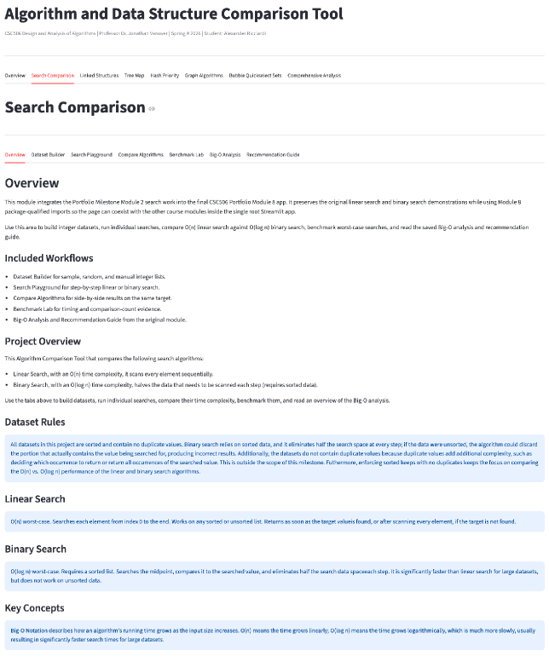
Search Comparison Overview
Introduce the Search Comparison module and its workflow for linear search, binary search, and supporting analysis tabs.
Key Takeaway
- Linear search and binary search are compared in one workflow.
- Local tabs move from setup to execution, benchmark, and guidance.
- The screen turns a textbook comparison into a visible lab.
4
Notes:
This is the landing page of the “Search Comparison” feature, showcasing the functionality of the Search algorithms module. It provides an overview of the different search algorithms. The Feature’s tabs: - Overview introduces the concept. - Dataset Builder prepares input values. - Search Playground runs the algorithms. - Compare Algorithms places them side by side. - Benchmark Lab measures behavior. - Big-O Analysis and Recommendation Guide explains what the measured results mean.

Slide 6
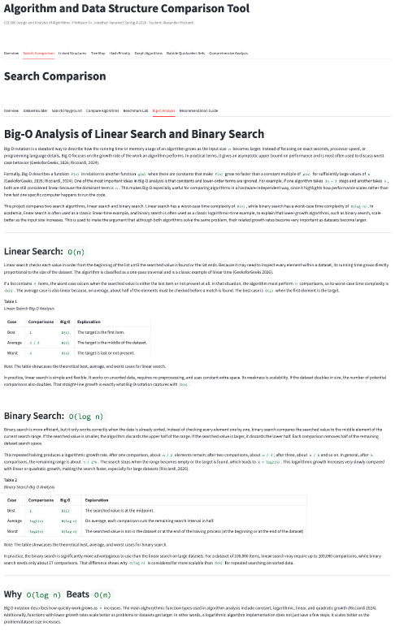
Search Comparison Big-O Analysis
Connect the search module to Big-O notation and explain why linear and logarithmic growth behave differently.
Key Takeaway
- Linear search can inspect every item: O(n).
- Binary search halves the remaining range: O(log n).
- The screenshot connects Big-O notation to measured comparison behavior.
5
Notes:
This showcases the “Search Comparison Big-O Analysis” for the “Search Comparison” feature. The analysis uses a Big-O perspective to analyze the search algorithms. The analysis results: - Linear search shows worst-case `O(n)` behavior because it may need to inspect every value in the dataset. - Binary search has worst-case `O(log n)` behavior because each comparison removes one half of the remaining interval. Note that the analysis implemented a theoretical and empirical approach. The analysis compares counts, step traces, and benchmark evidence.

Slide 7
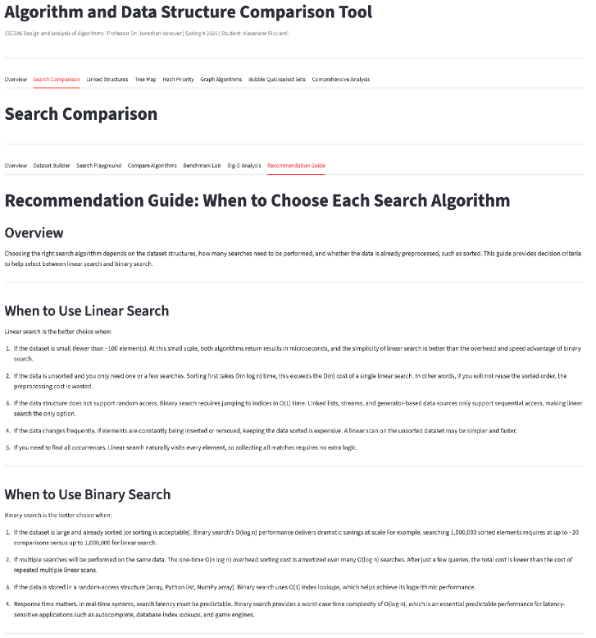
Search Comparison Recommendation Guide
Translate the search comparison evidence into practical recommendations about when to use each algorithm.
Key Takeaway
- Binary search wins when sorted data or repeated lookup is available.
- Linear search still fits small, unsorted, or changing datasets.
- The guide frames algorithm choice as workload fit.
6
Notes:
This showcases the recommendation guide for the “Search Comparison” feature. The recommendation guide uses analysis results to guide decision-making: - Binary search is the stronger choice when the dataset is pre-sorted or when repeated searches are required. - Linear search is a practical choice when the dataset is small, unsorted, or changing often. The key lesson from the guide and analysis is that algorithm choice depends on workload rather than on a universal ranking.

Slide 8
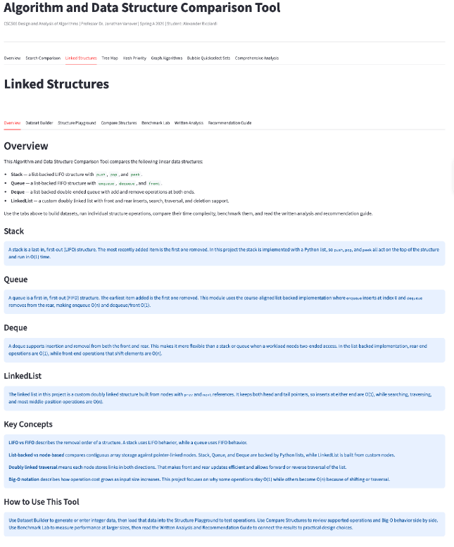
Linked Structures Overview
Introduce the Linked Structures module and its workflows for Stack, Queue, Deque, and LinkedList behavior.
Key Takeaway
- Stack, Queue, Deque, and LinkedList each model a different access pattern.
- The module links operations, benchmarks, and written analysis.
- The screen shows why similar structures can behave differently.
7
Notes:
This is the landing page of the “Linked Structures” feature, showcasing the functionality of the Linked structures module. It provides an overview of the different abstract data types. The data structures explored are list-backed Stack, Queue, and Deque, along with a custom doubly linked `LinkedList`. The feature provides the user with the following tabs/functionalities: build datasets, run operations, compare structure behavior, benchmark workloads, and read supporting analysis. The feature functionality allows the user to explore LIFO, FIFO, double-ended access, and node traversal concepts and implement their behavior. In practical terms, this module explains why linear structures can behave very differently under different workloads.

Slide 9
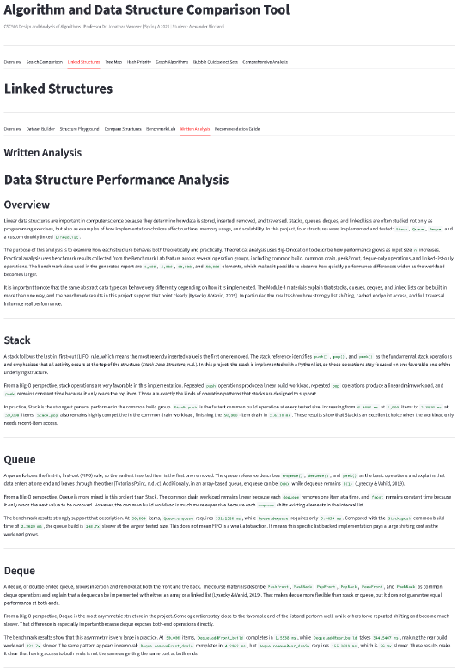
Linked Structures Written Analysis
Explain how the written analysis connects structure behavior to shifting, endpoint work, and traversal costs.
Key Takeaway
- Implementation details shape real performance, not just ADT names.
- Endpoint work, shifting, and traversal carry different costs.
- Benchmark evidence shows each structure has a best-fit workload.
8
Notes:
This showcases the “Linked Structures Written Analysis” for the “Linked Structures” feature. The analysis results show that implementation details matter just as much as abstract definitions of the data structure. For example: - A stack performs well when push and pop happen on the favorable end of a Python list. - Queue and Deque behavior depends on which end receives most of the work. - A linked list avoids some shifting costs, but traversal still grows with the structure length.

Slide 10
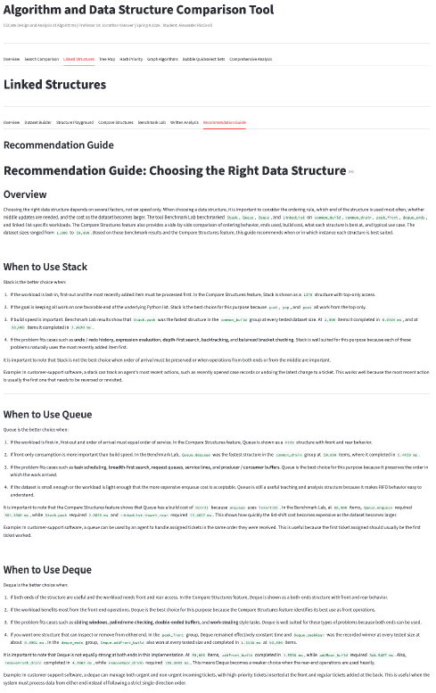
Linked Structures Recommendation Guide
Show how the module converts structure tradeoffs into workload-based recommendations.
Key Takeaway
- Stack supports LIFO; Queue supports FIFO.
- Deque helps when both ends matter.
- LinkedList fits node-based insertion, deletion, and traversal cases.
9
Notes:
This showcases the recommendation guide for the “Linked Structures” feature. The recommendation guide explains how to match a structure to the operation pattern of an application. For example: - A stack is best suited for last-in, first-out behavior. - A queue is best suited for first-in, first-out workflows. - A deque is best when both ends matter. - The `LinkedList` is best when node-based insertion, removal, and traversal behavior fit the problem better than list shifting.

Slide 11
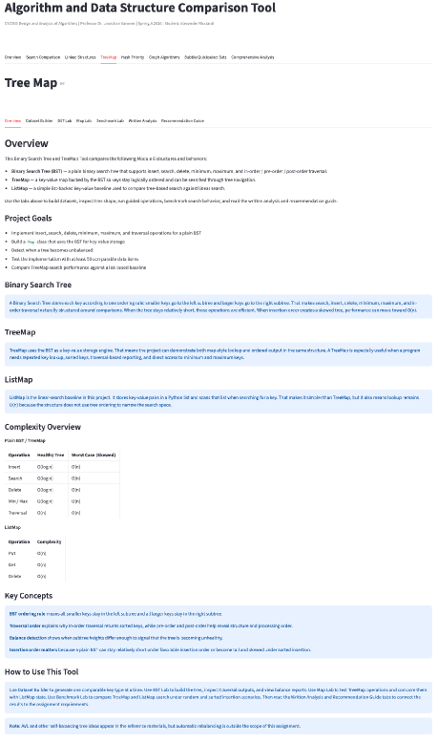
Tree Map Overview
Introduce the Tree Map module and its comparison between BST, TreeMap, and ListMap behavior.
Key Takeaway
- BST, TreeMap, and ListMap support ordered key workflows.
- Insertion order changes tree shape and practical performance.
- The screen introduces lookup, traversal, height, and balance evidence.
10
Notes:
This is the landing page of the “Tree Map” feature, showcasing the functionality of the tree map module. It provides an overview of the importance of tree maps in computer science. They combine key-based lookup with an ordered structure. The feature explores Binary Search Tree, a BST-backed `TreeMap`, and a list-backed `ListMap` baseline. It also explores insertion, search, deletion, traversal, minimum and maximum lookups, height reporting, balance detection operations, and a map comparison workflow. The features allow users to explore how a tree shape influences performance. It shows that tree-backed lookup can be efficient when the tree height is low; it shows how a plain BST is not self-correcting. The feature also provides an explanation of why ordered lookup can be powerful and why insertion order still matters.

Slide 12
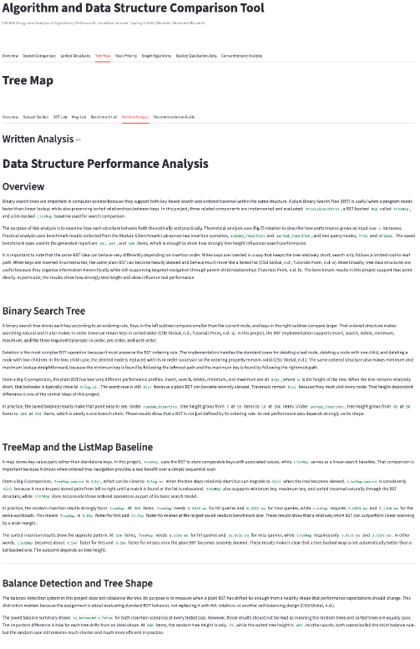
Tree Map Written Analysis
Explain how the Tree Map analysis connects height, skew, and ordered lookup to measured behavior.
Key Takeaway
- BST operations depend on height h.
- Healthy trees approach O(log n); skewed trees trend toward O(n).
- The analysis ties tree shape to benchmark results.
11
Notes:
This showcases the “Tree Map Written Analysis” for the “Tree Map” feature. The analysis uses a Big-O approach to show why BST behavior depends on height `h`. For example: - The search, insert, delete, minimum, and maximum operations have a complexity of `O(h)`. - However, when the tree is short, this complexity is closer to `O(log n)`. - When the tree becomes heavily skewed, this complexity is closer to `O(n)`. Note: the same structure can behave very differently depending on insertion order.

Slide 13
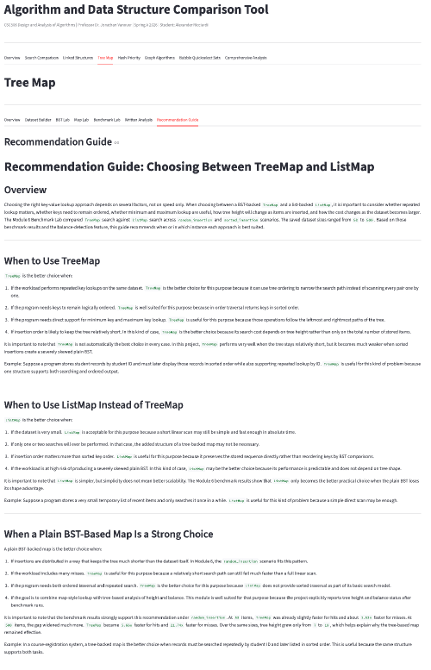
Tree Map Recommendation Guide
Show when tree-backed maps are a strong fit and when simpler linear maps remain practical.
Key Takeaway
- TreeMap fits ordered traversal and repeated lookup.
- ListMap remains practical for small or simple workloads.
- The guide warns that skew can erase the tree advantage.
12
Notes:
This showcases the recommendation guide for the “Tree Map” feature. The recommendation guide explains that: - `TreeMap` is best suited for situations when ordered traversal, repeated lookup, and minimum or maximum queries are required. -`ListMap` is easier to implement, but less efficient for large datasets, but it can still be a practical implementation for modest-sized datasets or simpler workloads. Tree-backed maps are useful when the tree shapes are not skewed.

Slide 14
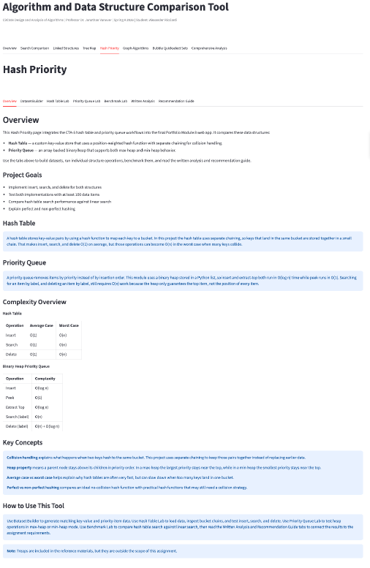
Hash Priority Overview
Introduce the Hash Priority module and its comparison of key-based lookup and priority-based retrieval.
Key Takeaway
- Hash tables optimize direct key lookup.
- Priority queues optimize repeated highest or lowest priority retrieval.
- The module compares two different fast-access problems.
13
Notes:
This is the landing page of the “Hash Priority” feature, showcasing the functionality of the hash tables and priority queues. These data structures are used to solve different kinds of retrieval problems. For example: - The hash table supports insert, search, delete, update, resizing, and bucket inspection using separate chaining. - The priority queue supports min-heap and max-heap workflows, including insert, peek, extract, search, and delete.
The module compares two solutions for two different access requirements: that is, hash tables are built for direct key lookup, while heaps are designed for repeated access to the next highest or lowest priority item.

Slide 15
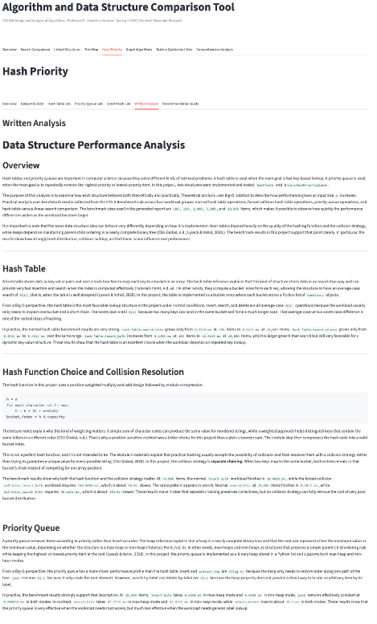
Hash Priority Written Analysis
Explain how the written analysis connects collision behavior, heap maintenance, and operation cost.
Key Takeaway
- Healthy hash tables support average O(1) key operations.
- Collisions still affect bucket-level search cost.
- Heap operations preserve priority order with O(log n) maintenance.
14
Notes:
This showcases the “Hash Priority Written Analysis” for the “Hash Priority” feature. The analysis uses a Big-O perspective to analyze hash tables and priority queues [from both theoretical and practical viewpoints. The analysis results: - A hash table can have a complexity average of `O(1)` for insert, search, and delete operations because keys map directly to bucket locations. It is important to note, however, that collisions may be an issue. Separate chaining preserves correctness, but depending on the key distribution, searching inside a bucket could be more expensive. - The priority queue shows different results. Heap insert and extract operations are typically `O(log n)` because the heap may need to restore order. Peek remains efficient because the highest or lowest priority value is stored at the root.

Slide 16
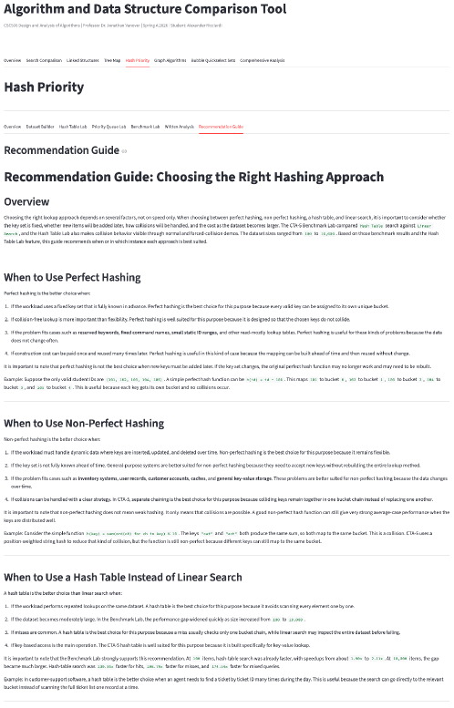
Hash Priority Recommendation Guide
Convert the Hash Priority evidence into practical guidance about lookup, priority access, and workload fit.
Key Takeaway
- Use hash tables for repeated key-based lookup.
- Use priority queues for repeated priority removal.
- Linear search stays useful as a baseline and teaching comparison.
15
Notes:
This showcases the recommendation guide for the “Hash Priority” feature. It explains that: - Hash tables are the best choice when repeated key-based lookups are required and when key distribution can be maintained. - Priority queues are the best choice when the application requires repeatedly removing the highest or lowest priority value. - Linear search is useful for simple implementation, educational purposes, and as a comparison point.

Slide 17
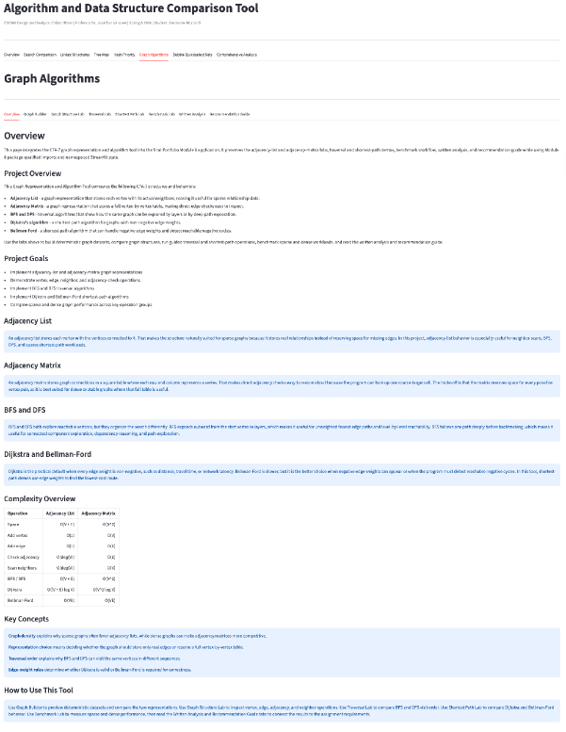
Graph Algorithms Overview
Introduce the Graph Algorithms module and its workflows for representation, traversal, shortest paths, and benchmarking.
Key Takeaway
- Graphs model relationships between objects.
- The module compares adjacency lists, matrices, traversal, and paths.
- Benchmarks separate sparse and dense graph behavior.
16
Notes:
This is the landing page of the “Graph Algorithms” feature. It highlights the importance of graphs, which are used to represent relationships between objects. The module showcases adjacency-list and adjacency-matrix data structure representations, and BFS, DFS, Dijkstra, and Bellman-Ford algorithms. It also provides labs for sparse and dense graph behavior. The features tabs: - Graph Builder allows the user to build different graph structures. - Graph Structure Lab showcases the different graph behaviors. - Traversal Lab showcases BFS and DFS. - Shortest Path Lab compares Dijkstra and Bellman-Ford algorithms for short path operations. - Benchmark Lab runs benchmarks for the different graph structures and the algorithms. - Written Analysis and Recommendation Guide analyzes the lab results and base on the results, gives guidance.

Slide 18
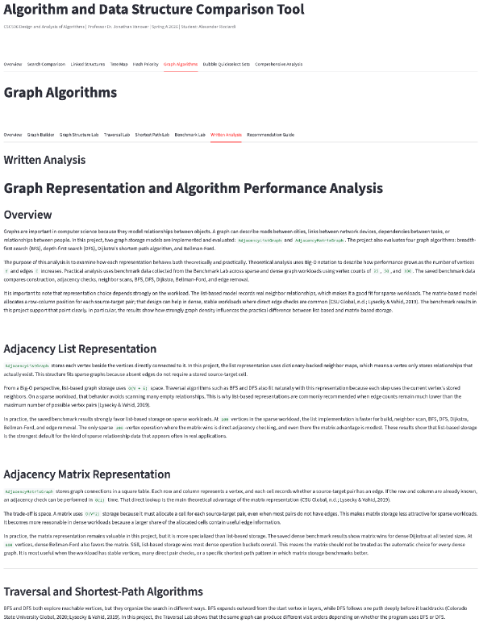
Graph Algorithms Written Analysis
Explain how the graph analysis connects representation choice, graph density, traversal, and shortest-path correctness.
Key Takeaway
- Adjacency lists are usually stronger for sparse graphs.
- Adjacency matrices support dense graphs and direct pair checks.
- Shortest-path algorithms depend on edge-weight assumptions.
17
Notes:
This showcases the “Graph Algorithms Written Analysis” for the “Graph Algorithms” feature. It shows that choosing a graph representation depends on the workload. For example: - An adjacency list stores only real neighbor relationships and is usually a strong fit for sparse graphs. - An adjacency matrix allocates a full row-column position for each source-target pair, which can be useful for dense workloads or direct adjacency checks. The algorithm analysis also explores BFS and DFS, both these algorithms explore vertices, but they organize that exploration differently. The analysis shows that: - Dijkstra is faster, but it is best suited for a graph with non-negative edge weights. - Bellman-Ford is slower but supports negative edges and negative-cycle detection.

Slide 19

Graph Algorithms Recommendation Guide
Show how the graph module turns representation and algorithm tradeoffs into workload-based recommendations.
Key Takeaway
- BFS fits breadth-oriented unweighted exploration.
- DFS fits depth-oriented traversal.
- Dijkstra and Bellman-Ford serve different weighted-path constraints.
18
Notes:
This showcases the recommendation guide for the “Graph Algorithms” feature. It explains when to use each graph structure and algorithm. For example: - Adjacency lists are useful when the graph is sparse or when neighbor scans are common. - Adjacency matrices become more attractive when direct pair checks matter or when the graph is dense and stable. - BFS is well-suited for breadth-oriented unweighted exploration. - DFS is well-suited for depth-oriented traversal. - Dijkstra is well-suited for non-negative weighted shortest paths. - Bellman-Ford is well-suited to situations where negative weights are required.

Slide 20
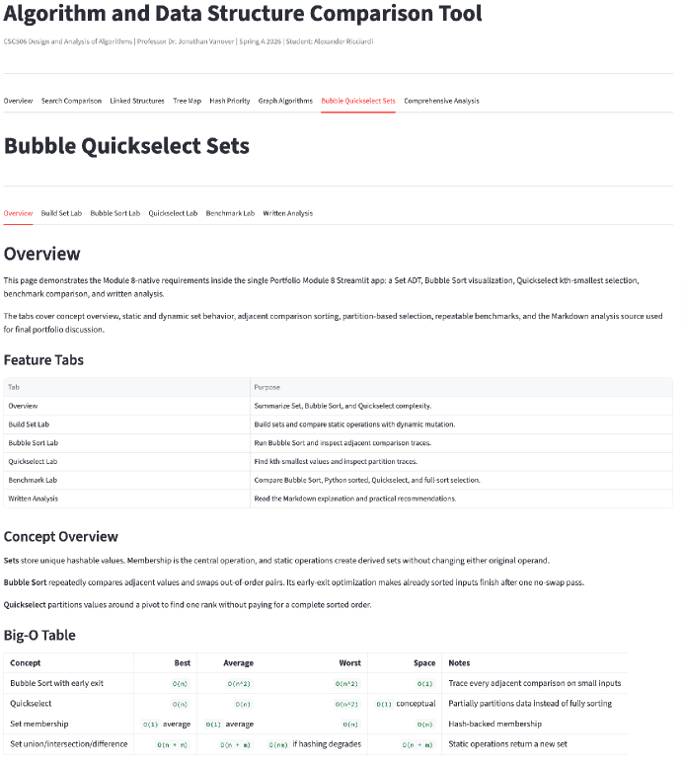
Bubble Quickselect Sets Overview
Introduce the Module 8-native feature area for sets, Bubble Sort, Quickselect, benchmarks, and written analysis.
Key Takeaway
- Module 8 adds sets, Bubble Sort, and Quickselect.
- Sets answer membership; sorting answers full order.
- Quickselect answers one rank without fully sorting everything.
19
Notes:
This is the landing page of the “Bubble Quickselect Sets” feature of the Bubble Quickselect Sets module. It includes an overview of the `CourseSet` implementation, the Bubble Sort routine with trace output, Quickselect for kth-smallest selection, benchmark comparison, and written analysis.
.

Slide 21
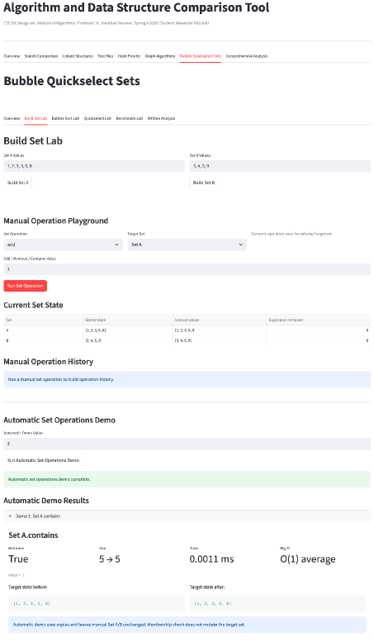
Build Set Lab: Initial Sets
Show the initial Set A and Set B workflow used to prepare the set demonstrations.
Key Takeaway
- Set A and Set B establish the demonstration data.
- Uniqueness matters more than item position.
- The screen prepares the static and dynamic set operations.
20
Notes:
In the Build Set Lab section of the feature, the user can build Set A and Set B, which are displayed so the user. It is important to note that the central idea of sets is uniqueness. Duplicates are not allowed, and item membership to a set matters more than order.
.

Slide 22
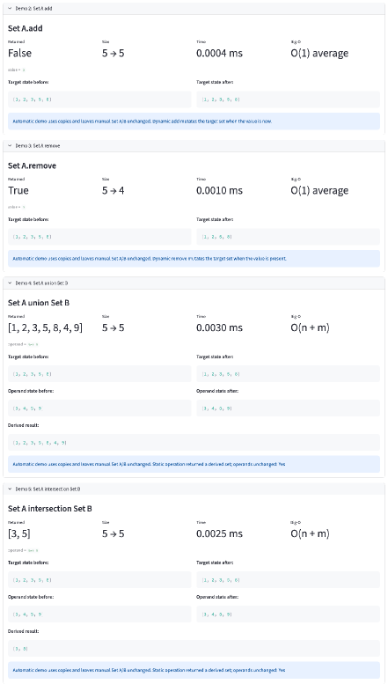
Build Set Lab: Dynamic Operations
Demonstrate dynamic set operations such as add, remove, and membership checks on a selected target set.
Key Takeaway
- Dynamic operations maintain or inspect one target set.
- Add, remove, and contains focus on membership behavior.
- Hash-backed sets support efficient average-case checks.
21
Notes:
This demonstrates Dynamic set operations. Operations such as `add`, `remove`, and `contains` are displayed; these operations either change a set or test whether a value is present. From a Big-O perspective, the set behavior differs from sorting or indexing behavior, with the point being not to find where a value sits in a sequence, but to determine whether the value belongs to the collection.

Slide 23
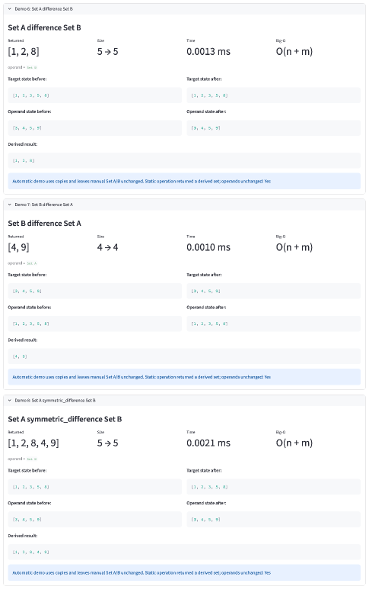
Build Set Lab: Static Operations
Demonstrate static set operations that derive new results from Set A and Set B.
Key Takeaway
- Static operations compare two sets at once.
- Union, intersection, difference, and symmetric difference answer relationship questions.
- The screen shows membership logic rather than sequence order.
22
Notes:
This demonstrates static set operations. They compare two collections and produce a result from them. The static operations are union, intersection, difference, and symmetric. These operations do not depend on position, but they depend on relationships between the two source sets.

Slide 24
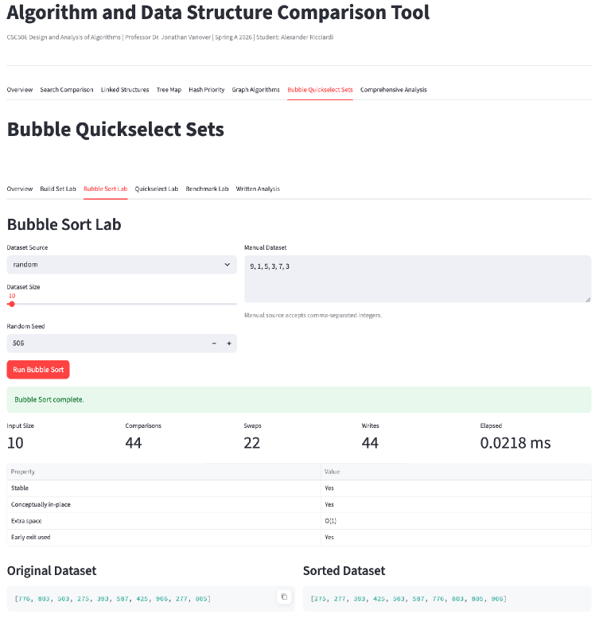
Bubble Sort Lab: Trace Setup
Introduce the Bubble Sort lab and its traceable workflow for sorting integer datasets.
Key Takeaway
- Bubble Sort traces adjacent comparisons and swaps.
- The setup makes the input and execution path visible.
- This lab favors clarity over production efficiency.
23
Notes:
The Bubble Sort Lab feature demonstrates bubble sort operations within a lab. This slide shows the set-up potion of the feature. The algorithm continually compares neighboring values and swaps them when they are in the wrong order. Bubble Sort is valuable for educational purposes and comparison with other sorting algorithms rather than for real-world applications.

Slide 25
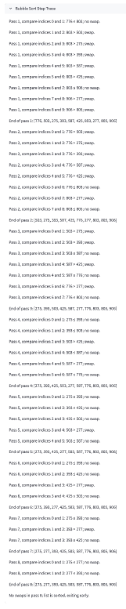
Bubble Sort Lab: Trace Results
Show the Bubble Sort trace output and connect adjacent comparison behavior to quadratic cost.
Key Takeaway
- Trace output exposes each pass of the algorithm.
- The result shows how local swaps produce full order.
- Students can see why Bubble Sort grows quadratically.
24
Notes:
This slide shows the traced result of the lab feature. The analysis uses a Big-O perspective to analyze Bubble Sort, which shows average and worst-case time complexity of `O(n^2)` as it may require fully scanning the list twice. - When the dataset is pre-sorted, Bubble Sort can stop quickly, it may have a complexity of `O(n)`. - When the dataset is in disorder state, Bubble Sort may have a quadratic cost.

Slide 26
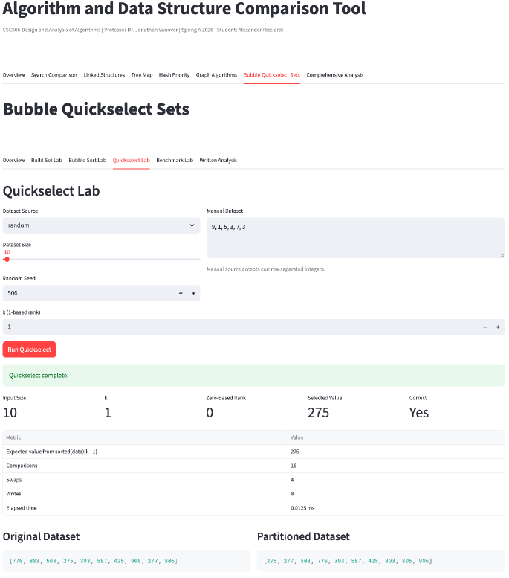
Quickselect Lab: Valid Rank Selection
Demonstrate Quickselect as a rank-selection algorithm rather than a full sorting algorithm.
Key Takeaway
- Quickselect returns the kth-smallest value.
- It avoids sorting the entire dataset when only one rank matters.
- The screen demonstrates selection as a different problem from sorting.
25
Notes:
The Quickselect Lab feature demonstrates bubble sort operations within a lab. This slide shows the selection validation of the feature Quickselect, which is used to answer a different question than a full sorting algorithm, like Bubble sort; its main purpose is to find a requested rank, such as the kth-smallest value, without having to fully to have to order the dataset. Quickselect has an average time complexity of `O(n)` as it recursively partitions the dataset and only selects and compares the side of the partition that can still contain the requested rank, rather than comparing each value in the dataset. Quickselect is best suited for workloads that require a specific rank rather (or a single element rather) than a fully sorted result.

Slide 27
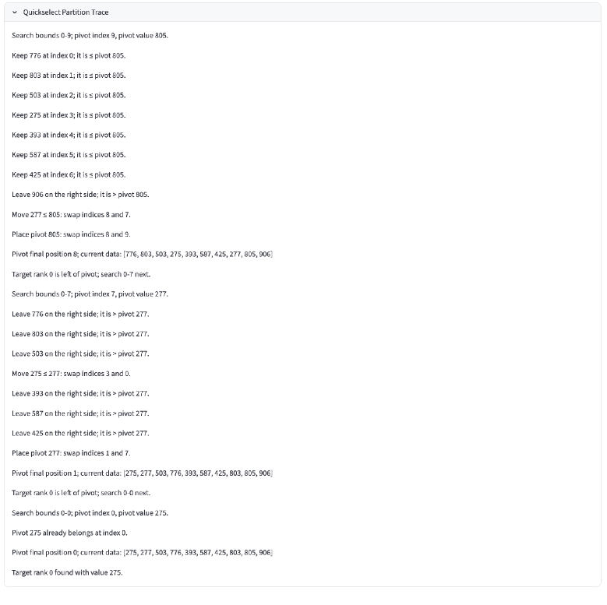
Quickselect Lab: Validation
Show how the Quickselect lab validates invalid rank input and preserves correct algorithm behavior.
Key Takeaway
- Invalid k values are handled with clear validation.
- The app protects the algorithm from impossible rank requests.
- This screen shows user-facing robustness, not only runtime behavior.
26
Notes:
This slide shows the value validation process of the lab feature. It verifies that A requested rank falls within the bounds of the dataset being processed. When it does not, the app prevents the operation and provides a message. Note that the app is not only implementing the algorithm itself. It is also handling the workflow by managing edge cases so that results are valid and understandable .

Slide 28
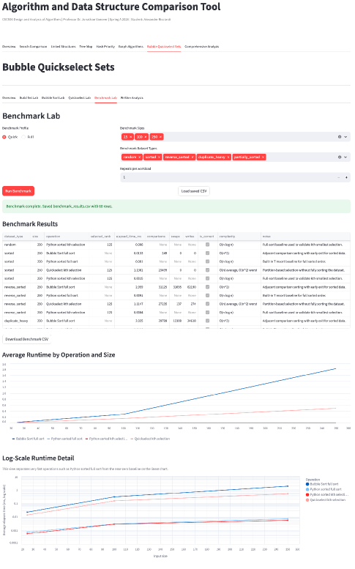
Bubble Quickselect Sets Benchmark Lab
Compare Bubble Sort, Python `sorted`, Quickselect, and full-sort selection with saved benchmark evidence.
Key Takeaway
- Benchmarks compare set membership, Bubble Sort, and Quickselect.
- Different operations produce different growth patterns.
- The lab connects observed timing to Big-O expectations.
27
Notes:
The Bubble Quickselect Sets Benchmark Lab feature demonstrates running the benchmark lab on the set data structure and on the Bubble Sort and Quickselect algorithms. This slide shows the comparison of Bubble Sort with Python's built-in `sorted()` and compares Quickselect with selecting from a fully ordered list. Note that the fastest result is not always the algorithm with the best asymptotic time complexity, but rather the one with smaller constant factors or better optimization for the specific input size.

Slide 29
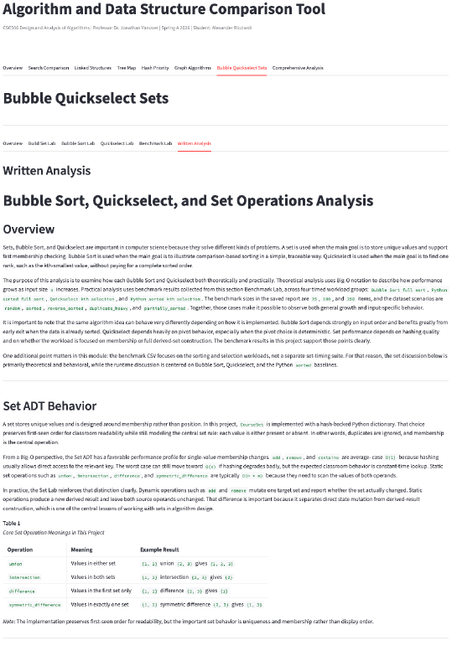
Bubble Quickselect Sets Written Analysis: Sorting and Selection
Explain how the written analysis connects Bubble Sort and Quickselect to different kinds of ordering problems.
Key Takeaway
- Bubble Sort is readable but inefficient for large input.
- Quickselect is better when only one rank is needed.
- The analysis separates full ordering from targeted selection.
28
Notes:
The Bubble Quickselect Sets Written Analysis Lab feature displays a written analysis of Bubble Sort, Quickselect, and the set data structure.
This slide shows the analysis of the Bubble Sort and Quickselect algorithms of the feature - Bubble Sort is used to produce a fully ordered list. - Quickselect is used to find one requested rank. Those are related problems, but with different purposes. In practical terms, this slide reinforces a central course idea. The best algorithm depends on the question being asked. If full ordering is required, a sorting algorithm is necessary. If only one rank is needed, Quickselect may be the more direct solution.

Slide 30
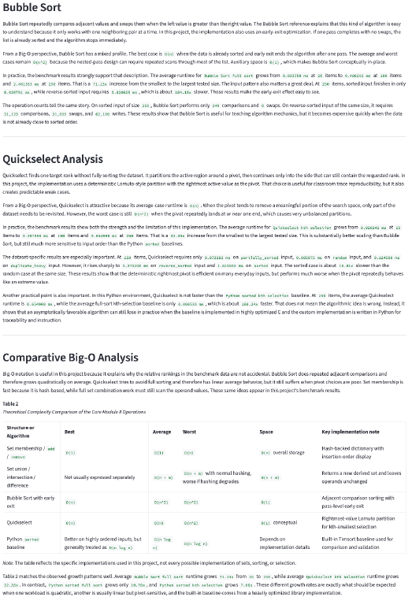
Bubble Quickselect Sets Written Analysis: Set Operations
Explain how the written analysis places set operations beside search, sorting, and selection as a different type of data question.
Key Takeaway
- Set operations focus on membership and uniqueness.
- Hashing can make membership checks efficient on average.
- The analysis explains why sets differ from sequence structures.
29
Notes:
This slide shows the set operations portion of the analysis. It explains that sets evaluate uniqueness, membership, and collection relationships. These operations are used to know whether a value belongs to a collection or how two collections relate to each other. In practical terms, sets help answer questions that search, sorting, and rank selection do not answer as directly.
.

Slide 31
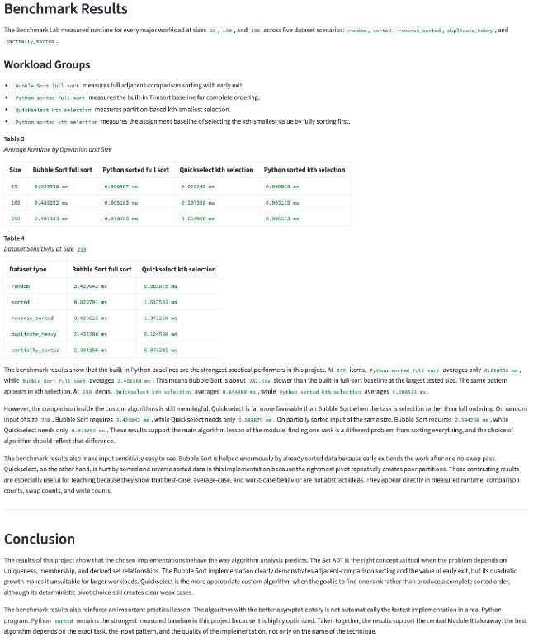
Bubble Quickselect Sets Written Analysis: Learning Outcomes
Summarize how the Module 8-native features extend the integrated portfolio and deepen the final learning outcomes.
What this screen shows
- The module reinforces theory through implementation and measurement.
- Traces, benchmarks, and validation make behavior inspectable.
- Learning outcomes connect algorithm choice to problem type.
30
Notes:
This slide shows the main learning outcomes that analysis provides. It explains how: - `CourseSet` adds set algebra and membership logic. - Bubble Sort adds a traceable sorting demonstration. - Quickselect adds efficient rank selection.

Slide 32
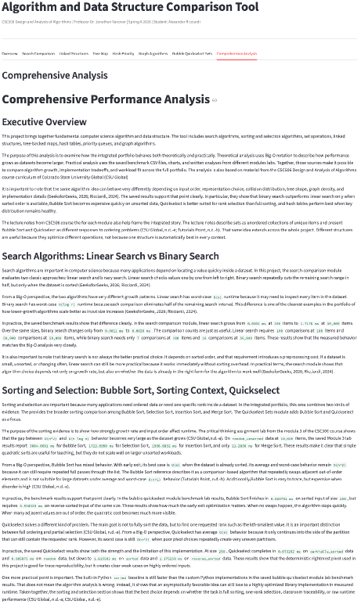
Comprehensive Analysis: Executive Overview
Introduce the comprehensive analysis as the integrated summary of the full portfolio's theory, benchmarks, and recommendations.
Key Takeaway
- The final analysis integrates results across all modules.
- It brings benchmarks, tradeoffs, and recommendations into one view.
- The screen turns separate labs into a portfolio-level argument.
31
Notes:
The Comprehensive Analysis feature provides a full written analysis of all the algorithms and data explored by the app. It brings together the written analyses, benchmark, and recommendation logic from all the app features The purpose of the analysis is to examine the different approaches both theoretically and practically. In other words, it is a comparison system that explains how different growth rates, data structures, and workload influence design and technical decision-making.
This slide displays the executive overview of the analysis, a comparison of linear search vs binary search algorithms, and a comparison of sorting and selection using the Bubble Sort and Quickselect algorithm.

Slide 33
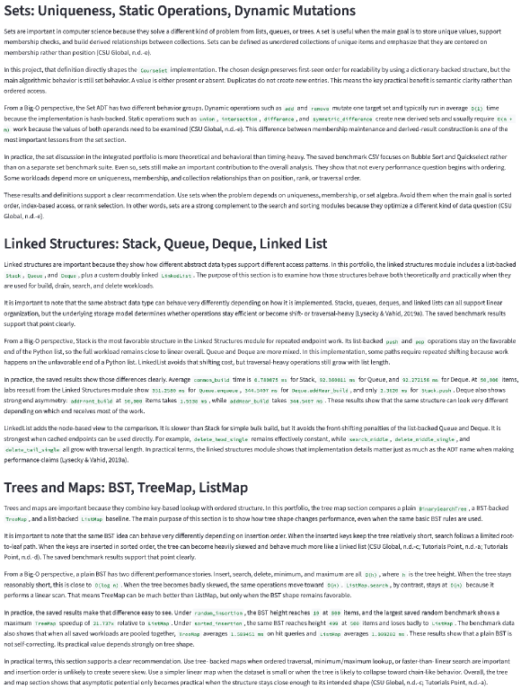
Comprehensive Analysis: Search, Sorting, and Selection Evidence
Show how the comprehensive analysis compares major algorithm families across different kinds of data questions.
Key Takeaway
- Search, sorting, and selection answer different data questions.
- Growth rates explain why the same input size can behave differently.
- The evidence links measured results to algorithmic complexity.
32
Notes:
This slide displays an analysis of: - The set data structure’s uniqueness, static operations, and dynamic mutations characteristics. - Linked data structures: Stack, Queue, Deque, Linked List. - Trees and maps data structures: BST, TreeMap, ListMap This slide places search, sorting, and selection in the same discussion: - Search algorithms locate values. - Sorting algorithms generate order. - Selection algorithms find one requested rank. Note that the analysis shows that - The binary search works well when items are ordered - Bubble Sort is expensive on larger unsorted workloads. - Quickselect is one-rank selection rather than a full ordering algorithm.

Slide 34
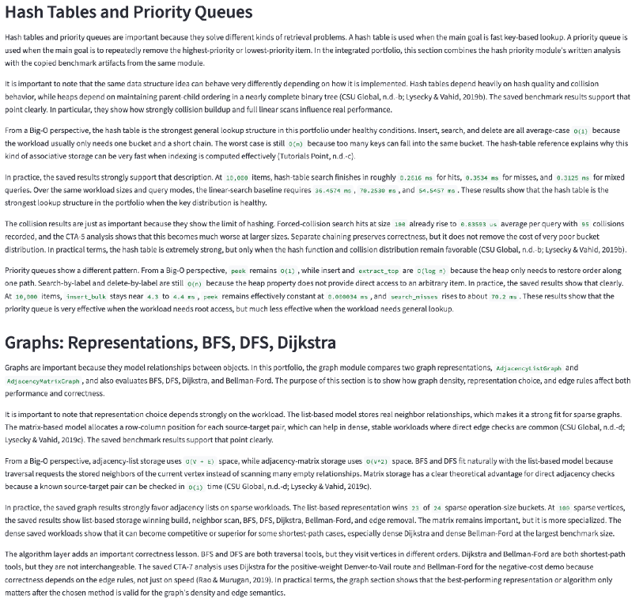
Comprehensive Analysis: Data Structure Tradeoffs
Compare the major data structure families and explain how their strengths depend on workload and implementation details.
Key Takeaway
- Structures optimize access patterns, not generic speed.
- Stacks, queues, maps, hashes, heaps, and graphs serve different workloads.
- The table supports comparison across the whole course.
33
Notes:
This slide displays an analysis of: - Hash tables and priority queues data structures - Graphs data structure and the BFS, DFS, and Dijkstra algorithms The analysis explains that - Linked structures manage endpoint work, shifting, and traversal tradeoffs. - Trees and maps balance ordered lookup and height sensitivity. - Hash tables handle direct key-based access and collision effects. - Priority queues are used for priority removal. - Graphs are a relationship storage and traversal strategy. The analysis explains that data structures are selected by workload requirement, not by a simple ranking from best to worst.

Slide 35
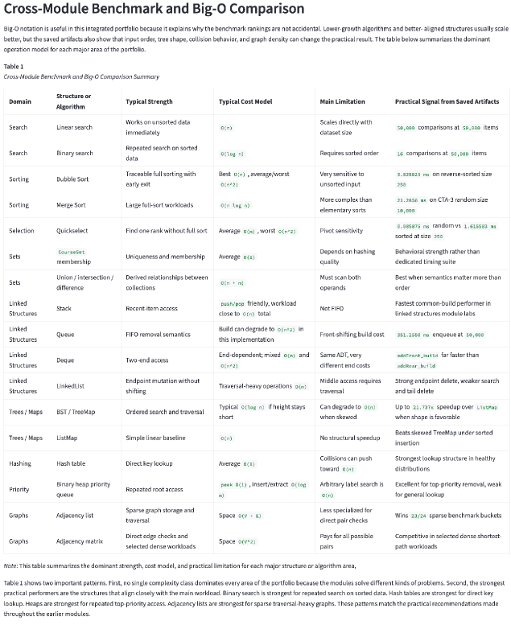
Comprehensive Analysis: Recommendation Matrix
Present the recommendation matrix that converts the full portfolio evidence into actionable algorithm and data structure choices.
Key Takeaway
- The recommendation matrix converts evidence into decisions.
- Each row maps a workload to a preferred structure or algorithm.
- The matrix makes tradeoffs usable beyond the demo app.
34
Notes:
This slide displays a Recommendation Matrix. The matrix provides a summarized analysis of the algorithms and data structures that can be easily translated into decisions. It covers repeated search, sorted lookup, full ordering, kth-rank selection, uniqueness, FIFO access, LIFO access, priority removal, sparse traversal, or dense adjacency checks. The matrix does not treat one algorithm as the winner in every category. Instead, it shows that different tools are useful because they optimize different operations under different constraints.

Slide 36
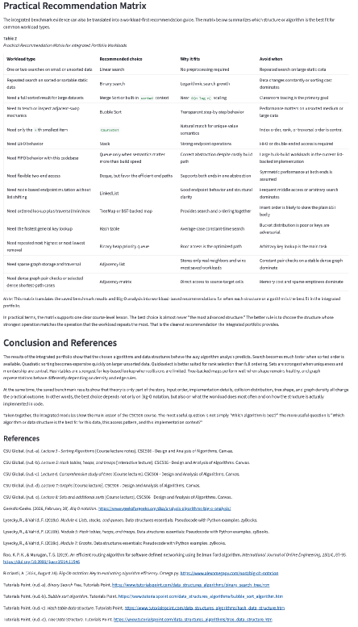
Comprehensive Analysis: Technical Achievements and Course Learning
Close the presentation by summarizing the technical achievements, integration work, and final CSC506 learning outcomes.
Key Takeaway
- The final summary of the complete technical achievement.
- The project combines implementation, testing, visualization, and analysis.
- The portfolio demonstrates theory, measurement, and recommendation together.
35
Notes:
This final slide displays the analysis conclusion and a Recommendation Matrix summarizing all the labs and analyses into a comprehensive recommendation guide.
The project integrates earlier assignments from CSC506. It includes dataset builders, guided labs, structure visualizations, algorithm traces, benchmark workflows, written analyses, and recommendation guides. It provides the central learning outcome stating that algorithm analysis is most useful when theory, implementation, measurement, and recommendation are considered together, that is: - Big-O notation explains growth. - Benchmarks labs provide empirically measured behavior confirming the theoretical findings from time and space complexity analysis. Showing that the most important question is not “Which algorithm is best?" is "Which algorithm or data structure is the best fit for this data, this access pattern, and this implementation context?"

