Slide 1
A new website for the pilgrimage to Lourdes
lurdy.eu, the old site and the new one compared: applications, security, compliance, look
October 2026
Notes:
Measured on 19 October 2026: the live old site www.lurdy.eu (WordPress with the Divi theme) and the new site's production build.

Slide 2
The new site in four numbers
ACCESSIBILITY ERRORS
OUTSIDE SERVICES
HOME PAGE DOWNLOAD, MB
LANGUAGES
0
0
0.45
5
was 15
was 1
was 1.4
was 1
WCAG 2.1 AA, home page
Google Fonts on every visit
desktop, first visit
CS · EN · FR · IT · DE
Measured 19 Oct 2026 in Chromium: axe-core accessibility scan and network log of the home page.
Notes:
Accessibility: 15 WCAG 2.1 A/AA problems on the old home page (12 low-contrast texts, 2 links without a name, zoom disabled on phones); none on the new one. Outside services: the old site loads Google Fonts from Google's servers, which sends every visitor's IP address to Google; the new site loads nothing from other servers. Download: 29 requests and 1.4 MB versus 19 requests and about 0.45 MB compressed.

Slide 3
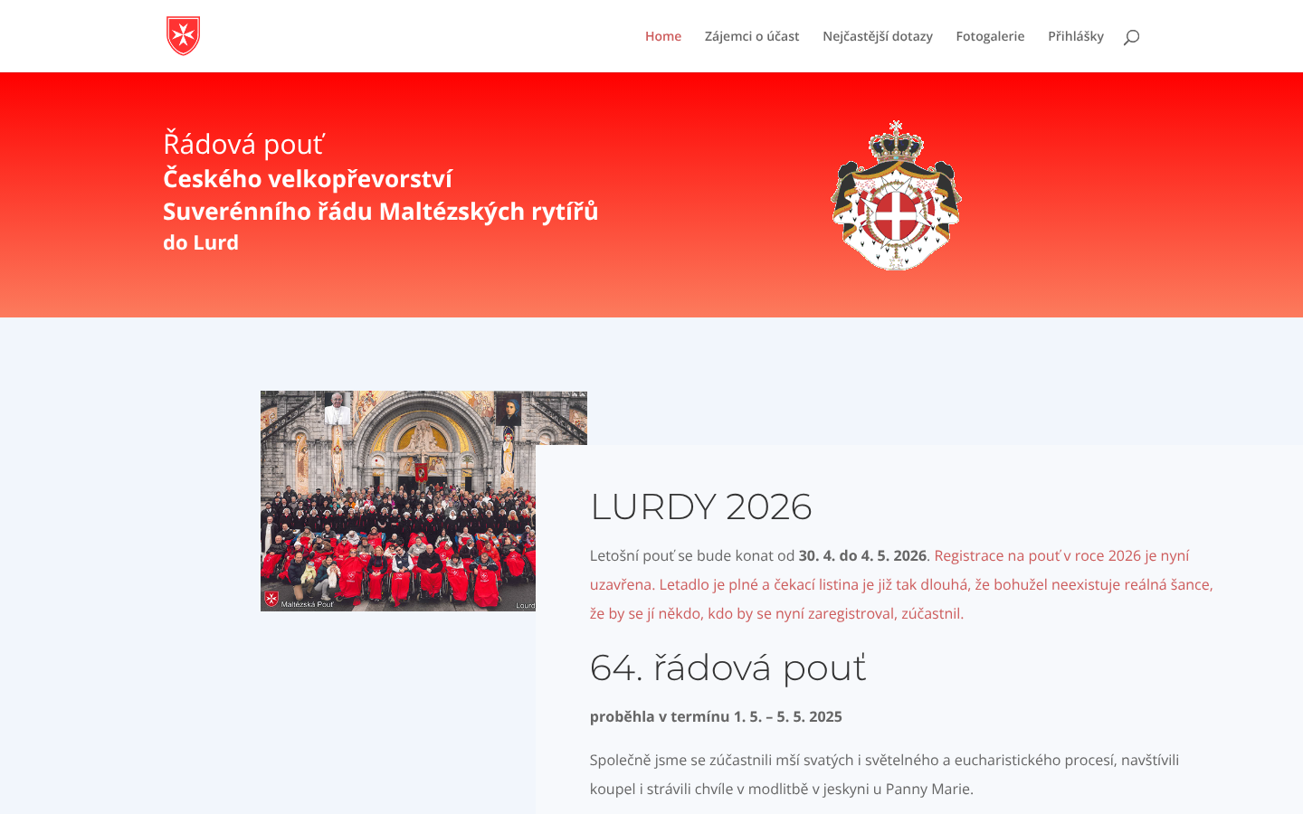

Look: theme template, Order frame
Old site
New site
Generic Divi theme, small shield, no Order banner
Dates and registration hidden in a block of text
Grand Magistry frame with the personalised lockup
Lourdes photograph, dates and Applications button up front
Notes:
Home page at 1440 x 900, 19 Oct 2026. The new site uses the same Order frame as the new maltezskyrad.cz: red top bar, banner with the lockup in the page language, graphite menu, grey/white/red footer.

Slide 4
Applications: easier and safer
 | Old site | New site
Online forms | Sick and pilgrims; the team page was empty | Sick, pilgrims and team, in five languages
Attachments | None; medical reports by post or email | Up to 5 photos or PDFs, shrunk on the applicant's device
Consent | Implied by sending | Explicit checkboxes for the declaration and health data
Copy to applicant | Full copy, health data included, to whatever address was typed | A receipt only, with none of the data
Unfinished form | Lost on reload | Kept in the applicant's browser until sent
Dates | Free text | Day, month, year in the page language, checked
Notes:
New applications are emailed to the organisers through Resend and are not stored on the website. Attachments: photos are redrawn at 2000 px, PDFs over 1 MB are compressed with Ghostscript running in the browser; a 6.8 MB scan went up as about 1 MB. The server checks each file by its content.

Slide 5
Security and compliance
 | Old site | New site
Software | WordPress with the Divi theme; the public API lists the administrator's login name | Static pages and one small form function; no admin area, no database
Security headers | None: no Content-Security-Policy, no HSTS | CSP, HSTS, X-Frame-Options, Referrer and Permissions policies
Privacy notice | None on the site | Full notice in five languages, including health data and attachments
Organiser identity | Not shown | Maltézský nadační fond LOURDES, IČO, seat and register entry in the footer
Visitor data to others | Google Fonts sends every visitor's IP address to Google | Nothing loads from other servers
Notes:
Old site headers: server Apache, no CSP or HSTS; /wp-json/wp/v2/users answers publicly with the administrator's name and login. Organiser from ARES: Maltézský nadační fond LOURDES, IČO 28930649, Velkopřevorské náměstí 485/4, Praha 1, foundation register N 751 at the Municipal Court in Prague. Google Fonts loaded from Google's servers without consent was ruled a GDPR breach by the Munich Regional Court in 2022.

Slide 6
What is needed to launch
1
Point lurdy.eu to the new site
Change the domain's DNS at the registrar to Vercel.
2
Verify lurdy.eu in Resend
Add Resend's DNS records and accept its data processing agreement, so applications can be emailed.
3
Sign off the privacy notice
Approval by the foundation of the text in five languages.
4
Review the translations
A native-speaker read of the English, French, Italian and German pages.
Notes:
Everything else is built: all content migrated, photo gallery 2003–2019, online applications with attachments for all three groups, old WordPress addresses redirect to the new pages.

