Slide 1
A new website for the Grand Priory of Bohemia
maltezskyrad.cz, the old site and the new one compared: security, compliance, visual language
October 2026
Notes:
Purpose: show why the old WordPress site should be replaced, and that the new site is ready apart from the sign-offs listed at the end. All figures were measured on 15 October 2026 on the live old site (cvp.maltezskyrad.cz) and on the new site's production build.

Slide 2
The new site in four numbers
ACCESSIBILITY ERRORS
THIRD-PARTY SERVICES
HOME PAGE DOWNLOAD, MB
LANGUAGES
0
1
0.37
5
was 63
was 9
was 1.4
was 1
WCAG 2.1 AA, home page
loaded on the home page
desktop, first visit
CS · EN · FR · IT · DE
Measured 15 Oct 2026 in Chromium: axe-core accessibility scan, network log of the home page.
Notes:
Accessibility: axe-core 4.10 found 63 WCAG 2.1 A/AA violations on the old home page (44 contrast failures, form fields without labels, links without names, an obsolete scrolling marquee); 0 on the new site's own markup. Third parties on the old home page: Facebook SDK, Twitter, Google Maps, Google Fonts and others (9 hosts); the new site loads only the AddCal calendar, and only when it scrolls into view. Download: 64 requests and 1.4 MB versus 29 requests and 0.37 MB. Languages: the old site is Czech with one English presentation link; the new site has every current page in five languages.

Slide 3

Visitors are warned away at the door
What happens
maltezskyrad.cz redirects to cvp.maltezskyrad.cz, whose certificate does not cover that name.
Who sees it
Every visitor who types the address or follows an old link. Most turn back at the warning.
New site
One address, www.maltezskyrad.cz, with valid HTTPS enforced by HSTS.
What a browser shows for www.maltezskyrad.cz today
Notes:
Checked 14 and 15 Oct 2026 with curl and Chromium: NET::ERR_CERT_COMMON_NAME_INVALID. The fix on the old server is independent of the redesign: remove the redirect or issue a certificate that includes cvp.maltezskyrad.cz. Pointing the domain at the new site removes the problem.

Slide 4
Security: exposed CMS, static site
 | Old site | New site
Software | WordPress with a 2018 theme bundling jQuery 1.10.2 (2013, known XSS flaws) | Static HTML: no server code, no database, no login
Admin exposure | The public API lists the administrator's login name | No admin area on the public site
Security headers | None: no Content-Security-Policy, no HSTS | CSP, HSTS, X-Frame-Options, Referrer and Permissions policies
Third parties | Facebook, Twitter, Google Maps and Google Fonts load on every visit | Only the AddCal calendar, loaded when scrolled to
Privacy page | A separate subdomain linked over plain HTTP; its HTTPS address fails the certificate check | Privacy notice on the site, in five languages
Notes:
Sources: response headers of cvp.maltezskyrad.cz (server: openresty, no CSP or HSTS); the theme loads /wp-content/themes/pokus2/js/jquery-1.10.2.min.js next to WordPress's own jQuery; /wp-json/wp/v2/users answers HTTP 200. The new site's headers are defined in vercel.json and checked on every build; a secrets scan of the repository and its history found nothing.

Slide 5
Compliance: Order rules and Czech law
Requirement | Source | Old | New
Grand Magistry banner with the personalised lockup | Entities Guidelines | No | Yes
Full official name of the Order in the banner | Communications Policy | No | Yes
Link to orderofmalta.int in the footer | Entities Guidelines | Yes | Yes
Registered name, seat and IČO on the site | Civil Code § 435 | No | Yes
Privacy notice on the site | GDPR art. 13 | No | Yes
No third-party tracking before consent | Act 127/2005 § 89 | No | Yes
Accessible to WCAG 2.1 AA | Good practice | No | Yes
Notes:
Old site: the header shows the coat of arms with 'Řád Maltézských rytířů – České velkopřevorství', not the Grand Magistry banner or the Order's full name; the footer reads 'Řád Maltézských rytířů - České velkopřevorství, 2022' with no IČO; the GDPR link goes to gdpr.maltezskyrad.cz over HTTP; Facebook, Twitter and Google services load before any consent. New site: lockup 'Maltézský řád – Česká republika' in each language, built to the Coat of Arms guidelines' proportions; registered name and IČO 00569623 from ARES in the footer; privacy notice awaiting the Grand Priory's sign-off.

Slide 6
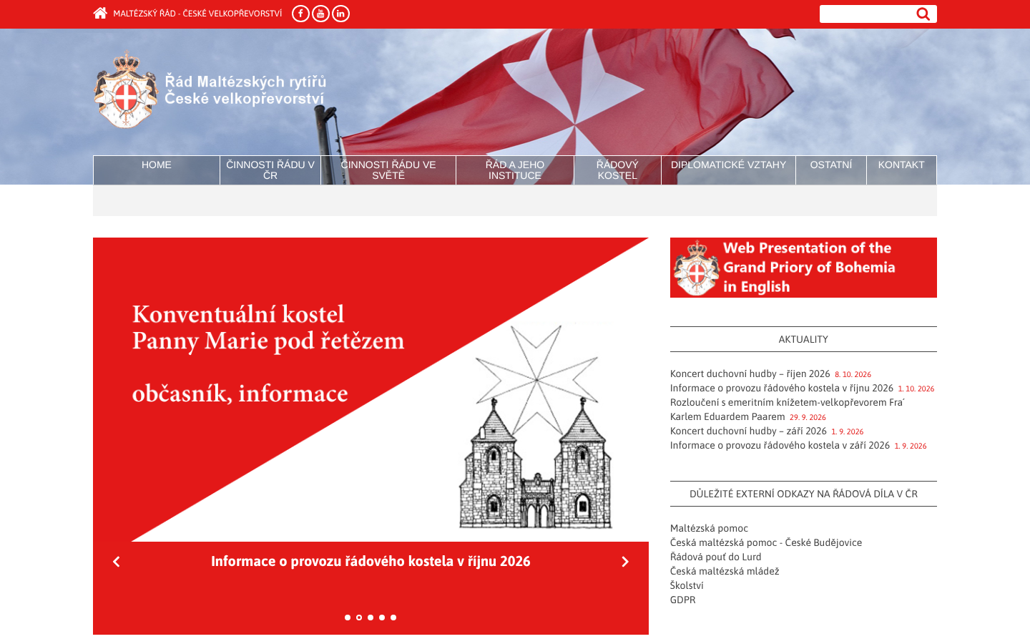
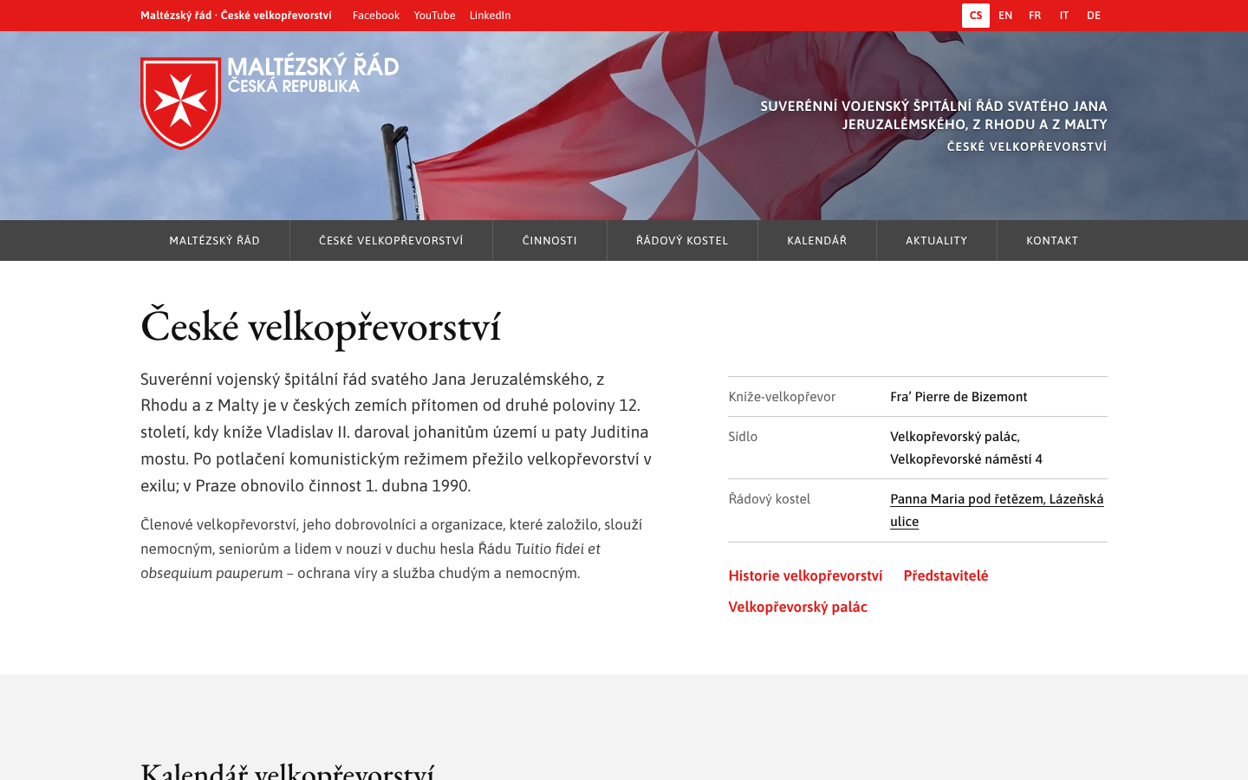
Visual language: old theme, Order frame
Old site
New site
Own header with the coat of arms, not the Grand Magistry banner
Menu labels wrap onto two lines over the photograph
Grand Magistry banner with the personalised lockup
Clear hierarchy: Garamond headings, Asap text, white space
Notes:
Both screenshots: home page, 1440 x 900, 15 Oct 2026. The old site also uses an obsolete scrolling <marquee> element and a slider; the new site follows the Grand Magistry Entities Theme frame (red top bar, banner, graphite menu, grey/white/red footer) with the Order's colours and fonts, and is the same frame on every page and in every language.

Slide 7
What is needed to launch
1
Point maltezskyrad.cz to the new site
Ends the certificate warning for every visitor.
2
Sign off the privacy notice
Grand Priory approval of the text in five languages.
3
Supply the registration number
Ministry of Culture entry of the Grand Priory, for the footer (Civil Code § 435).
4
Review translations and lockup
Native-speaker review; Grand Magistry confirmation of the lockup font.
Notes:
Everything else is done and live on the preview: content migrated with all 193 news posts at their original addresses, 2027 calendar, translations, security headers, legal identity in the footer.

