Slide 1

Doing Data Science
Presented by: Omid Mehrpour

Slide 2
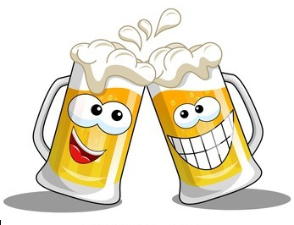
OBJECTIVES
Client: CEO and CFO of Budweiser.
Summary of Brewery and Beer
Information about ABV and IBU
Apparent relationship between ABV and IBU
KNN model
Ounces comparison by State

Slide 3
We analyzed and provided answers to the following questions:
How many breweries are present in each state?
Merge beer data with the breweries data. Print the first 6 observations and the last six observations to check the merged file.
Address the missing values in each column.
Compute the median alcohol content and international bitterness unit for each state.
Which state has the maximum alcoholic (ABV) beer? Which state has the most bitter (IBU) beer?
Comment on the summary statistics and distribution of the ABV variable.
Is there an apparent relationship between the bitterness of the beer and its alcoholic content?
Budweiser would also like to investigate the difference with respect to IBU and ABV between IPAs (India Pale Ales) and other types of Ale (any beer with “Ale” in its name other than IPA).

Slide 4

Datasets
Beer - 2410 US craft beers
Beer names
Beer ID
Brewery ID
Style
Sizes (Ounces)
Alcohol By Volume (ABV)
International Bitterness Units (IBU)
Breweries - 558 US breweries
Brewery names
Brewery ID
City
State

Slide 5

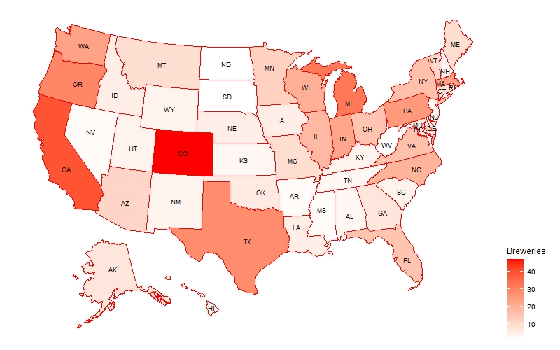
Breweries by State
Colorado has highest number(47) of breweries and, California has with 39 breweries which is in second place. In Colorado most breweries are in Boulder and Denver. Also, California most breweries are in San Diego.

Slide 6
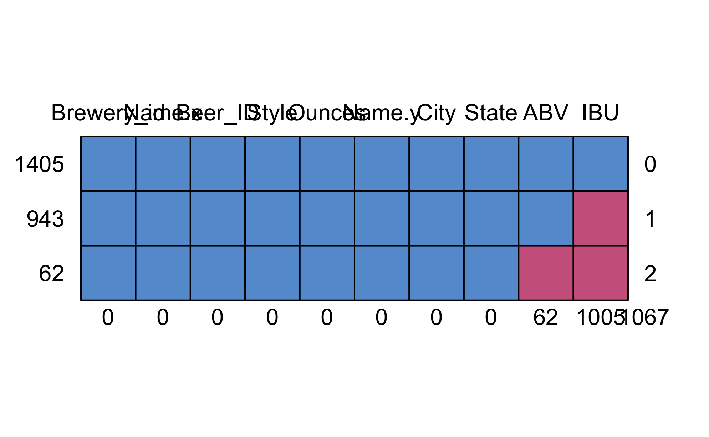
Missing map

Slide 7
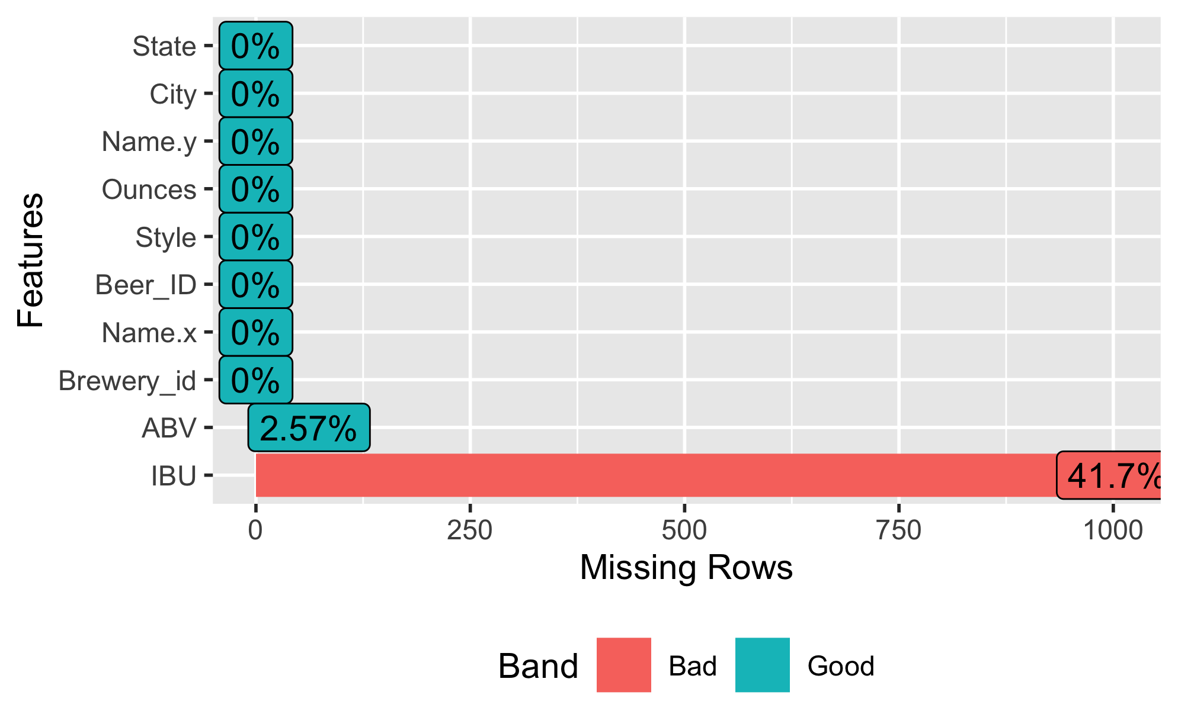
Missing map

Slide 8
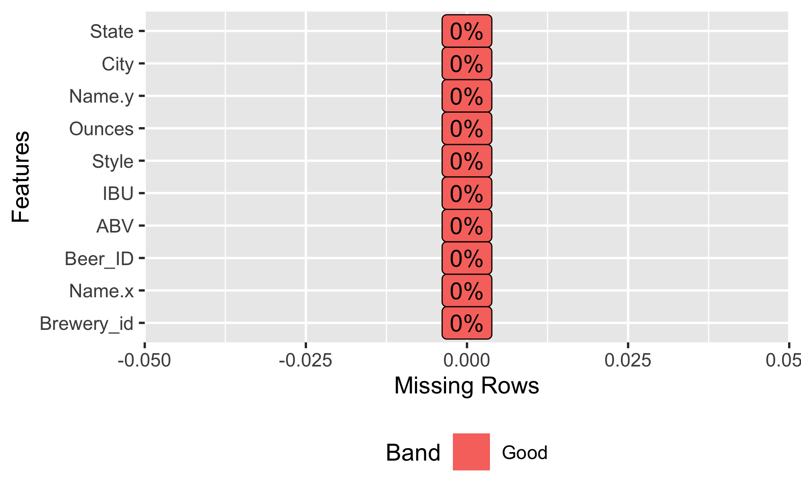
Missing map after replacing the missing values with median

Slide 9
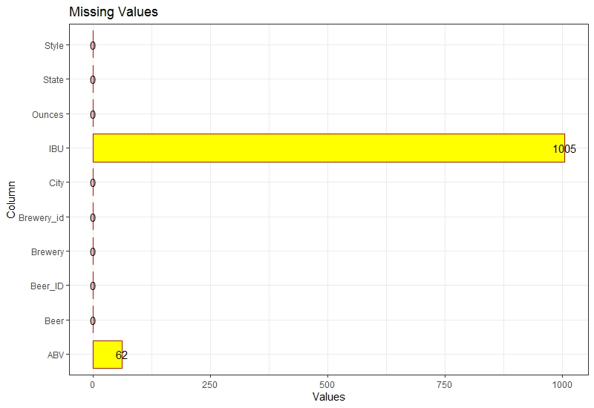
Columns with Missing Values
Both ABV and IBU columns have 62 NA Values
IBU columns only has 943 NA Values
ABV column missing values replace using State level median values and IBU column missing values replace using predictive regression model(ABV as independent)

Slide 10
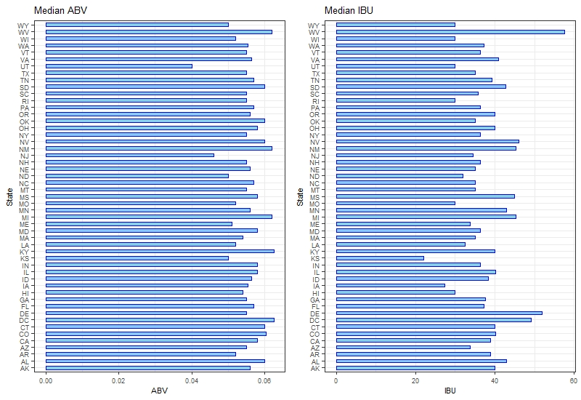
Medians of ABV and IBU cntd..
With replacing median values
ABV range is 4.0% (UT) to 6.25% (DC & KY).
IBU range is 22.0 (KS) to 57.5 (WV).
ABV values not changed very much, but IBU values are changed.

Slide 11
Colorado has the maximum ABV
 | State | ABV | IBU
 | CO | 0.128 | 35

Slide 12
Oregon has the maximum IBU
 | State | ABV | IBU
 | OR | 0.082 | 138

Slide 13
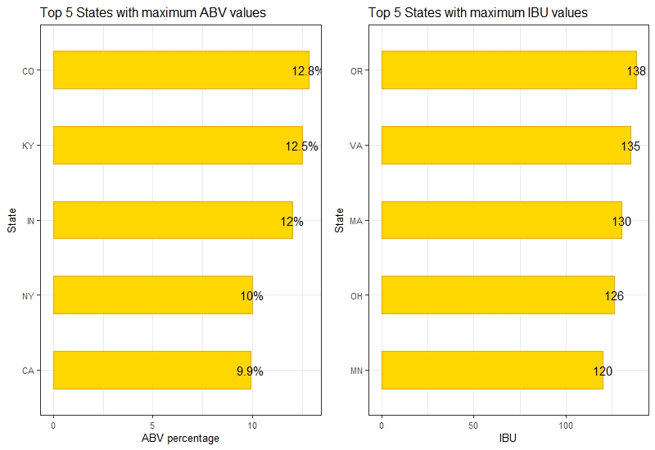
States with Maximum ABV and IBU
Colorado has the Maximum ABV at 0.128.
Oregon has the highest Max IBU at 138.

Slide 14
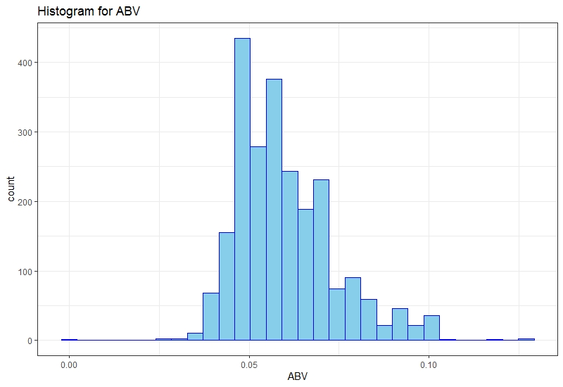
Distribution of ABV
Minimum | Q1 | Median | Mean | Q3 | Maximum
0.001 | 0.05 | 0.056 | 0.059 | 0.067 | 0.128
ABV distribution is positively skewed compared to the normal distribution.

Slide 15
Null hypothesis: the ABV is normally distributed?
Shapiro-Wilk normality test data: merged$ABV W = 0.93421, p-value < 2.2e-16
ABV had not a normal distribution

Slide 16
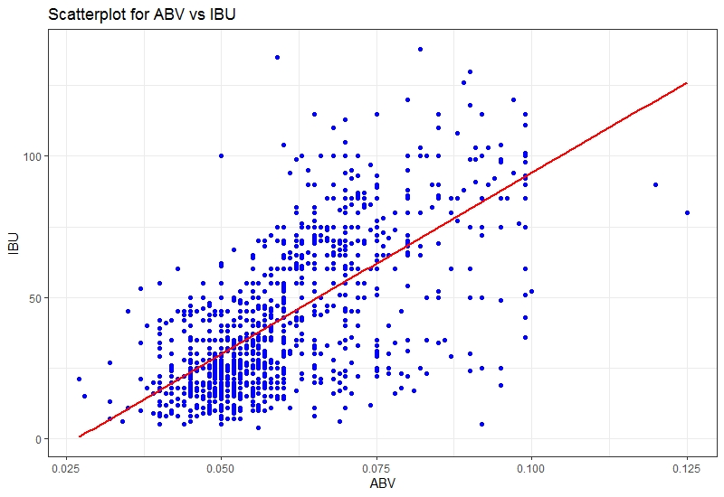
Relationship Between IBU and ABV

Slide 17
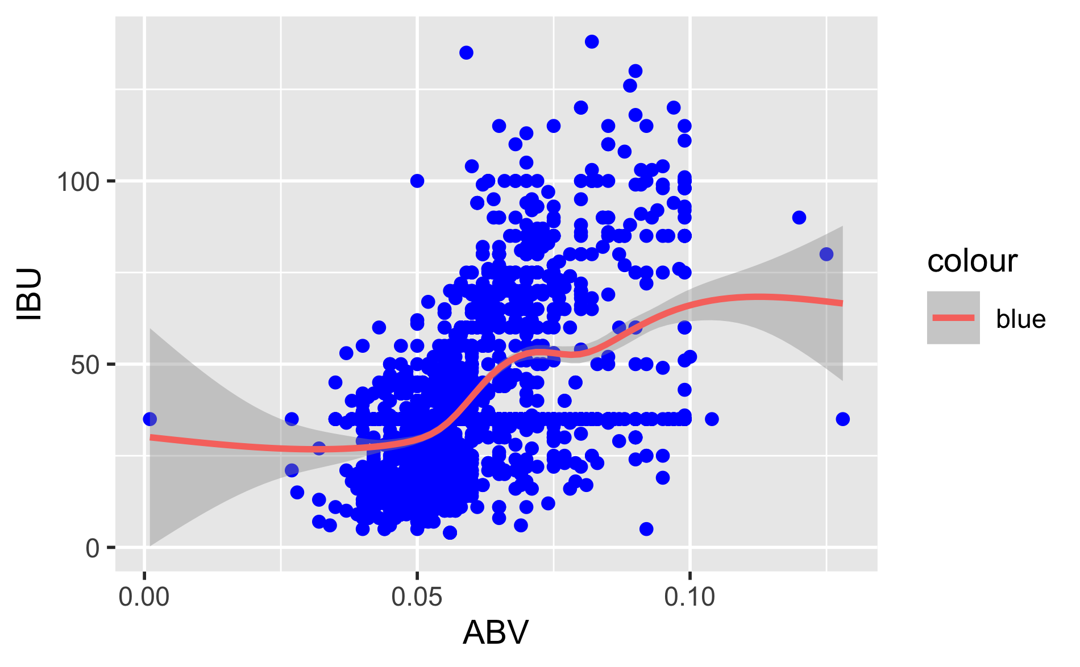
Relationship Between IBU and ABV

Slide 18
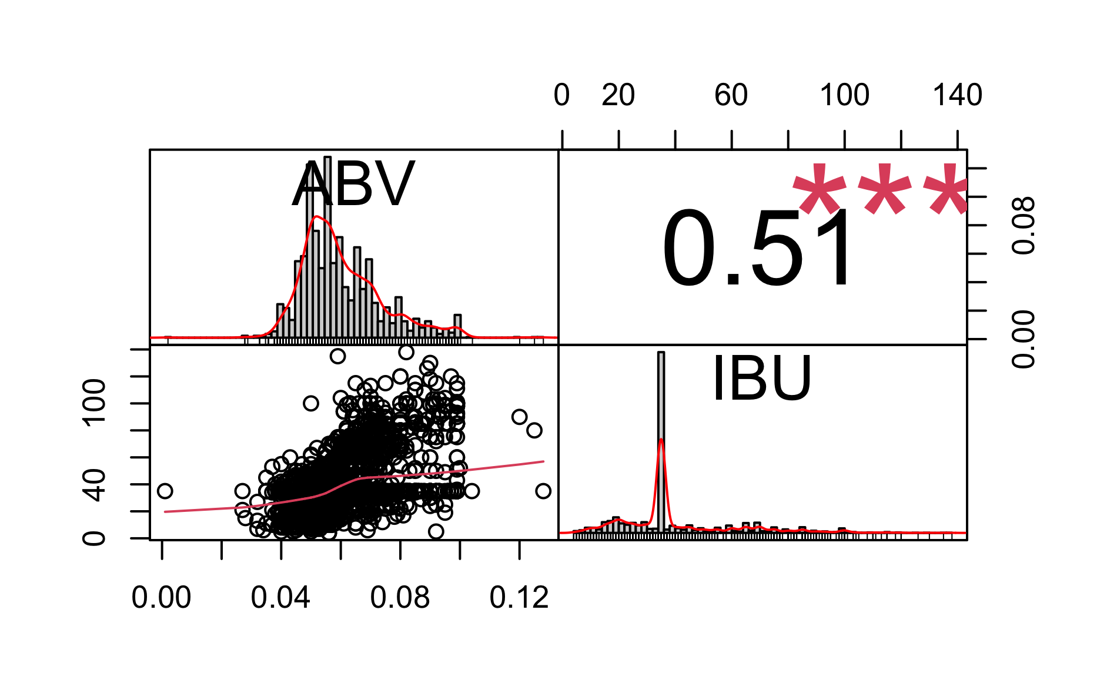
From the scatterplot, we can observe that ABV and IBU has positive linear relationship.

Slide 19
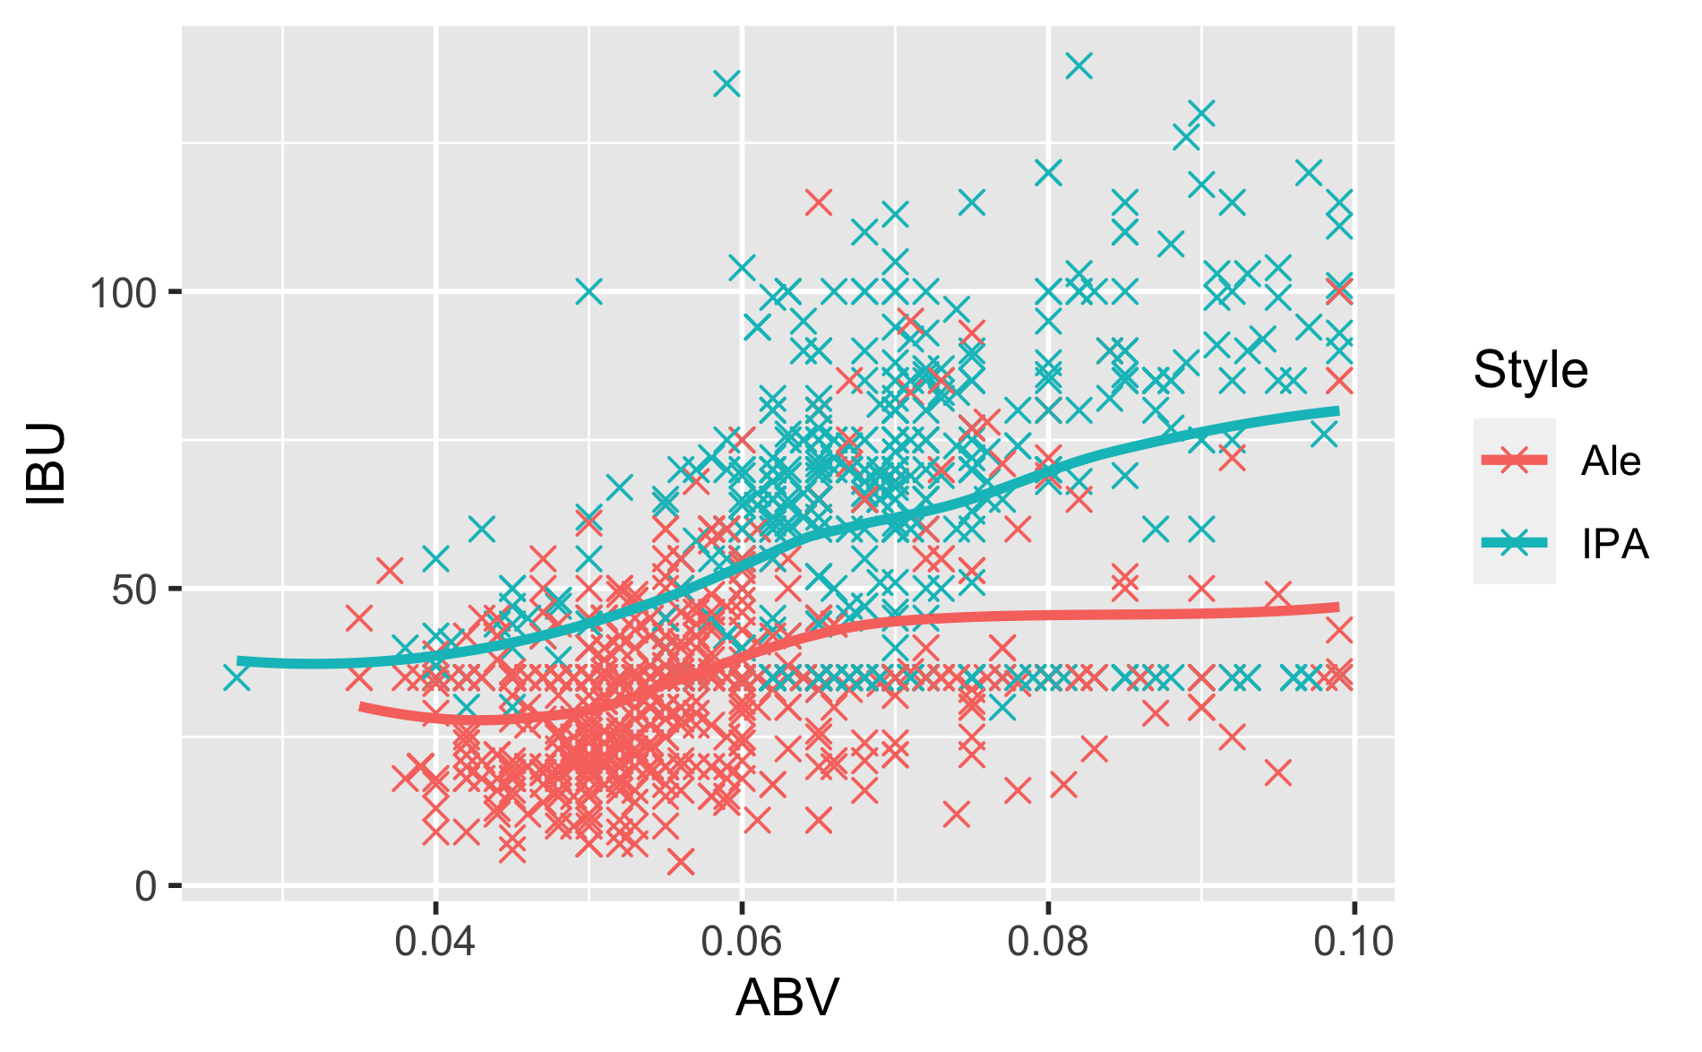
Relationship between ABV and IBU in different styles

Slide 20
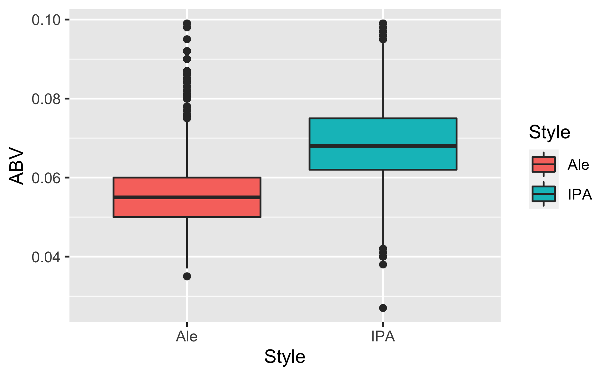
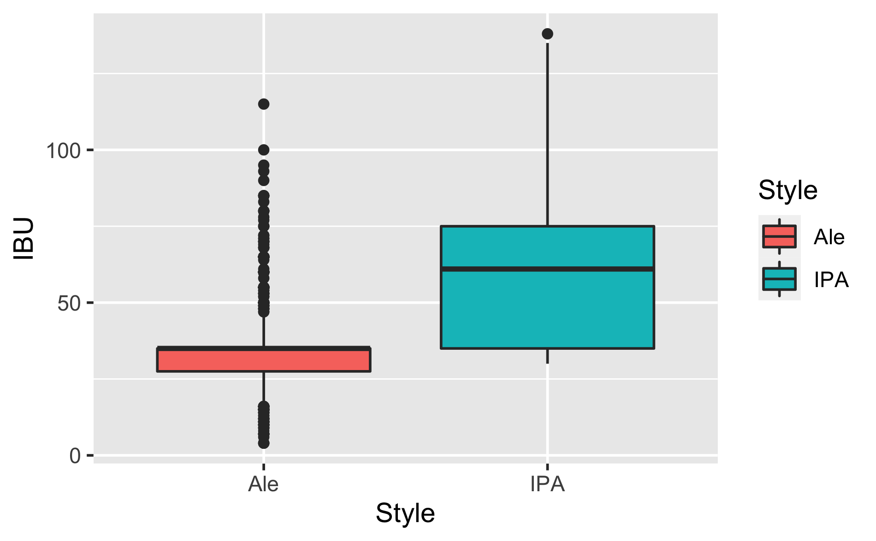
Mann Whitney test showed that ABV and IBU in India Pale were significantly higher than Ale style

Slide 21
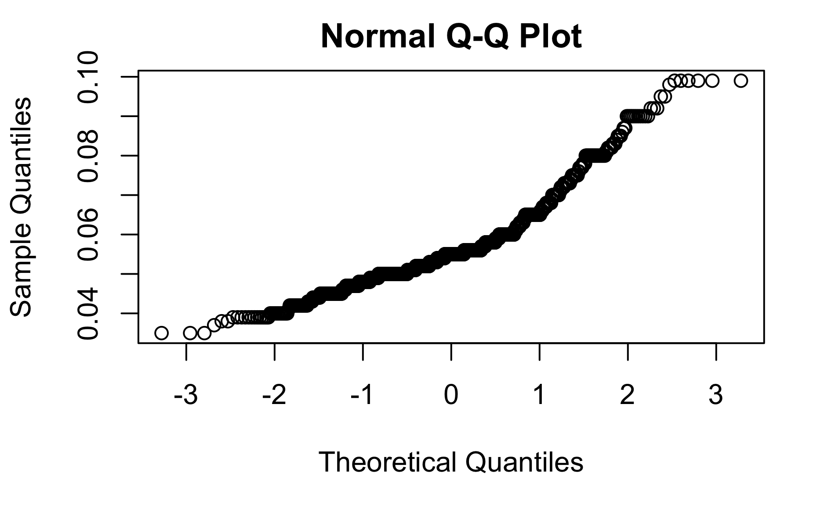
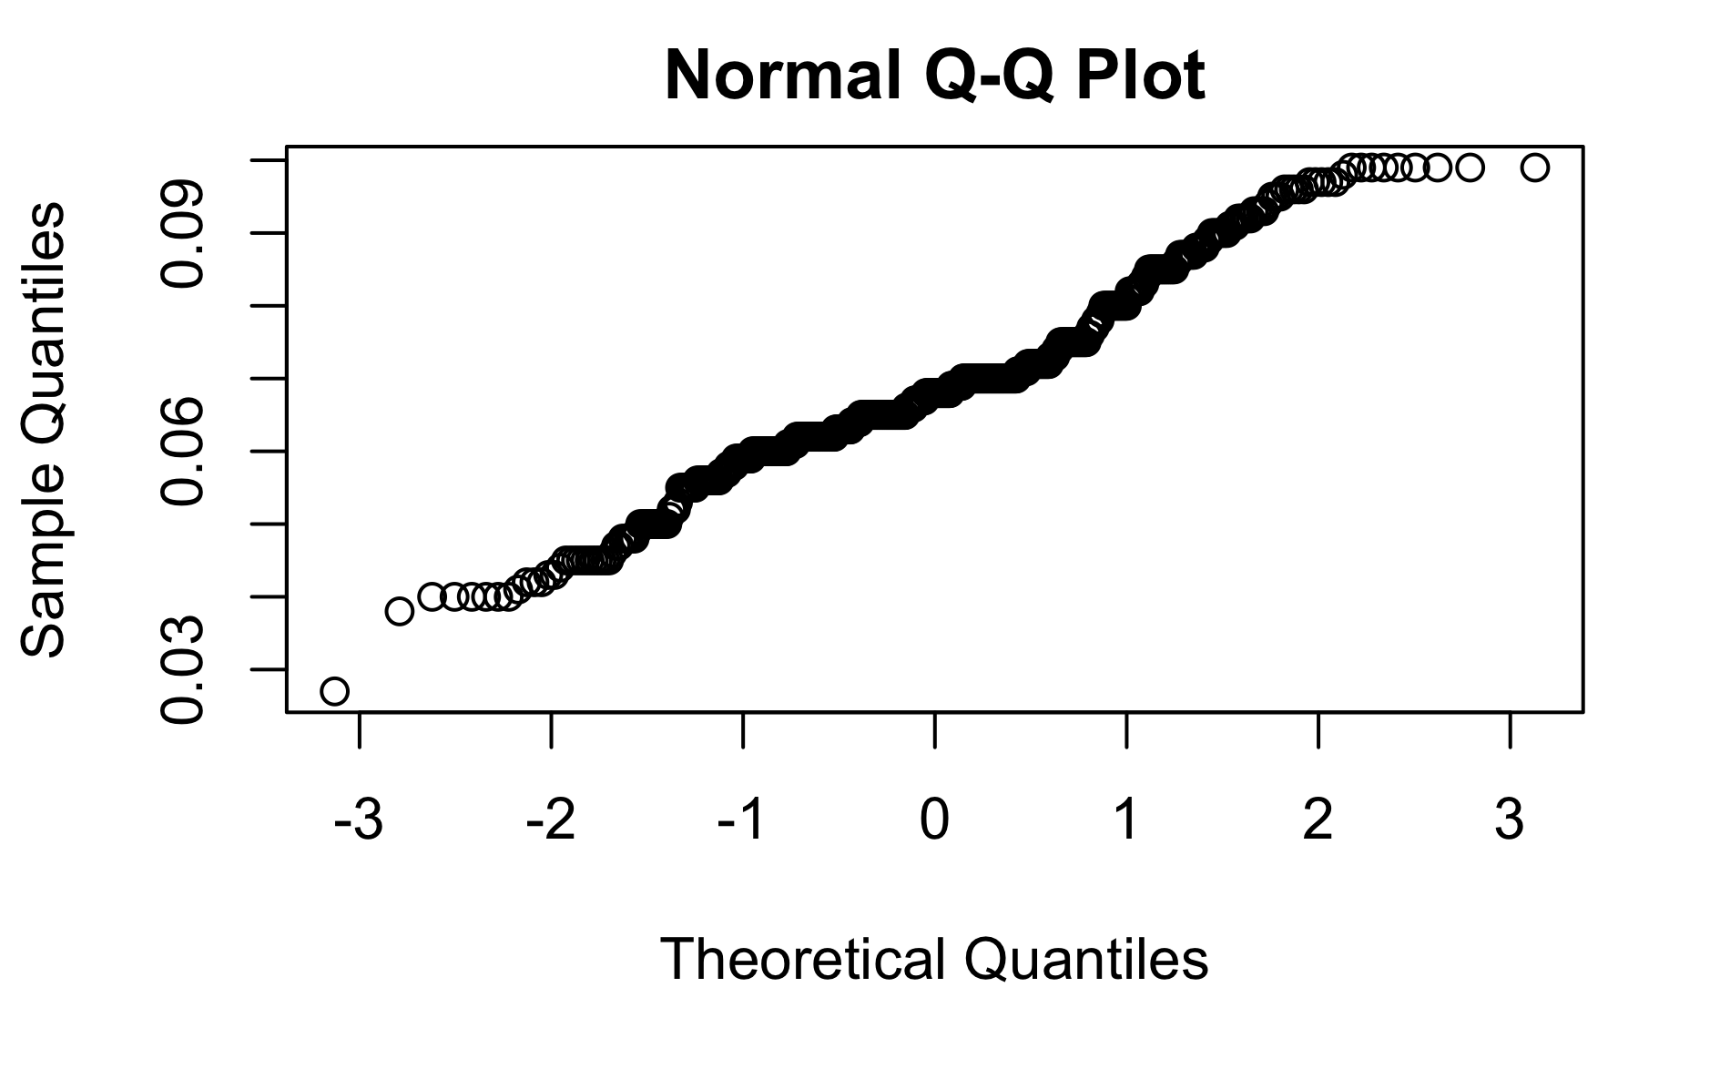
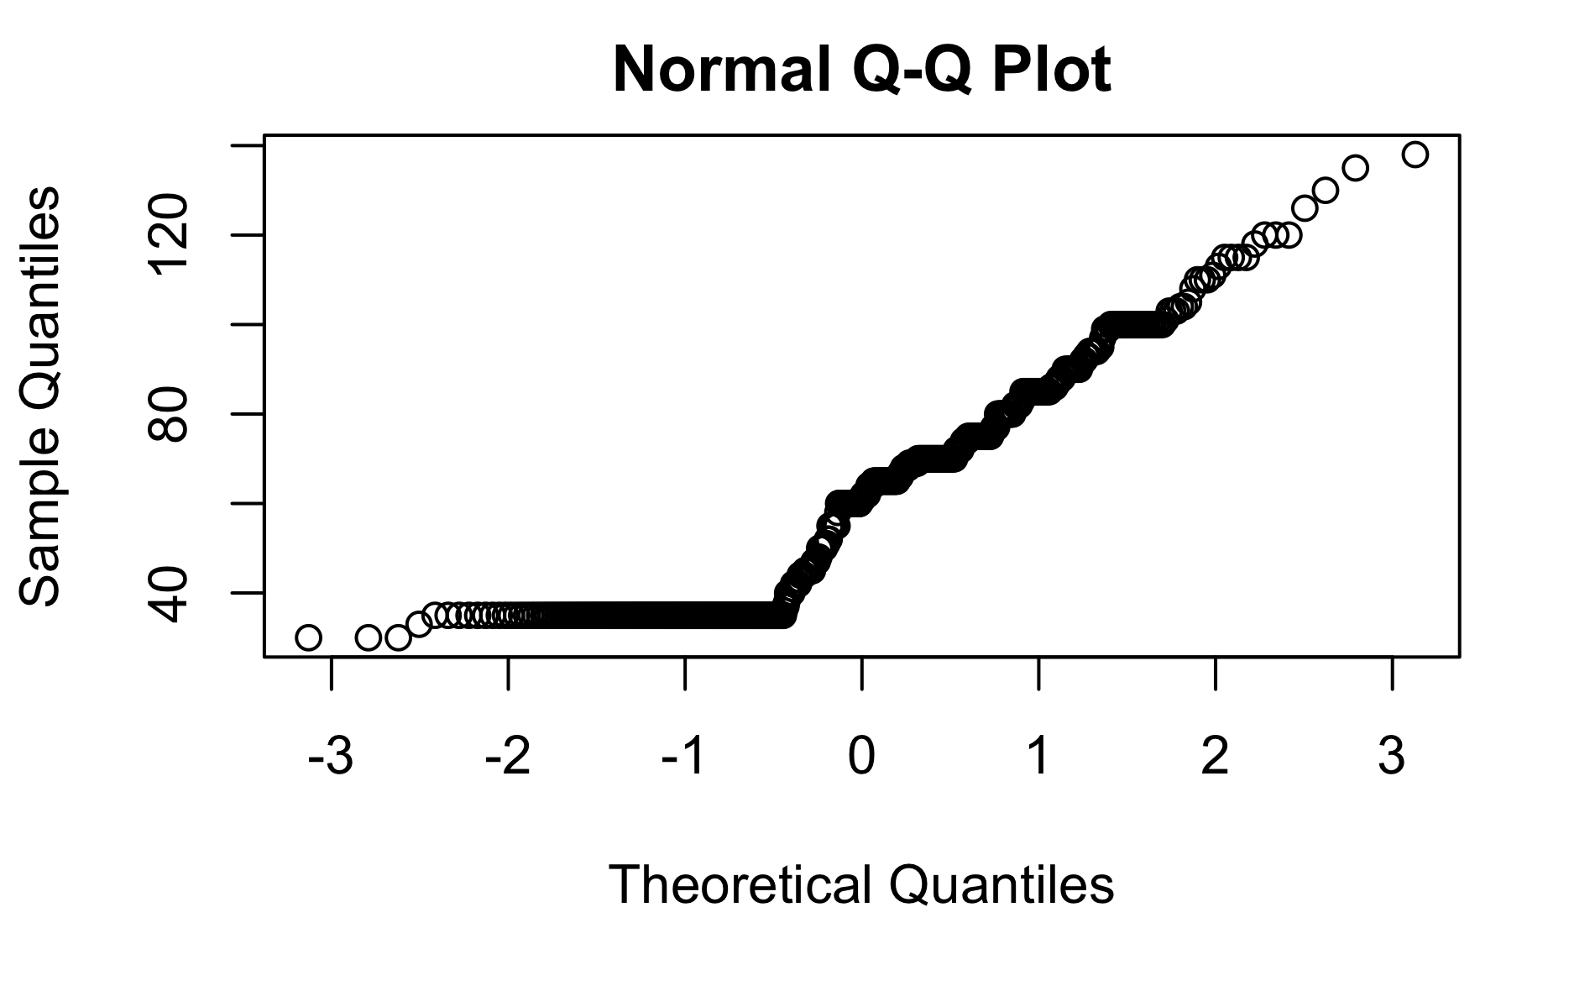
IBU in ale, and IPA
AND ABV in ale and IPU did not have a normal distribution

Slide 22
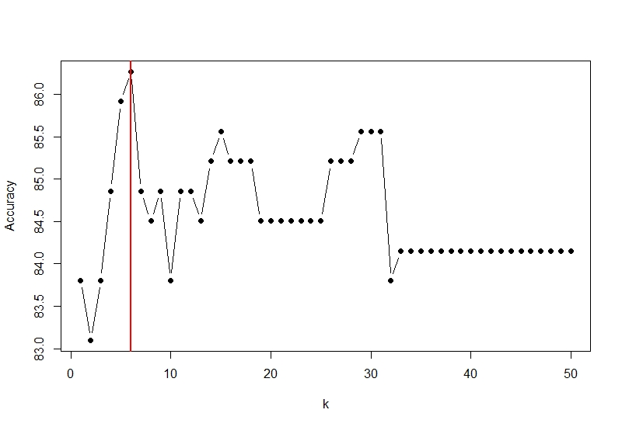
KNN Model for distinguishing IPA and ale
Used original dataset without missing values.
Optimal k value is 6
Accuracy | Misclassification Rate | Sensitivity | Specificity
86.27% | 0.14 | 0.82 | 0.89

Slide 23
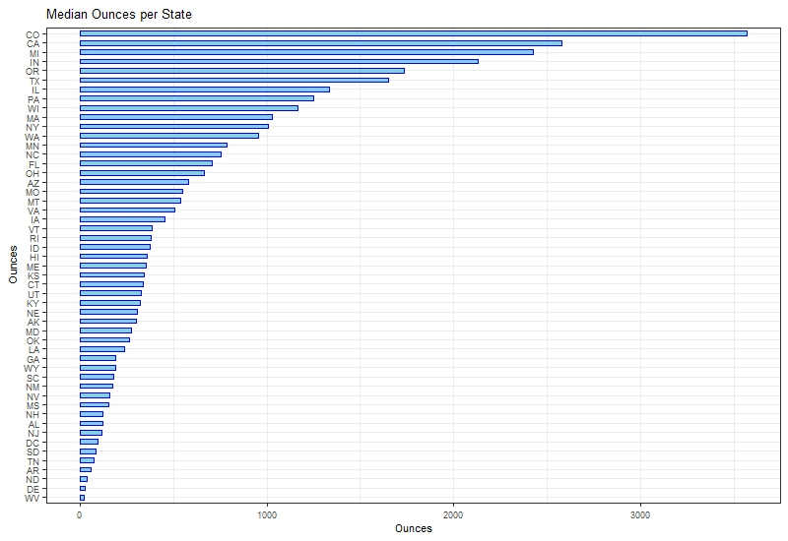
Ounces By State
Higher number of consumers are in Colorado, because higher number of ounces sold in there. and West Virginia has lower number of consumers.

Slide 24
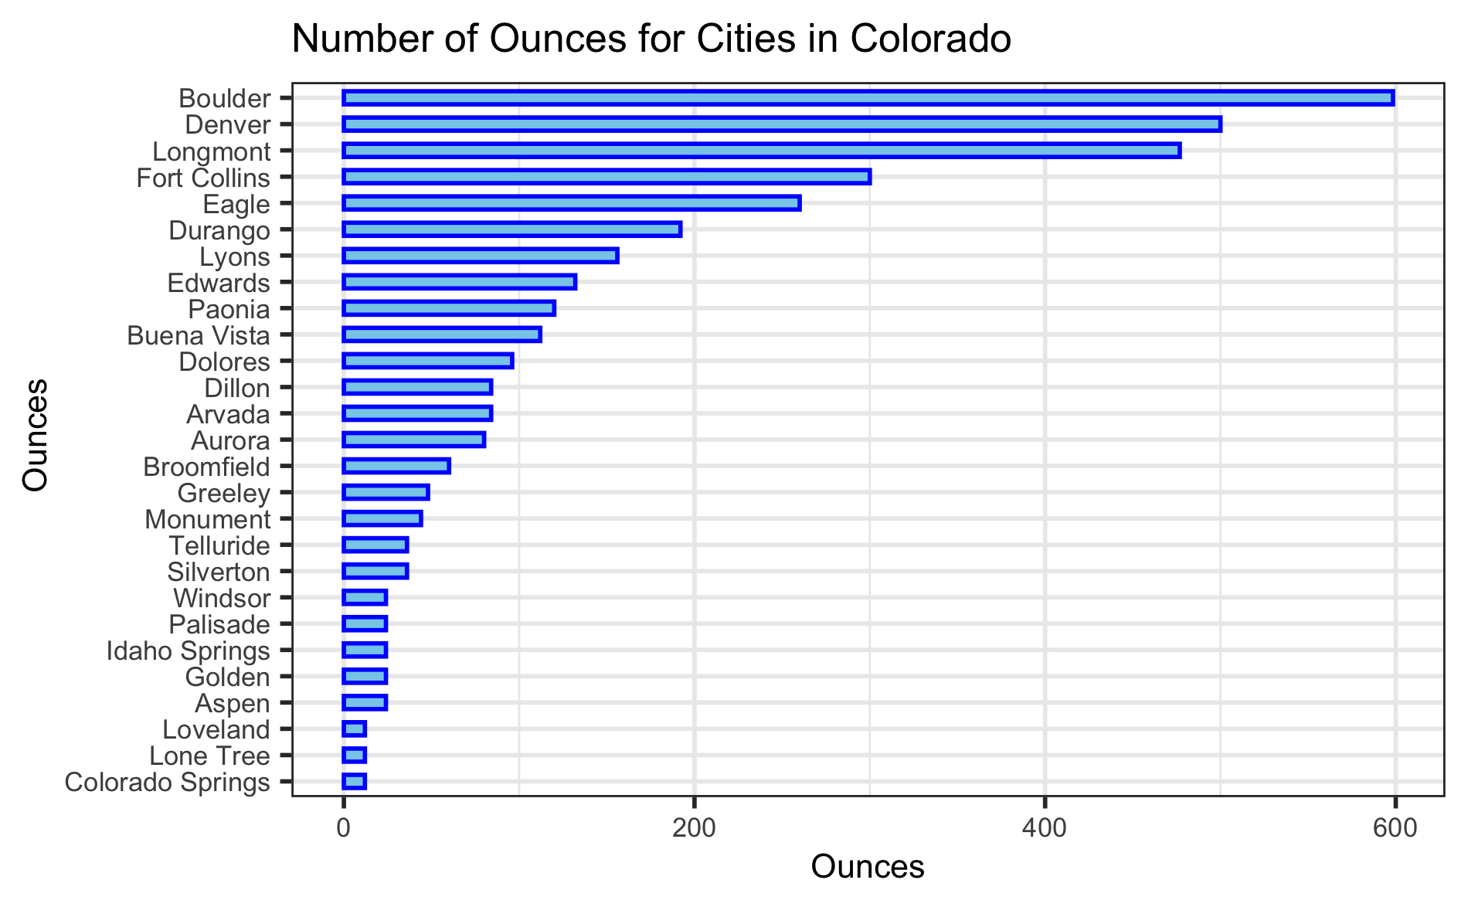
Ounces per cities in Colorado

Slide 25
Evaluation of the Ounces between two styles(IPA and Ale) in different cities in Colorado
Interestingly Mann Whitney test showed that ounces was similar in IPA and Ale in Colorado(p>0.05)

Slide 26


