Slide 1

MSDS 6306: Doing Data Science Case Study 01

Slide 2
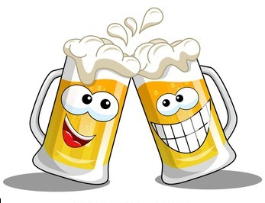
OBJECTIVES
Client: CEO and CFO of Budweiser.
Summary of Brewery and Beer
Information about ABV and IBU
Apparent relationship between ABV and IBU
KNN model
Ounces comparison by State

Slide 3

Datasets
Beer - 2410 US craft beers
Beer names
Beer ID
Brewery ID
Style
Sizes (Ounces)
Alcohol By Volume (ABV)
International Bitterness Units (IBU)
Breweries - 558 US breweries
Brewery names
Brewery ID
City
State

Slide 4

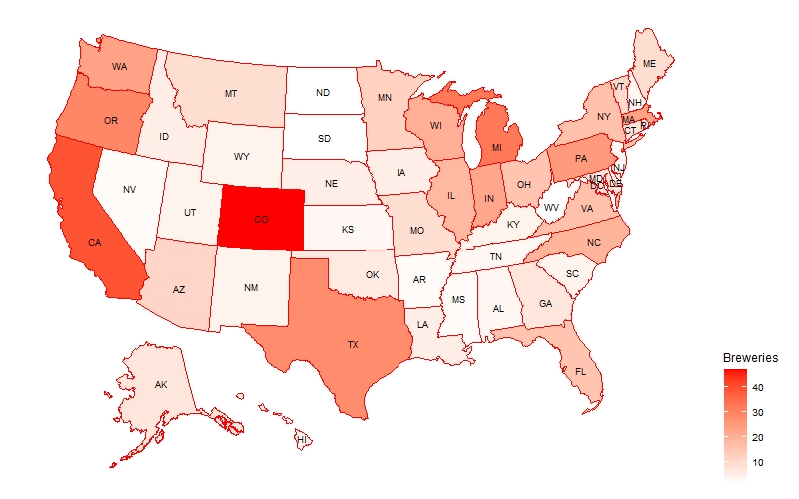
Breweries by State
Colorado has highest number(47) of breweries and, California has with 39 breweries which is in second place. In Colorado most breweries are in Boulder and Denver. Also, California most breweries are in San Diego.

Slide 5
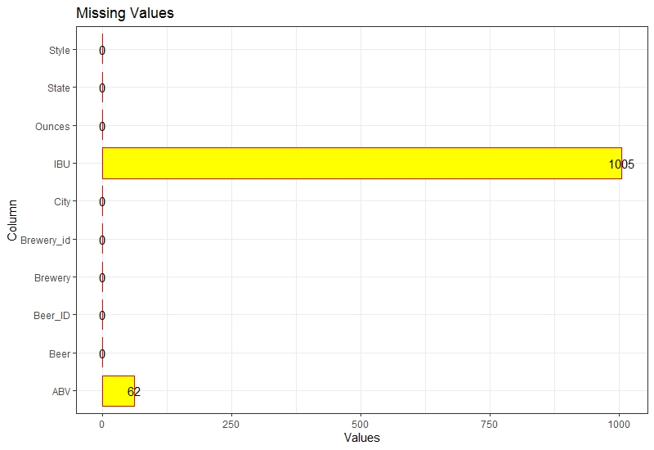
Columns with Missing Values
Both ABV and IBU columns have 62 NA Values
IBU columns only has 943 NA Values
ABV column missing values replace using State level median values and IBU column missing values replace using predictive regression model(ABV as independent)

Slide 6
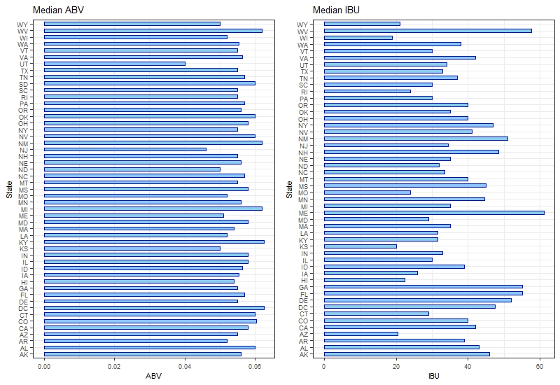
Medians of ABV and IBU
Without Replacing Missing Values
ABV range is 4.0% (UT) to 6.25% (DC & KY).
IBU range is 19.0 (WI) to 61 (ME).

Slide 7
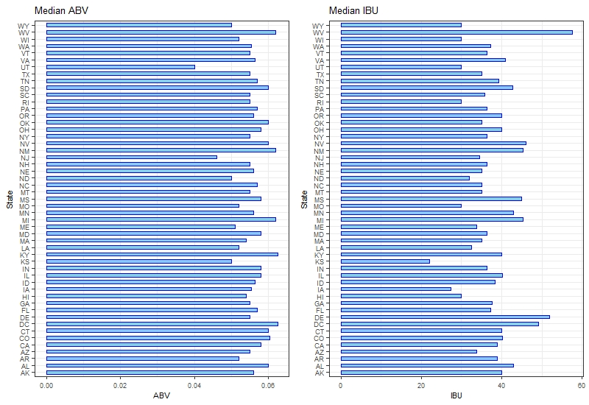
Medians of ABV and IBU cntd..
With replacing median values
ABV range is 4.0% (UT) to 6.25% (DC & KY).
IBU range is 22.0 (KS) to 57.5 (WV).
ABV values not changed very much, but IBU values are changed.

Slide 8
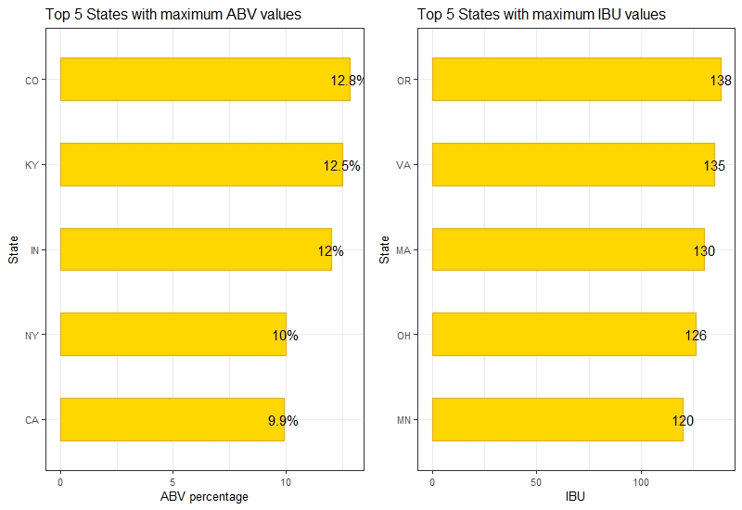
States with Maximum ABV and IBU
Colorado has the Maximum ABV at 0.128.
Oregon has the highest Max IBU at 138.

Slide 9
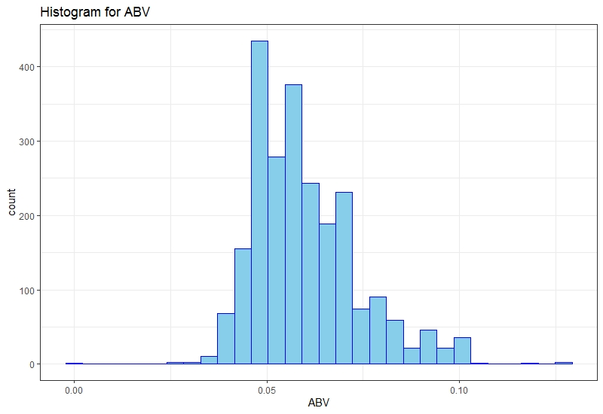
Distribution of ABV
Minimum | Q1 | Median | Mean | Q3 | Maximum
0.001 | 0.05 | 0.056 | 0.059 | 0.067 | 0.128
ABV distribution is positively skewed compared to the normal distribution.

Slide 10
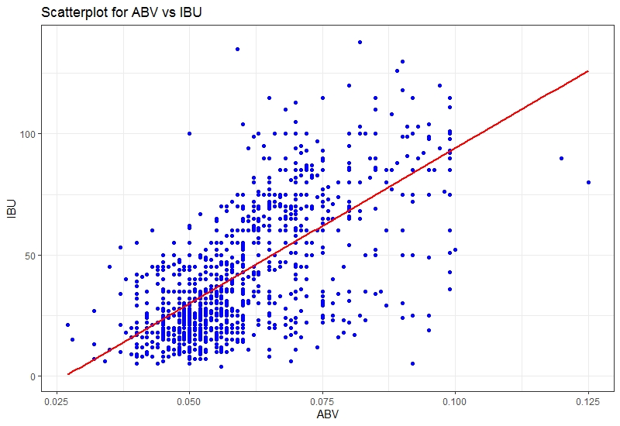
Relationship Between IBU and ABV
From the scatterplot, we can observe that ABV and IBU has positive linear relationship.
Cor(ABV,IBU) = 0.67

Slide 11
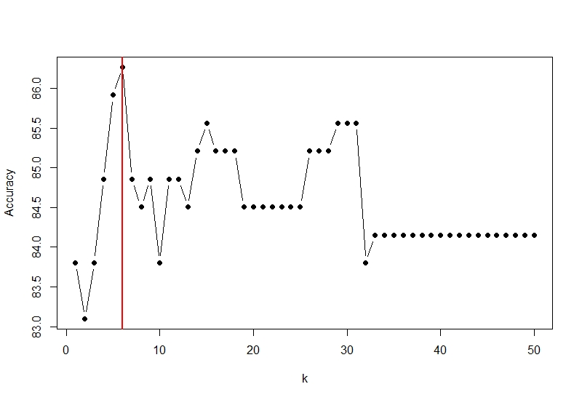
KNN Model
Used original dataset without missing values.
Optimal k value is 6
Accuracy | Misclassification Rate | Sensitivity | Specificity
86.27% | 0.14 | 0.82 | 0.89

Slide 12
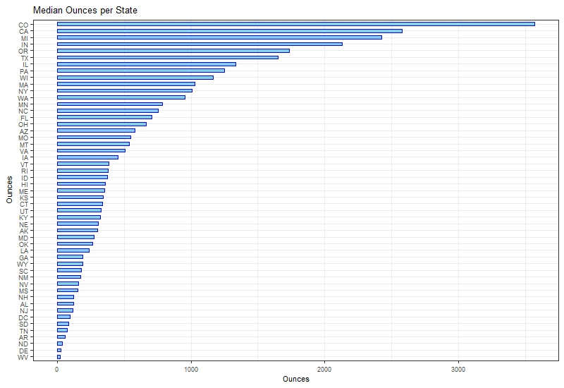
Ounces By State
Higher number of consumers are in Colorado, because higher number of ounces sold in there. and West Virginia has lower number of consumers.

Slide 13


