Slide 1

UniVibe
Bringing students closer to their campus
An AI-guided campus engagement demo that connects self-reported student context to relevant next steps.
Discover your campus. Discover your potential.
Notes:
Research basis: https://github.com/OmenSummon/AWS-GEN-AI---UniVibe (public README and repository listing, accessed 4 Nov 2026).
Product framing: user-provided UniVibe hackathon brief.
Cover artwork: generated illustration for this deck. It represents a concept, not a real campus or user.

Slide 2
UNIVIBE
02
The new-student information gap
Campus life offers many paths, but a student’s first view is often fragmented.
A first-year student is surrounded by possibilities, yet cannot easily tell which opportunity fits their interests, skills, available time, or long-term goal.
1
Scattered discovery
Events, clubs, peers, and campus guidance arrive through different channels.
2
Weak fit signals
UniVibe starts with a practical question:
Students do not receive a clear explanation of relevance or trade-offs.
What should I do next, and why does it fit me?
3
Limited organizer context
The desired product vision includes safe, consented insight into who may be interested.
Student intelligence engine
Notes:
Research basis: https://github.com/OmenSummon/AWS-GEN-AI---UniVibe (public README and repository listing, accessed 4 Nov 2026).
Product framing: user-provided UniVibe hackathon brief.
Problem definition follows the user’s product brief. No adoption, retention, or campus-impact statistics are asserted.

Slide 3
UNIVIBE
03
The UniVibe response
A shared intelligence layer connects student context with campus opportunities while keeping scope transparent.
01
02
03
Build a profile
Interpret the context
Make the next step clear
Department, year, interests, skills, available time, goal, and preferred tone.
Heuristic profile scores, hidden strengths, growth opportunities, and ranked interests.
Ranked opportunities, a growth journey, outreach drafts, event tools, and campus guidance.
Implemented design principle
Every opportunity is shown as VERIFIED or SUGGESTED, and profile scores are described as heuristic inferences from student-provided information.
Student intelligence engine
Notes:
Research basis: https://github.com/OmenSummon/AWS-GEN-AI---UniVibe (public README and repository listing, accessed 4 Nov 2026).
Product framing: user-provided UniVibe hackathon brief.
Implemented modules and integrity principles are described in the repository README.

Slide 4
UNIVIBE
04
Student flow — PartyRock prototype
The Student Intelligence Engine prototype moves from self-reported context to a practical next action.
Open Student prototype in PartyRock ↗
01
02
03
04
05
Profile
Interpret
Match
Plan
Act
Student adds context
and preferences
Profile returns archetype
and six heuristic scores
Five ranked campus
recommendations
Gap insights and a
phased growth journey
Outreach, event tools,
and concierge guidance
Prototype flow: profile → interpretation → match → plan → action. Open the PartyRock prototype for the interactive experience.
Student intelligence engine
Notes:
Research basis: https://github.com/OmenSummon/AWS-GEN-AI---UniVibe (public README and repository listing, accessed 4 Nov 2026).
Product framing: user-provided UniVibe hackathon brief.
Profile, Match AI, Gap Analyzer, Journey AI, Outreach Copilot, Event Marketing/Poster, and Campus Concierge map to the eight documented PartyRock modules.
PartyRock student prototype: https://partyrock.aws/u/Sarkar1Souparno/RgaRRjpro/UniVibe-Student-Intelligence-Engine
The PartyRock page is linked for live demonstration. This slide describes the intended flow, not independently verified production behavior.

Slide 5
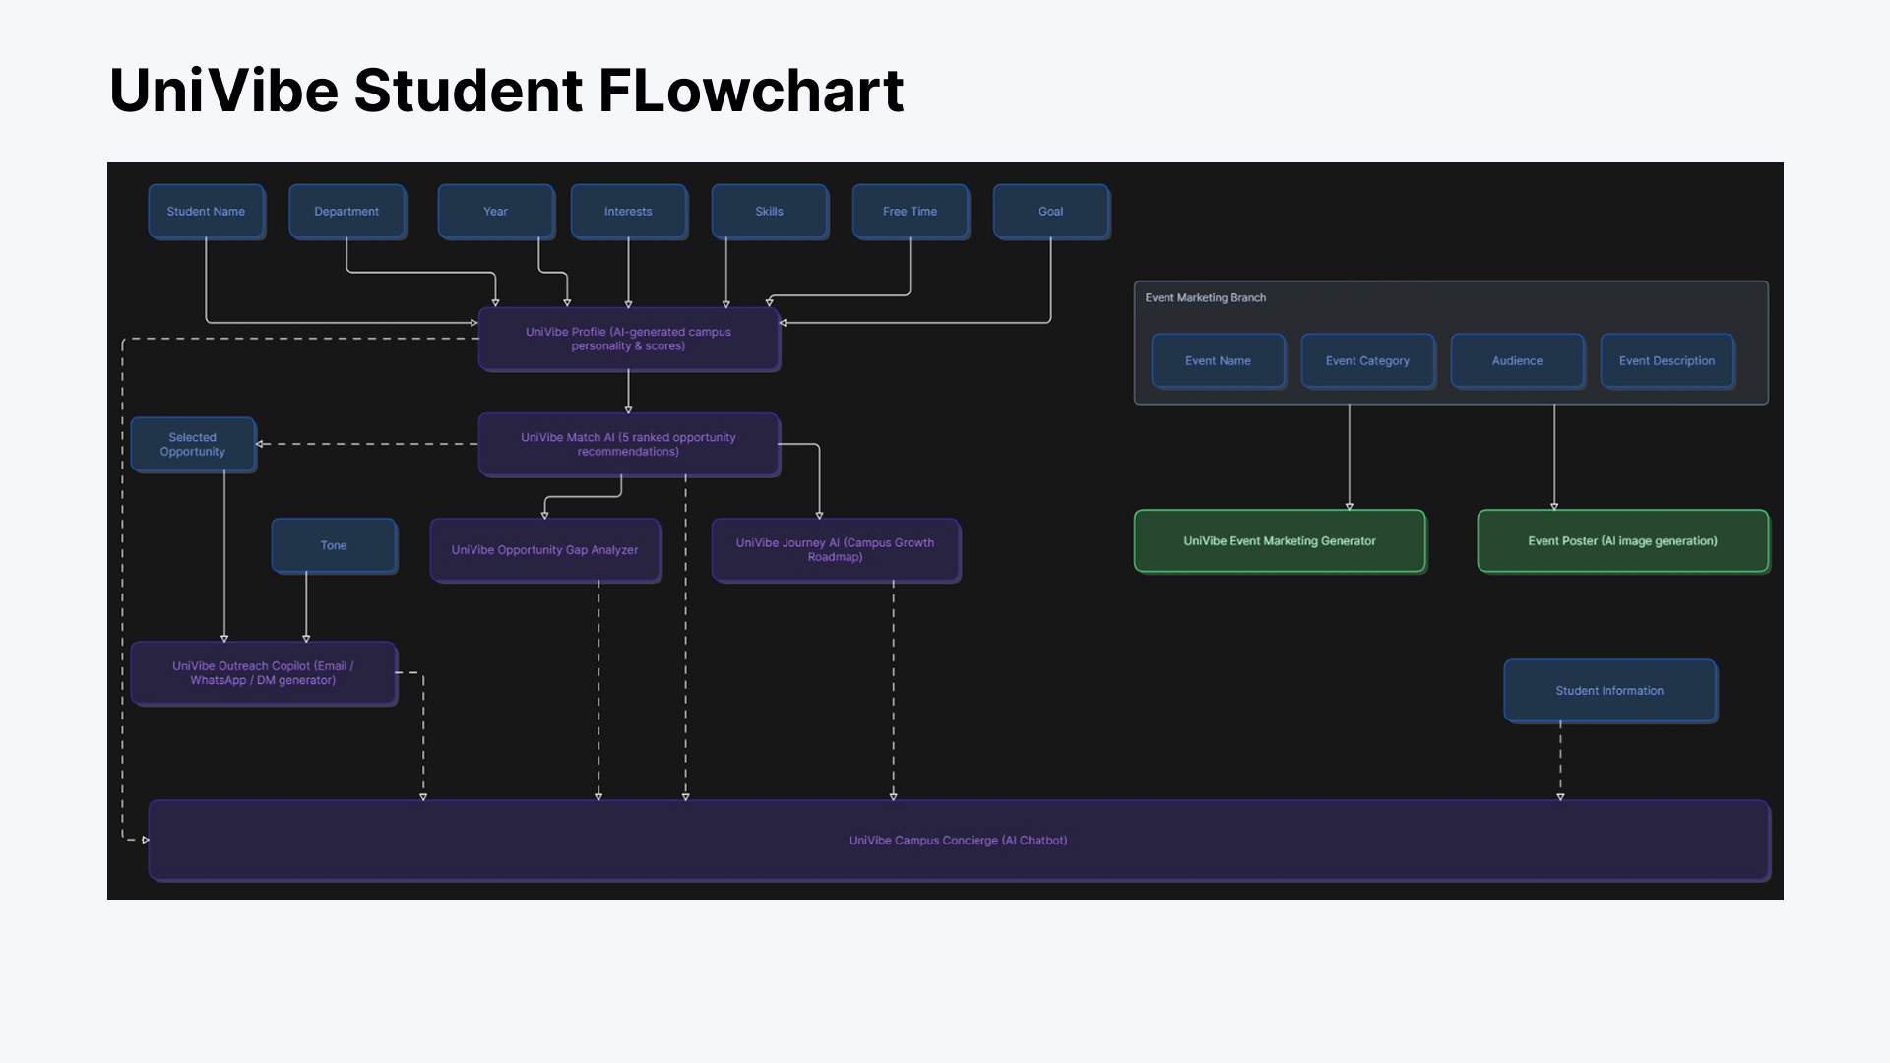
UNIVIBE
05
Student intelligence data flow
The PartyRock student prototype combines student context, opportunity guidance, event tools, and a campus concierge.
Student
name
Department
Year
Interests
Skills
Free time
Goal
Event marketing branch
UniVibe Profile
AI-generated campus personality and scores
Event
name
Category
Audience
Event
description
UniVibe Match AI
5 ranked opportunity recommendations
Event marketing
generator
Event poster
AI image generation
Selected
opportunity
Gap Analyzer
skills, blind spots, next action
Journey AI
7 days to academic year
Tone
Student information
Outreach Copilot
email, WhatsApp, DM
UniVibe Campus Concierge • contextual AI chatbot informed by profile, matches, journey and student context
Solid connectors show direct workflow steps. Dashed connectors provide context to the Campus Concierge.
Source: user-provided student-flow data diagram
Student intelligence engine
Notes:
Source: user-provided student-flow data diagram image, supplied 4 Nov 2026.
This slide recreates the diagram as editable PowerPoint objects and keeps the PartyRock student flow in the preceding slide.

Slide 6
UNIVIBE
06
Matching and evaluation workflow
The demo combines a student profile with a campus knowledge catalog, then explains the output rather than treating it as an objective score.
Inputs
Configured AI layer
Student outputs
Self-reported interests, skills, time, goals
Bedrock provider or simulated provider
Ranked opportunities with status
Department and academic year
Structured prompts and ranking logic
Gap insights and a next action
Seeded verified campus knowledge
Heuristic explanations for profile and match results
Milestones that persist progress
Truth safeguards
Verified records remain distinct from suggested opportunities. Self-reported profile scores are heuristic, not a formal assessment of a student’s ability or potential.
Student intelligence engine
Notes:
Research basis: https://github.com/OmenSummon/AWS-GEN-AI---UniVibe (public README and repository listing, accessed 4 Nov 2026).
Product framing: user-provided UniVibe hackathon brief.
The README identifies a verified campus knowledge catalog and the VERIFIED/SUGGESTED distinction. It describes profile scores as heuristic inferences from self-reported inputs.

Slide 7
UNIVIBE
07
AI modules in the current demo
Eight documented modules cover the student workflow from discovery through action.
UniVibe Profile
Archetype, six intelligence scores, strengths, and growth opportunities.
Match AI
Five ranked recommendations, status labels, and a seven-day mission.
Gap Analyzer
Blind spots, missing industry skills, cross-field synergies, and an action.
Journey AI
A four-phase roadmap with persistent milestone progress.
Outreach Copilot
Drafts for email, WhatsApp, social DMs, and follow-ups.
Event Marketing
Student-facing event promotion copy for multiple channels.
Event Poster
Portrait poster generation with download and regeneration.
Campus Concierge
Contextual campus guidance in a structured chat response.
Scope note: these are documented student-facing modules. Organizer-side pages may exist in the repository, but their behavior is not verified here.
Student intelligence engine
Notes:
Research basis: https://github.com/OmenSummon/AWS-GEN-AI---UniVibe (public README and repository listing, accessed 4 Nov 2026).
Product framing: user-provided UniVibe hackathon brief.
All module descriptions are concise paraphrases of the repository’s documented eight PartyRock AI modules.

Slide 8
UNIVIBE
08
Technical architecture
The repository describes a full-stack Next.js application with a configurable AI provider and a database-backed production path.
Student interface
Next.js 14 App Router, React 18, TypeScript, Tailwind CSS, Framer Motion, and Recharts.
Server-side application
Next.js Route Handlers and modular services expose the application APIs.
AI provider abstraction
BedrockProvider can call Amazon Bedrock. SimulatedAiProvider supports a no-credential demo path.
Data and integrity
Neon Serverless PostgreSQL, migrations, Row Level Security, seeded campus catalog, and a local-persistence fallback.
Configured Bedrock models in the README include a selectable text model and Stability AI image model. The environment decides whether the demo invokes Bedrock or a simulated provider.
Student intelligence engine
Notes:
Research basis: https://github.com/OmenSummon/AWS-GEN-AI---UniVibe (public README and repository listing, accessed 4 Nov 2026).
Product framing: user-provided UniVibe hackathon brief.
Architecture source: repository README. Named components include Next.js, Neon PostgreSQL, AWS Bedrock SDK, BedrockProvider/SimulatedAiProvider, RLS, migrations, and local persistence fallback.

Slide 9
UNIVIBE
09
Demo status and design boundaries
Clear scope keeps the pitch credible and gives the jury a realistic view of what to test today.
Documented demo scope
Unverified or proposed
Student profile, matching, gap analysis, growth journey, outreach, event tools, and concierge
Google or GitHub OAuth sign-in
Demo Mode when a database URL or Bedrock credentials are absent
Live institutional event feeds or real user datasets
Persistent local storage and simulated AI responses in that mode
Organizer dashboard, event, and registration pages may exist, but their behavior has not been verified
Student data controls, including a documented one-click purge
Production database or Bedrock use without valid configuration
Pitch language: call outputs AI-guided and heuristic. Repository documentation describes capabilities; it does not prove live campus operation.
Student intelligence engine
Notes:
Research basis: https://github.com/OmenSummon/AWS-GEN-AI---UniVibe (public README and repository listing, accessed 4 Nov 2026).
Product framing: user-provided UniVibe hackathon brief.
Repository-review boundary: the OmenSummon repo returned readable public documentation. The KAYO-ult fork at ${kayoUrl} could not be retrieved in the research environment. The user’s supplied outline indicates organizer, event, and registration pages exist, but their behavior remains unverified in this deck.

Slide 10
UNIVIBE
10
Organizer flow — PartyRock prototype
Organizer Committee Intelligence complements the student flow. Treat prototype behavior as unverified until it is tested end to end.
PARTYROCK PROTOTYPE
Open Organizer Committee Intelligence in PartyRock ↗
1
2
3
4
Verify an organizer
Publish trusted opportunities
Match consented candidates
Review interest signals
Institution-approved role with clear publishing permissions.
Organizers create or maintain event records that students can recognize as verified.
The system may surface opt-in students whose stated interests and skills relate to the opportunity.
Organizers see transparent relevance reasons and approved actions such as saves or interest, not a hidden student ranking.
Privacy boundary
Organizer discovery should be permissioned, explainable, and revocable by the student. The roadmap preserves student agency instead of creating a monitoring system.
Student intelligence engine
Notes:
Research basis: https://github.com/OmenSummon/AWS-GEN-AI---UniVibe (public README and repository listing, accessed 4 Nov 2026).
Product framing: user-provided UniVibe hackathon brief.
Organizer functionality comes from the user’s stated product vision and supplied outline. The source overview available during research did not verify organizer behavior.
PartyRock organizer prototype: https://partyrock.aws/u/Sarkar1Souparno/5oCsucuiQ/Univibe-Organizer-Committee-Intelligence
The PartyRock page is linked for live demonstration. Candidate discovery and skill-based recommendations remain proposed until verified.

Slide 11
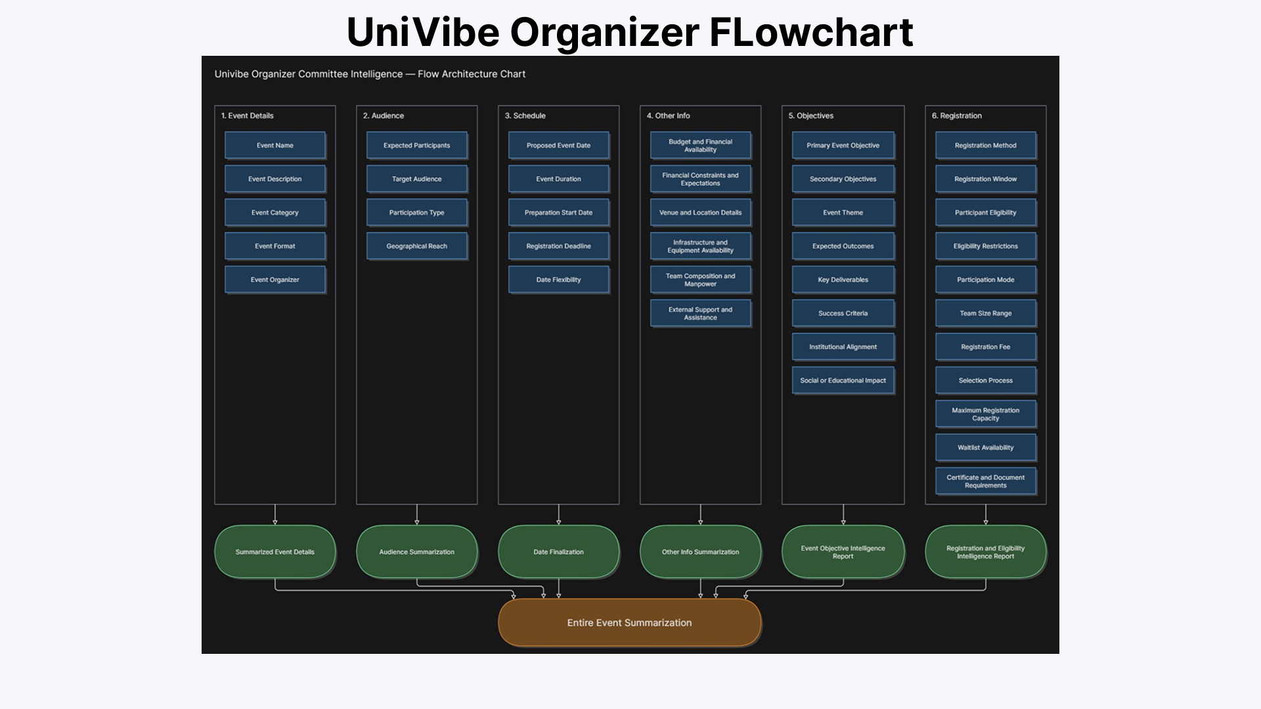
UNIVIBE
11
Organizer intelligence data flow
The PartyRock prototype turns structured event-planning inputs into focused reports and one overall event summary.
1. Event details
2. Audience
3. Schedule
4. Other info
5. Objectives
6. Registration
Event name
Event description
Event category
Event format
Event organizer
Expected participants
Target audience
Participation type
Geographical reach
Proposed event date
Event duration
Preparation start date
Registration deadline
Date flexibility
Budget and financial availability
Financial constraints and expectations
Venue and location details
Infrastructure and equipment availability
Team composition and manpower
External support and assistance
Primary event objective
Secondary objectives
Event theme
Expected outcomes
Key deliverables
Success criteria
Institutional alignment
Social or educational impact
Registration method
Registration window
Participant eligibility
Eligibility restrictions
Participation mode
Team size range
Registration fee
Selection process
Maximum registration capacity
Waitlist availability
Certificate and document requirements
Summarized
event details
Audience
summarization
Date
finalization
Other-info
summarization
Event objective
intelligence report
Registration and eligibility
intelligence report
Entire event summarization
Prototype architecture for planning input. Validate organizer behavior end to end before treating outputs as production functionality.
Organizer Committee Intelligence
Notes:
Source: user-provided organizer flow-architecture image, supplied 4 Nov 2026.
PartyRock organizer prototype: https://partyrock.aws/u/Sarkar1Souparno/5oCsucuiQ/Univibe-Organizer-Committee-Intelligence
The diagram documents the intended PartyRock prototype flow. Organizer behavior has not been independently verified end to end and is presented as prototype scope.

Slide 12
UNIVIBE
12
Roadmap to a credible campus product
The direction is clear: retain today’s usable student flow, then add trusted data and consented organizer capability.
Now
Next
Later
Harden the demo
Connect trusted campus data
Validate organizer capability
Student onboarding, AI modules, verified versus suggested distinction, privacy controls, and transparent demo mode.
Google and GitHub OAuth sign-in, real institutional feeds, data verification, managed database, Bedrock configuration, and operational monitoring.
Verify dashboard and registration behavior, then add consented candidate discovery, explainable relevance, and measured event outcomes.
All items in Next and Later are proposals. They should enter a pilot only after the team defines data stewardship, consent, and success criteria.
Student intelligence engine
Notes:
Research basis: https://github.com/OmenSummon/AWS-GEN-AI---UniVibe (public README and repository listing, accessed 4 Nov 2026).
Product framing: user-provided UniVibe hackathon brief.
Current demo scope is based on repository documentation. OAuth, live data feeds, managed production services, and organizer capability are roadmap proposals informed by the user’s brief.

Slide 13
UNIVIBE
13
A measured pilot, not invented impact
UniVibe should prove usefulness with an agreed baseline and clearly defined participation signals.
1
Access
Profile completion and first relevant action
Can a new student move from arrival to a useful campus step?
2
Relevance
Saved matches, interest actions, and milestone movement
Do students act on the explanations and recommendations they receive?
3
Trust
Feedback on reasons and verification labels
Do students understand what is verified, what is suggested, and why it appears?
4
Participation
Verified event participation when consented integrations exist
Does the workflow improve connection to real campus opportunities?
Pilot method
Set the baseline first, run a defined cohort, collect consented outcomes, and report limitations alongside results. No impact numbers belong in the pitch until the pilot produces them.
Student intelligence engine
Notes:
Research basis: https://github.com/OmenSummon/AWS-GEN-AI---UniVibe (public README and repository listing, accessed 4 Nov 2026).
Product framing: user-provided UniVibe hackathon brief.
This slide proposes a measurement framework. It intentionally contains no performance metrics or impact claims because no pilot results were supplied.

Slide 14
UNIVIBE
14
Discover your campus. Discover your potential.
UniVibe helps students find a practical place in the campus ecosystem.
Built in the demo
Next proof point
A student intelligence workflow: profile, match, gap analysis, journey planning, outreach, event tools, and campus concierge.
Trusted campus data, validated organizer features, and a measured pilot that can show whether the experience helps students act.
Demo walkthrough
1. Create a profile 2. Review explained matches 3. Take one next action
Thank you
Notes:
Research basis: https://github.com/OmenSummon/AWS-GEN-AI---UniVibe (public README and repository listing, accessed 4 Nov 2026).
Product framing: user-provided UniVibe hackathon brief.
Closing narrative reflects current demo scope plus the roadmap proposals clearly identified in the deck.

