Slide 1
AI-Powered Symptom Checker for Tropical Diseases (SCTD)
MENSAH OBED
AFRIQUE-AHALI KEKELI
SUPERVISOR: PROF. J.J. KPONYO
1

Slide 2
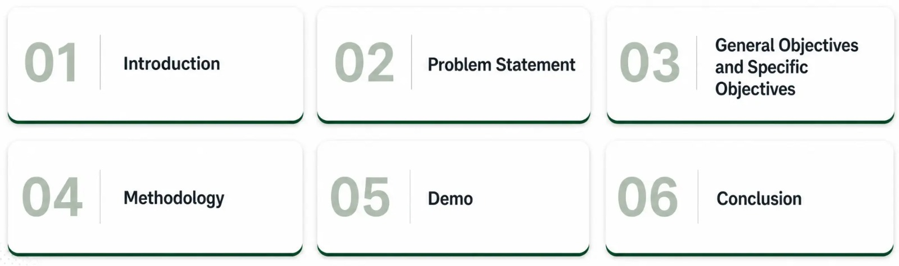
Outline
2

Slide 3

Introduction
Healthcare delivery in Ghana has improved over the years. Ghana already incorporates digital tools such as DHIMS2 and EHR for data aggregation and management. Artificial Intelligence enables intelligent data analysis and supports faster decision-making. Therefore, it can be incorporated in our healthcare systems to improve efficiency.
3

Slide 4







Problem Statement
Hospital Waiting Times
Incorrect Self Medication
Lack of Accessible Decision-Support tools
Uninformed Health Decisions
Disease Progression
Social and interpersonal influence
Unnecessary Hospital Visits
The absence of a symptom checker tool that provides health guidance leads individuals to make uninformed health decisions which can cause adverse effects.
4

Slide 5
General And Specific Objectives
To design an adaptive symptom assessment interface that dynamically selects relevant follow-up questions based on user responses.
To develop an AI-powered symptom assessment platform that enables individuals to communicate their symptoms, receive early tropical disease risk predictions, and access personalized health guidance.
To train our machine learning models on 22 tropical and common diseases relevant to Ghanaians.
To provide clear personalized recommendations, downloadable health reports.
5

Slide 6
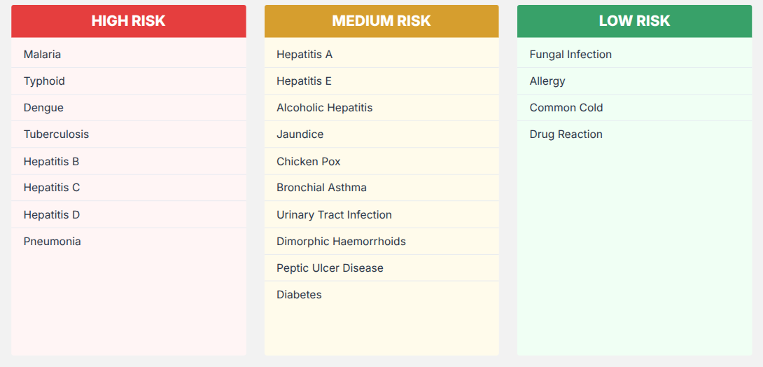
The 22 Diseases and Their Risk Classification
6

Slide 7
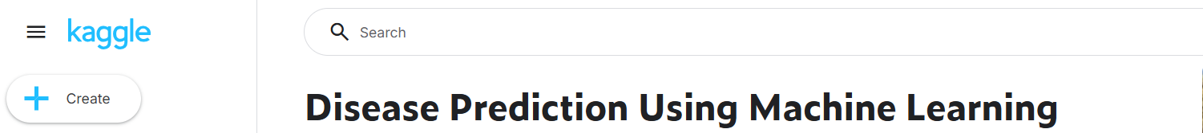
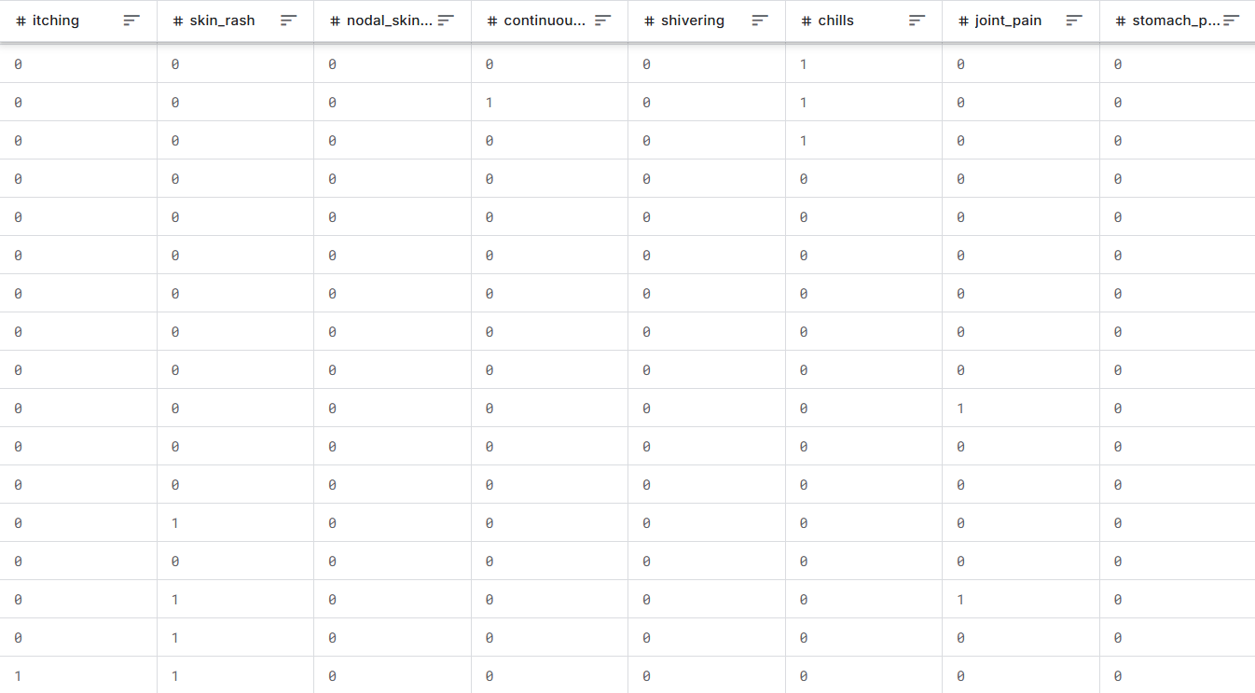
Dataset
Data obtained from Kaggle and 4,924 patient verified medical records. The dataset contains symptom-disease relationships of 22 target diseases. Symptoms encoded as binary values, 1 for Yes and 0 for No. It is structured dataset suitable for machine learning.
7

Slide 8
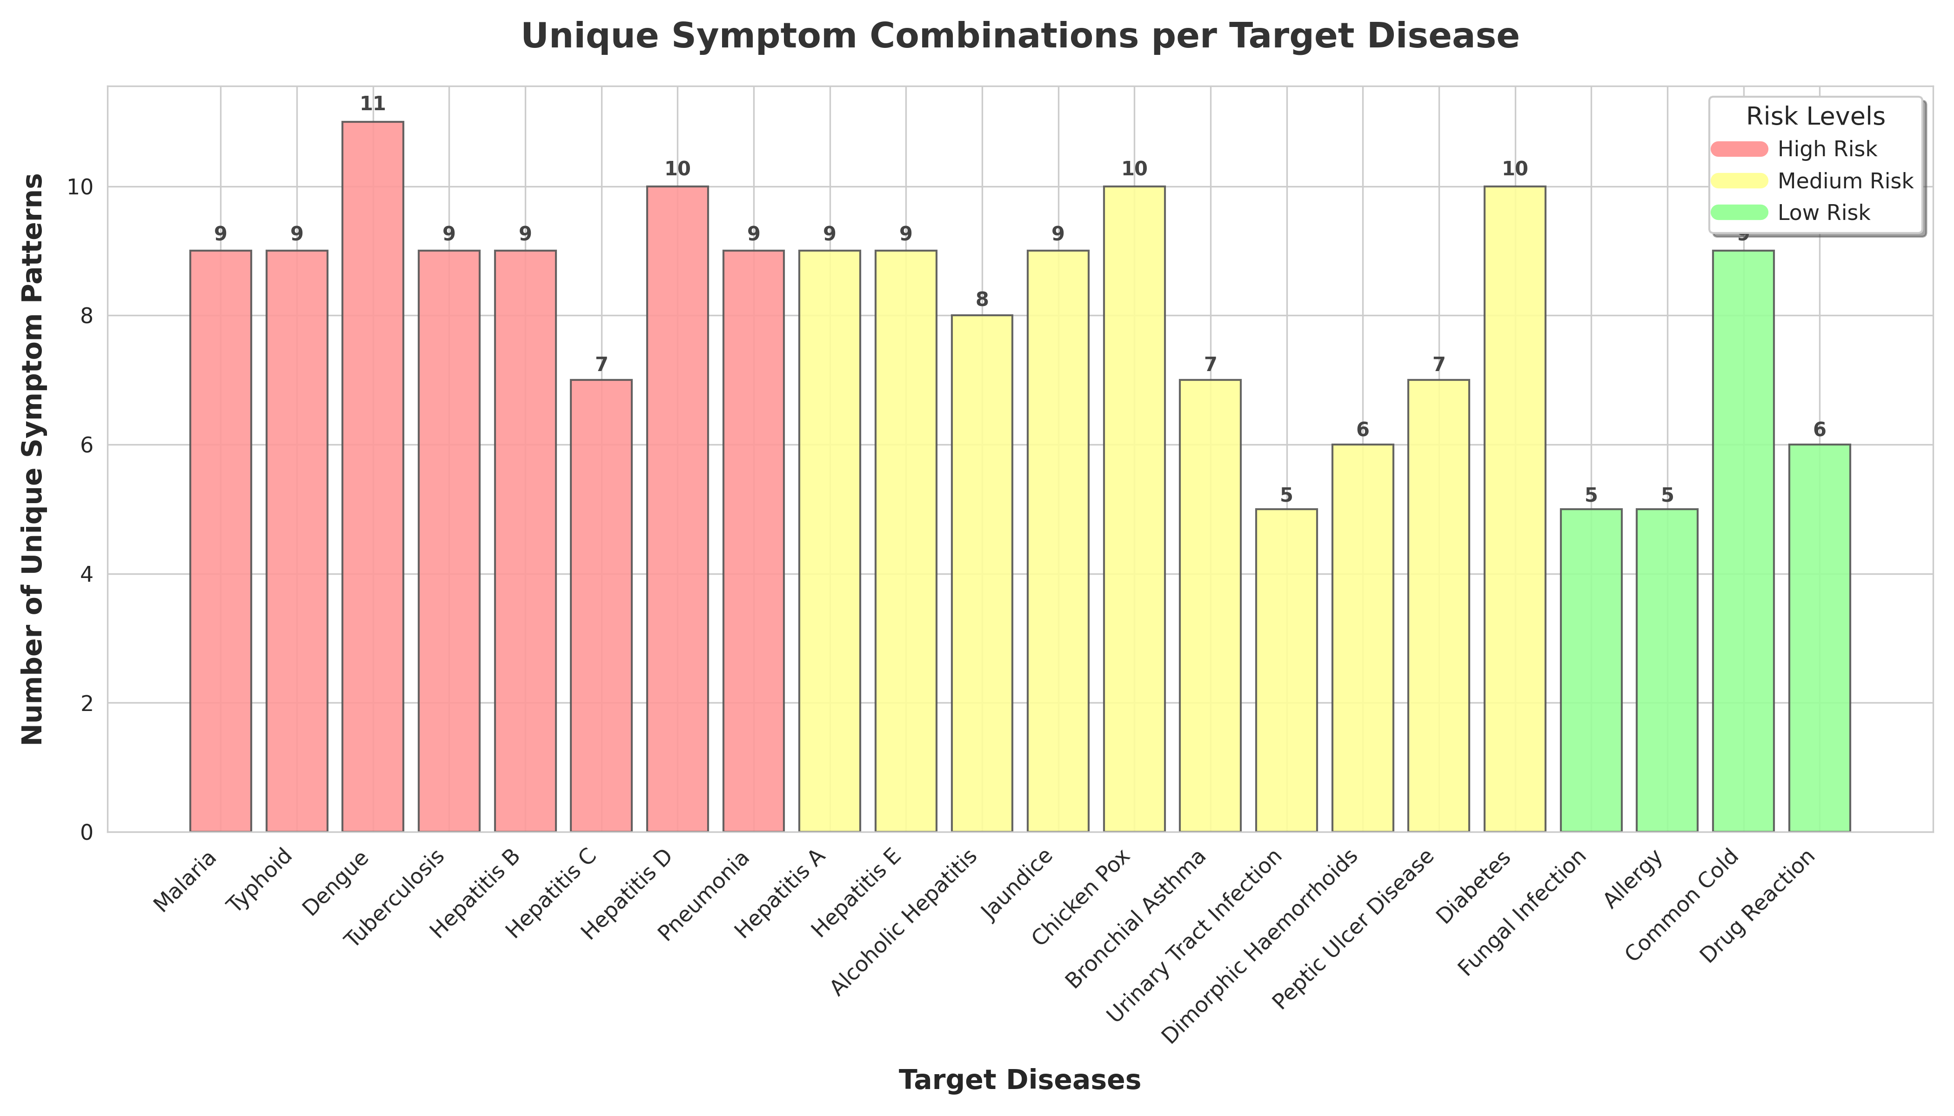
Dataset
8

Slide 9
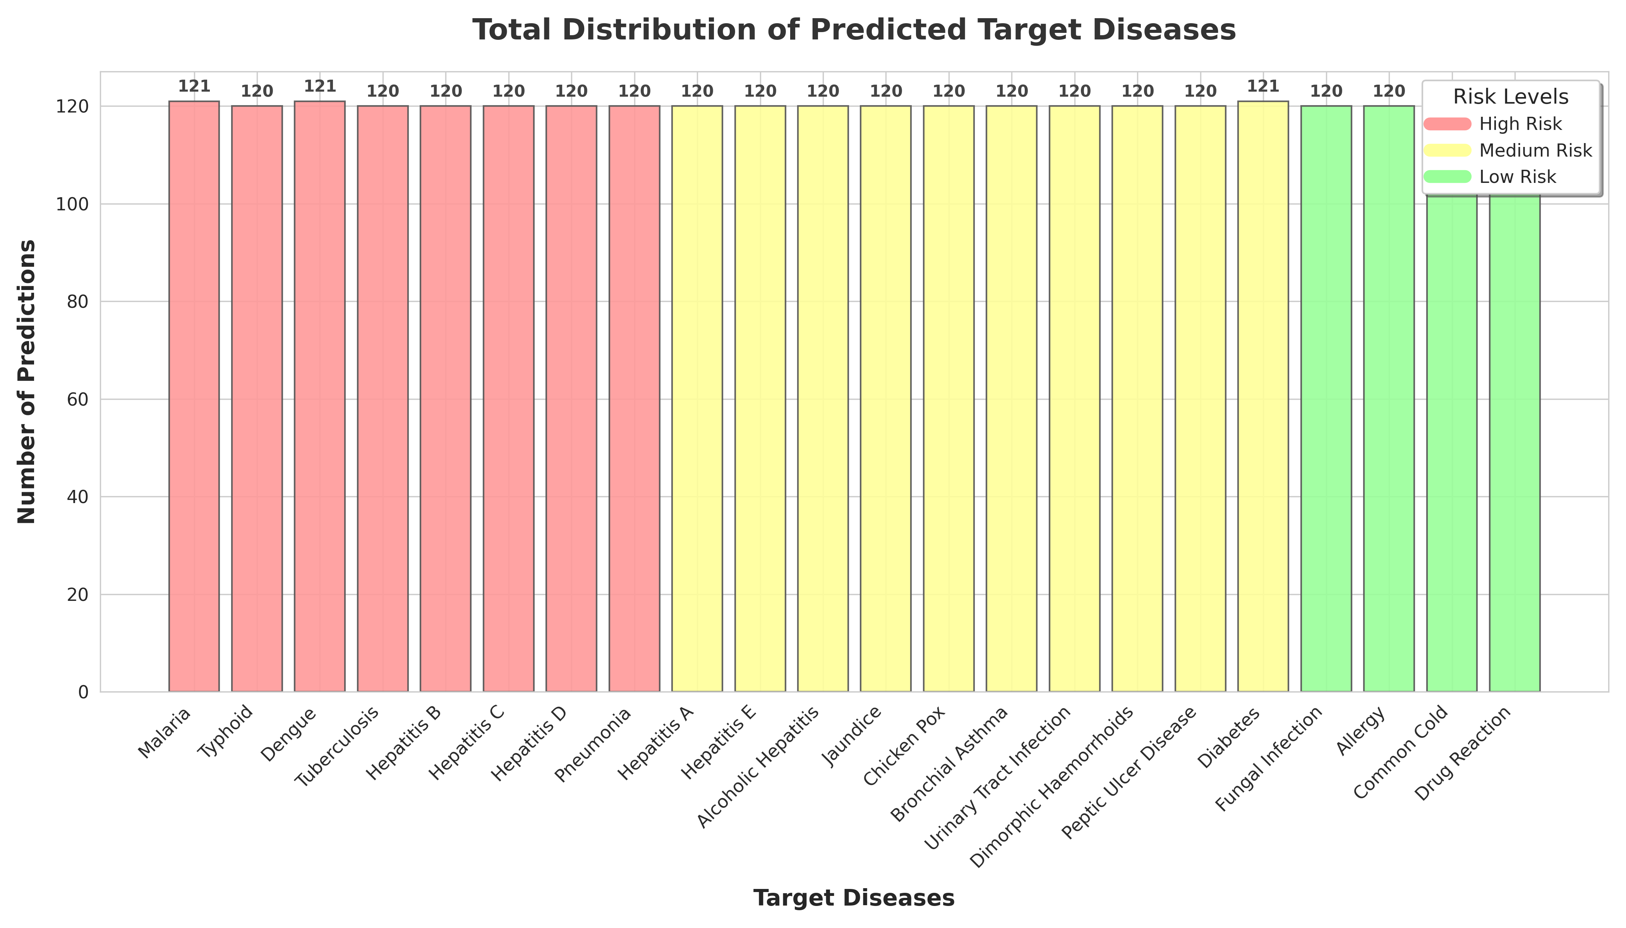
Dataset
9

Slide 10
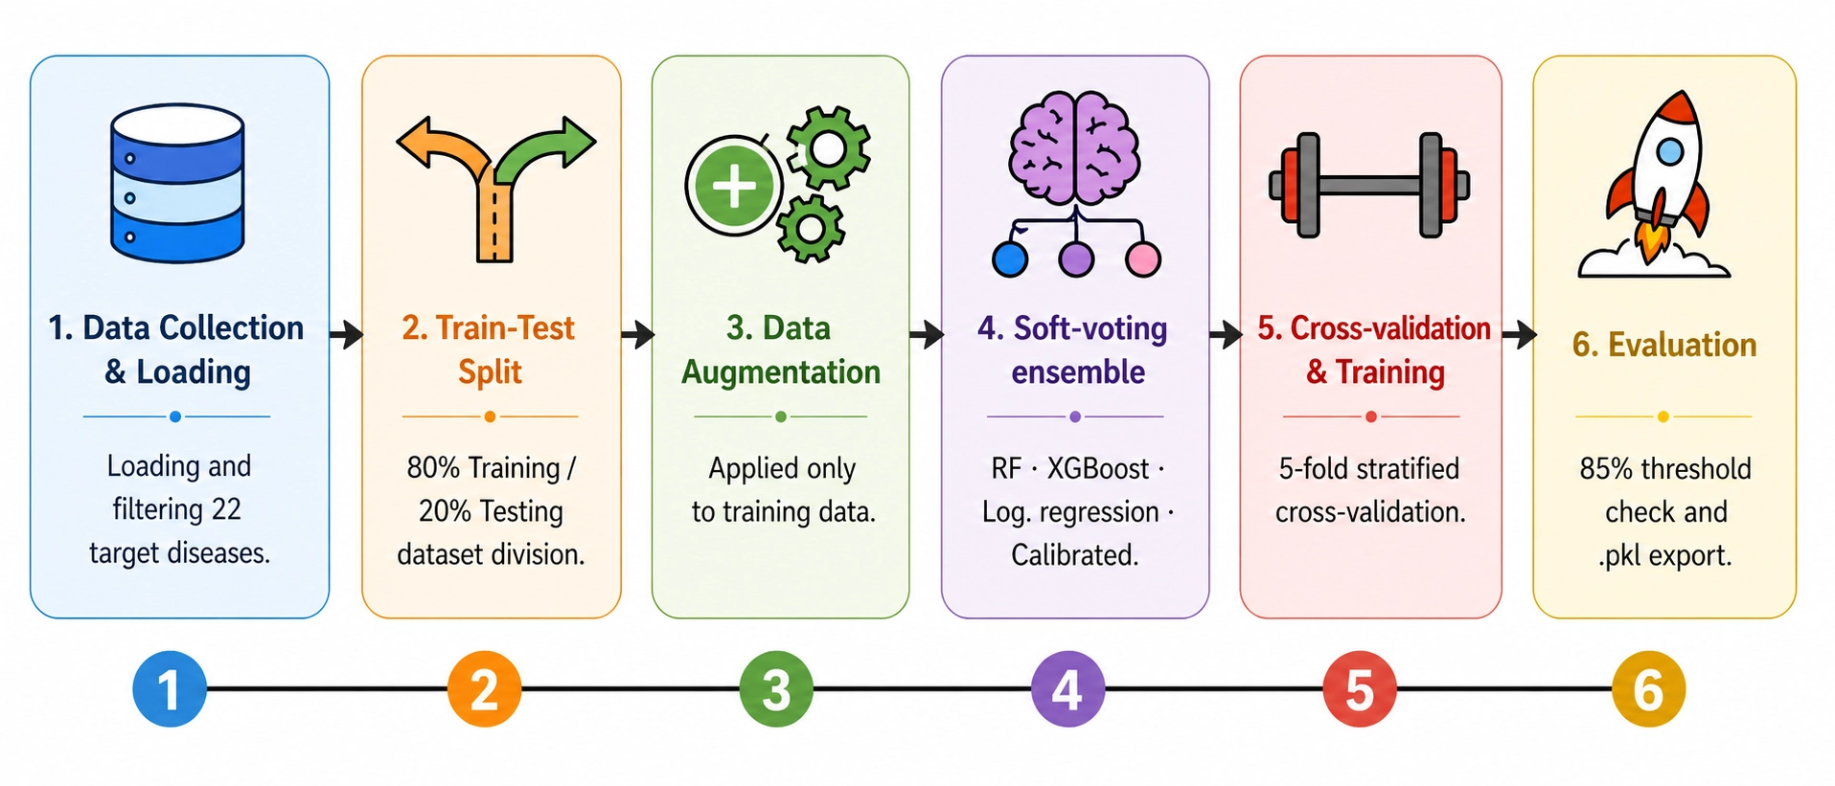
Model Development
10

Slide 11
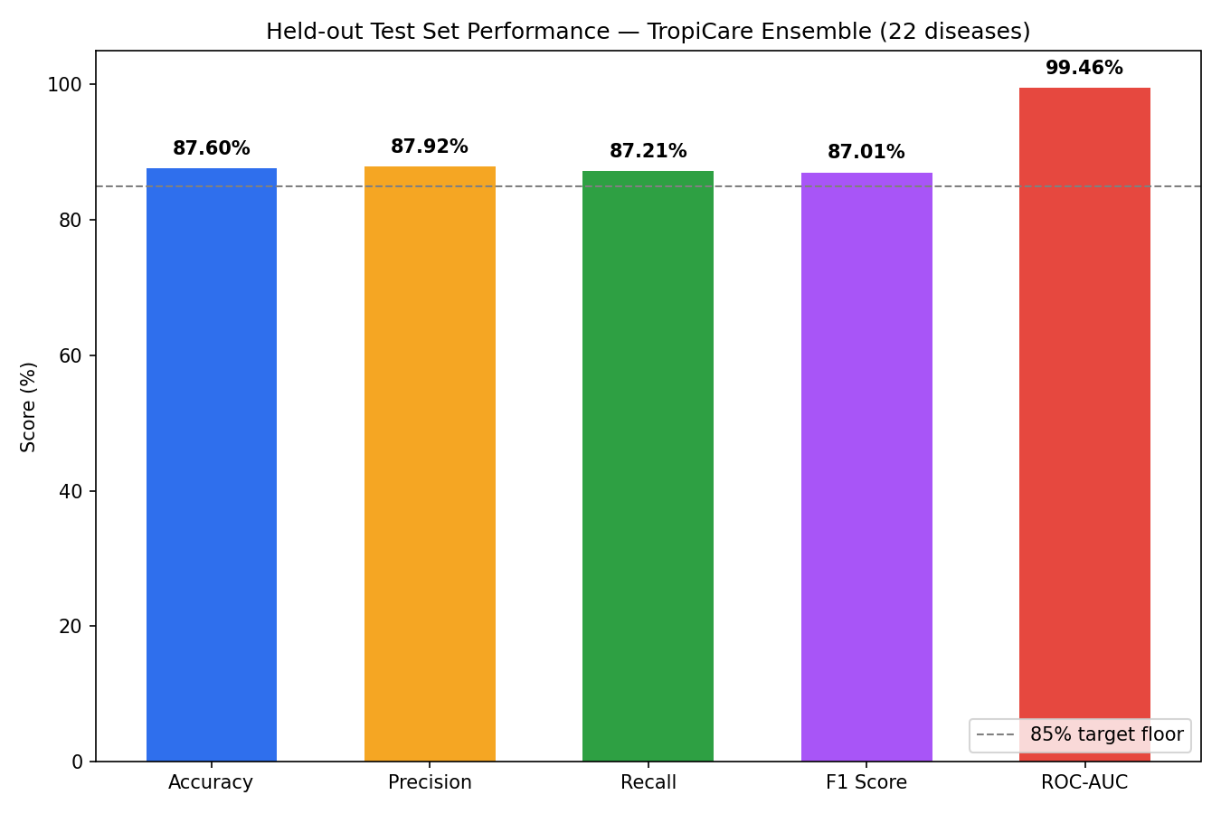
Model Evaluation Results
11

Slide 12
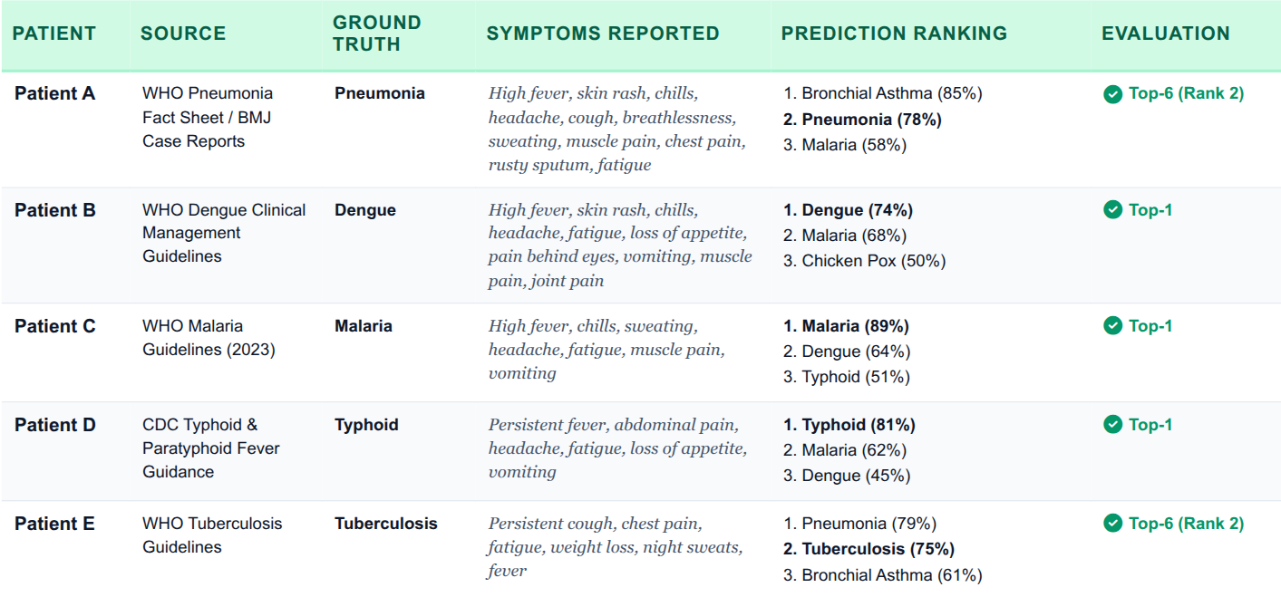
Testing and Evaluation
12

Slide 13
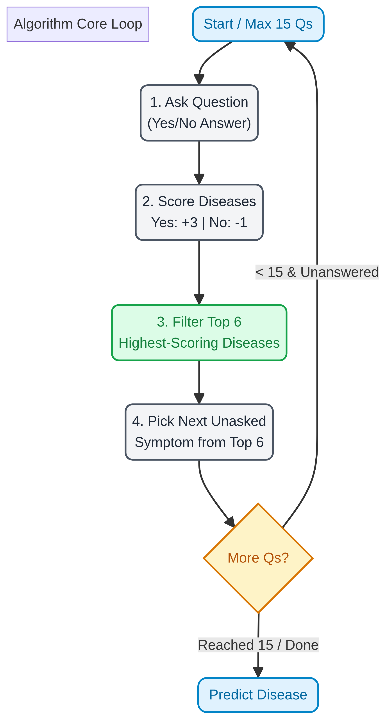
Adaptive Questioning Mechanism
You answer a question Yes or No
Every disease gets a score each Yes on a known symptom adds points, each No removes a few
The top 6 highest-scoring diseases become the focus the next question is pulled from whichever of those 6 still has unanswered symptoms
This repeats up to 15 questions then the system predicts
13

Slide 14
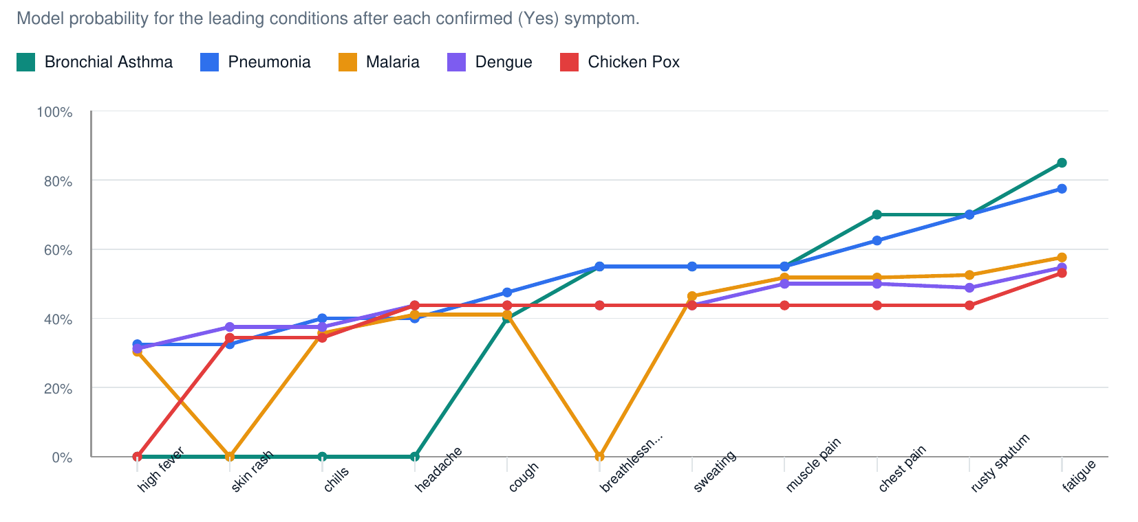
Confidence Evolution
14

Slide 15

Ethical Considerations
The system does not present its predictions as confirmed diagnoses rather it recommends further tests for confirmation. Dataset was verified and cross-checked against the WHO fact sheet and patient-verified medical records. Recommendations are aligned with the Ghana Standard Treatment Guidelines and are intended as guidance rather than a replacement for professional medical advice.
15

Slide 16







Tools & Technology
16

Slide 17
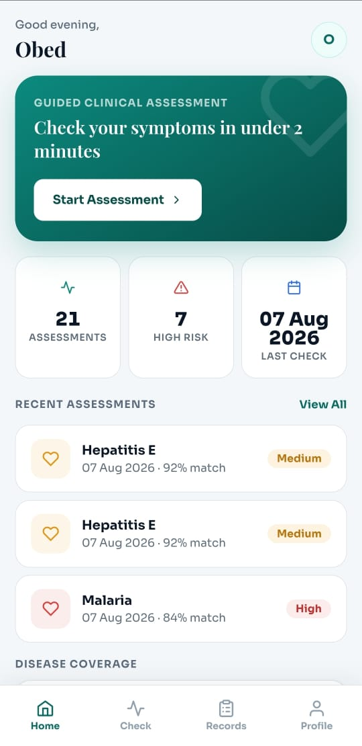
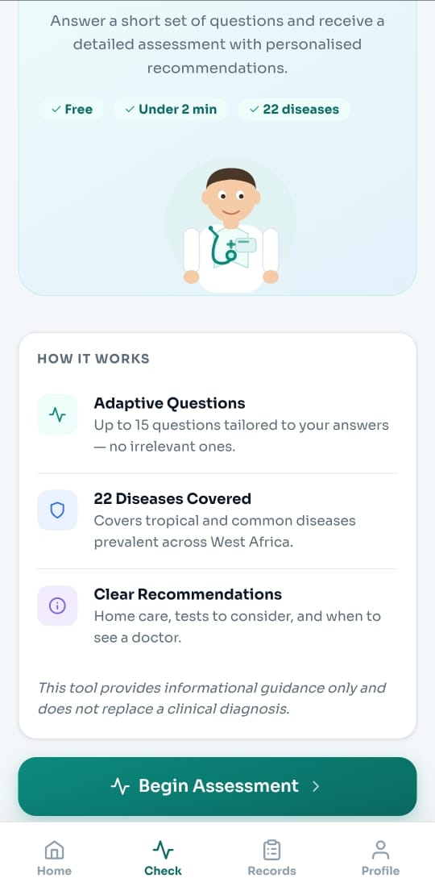
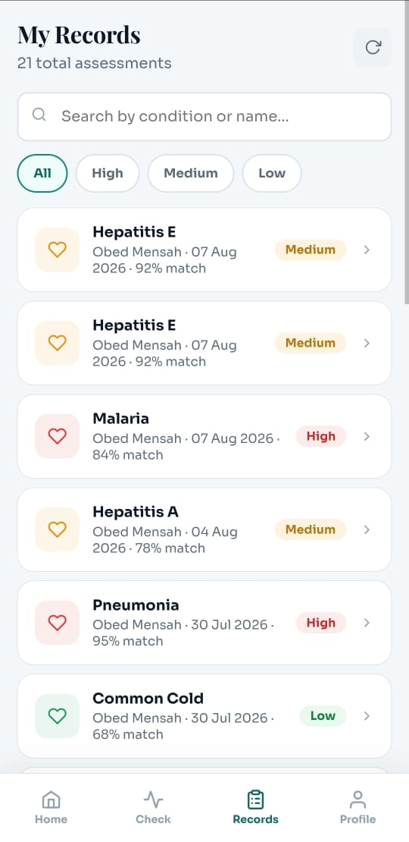
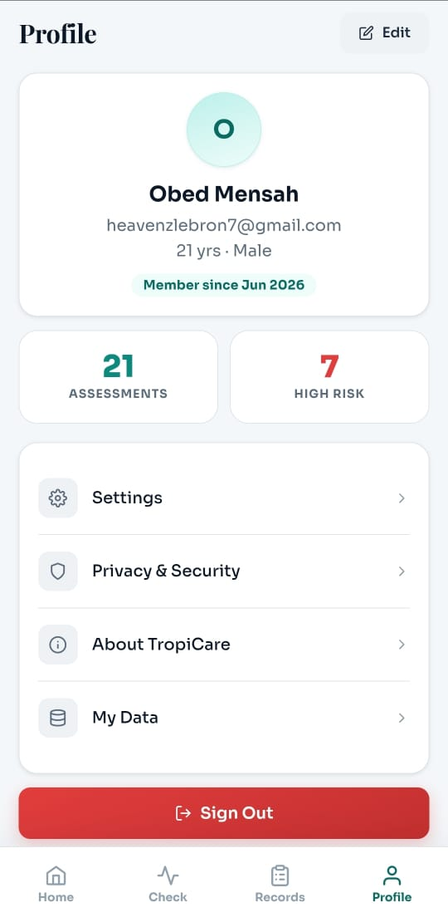
Demo
17

Slide 18
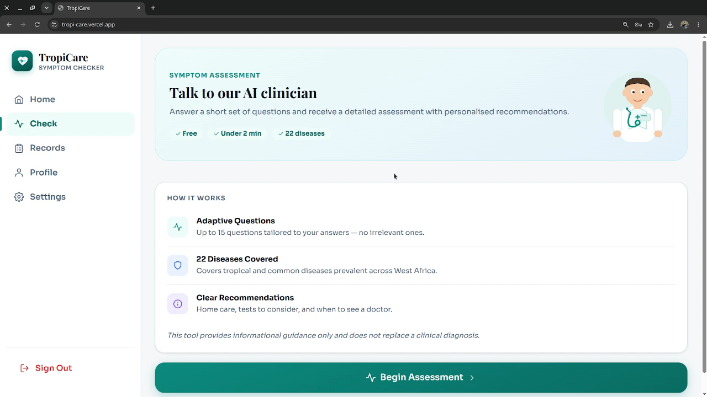
Demo
18

Slide 19
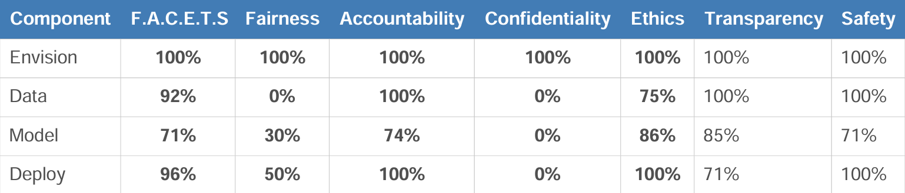
F.A.C.E.T.S Score: 90%
19

Slide 20
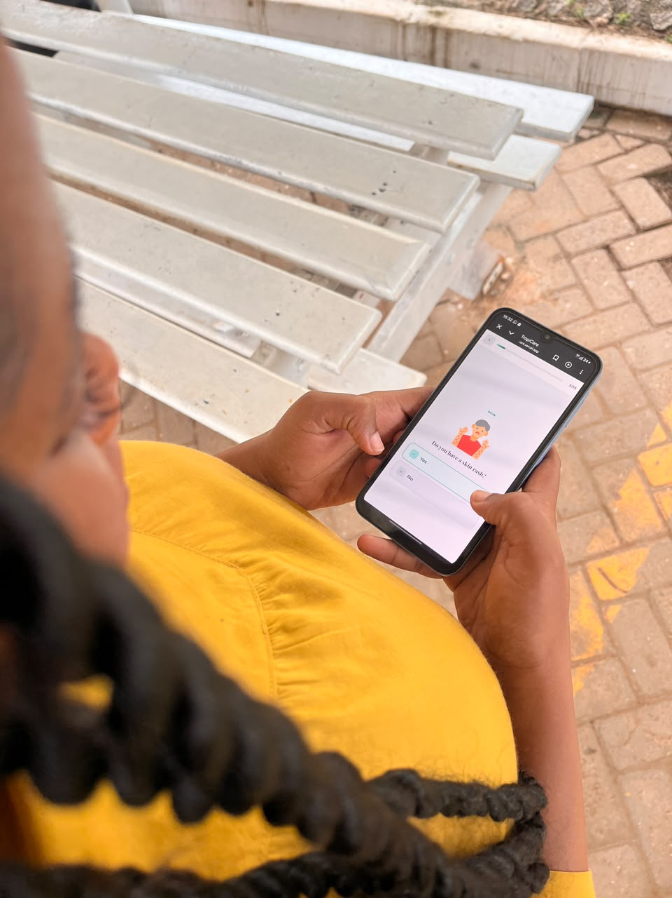
Conclusion
This project presents an AI-powered symptom assessment platform that supports early disease assessment and improves health decision-making. Key Outcomes: improve early disease detection provide medical guidance encourage timely medical consultation
20

Slide 21
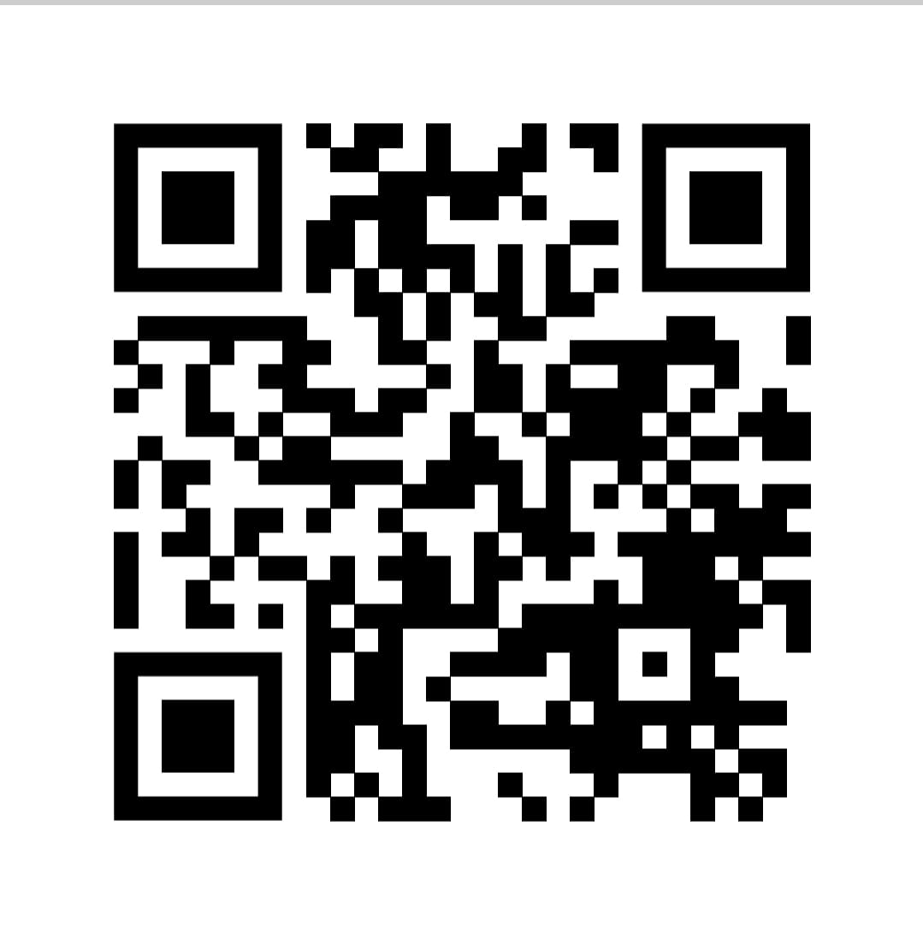
TropiCare
PLEASE SCAN TO ACCESS THE LIVE APPLLICATION
App url: https://tropi-care.vercel.app/
21

Slide 22
THANK YOU
22

