Slide 1
AI-Powered Symptom Checker for Tropical Diseases (SCTD)
MENSAH OBED
AFRIQUE-AHALI KEKELI
SUPERVISOR: PROF. J.J. KPONYO
1

Slide 2
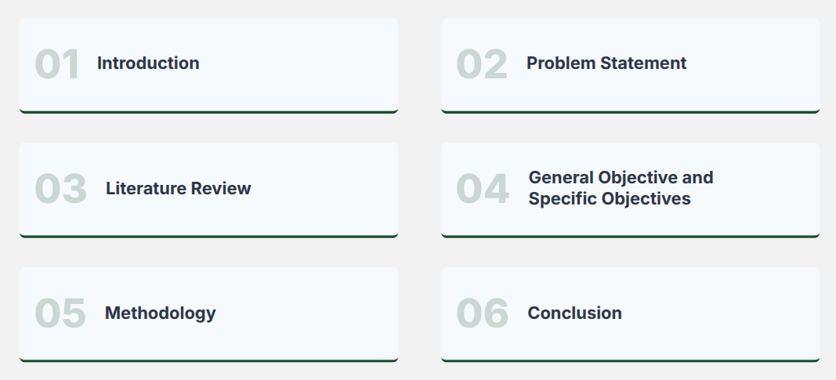
Outline
2

Slide 3

Introduction
Healthcare delivery in Ghana has improved over the years. Ghana already incorporates digital tools such as DHIMS2 and EHR for data aggregation and management. Artificial Intelligence enables intelligent data analysis and supports faster decision-making. Therefore, it can be incorporated in our healthcare systems to improve efficiency.
<number>

Slide 4







Problem Statement
Hospital Waiting Times
Incorrect Self Medication
Lack of Accessible Decision-Support tools
Reliance on Self-Diagnosis without Medical Knowledge
Disease Progression
Social and interpersonal influence
Unnecessary Hospital Visits
The absence of a symptom checker tool that provides health guidance leads individuals to make uninformed health decisions which can cause adverse effects.
<number>

Slide 5
Literature Review
No | ARTICLE | METHODOLOGY | FINDINGS | LIMITATIONS
1 | W. Wallace et al., 2021 “The diagnostic and triage accuracy of digital and online symptom checker tools: a systematic review” | Systematic review of 10 studies (MEDLINE, Web of Science), QUADAS-2 quality assessment. | Diagnostic accuracy very low (19–37.9%), triage accuracy inconsistent (48.8–90.1%) | Poor diagnostic reliability, safety concerns, lack of real-world validation.
2 | Gaurav Sharma et al., 2025 “AI-Based Symptom Checker Tools: Towards Accessible and Reliable Primary Healthcare Support” | Systematic review of AI symptom checkers and CDSS tools. | AI improves early detection, reduces hospital burden, enables self-triage. | Algorithm bias, poor datasets and lack of clinical validation.
3 | Yue You & Xinning Gui, 2021 “Self-Diagnosis through AI-enabled Chatbot-based Symptom Checkers” | User review analysis + interviews on chatbot-based symptom checkers. | Current systems lack depth compared to real clinical consultations. | Rigid symptom input and hard-to-understand questions.
<number>

Slide 6
Literature Review (Continued)
No | ARTICLE | METHODOLOGY | FINDINGS | LIMITATIONS
4 | Emmanuel Pratt-Koomson & Abraham Aidoo Borsah, 2025 “Enhancing Diabetes Diagnosis in Ghana Through Machine Learning” | ML models (LR, RF, SVM, XGBoost) on 4,500 Ghana Health Service records + interviews. | XGBoost achieved very high accuracy. | Low digital literacy and data privacy concerns.
5 | Pyla Jyothi et al., 2024 “Disease Prediction Using Naive Bayes, Random Forest, Decision Tree and KNN Algorithms.” | Used Naive Bayes, Random Forest, Decision Tree, and KNN classifiers to predict diseases from patient-reported symptoms. | The system accurately predicted diseases from symptoms. | Lack of adaptive questioning as users input symptoms manually.
<number>

Slide 7
General And Specific Objectives
To design an adaptive interface where individuals answer rounds of icon based yes or no questions, with AI dynamically choosing follow up questions.
To develop an AI powered symptom checker that helps individuals communicate their symptoms, receive disease predictions, and get guidance on appropriate action to take.
To train our machine learning models on 23 tropical and common diseases relevant to Ghanaians.
To display the predicted disease and recommend the best course of action to individuals.
<number>

Slide 8
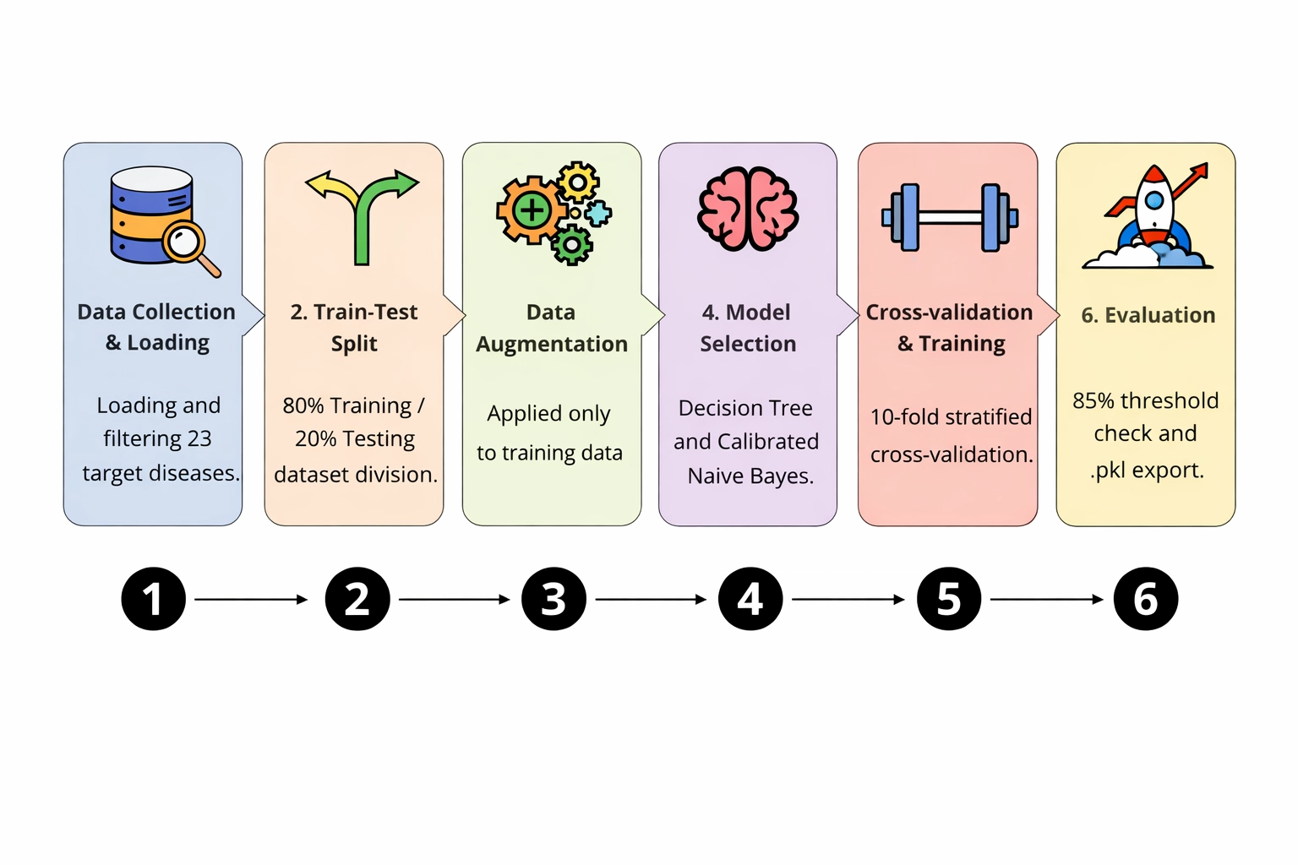
Model Development
<number>

Slide 9
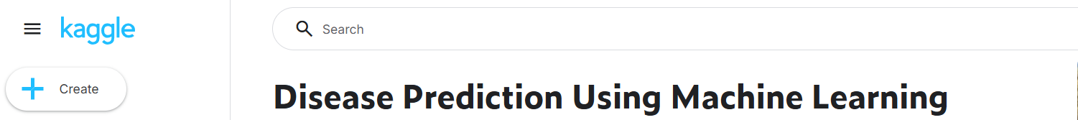
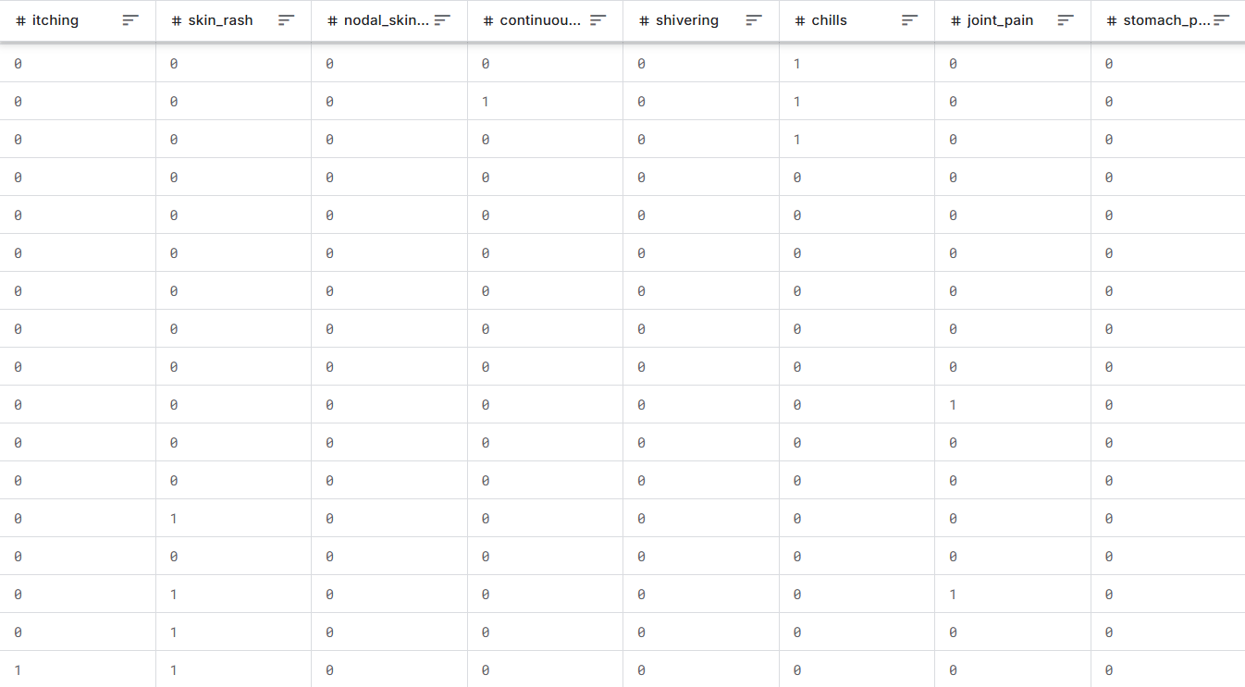
Dataset
Data obtained from Kaggle and verified medical information. The dataset contains symptom-disease relationships of 23 target diseases. Symptoms encoded as binary values, 1 for Yes and 0 for No. It is structured dataset suitable for machine learning.
<number>

Slide 10
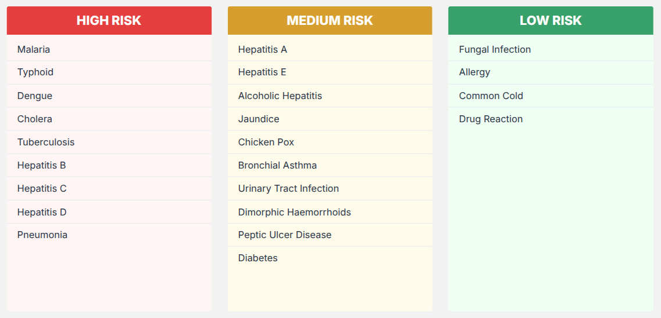
The 23 Diseases and Their Risk Classification
<number>

Slide 11
ML Model – Decision Tree (CART)
ROOT NODE
Yes
No
Internal Node
Internal Node
Yes
No
Yes
No
Leaf Node
Leaf Node
Leaf Node
Leaf Node
Advantages: Easy to understand, handles complex relationships effectively and it can be easily explained to users.
<number>

Slide 12
ML Model – Naïve Bayes
P(B│A) . P(A)
P(A│B) =
P(B)
Advantages: Easy to implement, effective in cases with a large number of features and parameters are easier to estimate.
<number>

Slide 13








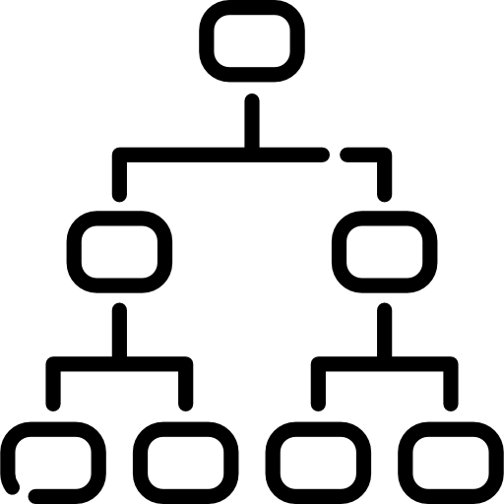
System Flow
User opens app
System asks symptom questions (Yes/No)
User provides responses
Encode User Responses
(Yes/No → Binary)
Display results and advice
Classify risk level
Naïve Bayes model calculates probability score
Decision Tree selects next relevant question
<number>

Slide 14
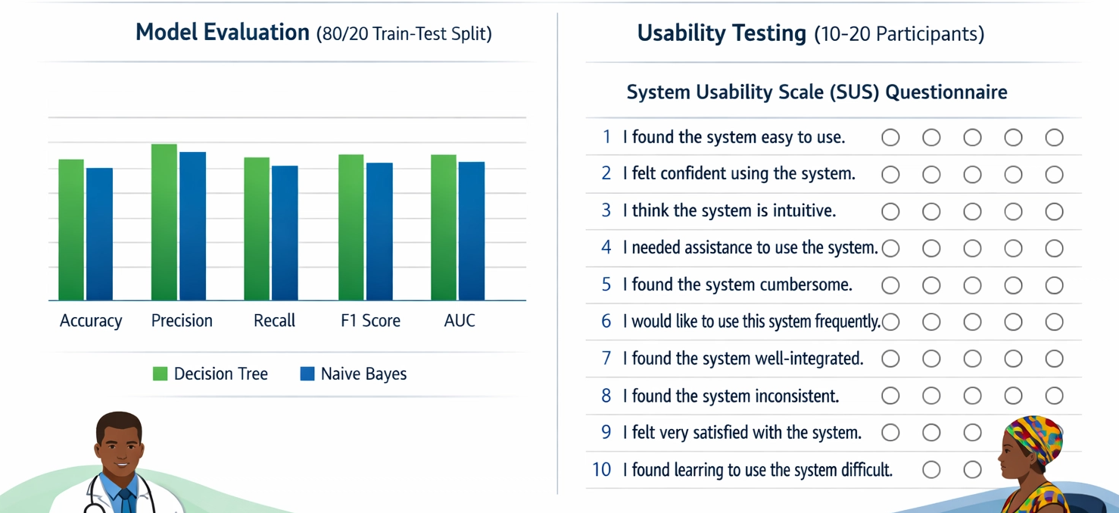
Testing & Evaluation
<number>

Slide 15




Tools & Technology
SQLite
Database
Jupyter Notebook
Model Development
Python
Backend Development
Streamlit
Frontend (UI)
<number>

Slide 16
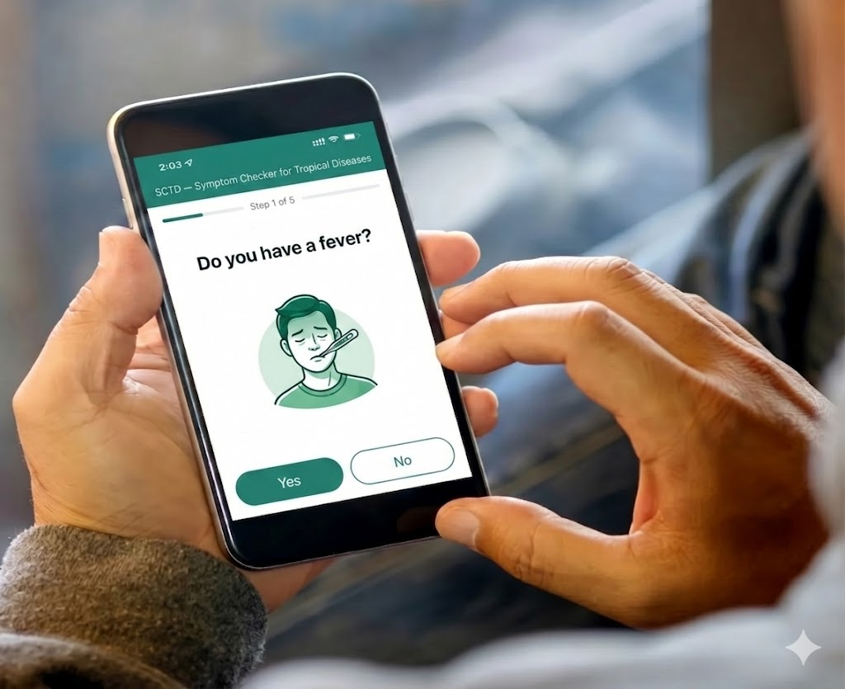
Conclusion
This project presents an AI-powered symptom checker that supports early disease assessment and improves health decision-making. Key Outcomes: improve early disease detection provide medical guidance encourage timely medical consultation
<number>

Slide 17
F.A.C.E.T.S
F.A.C.E.T.S Score: 50%
Component | F.A.C.E.T.S | Fairness | Accountability | Confidentiality | Ethics | Transparency | Safety
Envision | 100% | 100% | 100% | 100% | 100% | 100% | 100%
Data | 92% | 0% | 100% | 0% | 75% | 100% | 100%
<number>

Slide 18
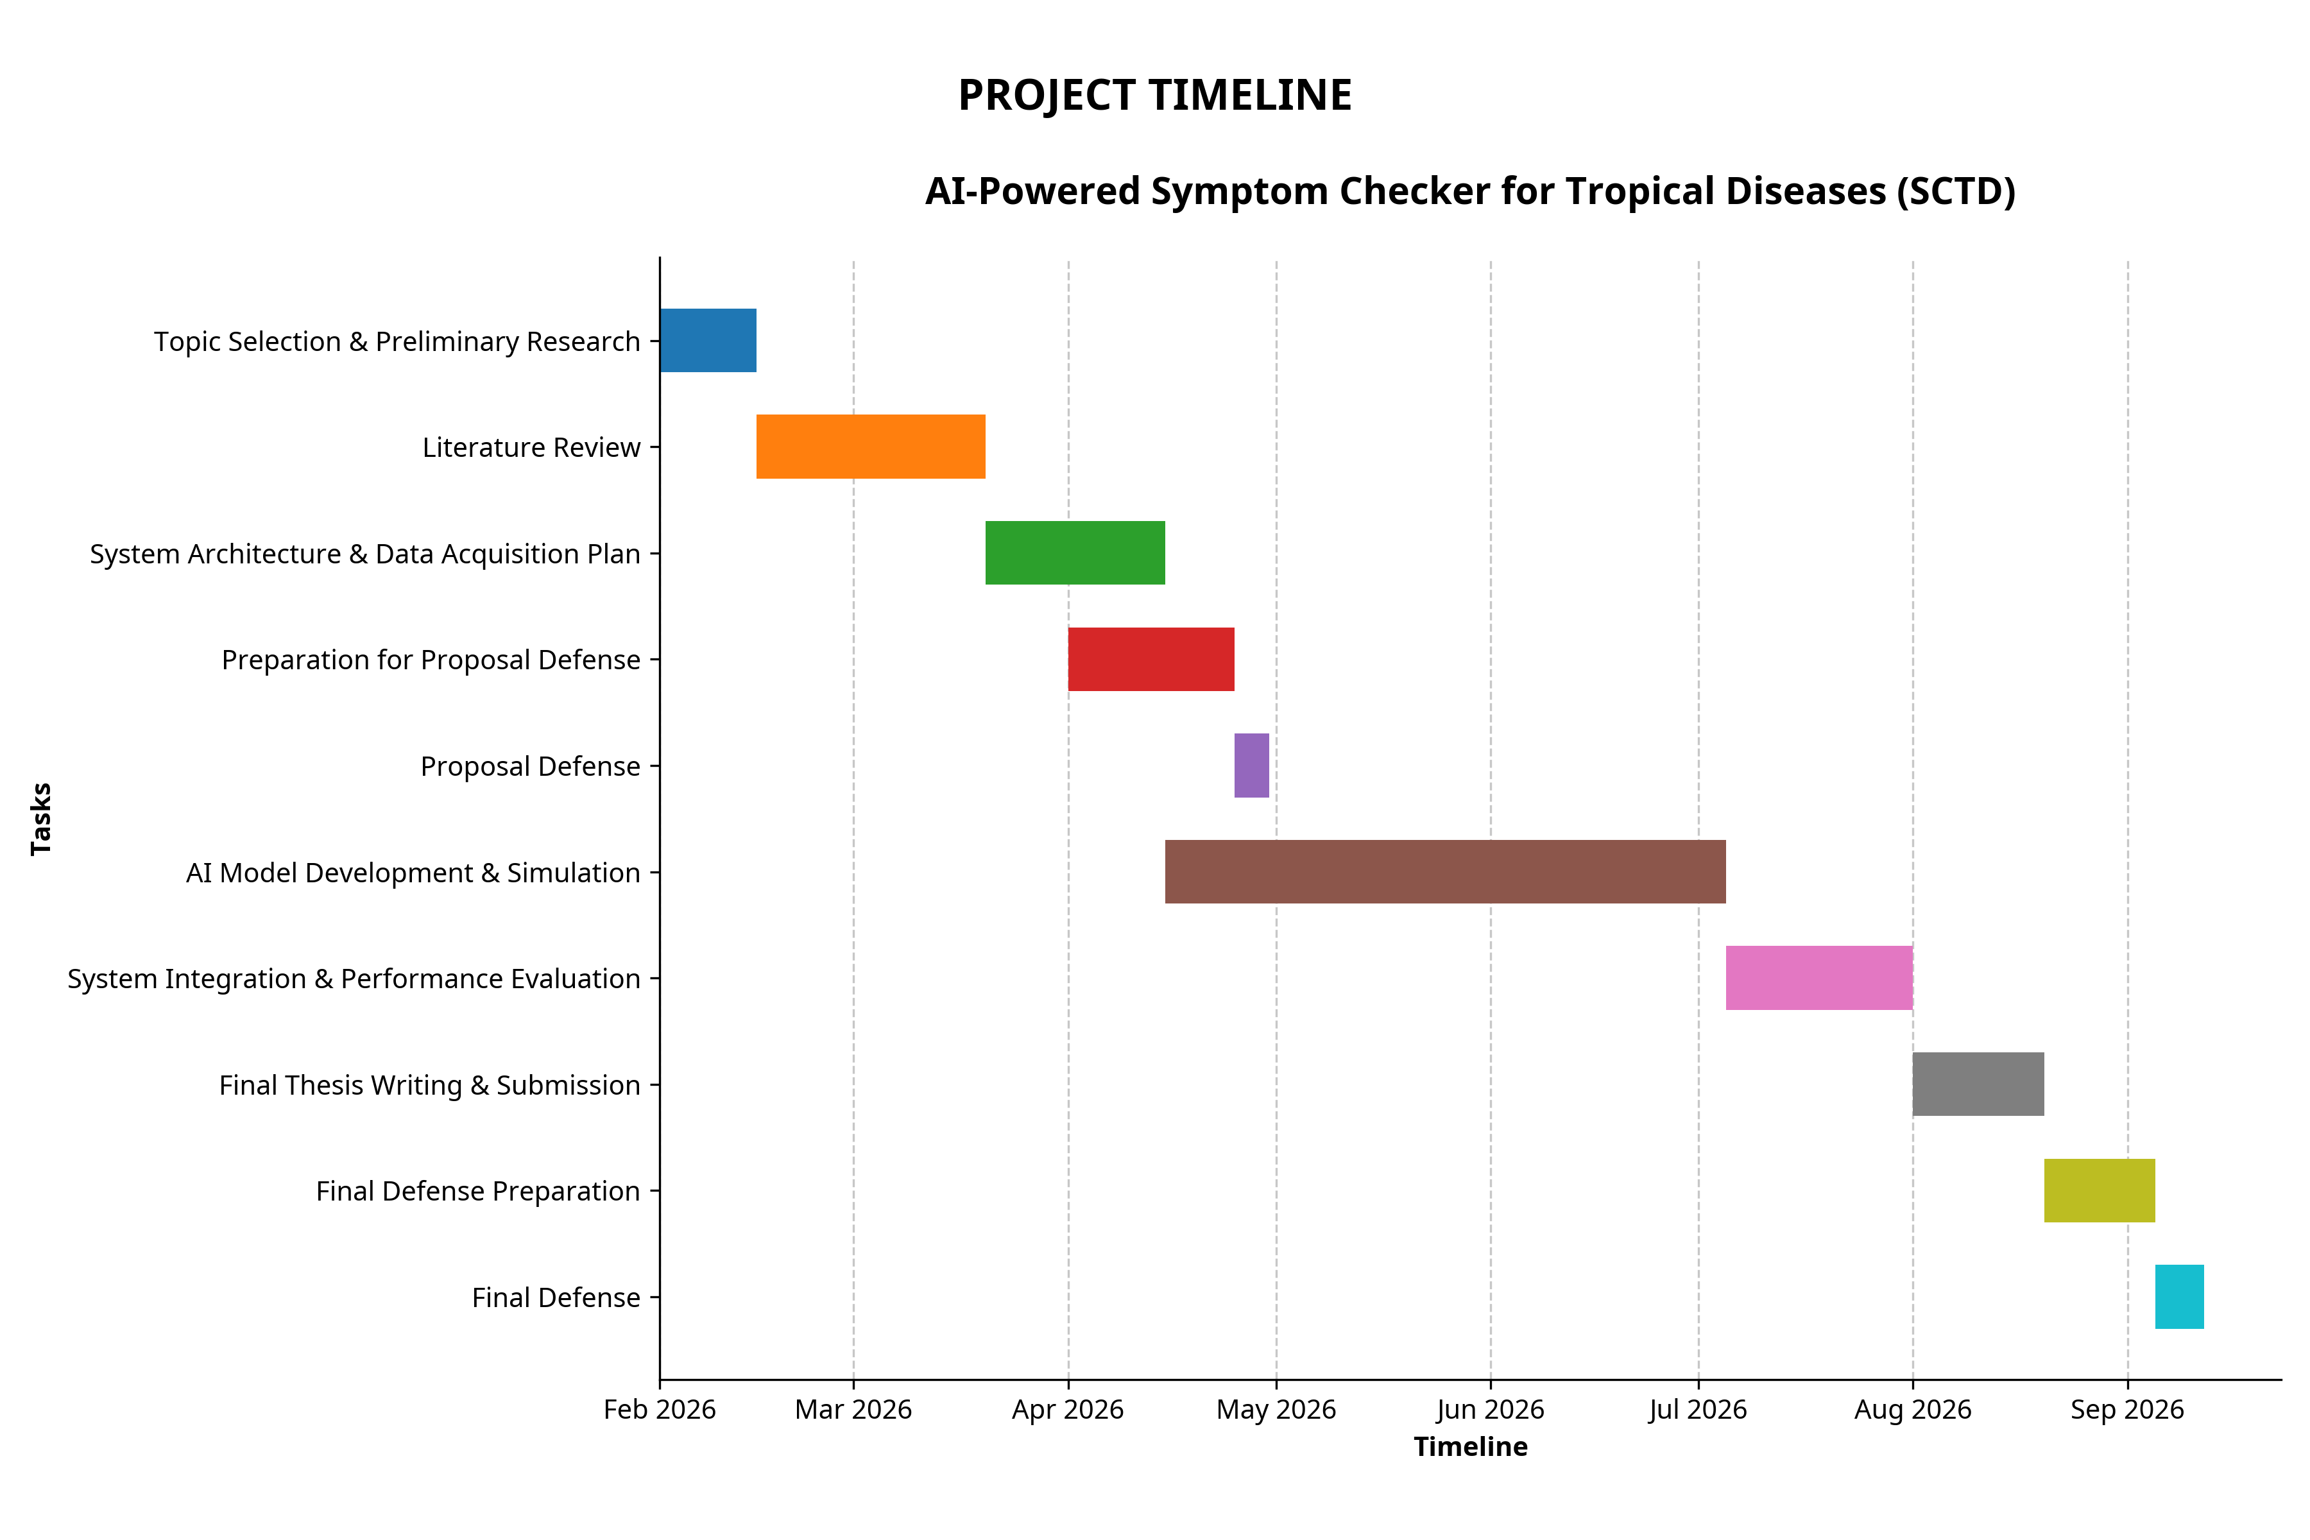
GANTT CHART
<number>

Slide 19
THANK YOU
<number>

