Slide 1
PHYS 390: Independent Study Variational Quantum Algorithms for Combinatorial Optimization and Modeling Progress Presentation
Name: Ömer Burak Duran
Instructor: Prof. Özgür E. Müstecaplıoğlu
Date: 13/03/2026

Slide 2
Weekly Log: 2026.03.06 - 2026.03.13
[X] Research about QUBO, QAOA, VQE, and relevant benchmark problems
[X] Continue studying the following papers:
"Quantum Bridge Analytics: A Tutorial on Formulating and Using QUBO Models"
"A Quantum Approximate Optimization Algorithm"
[X] Study demo implementations that use QUBO
[X] Research about PennyLane library on Python
[X] Try demo for 4-Node MaxCut using QAOA with PennyLane

Slide 3
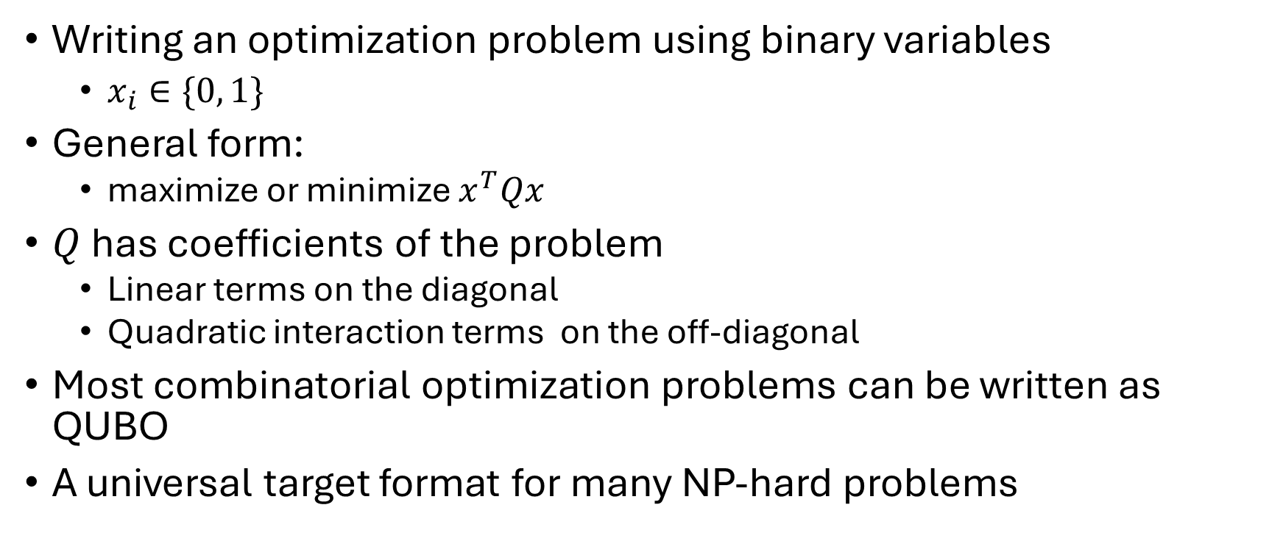
QUBO: Quantum Unconstrained Binary Optimization
Writing an optimization problem using binary variables
$x_{i}∈\{0, 1\}$
General form:
maximize or minimize $x^{T}Qx$
$Q$ has coefficients of the problem
Linear terms on the diagonal
Quadratic interaction terms on the off-diagonal
Most combinatorial optimization problems can be written as QUBO
A universal target format for many NP-hard problems

Slide 4
Quantum Approximate Optimization Algorithm & Variational Quantum Eigensolver
QAOA
Hybrid quantum-classical algorithm
A quantum circuit to prepare the parametrized state
A classical optimizer to update the parameters
Encode the problem in a cost Hamiltonian
Alternate between cost and mixer operator
Measure the output and adjust parameters to improve the objective value
Designed for combinatorial optimization
Commonly used for problems like MaxCut
VQE
Also a hybrid quantum-classical algorithm
Approximates the lowest energy of a Hamiltonian
Prepare a parametrized quantum state, and measure the expected energy
Use a classical optimizer to find the parameters that reduces the energy
If the optimization problem is written as a Hamiltonian, solving the problem becomes finding a low-energy state
Very flexible framework

Slide 5
Benchmark Problems
MaxCut
Split graph vertices into two groups
Maximize the number of edges crossing the split
Traveling Salesman Problem (TSP)
Visit every city exactly once
Return to the starting city
Minimize total distance
Facility Location
Choose which facilities to open
Assign customers to facilities
Minimize total opening and service cost

Slide 6
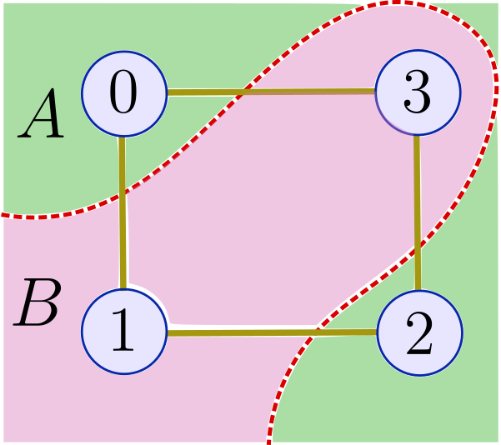
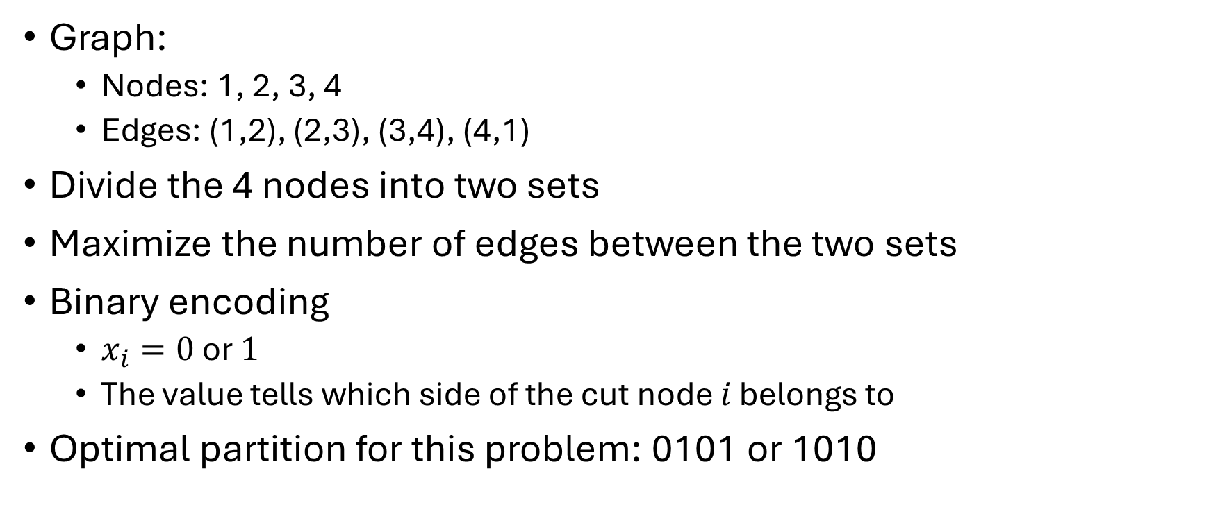
Example: 4-Node MaxCut
Graph:
Nodes: 1, 2, 3, 4
Edges: (1,2), (2,3), (3,4), (4,1)
Divide the 4 nodes into two sets
Maximize the number of edges between the two sets
Binary encoding
$x_{i}=0$ or $1$
The value tells which side of the cut node $i$ belongs to
Optimal partition for this problem: 0101 or 1010

Slide 7
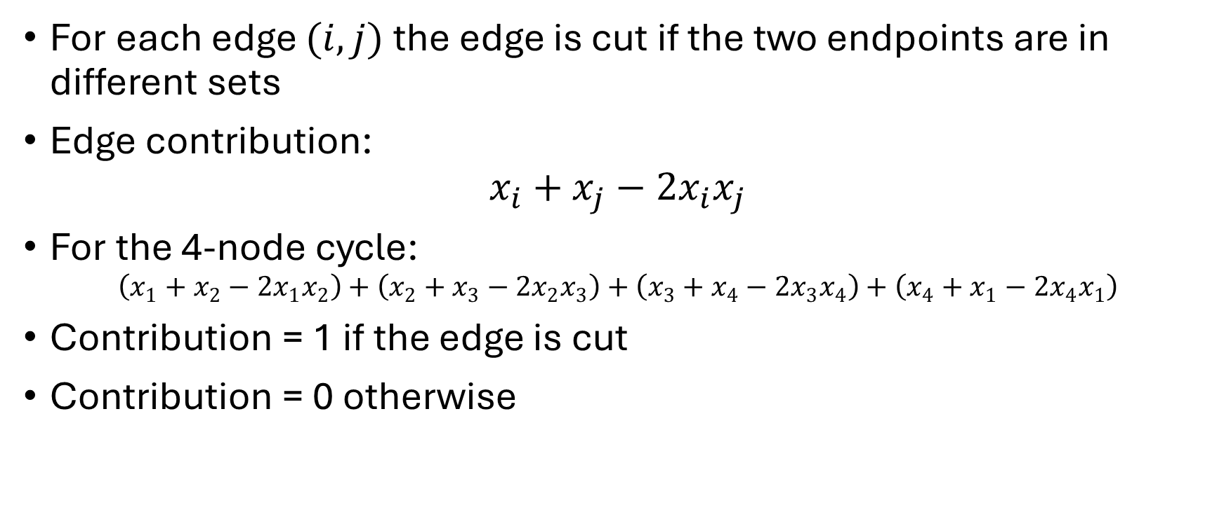
4-Node MaxCut: Classical Objective
For each edge $(i, j)$ the edge is cut if the two endpoints are in different sets
Edge contribution:
$$x_{i}+x_{j}−2x_{i}x_{j}$$
For the 4-node cycle:
$$\left(x_{1}+x_{2}−2x_{1}x_{2}\right)+\left(x_{2}+x_{3}−2x_{2}x_{3}\right)+\left(x_{3}+x_{4}−2x_{3}x_{4}\right)+\left(x_{4}+x_{1}−2x_{4}x_{1}\right)$$
Contribution = 1 if the edge is cut
Contribution = 0 otherwise

Slide 8
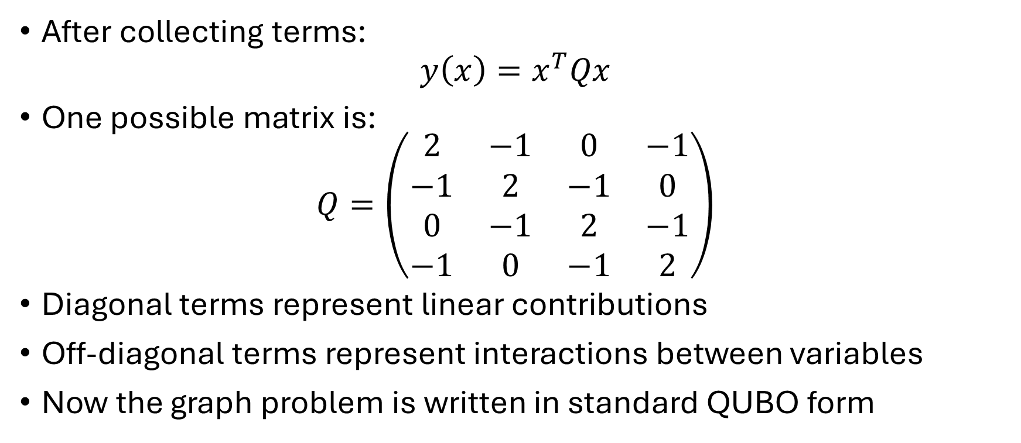
4-Node MaxCut: QUBO Form
After collecting terms:
$$y\left(x\right)=x^{T}Qx$$
One possible matrix is:
$$Q=\left(\begin{matrix}2 & −1 & 0 & −1 \\ −1 & 2 & −1 & 0 \\ 0 & −1 & 2 & −1 \\ −1 & 0 & −1 & 2\end{matrix}\right)$$
Diagonal terms represent linear contributions
Off-diagonal terms represent interactions between variables
Now the graph problem is written in standard QUBO form

Slide 9
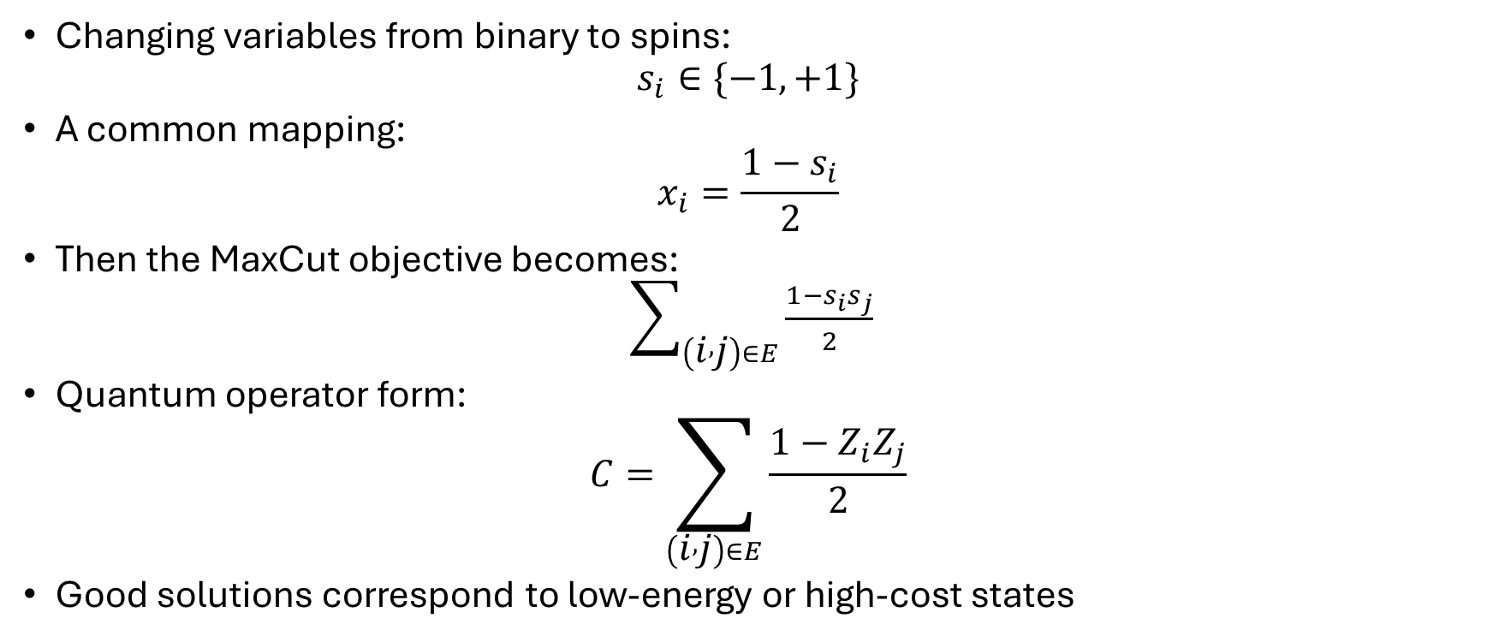
4-Node MaxCut: Ising / Hamiltonian Form
Changing variables from binary to spins:
$$s_{i}∈\{−1,+1\}$$
A common mapping:
$$x_{i}=\frac{1−s_{i}}{2}$$
Then the MaxCut objective becomes:
$\sum_{\left(i , j\right)∈E}{\frac{1−s_{i}s_{j}}{2}}$
Quantum operator form:
$$C=\sum_{\left(i , j\right)∈E}{\frac{1−Z_{i}Z_{j}}{2}}$$
Good solutions correspond to low-energy or high-cost states

Slide 10
4-Node MaxCut: QAOA and VQE
QAOA
Start from a simple initial state
Apply:
cost operator
mixer operator
Repeat for chosen depth 𝑝
Optimize circuit parameters
VQE
Choose a parameterized ansatz
Measure expected energy of the Hamiltonian
Use a classical optimizer to reduce the energy

Slide 11
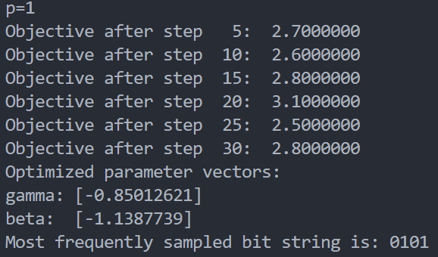
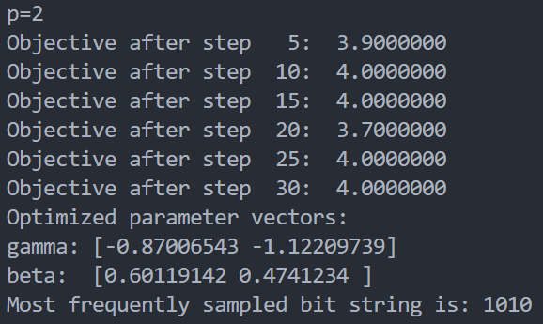
4-Node MaxCut: Applying QAOA

Slide 12
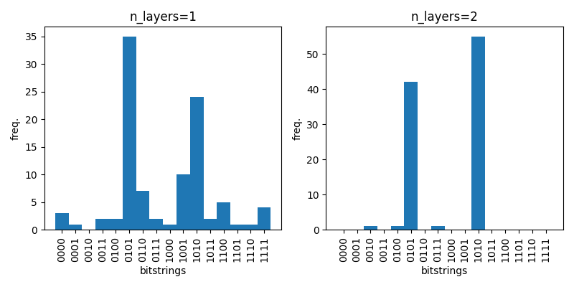
4-Node MaxCut: QAOA Results

Slide 13
TODO
Continue studying the papers
Practice QUBO Modeling techniques:
model more complex setups to QUBO
consider problems with different constraints, like Min Vertex Cover
apply QAOA and VQE for those problems
Research about QUBO optimization tricks:
converting a QUBO to its simpler version
this lets us work with a smaller QUBO problem

