Slide 1
Data Structures & Algorithms
هياكل البيانات والخوارزميات
Lecture 1
Introduction

Slide 2
Course Outline
Introduction
Array
Record
List
Stack
Queues
Graph
Trees

Slide 3
Textbook
Book1:
Data Structures and Program Design Using C++
D. Malhotra, N. Malhotra -Mercury Learning & Information (2019)
Book2:
C++ Programming: Program Design Including Data Structures
D.S. Malik, Eighth Edition (2017)

Slide 4
What is Data Structure?
A data structure is a way of organizing and storing data in a computer system that enables efficient access, manipulation, and management of the data.
Data structures is concerned with the representation and manipulation of data.
It should be designed and implemented in such a way that it reduces the space and time complexities and increases the efficiency.

Slide 5
Data Structure
When a problem is solved with the help of the computer, the following problems are confronted:
The relationship between the data items.
Operations performed on the logically related data elements.
Representation of data elements in the memory.
What programming language can be adopted to implement the operations on the data?

Slide 6
Data Structure
Data Structure study covers the following points:
Amount of memory require to store.
Amount of time require to process.
Representation of data in memory.
Operations performed on that data.

Slide 7
Why we need data structures?
Advantages of data structures
Data Organization: We need a proper way of organizing the data so that it can accessed efficiently when we need that particular data.
Efficiency: The main reason we organize the data is to improve the efficiency.
Efficient Memory use;
Example we can use linked list vs arrays when we are not sure about the size of data. When there is no more use of memory, it can be released.
Reusability: Data structures can be reused.
It allows to manage large amount of data such as large databases and indexing services such as hash table.

Slide 8
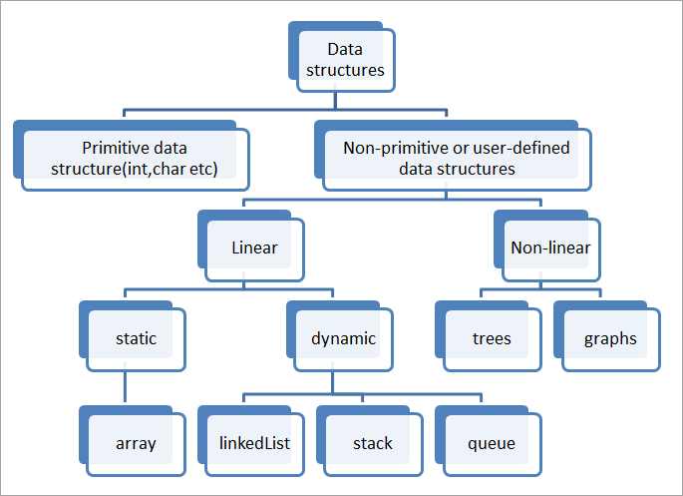
Classification of Data Structure

Slide 9
Primitive Data Structures
Primitive Data Structures are basic structures and are directly operated upon by machine instructions.
These data types are available in most programming languages as built-in data type.
Integer, float, character, double, boolean and pointer are examples of them.

Slide 10
Non-Primitive Data Structures
These data types are composed of primitive data types.
These are also referred to as user-defined data types as they are not pre-defined by the C++ compiler.
For example: arrays

Slide 11
Linear/Non-linear Data Structures
Linear Data Structures
A Linear data structure have data elements arranged in sequential manner and each member element is connected to its previous and next element.
Examples of linear data structures are List, Queue, Stack, Array etc.
Non-linear Data Structures
A non-linear data structure has no set sequence of connecting all its elements and each element can have multiple paths to connect to other elements.
Examples of non-linear data structures are Tree and Graphs

Slide 12
Static/Dynamic data structures
Static data structures are those whose sizes and structures associated memory locations are fixed, at compile time.
Example: Array
Dynamic structures are those which expands or shrinks depending upon the program need and its execution. Also, their associated memory locations changes.
In many applications, it is desirable to be able to start a program with the smallest amount of memory necessary and then allocate extra memory as the need arises.
It is created at run-time.
Example: Linked List created using pointers

Slide 13

Abstract data type (ADT)
Abstract Data Types (ADTs) are high-level descriptions of data structures that focus on their behavior and operations rather than their specific implementation details.
They define a set of operations that can be performed on the data structure, along with the expected behavior of these operations.
Typically, we choose a data structure and algorithms that provide an implementation of an ADT.
For example:
assume the simple ADT stack. The operations on this stack are called as axioms: new(), push(v, s), top(s) and popoff(s).
ADT
Push
pop
Abstract data structure
operations
interface

Slide 14
Operations Associated with Data Structures in C++
The basic operations that we can perform on data structures are as follows:
Insertion: adding a new data element into the data structure.
Deletion: Delete or remove an existing data element from the data structure.
Traversal: Process and display all the data elements in the data structure.
Searching: Search for a specific data element in the data structure.
Sorting: Arrange all the data elements in the data structure either in ascending or descending order or any other logically sequential order.
Merging: Combine similar data elements from two or more data structures, thus resulting in a newly formed data structure.

Slide 15
Efficiency
A solution is said to be efficient if it solves the problem within its resource constraints.
Space
Time
The cost of a solution is the amount of resources that the solution consumes.

Slide 16
Complexity of Algorithms
Algorithmic complexity is concerned about how fast or slow particular algorithm performs.
Algorithms are measured in terms of time and space complexity.
The time complexity of an algorithm is a measure of how much time is required to execute an algorithm for a given number of inputs and is measured by its rate of growth relative to standard functions.
The space complexity of an algorithm is a measure of how much storage is required by the algorithm.
It is possible to design an algorithm that uses more space and less time or less space and more time.

Slide 17
Calculating the Complexity
Time and space complexity depends on lots of things like hardware, operating system, processors, etc. However, we don't consider any of these factors while analyzing the algorithm. We will only consider the execution time of an algorithm.
Example 1: Consider the below simple code to print Hello World
int main()
{
int x=5;
cout << x;
return 0;
}
Time Complexity: In the above code is printed only once on the screen. So, the time complexity is constant “1”
Time Complexity = 1

Slide 18
Complexity Notation
The most common metric for calculating time complexity is Big O notation. This removes all constant factors so that the running time can be estimated in relation to a value.
Big Oh denotes "fewer than or the same as" <expression> iterations.
Note: in previous example, the time complexity is O(1)

Slide 19
Calculating the Complexity
Example 2:
Time Complexity: In the above code “Hello World !!!” is printed only n times on the screen, as the value of n can change. So, the time complexity is linear: O(n)
for (int i = 1; i <= n; i++)
cout << "Hello World !!!\n";

Slide 20
Calculating the Complexity
Example 3:
Time Complexity: O(n*n) = O(N²)
for(i=0; i < N; i++)
{
for(j=0; j < N;j++)
{
cout << "Hello World !!!\n";
}
}

Slide 21
ARRAYS
An array is a very common type of data structure where in all elements must be of the same data type.
Once defined , the size of an array is fixed number of objects and cannot increase to accommodate more elements.
Deletion and insertion operation are not performed on array.
Elements can be accessed or elements can be modified.
The first element of an array starts with zero.

Slide 22
ARRAYS
An array is a finite ordered collection of homogeneous data elements that provides direct access to any of its elements.
Finite - The number of elements in an array is finite or limited.
Ordered collection - The arrangement of all the elements in an array is very specific, that is, every element has a particular ranking in the array.
Homogeneous - All the elements of an array should be of the same data type.

Slide 23
Declaring Arrays
To declare an array in C++
The programmer specifies the type of the elements and the number of elements required by an array as follows:
type arrayName [ arraySize ];
Example:
int Array_A[20];
This statement will allocate a memory space to store 20 integer elements, and the name assigned to the array is Array_A.
char Name[30];
Similarly, this statement will create an array Name that can store 30 character data type elements in it.

Slide 24
Common Terms
The common terms associated with arrays are as follows:
Size of array - The maximum number of elements that would be stored in an array is the size of that array. It is also the length of that array.
Base - The base address of an array is the memory location where the first element of an array is stored. It is decided at the time of execution of a program. The value of this base address varies at every program execution as it is decided at the run-time.
It cannot be decided or defined even by a programmer.
Data type of an array The data type of an array indicates the data type of elements stored in that array.

Slide 25
Size of array
The amount of storage per element depends on the data type of the array. In C++,
the memory requirement for different datatypes
Example:
1 byte per element for each character,
4 bytes per element for integer variable, and
Data Type | Size
int | 4 bytes
float | 4 bytes
double | 8 bytes
boolean | 1 byte
char | 1 byte

Slide 26
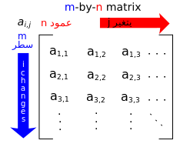
Array Layout
Array cells are contiguous in computer memory
The memory can be thought of as an array
x[0]
x[1]
x[2]
x[3]
x[4]
x[5]

Slide 27
Exercise
What is the output?
#include <iostream>
using namespace std;
void fun1(int *a, int b){
b = b - 1;
*a = *a + b;
cout << *a << " " << b << endl;
}
int main(){
int a=3, b=3;
fun1(&a,b);
cout << a << " " << b << endl;
getchar();
}

Slide 28
Exercise
What is the output?
#include <iostream>
using namespace std;
void fun2(int &a, int b){
a = a * 2;
b = a + b;
cout << a << " "<< b << endl;
}
void main(){
int x=3, y=5;
fun2(x,y);
cout << x << " "<< y << endl;
getchar();
}

Slide 29
Exercise
What will be the output of the following C++ code?
A. Hello students is printed once
B. Hello students is printed infinite times
C. Error
D. None of the above
#include <iostream>
using namespace std;
int main()
{
cout << "Hello students";
main();
getchar();
}

Slide 30
Questions
What is an ADT in data structure?
What are the different types of data structures?
What are the applications of data structures?
While data structures offer numerous benefits, they also come with certain disadvantages, explain that.

Slide 31
Questions
Which of the following is true for ADT that is ADT?
I. ADT is a type or class for objects whose behavior is defined by a set of values and a set of functions.
II. ADT is only stating that what operations are to be carried out.
III. ADT does not mention how data will be organized in memory.
(A) I and II are correct
(B) Only I is correct
(C) II and III are correct
(D) I, II and III are correct
Answer: (D)

Slide 32
Assignment 1
Find the most frequent number
You have an array consisting of n integer elements. Write a code in C++ to search for the most frequent elements in the array.
Example
Input: Array = {44, 25, 12, 15, 44, 14, 11, 25, 25, 14}
Output: the most frequent number is 25, it is repated 3 times
(save the code in A01_MostFreq.cpp)

Slide 33
Assignment 2
Write a C++ program to find the k smallest elements in a given array of integers.
(save the file as A02_largestk.cpp)
Sample Output:
Original array: 4 5 9 12 9 22 45 7 Largest 4 smallest Elements: 45 22 12 9
Sample Output:
Original array: 4 5 9 12 9 22 45 7 Largest 3 smallest Elements: 45 22 12
Sample Output:
Original array: 4 5 9 12 9 22 45 7 Largest 2 smallest Elements: 45 22

Slide 34
Assignment 3
You have two arrays of length n and m of integer elements. Write a code that searches for the common elements between the two arrays.
Example:
Array A: {12, 43, 44, 52, 0, 15 ,98, 34, 400, 99}
Array B: {13, 46, 88, 12, 20, 33, 98}
Output:
The common elements between the two arrays are: 12 and 98
(save the file as A03_Common.cpp)

