Slide 1
Data Structures & Algorithms
هياكل البيانات والخوارزميات
Lecture 3
Records (Structures Data Type)

Slide 2
Records - Structures Data Type
We have already dealt with arrays. Arrays are used to store similar type of data. Have you ever thought if there is any way to store dissimilar data?
The answer is yes.
We can use structures to store different types of data.
For example, you are a student. Your name is a string and your phone number and roll_no are integers.
Structure is a collection of variables of different data types under a single name.

Slide 3
The important of struct
Structures are used to represent a record, suppose you want to keep track of your books in a library.
You might want to track the following attributes about each book −
Title
Author
Subject
Book ID

Slide 4
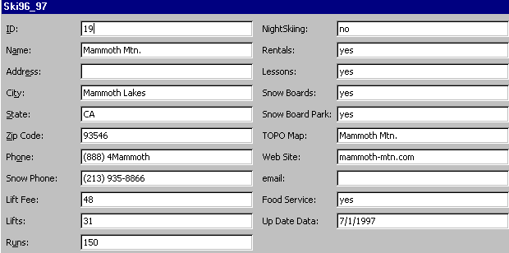
Form or Single Record Layout
This format displays all the fields and data elements for one record only. This is similar to a struct

Slide 5
Defining a Structure
To define a structure, you must use the struct statement. The struct statement defines a new data type, with more than one member, for your program.
The format of the struct statement is this −
struct structureName {
member definition;
member definition;
...
member definition;
};

Slide 6
The struct definition
An example to declare a Book structure:
struct Books
{
char title[50];
char author[50];
char subject[100];
int id;
};
structure tag
structure members
Note 1: struct is a reserved word.
Note 2: The components of a struct are called the members of the struct.
Note 3: Compiler will not reserve memory for a structure until you declare a structure variable same as you would declare normal variables such as int or float.

Slide 7
Creating Struct Instances
In the example, we have created a struct named books. We can create a struct variable as follows:
#include <iostream>
using namespace std;
int main()
{
struct Books {
char title[50];
char author[50];
char subject[100];
int id;
};
Books b1;
system("pause");
}
The b1 is a struct variable of type Books. We can use this variable to access the members of the struct.

Slide 8
Creating Struct Instances
In the example, we have created a struct named books. We can create a struct variable as follows:
#include <iostream>
using namespace std;
int main()
{
struct Books {
char title[50];
char author[50];
char subject[100];
int id;
};
Books b1;
Books b2;
}
#include <iostream>
using namespace std;
int main()
{
struct Books {
char title[50];
char author[50];
char subject[100];
int id;
} b1,b2;
}
OR
The b1,b2 are struct variables of type Books. We can use this variables to access the members of the struct.

Slide 9
Initializing Structs
A struct variable can be initialized, like any other data variables in C++, at the time it is declared. We could use:
struct Persons {
char name[20];
int age;
float salary;
} p1 = {"Ali", 25, 40000.50} ;
OR
Persons pr = {"Ali", 25, 40000.50} ;

Slide 10
Accessing the Members of a structure
A structure member variable is generally accessed using a dot ‘.’ operator.
To assign value to the Data members of the structure variable Books, we write,
struct Books {
char title[50];
char author[50];
char subject[100];
int id;
};
Books b1;
cin >> b1.title;
cin >> b1.subject;
b1.id = 1234;
The dot is called the member selector

Slide 11
Displaying struct Members
To display the contents of a struct variable, you must display each field separately, using the dot operator
struct Books {
char title[50];
char author[50];
char subject[100];
int id;
};
Books b1;
Wrong:
cout << b1; // won’t work!
Correct:
cout << b1.title << endl;
cout << b1.author << endl;
cout << b1.subject << endl;
cout << b1.id;

Slide 12
Accessing the Members of a structure
#include <iostream>
#include <cstring>
using namespace std;
int main()
{
struct Books {
char title[50];
char author[50];
char subject[100];
int id;
};
Books b1;
strcpy( b1.title, "Learn C++ Programming");
strcpy( b1.author, "kamal ali");
strcpy( b1.subject, "C++ Programming");
b1.id = 6495407;
cout << "Book 1 title : " << b1.title <<endl;
cout << "Book 1 author : " << b1.author <<endl;
cout << "Book 1 subject : " << b1.subject <<endl;
cout << "Book 1 id : " << b1.id <<endl;
system("pause");
}
Book 1 title : Learn C++ Programming
Book 1 author : kamal ali
Book 1 subject : C++ Programming
Book 1 id : 6495407
struct definition
Creating Struct Instance

Slide 13
Arrays of Structures
Suppose you would like to store the information of 100 Persons.
It would be tedious and unproductive to create 100 different Persons array variables and work with them individually.
It would be much easier to create an array of Person structures.
Structures of the same type can be grouped together into an array.

Slide 14
Syntax for declaring structure array
By following this syntax, we can declare an array of structure
struct struct-name {
datatype var1;
datatype var2;
…
datatype varN;
};
struct-name obj [ size ];

Slide 15
declaring structure array - Example
By following this syntax, we can declare an array of structure
struct Person {
char name[50];
int id;
};
Person p1[5];

Slide 16
Example of Array of Structures
#include <iostream>
#include <cstring>
using namespace std;
int main()
{
struct Person {
char name[50];
int id;
};
Person p1[5];
strcpy( p1[0].name, "Ali Ahmed");
p1[0].id = 24234;
strcpy( p1[1].name, "Abubaker");
p1[1].id = 323232;
cout << "Name : " << p1[0].name <<endl;
cout << "id : " << p1[0].id <<endl;
cout << "Name : " << p1[1].name <<endl;
cout << "id : " << p1[1].id <<endl;
system("pause");
}
Name : Ali Ahmed
id : 24234
Name : Abubaker
id : 323232

Slide 17
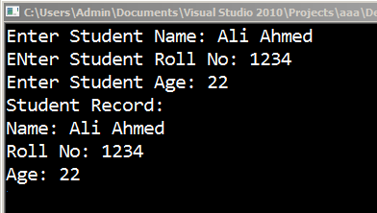
Example of Structures
#include <iostream>
using namespace std;
struct Student{
char stuName[30];
int stuRollNo;
int stuAge;
};
void main() {
Student s;
cout<<"Enter Student Name: ";
cin.getline(s.stuName, 30);
cout<<"Enter Student Roll No: ";
cin>>s.stuRollNo;
cout<<"Enter Student Age: ";
cin>>s.stuAge;
cout<<"Student Record:"<<endl;
cout<<"Name: "<<s.stuName<<endl;
cout<<"Roll No: "<<s.stuRollNo<<endl;
cout<<"Age: "<<s.stuAge<<endl;
system("pause");
}

Slide 18
Aggregate Operations with Structures
Recall that arrays had NO whole array operations (except passing reference to parameter)
Structures DO have aggregate operators
assignment statement =
parameter (value or reference)
return a structure as a function type

Slide 19
Aggregate Operations with Structures
With regular primitive types we have a wide variety of operations available, including assignment, comparisons, arithmetic, etc.
Most of these operations would NOT make sense on structures. Arithmetic and comparisons, for example
struct Student
{ int studentID;
short year;
double gpa;
};
Student s1, s2;
s1 = s1 + s2; // ILLEGAL
cout << s1 << s2; // ILLEGAL

Slide 20
Comparing struct Members
you cannot compare two struct variables directly:
if (s1 >= s2) // won’t work!
Instead, compare member variables:
if (s1.gpa >= s2.gpa) // ok

Slide 21
Copy struct
If two struct variables are of the same type, that is, they both were declared to be of the same type (same tag name) then we can copy one variable to another with a simple assignment statement. For example:
struct Person {
char name[50];
int id;
};
void main() {
Person p1,p2;
strcpy( p1.name, "Ali Ahmed");
p1.id = 24234;
p2 = p1;
cout << "Name : " << p2.name <<endl;
cout << "id : " << p2.id <<endl;
system("pause");
}
We just have to write p2 = p1 and that's it. By writing this, all the elements of p1 will get copied to p2.

Slide 22
Copy struct – Example
struct Person {
char name[50];
int id;
};
Person p[5];
strcpy( p[0].name, "Ali Ahmed");
p[0].id = 24234;
p[2] = p[0];
cout << "Name : " << p[2].name <<endl;
cout << "id : " << p[2].id <<endl;
system("pause");
}

Slide 23
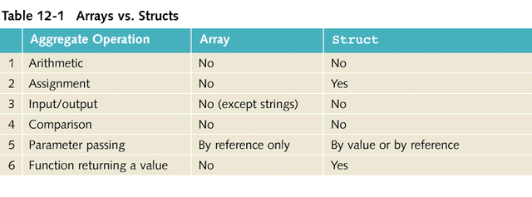
Contrast Arrays and structs

Slide 24
Embedded Structure (Nested Structures)
It’s possible for a structure variable to be a member of another structure Variable
This comes in useful when we deal with data structures like linked lists and trees. Here's an example:
struct PersonInfo
{ string name,
address,
city;
};
struct Student
{ int studentID;
PersonInfo pData;
short year;
double gpa;
};

Slide 25
Members of Nested Structures
Use the dot operator (.) multiple times to access fields of nested structures
Reference the nested structure’s fields by the member variable name, not by the structure name
struct PersonInfo
{ string name,
address,
city;
};
struct Student
{ int studentID;
PersonInfo pData;
short year;
double gpa;
};
Student s5;
s5.pData.name = "Ahmed";
s5.pData.city = "Aden";
s5.PersonInfo.name = "Ahmed"; // Wrong!!!
Why?

Slide 26
Embedded Structure - Example
struct Name {
char first_name[30];
char last_name[30];
};
struct Persons {
Name fullname;
int age;
float salary;
};
Persons P1 = {"Ali","Ahmed", 25, 40000.50} ;
cout<< P1.fullname.first_name << " " << P1.fullname.last_name << endl;
cout << P1.age << endl;
cout << P1.salary;
Embedded structure
Accessing to the Members of a embedded structure

Slide 27
Pointers to Structures
Like we have pointers to int, char and other data-types, we also have pointers pointing to structures. These pointers are called structure pointers.
Now, how to define a pointer to a structure? The answer is below:
struct structure_name
{
data-type member-1;
data-type member-1;
data-type member-1;
data-type member-1;
};
int main()
{
struct structure_name *ptr;
}
Pointer

Slide 28
Pointers to Structures
An example using structure pointer.
struct Person
{
char name[30];
int age;
};
Person P1 = {"Ahmed Ali", 22};
Person *P1_ptr;
P1_ptr = &P1;
cout<<"Printing the structure elements using the structure variable\n";
cout<<"Name : "<< P1.name<<", Age : "<<P1.age<<endl;
cout<<"\nPrinting the structure elements using the structure pointer\n";
cout<<"Name : "<< P1_ptr->name<<", Age : "<<P1_ptr->age<<endl;
system("pause");
}

Slide 29
Pointers to Structures
an example using structure pointer.
struct Person
{
char name[30];
int age;
};
Person P1 = {"Ahmed Ali", 22};
Person *P1_ptr;
P1_ptr = &P1;
cout<<"Printing the structure elements using the structure variable\n";
cout<<"Name : "<< P1.name<<", Age : "<<P1.age<<endl;
cout<<"\nPrinting the structure elements using the structure pointer\n";
cout<<"Name : "<< P1_ptr->name<<", Age : "<<P1_ptr->age<<endl;
system("pause");
}
Just like other pointers, the structure pointers are declared by placing asterisk (∗) in front of a structure pointer's name.

Slide 30
Pointers to Structures
an example using structure pointer.
struct Person
{
char name[30];
int age;
};
Person P1 = {"Ahmed Ali", 22};
Person *P1_ptr;
P1_ptr = &P1;
cout<<"Printing the structure elements using the structure variable\n";
cout<<"Name : "<< P1.name<<", Age : "<<P1.age<<endl;
cout<<"\nPrinting the structure elements using the structure pointer\n";
cout<<"Name : "<< P1_ptr->name<<", Age : "<<P1_ptr->age<<endl;
system("pause");
the dot operator ('.') requires a structure variable on its left
the members of structures are accessed using arrow operator ->

Slide 31
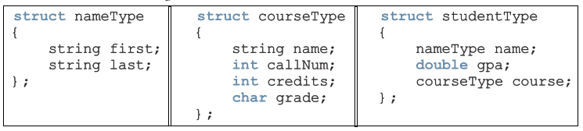

EXERCISE - 1
Consider the following statements:
Mark the following statements as valid or invalid. If a statement is invalid, explain why.
Next Slide ….

Slide 32
EXERCISE – 1 Cont’d
student.course.callNum = "CSC230";
b. cin >> student.name;
c. classList [ [ 0 0 ] ] = name;
d. classList [ [ 1 1 ] ] .gpa = 3.45;
e. name = classList [ [ 15 ] ] .name;
f. student.name = name;
g. cout << classList [ [ 10 ] ] << endl;
h. for ( (int j = 0; j < 100; j++)
classList
j = 0; j < 100; j++)
classList [ [ j j ] ] .name = name;
i. classList.course.credits = 3;
j. course = studentType.course;

Slide 33
EXERCISE – 2
Mark the following statements as true or false.
All members of a struct must be of different types. ( )
A struct is a definition, not a declaration. ( )
A struct variable must be declared after the struct definition. ( )
A struct member is accessed by using the operator :. ( )
The only allowable operations on a struct are assignment and member selection. ( )
An array can be a member of a struct . ( )
A member of a struct can be another struct . ( )

Slide 34
EXERCISE – 3
Find the Errors
Struct myStruct
{
int x;
float y;
};
___________________________________________________________
struct Lists
{
int number[10] = { 1, 2, 3, 4, 5, 6, 7, 8, 9, 0};
int total;
}
___________________________________________________________
struct TwoVals
{
int a, b;
};

Slide 35
EXERCISE – 3 (cont’d)
Find the Errors
struct FourVals
{
Int a, b, c, d;
};
int main ()
{
FourVals nums = {1, 2, , 4};
return 0;
}
struct ThreeVals
{
int a, b, c;
};
int main ()
{
TwoVals s, *sptr = nullptr;
sptr = &s;
*sptr.a = 1;
return 0;
}

Slide 36
Assignment (2) Passing Structures to Functions
Just like a variable of a basic type, a struct members can be passed as a parameter either by value or by reference
How?

Slide 37
Passing Structure to Function Call by Value
#include <iostream>
using namespace std;
struct Student
{
char fName[20]; // first name
char lName[20]; // last name
int id; // social security number
double gpa; // grade point average
};
void PrintStudent(Student s) // struct passed as parameter
{
cout << s.fName << ' ' << s.lName << " "<< s.id;
cout << " GPA: " << s.gpa << '\n';
}
int main()
{
Student s1 = {"Ahmed", "Ahmed", 123456789, 3.75};
Student s2 = {"Salah", "Salem", 123123123, 2.66};
PrintStudent(s1);
PrintStudent(s2);
return 0;
}
struct Student
{
char fName[20]; // first name
char lName[20]; // last name
int id; // id
double gpa; // grade point average
};
void PrintStudent(Student s) // struct passed as parameter
{
cout << s.fName << ' ' << s.lName << " "<< s.id;
cout << " GPA: " << s.gpa << '\n';
}
Ahmed Ahmed 123456789 GPA: 3.75
Salah Salem 123123123 GPA: 2.66

Slide 38
Passing Structure to Function Call by Reference
#include <iostream>
using namespace std;
struct Student
{ char fName[20]; // first name
char lName[20]; // last name
int id;
double gpa; // grade
};
void PrintStudent(Student s);
void GPA_100_scale(Student &s);
int main()
{
Student s1 = {"Ahmed", "Ahmed", 123456789, 3.75};
Student s2 = {"Salah", "Salem", 123123123, 2.66};
GPA_100_scale(s1);
GPA_100_scale(s2);
PrintStudent(s1);
PrintStudent(s2);
return 0;
}
Ahmed Ahmed 123456789 GPA: 93.75
Salah Salem 123123123 GPA: 66.5
In this function, the student's GPA will be converted to a 4.0 GPA to a 100 point scale
void GPA_100_scale (Student &s) // Call by Reference
{
s.gpa = s.gpa / 4.0 * 100;
}
void PrintStudent(Student s) // Call by value
{
cout << s.fName << ' ' << s.lName << " "<< s.id;
cout << " GPA: " << s.gpa << '\n';
}

Slide 39
Assignment (1)
Define a struct , carType , to store the following data about a car: Manufacturer ( string ), model ( string ), model type ( string ), color ( string ),number of doors ( int ), miles per gallon in city ( int ), miles per gallon on highway ( int ), year when the car was built ( int ), and the price ( double ).
Declare a carType variable and write C++ statements to store the following information:
Manufacturer—GMS
model—Cyclone
type—sedan
color—Green
number of doors—4
miles per gallon in city—28
miles per gallon on highway—32
year when the car was built—2006
the price—25000.00
Save the file as (A05_carType.cpp)

