Slide 1
Data Structures
Sorting Algorithms 1

Slide 2
Sorting is a basic operation in computer science.
Sorting refers to an operation of arranging data in any given sequence, that is, in increasing order or decreasing order.
There are a number of sorting techniques that can be employed to sort a given list of data elements.
The suitability of a specific technique in a specific situation depends on a number of factors, such as:
Size of the data structure.
Algorithm efficiency.
programmer’s knowledge of the technique.

Slide 3
The Sorting Problem
Input:
A sequence of n numbers a₁, a₂, . . . , a_{n}
Output:
A permutation (reordering) a₁’, a₂’, . . . , a_{n}’ of the input sequence such that a₁’ ≤ a₂’ ≤ · · · ≤ a_{n}’

Slide 4
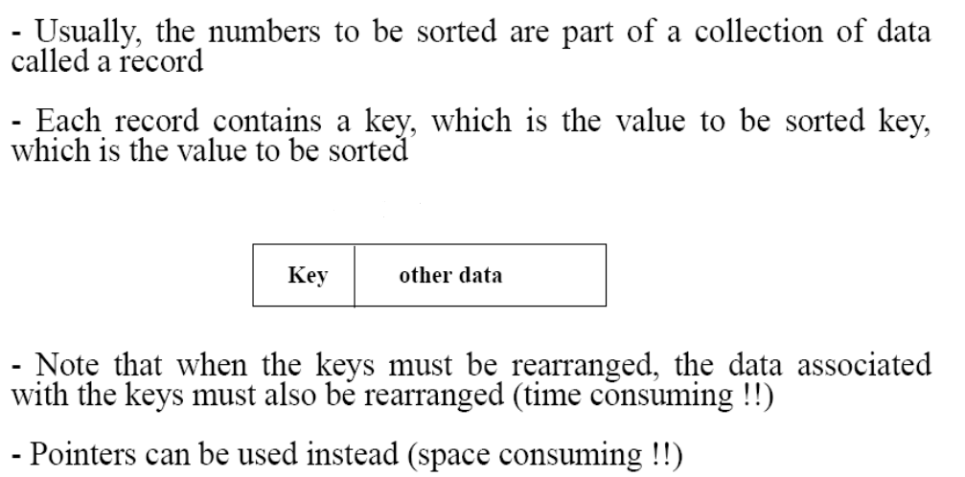
Structure of data

Slide 5
Why Study Sorting Algorithms?
Sorting is the best-studied problem in computer science, with a variety of different algorithms known.
Computers spend more time in sorting than any other operation.
Sorting is an important step to speed up the subsequent operations on a data structure.
Sorting is important because once a set of elements is sorted, many more other problems become easy to solve.
It is easier and faster to search the position of elements in a sorted list than unsorted.

Slide 6
Some Definitions
Internal Sort
The data to be sorted is all stored in the computer’s main memory.
External Sort
Some of the data to be sorted might be stored in some external, slower, device.
In Place Sort
The amount of extra space required to sort the data is constant with the input size.

Slide 7
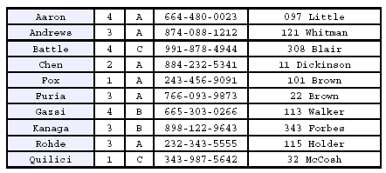
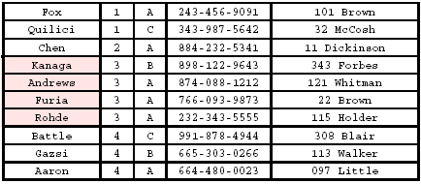
Stability
A STABLE sort preserves relative order of records with equal keys
Sorted on first key:
Sort file on second key:
Records with key value 3 are not in order on first key!!

Slide 8
Bubble Sort
Idea:
Repeatedly pass through the array
Swaps adjacent elements that are out of order
Easier to implement, but slower than Insertion sort
i
1
2
3
n
8
4
6
9
2
3
1
j

Slide 9
In bubble sort, each element is matched with its adjacent element. If the first element is greater than the second one, then the position of elements is interchanged, otherwise, it is not changed.
Then the subsequent element is compared with its next adjacent element, and the same process is repeated for all elements in the array.
In the first pass, first, the largest number in the array is placed in the last position in the array.
In the second pass, the second largest number in the array is placed at the second last position in the array and so on.

Slide 10
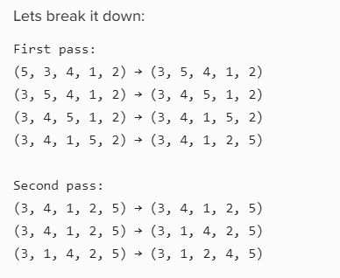
Example
Continued passes render the list completely sorted: (1, 2, 3, 4, 5)

Slide 11
Bubble Sort
i
8
4
6
9
2
3
1
i = 1
j
Alg.: BUBBLESORT(A)
for i ← 1 to length[A]
do for j ← length[A] downto i + 1
do if A[j] < A[j -1]
then exchange A[j] ↔ A[j-1]

Slide 12
Advantages of Bubble Sort
Bubble sort is a simple sorting method.
No additional data structure is necessary.
Items are exchanged in place without the use of additional temporary storage, so the required space is minimal.
Disadvantages of Bubble Sort
Bubble sort is a very inefficient method of sorting.
Even if the elements are in sorted order, all (n-1) passes will be done.
The bubble sort is mostly suitable for academic teaching but not for real-life applications.
Bubble sort does not deal well with a list containing a huge number of elements.

Slide 13
Complexity
The Bubble Sort algorithm has a time complexity of O(N²) and a space complexity of O(1) since it does not require any additional memory space apart from a temporary variable used for swapping.

Slide 14
Selection Sort
Idea:
Find the smallest element in the array
Exchange it with the element in the first position
Find the second smallest element and exchange it with the element in the second position
Continue until the array is sorted

Slide 15
Selection sort is also known as a push-down sort. The selection sort consists entirely of a selection phase in which the smallest element, in the array is searched.
Once the smallest element is found, it is placed in the first position of the array, that is, at index 0.
The other remaining elements are made to find the next smallest element, which is placed in the second position of the array, that is, at index 1 of the array and so on.
Thus, all elements are sorted into ascending order.

Slide 16
Example
8
4
6
9
2
3
1
1
2
3
4
9
6
8
1
4
6
9
2
3
8
1
2
3
4
6
9
8
1
2
6
9
4
3
8
1
2
3
4
6
8
9
1
2
3
9
4
6
8
1
2
3
4
6
8
9

Slide 17
Selection Sort
Alg.: SELECTION-SORT(A)
n ← length[A]
for j ← 1 to n - 1
do smallest ← j
for i ← j + 1 to n
do if A[i] < A[smallest]
then smallest ← i
exchange A[j] ↔ A[smallest]
8
4
6
9
2
3
1

Slide 18
Selection Sort
Selection Sort Complexity
Time Complexity
Best | O(n²)
Worst | O(n²)
Average | O(n²)
Space Complexity | O(1)
because it only requires a constant amount of additional space to perform the swaps.

Slide 19
Advantages of Selection Sort
1. Selection sort is a simple sorting method.
2. No additional data structure is required.
3. Selection sort is an in-place sorting algorithm, and no additional temporary storage is required to sort the elements in that particular list.
Disadvantages of Selection Sort
1. Selection sort is a very inefficient method of sorting.
2. Even if the elements are in sorted order, all (n-1) passes will be done.
3. Selection sort is poor efficiency when dealing with a huge list of elements.

