Slide 1
Data Structures
Search Algorithms

Slide 2
Today’s modern computers store a lot of information.
To read this information proficiently, we need very efficient searching algorithms.
Information searching is one of the most important applications of computer science.
The need to find one specific record of data among many hundreds, thousands or more.
Example, the need to find someone’s mobile number on mobile phone or to find the address that requires searching.
A particular record can be identified when the key value of that record matches the given input value.

Slide 3
If the desired record is found, then the search operation is said to be successful, otherwise searching is unsuccessful.
There are certain ways of organizing data that improve the searching process, which means if we keep the information in the right order, it is easy to search the required elements.
Definition: Searching refers to the operation of finding the position of a given item in a collection of items.

Slide 4
Types of searching:
Internal search:
The searching method in which all elements remain sustained in main memory is called internal search.
The time required is less but is perfect for a small amount of data. Linear search, binary search, binary search tree are internal searching techniques.
b. External search:
The searching method in which elements are kept in secondary storage is called external search.
The time required is longer, and the perfect search technique for a lot of data. B tree and B+ tree are external searching techniques.

Slide 5
Sequential Search or Linear Search
In linear search, each element of an array is accessed one by one sequentially and see whether or not it is desired element.
A search will be unsuccessful if all the elements are accessed, and the desired element is not found.

Slide 6
Algorithm of Linear Search
1. Start.
2. Traverse the array using any a loop.
3. In every iteration, compare the key element value with the current value of the array.
i. If the value gets a match, then print the current position or location of the array element.
ii. If the value does not match, move on to the next array element by incrementing the array index by one.
iii. If the last element in the array is checked with key elements and no match is found, then print the key element that is not present in the array or list.
4. Stop.

Slide 7
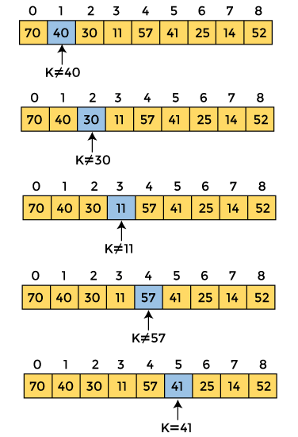

Slide 8
Algorithm of Linear Search
Time Complexity:
Best-case time complexity: O(1)
Average-case time complexity: O(n)
Worst-case time complexity: O(n)
Space Complexity:
The space complexity of linear search is O(1) because it only requires a constant amount of additional space to store variables for index tracking or comparisons.

Slide 9
Advantages of Linear Search
i. It is a very simple method.
ii. It does not require the data to be ordered form.
iii. It does not require any additional data structure.
Disadvantages of Linear Search
i. If the number of elements is very large, this method of searching will be very insufficient and slow.

Slide 10
Binary Search
Binary Search Basics
Binary search is a very efficient search technique, which works for sorted lists only either in ascending or in descending order.
Binary search is a fast searching algorithm.
This search algorithm is based on the divide-and-conquer principle.
For this algorithm to work properly, the data collection or list must be in sorted order.

Slide 11
Binary Search Algorithm
1. Start.
2. The array must be in ascending or descending sorted order. Then find the middle element of the array, which will be referred to as mid.
3. Compare the middle element, mid with searched element or key element, key.
4. There are three cases assumed that the array is in ascending order:
i. If mid = key, that is, if mid is the desired element, then the search is successful.
ii. If mid > key, that is, the mid element is greater than key element, then search only in the first half of the array.
iii. If mid < key, that is, the mid element is less than key element, then search only in the second half of the array, considered array elements are sorted in ascending order.
5. Repeat the above steps 1–3 until the key element is found.
6. Stop.

Slide 12
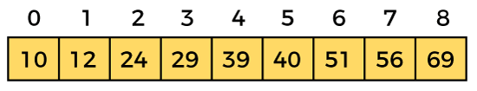
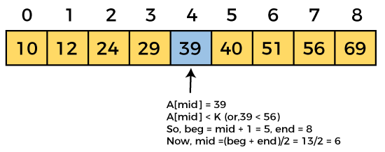
beg = 0
end = 8
mid = (0 + 8)/2 = 4.

Slide 13
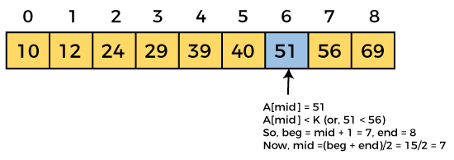
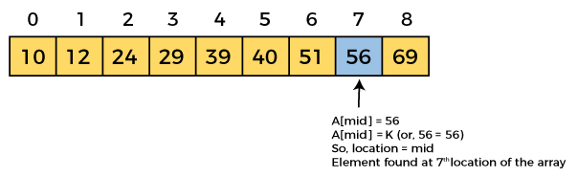

Slide 14
Advantages of Binary Search
Worst-case time complexity of the binary search is very efficient.
Compared to linear search, the binary search algorithm is much faster.
A binary search is a simple algorithm for finding an element in a sorted list.

Slide 15
Disadvantages of Binary Search
Does not apply to unsorted records. Data has to be in sorted order always before applying binary search.
Binary search is a more complicated algorithm than linear search.
Binary search doesn't work well for small lists.
Binary search is convenient for array-like direct access structures, but not appropriate for a linked list-like storage structures.

