Slide 1
Object Oriented Programming(OOP)
Introduction to OOP
Lecture 1

Slide 2
Topics
Outline of OOP Course
JAVA Basic
Java Compiler, JVM, development environments
Java components (Java Keywords, Identifiers, Comments…)
Array
Using classes from the library (string, system, math)
Introduction to OOP.
Methods
What is a method
Method Structure, and Method invocation
Return Statement
Method Parameters

Slide 3
Con’t
Classes and objects
Class Definitions
Objects (Instances of a Class)
Method Overloading
Variable Scope
Constructors
Information Hiding and Encapsulation
Inheritance and
Polymorphism
Abstract Classes and Interfaces

Slide 4
References
An Introduction to Object-Oriented Programming with Java, 5th Edition_2
Fundamentals of Computer Science Using Java, by David Hughes, Jones and Bartlett Publishers
Java in a Nutshell, by David Flanagan; 2nd Edition,

Slide 5
Introduction to programming Languages
Programming languages paradigm are often categorized into four main bins: imperative, functional, logic, and object oriented.
Structured or Procedural : The language provides a collection of statements, such as assignment statements , and procedures affecting data (variables). The imperative languages are such as FORTRAN, BASIC, COBOL, Pascal, C.
Functional: program is a collection of (math) functions. The functional languages are like LISP, Scheme, and Standard ML.
Logical: programs written in a logical programming language are sets of logical sentences, expressing facts and rules about some problem domain. The logical languages are such as Prolog.

Slide 6
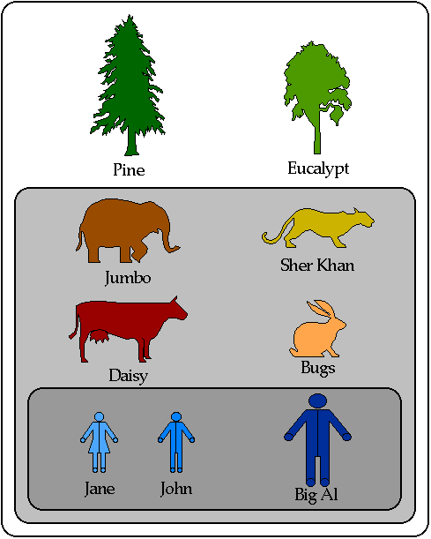
OOP
Object Oriented Programming (OOP)
is a programming way which uses objects and their interactions to design applications and computer programs.
Each object has a properties And perform an action.

Slide 7
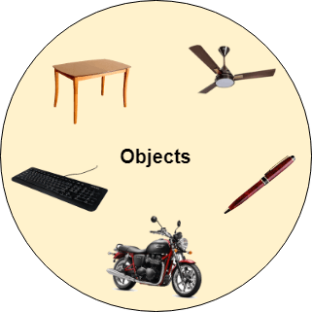
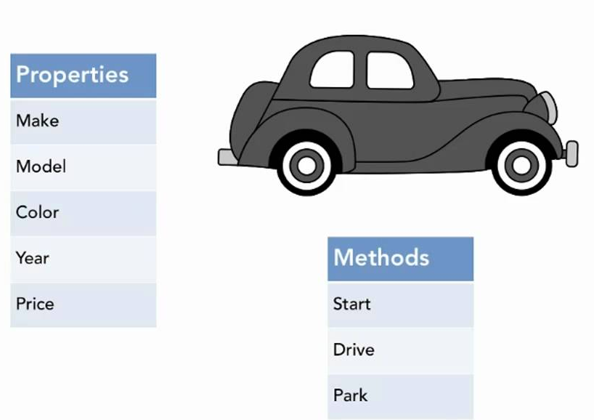
Introduction
Objects
is a thing which are usually instances of classes, have data fields (attributes that describe the object) and methods.
Each object has a specific characteristics which follows:
variable (what the objects have) also called state , field , attribute
Behavior (what the objects do ) Methods , function, operation
Identity (what makes them unique) like the name,ID

Slide 8
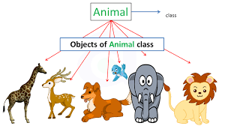
Introduction
Class is a template (blueprint) for an object that define what objects can and cannot do. Once a class is defined, we can create as many instances of the class called object.
In Java, class is the keyword used to define new types.
For example Ali is an object , Person is a class

Slide 9
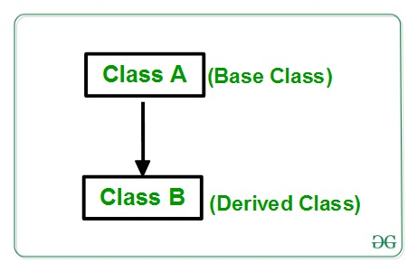
Java OOPs Concepts
Inheritance
When one object acquires all the properties and behaviors of a parent object, it is known as inheritance. It provides code reusability.
Polymorphism
If one task is performed in different ways, it is known as polymorphism.
For example: shape, triangle, rectangle, etc.
Another example can be to speak something; for example, a cat speaks meow, dog barks.
In Java, we use method overloading and method overriding to achieve polymorphism.

Slide 10
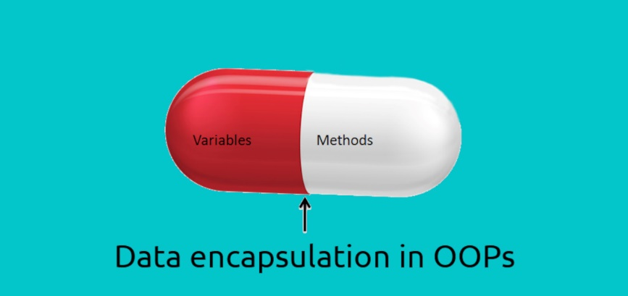
Abstraction
Hiding internal details and showing functionality is known as abstraction.
For example phone call, we don't know the internal processing.
In Java, we use abstract class and interface to achieve abstraction.
Encapsulation
Binding (or wrapping) code and data together into a single unit are known as encapsulation.
For example, a capsule, it is wrapped with different medicines.
A java class is the example of encapsulation.

Slide 11
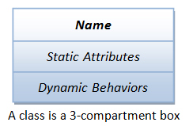
UML(Unified Modeling Language) notation to represent an object.
A Class is a 3-Compartment Box Encapsulating Data and Operations

Slide 12
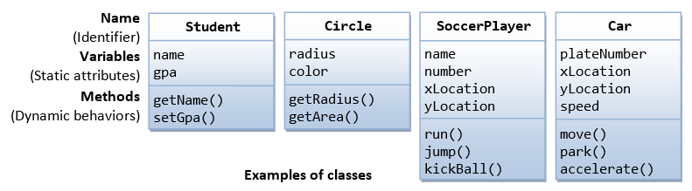
UML(Unified Modeling Language) notation to represent an object.

Slide 13
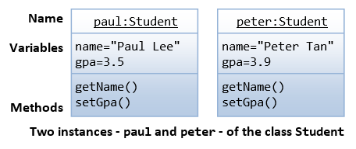
UML(Unified Modeling Language) notation to represent an object.
The following figure shows two instances of the class
Students, identified as "Paul" and “Peter".

Slide 14
Advantages of OOP
Modularization:
Decompose problem into smaller sub-problems that can be solved separately.
Understandability:
Individual modules are understandable by human readers.
Maintainability:
less work is needed to maintain it over time. Changes and maintenance in only a few modules does not affect the architecture.

Slide 15
Advantages of OOP
Data hiding (encapsulation):
The implementation of an objects private data and actions can change without affecting other objects that depend on it.
Code reuse through:
Inheritance: Objects can inherit state and behavior of other objects
Hierarchy:
Incremental development from small and simple to more complex modules.

Slide 16
disadvantages of OOP
Size
Object Oriented programs are much larger than other programs.
Effort
It is complex to create programs based on interaction of objects. Some of the key programming techniques, such as inheritance and polymorphism, can be challenging to comprehend initially.
Speed
OOP are typically slower than procedure based programs, partially because of their size and they typically require more instructions to be executed.
Not suitable for all types of problems:

Slide 17
Tray It Your self
Question
Draw the following class diagram:
Person
Employee

Slide 18
Any Questions

