Slide 1
OOP in Java
Lecture 2
Data Types
Strings
Access Modifiers
math Class

Slide 2
The Primitive Types
Java defines eight primitive types of data:
byte, short, int, long, char, float, double, and boolean.
The primitive types are also commonly referred to as simple types,
These can be put in four groups:

Slide 3
The Primitive Types
These can be put in four groups:
• Integers This group includes byte, short, int, and long, which are for whole-valued signed numbers.
• Floating-point numbers This group includes float and double, which represent numbers with fractional precision.
• Characters This group includes char, which represents symbols in a character set, like letters and numbers.
• Boolean This group includes boolean, which is a special type for representing true/false values.

Slide 4
Integers
Name | Bit | Byte | Range
Long | 64 | 8 | –9,223,372,036,854,775,808 to 9,223,372,036,854,775,807
int | 32 | 4 | –2,147,483,648 to 2,147,483,647
short | 16 | 2 | –32,768 to 32,767
byte | 8 | 1 | –128 to 127

Slide 5
For example, here is a program that computes the number of miles that light will travel in a specified number of days.
public static void main(String args[])
{
int lightspeed;
long days;
long seconds;
long distance;
// approximate speed of light in miles per second
lightspeed = 186000;
days = 1000; // specify number of days here
seconds = days * 24 * 60 * 60; // convert to seconds
distance = lightspeed * seconds; // compute distance
System.out.print("In " + days);
System.out.print(" days light will travel about ");
System.out.println(distance + " miles.");
}
following output:
In 1000 days
light will travel about 16070400000000 miles.
Clearly, the result could not have been held in an int variable.

Slide 6
Floating-Point Types
Name | Width in Bits | Approximate Range
double | 64 | 4.9e–324 to 1.8e+308
float | 32 | 1.4e–045 to 3.4e+038

Slide 7
Here is a short program that uses double variables to compute the area of a circle:
// Compute the area of a circle.
public static void main(String args[]) {
double pi, r, a;
r = 10.8; // radius of circle
pi = 3.1416; // pi, approximately
a = pi * r * r; // compute area
System.out.println("Area of circle is " + a);
}

Slide 8
Characters
In Java, the data type used to store characters is char. However, C/C++ programmers beware:
char in C or C++ is 8 bits wide
In Java char is a 16-bit type. The range of a char is 0 to 65,536.

Slide 9
Booleans
for logical values. It can have only one of two possible values , true or false.
public static void main(String args[]) {
boolean b;
b = false;
System.out.println("b is " + b);
b = true;
System.out.println("b is " + b);
// a boolean value can control the if statement
if(b) System.out.println("This is executed.");
b = false;
if(b) System.out.println("This is not executed.");
// outcome of a relational operator is a boolean value
System.out.println( 10 > 9);
}
The output
b is false
b is true
This is executed.
true

Slide 10
Variable
A variable : is a location in your computer's memory in which you can store a value and from which you can later retrieve that value.
There are three types of variables in java
local variable
instance variable
static variable

Slide 11
Local Variable
A variable that is declared inside the method or blocks is called local variable.
public static void main(String args[])
{
int age = 0;
age = age + 7;
System.out.println("age is : " + age);
}

Slide 12
Instance Variable
A variable that is declared inside the class but outside the method is called instance variable . It is not declared as static.
Instance variables have default values.
For numbers the default value is 0
for Booleans it is false.
class A
{ int data=50
void method()
{
int n=90;//local variable
}
}

Slide 13
Static variable (Class Variables)
A variable that is declared as static is called static variable. It cannot be local.
There would only be one copy of each class variable per class, regardless of how many objects are created from it.
class A{
static int m=100; //static variable
void method()
{
int n=90; //local variable
}
}

Slide 14
Java Mathematical Operators
Five mathematical operators are available:
addition (+),
subtraction (–),
multiplication (*),
division (/),
and modulus (%).
Mathematical operators example:
result = 56 + 32 // result = 88
result = 12 – 10 // result = 2
result = 21 / 7 // result = 3
result = 12 * 4 // result = 48
result = 21 % 4 // result = 1

Slide 15
Java Incrementing and Decrementing.
int Counter = 5;
Counter++; // Start with Counter and increment it.
Counter--; // Start with Counter and decrement it.
// OR
Counter = Counter + 1;
Counter = Counter - 1;
// OR
Counter += 1;
Counter -= 1;

Slide 16
Java Operator Precedence.
When two mathematical operators have the same precedence, they are performed in a left-to-right order.
For example :
x = 5 + 3 + 8 * 9 + 6 * 4;
// 8*9 = 72, and 6*4 = 24.
Now the expression is essentially.
x = 5 + 3 + 72 + 24;
and result will be
x=104;

Slide 17
Java Evaluating with the Relational Operators.
Name Operator Sample Evaluates
Equals == 100 == 50; false
Not equals != 100 != 50; true
Greater than > 100 > 50; true
Greater than or equal to >= 100 >= 50; true
Less than < 100 < 50; false
Less than or equal to <= 100 <= 50; false

Slide 18
Java String
string is a series of characters gathered together, like the word "Hello", or the phrase "practice makes perfect". Create a string in the code by writing its chars out between double quotes.
Creating a String
There are two ways to create a String in Java
String literal
Using new keyword

Slide 19
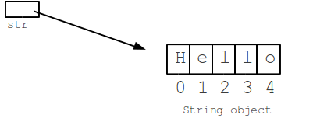
Example
String str = "Hello";

Slide 20
String Concatenation
The + (plus) operator between strings puts them together to make a new, bigger string. The bigger string is just the chars of the first string put together with the chars of the second string.
String a = "kit" + "ten"; // a is "kitten"

Slide 21
String Length
The "length" of a string is just the number of chars in it. So "hi" is length 2 and "Hello" is length 5. The length() method on a string returns its length,
like this:
String a = "Hello";
int len = a.length(); // len is 5

Slide 22

String Index Numbers
Index numbers -- 0, 1, 2, ...
Leftmost char is at index 0
Last char is at index length-1

Slide 23
String Substring
str.substring(start)
Chars beginning at index start
Through the end of the string
Later: more complex 2-arg substring()
String str = "Hello";
String a = str.substring(1); // a is "ello”
String b = str.substring(2); // b is "llo“
String c = str.substring(3); // c is "lo"

Slide 24
charAt() Method
String str = "Welcome to string handling tutorial";
char ch1 = str.charAt(0);
char ch2 = str.charAt(5);
Output:
Character at 0 index is: W
Character at 5th index is: m

Slide 25
trim() Method
public static void main(String args[]){
String str = new String(" How are you? ");
System.out.println("String before trim: "+ str);
System.out.println("String after trim: "+ str.trim());
}
Output:
String before trim: How are you?
String after trim: How are you?

Slide 26
replace() Method
String str = new String(“Mohammed");
System.out.println( str.replace('o', 'p') );
Output
Mphammed

Slide 27
Final Keyword In Java
The final keyword in java is used to restrict the user. The java final keyword can be used in many context. Final can be:
variable
method If you make any method as final, you cannot override it.
Class If you make any class as final, you cannot extend it.
Java final variable If you make any variable as final, you cannot change the value of final variable(It will be constant).
final int speedlimit=90; //final variable

Slide 28
Java Access Modifiers
One of the most important aspects of object-oriented design is data hiding, or encapsulation.
Basic Access Modifiers:
By default, the variables and methods of a class are accessible to members of the class itself and to other classes in the same package.
Methods and variables (members) declared as private are accessible only within their class.
Members declared as public are accessible from any class in any package.
Members declared as protected access by other classes in the package and subclasses inside or outside the package.

Slide 29
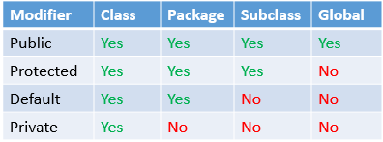
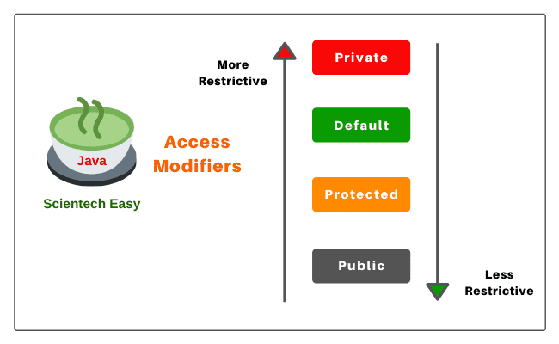

Slide 30
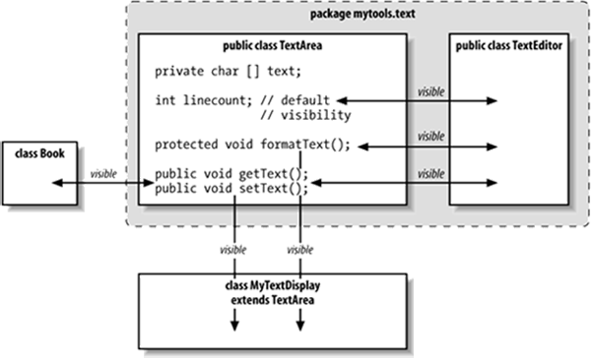

Slide 31
The Math Class
Method | Purpose
abs(int x) | Returns the absolute value of an integer x.
abs(double x) | Returns the absolute value of a double x
pow(double base, double exponent) | Returns the base raised to the exponent.
round(double x) | Returns x rounded to the nearest whole number. Returned value must be cast to an int before assignment to an int variable.
max(int a, int b) | Returns the greater of a and b.
min(int a, int b) | Returns the lesser of a and b.
double sqrt(double x) | Returns the square root of x.
random( ) | Returns a random number greater than or equal to 0.0 and less than 1.0.

Slide 32
Examples
int ans1; double ans2; ans1 = Math.abs(-4); //ans1 equals 4 ans1 = Math.abs(-3.6); //ans1 equals 3.6
ans2 = Math.pow(2.0,3.0); //ans2 equals 8.0 ans2 = Math.pow(25.0, 0.5); //ans2 equals 5.0
ans1 = Math.max(30,50); //ans1 equals 50 ans1 = Math.min(30,50); //ans1 equals 30 ans1 = (int) Math.round(5.66); //ans1 equals 6

Slide 33
Math.sqrt() Method
import java.lang.*;
public class MathDemo {
public static void main(String[] args)
{
double x = 9;
System.out.println(Math.sqrt(x));
}
}
Output :
3.0

