Slide 1
OOP in Java
Lecture 4
Classes and Objects

Slide 2
Class
A class is a named collection of ﬁelds that hold data values and methods that operate on those values.
Some classes also contain nested inner classes.
Classes are the most fundamental structural element of all Java programs. You cannot write Java code without deﬁning a class.
All Java statements appear within methods, and all methods are deﬁned within classes.

Slide 3
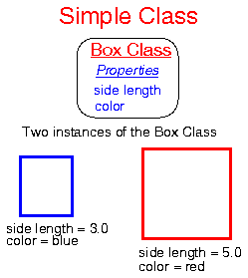
Class
A class is a template for an object,
an object is an instance of a class.

Slide 4
Class
Example, a circle can be described by the x, y position of its center and by its radius.
There are a number of things we can do with circles:
compute their circumference,
compute their area,
check whether points are inside them.

Slide 5
Example
public class Circle {
public double x, y; // The coordinates of the center
public double r; // The radius
public double circumference()
{ return 2 * 3.14159 * r; }
public double area()
{ return 3.14159 * r*r; }
}

Slide 6
Class
A class is a sort of template which has attributes and methods. An object is an instance of a class.
The methods and variables defined within a class are called members of the class. In most classes, the instance variables are acted upon and accessed by the methods defined for that class.

Slide 7
Objects Are Instances of a Class
By defining the Circle class in Java, we have created a new data type.
But this variable Mycircle is simply a name that refers to a circleobject, it is not an object itself. In Java, all objects must be created dynamically. This is almost always done with the new keyword:
Circle Mycircle;

Slide 8
Objects
Circle Mycircle;
Mycircle= new Circle();
The first line declares Mycircle as a reference to an object of type Circle. After this line executes, Mycircle contains the value null, which indicates that it does not yet point to an actual object.

Slide 9
Another example:
class Box {
double width;
double height;
double depth;
}
// ----------------------------------
class Box2 {
public static void main(String args[]) {
Box mybox; // declare reference to object
mybox = new Box(); // allocate a Box object
}
}
In the above example, mybox simply holds the memory address of the actual Box object.

Slide 10
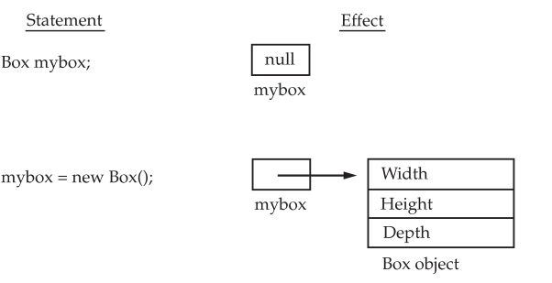
Explain
The effect of the first two commands of the above main method is shown in Figure 1.

Slide 11
Assigning Object Reference Variables
What do you think the following code does?
Box b1 = new Box();
Box b2 = b1;

Slide 12
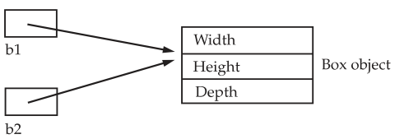
Answer
After the above code executes, b1 and b2 will both refer to the same object.
Thus, any changes made to the object through b2 will affect the object to which b1 is referring, since they are the same object .

Slide 13
Null
For example, a subsequent assignment to b1 will simply unhook b1 from the original object without affecting the object or affecting b2. For example:
Box b1 = new Box();
Box b2 = b1;
// ...
b1 = null;
Here, b1 has been set to null, but b2 still points to the original object.

Slide 14
Accessing Object Data
Circle c = new Circle();
c.x = 2.0;
c.y = 2.0;
c.r = 1.0;
Initialize our circle: center (2, 2) and radius 1.0.

Slide 15
Using Object Methods
To access the methods of an object, we use the same syntax as accessing the data of an object:
Circle c = new Circle();
double a;
c.r = 2.5;
a = c.area();
double cir= c.circumference();

Slide 16
The return statement:
The return statement is a statement which
begins with the keyword return,
is (optionally) followed by an Expression,
ends with a semicolon.
it can be placed anywhere within a method.
return(expression) ;

Slide 17
Method Overloading
When a class has two or more methods by same name but different parameters, it is known as method overloading.
int addNumbers(int a, int b)
{ // code }
int addNumbers()
{ // code }
int addNumbers(int a, int b, double b)
{ // code }

Slide 18
The void Keyword
public class ExampleOverloading{
public static void main(String[] args) {
int a = 11;
int b = 6;
double c = 7.3;
double d = 9.4;
int result1 = min(a, b);
double result2 = min(c, d);
System.out.println("MinValue = " + result1);
System.out.println("MinValue = " + result2);
}
public static int min(int n1, int n2)
{
int min;
if (n1 > n2)
min = n2;
else
min = n1;
return min;
}
Overloading methods makes program readable.
Here, two methods are given same name but with different parameters.
The minimum number from integer and double types is the result.
public static double min(double n1, double n2) {
double min;
if (n1 > n2)
min = n2;
else
min = n1;
return min;
}
}

Slide 19
This Keyword
this can be used to refer current class instance variable.
Class ScopeTest
{
int test = 10;
void printTest ()
{
int test = 20;
System.out.println(“test (inside Method) = “ + test);
System.out.println(“test(instance variable) = “ + this.test);
}
}
test (inside Method) = 20
test(instance variable) = 10
You can get around this particular instance by using this.test to refer to the instance variable, and just test to refer to the local variable.

Slide 20
Constructors
Java allows objects to initialize the variables in its class when they are created. This automatic initialization is performed through the use of a constructor.
A constructor initializes an object immediately upon creation. It has the same name as the class
the constructor is automatically called immediately after the object is created, before the new operator completes . Constructors look a little strange because they have no return type, not even void.

Slide 21
public class Circle {
public static final double PI = 3.14159;
public double r;
public Circle(double r) // constructor
{
this.r = r;
}
public double circumference()
{
return 2 * PI * r;
}
public double area()
{
return PI * r*r; }
}
}

Slide 22
Parameter
With this new constructor, the initialization becomes part of the object creation step:
Circle c = new Circle(0.25);
Here are some important notes about naming, declaring, and writing constructors:
The constructor name is always the same as the class name.
Unlike all other methods, a constructor is declared without a return type, not even void.
A constructor should not return any other value.

Slide 23
Defining Multiple Constructors:
public class Circle {
public static final double PI = 3.14159;
public double r;
public Circle() {
r = 1.0;}
public Circle(double r) {
this.r = r;}
public Circle(Circle obj) {
r = obj.r;}
public double circumference() {
return 2 * PI * r; }
public double area() {
return PI * r*r; }
}
if we have the following code:
Circle c1 = new Circle();
Circle c2 = new Circle(2.0);
Circle c3 = new Circle(c2);

Slide 24
Data Hidden and Encapsulation
Encapsulation is the technique of making the fields in a class private and providing access to the fields via public methods.
If a field is declared private, it cannot be accessed by anyone outside the class, thereby hiding the fields within the class. For this reason, encapsulation is also referred to as data hiding.
The main benefit of encapsulation is the ability to modify our implemented code without breaking the code of others who use our code. With this feature Encapsulation gives maintainability, flexibility and extensibility to our code.

Slide 25
فوائد التغليف
يمكنه جعل الأشياء الموجودة في الكلاس قابلة للقراءة أو للكتابة من قبل الكلاسات الخارجية.
من خلال توفير طريقة (دالة) setter أو getter فقط، يمكنك جعل الكلاس للقراءة فقط أو للكتابة فقط (زيادة المرونة) على سبيل المثال، إذا أردنا جعل الكلاس قابل للقراءة فقط "class read-only" نقوم بحذف دوال الضبط setter، وفي حال أردنا جعله للكتابة فقط نقوم بحذف دوال ال getter.
يسمح للكلاس بوضع شروط أثناء تخزين البيانات.
التغليف يساعد أيضاً في جعل البرنامج قابل للتطوير من مبرمجين آخرين بدون حاجة هؤلاء المبرمجين إلى معرفة تفاصيل الكود الأساسي في البرنامج.
لن يكون لدى المستخدم أي فكرة عن التنفيذ الداخلي للكلاس، حيث لن يكون مرئياً للمستخدم كيف يخزن الكلاس القيم في المتغيرات. سيعرف المستخدم فقط أننا نقوم بتمرير القيم إلى طريقة الضبط setter ويتم تهيئة المتغيرات بهذه القيمة الممررة.

Slide 26
public void setName(String n) { // بشرط أن يكون الإسم أكبر من 3 أحرف name هذه الدالة نعطيها رقم فتقوم بوضعه للخاصية
if (n.length() < 3) {
System.out.println("Name is too short, name can't be less then 3 characters!");
}
else {
name = n;
}
}

Slide 27
public class Person
{
private String name;
private int age;
public int getAge()
{
return age;
}
public String getName()
{
return name;
}
public void setAge( int newAge)
{
age = newAge;
}
public void setName(String newName)
{
name = newName;
}
}
these methods are referred as getters and setters.
Therefore any class that wants to access the variables should access them through these getters and setters.
The variables of the Personclass can be access as next slide:

Slide 28
public class Mainclass
{
public static void main(String args[])
{
Person p = new Person();
p.setName("James");
p.setAge(20);
System.out.print("Name : " + p.getName());
System.out.print("Name : "+ p.getAge());
}
}

Slide 29
Garbage Collection and finalize( ) Metho
Since objects are dynamically allocated by using the new operator, you might be wondering how such objects are destroyed and their memory released for later reallocation. In some languages, such as C++, dynamically allocated objects must be manually released by use of a delete operator. Java takes a different approach; it handles deallocation for you automatically.
The technique that accomplishes this is called garbage collection. It works like this: when no references to an object exist, that object is assumed to be no longer needed, and the memory occupied by the object can be reclaimed. There is no explicit need to destroy objects as in C++.Garbage collection only occurs sporadically (if at all) during the execution of your program. It will not occur simply because one or more objects exist that are no longer used. Furthermore ,different Java run-time implementations will take varying approaches to garbage collection, but for the most part, you should not have to think about it while writing your programs.

Slide 30
The finalize( ) Method
Sometimes an object will need to perform some action when it is destroyed. For example, if an object is holding some non-Java resource such as a file handle or character font, then you might want to make sure these resources are freed before an object is destroyed. To handle such situations, Java provides a mechanism called finalization. By using finalization, you can define specific actions that will occur when an object is just about to be reclaimed by the garbage collector.
To add a finalizer to a class, you simply define the finalize( ) method. The Java run time
calls that method whenever it is about to recycle an object of that class. Inside the finalize( ) method, you will specify those actions that must be performed before an object is destroyed.
The garbage collector runs periodically, checking for objects that are no longer referenced by any running state or indirectly through other referenced objects. Right before an asset is freed ,the Java run time calls the finalize( ) method on the object.

Slide 31
protected void finalize( )
{
// finalization code here
}

