Slide 1
OOP in Java
Lecture 3
Methods

Slide 3
Methods
A METHOD (also known as a procedure or function)
is a named sequence of instructions that can be referenced (invoked, called) in other places in the program
A function is a piece of code that is called by name

Slide 4
Procedures or Functions
Methods are also known as Procedures or Functions:
Procedures: They don't return any value.
Functions: They return value.

Slide 5
Creating Method
the syntax of a method:
public static int funcName(int a, int b)
{
// body
}
Here,
public static : modifier.
int : return type
funcName : function name
int a, int b : list of parameters

Slide 6
Syntax
Modifier returnType nameOfMethod (Parameter List) {
// method body
}
modifier: It defines the access type of the method and it is optional to use.
returnType : Method may return a value.
Name Of Method : This is the method name.
Method signature consists of the method name and the parameter list.
Parameter List: The list of parameters, it is the type, order, and number of parameters of a method. These are optional, method may contain zero parameters.
method body: The method body defines what the method does with statements.

Slide 7
Example
public static int minFunction(int n1, int n2)
{
int min;
if (n1 > n2)
min = n2;
else
min = n1;
return min;
}

Slide 8
Method Signatures
The signature of a method consists of:
The method name
The parameter list (that is, the parameter types and their order)
The signature does not include:
The parameter names
The return type

Slide 9
Method overloading
Each method defined in a class must have a unique signature.
Methods with the same name but different parameter are said to be overloaded.
int addNumbers(int a, int b)
{ // code }
int addNumbers()
{ // code }
int addNumbers(int a, int b, double b)
{ // code }

Slide 10
static
static - If you use static keyword in a method then it becomes a static method.
Static methods can be called without creating an instance of a class.

Slide 11
Method Calling
Method Calling:
For using a method, it should be called.
There are two ways in which a method is called
method returns a value or
returning nothing (no return value).

Slide 12
The process of method calling
When a program invokes a method, the program control gets transferred to the called method.
This called method then returns control to the caller in two conditions, when:
return statement is executed.
reaches the method ending closing brace.

Slide 13
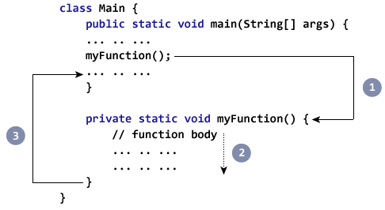
Example

Slide 14
example to demonstrate how to define a method and how to call it:
Public classExample MinNumber{
Public static void main(String[]args){
int a =11;
int b =6;
int c =minFunction(a, b);
System.out.println("Minimum Value = "+ c);
}
Public static int minFunction(int n1,int n2){
int min;
if(n1 > n2)
min= n2;
else
min= n1;
return min;
}
}

Slide 15
The return statement:
The return statement is a statement which
begins with the keyword return,
is (optionally) followed by an Expression,
ends with a semicolon.
it can be placed anywhere within a method.
return(expression) ;

Slide 16
Return Expression
There can be more than one return statement in a method.
The return statement is usually written as the last statement.
Private double f ( double x ) {
Return 0.0002 * x * x * x – 0.02 * x * x + 0.3 * x;
}

Slide 17
The void Keyword
The void keyword allows us to create methods which do not return a value.

Slide 18
void Example
public static void main(String[] args)
{
sum(7,8);
}
public static void sum (int x ; int y )
{
System.out.println(x+y);
}

Slide 19
Argument vs Parameter
We can design methods which when called can accept a value/s.
When a value is passed to a method it is called an Argument.
while the variable that receives the argument is the Parameter.

Slide 20
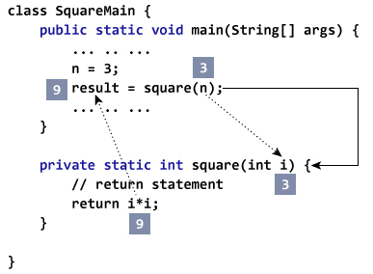

Slide 21
parameter
A method can accept more than one parameter. The method would be declared as follows:
int Meth(int a, double b, float c)
{
// ...
}

Slide 22
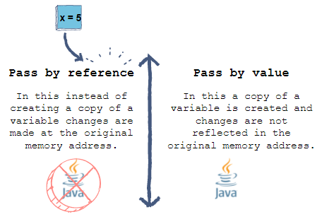
Passing Parameters by Value:
Parameters can be passed by value or by reference.
Passing Parameters by Value means calling a method with a parameter. Through this the argument value is passed to the parameter.

Slide 23
String Index Numbers
Public class swapping {
Public static void main(String[]args){
int a =30;
int b =45;
System.out.println("Before swap., a = "+a +" and b = "+ b);
wapFunction(a, b);
System.out.println("After swap., a = " + a + " and b is " + b);
}
Public static void swapFunction(int a,int b){
System.out.println("Before swap.Inside, a = " + a+ " b = " + b);
// Swap n1 with n2
int c = a;
a = b;
b = c;
System.out.println("After swap. Inside, a = "+ a +" b = "+ b);
}

Slide 24
Before swap., a = 30 and b = 45
Before swap.Inside, a = 30 b = 45
After swap.Inside, a = 45 b = 30
**Now, Before and After swapping
After swap., a = 30 and b is 45

Slide 25
advantages of using methods?
1. The main advantage is code reusability. We can write a method once, and use it multiple times. We do not have to rewrite the entire code each time.
2. Methods make code more readable and easier to debug. Here getSquare(), the method keeps the code to compute the square in a block. Hence, makes it more readable.

Slide 26
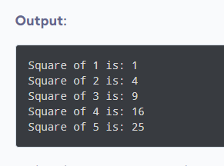
public class Main {
// method defined
private static int getSquare(int x){
return x * x;
}
public static void main(String[] args) {
for (int i = 1; i <= 5; i++) {
// method call
int result = getSquare(i);
System.out.println("Square of " + i + " is: " + result);
}
}
}

