Slide 1
Computer Programming
Lecture 2
Arrays in C++

Slide 2
What Is An Array?
An array is a collection of values that have the same data type which are stored contiguously in memory
Example:
A collection of int data values
or
A collection of bool data values
or
A collection of double data values
…etc
We refer to all stored values in an array by its name

Slide 3
Why do we need arrays?
Arrays are very important in any programming language. They provide a more convenient way of storing variables or a collection of data of a similar data type together instead of storing them separately.
Each value of the array will be accessed separately.

Slide 4
How To Declare Arrays
To declare an array in C++, you should specify the following things
The data type of the values
The name of the array
The dimensionality of the array:
One dimensional (i.e. list of values ),
Two-dimension array (a matrix or a table)
…etc.
The size of each dimension

Slide 5
Declaring a (one-Dimensional ) Array
To declare an array in C++, the programmer specifies the type of the elements and the number of elements required by an array as follows Syntax
where
type is any type that already exists
arrayName is the name of the array
arraySize is the number of elements in the array
Example:
grades
type arrayName [ arraySize ];
0
1
2
3
4
5
6
7
8
9
int grades[10];

Slide 6
More Examples
char fname[24]; // an array with 24 chars
int pixel[1024]; // an array with 1024 ints
double average[100]; // an array with 100 doubles
string fruit[5]; // an array of 5 C++ strings
bool xyz[10]; // an array with 10 bools
An element is a single object in an array.
The element type of an array is often called its base type.
The first example is an array with base type char, for example. One can say that fname is “an array of char”

Slide 7
Accessing Array Elements
An element is accessed by indexing the array name.
Array index starts with 0, which means the first array element is at index 0, second is at index 1 and so on.
This is done by placing the index of the element within square brackets [] after the name of the array.
Example:
index
salary[0]
salary[1]
salary[2]
salary[3]
salary[4]
2300
1000
9000
1200
4000
int salary[5];
Note: An index also sometimes is called a subscript.

Slide 8
Accessing Array Elements
Example: assume you have the following array:
The assignment statement: x[2] = 34; stores 34 in x[2] , which is the third component of the array list
int x[5];
x[0]
x[1]
x[2]
x[3]
x[4]
34
Array list after execution of the statement x[2]= 34;

Slide 9
Initialization the Array
Array initialization is the process of assigning/storing elements to an array.
Method 1: Set each element
int salary[4];
// salary has 4 ints
salary[0] = 100;
salary[1] = 300;
salary[2] = 600;
salary[3] = 200;
salary[0]
salary[1]
salary[2]
salary[3]
100
300
600
200

Slide 10
Initialization During Declaration
Method 2: Initializer list
Method 3: initializers determine size
int salary[4] = {100, 300, 600, 200};
// salary has 4 ints
int salary[] = {100, 300, 600, 200};
// salary has 4 ints
Note: If you declare an array without a size, but provide initialization values, C++ creates an array with the exact size you need.

Slide 11
More about Array Initialization
int x[] = {1,2,3}; // x has type int[3] and holds 1,2,3
int y[5] = {1,2,3}; // only initialize first 3 elements
// y has type int[5] and holds 1,2,3,0,0
int z[3] = {0}; // z has type int[3] and holds all zeroes
int a[2] = {0, 1, 2}; // Error: too many initializers
double distance[5] = {44.14, 720.52, 96.08, 468.78, 6.28};

Slide 12
More about Array Initialization
x[0]
x[1]
x[2]
1
2
3
int x[] = {1,2,3};
// x has type int[3] and holds 1,2,3
int y[5] = {1,2,3};
// only initialize first 3 elements
// y has type int[5] and holds 1,2,3,0,0
int z[3] = {0}; // z has type int[3] and holds all zeroes
int a[2] = {0, 1, 2}; // Error: too many initializers
y[0]
y[1]
y[2]
y[3]
y[4]
1
2
3
0
0
z[0]
z[1]
z[2]
0
0
0
It causes a compilation error, because there are 3 initializers and only 2 array elements.

Slide 13
Filling Up an Array – Using Loop
You can use the loop to fill up an array, one element at a time
int a[6];
for (int i = 0; i < 6; ++i)
{
a[i] = i + 1;
}
a[0]
a[1]
a[2]
a[3]
a[4]
a[5]
1
2
3
4
5
6

Slide 14
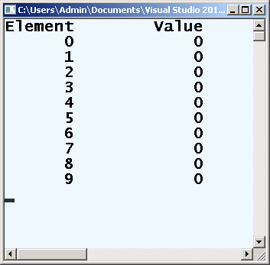
Example: Initializing an array's elements to zeros and printing the array
#include <iostream>
#include <iomanip>
using namespace std;
int main () {
int n[ 10 ]; // n is an array of 10 integers
// initialize elements of array n to 0
for ( int i = 0; i < 10; i++ )
n[ i ] = 0; // set element at location i to 0
cout << "Element" << setw( 13 ) << "Value" << endl;
// output each array element's value
for ( int j = 0; j < 10; j++ )
cout << setw( 7 ) << j << setw( 13 ) << n[ j ] << endl;
cin.get();
return 0;
}
Declare a 10-element array of integers.

Slide 15
Invalid Array Usage
Example:
Invalid array assignments:
Conversion will still occur:
float Sales[10];
Sales = 17.50; // Error: missing index []
Sales[-1] = 17.50; // Error: index, out of range
Sales[10] = 17.50; // Error: index, out of range
Sales[7.0] = 17.50; // Error: wrong index type
Sales['a'] = 17.50; // Error: wrong index type
Sales[7] = 'A'; // Error: data is wrong type
Sales[7] = 17; // 17 is converted to float: 17.0

Slide 16
No Copy or Assignment
We cannot initialize an array as a copy of another array, nor is it legal to assign one array to another
int x[] = {0, 1, 2}; // the array x has 3 elements 0,1,2
int y[] = x; // Error: cannot initialize one array with another
x = y; // Error: cannot assign one array to another
How to copy an array to another?

Slide 17
Copying One Array to Another
You must use a loop to copy element by element:
int x[3] = {10, 13, 99};
int y[3];
for (int i=0; i < 3; i++)
y[i] = x[i];

Slide 18
Reading data into an array
The following loop inputs the data into the array x. For simplicity, we assume that the data is entered from the keyboard.
int x[3];
for (int index = 0; index < 3; index++)
cin >> x[index];
Note: Each element can be assigned a value individually

Slide 19
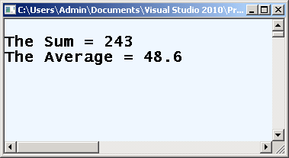
Example of using array
Finding the sum and average of the following array:
double sales[5] = {33, 44, 23, 91, 52};
#include <iostream>
using namespace std;
int main () {
double sales[5] = {33, 44, 23, 91, 52};
double sum, average;
sum = 0;
for (int index = 0; index < 5; index++)
sum = sum + sales[index];
average = sum / 5;
cout << "The Sum = " << sum << endl;
cout << "The Average = "<< average;
cin.get();
return 0;
}

Slide 20
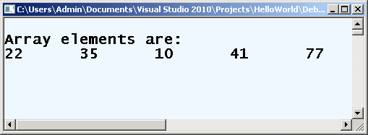
Displaying the Array
Displaying the array requires the for-loop.
We traverse to the entire array and display the elements of the array.
int x[5] = {22, 35, 10, 41, 77};
cout<<"Array elements are:"<<endl;
for(int i=0; i<5; i++)
{
cout << x[i] << "\t";
}

Slide 21
Specifying an Array's Size with a Constant Variable
Array size
Can be specified with constant variable (const)
const int size = 20;
Constants cannot be changed
Constants must be initialized when declared
Example 1:
Example 2:
const int size = 20;
int salary[size];
int size = 20;
int salary[size]; // Error

Slide 22
Example: Maximum Element
How to find the maximum element of an array?
Initializing the array with 6 elements
a[]
int a[] = {22,23,67,82,19,54};
int max = a[0];
for (int i = 1; i < 6; i++)
if (a[i] > max)
max = a[i];
cout << max;
/* Note i starts at 1 */
22
23
67
82
19
54

Slide 23
Operations on Arrays
Each member of an array is a variable and can be processed as such. This means that you can add the values of two members of the array(Number[2]+Number[0]), you can subtract the value of one of the members from another member(member[1]-Number[4]). In the same way, you can perform multiplication, division, or remainder operations on members of an array.

Slide 24
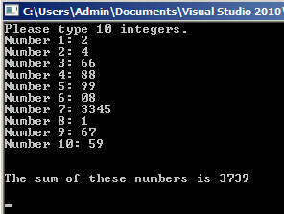
Operations on Arrays
Example of adding the values of the members to produce a sum
#include <iostream>
using namespace std;
void main()
{
// We know that we need a constant number of elements
const int max = 10;
int number[max];
// We will calculate their sum
int sum = 0;
cout << "Please type 10 integers.\n";
for( int i = 0; i < max; i++ )
{
cout << "Number " << i + 1 << ": ";
cin >> number[i];
sum += number[i];
}
cout << "\n\nThe sum of these numbers is " << sum << "\n\n";
system("pause");
}

Slide 25
Character Arrays
Character array: An array whose components are of type char .
C-strings are arrays of type char terminated with null character, that is, '\0' (ASCII value of null character is 0).
How to define a C-string?
In the above code, x is a string and it holds 4 characters.
Although, "C++" has 3 character, the null character \0 is added automatically to the end of the string.
char x[] = "C++";

Slide 26
Alternative ways of defining a string
A character array can be initialized in various ways.
char x1[4] = {'a','b','c'};
// x has 4 chars
char x2[] = {'a','b','c','\0'};
// x has 4 chars - explicit null
char x3[] = "abc";
// x has 4 chars : 'a', 'b', 'c', '\0‘
null terminator added automatically
The last char '\0' is a special string-termination character called the null character.

Slide 27
Reading and Writing with Character Arrays
Assume that we have the following array:
The aggregate operations are allowed for C -string input, the statement:
cin >> name;
Notes:
The length of the input Character Array must be less than or equal to 9.
If the length of the input string is 4, the computer stores the four characters that are input and the null character '\0‘.
If the length of the input is more than 9, error may accrue.
cin >> will stops reading data into the current variable as soon as it finds the first whitespace character or invalid data.
char name[10];

Slide 28
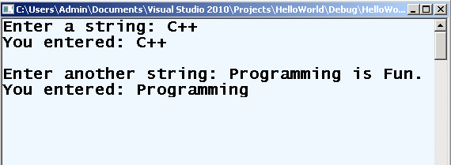
C++ program to display a string entered by user
#include <iostream>
using namespace std;
int main()
{
char x[100];
cout << "Enter a string: ";
cin >> x;
cout << "You entered: " << x << endl;
cout << "\nEnter another string: ";
cin >> x;
cout << "You entered: "<< x <<endl;
system("pause");
return 0;
}

Slide 29
C++ program to display a string entered by user
#include <iostream>
using namespace std;
int main()
{
char x[100];
cout << "Enter a string: ";
cin >> x;
cout << "You entered: " << x << endl;
cout << "\nEnter another string: ";
cin >> x;
cout << "You entered: "<< x <<endl;
system("pause");
return 0;
}
Notice that, only "Programming" is displayed instead of "Programming is fun.".
This is because the extraction operator >> considers a space " " is a terminating character.

Slide 30
Reading and Writing with Character Arrays
How do you input C -strings with blanks into a character array?
To read the text containing blank space, cin.get function can be used.
This function takes two parameters.
The first parameter is a C -string variable; the second parameter specifies how many characters to read into the string variable.
Example
Syntax:
cin.get(string_name, size);
char x[31];
cin.get(x, 31);

Slide 31
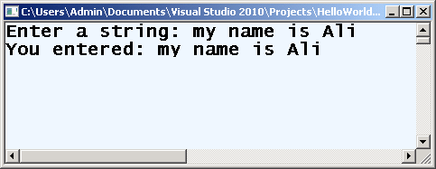
Reading and Writing with Character Arrays
#include <iostream>
using namespace std;
int main()
{
char x[31];
cout << "Enter a string: ";
cin.get(x, 31);
cout << "You entered: " << x << endl;
system("pause");
return 0;
}
This statement stores the next 30 characters, or all characters until the newline character '\n' is found, into x. The newline character is not stored in x

Slide 32
EXERCISE (1)
What is the output of the following code?
#include <iostream>
using namespace std;
void main()
{
int x[5];
x[0] = 10;
x[2] = -20;
x[3 / 2] = 30;
x[3] = x[0];
cout << x[0] << " " << x[1] << " " << x[2] << " " << x[3];
system("pause");
}
10 30 -20 10
How?

Slide 33
EXERCISE (2)
Determine whether the following array declarations are valid. If a declaration is invalid, explain why.
int list[61]; valid
double gpa[]; valid
double[-50] ratings[]; invalid (-50)
string flowers[35]; valid
int SIZE = 10;
double sales[2 * SIZE];. invalid (int, double)
int MAX_SIZE = 50;
double sales[100 - 2 * MAX_SIZE];

Slide 34
EXERCISE (3)
Suppose that you have the following declaration:
int alpha[5] = {3, 12, -25, 72};
If this declaration is valid, what is stored in each of the five components of alpha?

Slide 35
EXERCISE (4)
If you declare an array as int numbers[10]; , then numbers[1] represents ___________.
the first element in the array
the second element in the array
the address of the array
a new array with one element
If you declare an array as int scores[100]; , then the highest subscript you should use is ___________.
0
100
99
101

Slide 36
EXERCISE (5)
If integers take four bytes of storage, then int days[31]; reserves ___________ bytes of memory.
30
120
31
124
If you declare an array as int homeRuns[7]; , then the value of homeRuns[0] is ___________.
0
unknown
7
illegal—you cannot access the value homeRuns[0]

Slide 37
EXERCISE (6)
If you declare an array as int vals[5]; , then you can double the value stored in vals[2] with the statement ___________.
vals[5] = vals[5] * 2;
vals = vals * 2;
vals[2] *= vals[2];
vals[2] *= 2;

Slide 38
EXERCISE (7)
Identify error(s), if any, in the following array declarations. If a statement is incorrect, provide the correct statement.
int primeNum[99];
int testScores[0];
int list100[0..99];
double[50] gpa;
const double LENGTH = 26;
double list[LENGTH - 1];
const long SIZE = 100;
int list[2 * SIZE];

Slide 39
Assignments - Array
Print the following array to the screen using a loop:
(Save the file as 02printArray.cpp)
for(i = 0; i < 6; ++i) {
cout << xyz[i];
}
char xyz[] = {'a', 'R', '%', '+', 'C' };

Slide 40
Assignments - Array
Take 5 integer inputs from user and store them in an array. Now, copy all the elements in another array but in reverse order.
(Save the file as 02ReverseNumbers.cpp)

Slide 41
Assignments - Array
Write a program that accepts your first name into a character array string variable. Display your name with an asterisk between each letter. For example, if your name is Ahmed, display A*h*m*e*d*
(Save the file as 02AsteriskName.cpp)
Write a C++ program to find k largest elements in a given array of integers.
Example:
Original array: {4, 5, 9, 12, 9, 22, 45, 7}
Largest 3 Elements: 45 22 12
Largest 4 Elements: 45 22 12 9
(Save the file as 02K_largest.cpp)

Slide 42
Assignments - Array
Write a C++ program to find the most occurring element in an array of integers.
Sample Output:
Original array: 4 5 9 12 9 22 45 99 9 12 44 7
Most occurred number: 9
(Save the file as 02occurring.cpp)

Slide 43
Bonus Assignment (1+)
Show by example how to use the sizeof operator to get the number of members of an array.
(Save the file as Bonus02occurring.cpp)

Slide 44
EXAMPLE
This program illustrates how to use a sequential search in a program.
// This program illustrates how to use a sequential search in a program.
#include <iostream> //Line 1
using namespace std; //Line 2
const int ARRAY_SIZE = 10; //Line 3
int seqSearch(const int list[], int listLength,int searchItem); //Line 4
int main() //Line 5
{ //Line 6
int intList[ARRAY_SIZE];
int number;
cout << "Enter " << ARRAY_SIZE<< " integers." << endl;
for (int index = 0; index < ARRAY_SIZE; index++)
cin >> intList[index]; //Line 11
cout << endl;
cout << "Enter the number to be searched: ";
cin >> number;
cout << endl;
int pos = seqSearch(intList, ARRAY_SIZE, number);
if (pos!= -1)
cout <<"Line 18: " << number<< " is found at index " << pos<< endl;
else
cout << "Line 20: " << number<< " is not in the list." << endl;
system("pause");
return 0;
}
Enter 10 integers.
1 22 33 44 55 99 6 7 45 3
Enter the number to be searched: 99
Line 18: 99 is found at index 5
int seqSearch(const int list[], int listLength, int searchItem)
{
int loc;
bool found = false;
loc = 0;
while (loc < listLength && !found)
if (list[loc] == searchItem)
found = true;
else
loc++;
if (found)
return loc;
else
return -1;
}

