Slide 1
Computer Programming
Lecture 3
Multidimensional Arrays

Slide 2
Introduction
you have used one-dimensional arrays to model linear collections of elements.
You can use a two-dimensional array to represent a matrix or a table.
For example, the following table that describes the distances between the cities can be represented using a two-dimensional array.
 | Aden | Ataq | Mukalla
Aden | 0 | 352 | 810
Ataq | 352 | 0 | 280
Mukalla | 810 | 280 | 0
Distance Table (in Km)

Slide 3
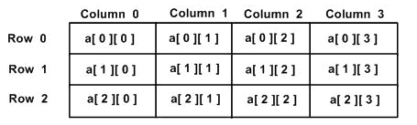
Two-dimensional array
Two-dimensional Array: a collection of a fixed number of components arranged in two dimensions
The syntax for declaring a two-dimensional array is:
where intexp1 and intexp2 are expressions yielding positive integer values
Here is a two-dimensional array containing 3 rows and 4:
dataType arrayName[intexp1][intexp2];

Slide 4
Initialization of two-dimensional array
we can initialize a multidimensional array in more than one way.
Initialization of two-dimensional array
The above method is not preferred. A better way to initialize this array with the same array elements is given below:
int x[2][3] = {2, 4, 5, 9, 0, 19};
int x[2][3] = { {2, 4, 5},
{9, 0, 19}
};
Row 0
Row 1
Column 0 | Column 1 | Column 2
2 | 4 | 5
9 | 0 | 19

Slide 5
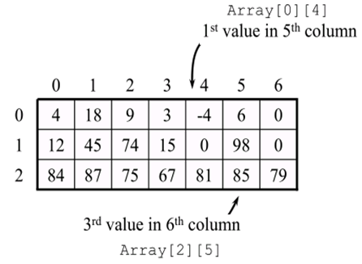
Accessing Two-Dimensional Array Elements
An element in two-dimensional array is accessed by using the subscripts, i.e., row index and column index of the array.
For example:
int Array[3][7];
Array[3][7]
3 rows
7 Columns

Slide 6
Accessing Two-Dimensional Array Elements
Caution
It is a common mistake to use matrix[2,1] to access the element at row 2 and column 1.
In C++, each subscript must be enclosed in a pair of square brackets, for example matrix[2][1];

Slide 7
Processing a 2-D Array
A one-dimensional array is usually processed via a for loop. Similarly, a two-dimensional array may be processed with nested for loops:
// an array with 5 rows and 2 columns.
int a[5][2] = { {0,0}, {1,2}, {2,4}, {3,6},{4,8}};
// output each array element's value
for ( int i = 0; i < 5; i++ )
{
for ( int j = 0; j < 2; j++ )
cout << a[i][j] << " ";
cout <<endl;
}
0 0
1 2
2 4
3 6
4 8
output

Slide 8
Example: Taking Input for Two Dimensional Array
#include <iostream>
using namespace std;
int main() {
int numbers[2][3];
cout << "Enter 6 numbers: " << endl;
// Storing user input in the array
for (int i = 0; i < 2; ++i) {
for (int j = 0; j < 3; ++j) {
cin >> numbers[i][j];
}
}
cout << "The numbers are: " << endl;
// Printing array elements
for (int i = 0; i < 2; ++i) {
for (int j = 0; j < 3; ++j) {
cout << "numbers[" << i << "][" << j << "]: " << numbers[i][j] << endl;
}
}
cin.get();
return 0;}
We have used a nested for loop to take the input of the 2d array. Once all the input has been taken, we have used another nested for loop to print the array members.
Enter 6 numbers:
1
2
3
4
5
6
The numbers are:
numbers[0][0]: 1
numbers[0][1]: 2
numbers[0][2]: 3
numbers[1][0]: 4
numbers[1][1]: 5
numbers[1][2]: 6

Slide 9
Example: Sum by Row
0 0 0
1 1 1
2 2 2
3 3 3
4 4 4
The following for loop finds the sum of each row of a matrix.
#include <iostream>
using namespace std;
int main() {
int sum;
// an array with 5 rows and 3 columns.
int matrix[5][3] = { {0,0,0}, {1,1,1}, {2,2,2}, {3,3,3},{4,4,4}};
for (int row = 0; row < 5; row++)
{
sum = 0;
for (int col = 0; col < 3; col++)
sum = sum + matrix[row][col];
cout << "Sum of row " << row + 1 << " = " << sum << endl;
}
cin.get();
return 0;
}
matrix[5][3]
Sum of row 1 = 0
Sum of row 2 = 3
Sum of row 3 = 6
Sum of row 4 = 9
Sum of row 5 = 12
The output

Slide 10
Sum by Column?
Assignment 1
Save the file as (sum_by_column.cpp)
0 0 0
1 1 1
2 2 2
3 3 3
4 4 4

Slide 11
Example: Largest element in each row
0 1 3
4 7 3
5 9 8
9 6 2
7 3 1
The following C++ code determines the largest element in each row of the matrix
#include <iostream>
using namespace std;
int main() {
int largest;
// an array with 5 rows and 3 columns.
int matrix[5][3] = { {0,1,3}, {4,7,3}, {5,9,8}, {9,6,2},{7,3,1}};
for (int row = 0; row < 5; row++)
{
largest = matrix[row][0]; //Assume that the first element
//of the row is the largest.
for (int col = 1; col < 3; col++)
if (matrix[row][col] > largest)
largest = matrix[row][col];
cout << "The largest element in row " << row + 1 << " = "<< largest << endl;
}
cin.get();
return 0;
}
matrix[5][3]
The largest element in row 1 = 3
The largest element in row 2 = 7
The largest element in row 3 = 9
The largest element in row 4 = 9
The largest element in row 5 = 7

Slide 12
Largest element in each column?
0 1 3
4 7 3
5 9 8
9 6 2
7 3 1
Assignment 2
Save the file as (Largest_clm.cpp)
matrix[5][3]

Slide 13
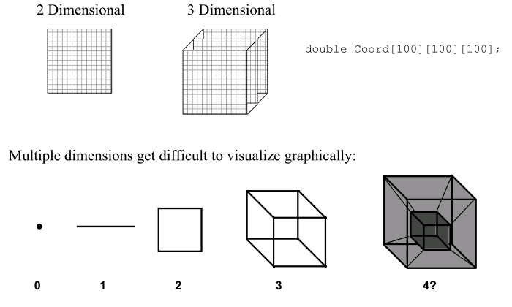
Higher-Dimensional Arrays
An array can be declared with multiple dimensions.

Slide 14
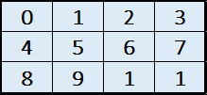
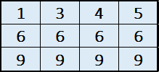
Initializing Three-Dimensional Array
Initialization in Three-Dimensional array is same as that of Two-dimensional arrays. The difference is as the number of dimension increases so the number of nested braces will also increase.
Method 1:
Better Method:
int x[2][3][4] = {0, 1, 2, 3, 4, 5, 6, 7, 8, 9, 1, 1, 1,
3, 4, 5, 6, 6, 6, 6, 9, 9, 9, 9};
4 columns
int x[2][3][4] =
{
{ {0,1,2,3}, {4,5,6,7}, {8,9,1,1} },
{ {1,3,4,5}, {6,6,6,6}, {9,9,9,9} }
};
3 rows
Array 1
Array 2
x[2][3][4]
2 Arrays
3 Rows
4 Columns

Slide 15
Initializing Three-Dimensional Array
You can use loops to process multidimensional arrays. For example, the nested for loops:
int x[10][5][7];
for (int i = 0; i < 10; i++)
for (int j = 0; j < 5; j++)
for (int k = 0; k < 7; k++)
x[i][j][k] = 0;

Slide 16
Processing a 3-D Array
Following is a simple C++ program to initialize three-dimensional (3D) array of dimensions 2*3*4, then it will access some elements present in the array and display the element on the screen :
int x[2][3][4] = {0, 1, 2, 3, 4, 5, 6, 7, 8, 9, 10, 11, 12, 13, 14, 15, 16, 17, 18, 19, 20, 21, 22, 23};
for ( int i = 0; i < 2; i++ )
{
for ( int j = 0; j < 3; j++ )
{
for (int k=0; k<4; k++)
cout << x[i][j][k] << "\t";
cout <<endl;
}
cout <<endl;
}
0 1 2 3
4 5 6 7
8 9 10 11
12 13 14 15
16 17 18 19
20 21 22 23
output

Slide 17
Searching Arrays with Linear Search
It may be necessary to determine whether an array contains a value that matches a certain key value.
The process of finding a particular element of an array is called searching
The linear search compares each element of an array with a search key .Because the array is not in any particular order.

Slide 18
Two-Dimensional Array Manipulation
3x3 arrays' subscripts and
their respective elements
--------------------------
[0][0]=10
[0][1]=25
[0][2]=33
[1][0]=21
[1][1]=32
[1][2]=43
[2][0]=20
[2][1]=42
[2][2]=51
The following example prints the 3 x 3 array’s subscript and their element.
#include <iostream>
using namespace std;
int main()
{
int i, j;
int x[3][3]={{10,25,33},
{21,32,43},{20,42,51}};
cout<<"\n3x3 arrays' subscripts and\n";
cout<<"their respective elements\n";
cout<<"--------------------------\n";
// the outer for loop, reading the row by row...
for(i=0; i<3; i++)
// the inner loop,read every column by column...
for(j=0; j<3; j++)
cout<<"["<<i<<"]"<<"["<<j<<"]"<<"="<<x[i][j]<<"\n";
system("pause");
return 0;
}

Slide 19
Example1 - Array Size
#include <iostream>
#include <string>
using namespace std;
int main() {
// Declare Array Variable
int array[5]= { 18, 24, 23, 34, 15 };
int size;
size = sizeof(array)/sizeof(int);
//Print size of Array
cout<<"The Size of Array is "<<size <<endl;
system("pause");
return 0;
}
The Size of Array is 5
Output

Slide 20
EXERCISE 1
Identify error(s), if any, in the following array declarations. If a statement is incorrect, provide the correct statement.
a. int primeNum[99];
b. int testScores[0];
c. string names[60];
d. int list100[0..99];
e. double[50] gpa;
f. const double LENGTH = 26;
double list[LENGTH - 1];
g. const long SIZE = 100;
int list[2 * SIZE];

Slide 21
EXERCISE 2
What is the output of the following program segment?
double list[5];
for (int i = 0; i < 5; i++)
list[i] = pow(i, 3) + i / 2.0;
cout << fixed << showpoint << setprecision(2);
for (int i = 0; i < 5; i++)
cout << list[i] << " ";
cout << endl;
list[0] = list[4] - list[2];
list[2] = list[3] + list[1];
for (int i = 0; i < 5; i++)
cout << list[i] << " ";
cout << endl;

Slide 22
EXERCISE 3
What is stored in list after the following C++ code executes?
int list[8];
list[0] = 1;
list[1] = 2;
for (int i = 2; i < 8; i++)
{
list[i] = list[i – 1] * list[i – 2];
if (i > 5)
list[i] = list[i] - list[i - 1];
}
list
? | ? | ? | ? | ? | ? | ? | ?

Slide 23
EXERCISE 4
Determine whether the following array declarations are valid. If a declaration is invalid, explain why.
a. int list[61];
b. strings names[20];
c. double gpa[];
d. double[-50] ratings[];
e. string flowers[35];
f. int SIZE = 10;
double sales[2 * SIZE];
g. int MAX_SIZE = 50;
double sales[100 - 2 * MAX_SIZE];

Slide 24
Assignment 1
uses a two-dimensional array grades to store the grades of a number of students on multiple exams. ( use 10x3 array)
Show two-dimensional array in a tabular format, along with each student's semester average.
Show Highest/Lowest grade of any student for the semester.
Show a bar chart of the distribution of all student grades for the semester.
Example of output:
The grades are:
Test 1 Test 2 Test 3 Average
Student 1 87 96 70 84.33
Student 2 68 87 90 81.67
Student 3 94 100 90 94.67
Student 4 100 81 82 87.67
Student 5 83 65 85 77.67
Student 6 78 87 65 76.67
Student 7 85 75 83 81.00
Student 8 91 94 100 95.00
Student 9 76 72 84 77.33
Student 10 87 93 73 84.33
Lowest grade in the grade book is 65
Highest grade in the grade book is 100
Overall grade distribution:
0-9:
10-19:
20-29:
30-39:
40-49:
50-59:
60-69: ***
70-79: ******
80-89: ***********
90-99: *******
100: ***
(Save the file as grades.cpp)

Slide 25
Assignment 2
Sorting an array containing 0’s, 1’s and 2’s
Given an array A[] consisting 0s, 1s and 2s, write a program that sorts A[]. The program should put all 0s first, then all 1s and all 2s in last.
Example a[] = {1,0,2,1,2,1,1,1,2,1,0}
After sorting: {0,0,1,1,1,1,1,1,2,2,2}
Save the file as (sorting012.cpp)

Slide 26
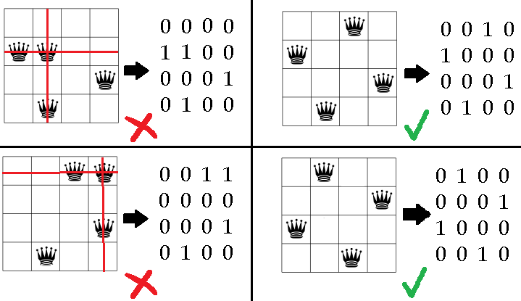
Bonus Assignment (+2)
Write a program to solve N-Queens puzzle problem by generating random solutions. The program will stop when a correct solution is found.
Represent the generated solution using NxN matrix as shown in the example below.
4-Queens puzzle & 4x4 matrix
(Save the file as N-Queens.cpp)

