Slide 1
Computer Programming
Lecture 5
C++ Functions
Part 2

Slide 2
Can functions call other functions?
They certainly can, and often do.
In fact main() is a function and main() calls the functions you write as well as the ones in the libraries.
See next example …

Slide 3
Function calls other function
#include <iostream>
using namespace std;
double tax(double x)
{
return x*0.15;
}
double profit(double m)
{
m = m - tax(m);
return m;
}
int main()
{
double income=4000;
cout << profit(income) << endl;;
system("pause");
return 0;
}
double tax(double x)
{
return x*0.15;
}
2
double profit(double m)
{
m = m - tax(m);
return m;
}
1
Output:
3400

Slide 4
Recursive Functions
A recursive function is a function that calls itself, either directly, or indirectly (through another function).
Recursion is a powerful tool for solving certain kinds of problems.
Recursion breaks a problem into smaller problems that are identical to the original, in such a way that solving the smaller problems provides a solution to the larger one.
It can be used to define mathematical functions, languages and sets, and algorithms or programming language functions

Slide 5
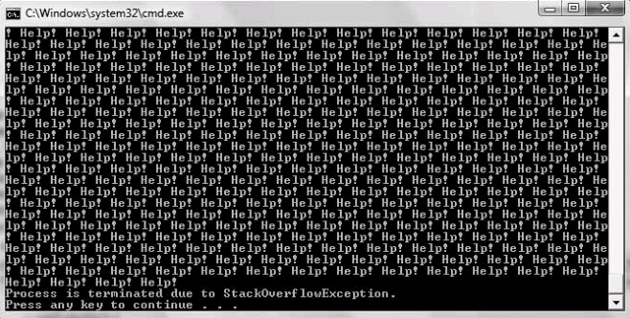
Simple Example of Recursion
The following code shows a simple example of recursion. In this program, the main() function calls the infinity() function. The infinity() function displays “Help!” and calls itself again (see the shaded statement). The second call to infinity() displays “Help!”; and generates a third call. The result is a large number of repetitions of the infinity() function.
#include<iostream>
using namespace std;
void infinity()
{
cout << "Help! ";
infinity();
}
int main()
{
infinity();
system("pause");
return 0;
}
void infinity()
{
cout << "Help! ";
infinity();
}
the function will continue to call itself until the program stack is exhausted

Slide 6
How to Stop a Recursive Function?
There must always be a path through a recursive function that does not involve a recursive call; otherwise, the function will recurse “forever,” meaning that the function will continue to call itself until the program stack is exhausted.

Slide 7
Compute the Factorial using Recursive Function
we recursively call factorial to compute the factorial of the numbers counting down from the original value in val. Once we have reduced val to 1, we stop the recursion by returning 1.
#include<iostream>
using namespace std;
int factorial(int val)
{
if (val == 1)
return 1;
else
return (val * factorial(val-1));
}
int main()
{
cout << factorial(5) << endl;
system("pause");
return 0;
}
int factorial(int val)
{
if (val == 1)
return 1;
else
return (val * factorial(val-1));
}
Note: the factorial of 5 (denoted as 5!) is 1*2*3*4*5 = 120.

Slide 8
Fibonacci Sequence
A Fibonacci sequence is one where each number is the sum of the proceeding two numbers.
This sequence makes an assumption that Fibonacci numbers for 0 and 1 are also 0 and 1. The Fibonacci equivalent for 2 would therefore be 1.
Let's see the sequence and their corresponding natural numbers:
Integers: 0, 1, 2, 3, 4, 5, 6, 7
Fibonacci: 0, 1, 1, 2, 3, 5, 8, 13

Slide 9
Fibonacci Sequence
#include<iostream>
using namespace std;
int fibonacci(int n) {
if (n <= 0)
return 0;
else if (n == 1)
return 1;
else
return fibonacci(n - 2) + fibonacci(n - 1);
}
int main()
{
cout << fibonacci(7) << endl;
system("pause");
return 0;
}
int fibonacci(int n) {
if (n <= 0)
return 0;
else if (n == 1)
return 1;
else
return fibonacci(n - 2) + fibonacci(n - 1);
}

Slide 10
Assignments
Write a program to print numbers from n to 1 using recursion.
How many numbers to print : 10 Expected Output : 10 9 8 7 6 5 4 3 2 1
(save the file as Recursive_seq.cpp)
Write a program to calculate the power of any number using recursion.
Input the base value : 5 , Input the exponent : 3 Expected Output : The value of 5 to the power of 3 is : 125
(save the file as recursive_pwr.cpp)

Slide 11
Print a Pattern
We write a program using a function to print a pattern (a triangle of stars) similar to the following:
The first line has one star with some blanks before the star, the second line has two stars, some blanks before the stars, and a blank between the stars, and so on.
*
* *
* * *
* * * *

Slide 12
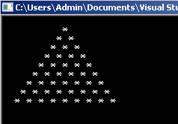
Print a Pattern
#include <iostream>
using namespace std;
void printStars(int blanks, int starsInLine)
{
int count;
//print the number of blanks before the stars in a line
for (count = 1; count <= blanks; count++)
cout << ' ';
//print the number of stars with a blank between stars
for (count = 1; count <= starsInLine; count++)
cout << " *";
cout << endl;
} //end printStars
int main()
{
for (int i=0; i<10; i++)
printStars(10-i,i);
system("pause");
return 0;
}
void printStars(int blanks, int starsInLine)
{
int count;
//print the number of blanks before the stars in a line
for (count = 1; count <= blanks; count++)
cout << ' ';
//print the number of stars with a blank between stars
for (count = 1; count <= starsInLine; count++)
cout << " *";
cout << endl;
} //end printStars

Slide 13
Example: Sum of Digits of a Number
Function to find out the sum of digits of a number
#include<iostream>
using namespace std;
int sum_digits(int number)
{
int sum = 0;
int digit;
while(number!=0){
digit = number%10;
number = number/10;
sum += digit;
}
return sum;
}
int main() {
int number = 1452;
cout<<sum_digits(number)<<endl;
return 0;
}
int sum_digits(int number)
{
int sum = 0;
int digit;
while(number!=0){
digit = number%10;
number = number/10;
sum += digit;
}
return sum;
}
Input: 1452
Output: 12
Input: 333
Output: 9

Slide 14
Assignment
Write a function to search for the smallest value stored in a ID array. Your function signature should be like this
int smallest (const int x[ ], int size);
// purpose – find the smallest value
// input – an array x and its size
// output – the smallest value
(Save the file as smallest.cpp)

