Slide 1
Database Administration (DBA)
SQL Server Databases
Lecture 2

Slide 2
SQL Instance
Every instance is a complete SQL Server Installation along with its own copy of server files, database engine, and databases.
A computer (or generally an SQL Server installation) can have one or more instances of SQL Server installed.
We give a unique name to each instance so as to uniquely identify them.
Each SQL Server instance has its own ports, databases and logins (users).

Slide 3
SQL Server Databases
It is essential that the DBA understand the types of databases in SQL server. There are two broad categories exist.
System Databases
User Databases

Slide 4
System Databases
When you install SQL Server, five databases are automatically attached:
Master Database
TempDB Database
Model Database
MSDB Database
Resource Database
Each of which is important to the efficient running of your instance.
The first four of these databases are visible using SQL Server Management Studio (SSMS), and the fifth one, the resource database, is invisible.

Slide 5
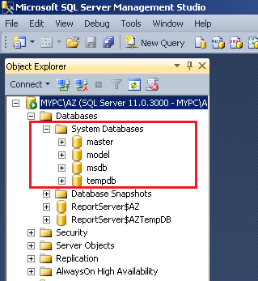
System Databases
System Database

Slide 6
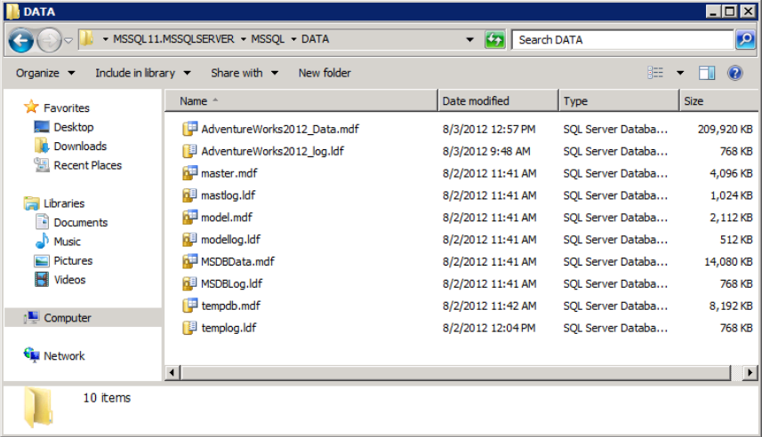
System Databases
The default data store including the system databases

Slide 7
(1) Master Database
The Master database is the primary configuration database in SQL Server.
The master database stores system wide information, such as logins, linked server information, and the server configuration.
It contains information on all the databases that exist on the server, including the physical database files and their locations.
Needless to say, if the master database is corrupt or unavailable, SQL Server cannot be available for users.

Slide 8
(2) TempDB Database
SQL Server uses the TempDB database for working storage of temporary tables and temporary stored procedures.
Temporary stored procedures and tables can be created by users, applications, or the system to support query requests.
The tempdb database is used automatically by the SQL Server database engine to process large queries and data modifications that cannot be handled entirely in memory.
For example, if you wrote a query that returned 100,000 rows and you wanted the results sorted by a date value in the results, SQL Server could send the unsorted results to a temporary work table, where it would perform the sorting operation and then return the sorted results to you.
The TempDB database is recreated each time SQL Server starts (only one TempDB per instance).

Slide 9
(2) TempDB Database (cont’d)
The TempDB database can be used by programmers.
For example, a programmer could execute the following code to utilize the tempdb database:
This statement would copy all of the data in the Students table into a temporary table named #test_table .
The temporary table could then be queried with code like the following:
Note: The tempdb database is stored in the same location as the other system databases by default. If your system uses the tempdb database excessively and performance is suffering, you may consider moving it to another location.
SELECT * INTO #test_table FROM Students;
SELECT * from #test_table;

Slide 10
(2) TempDB Database (cont’d)
---- for practise ----
To check the size of the tempdb database, execute the following code:
Moving the tempdb database to a different drive and folder:
USE tempdb
exec sp_helpfile
USE master
GO
ALTER DATABASE tempdb MODIFY FILE(NAME = tempdev,
FILENAME = 'D:\tempdata\tempdb.mdf');
GO
ALTER DATABASE tempdb MODIFY FILE (NAME = templog,
FILENAME = 'D:\tempdata\templog.ldf');
GO

Slide 11
(3) Model Database
The model database is used as a template for new databases.
Each time you create a new database in SQL Server, the contents of the Model database are copied to the new database to establish its default objects, including tables, stored procedures, and other database objects.
For example, if you set the Recovery Model to be Full on the Model database, then all new user databases will automatically be configured in the same way.
The model database is required and cannot be deleted, it is used by tempdb every time the SQL Server service starts.

Slide 12
(4) MSDB Database
MSDB is used to store information for various components of SQL Server such as:
Database Mail, database backup and restore history, and maintenance plan history.
The SQL Server Agent uses the msdb database extensively for the storage of automated job definitions, job schedules, operator definitions, and alert definitions.
The MSDB database is stored in the same directory as the master database. The filename for the data file is MSDBData.mdf , and the filename for the log file is MSDBLog.ldf. It is recommended to leave the MSDB database in the default location.

Slide 13
(5) Resource database
The Resource database is a read-only database that contains all the system objects that are included with SQL Server.
It should never be modified, except under guidance from Microsoft.
The full name of the Resource database is “mssqlsystemresource”.

Slide 14
User Databases
At a minimum, every SQL Server database has two operating system files: a data file and a log file.
Data files: contain data and objects such as tables, indexes, stored procedures, and views. There are two types of data files; primary and secondary.
Log files: A SQL Server log file is a transaction log file that records all database transactions and modifications. It contains the information that is required to recover all transactions in the database.
Data files (primary and secondary) can be grouped together in filegroups for allocation and administration purposes.

Slide 15
User Databases - Data files
Data files can be of two types: Primary or Secondary.
The Primary data file contains startup information for the database and points to other files in the database. User data and objects (tables, indexes, stored procedures, and views) can be stored in this file
Every database has one primary data file.
Secondary data files are optional and can be used to spread data across multiple files/disks by putting each file on a different disk drive.

Slide 16
User Databases
File | Description
Primary File | The primary data file contains the startup information for the database and points to the other files in the database. User data and objects can be stored in this file or in secondary data files. Every database has one primary data file. The recommended file name extension for primary files is .mdf.
Secondary File | Secondary data files are optional, are user-defined, and store user data. Secondary files can be used to spread data across multiple disks by putting each file on a different disk drive. The recommended file name extension for secondary files is .ndf.
Transaction Log | log file consisting of events such as modifying data, creating and dropping tables and indexes, and other transactional information. It used to recover the database. The recommended file name extension for transaction logs is .ldf

Slide 17
Filegroups
Within a database, data is stored in one or more data files. These files are grouped into logical containers called filegroups.
Every database has a primary filegroup. This filegroup contains the primary data file and any secondary files that are not put into other filegroups.
User-defined filegroups can be created to group data files together for administrative, data allocation, and placement purposes.
For example, three files, Data1.ndf, Data2.ndf, Data2.ndf can be created on three disk drives, respectively, and assigned to the filegroup group1.

Slide 18
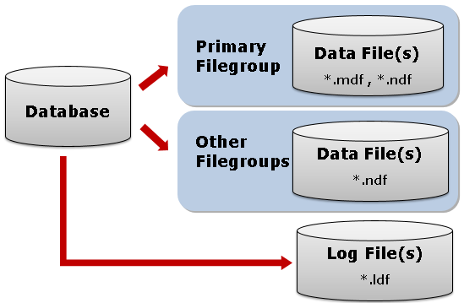
How Data Is Stored in SQL Server
How Data Is Stored in SQL Server
Data files (primary and secondary) can be grouped together in filegroups for allocation and administration purposes.

Slide 19
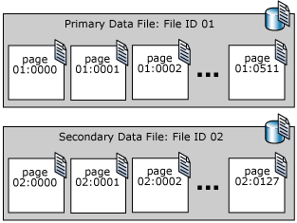
Data File Pages
The page is the fundamental unit of data storage in SQL Server.
A data page is 8KB.
Pages in a SQL Server data file are numbered sequentially, starting with zero (0) for the first page in the file.
Each file in a database has a unique file ID number. To uniquely identify a page in a database, both the file ID and the page number are required.
The example shows the page numbers in a database that has a 4-MB primary data file and a 1-MB secondary data file.

Slide 20
Logical and Physical File Names
SQL Server files have two file name types:
logical_file_name: The logical_file_name is the name used to refer to the physical file in all Transact-SQL statements. The logical file name must comply with the rules for SQL Server identifiers and must be unique among logical file names in the database.
os_file_name: The os_file_name is the name of the physical file including the directory path. It must follow the rules for the operating system file names.

Slide 21

Find the Location of Data Files and Log Files
If you only need to find the location of the files for a particular database, you can query the sys.database_files system catalog view instead. Simply switch to the applicable database and run the query.
Here’s an example:
This will return only the data and log files for the school database.
use school
SELECT name 'Logical Name',
physical_name 'File Location'
FROM sys.database_files;

Slide 22
File and Filegroup Example
The following example creates a database on an instance of SQL Server.
The database has a primary data file, a user-defined filegroup, and a log file.
The primary data file is in the primary filegroup and the user-defined filegroup has two secondary data files.
An ALTER DATABASE statement makes the user-defined filegroup the default.
A table is then created specifying the user-defined filegroup. (This example uses a path
C:\Program Files (x86)\Microsoft SQL Server\MSSQL11.UST\MSSQL\DATA\ change it depends on your version of SQL Server.

Slide 23
USE master;
GO
-- Create the database with the default data filegroup and a log file. Specify the growth increment and the max size for the primary data file.
CREATE DATABASE MyDB
ON PRIMARY
( NAME='MyDB_Primary',
FILENAME=
'C:\Program Files (x86)\Microsoft SQL Server\MSSQL11.UST\MSSQL\DATA\MyDB_Prm.mdf',
SIZE=5MB, MAXSIZE=10MB, FILEGROWTH=1MB),
FILEGROUP MyDB_FG1
( NAME = 'MyDB_FG1_Dat1',
FILENAME =
'C:\Program Files (x86)\Microsoft SQL Server\MSSQL11.UST\MSSQL\DATA\MyDB_FG1_1.ndf',
SIZE = 1MB, MAXSIZE=10MB,FILEGROWTH=1MB),
( NAME = 'MyDB_FG1_Dat2',
FILENAME =
'C:\Program Files (x86)\Microsoft SQL Server\MSSQL11.UST\MSSQL\DATA\MyDB_FG1_2.ndf',
SIZE = 1MB, MAXSIZE=10MB, FILEGROWTH=1MB)
LOG ON
( NAME='MyDB_log',
FILENAME =
'C:\Program Files (x86)\Microsoft SQL Server\MSSQL11.UST\MSSQL\DATA\MyDB.ldf',
SIZE=1MB, MAXSIZE=10MB, FILEGROWTH=1MB);

Slide 24
GO
ALTER DATABASE MyDB
MODIFY FILEGROUP MyDB_FG1 DEFAULT;
GO
-- Create a table in the user-defined filegroup.
USE MyDB
CREATE TABLE MyTable
( cola int PRIMARY KEY,
colb char(8) )
ON MyDB_FG1;
GO

Slide 25
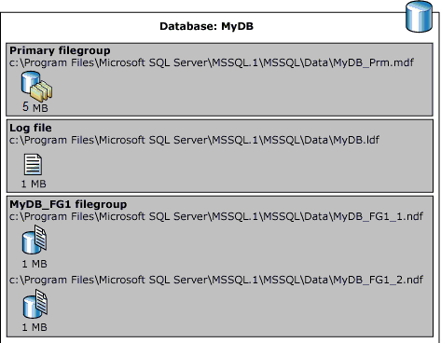
The following illustration summarizes the results of the previous example

Slide 26
Multiple transaction log files
You can create multiple transaction log files for a database, but they are not used like multiple data files.
The transactions are not striped across the multiple log files in any way.
Instead, the transactions are written to the first log file until it is full.
When the first log file is full, the transactions will begin to overflow into the second log file, and soon.
Note: Transaction log files are never part of any filegroups.

Slide 27
Questions
Why Should I Create Multiple Filegroups?
What are system databases?
What are NDF Files in SQL Server?

Slide 28
Questions
Give an example of implementation of Files and Filegroups in SQL Server
Filegroups allow files to be grouped together for administrative and data allocation/placement purposes. For example, three files (data1.ndf, data2.ndf, and data3.ndf) can be created on three disk drives, respectively, and assigned to the filegroup fgroup1. A table can then be created specifically on the filegroup fgroup1. Queries for data from the table will be spread across the three disks, thereby improving performance.

Slide 29
Multiple Choice Questions
Every database has . . . . . primary data file(s). The recommended file name extension for primary data files is . . . . . .
A) two, .ndf B) many, .ldf C) three, .mdf D) one, .mdf
When objects are created (in the database) without specifying the filegroup that they belong to, they are assigned to the . . . . . . . filegroup. At any time, exactly . . . . . filegroup(s) is designated as the . . . . . . filegroup.
A) default , one, default B) secondary, two, primary C) primary , one, secondary D) default , one, secondary

Slide 30
Multiple Choice Questions
The recommended file name extension for secondary data files is . . . . .
A) .ldf B) .ndf C) .mdf D) .hdf
Log files are not part of a filegroup and are managed separately from the data space.
A) True B) False
SQL Server works with files by assigning them to a Filegroup. If you have only one file in the database, it may or may not live in a Filegroup.
A) True
B) False

