Slide 1
Database Management and Security
Database Backup
Lecture 3

Slide 2
Database Backup
Backing up a database is one of the most important tasks that a DBA can perform.
SQL Server allows you to back up at the file and filegroup level as well as at the database level.
There is no need to disconnect users or shut down any services during backup process.
A backup file can be saved to local disk, an available network share, or even in Windows Azure blob storage.

Slide 3
How to perform Backups
There are many ways to perform Backups:
Using T-SQL commands
Using SQL Server Management Studio
Creating maintenance plans
Using third party backup tools

Slide 4
Backup types
There are different types of backup as follows:
Full backup
Differential backup
File/Filegroup backup
Partial backup
Copy-only backup
Transaction Log Backup

Slide 5
1- Full Backup
The Full backup is the most common and easy way to implement backup.
The Full backup simply backs up all the data in the database (including tables, indexes, stored procedures, views, and other database objects).
The advantage of the Full backup is that it is very simple.
However, it takes longer than other backup methods.
Using this backup type, you can restore the database to the point in time when the backup was taken.

Slide 6
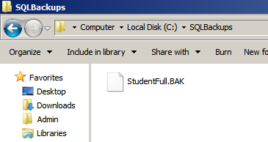
1- Full Backup
This is full backup example to backup “Student” database to local hard disk.
--Full database backup of Student database
BACKUP DATABASE Student
TO DISK = 'C:\SQLBackups\StudentFull.BAK'
WITH DESCRIPTION = 'Student FULL Backup'
Note: The folder C:\SQLBackups
must be existed

Slide 7
1- Full Backup
Note that the backup does not include unused or empty pages within the database files. To see how much space is consumed in a database, follow these steps:
1. Launch a new query window.
2. Change the context to the database you want to analyse
(We use Student database)
3. Once you have the proper context, execute the following statement in the query window:
use Student
EXECUTE sp_spaceused;

Slide 8
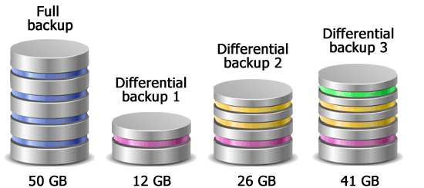
2- Differential Backup
A differential backup is a type of backup that captures only the changes made to the database since the last full backup.
Differential backups take less time to execute than Full backups, Because they only contain the extents of data files that have changed since the last Full backup.
The Differential backup is available regardless of the database recovery model and requires a base Full database backup.
Differential backup

Slide 9
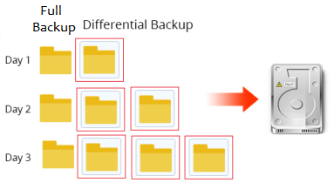
Differential Backup
Differential backup backs up pages (actually, it backs up the extents that contain the pages) and does not mark them as having been backed up.
For this reason, each differential backup is a backup of everything that has been changed since the last full backup.

Slide 10
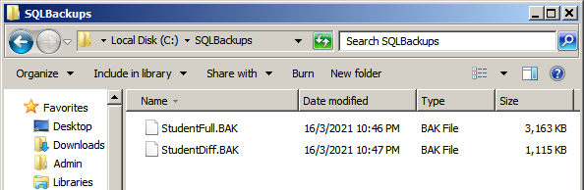
Differential Backup
The Differential database backup example to backup “Student” database:
BACKUP DATABASE Student
TO DISK = 'C:\SQLBackups\StudentDiff.BAK'
WITH DIFFERENTIAL,
DESCRIPTION='Student Differential Backup'
Note: You must perform at least one full database backup before you can perform a differential or a transaction log backup.

Slide 11
3- File/Filegroup Backup
When a database is divided across many files and filegroups, these files and filegroups can be backed up individually.
This type of backup is particularly useful for very large databases.
File and Filegroup backups work similarly as Full and Differential backups in that the data pages of the file.

Slide 12
File/Filegroup Backup
the SQL Server does not allow you to back up a single file if the data in the file is read-write data.
Only read-only data files may be backed up individually and restored individually.
The following command is used to backup of the "MyFilegroup1“ User-Defined Filegroup.
BACKUP DATABASE Student
FILEGROUP = 'MyFilegroup1'
TO DISK = 'C:\SQLBackups\MyFilegroup1.BAK'
WITH DESCRIPTION = 'Student-MyFilegroup1 Filegroup Backup'

Slide 13
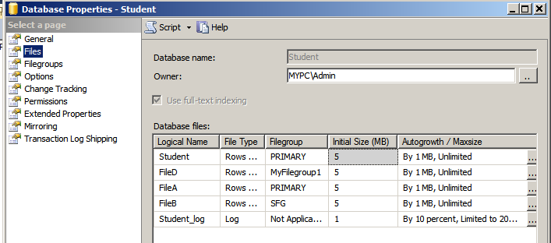
File/Filegroup Backup
The following command is used to backup of the data file called “FileA”, whereas, the logical name of the file is not the physical file name.
BACKUP DATABASE Student
FILE = 'FileA'
TO DISK = 'C:\SQLBackups\FileA.BAK'
WITH DESCRIPTION = 'Student-data file Backup'

Slide 14
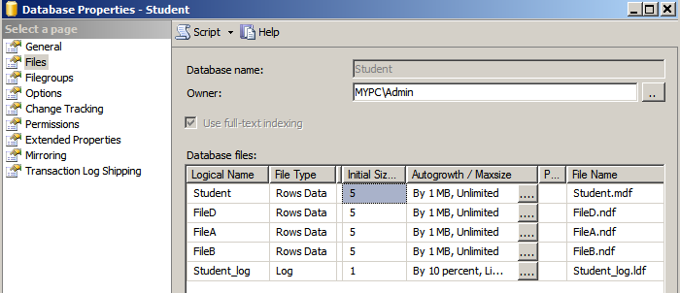
Logical and Physical File Names
SQL Server files have two file name types:
The logical_file_name is the name used to refer to the physical file in all Transact-SQL statements. It must comply with the rules for SQL Server identifiers and must be unique among logical file names in the database.
The os_file_name is the name of the physical file including the directory path. It must follow the rules for the operating system file names.

Slide 15
File/Filegroup with Differential
An additional option available when backing up files or filegroups is the ability to perform a Differential File or Filegroup backup.
This option works exactly like the typical Differential backup
only the changes to the file or filegroup since the last full File or Filegroup backup are captured as well as any changes to the files during the backup.
BACKUP DATABASE Student
FILE = 'FileA'
TO DISK = 'C:\SQLBackups\FileA_Diff.BAK'
WITH DIFFERENTIAL,DESCRIPTION = 'Student-data file Differential Backup'

Slide 16
4- Partial Backup
A partial backup is a backup that includes only a subset of the database.
By default, the Partial backup consists of:
The Primary filegroup
Read Write filegroups
Note: Partial backup can include any (optionally) one or more read-only files.
To take advantage of this type of backup, you must group the tables that change into a set of filegroups, and group the tables that are static or history into a different set of filegroups.
This can be very helpful if you have a large amount of archive data in the database.

Slide 17
Partial Backup
Type the following to generate a partial backup of the “Student” database
BACKUP DATABASE Student READ_WRITE_FILEGROUPS
TO DISK = 'C:\SQLBackups\Student_Partial.BAK'
WITH DESCRIPTION = 'Partial Backup of all Read/Write filegroups'

Slide 18
5- Copy Only Backup
A copy-only backup does not interrupt your backup cycles.
You can create a copy-only backup of the transaction log, and it will not truncate the transaction log.
You can create a copy-only backup of the database, and it will not show in the backup history.
A normal full database backup resets the differential backups made afterward, whereas a copy-only backup does not affect the next differential backup. It still contains the changes since the last full backup.
It can be used for test and development.

Slide 19
Copy Only Backup Cont’d
To create a copy of the “Student” database, you would use the following script:
BACKUP DATABASE Student
TO DISK = 'C:\SQLBackups\Student_CopyOnly.BAK'
WITH COPY_ONLY,DESCRIPTION = 'Copy Only Backup'

Slide 20
6- Transaction Log Backup
Transaction Log backups come in two main forms:
Transaction Log backups
Tail log backup

Slide 21
Transaction Log Backup
It called also a Pure Log backup and transaction log backup
A transaction log backup is a type of backup that captures the transaction log records of a database.
A transaction log backup contains all log records that have not been included in the last transaction log backup.
When you back up the transaction log, the log is truncated by default.

Slide 22
Transaction Log Backup Cont’d
Backing up the transaction log of a database throughout the day allows you to recover to the point of failure or to any point in time.
Note: The full or differential backups do not truncate the transaction log. Thus, it may be essential to back up the transaction log periodically just to truncate the log.
Transaction Log Backup is only possible when the database is in the Full or Bulk-Logged recovery model.

Slide 23
Transaction Log Backup Cont’d
Type the following to generate a log backup of the “Student” database using SQL script:
BACKUP LOG Student
TO DISK = 'C:\SQLBackups\StudentLog.TRN'
WITH DESCRIPTION = 'Student Log Backup'

Slide 24
Tail Log Backup
The tail-log backup captures records on the transaction log that were written since the last transaction log backup.
A tail log backup does not truncate the transaction log.
If you're going to restore a database to the point of failure, then you need to take a tail-log backup before you start the restore operation to capture all transaction log records that have not yet been backed up.
--Tail or Bulk Log Backup of Student
BACKUP LOG Student
TO DISK = 'C:\SQLBackups\StudentTailLog.TRN'
WITH NO_TRUNCATE,DESCRIPTION = 'Student Tail Log Backup'

Slide 25
Backup Devices
Tape or disk locations can be mapped to a backup device.
A backup device is an alias to the disk or tape location.
The advantage of backup devices is that they make the syntax of the backup command simpler.
The backup devices are usually created once to hold many backups, the device name will be less descriptive than is usually desired.

Slide 26
Backup Devices
The following example shows how to create a backup device and then back up the Student database to it:
--Create a device for backups of the Student database
EXEC sp_addumpdevice 'Disk', 'StudentBackup',
'C:\SQLBackups\StudentBackupfile.BAK'
Now, back up the Student database to the device “StudentBackup”:
--Backup the Student database to new device
BACKUP DATABASE Student
TO StudentBackup
WITH DESCRIPTION = 'Student DB Full Backup'

Slide 27
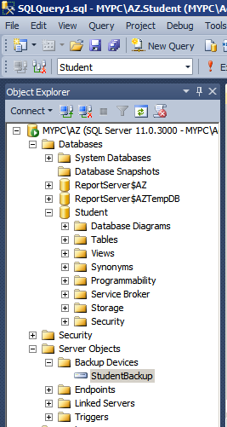
Backup Devices in Management Studio
You can Create/Show/Delete a Device using the graphical tools provided with Management Studio
--Create a device
EXEC sp_addumpdevice 'Disk', 'StudentBackup',
'C:\SQLBackups\StudentBackupfile.BAK'

Slide 28
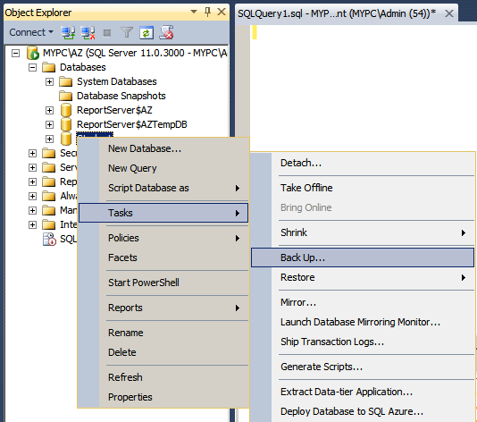
Backup using Management Studio
Databases can also be backed up using the graphical tools provided with Management Studio

Slide 29
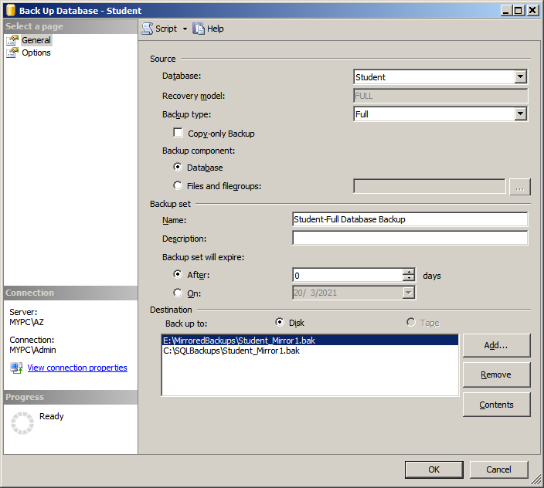
Backup Devices in Management Studio

Slide 30
Backup Stripe
Striping a backup across multiple devices may save time in the backup process since multiple physical devices are being written to simultaneously.
To create a backup stripe, simply add multiple destinations to the backup command as shown in the following code:
BACKUP DATABASE Student
TO DISK = 'C:\StripedBackupsA\StudentDB1.bak',
DISK = 'D:\StripedBackupsB\StudentDB2.bak',
DISK = 'E:\StripedBackupsC\StudentDB3.bak'

Slide 31
Backup Options: Mirrored Backup
The newest versions of SQL Server provide the built-in ability to mirror database backups.
Mirrored backups are not supported through the visual tools.
The following code demonstrates how to back up a database to one destination and mirror the entire backup to another destination simultaneously.
BACKUP DATABASE Student
TO DISK = 'C:\SQLBackups\Student_Mirror1.bak'
MIRROR TO DISK='E:\MirroredBackups\Student_Mirror1.bak'
WITH FORMAT,
DESCRIPTION = 'Mirrored Backup'
The “WITH FORMAT” option is required to create a new mirrored backup set.

Slide 32
Backup Options: Compressed Backup
Compressed backups actually are faster than non-compressed backups.
They also restore faster. However, this speed does not come without a cost.
Compressed backups consume significantly more CPU resources than non-compressed backups.

Slide 33
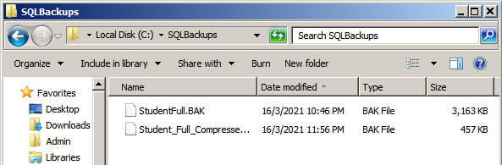
Backup Options: Compressed Backup
To create a Full compressed backup of the “Student” database, you would use the following script:
BACKUP DATABASE Student
TO DISK='C:\SQLBackups\Student_Full_Compressed.bak'
WITH COMPRESSION, DESCRIPTION = 'Compressed Backup'
Before compression
After compression

Slide 34
Backup Options
Parameter | Description
NAME | Specifies a name for the backup set.
DESCRIPTION | Adds a description to the backup set.
FORMAT/NOFORMAT | The FORMAT option is used to create a new backup media set. It will overwrite any existing media set at the destination. NOFORMAT preserves the existing media header, which is the default behavior.
PASSWORD | Specifies a password for the backup set. If defined, the password must be supplied to perform a restore.

Slide 35
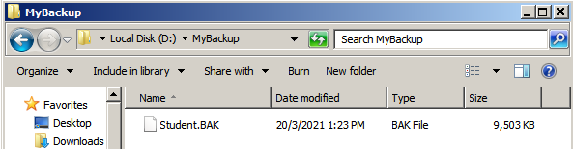
Backup Information
If you perform the following statements, all the backup files will be appended to the same media set “Student.BAK”:
BACKUP DATABASE Student
TO DISK = 'D:\MyBackup\Student.BAK'
WITH DESCRIPTION = 'Full Student Backup', NAME='StudentDB', FORMAT
BACKUP DATABASE Student
TO DISK = 'D:\MyBackup\Student.BAK'
WITH DESCRIPTION = 'Differential Student Backup 1', NAME='StudentDB'
BACKUP DATABASE Student
TO DISK = 'D:\MyBackup\Student.BAK'
WITH DESCRIPTION = 'Differential Student Backup 2', NAME='StudentDB'
Full Backup
Diff Backup
Diff Backup
To display general information about this backup, use the following statements:
RESTORE HEADERONLY
FROM DISK = 'D:\MyBackup\Student.BAK';

Slide 36
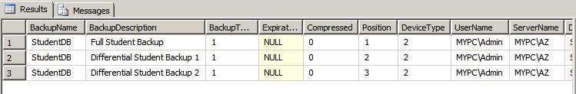
Backup Information
To display general information about the backup file.
RESTORE HEADERONLY
FROM DISK = 'D:\MyBackup\Student.BAK';

Slide 37
Check the backup file is a usable state
The “RESTORE VERIFYONLY” command is used to check or validate the backup and it will ensure that the backup file is not corrupted and can be successfully restored when needed.
RESTORE VERIFYONLY FROM DISK = 'D:\AdventureWorks.bak’;
GO

Slide 38
Questions
How many types of SQL Server database backups are there?
What is a SQL Server differential backup?
If you have multiple SQL Server differential database backups, do you need to restore all differential database backups with the full backup?
Answer: No, differential backups contain data all extents that have changed since the last full backup. Therefore, we need to restore the full backup followed by the just the latest differential backup.
How can we perform a SQL Server compressed backup?
Can we split SQL Server backups into multiple files and if yes, how is that coded?

Slide 39
Questions
How can we create multiple copies of a SQL Server backup?
What is a SQL Server partial backup?
What is the difference between tail log backup and transaction log backup?
Can I restore a differential backup without restoring the full backup first?

Slide 40
Questions
Can you explain the benefits of using compressed backups in SQL Server?
Reduced Storage Space
Faster Backup and Restore. the smaller backup file size enables faster data transfer from the backup media to the database.
Reduced Network Bandwidth: If you are performing backups across a network
Improved Disk I/O
Note: It's important to note that while compressed backups offer these benefits, they may require additional CPU resources during the backup and restore processes.

Slide 41
Questions
What is the main purpose of a transaction log backup?
The main purpose of a transaction log backup is to protect the transaction log and enable point-in-time recovery. By regularly backing up the transaction log, you ensure that you have a copy of all transactions and can restore the database to a specific point in time.

Slide 42
Assignment
What is database shrink in SQL Server?
Should I shrink a SQL Server database?
How do you shrink database log in SQL Server?
What is the difference between compression and shrink?

