Slide 1
Database Management and Security
Restores
Lecture 4

Slide 2
Database Restore
True valid backups of a database can help you recover data from many types of failures, such as:
User errors, for example, deleting records from a table.
Hardware failures like a damaged disk drive or server crashing.
Natural disasters like flooding, fire, or earthquakes.

Slide 3
Recovery Models
The recovery model determines how the transaction log is managed by SQL Server and how point-in-time recovery is supported.
The model you choose depends on the backup/restore plan you have for a database.
The three recovery models are:
Full Recovery Model
Bulk-logged Recovery Model
Simple Recovery Model

Slide 4
1. Full Recovery Model
The full recovery model logs every single transaction to the log (the transaction log is not truncated automatically).
The advantage of this full logging is that every transaction can be recovered in the event of a failure.
It allows you to restore a database to a specific point in time.

Slide 5
Full Recovery Model cont’d
The disadvantage of the Full recovery model is the same as the advantage:
Almost everything that affects the database is fully logged. As a result, the transaction log can fill up very quickly.
If it is set to auto-grow, it can also get very large, very quickly.

Slide 6
2. Simple Recovery Model
In the Simple recovery model, the transaction log is automatically truncated (i.e., space is reused) after a checkpoint occurs.
There is no ability to do a point in time recovery.
Data loss is a real possibility.
Data can be recovered from the most recent backup of the database.
The simple recovery model is useful for test databases, development databases, and even production databases that are read-only.

Slide 7
3. Bulk-Logged Recovery Model
The bulk-logged recovery model is designed to temporarily replace the full recovery model during large bulk operations.
In Bulk-Logged Model, the SQL Server will log minimal amount of information for bulk operations such as:
SELECT INTO, CREATE INDEX, ALTER INDEX, BULK INSERT … etc.
Risk of data loss
Immediately before you switch to the BULK LOGGED recovery model, and immediately after you switch back to FULL recovery model, it is good practice to take a transaction log backup.

Slide 8
Bulk-Logged Recovery Model cont’d
Bulk operations are actions that are performed on a large scale.
Example bulk operations tasks include importing or exporting items, changing prices on a mass scale, and assigning products to a warehouse.

Slide 9
Recommendations Switching recovery models
from Full to Bulk-Logged
Do a transaction log backup
from Full to Simple
Do a transaction log backup
from Bulk-Logged to Full
Do a transaction log backup
from Bulk-Logged to Simple
Do a transaction log backup

Slide 10
Changing recovery models
Using Transact-SQL
To change the recovery model by using Transact-SQL, execute the ALTER DATABASE statement with SET RECOVERY option.
ALTER DATABASE <database_name> SET RECOVERY <model>
The following examples shows how to change the recovery models for AdventureWorks database:
ALTER DATABASE AdventureWorks SET RECOVERY SIMPLE
ALTER DATABASE AdventureWorks SET RECOVERY FULL
ALTER DATABASE AdventureWorks SET RECOVERY BULK_LOGGED

Slide 11
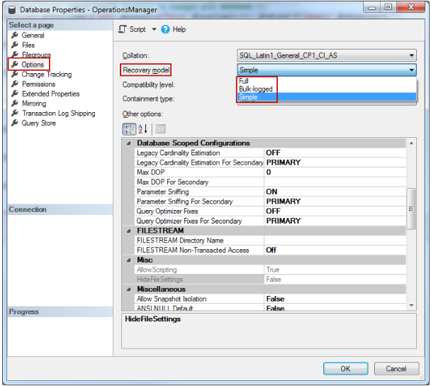
Changing recovery models
Using SSMS
select the desired database
Right-click the selected database, go to Properties
In the database properties window, choose Options
The Recovery model list box highlights the current recovery model.
Select the desired recovery model: Full, Bulk-logged, or Simple

Slide 12
Restoring Databases
SQL Server is very flexible in allowing different backup types at different times, however, we should understand well how those backups are restored.
The critical issue in most restoration plans is the sequence of backups.

Slide 13
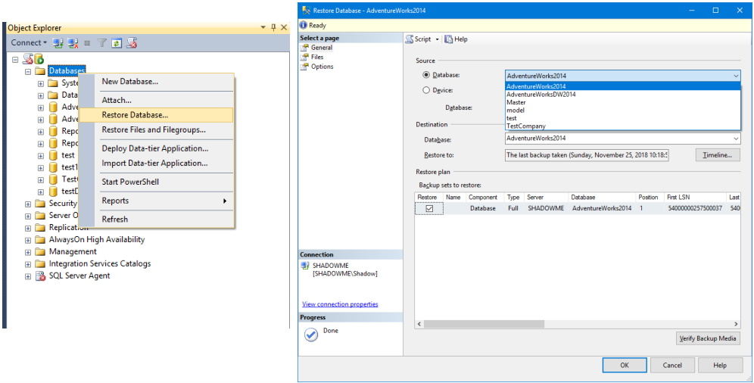
RESTORE using Management Studio
Databases can be restored effectively with the graphical tools provided in SSMS:

Slide 14
RESTORE using T-SQL
RESTORE DATABASE | LOG database_name
[File | FileGroup]
[FROM <backup_media> [ ,...n ] ]
[WITH [CHECKSUM | NO_CHECKSUM]
[[,] FILE = file_number]
[[,] MOVE ‘logical_file_name’ TO
‘operating_system_file_name’] [,...n]
[[,] RECOVERY | NORECOVERY | STANDBY =
standby_file_name]
[[,] REPLACE]
[[,] STOPAT = date_time ]
See next slides …

Slide 15
RESTORE using T-SQL
RESTORE DATABASE | LOG database_name
[File | FileGroup]
[FROM <backup_media> [ ,...n ] ]
[WITH [CHECKSUM | NO_CHECKSUM]
[[,] FILE = file_number]
[[,] MOVE ‘logical_file_name’ TO
‘operating_system_file_name’] [,...n]
[[,] RECOVERY | NORECOVERY | STANDBY =
standby_file_name]
[[,] REPLACE]
[[,] STOPAT = date_time ]
database_name : specifies the logical name of the target database to restore.
So only that file is restored from the backup_media.
See next slides …

Slide 16
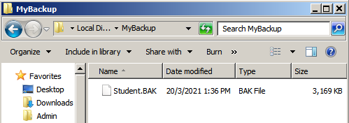
Executing a Simple Restore
To restore a database you simply need to run the following code:
USE Master
RESTORE DATABASE Student
FROM DISK = 'D:\MyBackup\Student.BAK';
The statement restores a full database backup of “Student” from a disk device.
Full database backup file

Slide 17
Executing a Simple Restore
To restore a database including replacing the existing database, you need to run the following code:
USE Master
RESTORE DATABASE Student
FROM DISK = 'D:\MyBackup\Student.BAK'
WITH REPLACE;
The “WITH REPLACE” option is used to overwrite the existing database in the server instance.
If the database is not existing, then no need to use this option.

Slide 18
Restoring Differential Backups
Differential backups are the backups that contain only the changes within the database since the last full backup.
Restoring one of these backups is a two-step process:
Resorting the previous full backup file
Then, restore the differential backup file
USE MASTER ;
--Restore Full backup as the first step
RESTORE DATABASE StudentDB
FROM DISK = 'D:\MyBackup\StudentDB_Full.bak'
WITH REPLACE, NORECOVERY ;
--Restore Diffrential backup as the Second step
RESTORE DATABASE StudentDB
FROM DISK = 'D:\MyBackup\StudentDB_Diff.bak'

Slide 19
RECOVERY | NORECOVERY options
Each RESTORE command includes an option “WITH RECOVERY” or “WITH NORECOVERY”.
When restoring a database from a sequence of backups, all but the last backup must be restored with the NORECOVERY option.
The last restore has to be (WITH RECOVERY).
There is no way to restore addition backups after a restore WITH RECOVERY.
WITH RECOVERY is the default setting, so it is important to override it until the final backup is being applied.

Slide 20
Restoring Differential Backups: Example
The scenario as the following:
Create a database called “StudentDB”
Create a Table and insert 3 rows to it
Perform Full backup
Insert 2 new rows to the table
Perform Differential backup
Delete 1 row from the table (4 rows remain)
Now we want to recover the Database to bring back the removed row!!!
To Recover the Database, we perform the following steps:
Restore the Full backup
Restore the differential backup

Slide 21
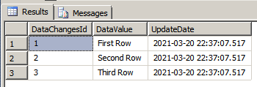
Restoring Differential Backups: Example
USE MASTER ;
-- Create a Database "StudentDB"
CREATE DATABASE StudentDB ;
USE StudentDB ;
-- Create a Table
CREATE TABLE dbo.DataChanges
(DataChangesId INT IDENTITY(1, 1)
NOT NULL, DataValue NVARCHAR(50) NOT NULL,
UpdateDate DATETIME NOT NULL,
CONSTRAINT PK_DataChanges PRIMARY KEY CLUSTERED (DataChangesId)
) ;
INSERT INTO dbo.DataChanges
(DataValue, UpdateDate)
VALUES (N'First Row', GETDATE()),
(N'Second Row', GETDATE()),
(N'Third Row', GETDATE()) ;
SELECT * FROM dbo.DataChanges;

Slide 22
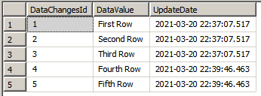
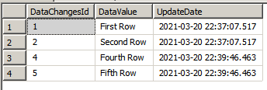
Restoring Differential Backups: Example
-- Perform Full backup
BACKUP DATABASE StudentDB
TO DISK = 'D:\MyBackup\StudentDB_Full.bak';
-- insert 2 new rows
INSERT INTO dbo.DataChanges
(DataValue, UpdateDate)
VALUES (N'Fourth Row', GETDATE()),
(N'Fifth Row', GETDATE()) ;
SELECT * FROM dbo.DataChanges;
-- Perform DIFFERENTIAL backup
BACKUP DATABASE StudentDB
TO DISK = 'D:\MyBackup\StudentDB_Diff.bak'
WITH DIFFERENTIAL ;
-- remove the third row
DELETE dbo.DataChanges
WHERE DataChangesId = 3 ;
SELECT * FROM dbo.DataChanges;

Slide 23
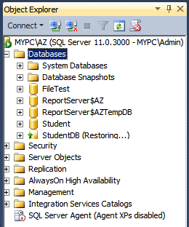
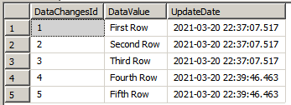
Restoring Differential Backups: Example
To recover the Database to bring back the removed row
USE MASTER ;
--Restore Full backup as the first step
RESTORE DATABASE StudentDB
FROM DISK = 'D:\MyBackup\StudentDB_Full.bak'
WITH REPLACE, NORECOVERY ;
--Restore Differential backup as the Second step
RESTORE DATABASE StudentDB
FROM DISK = 'D:\MyBackup\StudentDB_Diff.bak'
USE StudentDB ;
SELECT * FROM dbo.DataChanges;
StudentDB database stopped at the point of recovery

Slide 24
Restoring Differential Backups: Example
To recover the Database to bring back the removed row
USE MASTER ;
--Restore Full backup as the first step
RESTORE DATABASE StudentDB
FROM DISK = 'D:\MyBackup\StudentDB_Full.bak'
WITH REPLACE, NORECOVERY ;
--Restore Differential backup as the Second step
RESTORE DATABASE StudentDB
FROM DISK = 'D:\MyBackup\StudentDB_Diff.bak'
USE StudentDB ;
SELECT * FROM dbo.DataChanges;
NOTE: The “NORECOVERY” option leaves the database in a restoring state
StudentDB database stopped at the point of recovery

Slide 25
Restoring Log Backups
The RESTORE LOG statement specifies that the restore process is for a database transaction log.
In order to restore a transaction log backup, the database has to be in a restoring state which means that a full backup or a full backup and differential backup were first restored using the “NORECOVERY” option to allow transaction log backups to be restored.
RESTORE LOG StudentDB
FROM DISK = 'D:\MyBackup\StudentDB_log.bak'

Slide 26
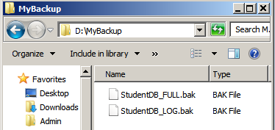
Restoring Log Backups
The following example starts by restoring the StudentDB database by using a full database.
Then, restore transaction log
USE MASTER
-- Perform Full backup
RESTORE DATABASE StudentDB
FROM DISK = 'D:\MyBackup\StudentDB_FULL.bak'
WITH NORECOVERY, REPLACE;
-- Perform LOG backup
RESTORE LOG StudentDB
FROM DISK = 'D:\MyBackup\StudentDB_LOG.bak';

Slide 27
Point in Time Recovery
A point in time recovery is restoring a database to a specified date and time.
It is required due to a variety of reasons, that include accidentally deleting a specific table, incorrect execution commands, etc. Thus, to overcome these problems through rolling back of the database to its previous state.
but only if the database is configured in the Full or Bulk-Logged recovery models.

Slide 28

Point in Time Recovery (cont..)
To do a point in time restore you will need to issue two different "RESTORE" commands.
First: Restore the database from the FULL backup
Second: perform the point in time restore of the transaction LOG backup.
-- Restore Full backup
RESTORE DATABASE StudentDB
FROM DISK = 'D:\MyBackup\StudentDB_FULL.bak'
WITH NORECOVERY, REPLACE;
-- Restore LOG backup to specific point
RESTORE LOG StudentDB
FROM DISK = 'D:\MyBackup\StudentDB_LOG.bak'
WITH STOPAT = '2021-03-21 11:02:00.000', RECOVERY;

Slide 29
Restoring FILE
A file can be specified for Full, File, and Filegroup backups.
RESTORE DATABASE StudentDB
FROM DISK = 'D:\MyBackup\StudentDB_Full.bak'
RESTORE DATABASE StudentDB
FILE = 'StudentDBData2'
FROM DISK = 'D:\MyBackup\StudentDB_data2.bak'

Slide 30
Restoring FILEGROUP
The RESTORE DATABASE database_name statement can also be followed by the name of a database filegroup so that only that filegroup is restored from the backup media.
A filegroup can be specified for Full and Filegroup backups.
RESTORE DATABASE StudentDB
FILEGROUP = 'StudentDBFilegroup1'
FROM DISK = 'D:\MyBackup\StudentDB_Filegroup1.bak'

Slide 31
READ_WRITE_FILEGROUPS
The READ_WRITE_FILEGROUPS option only restores those filegroups in the database not marked as Read Only.
This option can be used with Full and Partial backups.
RESTORE DATABASE StudentDB
READ_WRITE_FILEGROUPS
FROM DISK = 'D:\MyBackup\StudentDB_FULL.BAK'

Slide 32
FILE option
One of the more confusing aspects of the RESTORE command is that there is a FILE = option in the RESTORE clause that specifies a logical filename and another FILE = option in the WITH clause,
where an integer value that represents the backup location in the file is specified.
Since multiple backups can be stored in a single location identified with a name, it is important to be able to differentiate them.
When sending multiple backups to the same file location, it is essentially like storing files within files.
To differentiate between the different backups stored in a single file, the FILE = backup_number option is specified

Slide 33
FILE option ( cont..)
The following example shows multiple backups being sent to the same destination: The first is a Full backup, the second is a Differential backup, and the last is a Tail Log backup.
--Initialize the backup file and backup the StudentDB database to the file
BACKUP DATABASE StudentDB
TO DISK = 'D:\MyBackup\StudentDB_Backups.bak'
WITH INIT
--Send an Additional backup to the file
BACKUP DATABASE StudentDB
TO DISK = 'D:\MyBackup\StudentDB_Backups.bak'
WITH DIFFERENTIAL
--Capture the tail of the log prior to restore operation
BACKUP LOG StudentDB
TO DISK = 'D:\MyBackup\StudentDB_Backups.bak'
WITH NO_TRUNCATE;

Slide 34
FILE option ( cont..)
The following example shows multiple backups being sent to the same destination: The first is a Full backup, the second is a Differential backup, and the last is a Tail Log backup.
--Initialize the backup file and backup the StudentDB database to the file
BACKUP DATABASE StudentDB
TO DISK = 'D:\MyBackup\StudentDB_Backups.bak'
WITH INIT
--Send an Additional backup to the file
BACKUP DATABASE StudentDB
TO DISK = 'D:\MyBackup\StudentDB_Backups.bak'
WITH DIFFERENTIAL
--Capture the tail of the log prior to restore operation
BACKUP LOG StudentDB
TO DISK = 'D:\MyBackup\StudentDB_Backups.bak'
WITH NO_TRUNCATE;
Note: INIT specifies that subsequent backups will overwrite the existing backup file contents.
The default setting is (NOINIT) which specifies that any backups sent to the destination will be appended to the backup file.

Slide 35
FILE option ( cont..)
Restoration: The first is a Full backup, the second is a Differential backup, and the last is a Tail Log backup. The example goes on to show the restoration of the backups from the same file :
--Restore the Full Backup with NORECOVERY
USE MASTER
RESTORE DATABASE StudentDB
FROM DISK = 'D:\MyBackup\StudentDB_Backups.bak'
WITH FILE = 1, NORECOVERY, REPLACE;
--Restore the Differential Backup with NORECOVERY
RESTORE DATABASE StudentDB
FROM DISK = 'D:\MyBackup\StudentDB_Backups.bak'
WITH FILE = 2, NORECOVERY
--Restore the Tail Log Backup with RECOVERY
RESTORE LOG StudentDB
FROM DISK = 'D:\MyBackup\StudentDB_Backups.bak'
WITH File = 3, RECOVERY

Slide 36
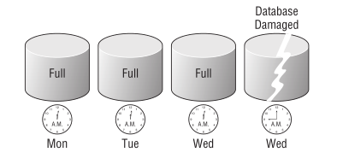
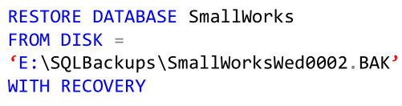
Full Restoring User Databases
If the database needs to be restored, simply find the most recent Full backup, and use it to restore the database.
Example: The following figure illustrates a database that is damaged at 9:00 a.m. The most recent backup was completed at 12:02 a.m. In this case, the 12:02 a.m. backup would be restored with recovery.

Slide 37
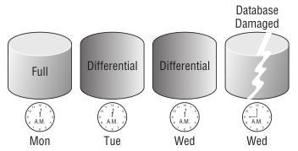
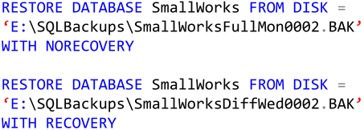
Full with Differential Restore
Differential backups require a Full backup to be applied prior to the restoration of the Differential
Example- the scenario was as the following:
Full backup at 12:02 a.m. on Monday.
Differential backup at 12:02 a .m. on Tuesday.
Differential backup at 12:02 a.m. on Wednesday.
a failure of the SmallWorks database at 9:00 a.m. on Wednesday.
Restoring process: the Differential backup on Tuesday can be ignored. The recovery process is the Monday Full backup followed by the Wednesday Differential backup

Slide 38
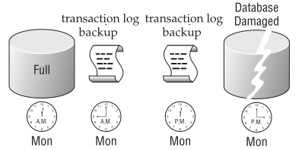
Full with Transaction Log Restore
Figure illustrates a SmallWorks database damaged at 3:00 p.m.
To restore the database, first the Tail Log backup is performed. Then, the restoration process can be executed, starting at the Monday Full backup and then proceeding through the remaining Transaction Log backups
(see next slide …)

Slide 39
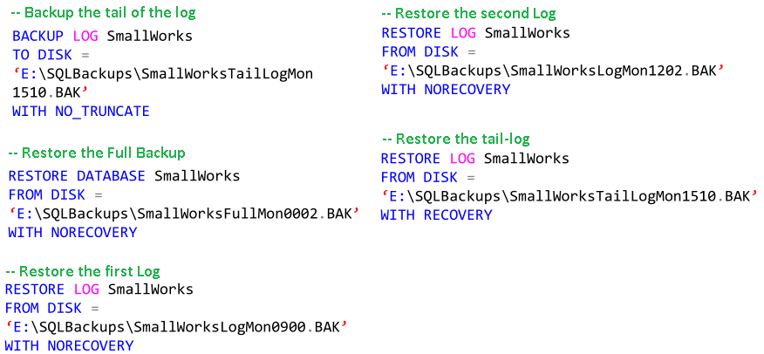
Full with Transaction Log Restore

Slide 40
Scenarios of Appling Transaction Log Backups
Example: Assume the following sequence of events
Time | Event
8:00 A.M. | Full Back up
Noon | Back up transaction log.
4:00 P.M. | Back up transaction log.
6:00 P.M. | Full Back up
8:00 P.M. | Back up transaction log.
9:45 P.M. | Failure occurs.

Slide 41
Scenarios of Appling Transaction Log Backups
To restore the database to its state at 9:45 P.M. (the point of failure), either of the following alternative procedures can be used:
Restore the database by using the most recent full database backup
Create a tail-log backup of the currently active transaction log as of the point of failure.
restore the more recent 6:00 P.M. full database backup, and then apply the 8:00 P.M. log backup and the tail-log backup.
Time | Event
8:00 A.M. | Full Back up
Noon | Back up transaction log.
4:00 P.M. | Back up transaction log.
6:00 P.M. | Full Back up
8:00 P.M. | Back up transaction log.
9:45 P.M. | Failure occurs.

Slide 42
Design a restore strategy
It is important to design your restore strategy before performing any restore operations to ensure that you restore your database correctly, that you do not lose any data.

Slide 43
Design a restore strategy - Example
Let’s assume you have an On-Line Transactional Processing database that is 400GB in size. The database is only used during weekdays between 09:00 and 17:00. The database has the following backup strategy:
A full backup is performed every Sunday at 20:00.
The full backup is 250GB in size (due to compression).
The full backup takes under two hours to complete.
A differential backup is performed every Monday, Tuesday, Wednesday, Thursday, and Friday at 23:00.
These differential backups take under one hour to complete.
These differential backups typically start off being 5GB in size, and grow to 9GB in size by Friday.
Log backups are performed every hour from 09:00 to 18:00.
These log backups are on average 1GB in size, and take 15 minutes to complete.

Slide 44
Design a restore strategy - Example (cont’d)
If the database’s data files crash on Friday at 10:30, then you could use the following restore sequence:
1. Perform a tail-log backup.
2. Restore the full backup.
3. Restore Monday’s 10 log backups.
4. Restore Tuesday’s 10 log backups.
5. Restore Wednesday’s 10 log backups.
6. Restore Thursday’s 10 log backups.
7. Restore Friday’s 9:00 and 10:00 log backup.
8. Restore the tail log.
All the log restores would involve replaying 42GB of log backups.

Slide 45
Design a restore strategy - Example (cont’d)
It would be quicker to use the following restore sequence:
1. Perform a tail-log backup.
2. Restore the full backup.
3. Restore Thursday’s differential backup.
4. Restore Friday’s 9:00 and 10:00 log backup.
5. Restore the tail log.
Because this restore sequence would involve restoring an 8GB differential backup followed by 2GB worth of log backups, it would be much quicker.
If the differential backups grew by 15GB each day, Thursday’s differential backup would be 60GB in size. In this case, it would probably be quicker to restore all 42 log backups.

Slide 46
Design a restore strategy - Example (cont’d)
Question:
If the database’s data files crash on Friday at 10:30, then you could use the following restore sequence:
Assume that Thursday’s differential failed due to a lack of disk space. In this case what would you use to restore the database?
1. Perform a tail-log backup.
2. Restore the full backup.
3. Restore Wednesday’s differential backup.
4. Restore Thursday’s 10 log backups.
5. Restore Friday’s 9:00 and 10:00 backup.
6. Restore the tail log.

Slide 47
Design a restore strategy - Example (cont’d)
Question:
If the database’s data files crash on Friday at 23:30, then you could use the following restore sequence:
Assume that Thursday’s differential failed due to a lack of disk space. In this case what would you use to restore the database?

